Slide 1

Дипломная работа DIPLOM-DEG-11
Лешков А.М.

Slide 2
Ключевые особенности
Все шаги ETL сделаны с помощью SQL и PL/pgSQL
Использованы только широкораспространенных OpenSource инструментов:
- PostgreSQL
- Clickhouse
- Apache Airflow
- Apache Superset
Стенд и интеграции сделаны с помощью docker-compose

Slide 3
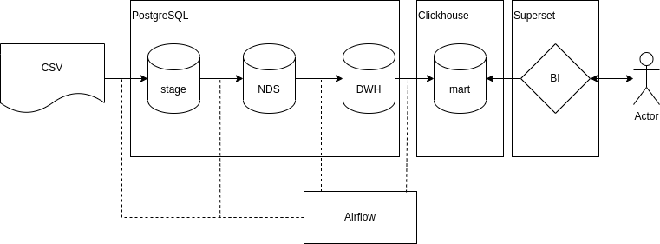
Общая схема ETL процесса

Slide 4
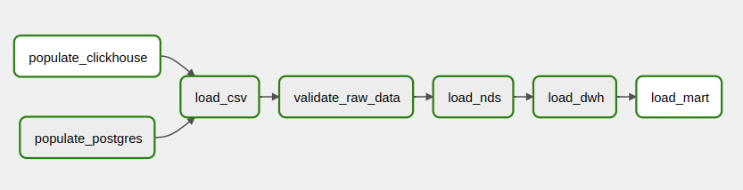
DAG в Airflow

Slide 5
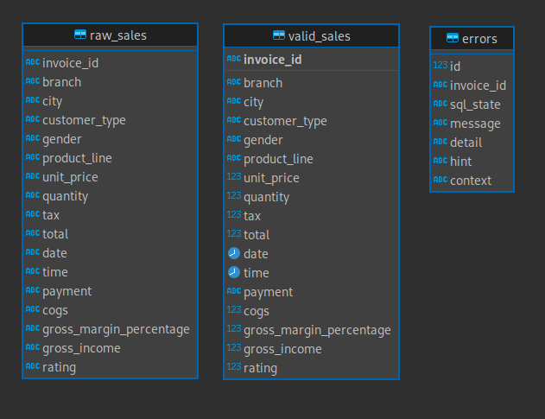
Stage

Slide 6
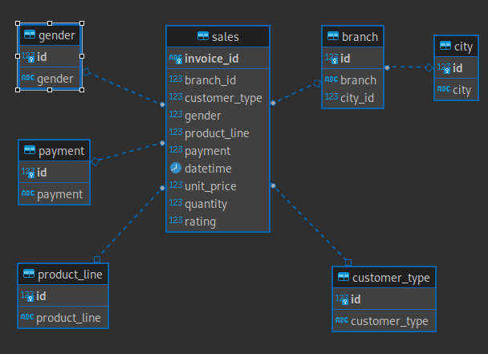
NDS

Slide 7
nds.gender_lookup_update
CREATE OR REPLACE FUNCTION nds.gender_lookup_update(v text) RETURNS int
AS $BODY$
DECLARE res int;
BEGIN
SELECT id
INTO res
FROM nds.gender
WHERE gender = v;
IF res IS NOT NULL
THEN RETURN res;
END IF;
INSERT INTO nds.gender (gender)
VALUES (v) RETURNING id INTO res;
RETURN res;
END
$BODY$
LANGUAGE plpgsql;

Slide 8
Загрузка в NDS (load_nds)
INSERT INTO nds.sales (
invoice_id
, branch_id
, customer_type
, gender
, product_line
, payment
, datetime
, unit_price
, quantity
, rating
)
SELECT
invoice_id
, nds.branch_lookup_update(branch, city)
, nds.customer_type_lookup_update(customer_type)
, nds.gender_lookup_update(gender)
, nds.product_line_lookup_update(product_line)
, nds.payment_lookup_update(payment)
, "date" + "time"
, unit_price
, quantity
, rating
FROM stage.valid_sales;

Slide 9
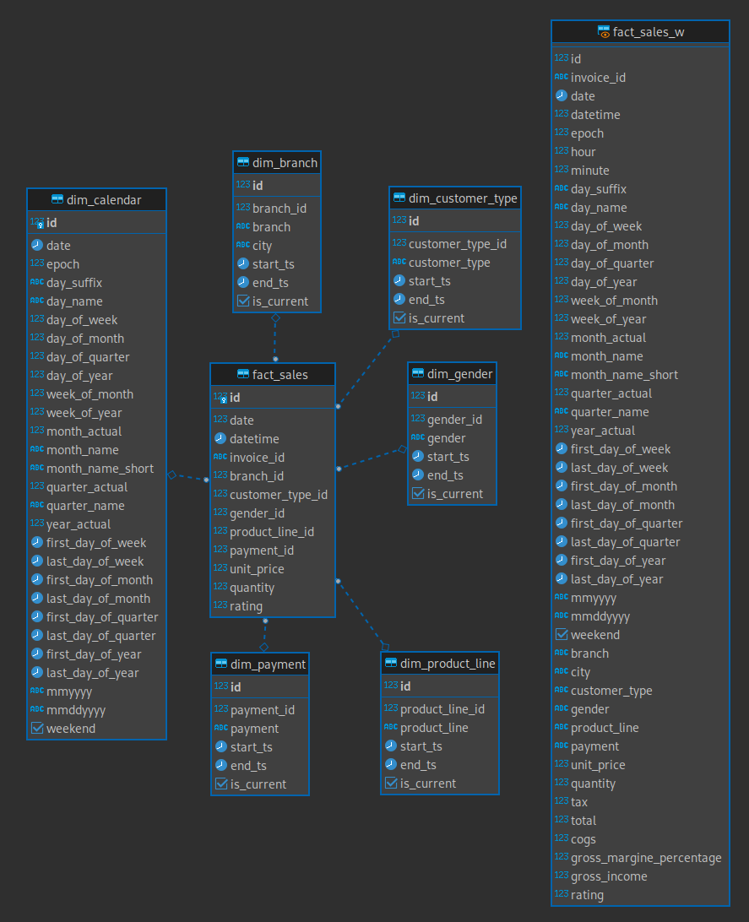
DWH

Slide 10
dwh.gender_lookup_update
CREATE OR REPLACE FUNCTION dwh.dim_gender_lookup_update(v_id int, v TEXT) RETURNS int
AS $BODY$
DECLARE res int;
BEGIN
SELECT id
INTO res
FROM dwh.dim_gender
WHERE gender_id = v_id
AND gender = v;
IF res IS NOT NULL
THEN RETURN res;
END IF;
INSERT INTO dwh.dim_gender (
gender_id
, gender
) VALUES (
v_id
, v
) RETURNING id INTO res;
RETURN res;
END
$BODY$
LANGUAGE plpgsql;

Slide 11
dwh.dim_gender_scd2()
CREATE OR REPLACE function dwh.dim_gender_scd2()
returns trigger
AS $BODY$
BEGIN
IF exists(
SELECT 1
FROM dwh.dim_gender
WHERE gender_id = NEW.gender_id
AND gender = NEW.gender
)
THEN RETURN NULL;
END IF;
IF exists(
SELECT 1
FROM dwh.dim_gender
WHERE gender_id = NEW.gender_id
AND gender <> NEW.gender
)
THEN
update dwh.dim_gender
set end_ts = now(),
is_current = false
where gender_id=new.gender_id
AND end_ts = '2999-01-01';
return new;
END IF;
RETURN NEW;
END;
$BODY$
LANGUAGE plpgsql;

Slide 12
dim_gender_trigger
CREATE TRIGGER dim_gender_trigger before INSERT ON dwh.dim_gender
FOR EACH ROW EXECUTE PROCEDURE dwh.dim_gender_scd2();

Slide 13
Загрузка в dwh.fact_sales
INSERT INTO dwh.fact_sales (
"date"
, "datetime"
, invoice_id
, branch_id
, customer_type_id
, gender_id
, product_line_id
, payment_id
, unit_price
, quantity
, rating
)
SELECT
to_char(s.datetime, 'YYYYMMDD') :: int AS "date"
, s.datetime AS "datetime"
, s.invoice_id
, dwh.dim_branch_lookup_update(s.branch_id, b.branch, c.city) AS branch_id
, dwh.dim_customer_type_lookup_update(s.customer_type, ct.customer_type) AS customer_type_id
, dwh.dim_gender_lookup_update(s.gender, g.gender) AS gender_id
, dwh.dim_product_line_lookup_update(s.product_line, pl.product_line) AS product_line_id
, dwh.dim_payment_lookup_update(s.payment, p.payment) AS payment_id
, s.unit_price
, s.quantity
, s.rating
FROM nds.sales AS s
JOIN nds.customer_type AS ct ON ct.id = s.customer_type
JOIN nds.gender AS g ON g.id = s.gender
JOIN nds.product_line AS pl ON pl.id = s.product_line
JOIN nds.payment AS p ON p.id = s.payment
JOIN nds.branch AS b ON b.id = s.branch_id
JOIN nds.city AS c ON c.id = b.city_id;

Slide 14
Объекты и загрузка в sales_mart
CREATE TABLE fact_sales_mart (
id Int16
, invoice_id FixedString(11)
…
) ENGINE = MergeTree()
ORDER BY date
PARTITION BY year_actual;
CREATE DATABASE postgresql
ENGINE = PostgreSQL('postgres:5432', 'dwh', 'dwh', 'dwh', 'dwh', 1);
INSERT INTO fact_sales_mart
SELECT * FROM postgresql.fact_sales_w

Slide 15
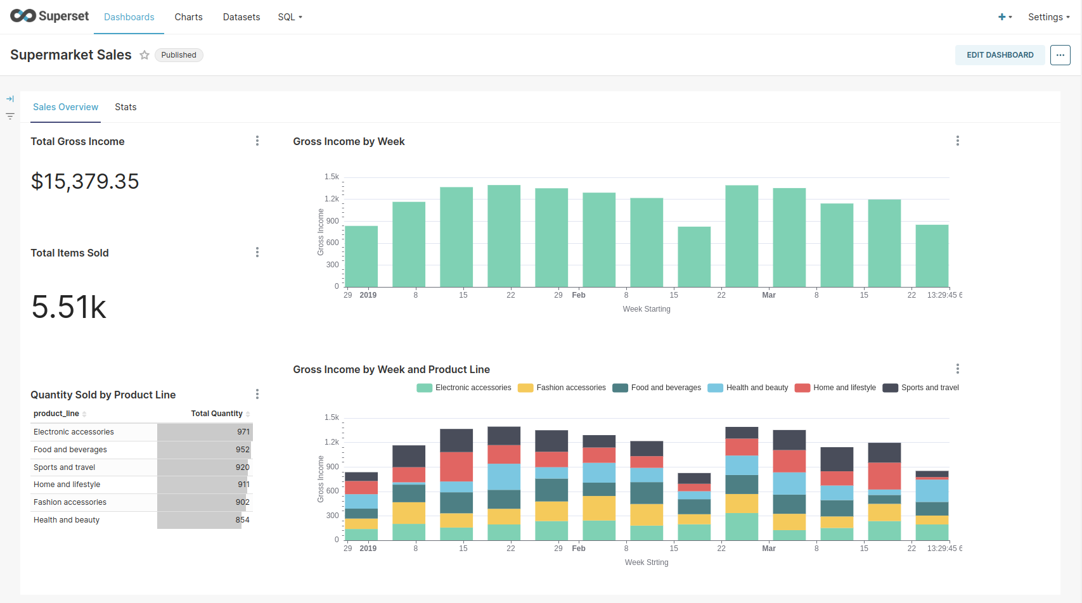

Slide 16
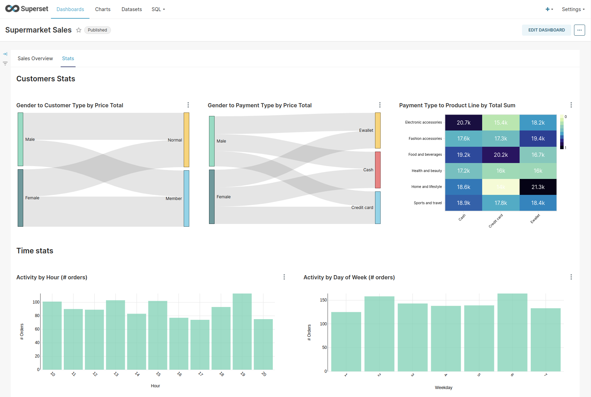

Slide 17
Выводы
Использование PL/pgSQL позволяет легко организовать идемпотентность загрузок непосредственно внутри БД
Использование Clickhouse для создания плоской витрины ускоряет аналитические запросы на 1-2 порядка
Airflow позволяет очень гибко оркестровать ETL процессы в т.ч. за счет использования Python

Slide 18
Ссылки
Дипломная работа
https://github.com/amleshkov/DIPLOM-DEG-11/tree/main
Using multiple databases with the official PostgreSQL Docker image
https://github.com/mrts/docker-postgresql-multiple-databases
Postgres Docker Image
https://hub.docker.com/_/postgres
ClickHouse Server Docker Image
https://hub.docker.com/r/clickhouse/clickhouse-server
Apache/Airflow and PostgreSQL with Docker and Docker Compose
https://towardsdatascience.com/apache-airflow-and-postgresql-with-docker-and-docker-compose-5651766dfa96
Installing Superset Locally Using Docker Compose
https://superset.apache.org/docs/installation/installing-superset-using-docker-compose/

