Slide 1
Exploring Optimization Strategies for Mastermind
Gioia Dominedò • Amy Lee • Kendrick Lo • Reinier Maat AM207 Final Project (2016)

Slide 2
MASTERMIND
Hidden code:
Example guess:
Response:
1 x
2 x
Notes:
Mastermind is a game where one needs to guess a hidden code of colors. It is inspired on the ancient game of ‘Bulls and Cows’ which has been played since more than a centrury ago, where one needs to guess digits or letters.
In the original Mastermind game, the code maker creates a code consisting of 4 positions containing any of 6 colors.
The code breaker then guesses codes until they have found the hidden code. After every guess of the code breaker, the code maker responds by giving black and white pegs, indicating the number of correct colors in the right place, and the number of correct colors in the wrong place respectively. In order to win the game, the code breaker needs to find the hidden code within 10 guesses.
In this project we try to win the game as code breaker using stochastic optimization techniques. We are especially interested in performance as we expand the game to more positions than 4 and more colors than 6.

Slide 3
MASTERMIND
Popular Strategies
Exclude all possibilities logically (Knuth’s Algorithm)
Random Search
Heuristics (e.g. guess all colors first)
Problems with popular strategies
Exhaustive search
Can take exponentially more time if game scales up
Keep track of many probabilities
Goal: find strategy that is tractable works when game scales up
Notes:
Pretty self explanatory; mention some heuristics….

Slide 4
TECHNIQUES EXPLORED
Simulated Annealing
Genetic Algorithms
Expectation Maximization
Different Objective Functions
E.g. entropy

Slide 5
SIMULATED ANNEALING

Slide 6
SIMULATED ANNEALING

Slide 7
SIMULATED ANNEALING

Slide 8
SIMULATED ANNEALING

Slide 9
SIMULATED ANNEALING

Slide 10
SIMULATED ANNEALING

Slide 11
SIMULATED ANNEALING

Slide 12
SIMULATED ANNEALING

Slide 13
SIMULATED ANNEALING

Slide 14
SIMULATED ANNEALING

Slide 15
SIMULATED ANNEALING

Slide 16
SIMULATED ANNEALING

Slide 17
SIMULATED ANNEALING

Slide 18
SIMULATED ANNEALING

Slide 19
SIMULATED ANNEALING

Slide 20
SIMULATED ANNEALING

Slide 21
SIMULATED ANNEALING

Slide 22
SIMULATED ANNEALING

Slide 23
SIMULATED ANNEALING

Slide 24
SIMULATED ANNEALING

Slide 25
SIMULATED ANNEALING

Slide 26
SIMULATED ANNEALING

Slide 27
SIMULATED ANNEALING

Slide 28
SIMULATED ANNEALING

Slide 29
SIMULATED ANNEALING

Slide 30
SIMULATED ANNEALING

Slide 31

SIMULATED ANNEALING

Slide 32
SIMULATED ANNEALING

Slide 33
SIMULATED ANNEALING

Slide 34
SIMULATED ANNEALING

Slide 35
SIMULATED ANNEALING

Slide 36
SIMULATED ANNEALING

Slide 37
SIMULATED ANNEALING

Slide 38
SIMULATED ANNEALING

Slide 39
SIMULATED ANNEALING

Slide 40
SIMULATED ANNEALING

Slide 41
SIMULATED ANNEALING

Slide 42
SIMULATED ANNEALING

Slide 43
SIMULATED ANNEALING

Slide 44
SIMULATED ANNEALING

Slide 45
SIMULATED ANNEALING

Slide 46
SIMULATED ANNEALING

Slide 47
SIMULATED ANNEALING

Slide 48
SIMULATED ANNEALING

Slide 49
SIMULATED ANNEALING

Slide 50
SIMULATED ANNEALING

Slide 51
SIMULATED ANNEALING

Slide 52
SIMULATED ANNEALING
local minimum

Slide 53
SIMULATED ANNEALING
local minimum global optimum

Slide 55
permutation

Slide 56
permutation

Slide 57
permutation

Slide 59
mutation

Slide 60
mutation

Slide 61
mutation

Slide 62
SIMULATED ANNEALING

Slide 63
SIMULATED ANNEALING

Slide 64
SIMULATED ANNEALING

Slide 65
SIMULATED ANNEALING

Slide 66
SIMULATED ANNEALING

Slide 67
SIMULATED ANNEALING

Slide 68
SIMULATED ANNEALING

Slide 69
SIMULATED ANNEALING

Slide 70
SIMULATED ANNEALING

Slide 71
SIMULATED ANNEALING

Slide 72
SIMULATED ANNEALING

Slide 73
SIMULATED ANNEALING

Slide 74
SIMULATED ANNEALING

Slide 75
SIMULATED ANNEALING

Slide 76
GENETIC ALGORITHMS

Slide 77
GENETIC ALGORITHMS

Slide 78
GENETIC ALGORITHMS
crossover

Slide 79
GENETIC ALGORITHMS
crossover

Slide 80
GENETIC ALGORITHMS
crossover point
crossover

Slide 81
GENETIC ALGORITHMS
crossover point
crossover

Slide 82
GENETIC ALGORITHMS
crossover point
crossover

Slide 83
GENETIC ALGORITHMS
crossover point
crossover

Slide 84
GENETIC ALGORITHMS
crossover point
crossover

Slide 85
GENETIC ALGORITHMS

Slide 86
GENETIC ALGORITHMS
inversion

Slide 87
GENETIC ALGORITHMS
inversion

Slide 88
GENETIC ALGORITHMS
inversion

Slide 89
GENETIC ALGORITHMS

Slide 90
GENETIC ALGORITHMS

Slide 91
GENETIC ALGORITHMS

Slide 92
GENETIC ALGORITHMS

Slide 93
GENETIC ALGORITHMS
permutation + mutation
crossover
inversion

Slide 94
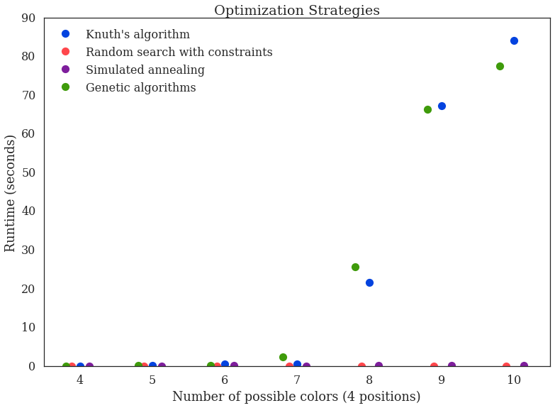
RESULTS: Runtime
Notes:
- Number of guesses
- Execution time
- Time-Space tradeoff

Slide 95
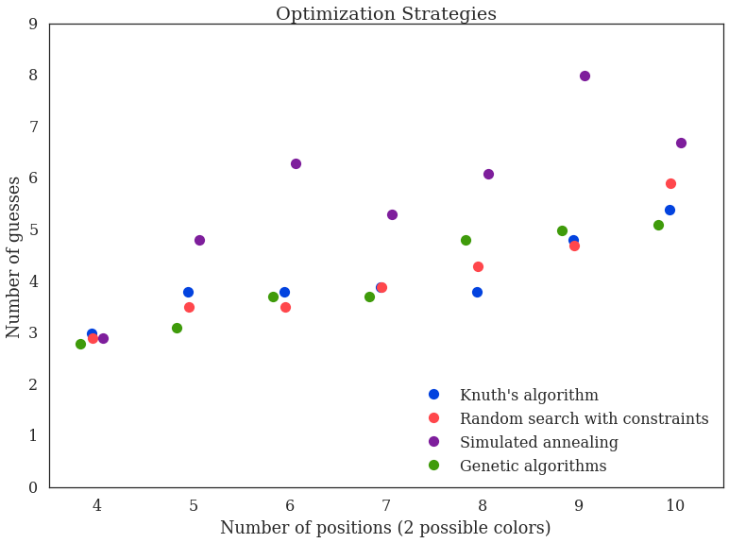
RESULTS: Guesses
Notes:
- Number of guesses
- Execution time
- Time-Space tradeoff

Slide 96
CONCLUSION
Exhaustive strategies: Colors↑ = Runtime↑↑
Stochastic strategies:
Lower runtimes
Similar amount of guesses
Stochastic techniques make scaled-up Mastermind winnable in finite time

Slide 97
Thanks for watching!

Slide 98
LOTS OF GRAPHS –
PICK YOUR FAVORITES!

Slide 101
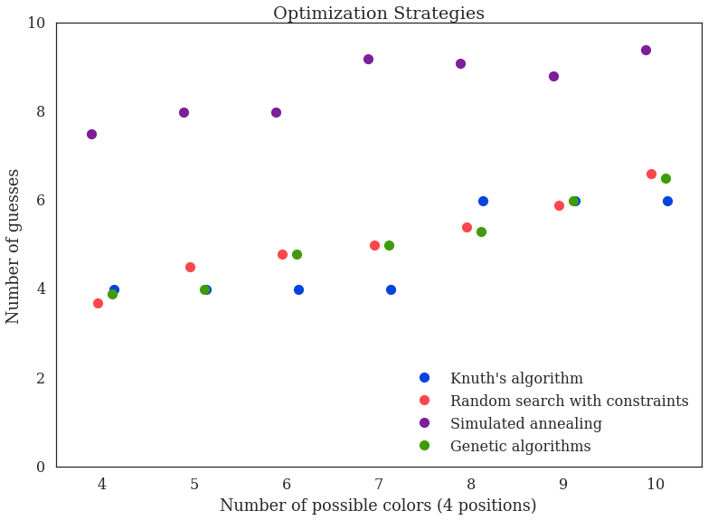

Slide 102
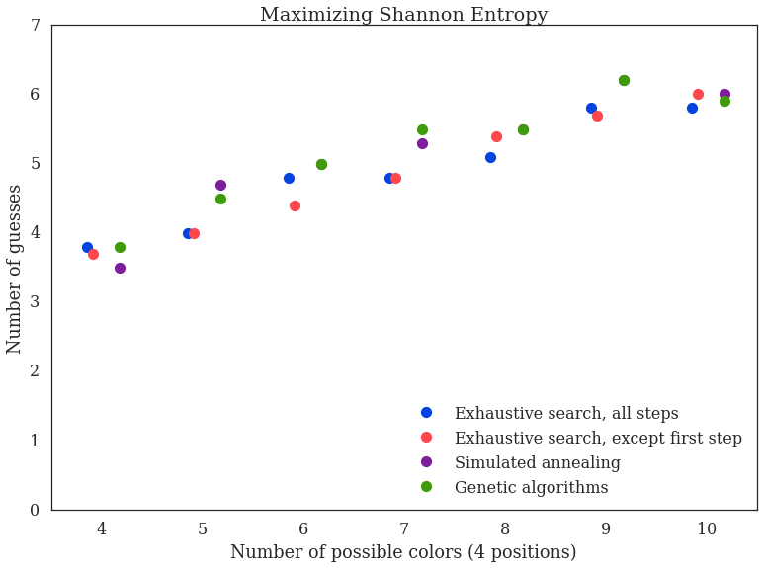

Slide 103
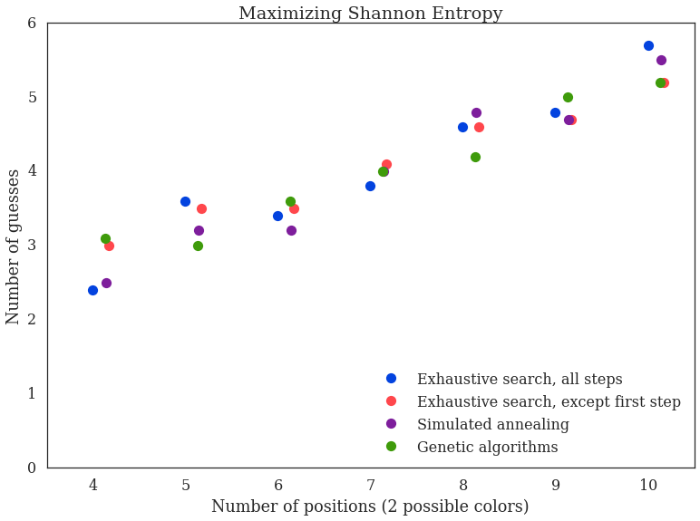

Slide 104
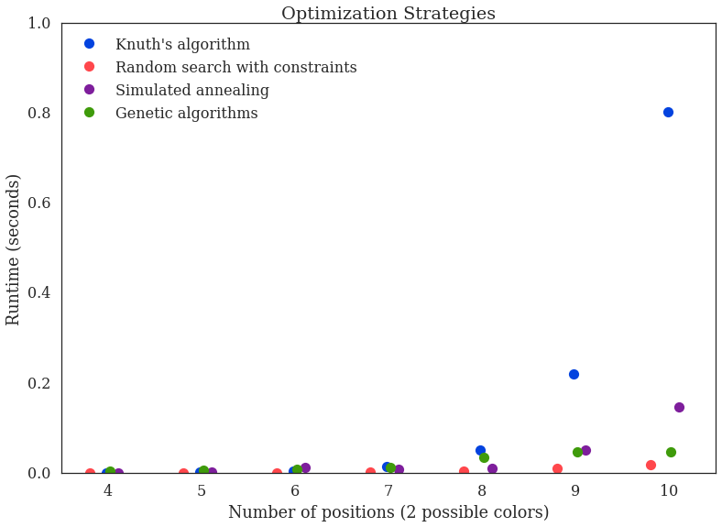

Slide 105
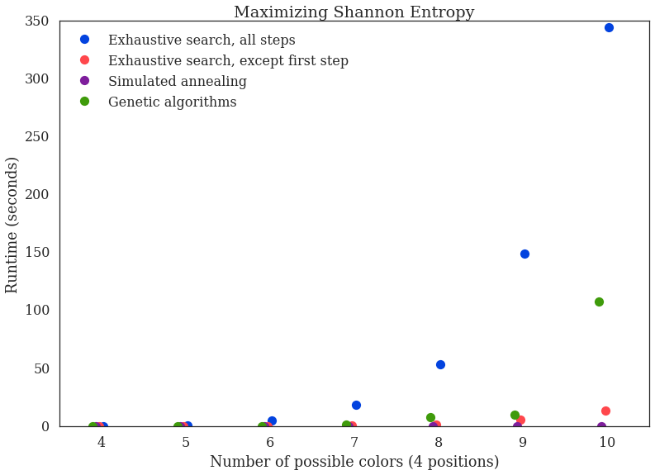

Slide 106
