Slide 1

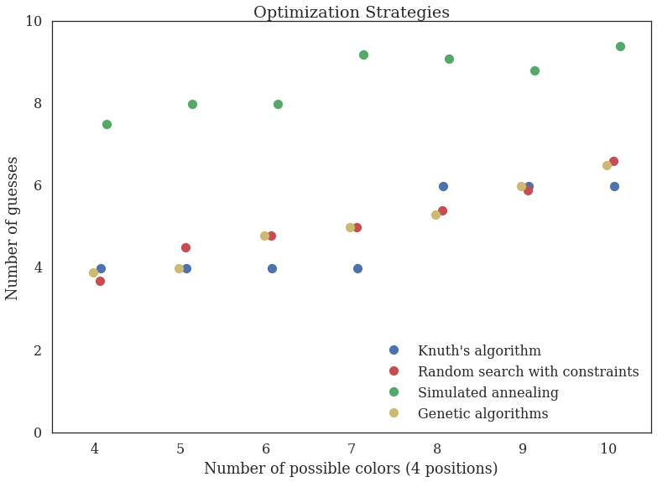
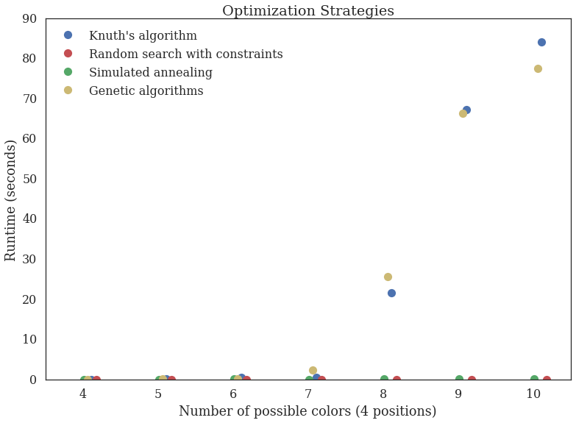
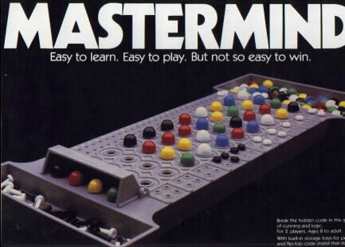
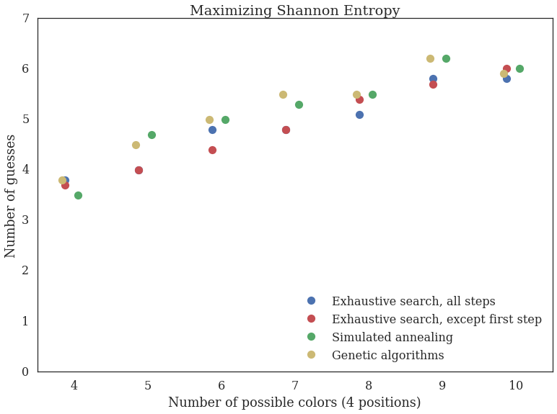
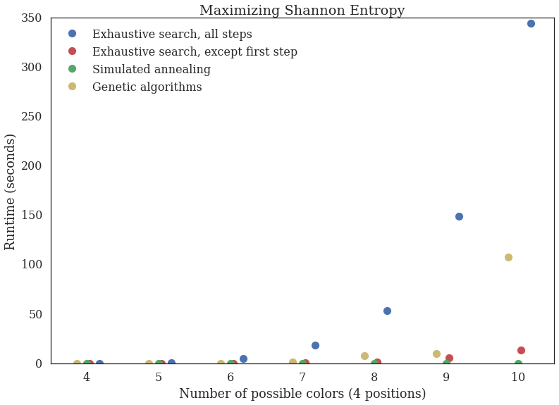
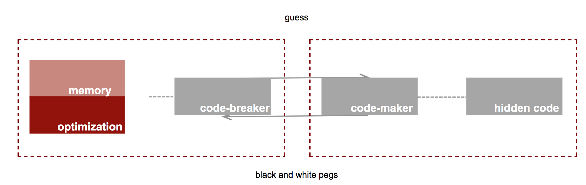
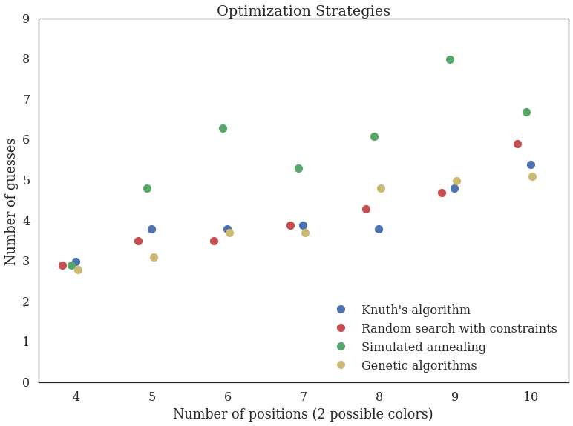
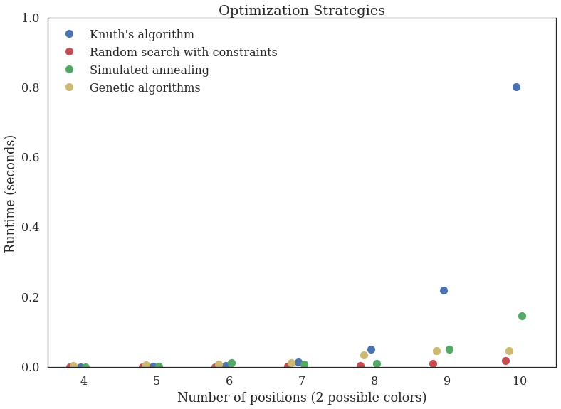
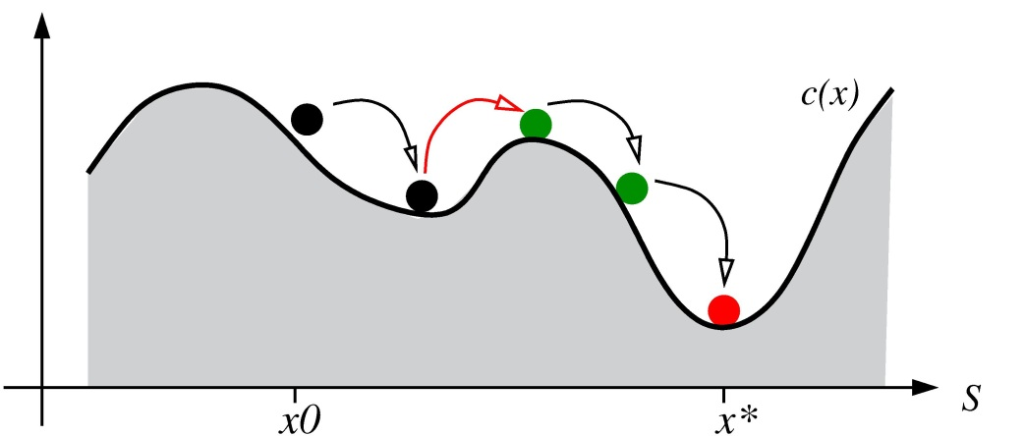
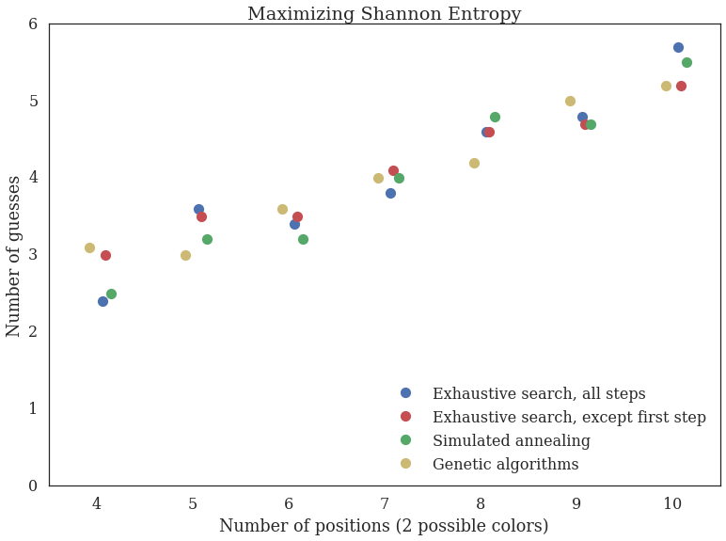
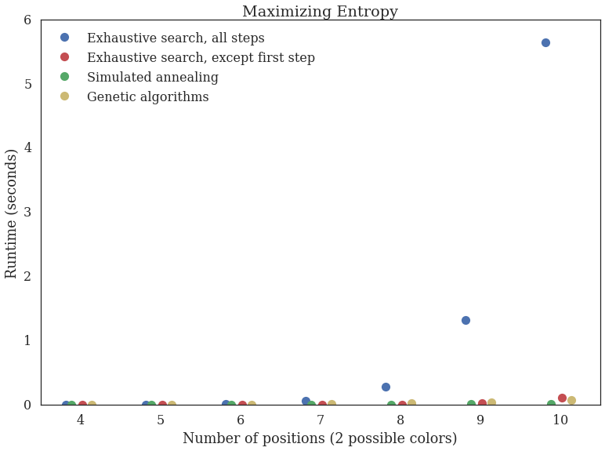

Optimizing Mastermind
Gioia Dominedo, Amy Lee, Kendrick Lo, Reinier Maat
AM 207 Stochastic Methods for Data Analysis, Inference, and Optimization
Spring 2016
Varying the number of possible digits
Introduction
I am an abstract. I am succinct and carefully written.
blah blah blah
blah blah blah
Data
Describe the data, experiments etc
Conclusions
blah blah blah
Approach
Results
Varying the number of possible colors
blah blah blah
Optimization Methods:
Knuth’s Five-Guess Algorithm
Random Search
Maximizing Shannon Entropy
Simulated Annealing
Genetic Algorithms
blah blah blah
Figure 2. And all about Figure 2.
Selected Citations
Knuth, D.E. 1976. The Computer as a Master Mind. Journal of Recreational Mathematics.
Bernier, Jose Luis. Solving Mastermind using GAs and Simulated Annealing: a Case of Dynamic Constraint Optimization. Parallel Problem Solving from Nature: 553-563, 1996.
Vomlel, Jiri. Bayesian networks in mastermind. Proceedings of the 7th Czech-Japan Seminar. 2004.
Figure 1. And all about Figure 1.
School of Engineering and Applied Sciences • Institute for Applied Computational Science

