Slide 1
Exploring Optimization Strategies for Mastermind
Gioia Dominedò • Amy Lee • Kendrick Lo • Reinier Maat AM207 Final Project (2016)

Slide 2
MASTERMIND
Very brief history / background
Object of the game

Slide 3
MASTERMIND
Popular Strategies (describe)
Knuth’s Algorithm
Random Search
Heuristics (e.g. guess all colors first)
Exhaustive Search

Slide 4
TECHNIQUES EXPLORED
Simulated Annealing
Genetic Algorithms
Expectation Maximization
Use of Entropy Objective Function

Slide 5
SIMULATED ANNEALING

Slide 6
SIMULATED ANNEALING

Slide 7
SIMULATED ANNEALING

Slide 8
SIMULATED ANNEALING

Slide 9
SIMULATED ANNEALING

Slide 10
SIMULATED ANNEALING

Slide 11
SIMULATED ANNEALING

Slide 12
SIMULATED ANNEALING

Slide 13
SIMULATED ANNEALING

Slide 14
SIMULATED ANNEALING

Slide 15
SIMULATED ANNEALING

Slide 16
SIMULATED ANNEALING

Slide 17
SIMULATED ANNEALING

Slide 18
SIMULATED ANNEALING

Slide 19
SIMULATED ANNEALING

Slide 20
SIMULATED ANNEALING

Slide 21
SIMULATED ANNEALING

Slide 22
SIMULATED ANNEALING

Slide 23
SIMULATED ANNEALING

Slide 24
SIMULATED ANNEALING

Slide 25
SIMULATED ANNEALING

Slide 26
SIMULATED ANNEALING

Slide 27
SIMULATED ANNEALING

Slide 28
SIMULATED ANNEALING

Slide 29
SIMULATED ANNEALING

Slide 30
SIMULATED ANNEALING

Slide 31

SIMULATED ANNEALING

Slide 32
SIMULATED ANNEALING

Slide 33
SIMULATED ANNEALING

Slide 34
SIMULATED ANNEALING

Slide 35
SIMULATED ANNEALING

Slide 36
SIMULATED ANNEALING

Slide 37
SIMULATED ANNEALING

Slide 38
SIMULATED ANNEALING

Slide 39
SIMULATED ANNEALING

Slide 40
SIMULATED ANNEALING

Slide 41
SIMULATED ANNEALING

Slide 42
SIMULATED ANNEALING

Slide 43
SIMULATED ANNEALING

Slide 44
SIMULATED ANNEALING

Slide 45
SIMULATED ANNEALING

Slide 46
SIMULATED ANNEALING

Slide 47
SIMULATED ANNEALING

Slide 48
SIMULATED ANNEALING

Slide 49
SIMULATED ANNEALING

Slide 50
SIMULATED ANNEALING

Slide 51
SIMULATED ANNEALING

Slide 52
SIMULATED ANNEALING
local minimum

Slide 53
SIMULATED ANNEALING
local minimum global optimum

Slide 55
permutation

Slide 56
permutation

Slide 57
permutation

Slide 59
mutation

Slide 60
mutation

Slide 61
mutation

Slide 62
SIMULATED ANNEALING

Slide 63
SIMULATED ANNEALING

Slide 64
SIMULATED ANNEALING

Slide 65
SIMULATED ANNEALING

Slide 66
SIMULATED ANNEALING

Slide 67
SIMULATED ANNEALING

Slide 68
SIMULATED ANNEALING

Slide 69
SIMULATED ANNEALING

Slide 70
SIMULATED ANNEALING

Slide 71
SIMULATED ANNEALING

Slide 72
SIMULATED ANNEALING

Slide 73
SIMULATED ANNEALING

Slide 74
SIMULATED ANNEALING

Slide 75
SIMULATED ANNEALING

Slide 76
GENETIC ALGORITHMS

Slide 77
GENETIC ALGORITHMS

Slide 78
GENETIC ALGORITHMS
crossover

Slide 79
GENETIC ALGORITHMS
crossover

Slide 80
GENETIC ALGORITHMS
crossover point
crossover

Slide 81
GENETIC ALGORITHMS
crossover point
crossover

Slide 82
GENETIC ALGORITHMS
crossover point
crossover

Slide 83
GENETIC ALGORITHMS
crossover point
crossover

Slide 84
GENETIC ALGORITHMS
crossover point
crossover

Slide 85
GENETIC ALGORITHMS

Slide 86
GENETIC ALGORITHMS
inversion

Slide 87
GENETIC ALGORITHMS
inversion

Slide 88
GENETIC ALGORITHMS
inversion

Slide 89
GENETIC ALGORITHMS

Slide 90
GENETIC ALGORITHMS

Slide 91
GENETIC ALGORITHMS

Slide 92
GENETIC ALGORITHMS

Slide 93
GENETIC ALGORITHMS
permutation + mutation
crossover
inversion

Slide 94
RESULTS
Put main points here
Plot(s) of results?
Number of guesses
Execution time
Time-Space tradeoff ?

Slide 95
LOTS OF GRAPHS –
PICK YOUR FAVORITES!

Slide 96
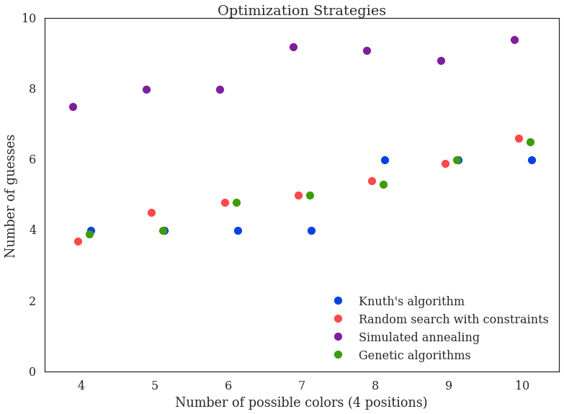

Slide 97
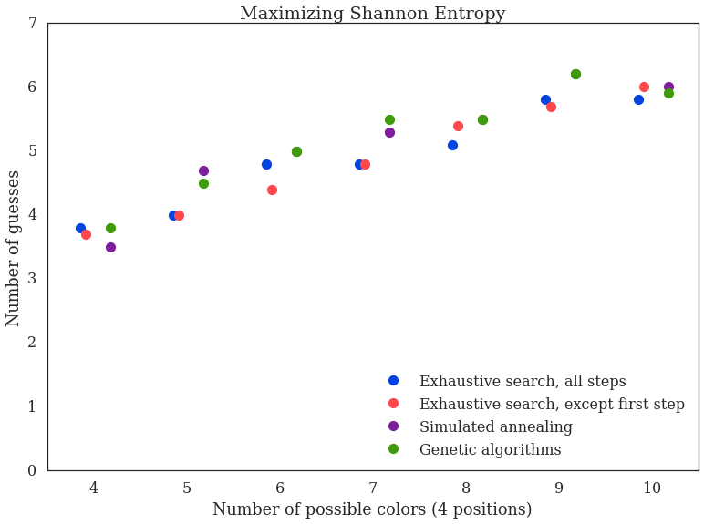

Slide 98
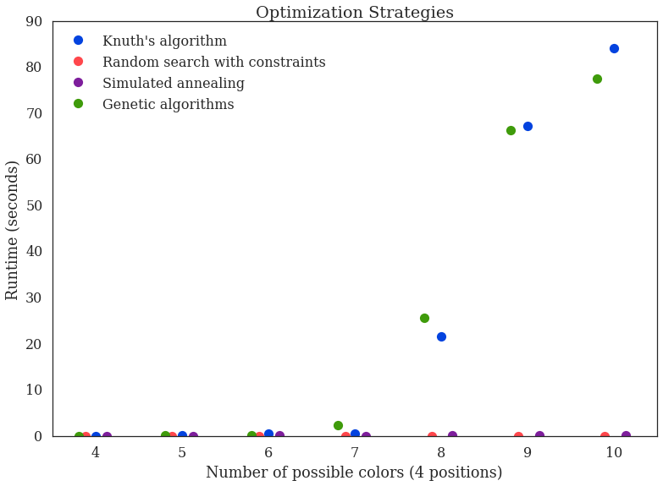

Slide 99
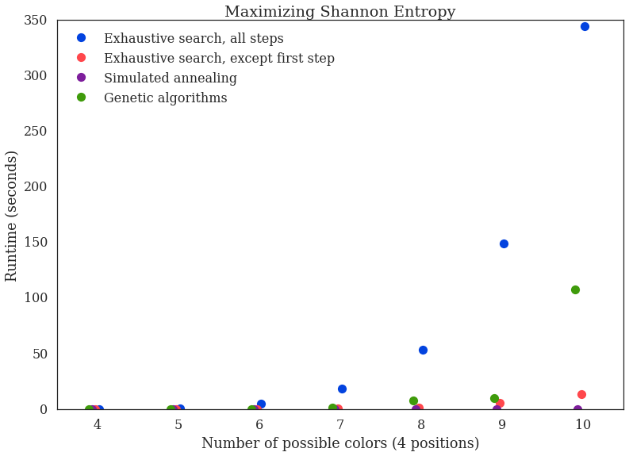

Slide 100
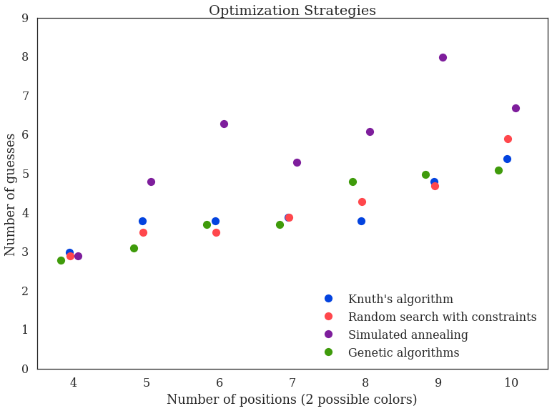

Slide 101
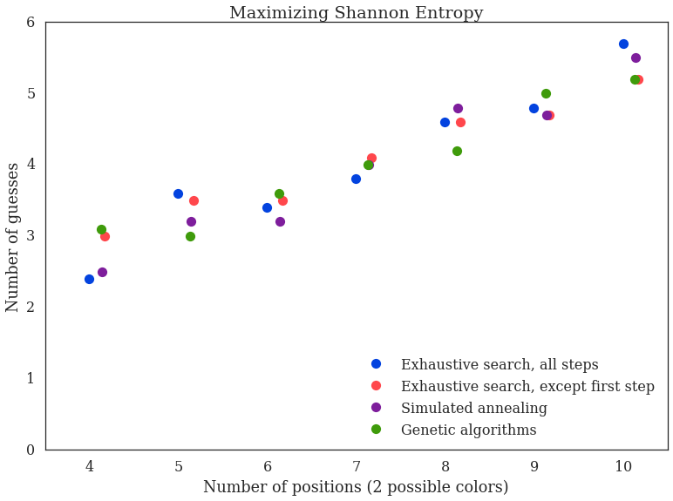

Slide 102
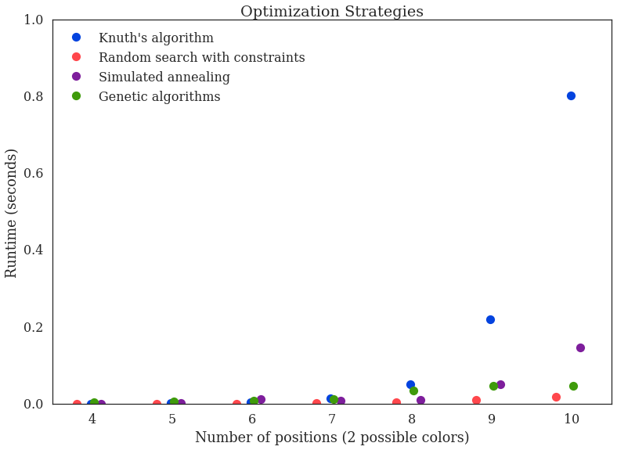

Slide 103
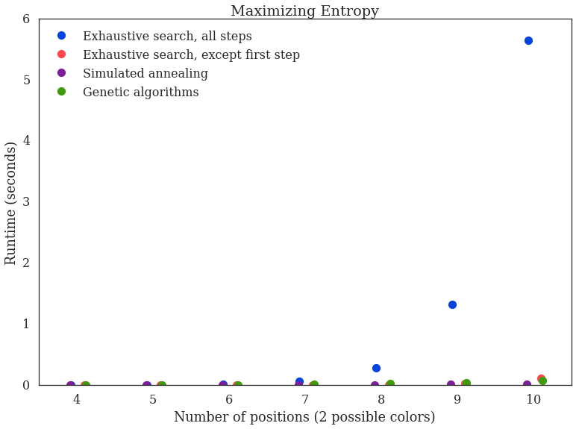

Slide 104
SUMMARY/CONCLUSION
Main takeaway(s)
Thanks for watching!

