Slide 1

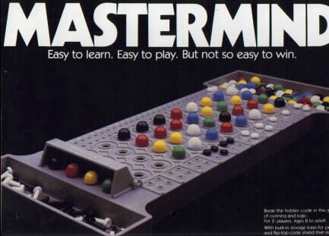
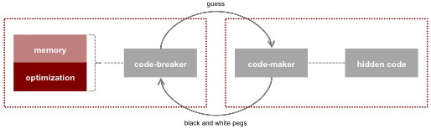
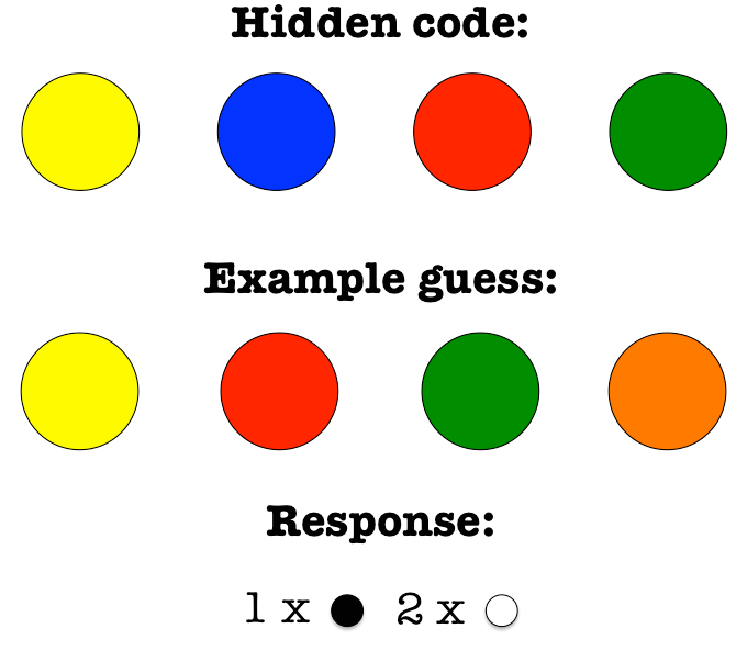
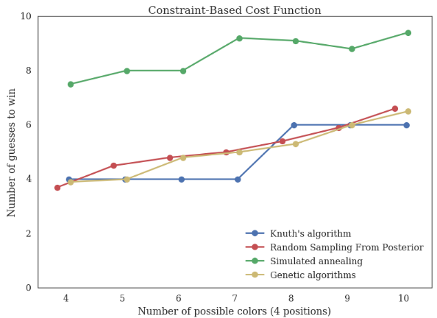
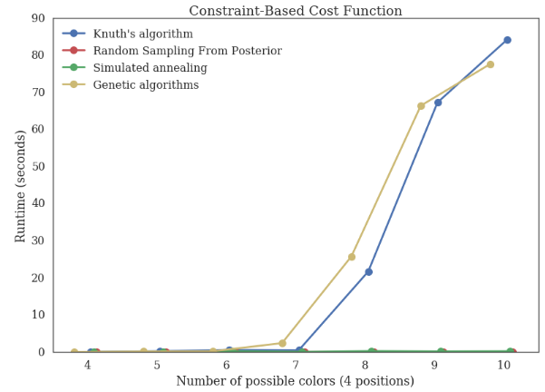
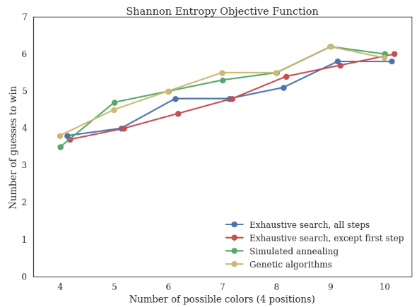
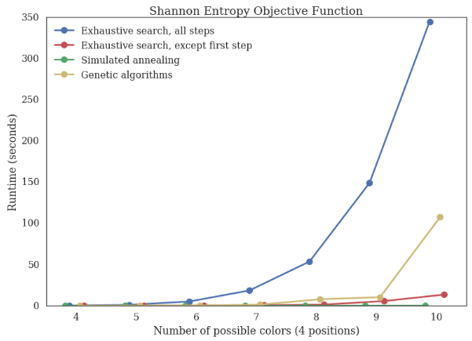
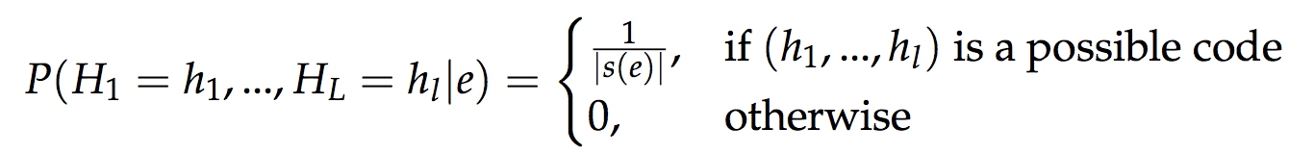
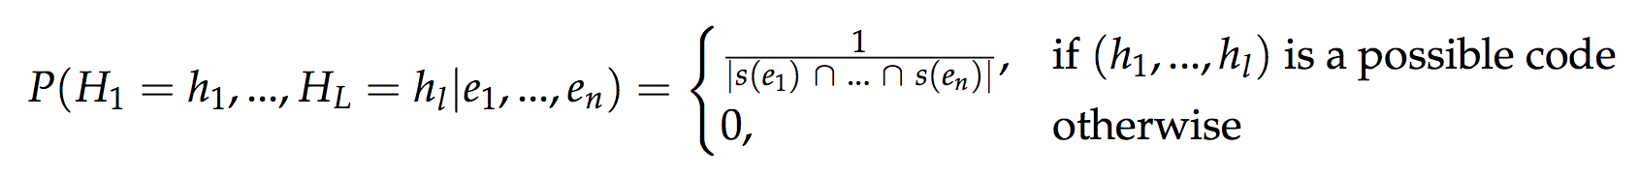
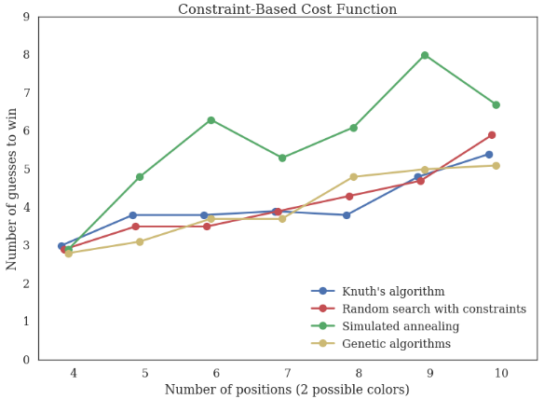
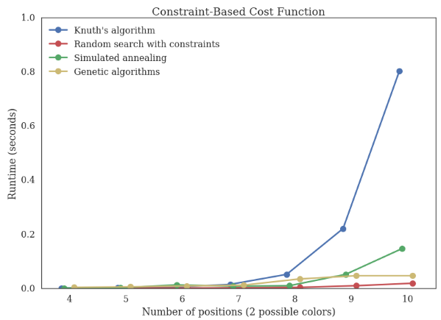
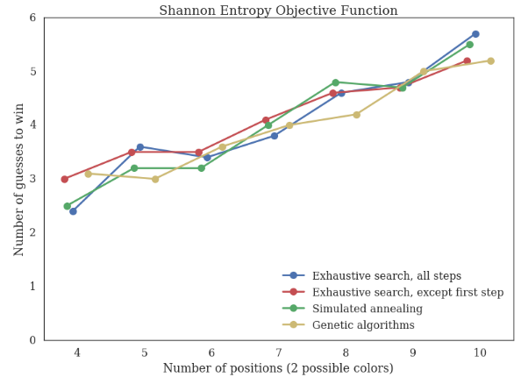
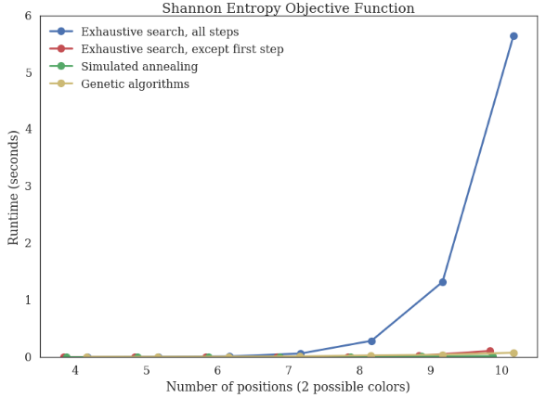
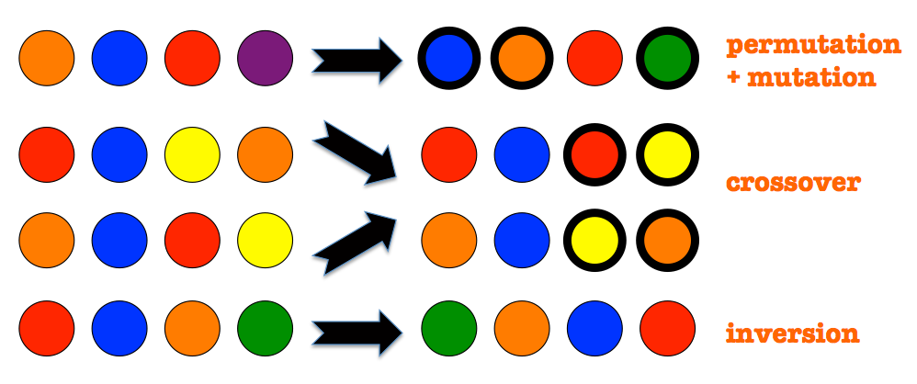
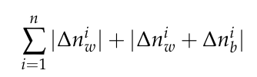
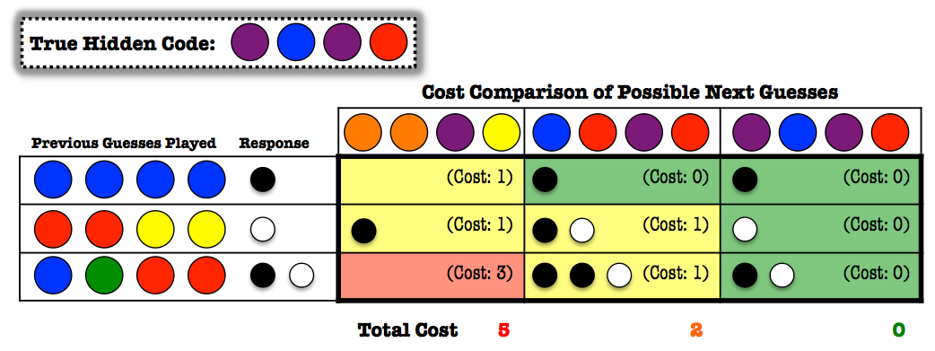






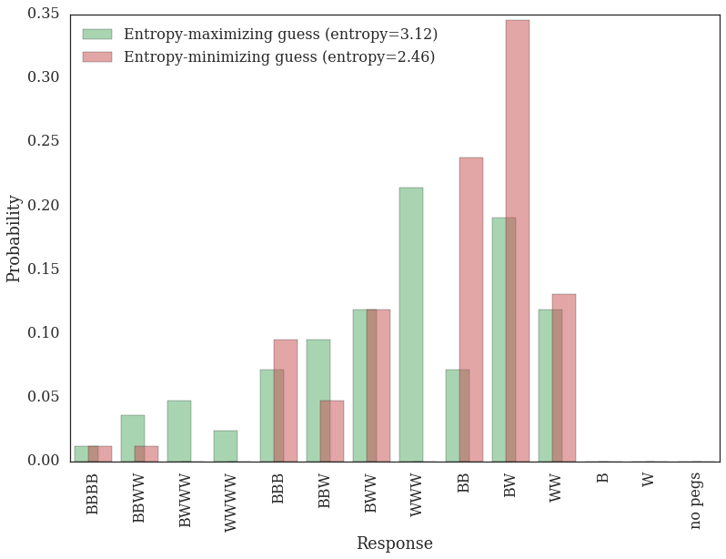
Exploring Optimization Strategies for MasterMind
Gioia Dominedò, Amy Lee, Kendrick Lo, Reinier Maat
AM207 Stochastic Methods for Data Analysis, Inference, and Optimization
Spring 2016
Introduction
Abstract: We investigated various stochastic “code-breaking” optimization methods for solving higher-dimensional versions of the classic game, MasterMind. We tested our techniques on different game board variations and compared the performance of these techniques in terms of the number of guesses and computation time.
MasterMind is a classic game that has been studied by mathematicians and computer scientists alike. It can be viewed as a dynamically constrained optimization problem in which the constraints are not known in advance but are discovered as the game progresses.
Results
Experiments explored 4-10 colors with positions fixed at 4, and 4-10 positions with colors fixed at 2; metrics averaged over 20 simulations.
Varying Color Selection
Approach
# of Guesses Runtime
Optimization Methods
Knuth’s Five-Guess Algorithm – a well-known global optimization technique that can solve the classic game configuration in at most 5 moves by starting with a fixed initial guess and choosing subsequent guesses that eliminate the maximum number of potential codes.
Random Sampling from Posterior – a constrained random search algorithm involving Bayesian posterior updates of the joint distribution over all possible code sequences, P(H₁, … , H_{L}). Each item of an L-length code is denoted as H_{i} with C possible colors. With no information, our prior is uniformly distributed:
Using evidence, e = (B, W), obtained at each step, we update the posterior joint distribution over code sequences as follows:
where s(e) is the set of possible hidden codes given e, and |s(e)| denotes the cardinality of this set. The posterior after multiple game steps is:
Exhaustive Search with Shannon Entropy – see function below.
Simulated Annealing – a local optimization technique adapted from the Metropolis-Hastings algorithm, used to find approximations of a global optimum within large search spaces. Proposed guesses of low “cost” are always accepted; higher cost proposals are accepted with some probability that is a function of a temperature parameter.
Genetic Algorithms – a local optimization technique that draws inspiration from natural evolution, in which
generations of populations of potential
guesses are formed through permutations,
mutations, crossovers, and inversions.
Entropy Constraint-Based
Varying Code Length
# of Guesses Runtime
Entropy Constraint-Based
Objective Functions
Constraint-Based Cost Function:
where n is the # of
previous guesses and
and are differences
in white and black peg
responses.
Basic Idea: Any guess that
has a chance of being the true solution must generate all the same
responses when compared to previous guesses.
2. Shannon Entropy:
where is the i ^{th} response category and
R is the number of possible responses.
Basic Idea: Maximize in order to be able
to discard as many potential codes as
possible at the next step.
Conclusions
Global optimization methods (Knuth’s algorithm, random sampling, and exhaustive search with Shannon Entropy) win in fewer moves, but require excessive runtimes given more complex board configurations.
Local optimization methods (Simulated Annealing and Genetic Algorithms) require more moves to win, but less time to arrive at reasonable guesses, particularly in high-dimensional spaces.
Citations
Knuth, D.E. 1976. The Computer as a Master Mind. Journal of Recreational Mathematics.
Bernier, Jose Luis. Solving Mastermind using GAs and Simulated Annealing: a Case of Dynamic Constraint Optimization. Parallel Problem Solving from Nature: 553-563, 1996.
School of Engineering and Applied Sciences • Institute for Applied Computational Science
Notes:
The game involves two players, a code-maker and code-breaker. The code-breaker must uncover the hidden sequence of colors (typically of length 4, with 6 possible colors) set by the code-maker through a series of guesses. After each guess, the code-maker provides feedback in the form of black and white pegs, where black pegs indicate the number of correct colors in the right positions, and white pegs denote the number of correct colors in the wrong positions.
We explored approaches for solving higher-dimensional versions of the game. Five iterative “code-breaking” optimization methods and two different objective functions were investigated
True solution generated all these responses. Any guess that has any chance of being correct has to generate all the same responses when compared to the previous guesses.
How close it is to a feasible solution given responses to all previous guesses.
We first experimented with the number of possible colors per position
(e.g. 4-10) while keeping the code length constant at 4. We then varied the code length (e.g. 4-10 positions) while keeping the number of colors constant at 2.
Each method was tested 20 times for each experiment, and the average number of guesses to win and the runtime were recorded.
The best performer in terms of balancing number of guesses and speed (10 colors) was simulated annealing with the entropy objective function; the best performer that trades off these factors (10 positions) was genetic algorithms with the constraint-based objective function.

