Slide 1
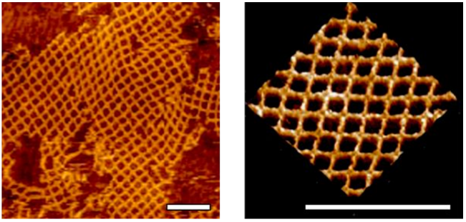
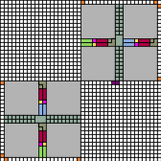
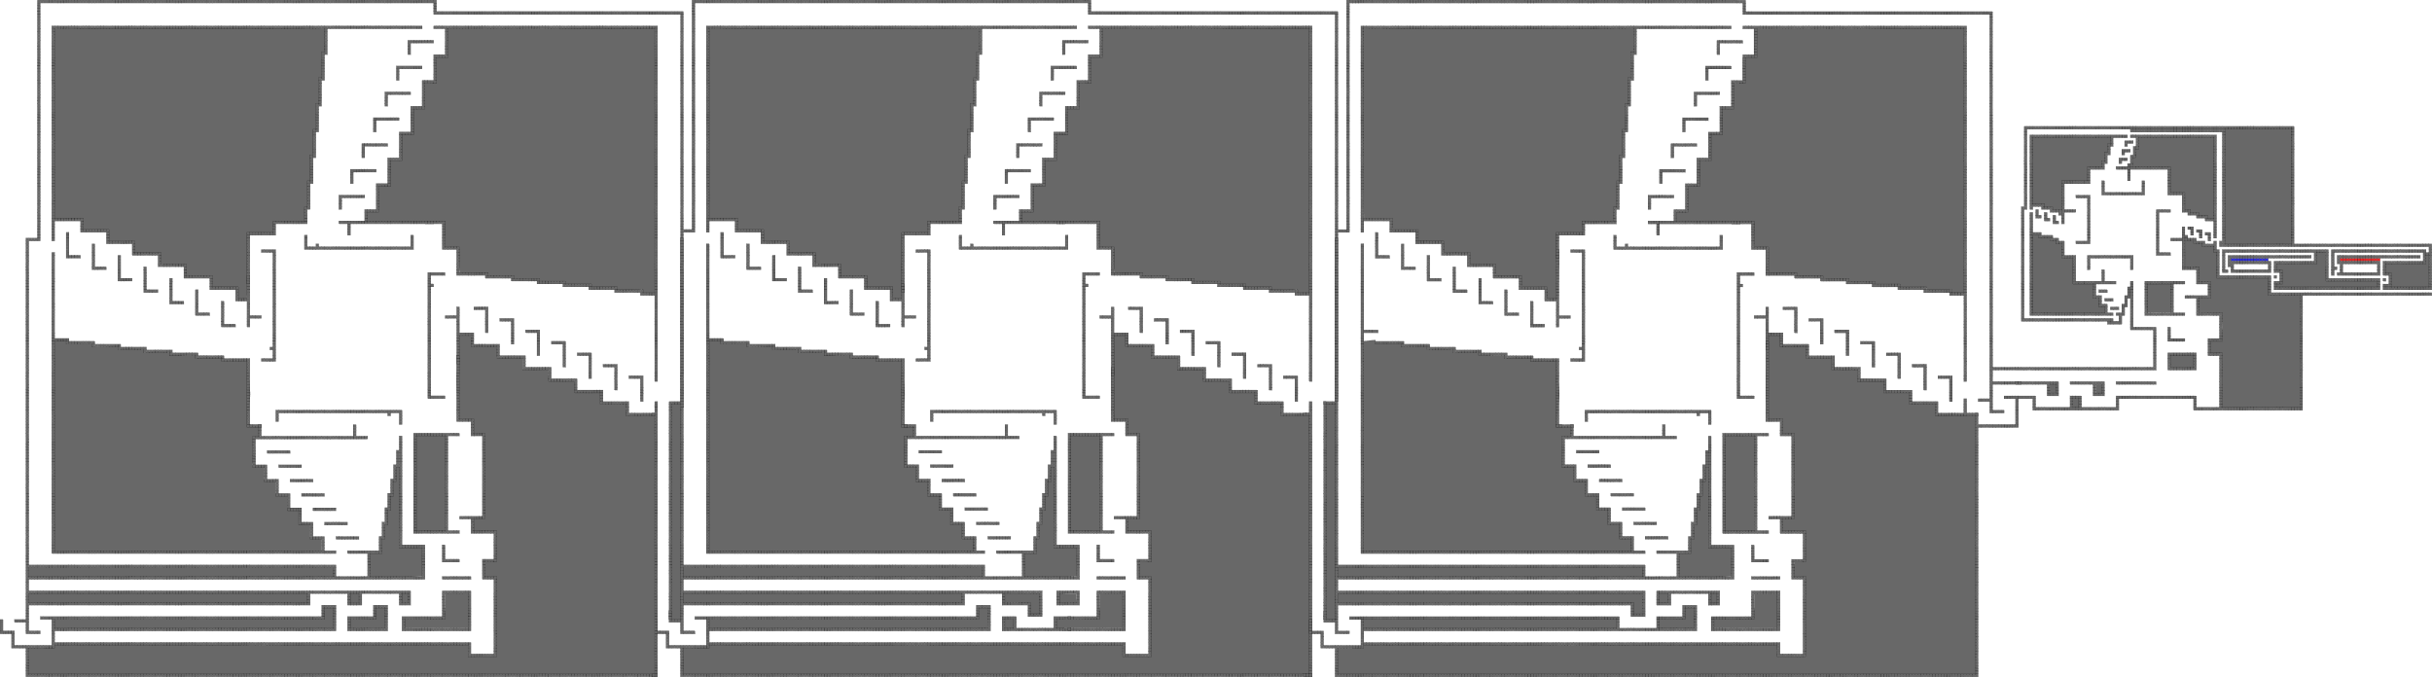
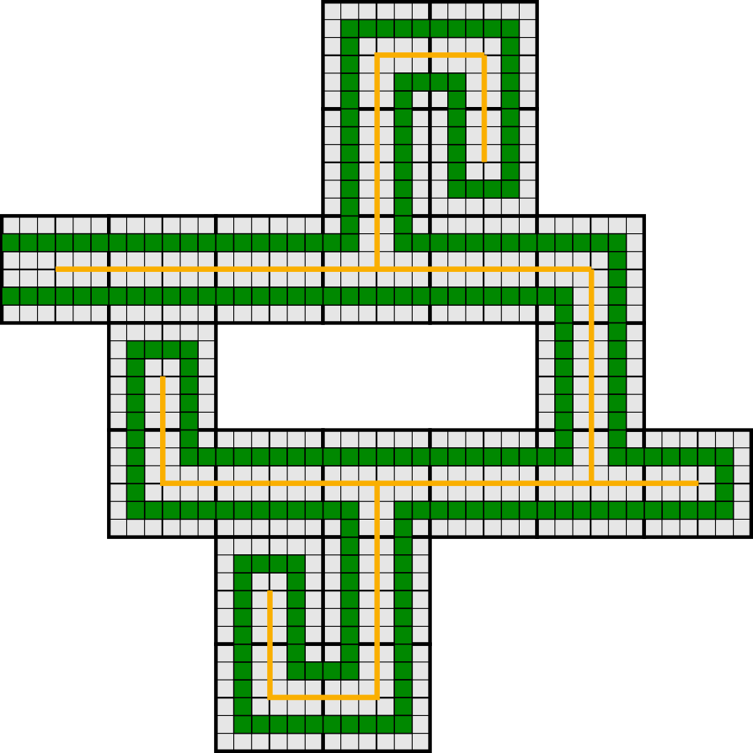
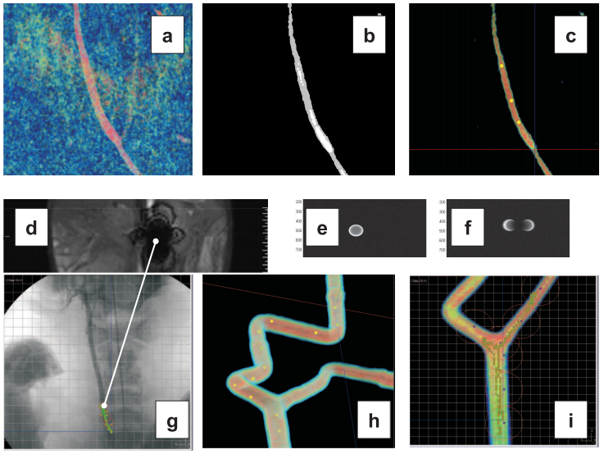
Algorithmic Assembly of Nanoscale Structures
May 7th, 2020
Austin Luchsinger
^{Master’s Thesis Defense}
Advisor: Dr. Schweller
Notes:
A lot of this work was done in collaboration with members of the Algorithmic Self-Assembly Research Group (ASARG) under Dr. Schweller and Dr. Wylie.
I am very grateful to have been a part of this group.

Slide 2
Motivation (Nanofabrication
Advantages and Disadvantages¹
Top-Down Approach:
+ Well developed techniques from micro-fabrication
- Limitations when it comes to tool precision at the nanoscale
+ Generally fewer defects at the nanoscale
- More difficult algorithmic task of assembling
smaller pieces into larger structure
Bottom-Up Approach:
¹https://www.researchgate.net/
Discussion on nanofabrication techniques.

Slide 3
Outline
Self-Assembly
- constant scale
- constant tile types
Guided Assembly
- universal constructors
- shape hierarchy
Notes:
Here is a very brief outline of topics which we will be referring to throughout the presentation.

Slide 4
Outline
Self-Assembly
- constant scale
- constant tile types
Guided Assembly
- universal constructors
- shape hierarchy

Slide 5
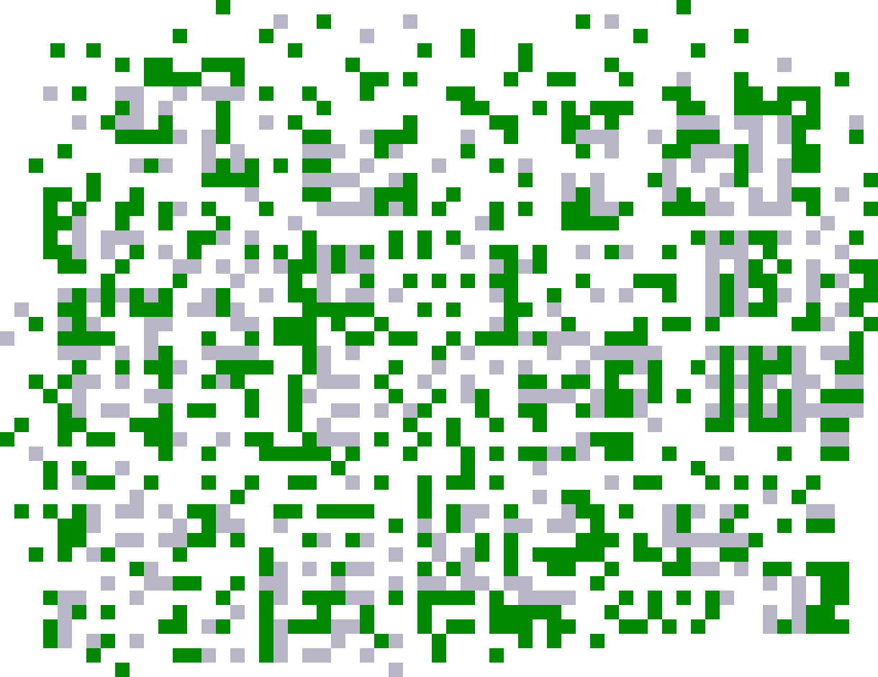
Self-Assembly
System monomers autonomously come together to form complex structures.

Slide 6
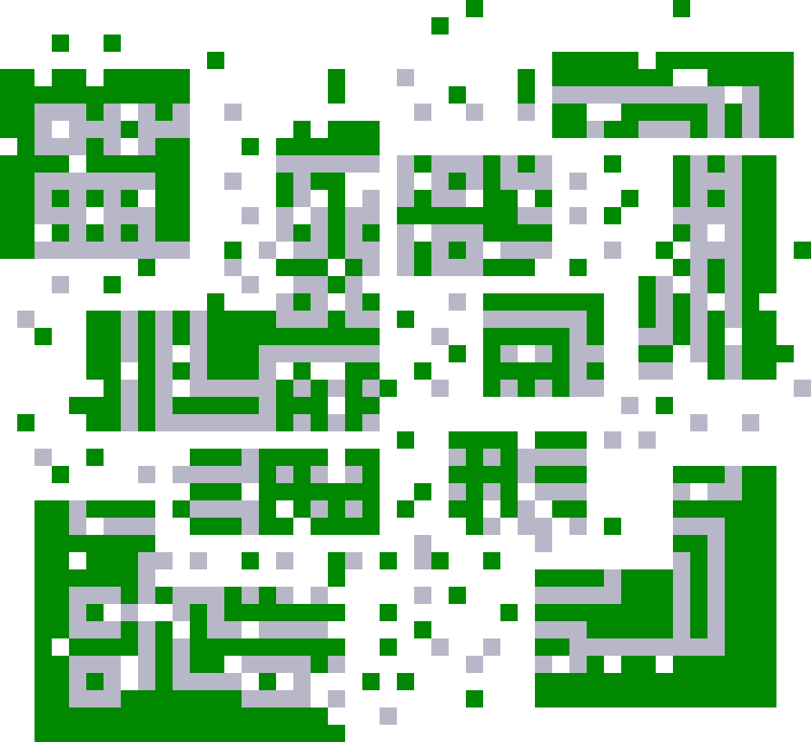
Self-Assembly
System monomers autonomously come together to form complex structures.

Slide 7
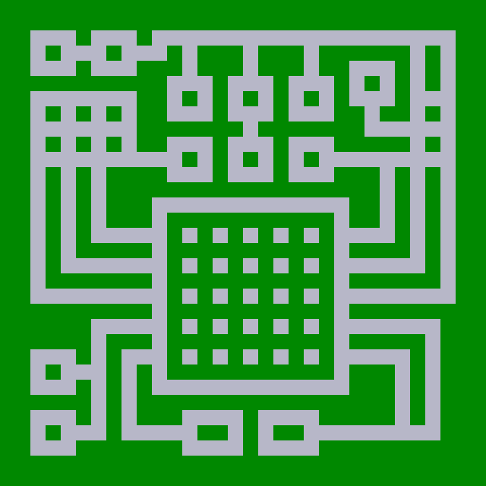
Self-Assembly
System monomers autonomously come together to form complex structures.

Slide 8
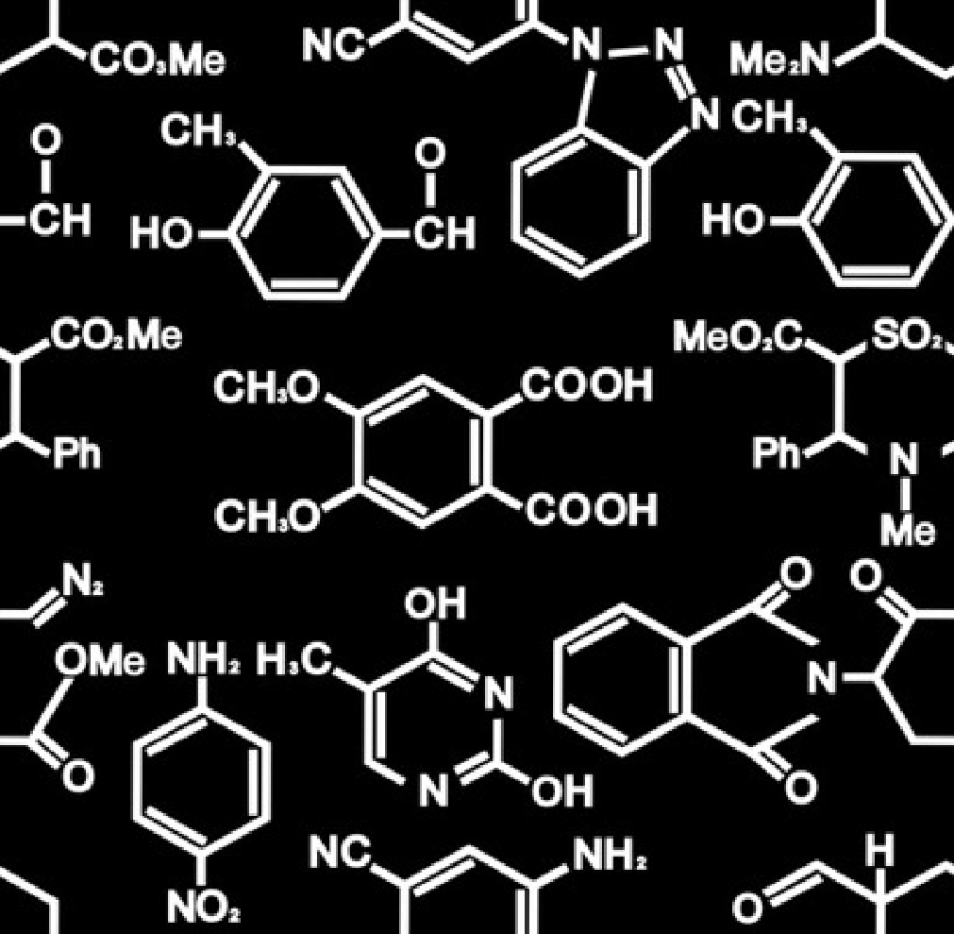
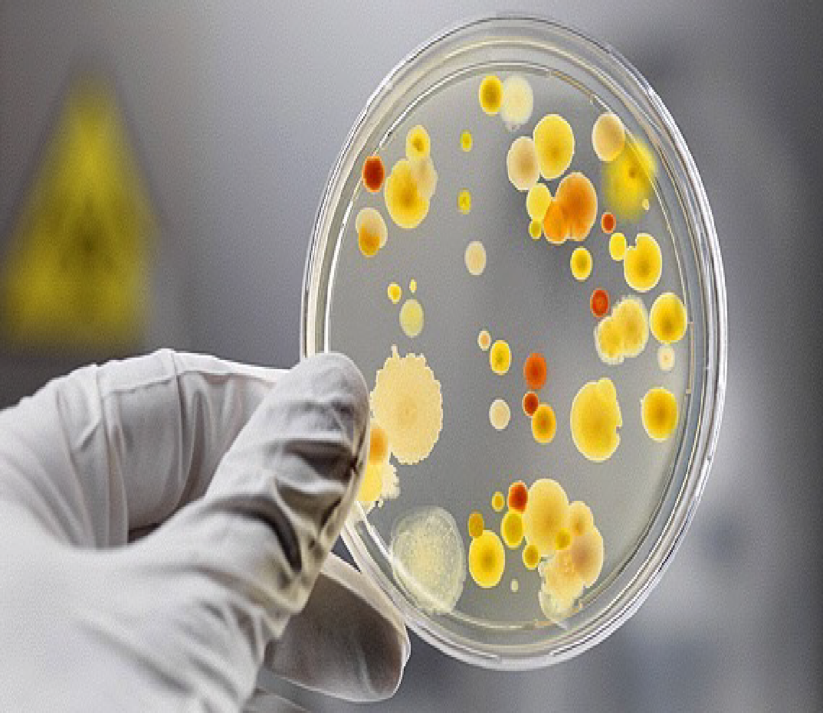
Self-Assembly
Chemistry
Biology
Notes:
This phenomenon is particularly abundant in the areas of Chemistry and Biology. One promising area has been an attempt to harness the power of DNA to assemble complex structures.

Slide 9
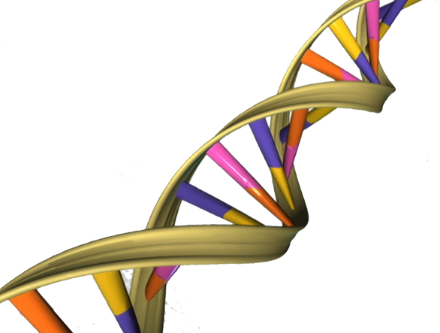
Self-Assembly
Chemistry
Biology
Notes:
This approach of using DNA self-assembly to engineer structures was pioneered by Ned Seeman, whose idea was to assemble tilings of DNA from what’s known as a Branched Junction Molecule.

Slide 10
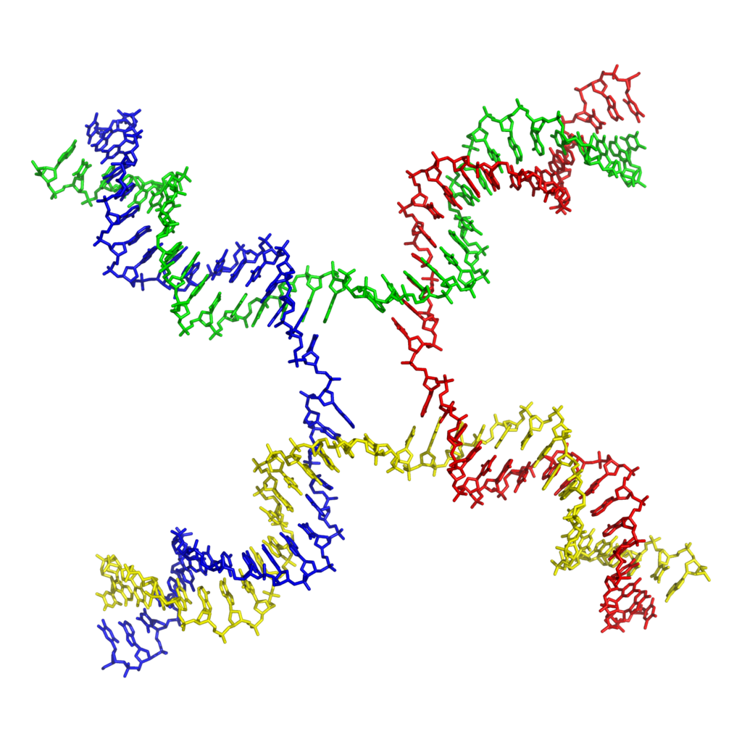
Tile Self-Assembly
Notes:
For these Branched Junction Molecules, the idea is to intertwine multiple strands of DNA.

Slide 11




Tile Self-Assembly
Notes:
By exposing ``loose’’ ends with complimentary sequences of Watson Crick base-pairs, multiple copies of a branched junction molecule might stick together.

Slide 12
Self-Assembly
Notes:
And that pumping these molecules into a system could tile a plane.

Slide 13
Self-Assembly
Notes:
And that pumping these molecules into a system could tile a plane.

Slide 14
Self-Assembly
Notes:
And that pumping these molecules into a system could tile a plane.

Slide 15
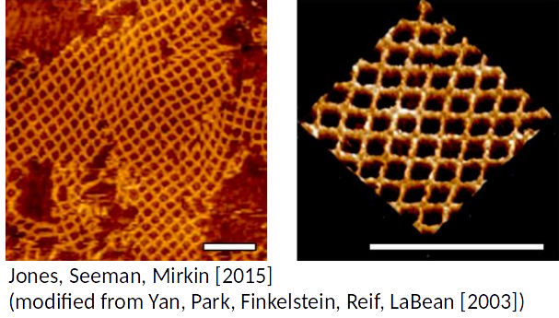
Self-Assembly
Notes:
And it turns out that this actually works! These are images taken by an Atomic Force Microscope of engineered DNA structures (inspired by the branched junction molecule) forming a 2D lattice structure.

Slide 16
Tile Self-Assembly
Notes:
But, the chemistry and biology of this type of implementation is all very involved.

Slide 17
Tile Self-Assembly
(Winfree, 1998)
Notes:
So Erik Winfree, in his PhD thesis, abstracted away the details by representing structures like this Branched Junction Molecule with a square with labeled edges.

Slide 18
Tile Self-Assembly
Green
Glue
Orange
Glue
Purple
Glue
Blue
Glue
(Winfree, 1998)
Notes:
So, instead of exposed strings of complementary base-pairs, we can just think of them as “sticky” sides of the square.

Slide 19
Tile Self-Assembly
Str(G) = 2
Str(O) = 2
Str(P) = 1
Str(B) = 1
(Winfree, 1998)
Notes:
And notably, Winfree imagined that these glues might have varying attachment strengths.

Slide 20
Tile Self-Assembly
(Winfree, 1998)
Notes:
As a visual aid, I’ll be representing glue strengths with the number of colored rectangles on a given side of the square.

Slide 21
Tile Self-Assembly
Rotation
Translation
(Winfree, 1998)
Notes:
Also, something to keep in mind is that these tiles only translate through the systems we’ll be discussing. They do not rotate. Obviously an actual DNA implementation might rotate, but we mean that we can create glue labels which do not allow rotated tiles to stick unless they are both rotated the same amount.

Slide 22
Tile Self-Assembly (2HAM)
(Rothemund, Winfree, Adleman)
Tileset:
Temperature:
2
1
∞ counts of each
tile type

Slide 23
Tile Self-Assembly (2HAM)
Tileset:
Temperature:
2
1

Slide 24
Tile Self-Assembly (2HAM)
Tileset:
Temperature:
2
1

Slide 25
Tile Self-Assembly (2HAM)
Tileset:
Temperature:
2
1

Slide 26
Tile Self-Assembly (2HAM)
Tileset:
Temperature:
2
1

Slide 27
Tile Self-Assembly (2HAM)
Tileset:
Temperature:
2
1

Slide 28
Tile Self-Assembly (2HAM)
Tileset:
Temperature:
2
1

Slide 29
Tile Self-Assembly (2HAM)
Tileset:
Temperature:
2
1

Slide 30
Tile Self-Assembly (2HAM)
Tileset:
Temperature:
2
1

Slide 31
Tile Self-Assembly (2HAM)
Tileset:
Temperature:
2
1

Slide 32
Tile Self-Assembly (2HAM)
Tileset:
Temperature:
Terminal
2
1

Slide 33
Tile Self-Assembly (2HAM)
This system uniquely
produces a 3x3 square:
Tileset:
Temperature:
2
1
Number of tile types = 6

Slide 34
Tile Self-Assembly (2HAM)
This system uniquely
produces a 3x3 square:
Tileset:
Temperature:
2
1
Goal: What is the minimum tile complexity for assembling an
n x n square?
Number of tile types = 6

Slide 35
Tile Self-Assembly (2HAM)
This system uniquely
produces a 3x3 square:
Tileset:
Temperature:
2
1
Ω( )
n x n squares:
log n
log log n
(Rothemund, Winfree, 2000)
Number of tile types = 6

Slide 36
Tile Self-Assembly (2HAM)
This system uniquely
produces a 3x3 square:
Tileset:
Temperature:
2
1
Goal: Use as few tile types as possible.
Number of tile types = 6

Slide 37
Tile Self-Assembly (2HAM)
This system uniquely
produces a 3x3 square:
Tileset:
Temperature:
2
1
Goal: What is the minimum tile complexity for assembling an
n x n square?
Tile Complexity = 6

Slide 38
Tile Self-Assembly (2HAM)
This system uniquely
produces a 3x3 square:
Tileset:
Temperature:
2
1
Ω( )
Tile Complexity = 6
n x n squares:
log n
log log n
(Rothemund, Winfree, 2000)

Slide 39
Negative Glues
(Patitz, Schweller, Summers, 2011)
Tileset:
Temperature:
2
1

Slide 40
Negative Glues
Tileset:
Temperature:
2
1

Slide 41
Negative Glues
Tileset:
Temperature:
2
1

Slide 42
Negative Glues
Tileset:
Temperature:
2
1

Slide 43
Negative Glues
Tileset:
Temperature:
2
1

Slide 44
Negative Glues
(Patitz, Schweller, Summers. 2011)
Tileset:
Temperature:
2
1
Str(R) = -1

Slide 45
Negative Glues
Tileset:
Temperature:
2
1

Slide 46
Negative Glues
Tileset:
Temperature:
2
1

Slide 47
Negative Glues
Tileset:
Temperature:
2
1

Slide 48
Negative Glues
Tileset:
Temperature:
2
1

Slide 49
Negative Glues
Tileset:
Temperature:
2
1

Slide 50
Negative Glues
This system produces
two terminal assemblies:
Tileset:
Temperature:
2
1

Slide 51
Negative Glues
This system produces
two terminal assemblies:
Tileset:
Temperature:
2
1

Slide 52
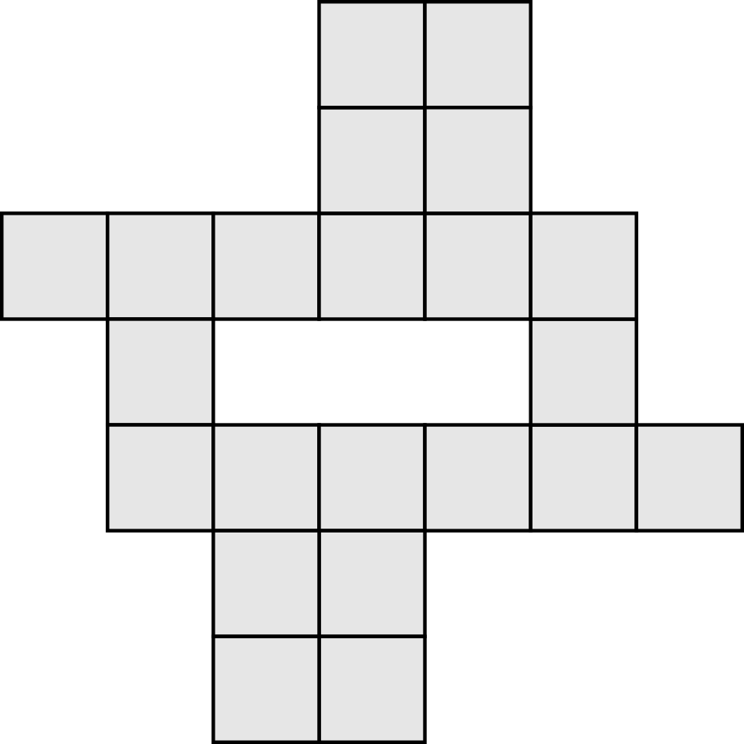
Self-Assembly of Shapes
What if you wanted to assemble an arbitrary shape (S)?
S =

Slide 53
Self-Assembly of Shapes
What if you wanted to assemble an arbitrary shape (S)?
Goal: What is the minimum tile complexity for assembling arbitrary shapes?
S =

Slide 54
Self-Assembly of Shapes
What if you wanted to assemble an arbitrary shape (S)?
Ω( )
K(S)
S =
log(K(S))
(Soloveichik, Winfree, 2007)

Slide 55
Self-Assembly of Shapes
Model | Tile Complexity | Scale Factor
aTAM (Soloveichik, Winfree, 2007)
Staged RNAse (Demaine, Patitz, Schweller, and Summers, 2010)
Negative Glue 2HAM
O( )
K(S)
arbitrary
log(K(S))

Slide 56
Self-Assembly of Shapes
Model | Tile Complexity | Scale Factor
aTAM (Soloveichik, Winfree, 2007)
Staged RNAse (Demaine, Patitz, Schweller, and Summers, 2010)
Negative Glue 2HAM
O( )
K(S)
arbitrary
log(K(S))
O( )
K(S)
logarithmic
log(K(S))

Slide 57
Self-Assembly of Shapes
Model | Tile Complexity | Scale Factor
aTAM (Soloveichik, Winfree, 2007)
Staged RNAse (Demaine, Patitz, Schweller, and Summers, 2010)
Negative Glue 2HAM
O( )
K(S)
arbitrary
log(K(S))
O( )
K(S)
logarithmic
log(K(S))
O( )
K(S)
constant
log(K(S))

Slide 58
Outline
Self-Assembly
- constant scale
- constant tile types
Guided Assembly
- universal constructors
- shape hierarchy
The following portion of this presentation was published as:
Luchsinger, Schweller, Wylie, Self-Assembly of Shapes at Constant Scale Using Repulsive Forces, In Natural Computing, 18(1), 93-105, 2019

Slide 59
Self-Assembly of Shapes
Input
Optimal description
of shape S:

Slide 60
Self-Assembly of Shapes
Input
Optimal description
of shape S:
Tileset
Temperature
10

Slide 61
Self-Assembly of Shapes
Input
Optimal description
of shape S:
Tileset
Temperature
10

Slide 62
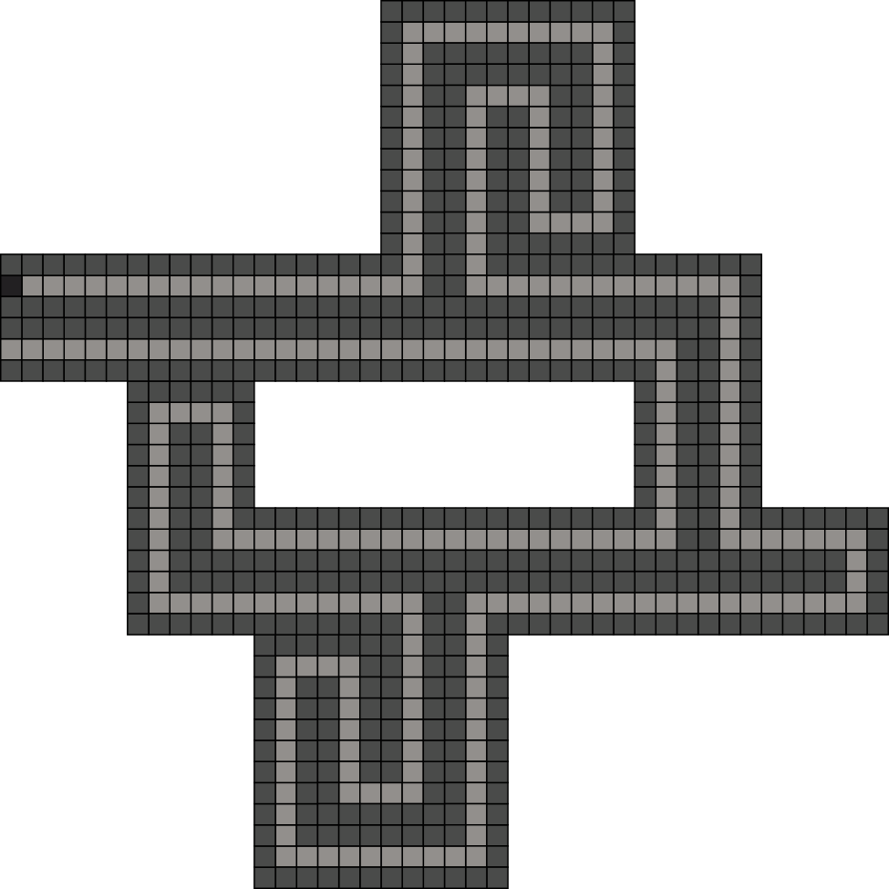
Self-Assembly of Shapes
Input
Output
Optimal description
of shape S:
Tileset
Temperature
10
An assembly of shape S at constant scale

Slide 63
Shape Scaling
Target Shape S

Slide 64
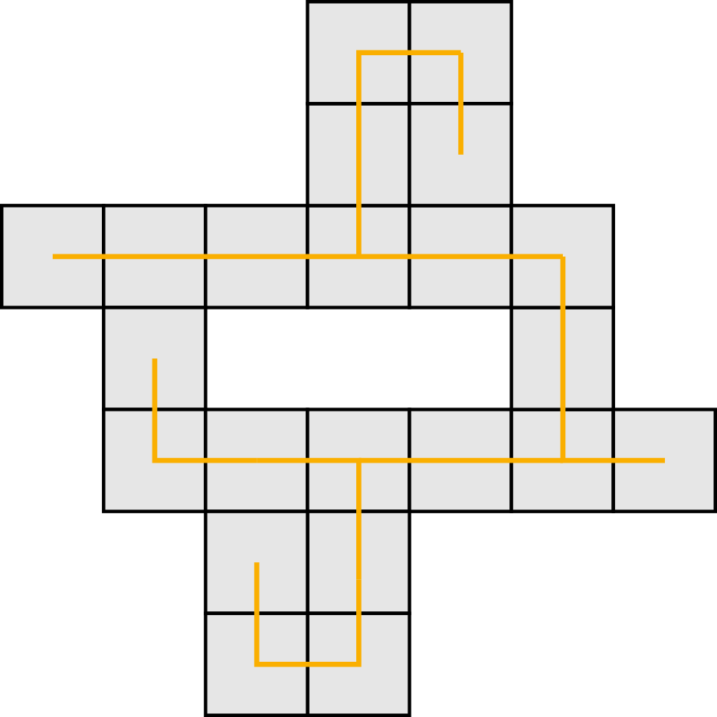
Shape Scaling
Spanning Tree of S
Notes:
A spanning tree for a shape can be found in linear time w.r.t. the size of the shape, with either a depth-first of breadth-first search.

Slide 65
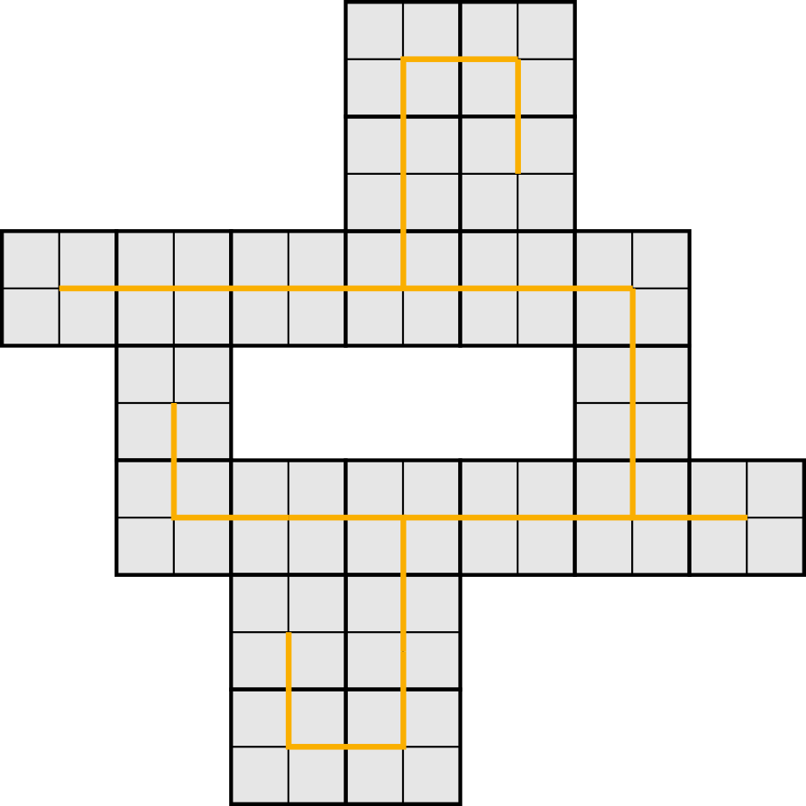
Shape Scaling
Shape S at scale 2
x2

Slide 66
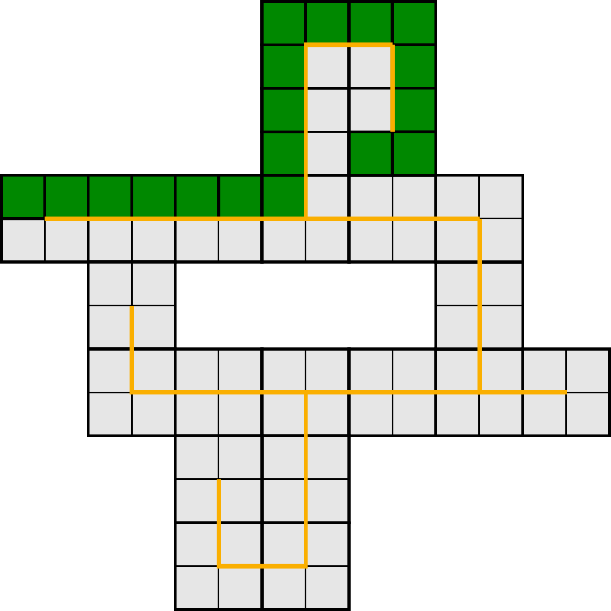
Shape Scaling
Path around spanning tree of S

Slide 67
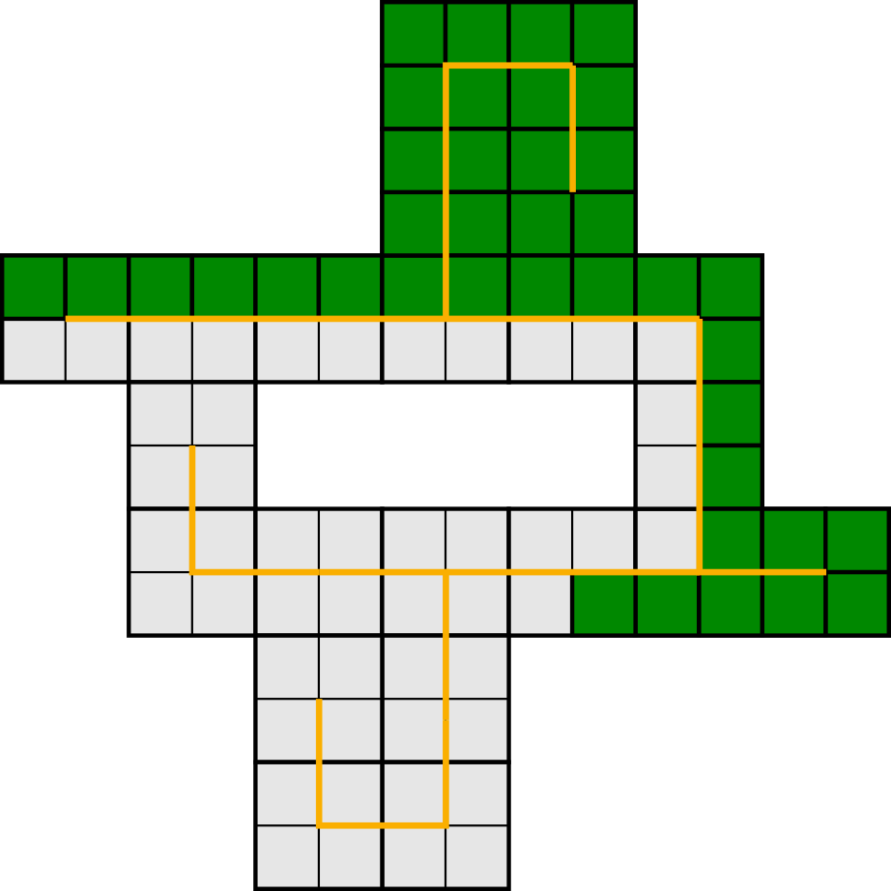
Shape Scaling
Path around spanning tree of S

Slide 68
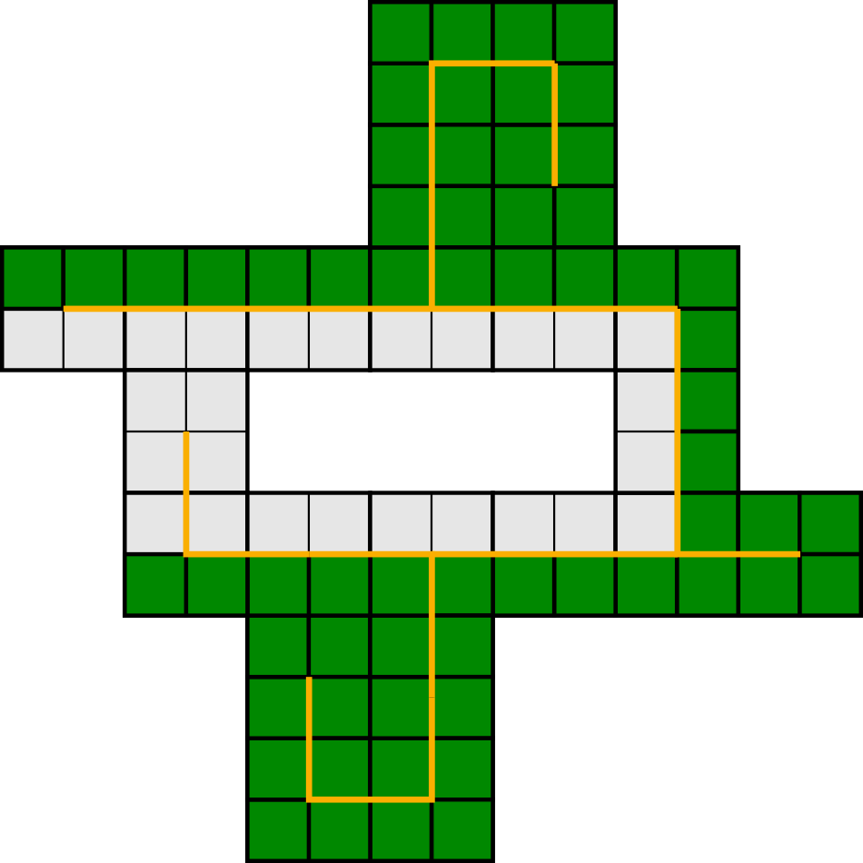
Shape Scaling
Path around spanning tree of S

Slide 69
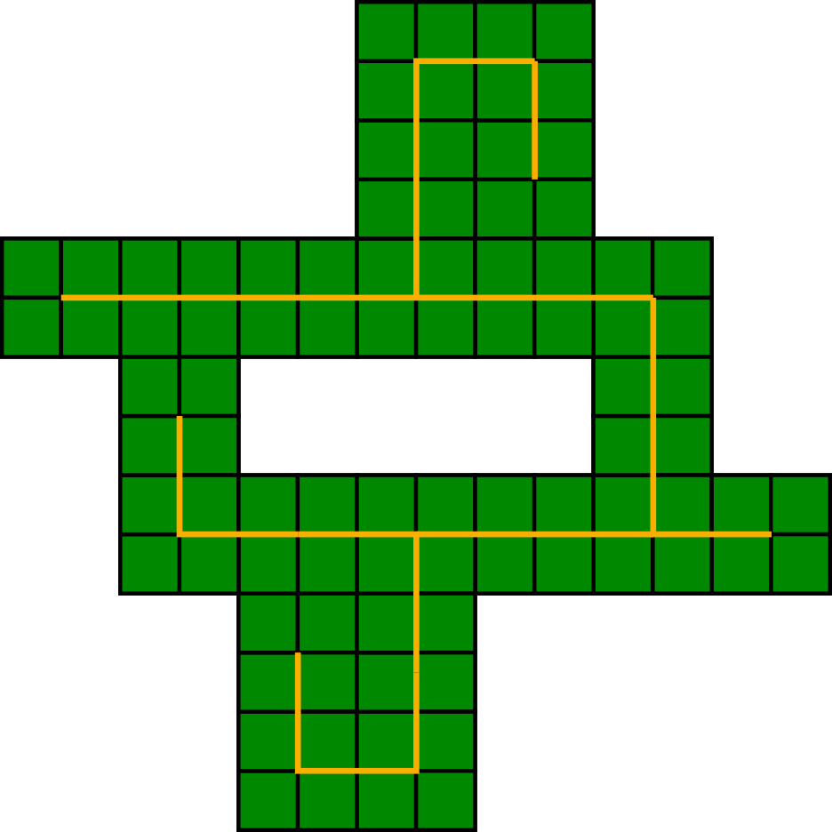
Shape Scaling
Path around spanning tree of S

Slide 70
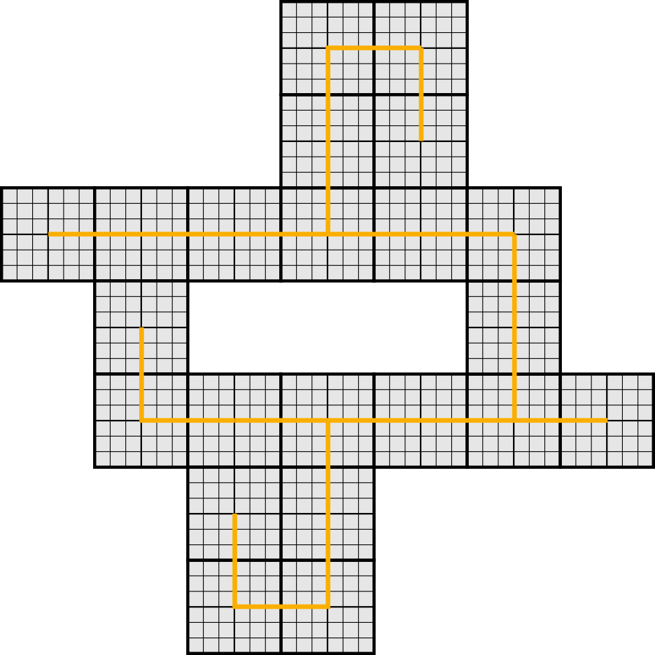
Shape Scaling
Shape S at scale 6
x3

Slide 71
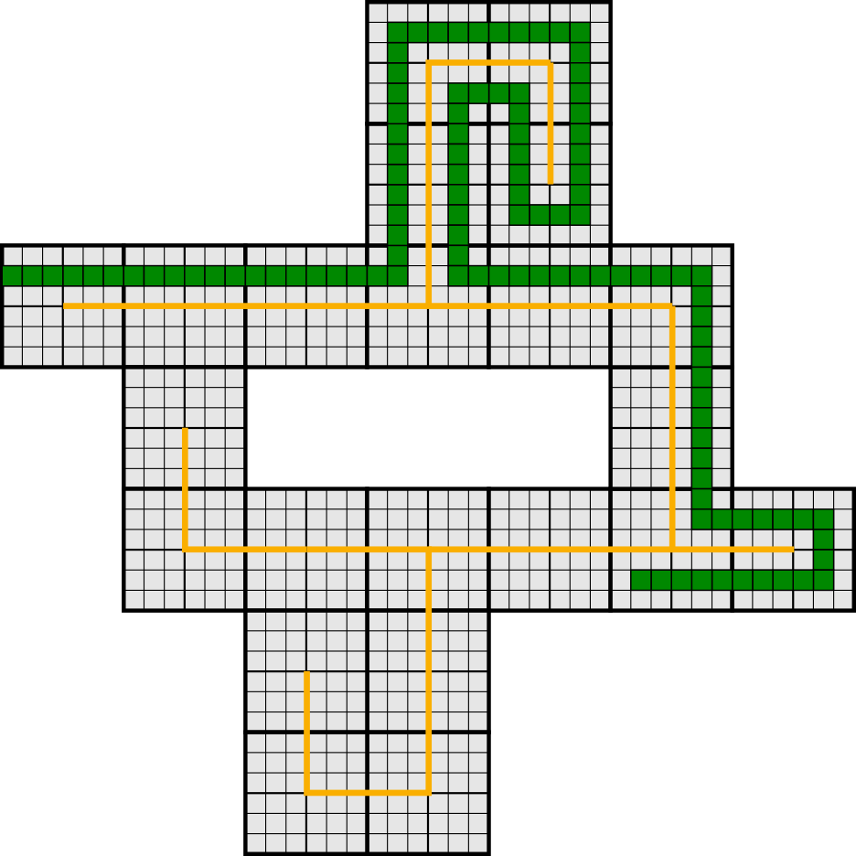
Shape Scaling
Path around spanning tree of S with “buffer”

Slide 72
Shape Scaling
Path around spanning tree of S with “buffer”

Slide 73
Process Overview
O( )
K(S)
distinct tile types
log(K(S))

Slide 74
Process Overview
O( )
K(S)
distinct tile types
log(K(S))
Higher-Base Representation
4
4
1
1
7
7
3
3
0
0
2
2
8
8
1
1
Self Assembles

Slide 75
Process Overview
O( )
K(S)
distinct tile types
log(K(S))
Higher-Base Representation
4
4
1
1
7
7
3
3
0
0
2
2
8
8
1
1
Binary Representation of length K(S)
Self Assembles
1
0
0
1
0
1
1
1
0
1
0
1
0
1
1
0
O( )
TM using
K(S)
tile types
log(K(S))

Slide 76
Process Overview
O( )
K(S)
distinct tile types
log(K(S))
Higher-Base Representation
4
4
1
1
7
7
3
3
0
0
2
2
8
8
1
1
Binary Representation of length K(S)
Self Assembles
1
0
0
1
0
1
1
1
0
1
0
1
0
1
1
0
O( )
TM using
K(S)
tile types
log(K(S))
Method introduced by (Soloveichik, Winfree)

Slide 77
Process Overview
O( )
K(S)
distinct tile types
log(K(S))
Higher-Base Representation
4
4
1
1
7
7
3
3
0
0
2
2
8
8
1
1
Binary Representation of length K(S)
Self Assembles
1
0
0
1
0
1
1
1
0
1
0
1
0
1
1
0
Explicit Encoding
O( )
TM using
K(S)
tile types
log(K(S))
F
F
F
L
F
F
F
R
F
F
F
R
F
F
F
L
TM using O(1) tile types

Slide 78
Process Overview
O( )
K(S)
distinct tile types
log(K(S))
Higher-Base Representation
4
4
1
1
7
7
3
3
0
0
2
2
8
8
1
1
Binary Representation of length K(S)
Self Assembles
1
0
0
1
0
1
1
1
0
1
0
1
0
1
1
0
Explicit Encoding
O( )
TM using
K(S)
tile types
log(K(S))
F
F
F
L
F
F
F
R
F
F
F
R
F
F
F
L
Scaled Shape
TM using O(1) tile types
O(1) tile types

Slide 79
Process Overview
O( )
K(S)
distinct tile types
log(K(S))
Higher-Base Representation
4
4
1
1
7
7
3
3
0
0
2
2
8
8
1
1
Binary Representation of length K(S)
Self Assembles
1
0
0
1
0
1
1
1
0
1
0
1
0
1
1
0
Explicit Encoding
O( )
TM using
K(S)
tile types
log(K(S))
F
F
F
L
F
F
F
R
F
F
F
R
F
F
F
L
Scaled Shape
TM using O(1) tile types
O( )
O(1) tile types
K(S)
log(K(S))

Slide 80
Process Overview
Path-walking instructions

Slide 81
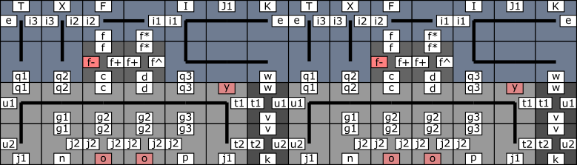
Process Overview
Inspired by (Schweller, Sherman, 2013)

Slide 82
Process Overview
Information Block

Slide 83
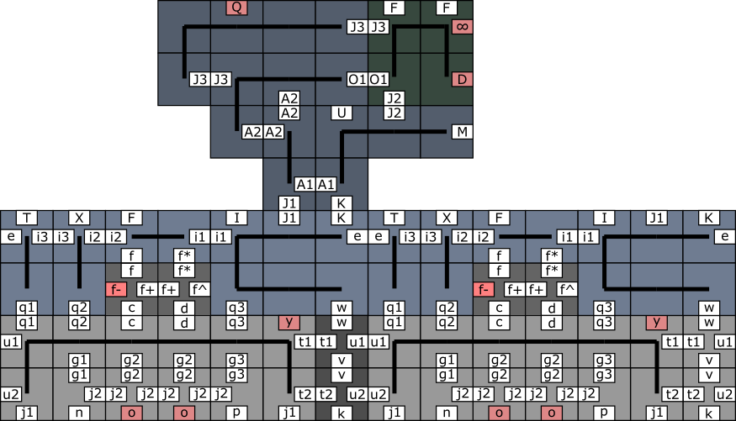
Process Overview

Slide 84
Process Overview

Slide 85
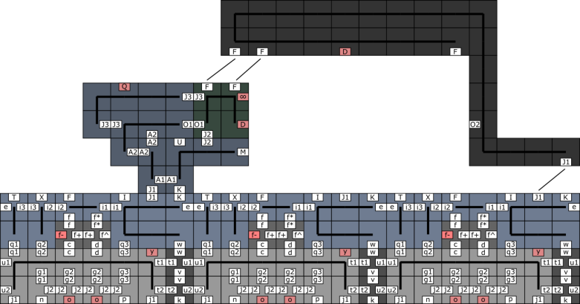
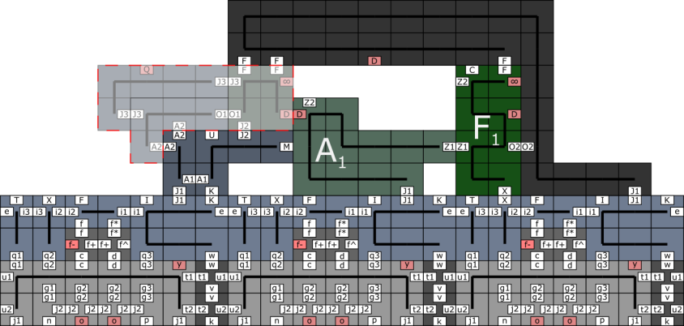
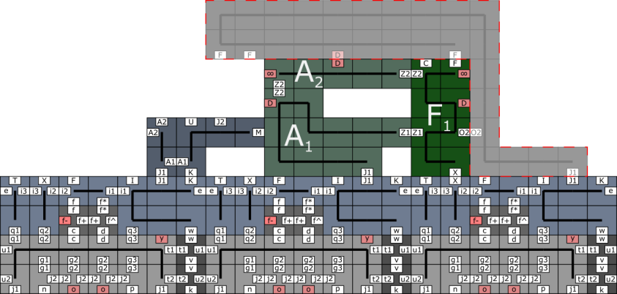
Process Overview

Slide 86
Process Overview

Slide 87
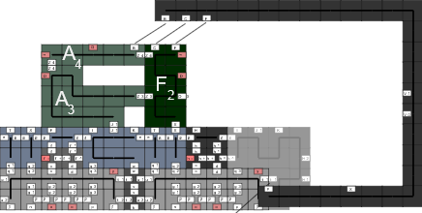
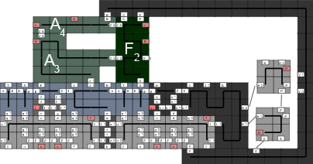
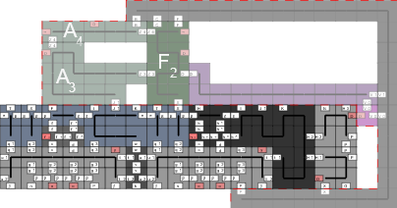
Process Overview

Slide 88
Process Overview
Outlining Path

Slide 89
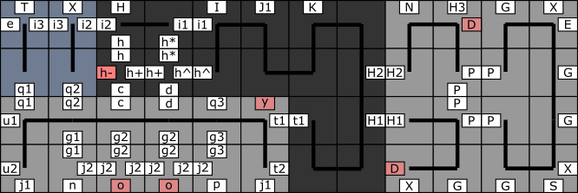
Process Overview

Slide 90
Process Overview

Slide 91
Process Overview

Slide 92
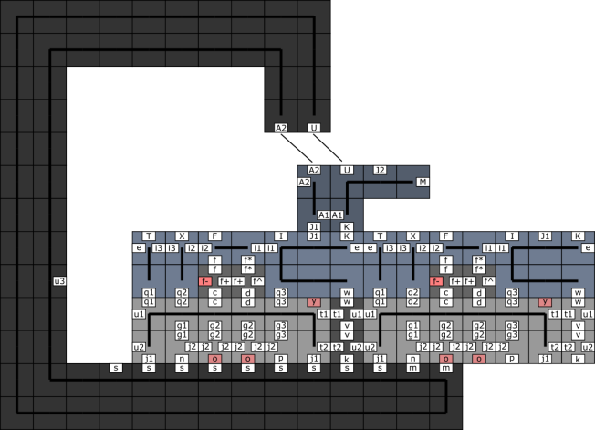
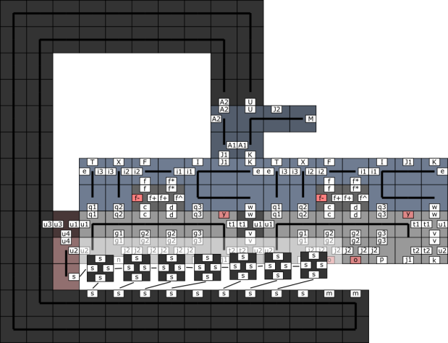
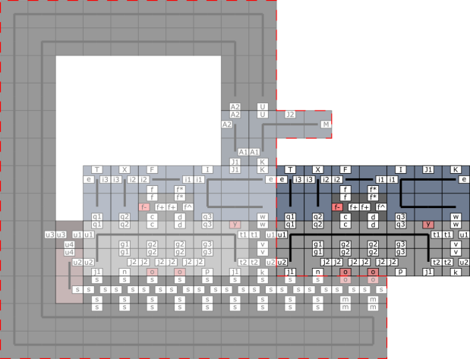
Process Overview

Slide 93
Process Overview

Slide 94
Process Overview

Slide 95
Process Overview

Slide 96
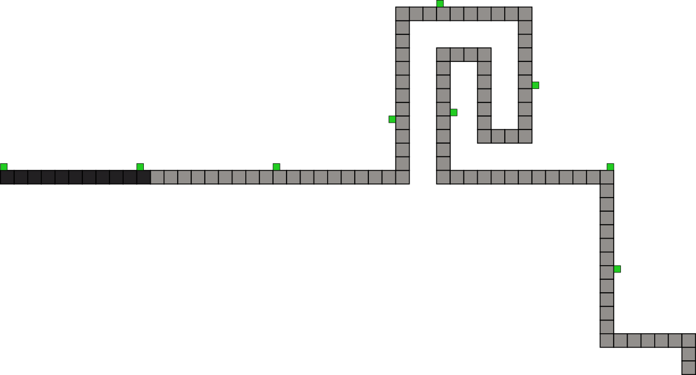
Process Overview

Slide 97
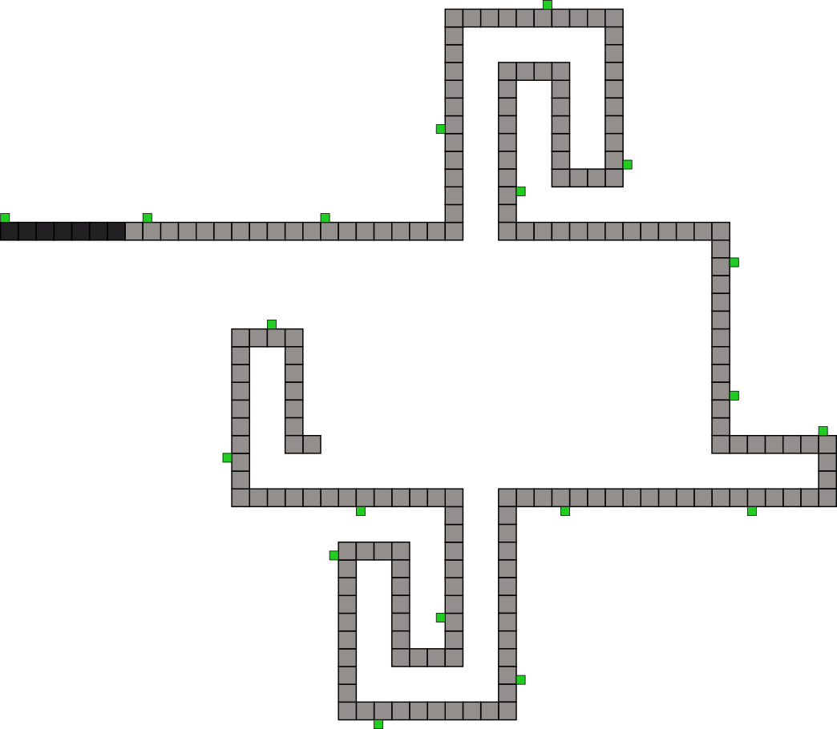
Process Overview

Slide 98
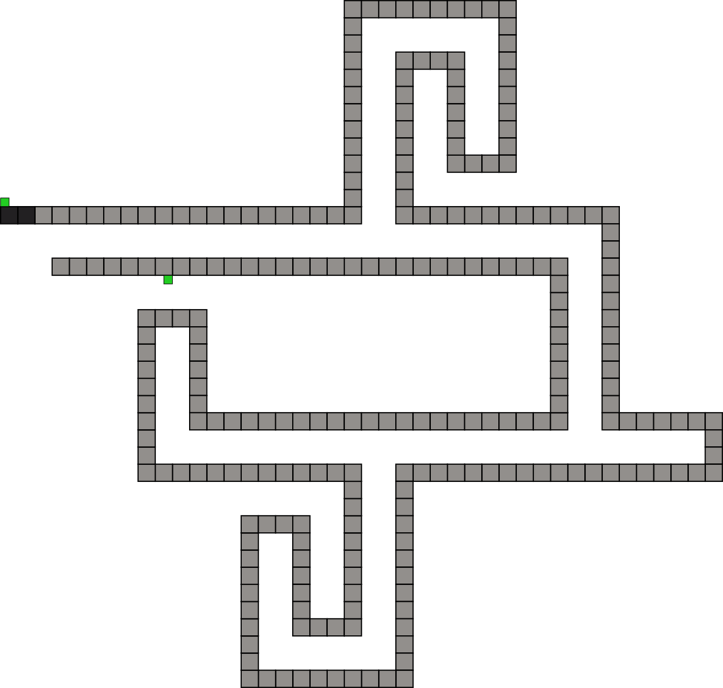
Process Overview

Slide 99
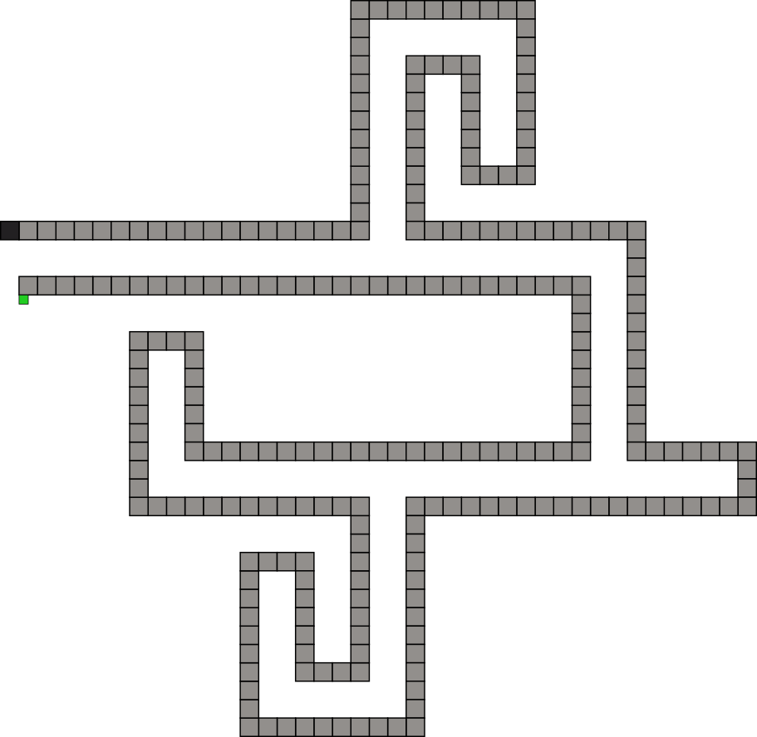
Process Overview

Slide 100
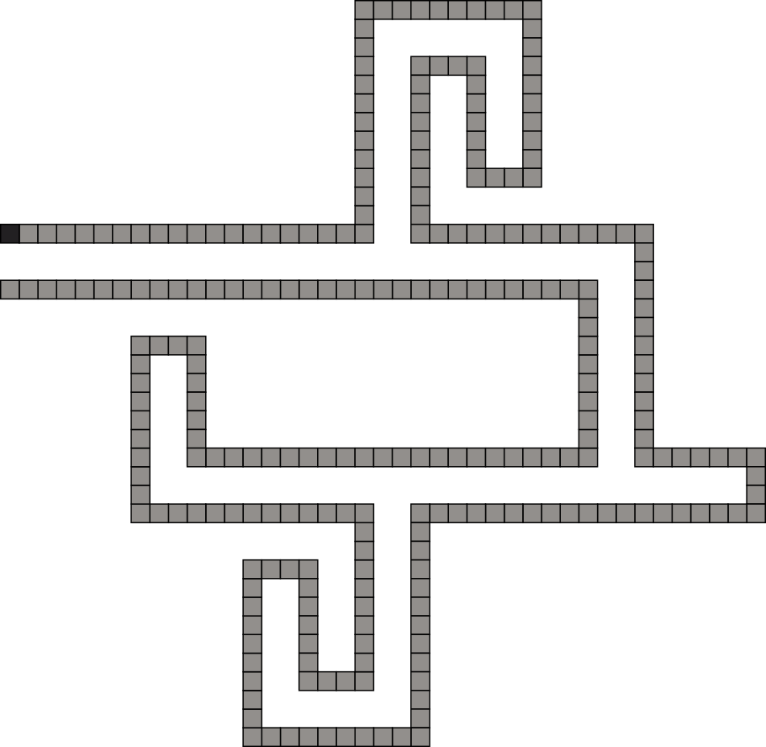
Process Overview

Slide 101
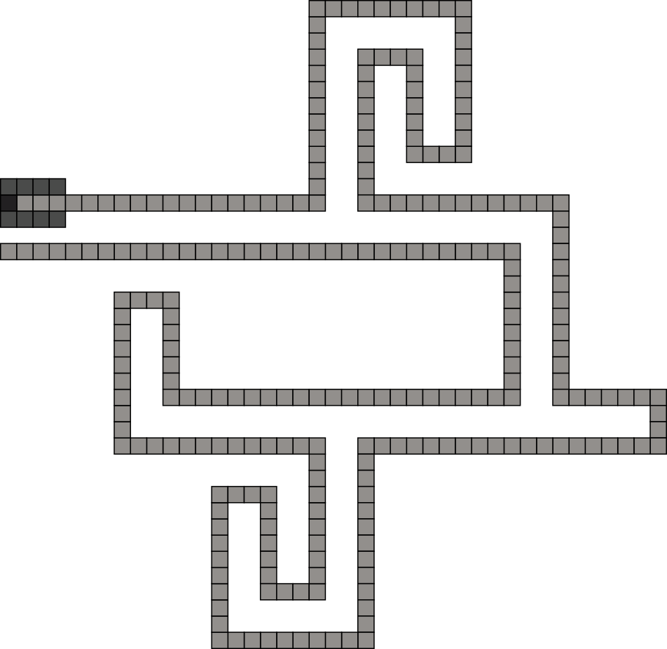
Process Overview

Slide 102
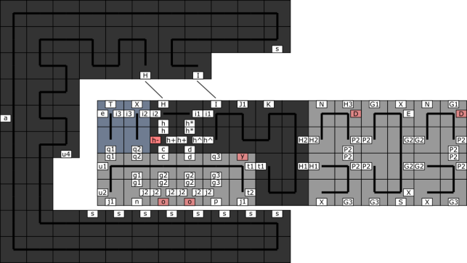
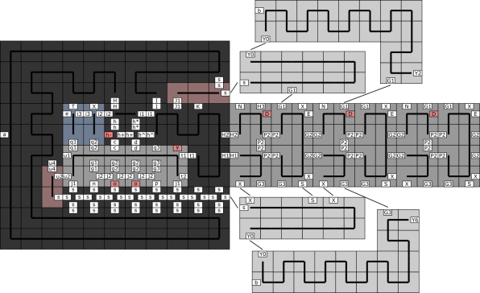
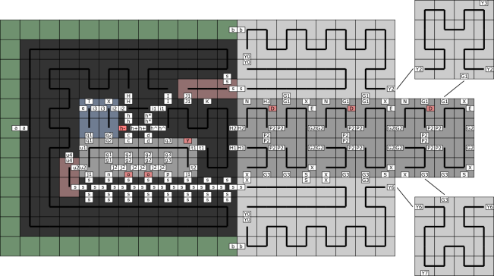
Process Overview

Slide 103
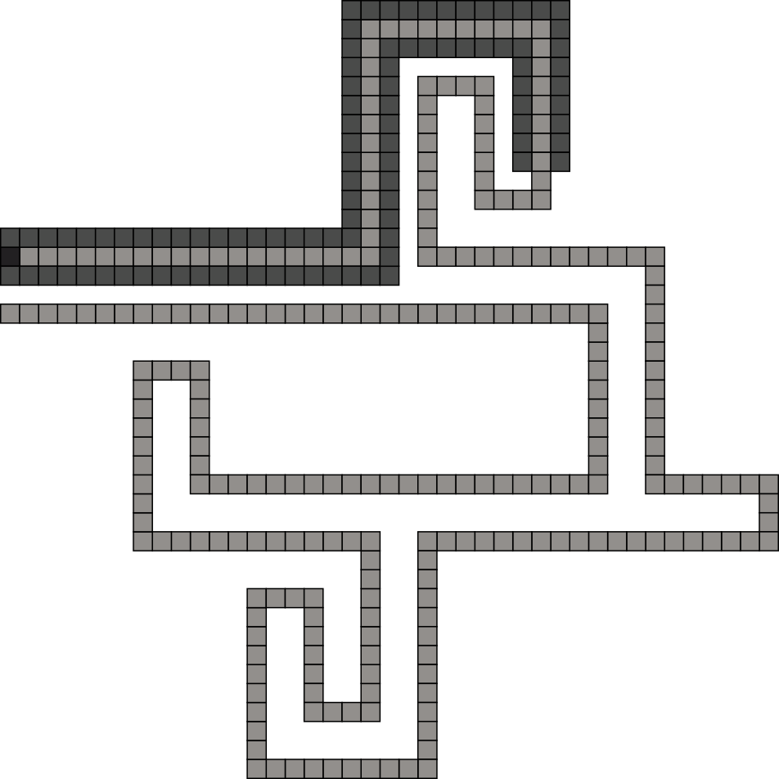
Process Overview

Slide 104
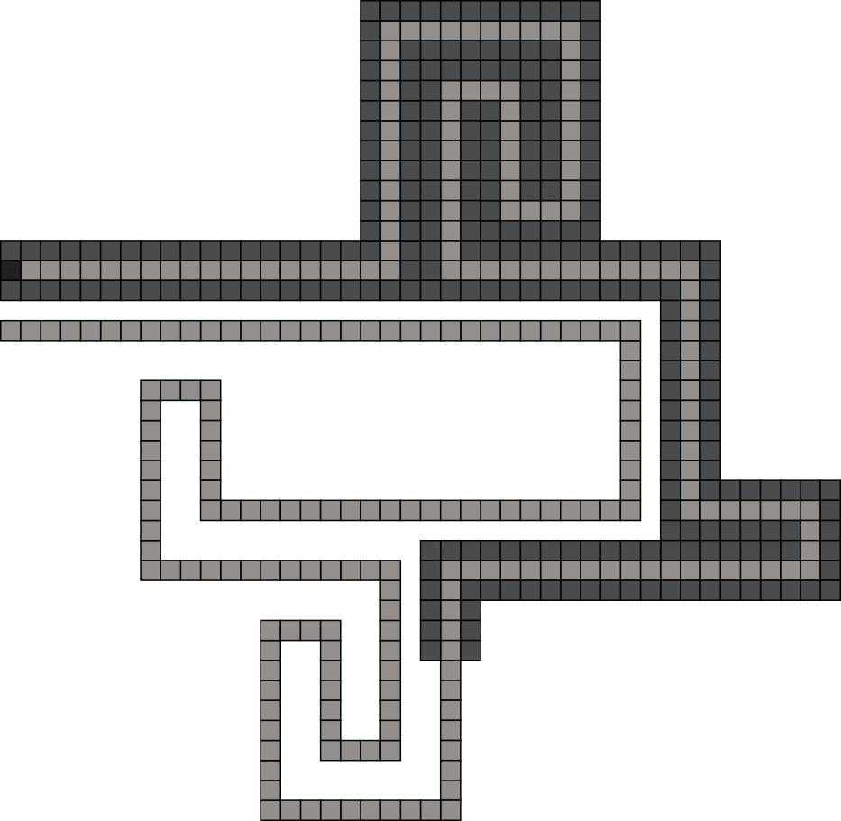
Process Overview

Slide 105
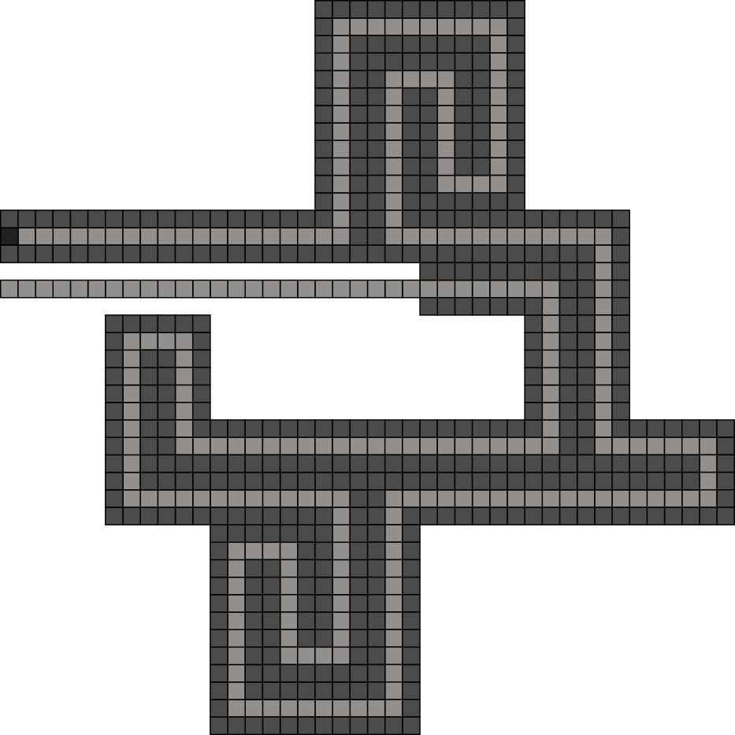
Process Overview

Slide 106
Process Overview

Slide 107
Process Overview
Optimal description
of shape S:

Slide 108
Summary
Model | Tile Complexity | Scale Factor
aTAM (Soloveichik, Winfree, 2007)
Staged RNAse (Demaine, Patitz, Schweller, and Summers, 2010)
Negative Glue 2HAM
O( )
K(S)
arbitrary
log(K(S))
O( )
K(S)
logarithmic
log(K(S))
O( )
K(S)
constant
log(K(S))

Slide 109
Summary
Model | Tile Complexity | Scale Factor
aTAM (Soloveichik, Winfree, 2007)
Staged RNAse (Demaine, Patitz, Schweller, and Summers, 2010)
Negative Glue 2HAM
O( )
K(S)
arbitrary
log(K(S))
O( )
K(S)
logarithmic
log(K(S))
O( )
K(S)
constant
log(K(S))
Question
Can we reduce the tile complexity even more?

Slide 110
Summary
Model | Tile Complexity | Scale Factor
aTAM (Soloveichik, Winfree, 2007)
Staged RNAse (Demaine, Patitz, Schweller, and Summers, 2010)
Negative Glue 2HAM
O( )
K(S)
arbitrary
log(K(S))
O( )
K(S)
logarithmic
log(K(S))
O( )
K(S)
constant
log(K(S))
Question
Can we move the information complexity to a different part of the system?

Slide 111
Outline
Self-Assembly
- constant scale
- constant tile types
Guided Assembly
- universal constructors
- shape hierarchy
The following portion of this presentation was published as:
Chalk, Luchsinger, Schweller, Wylie, Self-Assembly of Any Shape with Constant Tile Types using High Temperature, In Proceedings of the 26th Annual European Symposium on Algorithms, 2018

Slide 112
Self-Assembly of Shapes
Problem: Given a shape S, design a tile system T that builds a scaled version of S.
Input:
Output:
S =
T =

Slide 113
Self-Assembly of Shapes
Problem: Given a shape S, design a tile system T that builds a scaled version of S.
Input:
Output:
S =
T =
Goal: Design a tile system which does this using as few tile types as possible.

Slide 114
Self-Assembly of Shapes
Model | No. of Tile Types
aTAM (Soloveichik, Winfree, 2007)
Negative Glue 2HAM w/ High Temperature
O( )
K(S)
log(K(S))
Notes:
The premier result for this question is that of Soloveichik and Winfree. The Kolmogorov complexity of shape S, K(S), is the number of bits in the smallest program which outputs S w.r.t. a universal Turing machine. They encode S in the number of tile types of the system.
Since the Kolmogorov complexity of a string depends on the universal Turing machine chosen, the complexity community adopted a notion of additive equivalence, where additive constants are ignored. However, Theorem 4.1 includes multiplicative constants as well, which are not customarily discounted.

Slide 115
Self-Assembly of Shapes
Model | No. of Tile Types
aTAM (Soloveichik, Winfree, 2007)
Negative Glue 2HAM w/ High Temperature
O( )
K(S)
log(K(S))
O(1)

Slide 116
Self-Assembly of Shapes
Model | No. of Tile Types
aTAM (Soloveichik, Winfree, 2007)
Negative Glue 2HAM w/ High Temperature
O( )
K(S)
log(K(S))
O(1)
How is this possible?
Notes:
We encode S in the temperature and glue function of the tile system, rather than in the number of tile types.

Slide 117
Self-Assembly of Shapes
Model | No. of Tile Types | Temp. & Glue Function
aTAM (Soloveichik, Winfree, 2007)
Negative Glue 2HAM w/ High Temperature
O( )
O(1)
K(S)
log(K(S))
O(1)
Notes:
We encode S in the temperature and glue function of the tile system, rather than in the number of tile types.

Slide 118
Self-Assembly of Shapes
Model | No. of Tile Types | Temp. & Glue Function
aTAM (Soloveichik, Winfree, 2007)
Negative Glue 2HAM w/ High Temperature
O( )
O(1)
K(S)
log(K(S))
O(1)
O( 2^{K(S)} )
Notes:
We encode S in the temperature and glue function of the tile system, rather than in the number of tile types.

Slide 119
Tile Self-Assembly (2HAM)
This system uniquely
produces a 3x3 square:
Tileset:
Temperature:
2
1
Goal: Use as few tile types as possible.
Number of tile types = 6

Slide 120
Negative Glues
Tileset:
Temperature:
2
1

Slide 121
Negative Glues
Tileset:
Temperature:
2
1
No Detachment!
Growth Only

Slide 122
Negative Glues
This system produces
two terminal assemblies:
Tileset:
Temperature:
2
1

Slide 123
Negative Glues
This system produces
two terminal assemblies:
Tileset:
Temperature:
2
1
No Detachment!
Growth Only

Slide 124
High Temperature
Tileset:
Temperature:
τ
Glue Function:
Str(P) = τ
Str(B) = τ
Str(G) = 1

Slide 125
High Temperature
Tileset:
Temperature:
τ
Glue Function:
Str(P) = τ
Str(B) = τ
Str(G) = 1

Slide 126
High Temperature
Tileset:
Temperature:
τ
Glue Function:
Str(P) = τ
Str(B) = τ
Str(G) = 1

Slide 127
High Temperature
Tileset:
Temperature:
τ
Glue Function:
Str(P) = τ
Str(B) = τ
Str(G) = 1

Slide 128
High Temperature
Tileset:
Temperature:
τ
. . .
Glue Function:
Str(P) = τ
Str(B) = τ
Str(G) = 1
. . .

Slide 129
High Temperature
τ
Tileset:
Temperature:
τ
. . .
Glue Function:
Str(P) = τ
Str(B) = τ
Str(G) = 1
. . .
τ

Slide 130
High Temperature
Tileset:
Temperature:
τ
. . .
Glue Function:
Str(P) = τ
Str(B) = τ
Str(G) = 1
. . .
τ

Slide 131
Process Overview
Encode S in τ and glue function
τ
O(1) tile types

Slide 132

Process Overview
Encode S in τ and glue function
τ
Precise-width Rectangle
O(1) tile types
Self-Assembles

Slide 133
Process Overview
Encode S in τ and glue function
τ
Precise-width Rectangle
O(1) tile types
Seed Block which encodes the
program to assemble S
Self-Assembles
Self-Assembly Continues

Slide 134
Process Overview
Encode S in τ and glue function
τ
Precise-width Rectangle
O(1) tile types
Seed Block which encodes the
program to assemble S
Self-Assembles
Scaled Shape
Self-Assembly Continues
TM’s using O(1) tile types

Slide 135
Process Overview
Encode S in τ and glue function
(Soloveichik, Winfree, 2007)
τ
Precise-width Rectangle
O(1) tile types
Seed Block which encodes the
program to assemble S
Self-Assembles
Scaled Shape
Self-Assembly Continues
TM’s using O(1) tile types

Slide 136
Process Overview
Encode S in τ and glue function
(Soloveichik, Winfree, 2007)
τ
Incurred tile types
O( )
Precise-width Rectangle
K(S)
O(1) tile types
log(K(S))
Seed Block which encodes the
program to assemble S
Self-Assembles
Scaled Shape
Self-Assembly Continues
TM’s using O(1) tile types

Slide 137
Process Overview
Encode S in τ and glue function
τ
O(1)
Precise-width Rectangle
We can achieve:
tile types
O(1) tile types
Seed Block which encodes the
program to assemble S
Self-Assembles
Scaled Shape
Self-Assembly Continues
TM’s using O(1) tile types

Slide 138
Key Idea
Precise-width Rectangle
w
There exists a binary program P
which assembles S in
(Soloveichik, Winfree, 2007)
W can be thought of as a
unary encoding of program P

Slide 139
Precise-width Rectangle
Base assembly

Slide 140
Precise-width Rectangle
“Up” domino
u

Slide 141
Precise-width Rectangle
Signal-passing
u

Slide 142
Precise-width Rectangle
u

Slide 143
Precise-width Rectangle
u

Slide 144
Precise-width Rectangle
d
u

Slide 145
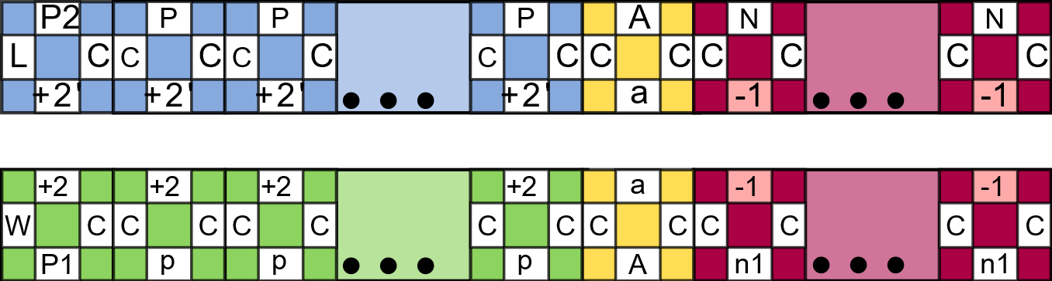
Precise-width Rectangle
Str(a) = 2τ -1
d
u

Slide 146
Precise-width Rectangle
d
u

Slide 147
Precise-width Rectangle
d
d
u

Slide 148
Precise-width Rectangle
d
d
u
u
d
d

Slide 149
Precise-width Rectangle
d
d
u
u
d
d

Slide 150
Precise-width Rectangle
d
d
u
d
u
d
u
u
d
τ iterations

Slide 151
Precise-width Rectangle
d
d
u
u
d
d

Slide 152
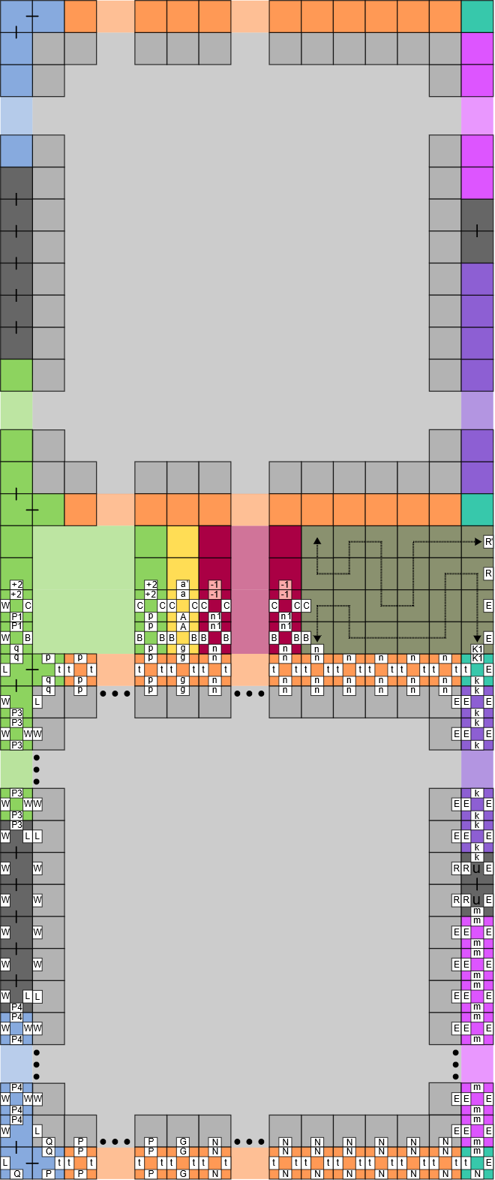
Precise-width Rectangle

Slide 153
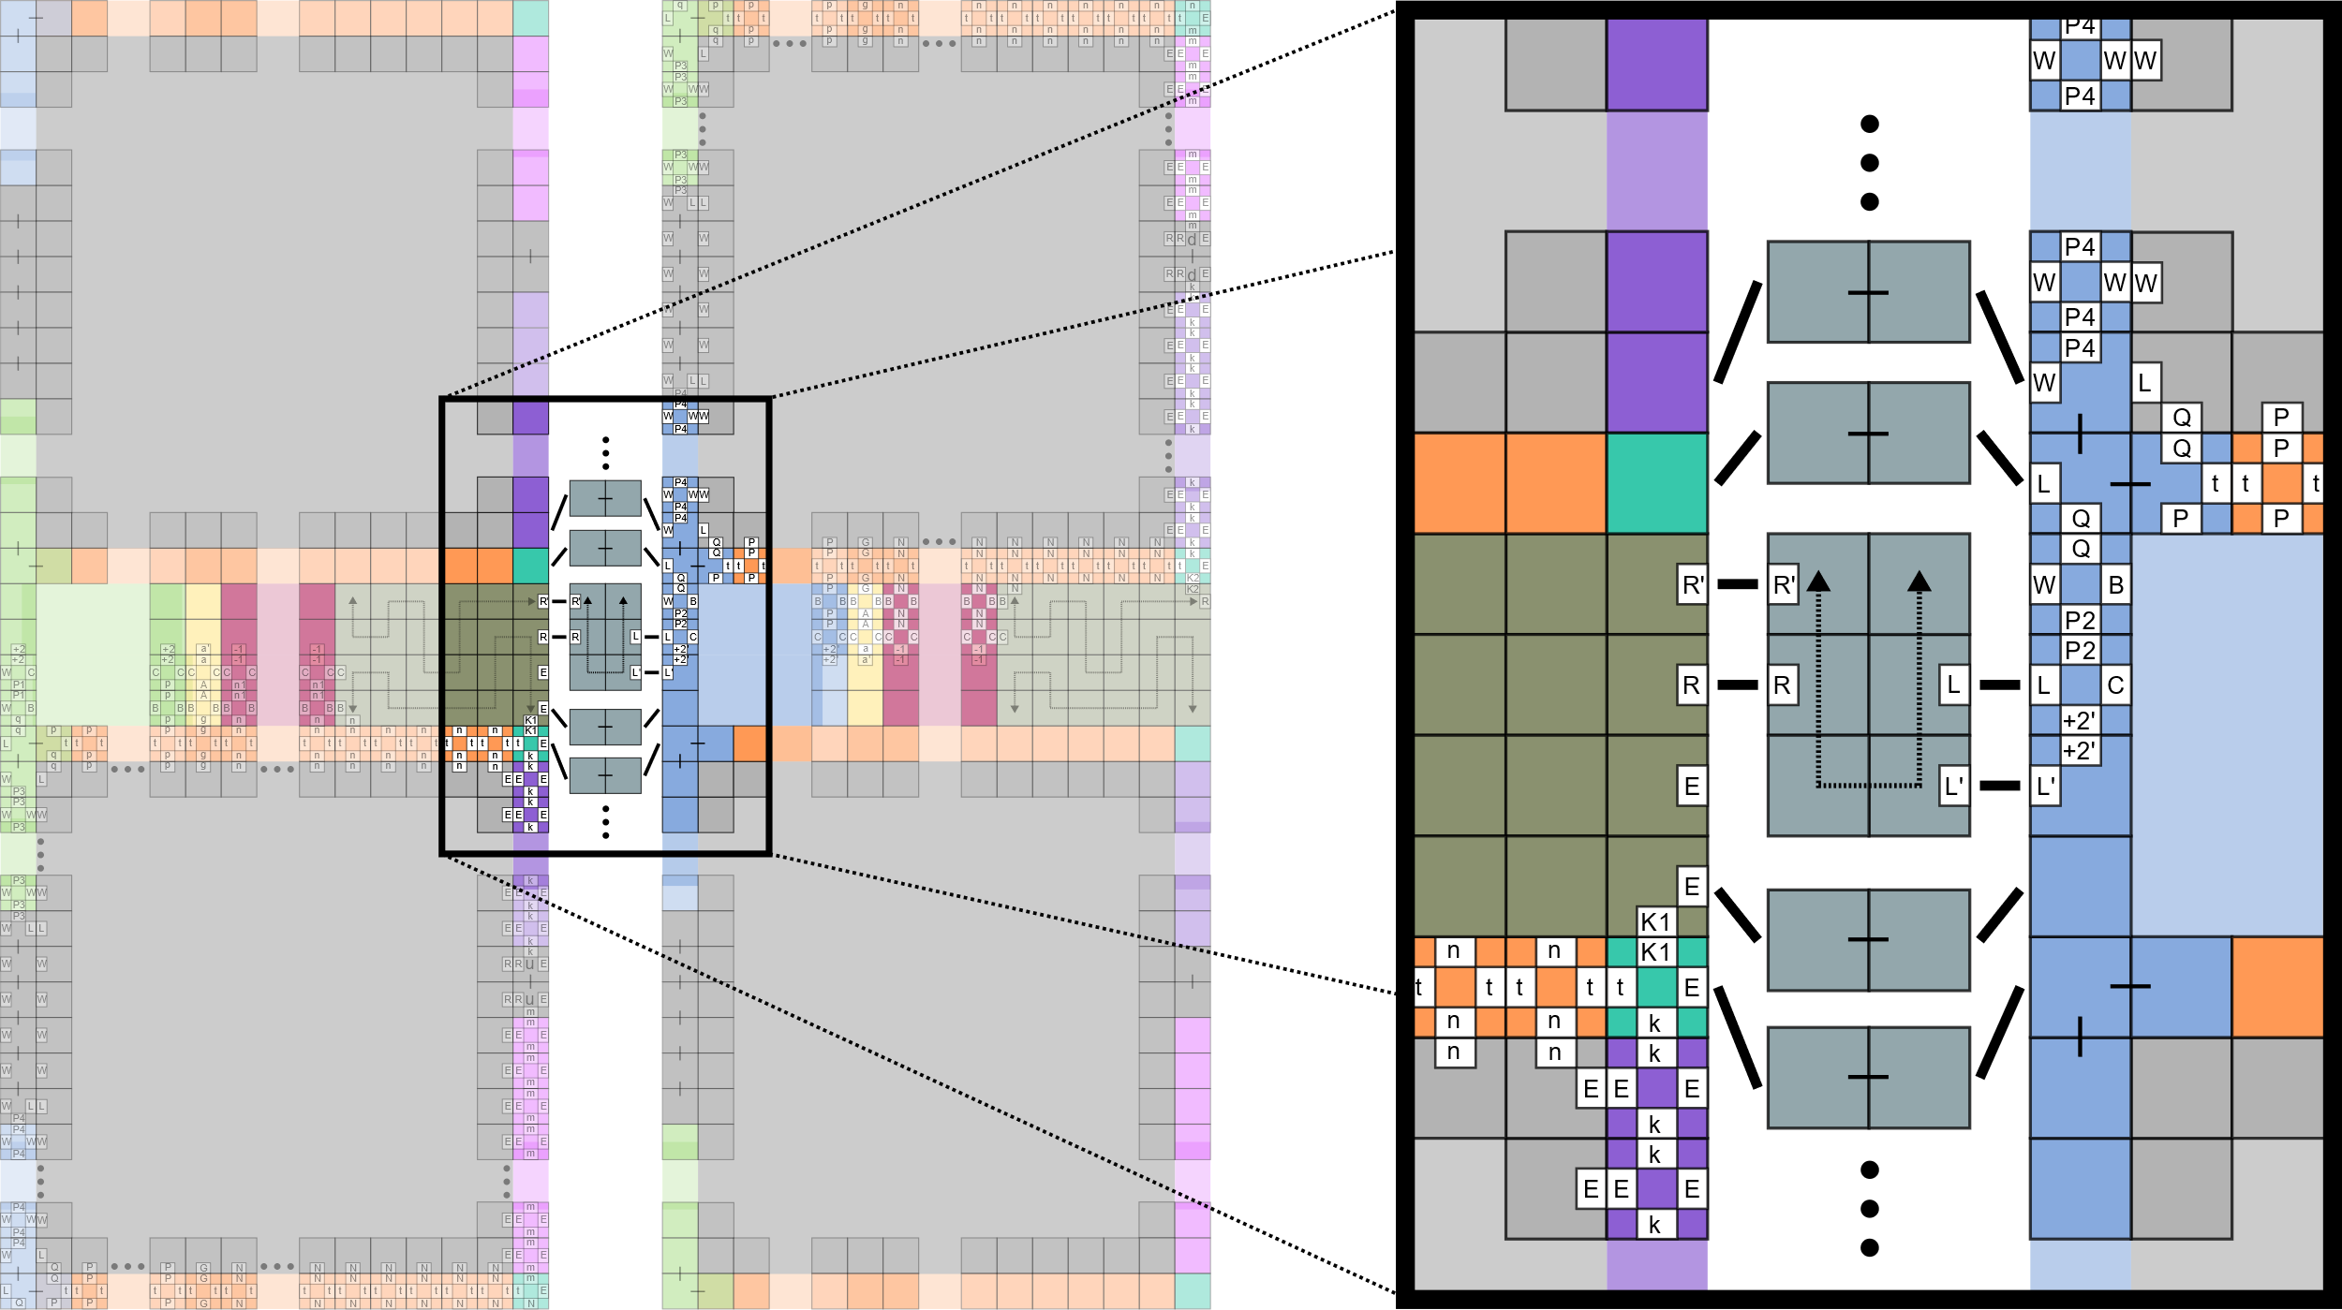
Precise-width Rectangle

Slide 154
Precise-width Rectangle
Str(a) = 2τ -1
d
u

Slide 155
Precise-width Rectangle
cτ

Slide 156


Seed Assembly

Slide 157
Seed Assembly
Unary Encoding of program P¹
¹Let P be the binary program used to assemble the shape via the construction of (Soloveichik, Winfree, 2007)

Slide 158
Seed Assembly
Conversion to P
via O(1)-size
TM simulation

Slide 159

Process Overview
O(1)-sized TM simulations of
(Soloveichik, Winfree, 2007)

Slide 160
Self-Assembly of Shapes
Model | No. of Tile Types
aTAM (Soloveichik, Winfree, 2007)
Negative Glue 2HAM (growth-only)
O( )
K(S)
log(K(S))
O(1)

Slide 161
Outline
Self-Assembly
- constant scale
- constant tile types
Guided Assembly
- universal constructors
- shape hierarchy

Slide 162

Manually-Controlled Particles
Martel et al. [2009]
MRI-based Medical Nanorobotic Platform for the Control of Magnetic Nanoparticles
http://sitn.hms.harvard.edu/
Notes:
Martel et al. [2009]
MRI-based Medical Nanorobotic Platform for the Control of Magnetic Nanoparticles
Some MRI techniques used for the experiments:
(a), (b) unfiltered and filtered MRI images of the carotid artery of the living animal
(c) the same artery with waypoints being plotted to provide trajectory control commands to the computer
(d) distorted MRI image created by the 1.5 mm chrome steel sphere (see Extension 1)
(e), (f) MRI image of the ferromagnetic sphere using the MS-SET method as seen in the transversal and sagittal plane, respectively
(g) the same ferromagnetic sphere being tracked using the MS-SET method over a pre-acquired X-ray image (optional) providing additional physiological information (e.g. the spinal cord) while being controlled at 24 Hz in the carotid artery of the living swine along the waypoints
(h) shows the waypoints plotted over the MRI image of a phantom mimicking human vascular conditions and being shown through a dedicated imaging software with
the respective real-time displacement of the sphere being displayed.
magnetotactic bacteria (MTB) can sense magnetic fields.
Fabricated Magnetic nanoparticles (tiny magnetic particles 1-1000nm in size) are used in many different areas of research.

Slide 163
Particles Controlled by Global Signals
Global Signals
Aaron T. Becker, Erik D. Demaine, Sandor P. Fekete, Golnaz Habibi, and James McLurkin,
Reconguring massive particle swarms with limited, global control,
Algorithms for Sensor Systems (2014).

Slide 164


Robotic Motion Planning
Mega Maze – Phillips Media
Tilt – Thinkfun
Aaron T. Becker, Erik D. Demaine, Sandor P. Fekete, Golnaz Habibi, and James McLurkin,
Reconguring massive particle swarms with limited, global control,
Algorithms for Sensor Systems (2014).

Slide 165

Tilt Assembly Model
Elements:
Commands:
Board:
- Free
- Blocked
Polyominoes:
- Red
- Blue
- Combine
Configuration C
- Don’t Combine
- Don’t Combine
Notes:
This is most similar to the gravity-fed logic maze Tilt TM, invented by Vesa Timonen and Timo Jokitalo and distributed by ThinkFun since 2010.

Slide 166
Tilt Assembly Model
Elements:
Commands:
Board:
- Free
- Blocked
Polyominoes:
- Red
- Blue
Configuration C
- Combine
Configuration C′
- Don’t Combine
- Don’t Combine
Aaron T. Becker, Erik D. Demaine, Sandor P. Fekete, Golnaz Habibi, and James McLurkin,
Reconguring massive particle swarms with limited, global control,
Algorithms for Sensor Systems (2014).
Notes:
This is most similar to the gravity-fed logic maze Tilt TM, invented by Vesa Timonen and Timo Jokitalo and distributed by ThinkFun since 2010.

Slide 167
Micro-Factories
Drop Shapes
Aaron T. Becker, Sandor P. Fekete, Phillip Keldenich, Dominik Krupke, Christian Rieck, Christian Scheer, and Arne Schmidt,
Tilt Assembly: Algorithms for Micro-Factories that Build Objects with Uniform External Forces
28th International Symposium on Algorithms and Computation (ISAAC 2017)

Slide 168
Outline
Self-Assembly
- constant scale
- constant tile types
Guided Assembly
- universal constructors
- shape hierarchy
The following portion of this presentation was published as:
Balanza-Martinez, Caballero, Cantu, Garcia, Luchsinger, Reyes, Schweller, Wylie, Full Tilt: Universal Constructors for General Shapes with Uniform External Forces, In Proceedings of the 30th ACM-SIAM Symposium on Discrete Algorithms, 2019

Slide 169
Results Tables
Result | Shape Class | Universal | Tilts | Size | Bonding Complexity | Geometry Complexity | Published
Fixed Shape | DROP | No | O(wh) | O(w³h³) | 2 labels | Complex | (ISAAC 2017)

Slide 170
Shape Representation
Weak:
Strong:
Some polyominoes exist
in the configuration which
do not count towards the
shape.
This configuration
represents an ‘A’ shape.
Configuration consists
of a single polyomino.

Slide 171
Shape Construction
We want to transform some initial configuration
into another (via a sequence of tilts) which
represents a desired shape.
⟨ ←, ↑ , … ,↓, → ⟩
C₀
C_{k}

Slide 172
Universal Configuration
A configuration C′ is considered universal to
a set of configurations C = {C₁, C₂, ..., C_{k}} if and only if
C′ can be reconfigured into C_{i} ∀C_{i} ∈ C .
(Strong or weak)
{
}
, …,
⟨ ↑ , ↓ , … , ←, → ⟩
C₁
C_{k}
C′

Slide 173
Pattern Construction
Given two integers w and h, there exists a configuration which is weakly universal for all w x h rectangular binary patterns.
{
}
, …,
C′

Slide 174


Pattern Construction

Slide 175
Pattern Construction

Slide 176

Pattern Construction
Add Tile:

Slide 177
Pattern Construction
Add Tile:
Remove Tile:

Slide 178
Pattern Construction
Add Tile:
Remove Tile:

Slide 179
Pattern Construction
Add Tile:
Remove Tile:
Add Row:

Slide 180

Weakly Universal Pattern Construction

Slide 181
Results Tables
Result | Shape Class | Universal | Tilts | Size | Bonding Complexity | Geometry Complexity | Published
Fixed Shape | DROP | No | O(wh) | O(w³h³) | 2 labels | Complex | (ISAAC 2017)
Universal Pattern | All | Weakly | O(whk) | O(whk) | k labels | Simple | (SODA 2019)

Slide 182
Weakly Universal Shape Constructor
Given two integers w and h, there exists a configuration which is weakly universal for all shapes which fit inside a w x h bounding box.
{
}
, …,
C′

Slide 183

Weakly Universal Shape Constructor

Slide 184
Results Tables
Result | Shape Class | Universal | Tilts | Size | Bonding Complexity | Geometry Complexity | Published
Fixed Shape | DROP | No | O(wh) | O(w³h³) | 2 labels | Complex | (ISAAC 2017)
Universal Pattern | All | Weakly | O(whk) | O(whk) | k labels | Simple | (SODA 2019)
Universal Shapes | All | Weakly | O(wh) | O(wh) | 1 label | Simple | (SODA 2019)

Slide 185
Results Tables
Result | Shape Class | Universal | Tilts | Size | Bonding Complexity | Geometry Complexity | Published
Fixed Shape | DROP | No | O(wh) | O(w³h³) | 2 labels | Complex | (ISAAC 2017)
Universal Pattern | All | Weakly | O(whk) | O(whk) | k labels | Simple | (SODA 2019)
Universal Shapes | All | Weakly | O(wh) | O(wh) | 1 label | Simple | (SODA 2019)
Problem | Shapes | Complexity | Published

Slide 186
Strongly Universal Drop-Shape Constructor
Given two integers w and h, there exists a configuration which is strongly universal for all shapes which fit inside a w x h bounding box.
{
}
, …,
C₁
C_{k}
C′

Slide 187

Strongly Universal Drop-Shape Constructor

Slide 188

Strongly Universal Drop-Shape Constructor

Slide 189
Strongly Universal Drop-Shape Constructor

Slide 190

Strongly Universal Drop-Shape Constructor

Slide 191
Results Tables
Result | Shape Class | Universal | Tilts | Size | Bonding Complexity | Geometry Complexity | Published
Fixed Shape | DROP | No | O(wh) | O(w³h³) | 2 labels | Complex | (ISAAC 2017)
Universal Pattern | All | Weakly | O(whk) | O(whk) | k labels | Simple | (SODA 2019)
Universal Shapes | All | Weakly | O(wh) | O(wh) | 1 label | Simple | (SODA 2019)
Universal Shapes | DROP | Strongly | O(wh²) | O(wh²) | 2 labels | Complex | (SODA 2019)

Slide 192
The following portion of this presentation was published as:
Balanza-Martinez, Caballero, Cantu, Flores, Gomez, Luchsinger, Reyes, Schweller, Wylie, Hierarchical Shape Construction and Complexity for Slidable Polyominos under Uniform External Forces, In Proceedings of the 31st ACM-SIAM Symposium on Discrete Algorithms, 2020
Outline
Self-Assembly
- constant scale
- constant tile types
Guided Assembly
- universal constructors
- shape hierarchy

Slide 193



Tilt Assembly Model
Elements:
Commands:
Board:
- Free
- Blocked
Polyominoes:
- Red
Configuration C
Configuration C′
Aaron T. Becker, Erik D. Demaine, Sandor P. Fekete, Golnaz Habibi, and James McLurkin,
Reconguring massive particle swarms with limited, global control,
Algorithms for Sensor Systems (2014).
Notes:
A tilt assembly system consists of tiles that exists on a board
The boards consists of blocked and open spaces
We then give commands that we call tilts
These cause the tiles to move in one direction until the hit a blocked space,
Or another tile

Slide 194
Tilt Assembly Model
Elements:
Elements:
Commands:
Board:
Board:
- Free
- Free
- Blocked
- Blocked
Polyominoes:
Polyominoes:
- Red
- Red
- Blue
Configuration C
- Combine
Configuration C′
- Don’t Combine
- Don’t Combine
Aaron T. Becker, Erik D. Demaine, Sandor P. Fekete, Golnaz Habibi, and James McLurkin,
Reconguring massive particle swarms with limited, global control,
Algorithms for Sensor Systems (2014).
Notes:
Also we allow for these tiles to stick together based on certain rules very similar to the previous presentation

Slide 195

Overview
Model of Assembly:
Model of Computation:
Polynomial Time Membership Algorithm for Largest Class of Known Buildable Shapes
Universal Constructor
PSPACE-Completeness of Occupancy Problem
Open Problem from 2014
Aaron T. Becker, Erik D. Demaine, Sὰndor P. Fekete, and James McLurkin, Particle computation: Designing worlds to control robot swarms with only global signals, (2014), 6751–6756.
Notes:
This model has been viewed in two different ways
We present three results in these two areas
A polynomial time algorithm for determining if a shape is in the class of shapes we can currently build
A universal Constructor for this class
PSPACE-Completeness of the occupancy problem

Slide 196
Overview
Model of Assembly:
Model of Computation:
Polynomial Time Membership Algorithm for Largest Class of Known Buildable Shapes
Universal Constructor
PSPACE-Completeness of Occupancy Problem
Open Problem from 2014
Aaron T. Becker, Erik D. Demaine, Sὰndor P. Fekete, and James McLurkin, Particle computation: Designing worlds to control robot swarms with only global signals, (2014), 6751–6756.
Notes:
So what is this class of shapes?
Well looking back at previous work…

Slide 197
Micro-Factories
Drop Shapes
Aaron T. Becker, Sándor P. Fekete, Phillip Keldenich, Dominik Krupke, Christian Rieck, Christian Scheer, and Arne Schmidt,
Tilt Assembly: Algorithms for Micro-Factories that Build Objects with Uniform External Forces
28th International Symposium on Algorithms and Computation (ISAAC 2017)
Notes:
In 2017 these Authors define a class of shapes called drop shapes
Shapes we can build by starting with one tile and repeat “dropping” tiles on to from any direction.

Slide 198



Drop Shape Hierarchy $𝔇$
$𝔇_{0}$(Level-0):
The single tile
$𝔇_{1}$(Level-1):
Drop shapes (Includes single tile)
$𝔇_{2}$(Level-2):
Shapes that can be built by dropping level-1s onto each other
Notes:
We generalize this definition to a drop shape heirarchy
We define level-0 to be the single tile
Level-1 is the class of drop shapes
Level-2 is the class of shapes that can be built by dropping level-1 polyominos

Slide 199




Drop Shape Hierarchy $𝔇$
$𝔇_{H}$(Level-H):
The union of
$𝔇_{H −1}$
Shapes that can build by dropping a shape in $𝔇_{H−1}$ onto a shape in $𝔇_{H}$
${\hat{𝔇}}_{H}$(Strict Level-H):
A shape that is in $𝔇_{H}$ but not in $𝔇_{H −1}$
Notes:
In the general case we define a level recursively
Level-H includes everything in level-H-1 and everything that can be built by taking something in level-H and dropping a shape in level-H-1 on it
We say a polyomino is in strict level-H if H is the lowest level it can be built in

Slide 200


Drop Shape Hierarchy $𝔇$
$𝔇$ The hierarchy
The union of all levels $𝔇_{H}$
Equivalent to the set of 2-cuttable shapes
2-cuttable:
A shape that can be decomposed into single tiles using valid 2-cuts
Arne Schmidt, Sheryl Manzoor, Li Huang, Aaron T. Becker, and Sándor Fekete, Efficient parallel selfassembly under uniform control inputs, IEEE Robotics and Automation Letters (2018), 1–1.
Notes:
When we refer to “The Hierarchy” we mean the union of all levels
This is actually equivalent to a set of shapes that’s already been investigated
I will go over the definition of 2-cut in a couple slides

Slide 201
Can we efficiently decide membership in $𝔇$?
Notes:
So we’ve defined this set of shapes the first question is can we decide this quickly?

Slide 202
Yes! For Simple Polyominos
Simple Polyomino:
Genus-0
A polyomino that does not contain holes
Notes:
The answer is yes……. For simple polyominos

Slide 203
Cut
2-cut:
Valid:
Results in 2 separate subpolyominos
If the resulting polyominos can be pulled apart in opposite directions
Notes:
A cut is a line through a shape
A 2 cut splits the shape in two
Valid means they can be pulled apart
Decomposition is the same as construction
The reserve process is dropping

Slide 204
Decomposition Tree
Notes:
We can use two cuts to create a decomposition tree
Starting with our top shape we can make a cut resulting in two subpolyominos
We then repeat this process until we get down to less complex shapes

Slide 205

Atomic Decomposition Tree
Lemma:
Given a hole-free polyomino P, P $∈ 𝔇$ if and only if there exists an atomic decomposition tree for P.
Notes:
If we can cut all the way down to get single tiles as all the leaves we say it’s an atomic decomposition tree
With this lemma we in order to show a polyomino is in the hierarchy we just need to find an atomic decomposition tree
Now let’s look at a shape not in the heirarchy

Slide 206

Tangled
Tangled Polyomino:
A polyomino for which there does not exist a valid 2-cut
Notes:
Tangled polyominoes are one type of shape that are not in the hierarchy
No matter how you cut this shape it will never result in two polyominos that can be pulled apart

Slide 207


Decomposition Tree
Lemma:
If there exists a decomposition tree for hole-free polyomino P which has a tangled polyomino S as a leaf, S must be a leaf in every decomposition tree of P
Notes:
So let’s say we start cutting a shape and we end up with a tangled polyomino
Well, we show that for SIMPLE shapes if we find a tangled polyomino we will always find that shape no matter how we cut it

Slide 208

Theorem:
A hole-free size-n polyomino P can be checked for membership in the drop-shape hierarchy in $O(n^{4}\log{n})$ time
Proof
Algorithm(Polyomino P)
Base Case: Is P a single tile? If yes return yes,
Is P tangled? If yes return no
Recursive Case: Select a valid 2-cut that splits P into subpolyominoes a and b.
Recurse on a and b and return yes only if both return yes.
Notes:
We use these two lemmas to create a recursive algorithm
Our two base cases
If P is a single tile we return yes because we know that is in the hierarchy
If not we try to find a valid 2-cut, If we don’t this is a tangled polyomino we can’t build it so we return no
If we find a 2-cut we recurse on the two resulting subpolyminos and if we both return yes this shape is in the hierarchy

Slide 209

Membership Algorithm Results
Shape Class | Runtime | Published
Simple Drop Shapes | $$O(n\log{n})$$ | ISAAC 2017
Drop Shapes | $$O(n^{2}h!)$$ | IEEE 2017
Simple Straight 2-cuttable | $$O(n^{3}\log{n})$$ | IEEE 2018
Simple shapes in $𝕯$ | $O(n^{4}\log{n})$ | SODA2020
Aaron T. Becker, Sándor P. Fekete, Phillip Keldenich, Dominik Krupke, Christian Rieck, Christian Scheer, and Arne Schmidt,
Tilt Assembly: Algorithms for Micro-Factories that Build Objects with Uniform External Forces
28th International Symposium on Algorithms and Computation (ISAAC 2017)
Sheryl Manzoor, Samuel Sheckman, Jarrett Lonsford, Hoyeon Kim, Min Jun Kim, and Aaron T. Becker, Parallel self-assembly of polyominoes under uniform control inputs, IEEE Robotics and Automation Letters 2 (2017), no. 4, 2040–2047
Arne Schmidt, Sheryl Manzoor, Li Huang, Aaron T. Becker, and Sándor Fekete, Efficient parallel selfassembly under uniform control inputs, IEEE Robotics and Automation Letters (2018), 1–1.
Notes:
All of these runtimes are in the size of the shape
The first two results are for drop shapes,
A polynomial time algorithm for simple drop shapes
The second works for general shapes but the run time is factorial in the number of holes in the shape
The next two results identify shapes in the class “Straight 2-cuttable” which is a slightly more restricted class
Our algorithm can classify simple shapes in the hierarchy
So now what is the difference between these algorithms?

Slide 210
Overview
Model of Assembly:
Model of Computation:
Polynomial Time Membership Algorithm for Largest Class of Known Buildable Shapes
Universal Constructor
PSPACE-Completeness of Occupancy Problem
Open Problem from 2014
Aaron T. Becker, Erik D. Demaine, Sὰndor P. Fekete, and James McLurkin, Particle computation: Designing worlds to control robot swarms with only global signals, (2014), 6751–6756.
Notes:
This model has been viewed in two different ways
We present three results in these two areas
A polynomial time algorithm for determining if a shape is in the class of shapes we can currently build
A universal Constructor for this class
PSPACE-Completeness of the occupancy problem

Slide 211
Shape Representation
This configuration
represents an ‘A’ shape.
Notes:
A board can represent a shape in a very natural way
If a board contains a polyomino that is in a specific shape we can say that configuration represents a shape

Slide 212
Shape Construction
We want to transform some initial configuration
into another (via a sequence of tilts) which
represents a desired shape.
⟨ ←, ↑ , … ,↓, → ⟩
C₀
C_{k}
Notes:
We say we construct a shape if we can use tilts to go from some starting configuration to a configuration that represents that shape

Slide 213
Universal Configuration
A configuration C′ is considered universal to
a set of configurations C = {C₁, C₂, ..., C_{k}} if and only if
C′ can be reconfigured into C_{i} ∀C_{i} ∈ C .
{
}
, …,
⟨ ↑ , ↓ , … , ←, → ⟩
C₁
C_{k}
C′
Notes:
We say a configuration is universal for a set of shapes if it is possible to construct any shape in that from that configuration

Slide 214

Strongly Universal Drop-Shape Constructor
Jose Balanza-Martinez, David Caballero, Angel Cantu, Luis Garcia, Austin Luchsinger, Rene Reyes, Robert Schweller, and Tim Wylie, Full tilt: Universal constructors for general shapes with uniform external forces, 30th Annual ACM-SIAM Symposium on Discrete Algorithms, SODA’19, 2019.
Notes:
Work published by our group last year in SODA presented a universal constructor for all drop shapes up to a certain size.
It works by extracting a single tile from the fuel chamber on the right, then selecting what direction you want to drop the tile from,
Then what column
We expand on this

Slide 215

$𝔇_{i}$Constructor
Notes:
and allow for polyominoes to be dropped instead of only single tiles
We can then connect multiple copies of this

Slide 216

$𝔇$Constructor
$$\left\lfloor \log{wh}\right\rfloor −1$$
Notes:
To create a universal configuration
We can build level-1s in the right most chamber.
Than pass them forward to build the next level.
We only need logp total chambers and one will be the little one

Slide 217

Shape Builder Results
Result | Shape Class | Tilts | Published
Fixed Shape | DROP | O(wh) | ISAAC 2017
Fixed Shape | 2-CUT/$𝕯$ | O(wh) | IEEE 2018
Universal Constructor | DROP | O(wh²) | SODA 2019
Universal Constructor | 2-CUT/$𝕯$ | O(w²h³) | SODA 2020
Aaron T. Becker, Sándor P. Fekete, Phillip Keldenich, Dominik Krupke, Christian Rieck, Christian Scheer, and Arne Schmidt,
Tilt Assembly: Algorithms for Micro-Factories that Build Objects with Uniform External Forces
28th International Symposium on Algorithms and Computation (ISAAC 2017)
Arne Schmidt, Sheryl Manzoor, Li Huang, Aaron T. Becker, and Sándor Fekete, Efficient parallel selfassembly under uniform control inputs, IEEE Robotics and Automation Letters (2018), 1–1.
Jose Balanza-Martinez, David Caballero, Angel Cantu, Luis Garcia, Austin Luchsinger, Rene Reyes, Robert Schweller, and Tim Wylie, Full tilt: Universal constructors for general shapes with uniform external forces, 30th Annual ACM-SIAM Symposium on Discrete Algorithms, SODA’19, 2019.
Notes:
Here are some are the current constructor results for this area
The first two results provide a configuration that can produce copies of a single shape in that class

Slide 218
Overview
Model of Assembly:
Model of Computation:
Polynomial Time Membership Algorithm for Largest Class of Known Buildable Shapes
Universal Constructor
PSPACE-Completeness of Occupancy Problem
Open Problem from 2014
Aaron T. Becker, Erik D. Demaine, Sὰndor P. Fekete, and James McLurkin, Particle computation: Designing worlds to control robot swarms with only global signals, (2014), 6751–6756.
Notes:
Now were going to show how we solved the open problem and prove PSPACE-Completeness of the occupancy problem and others

Slide 219
Outline
Self-Assembly
- constant scale
- constant tile types
Guided Assembly
- universal constructors
- shape hierarchy

Slide 220
Future Work
Self-Assembly
Can we reduce the scale factor while using O(1) tile types?
Could this potentially be done in a non-negative system?
Guided-Assembly
Does there exist a shape which is not buildable?
Fast Membership Algorithms for General Shapes?
Notes:
Looking forward here are some of the areas we want to explore,
The biggest question right now is does there exist a shape that is not buildable in this model? Or does there exist a general constructor?
The others questions involve finding fast classification algorithms for shapes with holes or does adding holes make this questions hard?
Lastly are the decision problems we explored still hard with limited boards? There exists a hierarchy of board geometries and maybe these problems become easier when limiting this.

Slide 221


Simulators
https://asarg.hackresearch.com/main/software/.

Slide 222
Thank You!
Self-Assembly
- constant scale
- constant tile types
Guided Assembly
- universal constructors
- shape hierarchy

Slide 223


Thank You!
Membership Algorithms
Shape Class | Runtime | Published
Simple Drop Shapes | $$O(n\log{n})$$ | ISAAC 2017
Drop Shapes | $$O(n^{2}h!)$$ | IEEE 2017
Simple Straight 2-cuttable | $$O(n^{3}\log{n})$$ | IEEE 2018
Simple shapes in $𝕯$ | $O(n^{4}\log{n})$ | SODA 2020
Construction
Result | Shape Class | Tilts | Published
Fixed Shape | DROP | O(wh) | ISAAC 2017
Fixed Shape | 2-CUT/$𝕯$ | O(wh) | IEEE 2018
Universal | DROP | O(wh²) | SODA 2019
Universal | $$\text{2−}\text{CUT}\text{/}𝕯$$ | O(w²h³) | SODA 2020
Complexity
Problem | Shapes | Complexity | Published
Occupancy/Relocation | 1x1 | NP-hard | Natural Computing 2019
Minimum Reconfiguration | 1x1 | PSPACE-complete | Natural Computing 2019
Occupancy/Relocation | 1x1, 2x2 | PSPACE-complete | SODA 2019
Reconfiguration | 1x1, 2x2 | PSPACE-complete | SODA 2019
Occupancy/Relocation | 1x1 | PSPACE-complete | SODA 2020
Reconfiguration | 1x1 | PSPACE-complete | SODA 2020

Slide 224

Straight 2-Cut
Straight 2-cut:
A 2-Cut that does not take any turns inside the polyomino.
Seen on left
Notes:
A straight 2-cut is a cut that does not take any turns while inside the polyomino
The cut on the left is straight while the cut on the right is not

Slide 225
Straight 2-Cuttable Shapes
Straight 2-cuttable:
A shape that can be decomposed into single tiles using valid Straight 2-cuts
Open Problem!
Are the classes 2-Cuttable and Straight 2-Cuttable equivalent
Arne Schmidt, Sheryl Manzoor, Li Huang, Aaron T. Becker, and Sándor Fekete, Efficient parallel selfassembly under uniform control inputs, IEEE Robotics and Automation Letters (2018), 1–1.
Notes:
Straight 2-cuttable follows pretty naturally from the definition of 2-cuttable
It’s actually an open problem whether these two classes are equivalent!
If this is true then it will help lower the run time of our algorithm

Slide 226



Theorem:
For all positives integers $h$, there exists a polyomino in $\hat{𝔇_{h}}$

Slide 227
Upper Bound on Level
Theorem:
For any polyomino $P ∈ 𝒟, P ∈ 𝔇_{\left\lceil \log{|P|}\right\rceil }$

Slide 228

Occupancy Decision Problem
Occupancy Problem. Given an initial configuration C and a specified goal location g, decide if a tilt sequence exists ends with a tile in g.
g
?
g
⟨ ←, ↑ , … ,↓, → ⟩
Notes:
The first problem in this model is the occupancy problem and like mentioned before it was posed in 2013
This problem asks given a configuration and a goal location in that configuration, can a tile be moved to that position

Slide 229


Relocation Decision Problem
Relocation Problem. Given an initial configuration C, a tile t, and a specified goal location g, decide if a tilt sequence exists ends with tile t in g.
g
?
g
⟨ ←, ↑ , … ,↓, → ⟩
Notes:
The Second problem is very similar but instead of asking if any tile can get to that position, can a specific tile get to that position?
In this case can the blue tile get to that location

Slide 230


Reconfiguration Decision Problem
Reconfiguration Problem. Given an initial configuration C and a goal configuration D, decide if a tilt sequence exists that will reconfigure C into D.
?
⟨ ←, ↑ , … ,↓, → ⟩
C
D
Notes:
The last problem is reconfiguration, Given a start and goal configuration, does there exist a tilt sequence to reconfiguration the first into the second

Slide 231
Complexity Results
Problem | Shapes | Complexity | Published
Occupancy/Relocation | 1x1 | NP-hard | Natural Computing 2019
Minimum Reconfiguration | 1x1 | PSPACE-complete | Natural Computing 2019
Occupancy/Relocation | 1x1, 2x2 | PSPACE-complete | SODA 2019
Reconfiguration | 1x1, 2x2 | PSPACE-complete | SODA 2019
Occupancy/Relocation | 1x1 | PSPACE-complete | SODA 2020
Reconfiguration | 1x1 | PSPACE-complete | SODA 2020
Aaron T. Becker, Erik D. Demaine, Sándor P. Fekete, Jarrett Lonsford, and Rose Morris-Wright, Particle computation: complexity, algorithms, and logic, Natural Computing (2019)
Jose Balanza-Martinez, David Caballero, Angel Cantu, Luis Garcia, Austin Luchsinger, Rene Reyes, Robert Schweller, and Tim Wylie, Full tilt: Universal constructors for general shapes with uniform external forces, 30th Annual ACM-SIAM Symposium on Discrete Algorithms, SODA’19, 2019.
Notes:
Here is the table with currently know results,
The first results showed the occupancy problem was NP-hard using only single tiles and that finding the minimum tilt sequence for reconfiguration was PSPACE-Complete
Last year in addition to the universal constructor our group showed that if a single 2x2 polyomino was allowed all three problems were PSPACE-Complete
Now we present the answer to the original formulation of the problem showing that these problems are PSPACE-Complete EVEN with only 1x1 tiles

Slide 232




Constraint Logic
Weight = 1
Weight = 2
must have:
or
Robert A. Hearn and Erik D. Demaine, The nondeterministic constraint logic model of computation:
Reductions and applications, Proceedings of the 29th International Colloquium on Automata, Languages
and Programming (London, UK, UK), ICALP ’02, Springer-Verlag, 2002, pp. 401–413.
Notes:
We do so from a reduction from non-deterministic constraint logic
We have a graph with weighted directed edges
The inflow of each vertex must be at least the constraint (2)

Slide 233
Constraint Logic
Weight = 1
Problem:
Can we reconfigure this into a given goal configuration?
Weight = 2
must have:
or
Robert A. Hearn and Erik D. Demaine, The nondeterministic constraint logic model of computation:
Reductions and applications, Proceedings of the 29th International Colloquium on Automata, Languages
and Programming (London, UK, UK), ICALP ’02, Springer-Verlag, 2002, pp. 401–413.
Notes:
A legal move on this graph is the flipping of a single edge such that the constraint of all vertices remains satisfied
The problem we are reducing from is called the Configuration-to-Configuration problem and asks
Given two configurations of a graph can one configuration be reconfigured to the other using legal edge flips

Slide 234
Constraint Graph
Notes:
So here we have part of a constraint graph,
This reduction works by instead of looking at the full graph we’re going to focus on each induvial vertex

Slide 235
Constraint Graph
1
4
7
6
3
5
5
2
4
8
3
7
Notes:
We can label all the edges and look at each vertex as having a state that is represented by the orientation of it’s edges
If we flip one edge we are changing the state of the two vertices it is connected too

Slide 236
Constraint Graph
1
4
7
6
5
5
2
3
4
8
3
7
Notes:
Now we can think of each vertex has having legal states, when the constraint is met
Illegal states when it is not
And a goal state which is the state it is in in the goal configuration

Slide 237

1
6
4
3
5
7
5
2
4
3
8
7
Notes:
So we can get into the reduction
Here is the framework for our reduction,
In the boxes we will create vertex gadgets that will represent and act like vertices in a constraint logic graph

Slide 238
Vertex Gadget
Represent the state of a vertex
Enforce State Changes
Prevent Illegal States
Notes:
Here are the three properties our vertex gadget will need mimic from NCL vertices
We need to
Represent the current state of the vertex
Be able to flip edges changing the state of only the two vertices that are connected by that edge
Prevent the problem from being solved if a vertex enters an illegal state
We also need one more thing,
A way to solve the problem

Slide 239


Overview
Notes:
Here is the frame work we created, our goal location… We have two rows…….
Each vertex gadget will have a tile. We will create a move sequence that extracts all tiles
If a vertex is in it’s goal state it will be sent to the goal row, if not the invalid row

Slide 240
Overview
Notes:
In order to solve the c-2-c problem all vertices must be in their goal state
To mimic this we set the goal location to be the number vertices spaces away from the left wall
We need all vertices to have been in their goal state in order to TILT LEFT and allow a tile to reach the GOAL LOCATION

Slide 241

Vertex Gadget
Represent the state of a vertex
Enforce State Changes
Prevent Illegal States
Able to extract tile only if in goal state
Notes:
So now we have all four properties our vertex must have,
And here is the gadget, It sits above the two rows we used
Each gadget contains a single tile
There are multiple colored paths through out the gadget,
There is a path and section of the gadget for each legal state of a vertex (MAX DEGREE-3)
The path that the tile is currently on represents the state of the vertex

Slide 242
Vertex Gadget
Represent the state of a vertex
Enforce State Changes
Prevent Illegal States
Able to extract tile only if in goal state
Notes:
So now we need to be able to flip edges,
Let’s look closer at this part of the gadget which we call the state gadget and transition area

Slide 243


State Gadget and Transition Area
1
1
2
3
4
5
6
7
8
2
3
5
6
4
7
8
Notes:
Assume this is the full graph
So on the right is what we call the State Gadget, Is has as many rows as edges in the configuration
*Let’s say we want to flip edge 2
Tile starts by coming into the top of the gadget, *then we move downward to select what edge we want to flip then tilt left
The tile goes to what we call the transition area, here there is concrete that changes the path of the tile

Slide 244

State Gadget and Transition Area
1
1
2
3
4
5
6
7
8
2
3
5
6
4
7
8
Notes:
The tile then enters a new state gadget and is along a new path representing the vertex is in a new state
Now since all the tiles are receiving these signals what about when we want to flip edge 6*
Well as you can see there are dotted lines on all the rows of edges not connected to this vertex
*These rows keep the tiles on the same path and don’t change the state

Slide 245

Vertex Gadget
Represent the state of a vertex
Enforce State Changes
Prevent Illegal States
Able to extract tile only if in goal state
Notes:
Now what happens if we enter an illegal state
Well if you notice there are some black paths that don’t have a state gadget,*
If we zoom in on the top of the gadget we can see that these paths trap a tile in this column and it can no longer change states or be extracted
If a vertex ever enters an illegal state it’s tile will be trapped in one of these columns

Slide 246
Vertex Gadget
Represent the state of a vertex
Enforce State Changes
Prevent Illegal States
Able to extract tile only if in goal state
Notes:
Now the last thing we need to do is be able to enforce we can only extract the tile if a vertex is in it’s goal state
Again lets zoom on the gadget

Slide 247
Extraction
Notes:
As you can see the bottom of each state gadget outputs to the bottom rows
*Only one state outputs to the goal row the rest stop the tile in the invalid row

Slide 248
Vertex Gadget
Represent the state of a vertex
Enforce State Changes
Prevent Illegal States
Able to extract tile only if in goal state
Notes:
So here our vertex gadget has all the necessary properties
We have a way to represent states of vertices and to be able to change them like in NCL
The only way to solve the occupancy problem is too be able to change the state of all the vertex gadgets into their goal states using legal edge flips

Slide 249
Problem | Shapes | Complexity | Published
Occupancy/Relocation | 1x1 | NP-hard | Natural Computing 2017
Minimum Reconfiguration | 1x1 | PSPACE-complete | Natural Computing 2017
Occupancy/Relocation | 1x1, 2x2 | PSPACE-complete | SODA 2019
Reconfiguration | 1x1, 2x2 | PSPACE-complete | SODA 2019
Occupancy/Relocation | 1x1 | PSPACE-complete | SODA 2020
Reconfiguration | 1x1 | PSPACE-complete | SODA 2020
Aaron T. Becker, Erik D. Demaine, Sándor P. Fekete, Jarrett Lonsford, and Rose Morris-Wright, Particle computation: complexity, algorithms, and logic, Natural Computing (2019)
Jose Balanza-Martinez, David Caballero, Angel Cantu, Luis Garcia, Austin Luchsinger, Rene Reyes, Robert Schweller, and Tim Wylie, Full tilt: Universal constructors for general shapes with uniform external forces, 30th Annual ACM-SIAM Symposium on Discrete Algorithms, SODA’19, 2019.
Notes:
The reduction is easily extended to the relocation and reconfiguration problems
So now we have a complete answer to these problems when using only 1x1 pieces

Slide 250
Results Tables
Result | Shape Class | Universal | Tilts | Size | Bonding Complexity | Geometry Complexity | Published
Fixed Shape | DROP | No | O(wh) | O(w³h³) | 2 labels | Complex | (ISAAC 2017)
Universal Pattern | All | Weakly | O(whk) | O(whk) | k labels | Simple | (SODA 2019)
Universal Shapes | All | Weakly | O(wh) | O(wh) | 1 label | Simple | (SODA 2019)
Universal Shapes | DROP | Strongly | O(wh²) | O(wh²) | 2 labels | Complex | (SODA 2019)
Problem | Shapes | Complexity | Published

Slide 251
Relocation Decision Problem
Relocation Problem. Given an initial configuration C and a specified goal location g, decide if a tilt sequence exists ends with some tile t in g.
?
g
g
⟨ ←, ↑ , … ,↓, → ⟩
C

Slide 252
Reconfiguration Decision Problem
Reconfiguration Problem. Given an initial configuration C and a goal configuration D, decide if a tilt sequence exists that will reconfigure C into D.
?
⟨ ←, ↑ , … ,↓, → ⟩
C
D

Slide 253
Previous Complexity Work
Result | Shape Class | Universal | Tilts | Size | Bonding Complexity | Geometry Complexity | Published
Fixed Shape | DROP | No | O(wh) | O(w³h³) | 2 labels | Complex | (ISAAC 2017)
Universal Pattern | All | Weakly | O(whk) | O(whk) | k labels | Simple | (SODA 2019)
Universal Shapes | All | Weakly | O(wh) | O(wh) | 1 label | Simple | (SODA 2019)
Universal Shapes | DROP | Strongly | O(wh²) | O(wh²) | 2 labels | Complex | (SODA 2019)
Problem | Shapes | Complexity | Published
Relocation | 1x1 | NP-hard | (Natural Computing 2017)
Tilt-minimization | 1x1 | PSPACE-complete | (Natural Computing 2017)
Aaron T. Becker, Erik D. Demaine, Sandor P. Fekete, Jarrett Lonsford, and Rose Morris-Wright,
Particle computation: complexity, algorithms, and logic
Natural Computing (2017).

Slide 254
Toggle Gadgetry
Crossing 2-toggle (C2T)
Erik D. Demaine, Isaac Grosof, Jayson Lynch, and Mikhail Rudoy,
Computational complexity of motion planning of a robot through simple gadgets,
9th International Conference on Fun with Algorithms, (FUN 2018)

Slide 255
Toggle Gadgetry
S
T
Reduced from
3QSAT to show
PSPACE-complete.
Erik D. Demaine, Isaac Grosof, Jayson Lynch, and Mikhail Rudoy,
Computational complexity of motion planning of a robot through simple gadgets,
9th International Conference on Fun with Algorithms, (FUN 2018)

Slide 256

Relocation Complexity

Slide 257
Relocation Complexity

Slide 258
Relocation Complexity

Slide 259
Relocation Complexity

Slide 260

Relocation Complexity

Slide 261
Relocation Complexity

Slide 262

Relocation Complexity

Slide 263
Relocation Complexity Verification
C₁
C₂
C₇
C₆
C₅
C₃
C₈
C₄
C₉
Initial configs.
Valid toggle configs.
Invalid toggle configs.

Slide 264
Results Tables
Result | Shape Class | Universal | Tilts | Size | Bonding Complexity | Geometry Complexity | Published
Fixed Shape | DROP | No | O(wh) | O(w³h³) | 2 labels | Complex | (ISAAC 2017)
Universal Pattern | All | Weakly | O(whk) | O(whk) | k labels | Simple | (SODA 2019)
Universal Shapes | All | Weakly | O(wh) | O(wh) | 1 label | Simple | (SODA 2019)
Universal Shapes | DROP | Strongly | O(wh²) | O(wh²) | 2 labels | Complex | (SODA 2019)
Problem | Shapes | Complexity | Published
Relocation | 1x1 | NP-hard | (Natural Computing 2017)
Tilt-minimization | 1x1 | PSPACE-complete | (Natural Computing 2017)
Relocation | 1x1, 2x2 | PSPACE-complete | (SODA 2019)

Slide 265

Reconfiguration Complexity

Slide 266

Reconfiguration Complexity

Slide 267
Reconfiguration Complexity

Slide 268

Reconfiguration Complexity

Slide 269

Reconfiguration Complexity

Slide 270
Results Tables
Result | Shape Class | Universal | Tilts | Size | Bonding Complexity | Geometry Complexity | Published
Fixed Shape | DROP | No | O(wh) | O(w³h³) | 2 labels | Complex | (ISAAC 2017)
Universal Pattern | All | Weakly | O(whk) | O(whk) | k labels | Simple | (SODA 2019)
Universal Shapes | All | Weakly | O(wh) | O(wh) | 1 label | Simple | (SODA 2019)
Universal Shapes | DROP | Strongly | O(wh²) | O(wh²) | 2 labels | Complex | (SODA 2019)
Problem | Shapes | Complexity | Published
Relocation | 1x1 | NP-hard | (Natural Computing 2017)
Tilt-minimization | 1x1 | PSPACE-complete | (Natural Computing 2017)
Relocation | 1x1, 2x2 | PSPACE-complete | (SODA 2019)
Reconfiguration | 1x1, 2x2 | PSPACE-complete | (SODA 2019)

