Slide 1
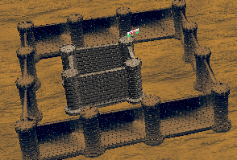
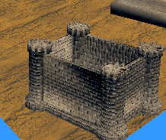
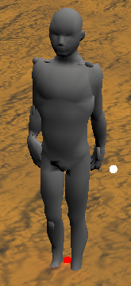
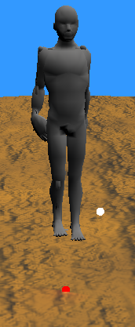

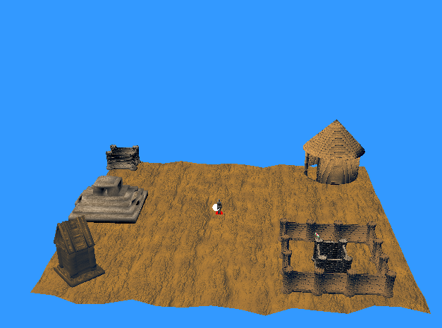
ST20247757_CIS5013_POSTER
Populus II: Trials of the Olympian Gods
Importing Assets
Image 1 – I have shown image of my castle with pillar and flag I have got it to load in the object how I went about getting the asset to load in there was a house setup in the code already and I edited it and changed certain parts of the code so it could load in my castle with pillar and flag, there was no problems with me loading it in I found the only problems I found where when I got to the texturing stage the meshes wouldn’t show so I had to comment out the show cull part and then the meshes of the object to show and I had to play around with the lighting to get to work the normal map I changed the lighting so it is always on before in the code provided the lighting would start Suttle then go down to darkness so I decided to tweak and change the translation matrix and it set it to the middle where my character is and it worked fine. ( I think how I went about creating and the assets and textures how they would look and link with the populus theme that I was going for.
interaction
Image 3 – I'm showing the asset with the normal map how I went about implementing it I used add push back then created a add normal map to the object and I loaded in an array in the directional light so it can display the normal map and base colour map on the screen as displayed in this small castle here. ( I made certain parts of the object burnt to show how when the gods in populus when they strike the players buildings and how its similar it worked out in the end.
Image 2 – in image 2 I'm just displaying my player character in the stance I'm just showing how it looks in the stance I haven’t added any textures or normal maps to my player character I kept it just normal without any textures just to show it I added to points to it so it can jump on the spot as well I will show a second image of it jumping but from the sky here. I used the given movement and created a new when pressed spacebar it would make the player character hop/jump on the spot. ( I also added in movement In recently for the player the sand looking player has wasd movement.)
Lighting and camera
For the last image I'm showing the camera projection I have played around with the camera I firstly got it to stay top down but there is also a chance that the camera spawns in on the players toes, but you can scroll out using the scroll, from this image you can see the overall lighting of the level and how nice the lighting projectisation looks and how it projects light out of the level. I was playing around with lighting for a couple weeks until I fully understood it and then I decided to edit it so the light projection was always displaying on, and I also made the background blue but that doesn’t affect anything to do with the overall lighting that’s just a background colour the reason behind me doing it this colour because I'm going for a populus desert style dlc and it fits the overall concept for me. ( I forgot to add how it fits populus ii and how it could be used I made the lighting brighter, so it makes easier for the player and keeping it top down like how god games are, and I wanted to replicate it).

