Slide 1
Who earns what in rural KP?
PSLM 2019-20 | ECO346 Assignment 1 | FA24-BEDS-104 | Khyber Pakhtunkhwa (KP)
Variant 4 = KP rural (last two digits 04 = 0 x 8 + 4)
3,396
Rs 187,200
Rs 456,000
6.51
earners aged 15-64
weighted median
90th percentile
p90 / p10 ratio
All statistics weighted by household weight (hhweight)
Notes:
Introduce: my registration is FA24-BEDS-104; the last two digits are 04, and 4 = 0x8+4, so variant 4, rural Khyber Pakhtunkhwa. Sample is persons 15-64 with earnings above zero: 3,396 earners. Everything is weighted by hhweight, and weighted quantiles use the course definition, not R's quantile().

Slide 2
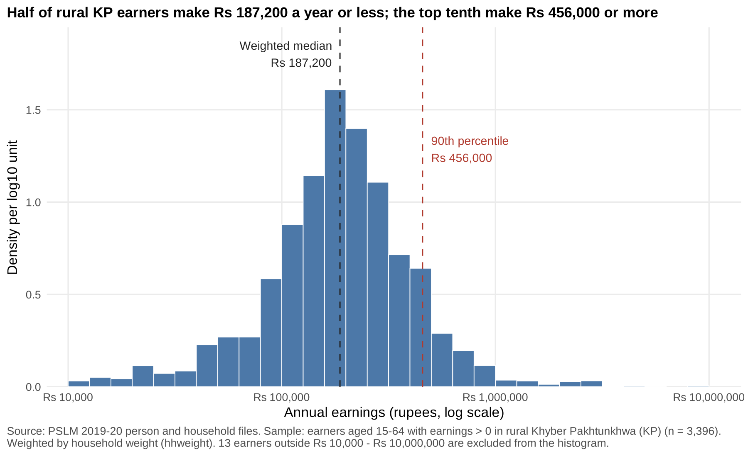
Half of earners make Rs 187,200 or less; the top tenth make Rs 456,000+
Rs 187,200
weighted median (unweighted: Rs 180,000)
Rs 70,000 / 456,000
10th / 90th percentile
6.51x
spread, p90 over p10
13 earners outside Rs 10,000 - 10,000,000 excluded from the histogram
Notes:
Density per log10 unit, bins 0.1 wide. Weighted median is Rs 187,200, unweighted Rs 180,000. About 8.4% of earners report exactly Rs 180,000; unweighted 50.5% are at or below it, but weighted only 49.5%, because households of higher earners carry slightly larger weights, so the weighted 50% mark moves just above. Right tail is long: p90 is 6.51 times p10.

Slide 3
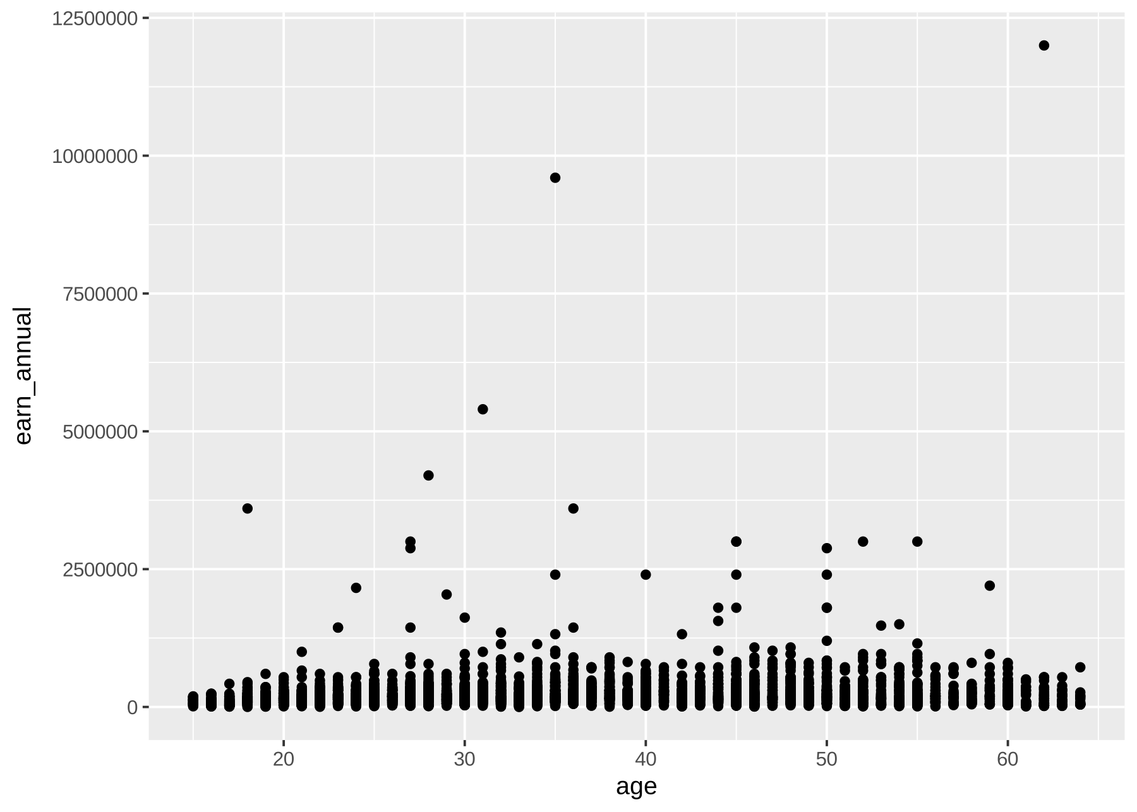
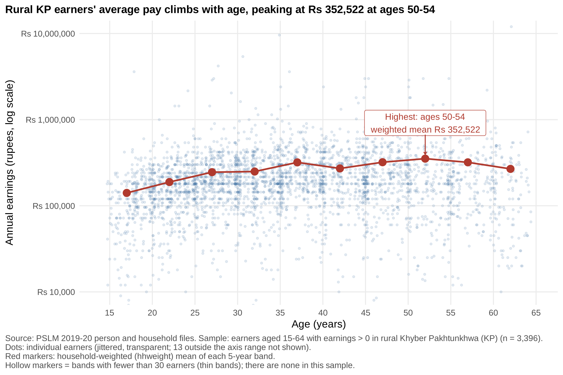
The makeover: from R's default to a readable finding
Default: geom_point() only
Redesign
Log axis
outliers no longer squash the bulk
Alpha 0.15 + jitter
fixes overplotting
Weighted band means
conditional mean + direct label
Notes:
Left is the untouched default. Changes: (1) log scale, equal ratios = equal distances, one earning of Rs 12 million no longer squashes the rest; (2) transparency 0.15 and jitter of at most 0.4 years fix overplotting on whole-number ages; (3) weighted band means with the peak annotated give the conditional mean. Also data-ink: no grey panel, finding as title, rupee labels. What the default shows that the redesign hides: one earner above Rs 10 million (Rs 12 million). I chose alpha 0.15 because lighter hides the tails and darker makes a solid block.

Slide 4
Average pay peaks at Rs 352,522 for ages 50-54
Experience pays
from Rs 141,017 (15-19) to about Rs 320,000 by 35-39, then a plateau
Large spread
individual earnings scatter widely at every age
Cannot tell
age effect vs cohort effect: one cross-section, different people
Python = R
band 25-29 mean Rs 245,584 in both, all bands match to the rupee
Notes:
Most important finding: weighted mean earnings rise steeply from the late teens to about Rs 320,000 by the late thirties, then move sideways, plateau, peak at 50-54 (Rs 352,522), then dip at 60-64. Band 25-29 is Rs 245,584. What the figure cannot tell us: whether older workers earn more because they age or because they are from different cohorts with different education. Q5: I recomputed the band table in Python and it matches R to the rupee; matplotlib defaults differ (large opaque markers, minor log ticks) so I set size, alpha and ticks by hand.

