Slide 1

PREDICTING HOME PRICES WITH REGRESSION ANALYSIS USING BOSTON HOUSING DATASET
Submitted by
Md. Ammaar Quadri | 21E41A3312
M. Sahithi | 21E41A3313
Mohd Arbas | 21E41A3314
P.S Jyothi | 22E45A3301
Under the Supervision of
Puneet Shetteppanavar
Assistant Professor

Slide 2





Motivation
Accurately predict home prices, enabling informed buying and selling decisions in the real estate market.
Leverage regression models to uncover key factors affecting property values, such as crime rates, proximity to amenities, and tax rates.
Automate the prediction process, making real estate analysis faster and more efficient for market stakeholders.
Assist urban planners and policymakers by providing data-driven insights for better infrastructure development and housing policies.
Utilize the growing availability of housing datasets to enhance the accuracy and reliability of predictive analytics.

Slide 3
Introduction
The real estate market is highly dynamic, with home prices influenced by various factors such as location, crime rates, property size, and tax rates. Accurate prediction of housing prices is crucial for potential buyers, sellers, real estate developers, and policymakers to make informed decisions. This project explores the use of regression analysis, a widely-used machine learning technique, to model and predict home prices based on the well-known Boston Housing Dataset. The dataset provides valuable information, including property features and neighborhood statistics, making it an ideal choice for price prediction analysis.
By leveraging regression models, this project aims to uncover the relationships between various features and property prices to develop a reliable price prediction system. Such predictions can empower market stakeholders with actionable insights while assisting urban planners in identifying factors impacting property values. Additionally, this study offers a hands-on experience in data preprocessing, feature selection, and machine learning, making it a significant step toward applying theoretical concepts to real-world applications in predictive analytics.

Slide 4
Objectives
Accurately predict home prices using regression analysis models based on the Boston Housing Dataset.
Identify and analyze key factors that influence property values, such as crime rates, property size, and tax levels.
Develop a robust machine learning pipeline for data preprocessing, feature selection, and model training.
Evaluate the performance of regression models using appropriate evaluation metrics to ensure prediction accuracy.
Provide actionable insights for real estate market stakeholders and urban planners to support informed decision-making.
Gain hands-on experience in applying regression techniques and enhancing predictive analytics skills for real-world applications.

Slide 5
Dataset Description
The Boston Housing Dataset contains 506 rows and 13 features related to housing prices in the Boston area. The target variable is the median home value (MEDV).
Key features include:
CRIM: Crime rate by town
ZN: Proportion of residential land for large lots
INDUS: Proportion of non-retail business land
CHAS: Charles River dummy (1 if tract bounds river)
NOX: Nitrogen oxide concentration (air pollution)
RM: Average number of rooms per dwelling
AGE: Proportion of units built before 1940
TAX: Property tax rate per $10,000
LSTAT: Percentage of lower-status population
This dataset helps analyze the factors influencing home prices and is used to build a regression model for price prediction.

Slide 6
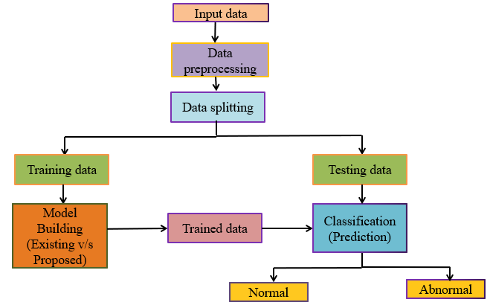
System Architecture

Slide 7
Model and Analysis
For predicting home prices, regression analysis is used to establish relationships between the target variable (MEDV) and the features in the dataset. The following steps were followed in the analysis:
Data Preprocessing:
Cleaned the dataset by handling missing values and outliers.
Normalized or scaled numerical features to ensure consistency for model training.
Model Selection:
Linear Regression: A simple and interpretable model to understand the relationship between independent variables and the target price.
Multiple Linear Regression: Used to analyze multiple features simultaneously to predict home prices.
Regularization Techniques (e.g., Ridge and Lasso): Applied to reduce overfitting by penalizing large coefficients and improving model generalization.
Model Evaluation:
R-squared (R²): Measures how well the model explains the variance in home prices.
Mean Squared Error (MSE): Evaluates model accuracy by measuring the difference between predicted and actual prices.
The regression models aim to find the most significant predictors and optimize them for accurate price predictions.
.

Slide 8
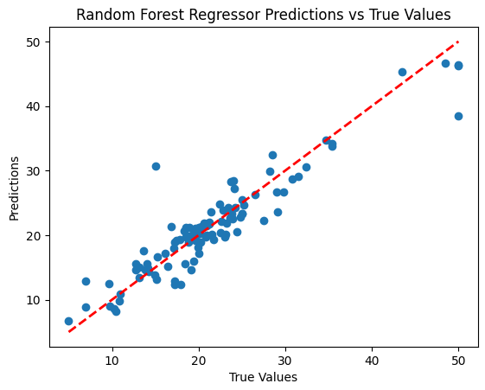

Results
Random Forest Regression:
Achieved high accuracy with closely aligned predictions and true values.
2. XGBoost Forest Regression:
Delivered efficient predictions with minimal deviations from true values.

Slide 9

Conclusion
The project successfully demonstrated the use of regression models for predicting home prices using Boston Housing Dataset. Random Forest and XGBoost models provided accurate predictions by capturing complex patterns in the data.
This analysis highlighted the significance of key factors influencing housing prices and showcased the practical application of machine learning in real estate. This project reinforces the importance of data-driven decision-making in dynamic market like real estate.

Slide 10
Thank
You

