Slide 1

ALY 6000 Introduction to Analytics Module 4: Project Presentation Year Term 1/A Forbes' Billionaires List 2023
Amma A. Boa-Amponsem
boaamponsem.a@northeastern.edu

Slide 2
Overview
Source
Project Overview
Introduction
Exploratory Data Analysis
Conclusion
Recommendations
Observations

Slide 3


Source
Luhar, S. (2023, Oct 21). Billionaires listed in Forbes: Unveiling the Finest: Forbes' Exclusive Billionaires Club
Forbes. (2023, Mar 10). Forbes World’s Billionaires List: The Richest in 2023

Slide 4
Project Overview
This dataset contains:
Widespread information on the World’s Billionaires listed by Forbes
Includes their rank, name, net worth, country, marital status and education
Exactly 2640 Columns and 14 Rows
Ranking the Billionaires in ascending order
Information obtained as of March 2023
R programming language codes and analysis

Slide 5
Introduction
According to Forbes’ list, there was a decline this year in most Billionaires’ wealth from last year’s list
From 2668 to 2640 listed
Nearly half the list is poorer than a year ago
Factors that could influence the growth of both country and its people include age, industry, rising and falling of stocks, interest rates, infrastructure, and others
This data analysis aims to give well-informed decision-making insights for policymakers, entrepreneurs and any contributor to the country’s growth and development
Descriptive statistics and visualizations were obtained

Slide 6
Exploratory Data Analysis
Tools used:
R
R Studio
Microsoft Excel (.csv)
Data Analysis was completed on this dataset:
Renaming Columns
Removal of NAs
Correction of Data types
Removal of Columns and Rows
Reorganising the data
Visualizations
Bar Chart
Histogram
Pareto Chart and Ogive

Slide 7
Exploratory Data Analysis
Four (4) Questions were examined:
Does the choice of Industry affect a Billionaire’s net worth?
Is Age a factor in becoming a Billionaire?
What is the correlation between a Billionaire’s net worth and their Country of origin?
Sampled Top 20 Billionaires vs Countries
What is the cumulative distribution of Billionaires across the Countries?
Sampled Top 12 Countries vs Billionaire Counts
The goal is to determine what factors can affect:
a country’s wealth and growth
an individual’s net worth

Slide 8
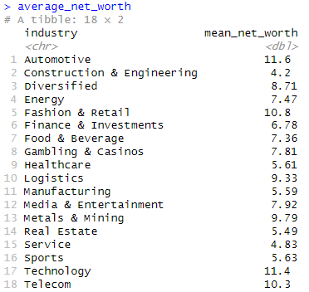
Q1: Does the choice of Industry affect a Billionaire’s net worth?

Slide 9
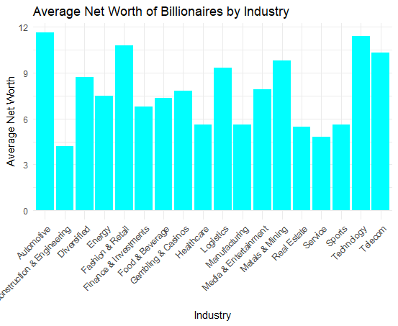
Q1: Does the choice of Industry affect a Billionaire’s net worth?

Slide 10
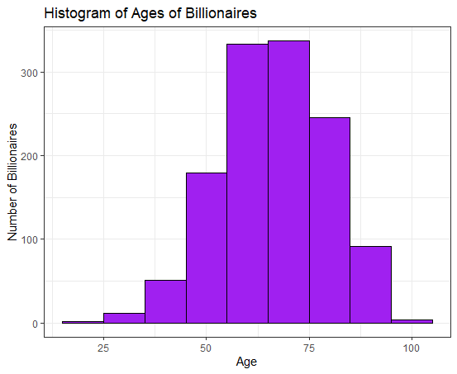
Q2: Is Age a factor in becoming a Billionaire?

Slide 11
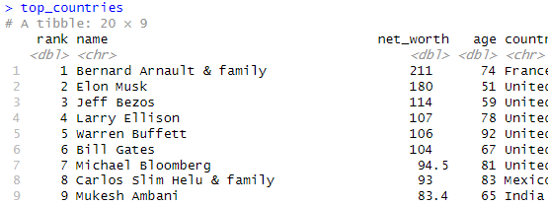
Q3: What is the correlation between a Billionaire’s net worth and their Country of origin?

Slide 12
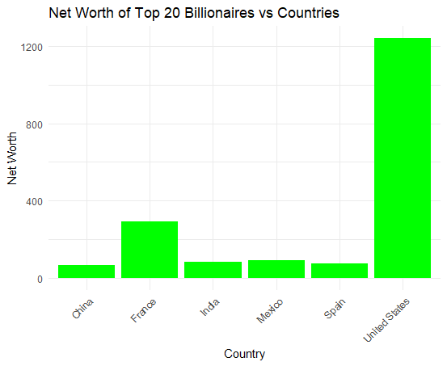
Q3: What is the correlation between a Billionaire’s net worth and their Country of origin?

Slide 13
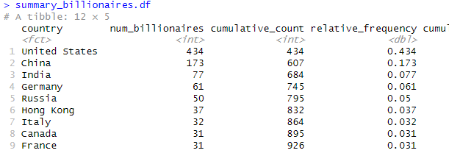
Q4: What is the cumulative distribution of Billionaires across the Countries?

Slide 14
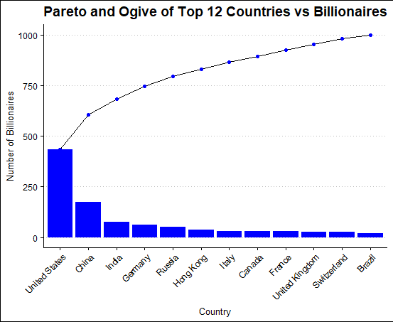
Q4: What is the cumulative distribution of Billionaires across the Countries?

Slide 15
Conclusion
Based on our questions and analysis:
United States has the greatest number of Billionaires
United States has higher and advanced facilities that increases the net worths of its Billionaires
Most of the Billionaires listed are over 50 years showing that age can be a factor in becoming a Billionaire
The Automotive, Technology and Fashion Industries, in an ascending order of position, are the most lucrative fields that could improve a country’s growth and its employment rate

Slide 16
Recommendations
I would recommend that:
Policymakers in any of the countries should provide more jobs or incentives to the people in the thriving industries
Entrepreneurs can re-strategize on their businesses and marketing strategies through in-depth research on the market trends
The youth of a country should be motivated and given platforms to express their creativity and skills so more young Billionaires will be developed

Slide 17
Observations
I made a few observations that could assist in further future analysis:
Missing Data – There are some few missing data in the dataset including the age column
Educational Background – Analysis can be done on their educational data provided in the dataset
“Do their educational backgrounds affect their net worth?”
“Do those with higher educational status tend to have high net worths?”
Predictive Analysis - Data on their billionaire timeline status should be collected in the future for predictive observations
“How did each billionaire’s net worth change over time?”
What were their previous jobs before they started building their own empires?

Slide 18
Thank you

