Slide 1

ITC 6000 Database Management Systems Final Project Presentation Year Term 1/A Online Furniture Marketplace
Amma A. Boa-Amponsem and Laura U. Onajite
boaamponsem.a@northeastern.edu
onajite.l@northeastern.edu

Slide 2
Overview
Project Overview
User Personas
Business Rules
ER Diagram
Solution Architecture and Hosting Model
Major SQL examples
Metrics and Analytics
Security & Privacy
Lessons learned

Slide 3
Project Overview
Online Second-Hand Furniture Marketplace website Project
Initiates the solution to the challenges of online furniture shoppers
Make the right decisions on budget-friendly purchasing
High quality yet affordable furniture products
Factors such as budget considerations, standard type, material, quality and sizes

Slide 4

Project Overview
Build a community for fellow furniture enthusiasts and regular users
Choose furniture pieces or sets for their ideal uses

Slide 5
Personas
Budget Shoppers
Potentially millions of users
As a User, I want to:
Buy second-hand Furniture pieces
Review bought furniture products (i.e., rate or comment)
Distributors
Potentially thousands of distributors
As a distributor on the platform, I want to:
Sell second-hand furniture pieces
Target my ads to specific users on the platform
Know which users like or dislike my furniture through reviews
Website Administrators
Two back-end Admins
Need to investigate and ‘ban’ bad users
Need to handle the administration of the website

Slide 6
Business Rules
They are:
a USER could ORDER one or many FURNITURE pieces
a USER could RATE many FURNITURE pieces
a FURNITURE can have many RATINGS, but a USER can RATE a FURNITURE once
a DISTRIBUTOR can SELL his/her FURNITURE pieces
ADMINISTRATOR could disable USER comments or ban USER for misbehavior
USER could REPORT or ISSUE a complaint to an ADMINISTRATOR about comments or other USERS

Slide 7
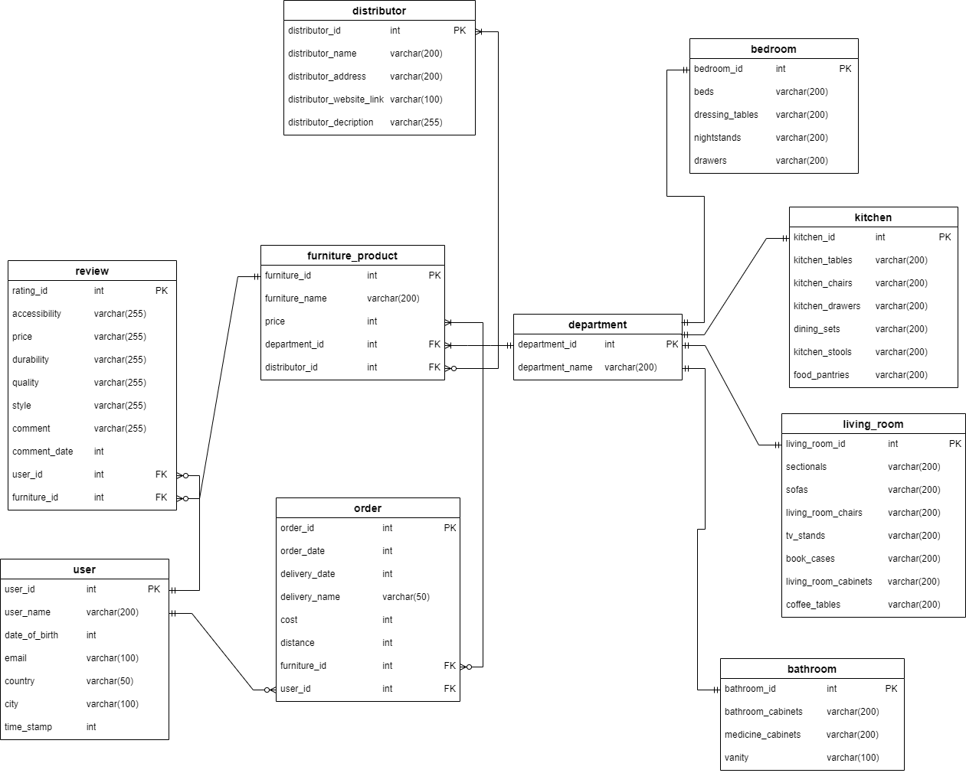
ER Diagram

Slide 8
Solution Architecture
Client/Server Architecture:
Client: Our platform’s user interface will include web browsers and mobile apps used by the users
Server: The main server will handle several functions including:
Database Management – It will operate the core database, that is, user profiles, furniture details, reviews, etc
Application Logic – Application logic will be executed by the main server. This will include the user authentication, recommendation algorithms and data analytics
Application Programming Interfaces (APIs): For communication between the user and server to be enabled, we will develop APIs for seamless data exchange
Hosting Model
Hosting it in the cloud is the preferred choice given the accessibility and flexibility required for our platform
Storage Required: A few terabytes, that is, about 15-30 TB

Slide 9
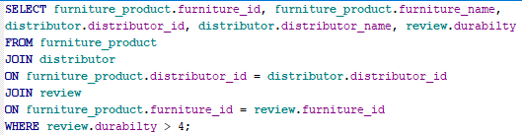
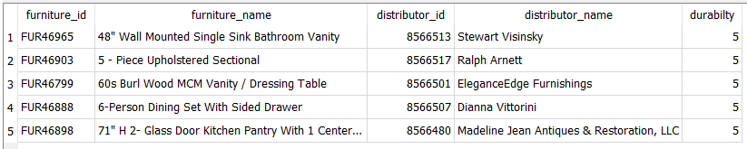
SQL Examples
Find the furniture product of a distributor that has ratings above 4 stars on durability

Slide 10
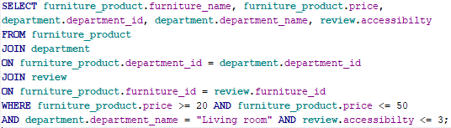

SQL Examples
Find a living room furniture that was sold between 20 and 50 usd and has 3-star ratings and below in accessibilty

Slide 11
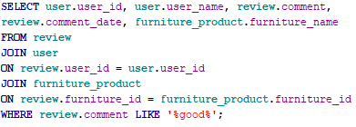
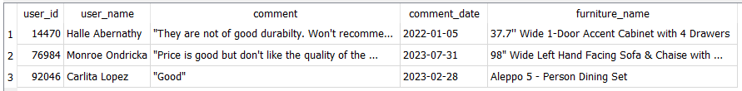
SQL Examples
Find the name of the person who made a comment with the word "good" in it on a product and the date he/she commented.

Slide 12
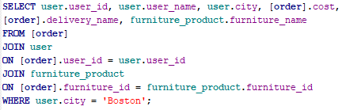
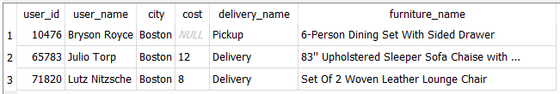
SQL Examples
Find the furniture product, its cost of delivery and the name of the person who received his/her product in Boston

Slide 13
Metrics and Analytics
Users
# of favourites, # of shares, # of comments, # of ratings
Distributors
“Views”, % Clicks on item, “Listings”, % Clicks on website link
Administrators
Total # of users
Total # of distributors
% of Users with activity in the past 7 days
Most active distributors uploading Furniture pieces

Slide 14
Security and Privacy
Our user's information details and data on furniture will be securely stored on a server
Follow the guidelines and policies of data security
Higher security and access control on certain vital and confidential data will only be accessed by the two Administrators and authorized personnels approved by the Administrators
Disclaimer: We will put a disclaimer that no payment should be made online prior to a physical inspection of the product to prevent users from being scammed.

Slide 15
Lessons Learned
Communication with team members to bring ideas to life
Creating and gathering data
Creating database
Learning SQL commands
Building a database architecture

Slide 16
Thank you

