Slide 1

Clustering New York’s Boroughs based on the Citizen’s Service Requests
Andrea Marie Maderazo

Slide 2
Clustering New York’s Boroughs based
on the Citizen’s Service Requests
To address the concerns of the citizens that are not classified as emergencies of outmost urgency, the service request hotline (311) is open for them. Using this hotline citizens of New York can contact local authorities and departments to address and solve their concerns and problems such as noise complaints, water service complaints, and a like.

Slide 3
Clustering New York’s Boroughs based
on the Citizen’s Service Requests
Group the five boroughs of New York according to the most frequent service requests that are addressed by the different departments

Slide 4
Data Acquisition and Cleaning
The service requests data is downloaded from NYC Open Data in the format .csv. While the other geojson data were gathered from Foursquare API.
This was processed on Jupyter Notebook using Python
There are a total of 1048574 service request calls with 52 columns that logs the details of the call.

Slide 5
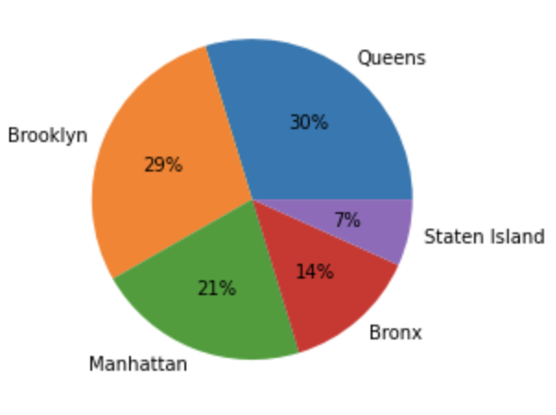
New York Service Request Calls
The pie chart of the percentage of service requests calls from each Boroughs with 30% of the calls coming from Queens and the least count of calls from Staten Island.

Slide 6
New York Service Request Calls
Borough | Total Count of Service Request Calls | Percentage
Queens | 195164 | 30%
Brooklyn | 187361 | 29%
Manhattan | 140978 | 21%
Bronx | 88976 | 14%
Staten Island | 44144 | 7%
The pie chart of the percentage of service requests calls from each Boroughs with 30% of the calls coming from Queens and the least count of calls from Staten Island.

Slide 7
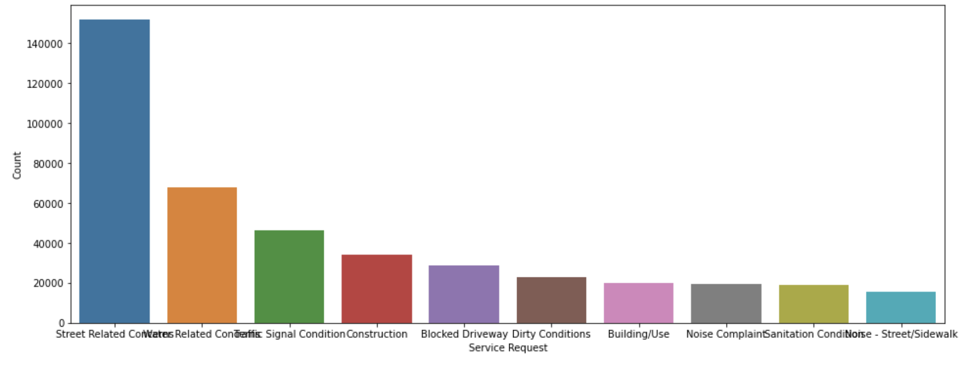
New York Service Request Calls
The ten types of service request calls with the highest count are street related concerns, water related concerns, traffic signal condition, construction, blocked driveways, dirty conditions, building/use, noise complaint, sanitation, and noise- street/sidewalk. The most common 311 calls in New York are the street related concerns with 151803 and followed by water related concerns with 67965 calls.

Slide 8
New York Service Request Calls
Service Request Type | Count
Street Related Concerns | 151803
Water Related Concerns | 67965
Traffic Signal Condition | 46197
Construction | 34097
Blocked Driveway | 28943
Dirty Conditions | 22996
Building/Use | 19787
Noise Complaint | 19432
Sanitation | 18770
Noise-Street/Sidewalk | 15524
The ten types of service request calls with the highest count are street related concerns, water related concerns, traffic signal condition, construction, blocked driveways, dirty conditions, building/use, noise complaint, sanitation, and noise- street/sidewalk. The most common 311 calls in New York are the street related concerns with 151803 and followed by water related concerns with 67965 calls.

Slide 9
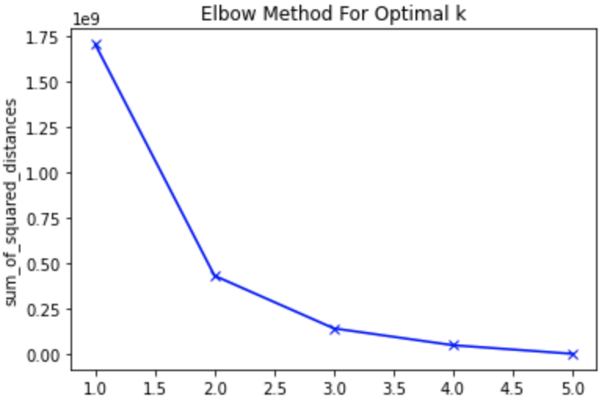
Clustering using K Means Clustering Algortihm
The machine learning algorithm K mean clustering was used to group the boroughs of New York according to the service request type. This algorithm will group the boroughs based on the service request calls. The elbow method was used to determine the optimal value of k. As show in figure 3, the graph of the sum of squared distances between the data points and three will be used as k.

Slide 10
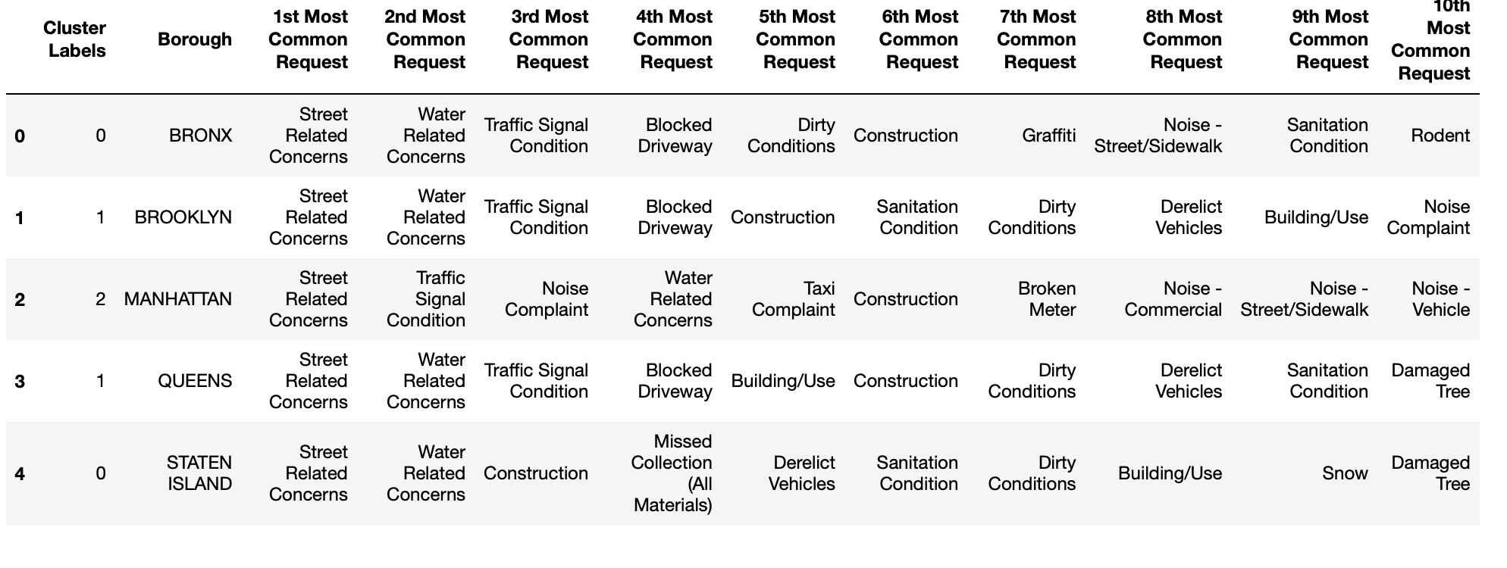
Clustering New York’s Boroughs based
on the Citizen’s Service Requests

Slide 11
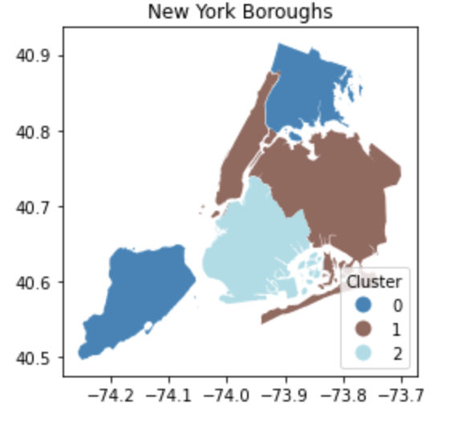
Clustered New York Map

Slide 12
Conclusion and Future Directions
For future capstone of the same topic or improvements to the current map, the boroughs of New York can be analyzed and clustered with the data on the departments and agencies that address the issue. Another thing that can be added is a map with the current placement of the agencies involved to have a map where future agencies can be planned for construction. Since this capstone focuses only on service requests calls of New York Boroughs due to the data restrictions in relation to privacy, specific details such as neighborhood or streets of the call would be insightful.

Slide 13
THANK YOU!

