Slide 1

Machine Learning
BS/MS (Computer Science)
Lecture-09
Summer-2014

Slide 2
Revision
Machine Learning Dr. S. Nadeem Ahsan, IU

Slide 3
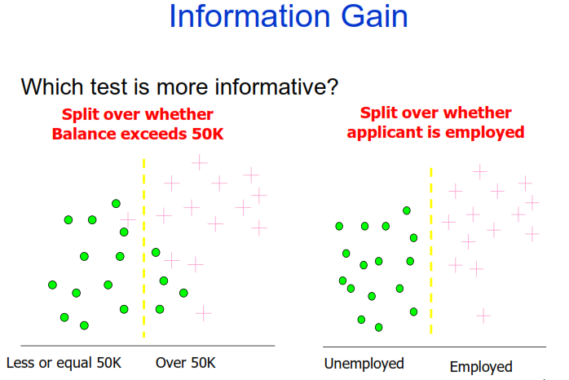
Machine Learning Dr. S. Nadeem Ahsan, IU

Slide 4
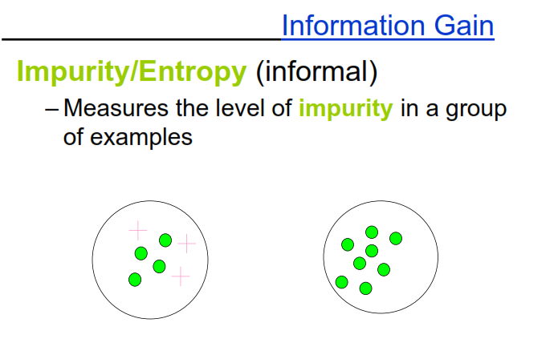
Machine Learning Dr. S. Nadeem Ahsan, IU

Slide 5
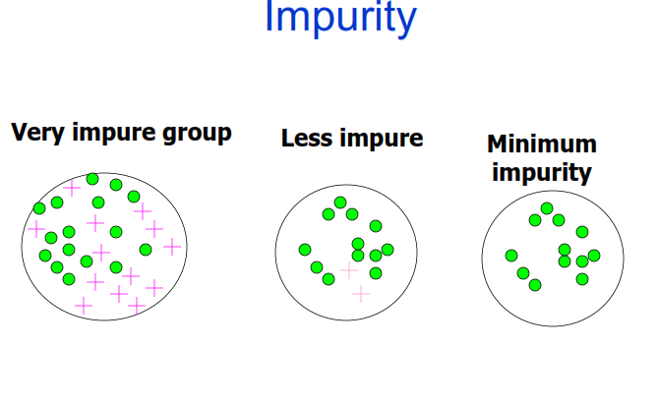
Machine Learning Dr. S. Nadeem Ahsan, IU

Slide 6
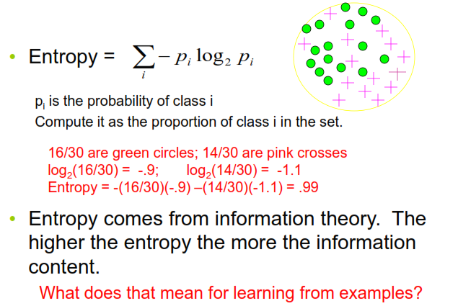
Entropy, a common way to measure impurity
Machine Learning Dr. S. Nadeem Ahsan, IU

Slide 7
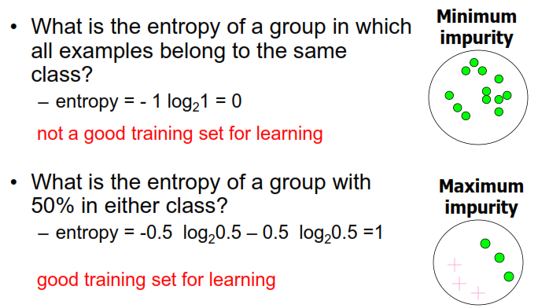
2- Class Cases
Machine Learning Dr. S. Nadeem Ahsan, IU

Slide 8
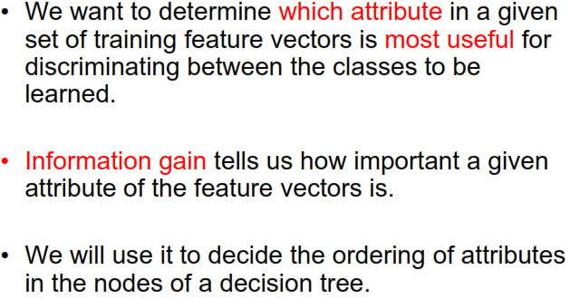
Information Gain
Machine Learning Dr. S. Nadeem Ahsan, IU

Slide 9
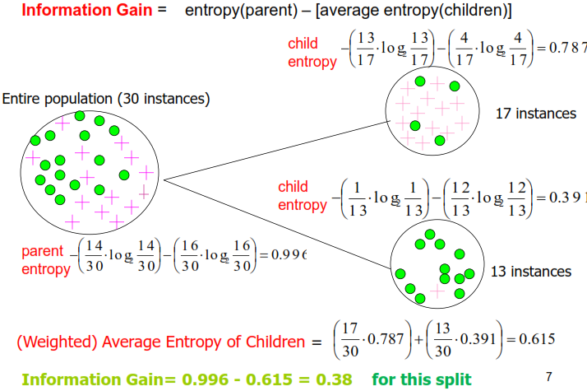
Calculating Information Gain
Machine Learning Dr. S. Nadeem Ahsan, IU

Slide 10
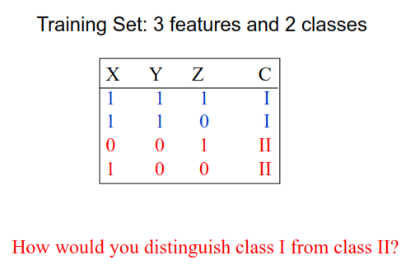
Simple Example
Machine Learning Dr. S. Nadeem Ahsan, IU

Slide 11
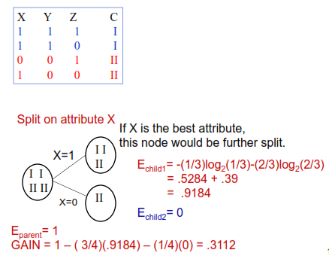
Simple Example
Machine Learning Dr. S. Nadeem Ahsan, IU

Slide 12
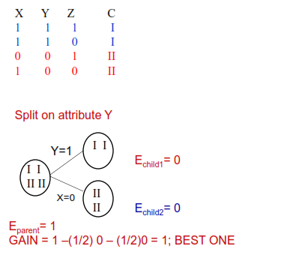
Simple Example
Machine Learning Dr. S. Nadeem Ahsan, IU

Slide 13
Decision Tree Learning
Decision tree learning is a method for approximating discrete-valued target functions, in which the learned function is represented by a decision tree.
Learned trees can also be re-represented as set of IF-THEN rules to improve human readability

Slide 14
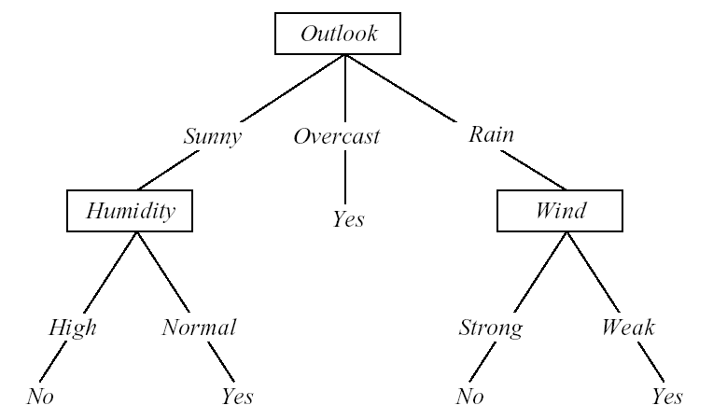
Converting A Tree to Rules
IF (Outlook = Sunny) ∧ (Humidity = High)
THEN PlayTennis = No
IF (Outlook = Sunny) ∧ (Humidity = Normal)
THEN PlayTennis = Yes
….

Slide 15
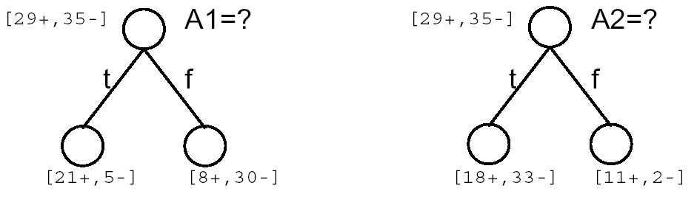
Top-Down Induction of Decision Trees (Approach)
Main loop:
  1. A ← the “best” decision attribute for next node
  2. Assign A as decision attribute for node
  3. For each value of A, create new descendant of node
  4. Sort training examples to leaf nodes
  5. If training examples perfectly classified, Then STOP, Else iterate over new leaf nodes
Which attribute is best?

Slide 16
Entropy(2/2)
Entropy(S) = expected number of bits needed to encode class (⊕ or ⊖) of randomly drawn member of S (under the optimal, shortest-length code)
Why?
Information theory: optimal length code assigns
  log₂p bits to message having probability p.
So, expected number of bits to encode ⊕ or ⊖ of random
member of S:
p⊕(-log₂ p⊕) + p⊖(-log₂ p⊖)
Entropy(S) ≡ - p⊕log₂ p⊕ - p⊖log₂ p⊖

Slide 17
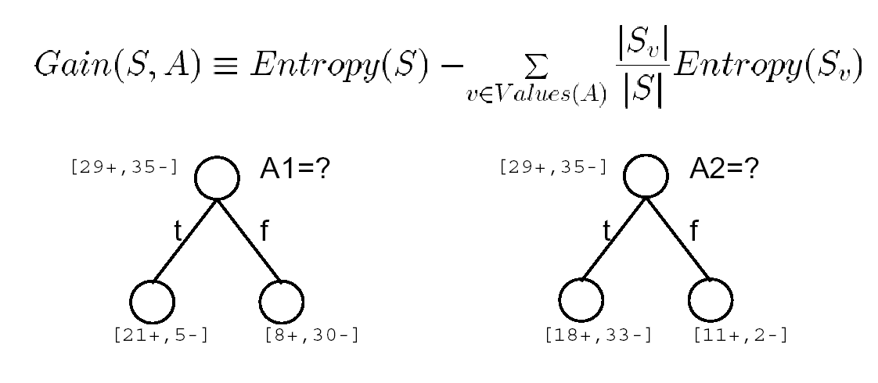
Information Gain
Gain(S, A) = expected reduction in entropy due to sorting on A

Slide 18
Neural Network
Machine Learning Dr. S. Nadeem Ahsan, IU

Slide 19
Biological Inspirations
Some numbers…
  The human brain contains about 10 billion nerve cells (neurons)
  Each neuron is connected to the others through 10000 synapses
Properties of the brain
  It can learn, reorganize itself from experience
  It adapts to the environment
  It is robust and fault tolerant

Slide 20
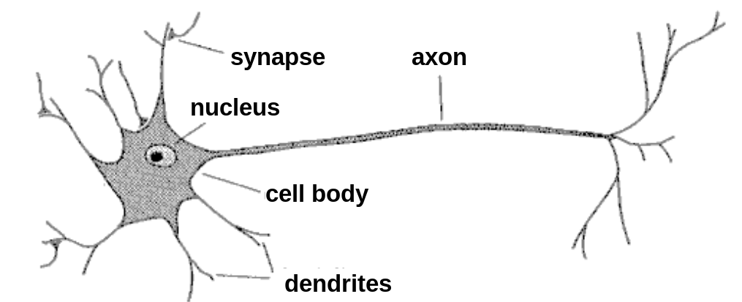
Biological Neuron
A neuron has
  A branching input (dendrites)
  A branching output (the axon)
The information circulates from the dendrites to the axon via the cell body
Axon connects to dendrites via synapses
  Synapses vary in strength
  Synapses may be excitatory or inhibitory

Slide 21
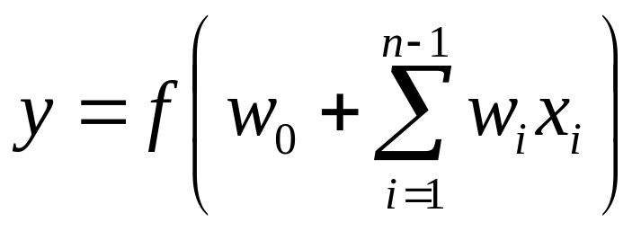
What is an artificial neuron ?
Definition : Non linear, parameterized function with restricted output range
y
w0
x1
x2
x3

Slide 22
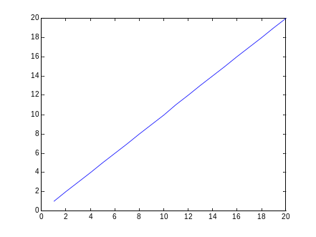

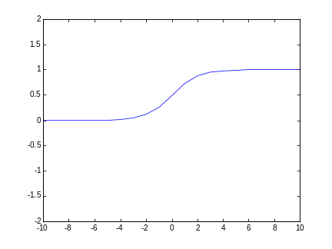
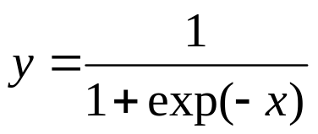
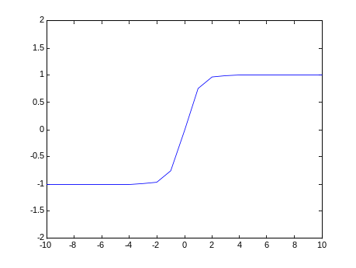
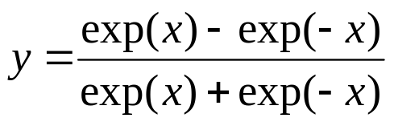
Activation Functions
Linear
Logistic
Hyperbolic tangent

Slide 23
Neural Networks
A mathematical model to solve engineering problems
  Group of highly connected neurons to realize compositions of non linear functions
Tasks
  Classification
  Discrimination
  Estimation
2 types of networks
  Feed forward Neural Networks
  Recurrent Neural Networks

Slide 24
Feed Forward Neural Networks
Output layer
The information is propagated from the inputs to the outputs
Computations of No non linear functions from n input variables by compositions of Nc algebraic functions
Time has no role (NO cycle between outputs and inputs)
2nd hidden
layer
1st hidden
layer
x1
x2
…..
xn

Slide 25
Recurrent Neural Networks
Can have arbitrary topologies
Can model systems with internal states (dynamic ones)
Delays are associated to a specific weight
Training is more difficult
Performance may be problematic
  Stable Outputs may be more difficult to evaluate
  Unexpected behavior (oscillation, chaos, …)
0
1
0
0
1
0
0
1
x1
x2

Slide 26
Learning
The procedure that consists in estimating the parameters of neurons so that the whole network can perform a specific task
3 types of learning
  The supervised learning
  The unsupervised learning
  Reinforcement learning
The Learning process (supervised)
  Present the network a number of inputs and their corresponding outputs
  See how closely the actual outputs match the desired ones
  Modify the parameters to better approximate the desired outputs

Slide 27
Building a Neural Network
“Select Structure”: Design the way that the neurons are interconnected
“Select weights” – decide the strengths with which the neurons are interconnected
  weights are selected so get a “good match” to a “training set”
  “training set”: set of inputs and desired outputs
  often use a “learning algorithm”

Slide 28
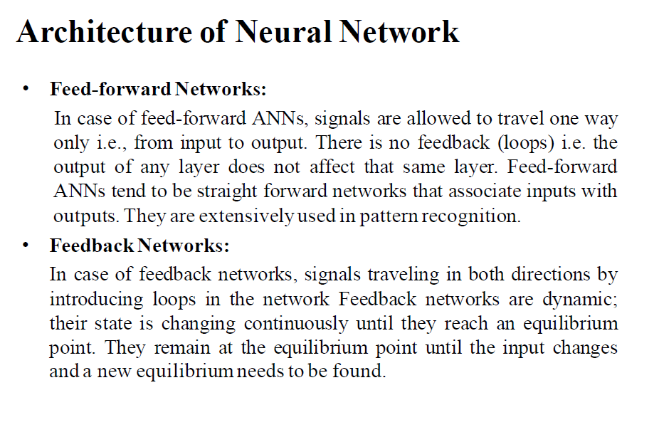
Machine Learning Dr. S. Nadeem Ahsan, IU

Slide 29
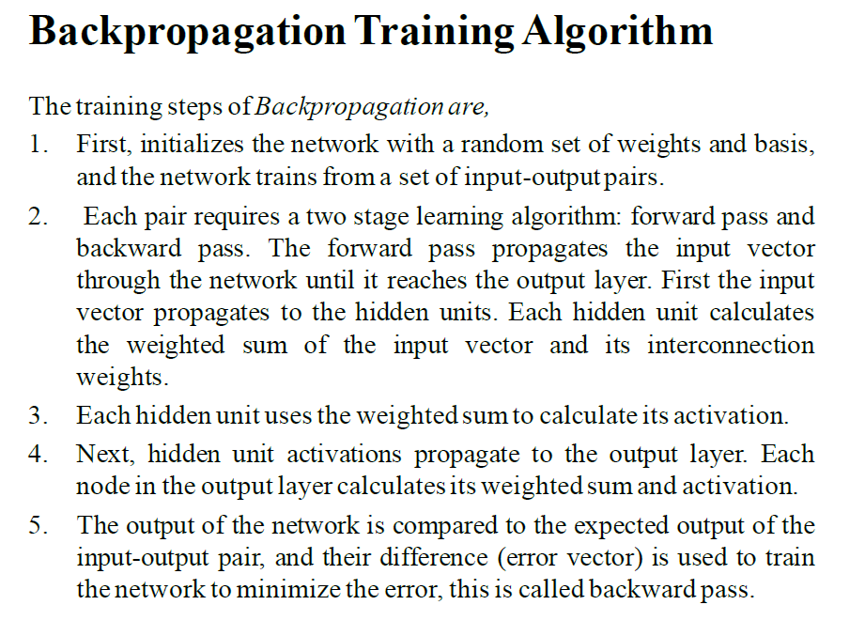
Machine Learning Dr. S. Nadeem Ahsan, IU

Slide 30
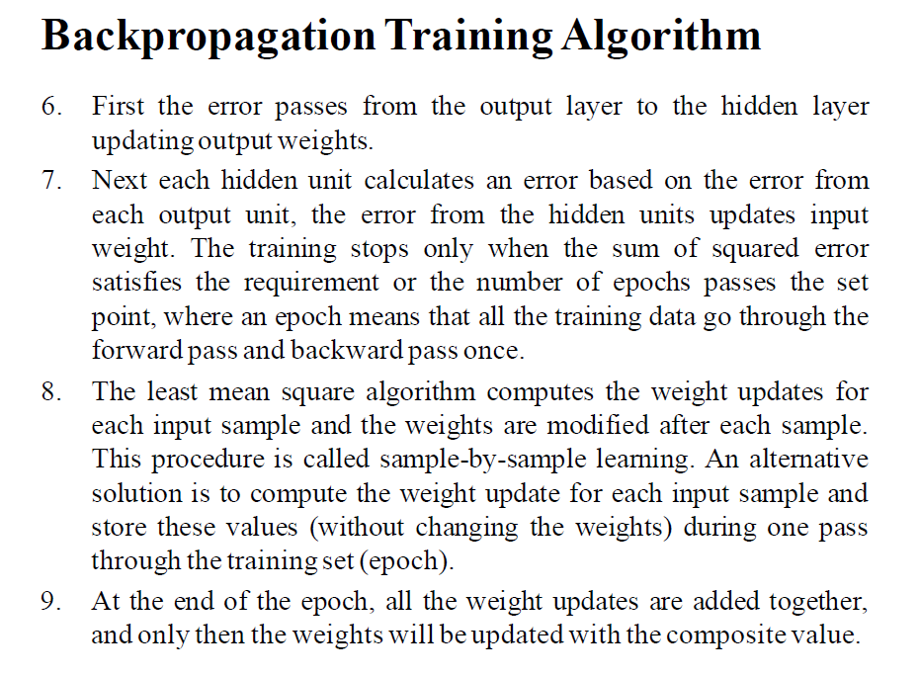
Machine Learning Dr. S. Nadeem Ahsan, IU

Slide 31
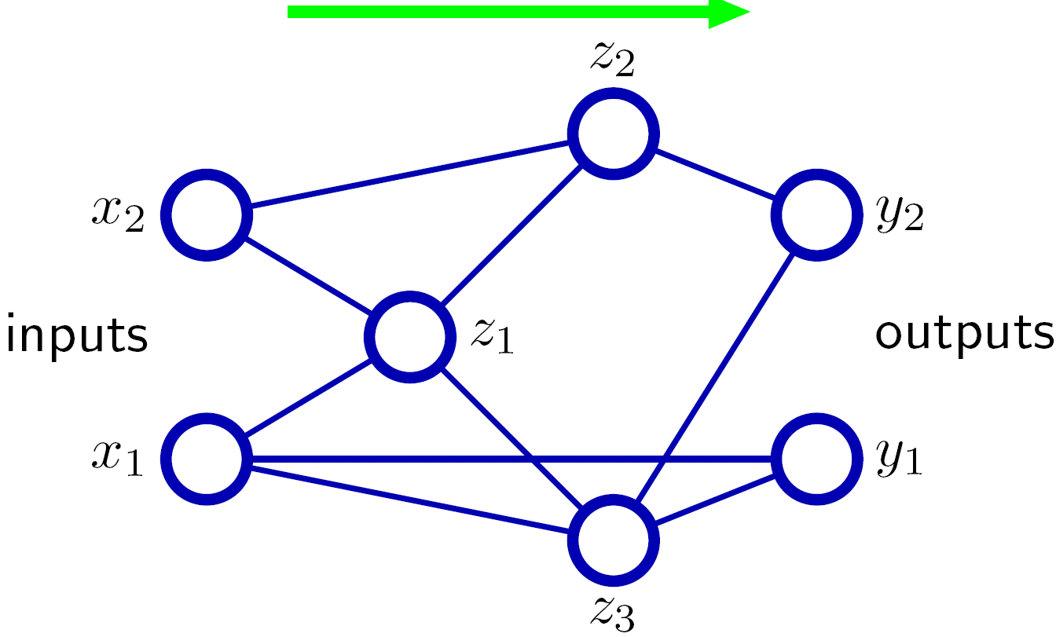
Forward-propagating local input signals
Forward propagation gives all the a’s and z’s

Slide 32
Back-propagating local error signals
t₂
t₁
Back-propagation gives all the δ ’s

Slide 33
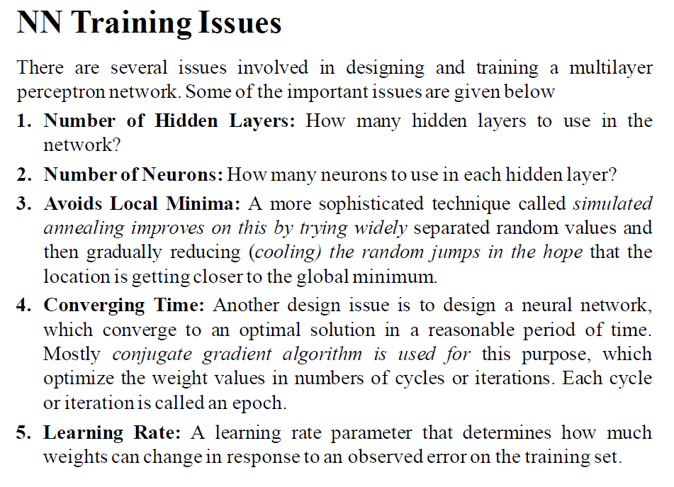
Machine Learning Dr. S. Nadeem Ahsan, IU

Slide 34
Gradient Decent
Learning in a backpropagation network is in two steps.
First each pattern is presented to the network and propagated forward to the output.
Second, a method called gradient descent is used to minimize the total error on the patterns in the training set.
In gradient descent, weights are changed in proportion to the negative of an error derivative with respect to each weight:
Machine Learning Dr. S. Nadeem Ahsan, IU

Slide 35
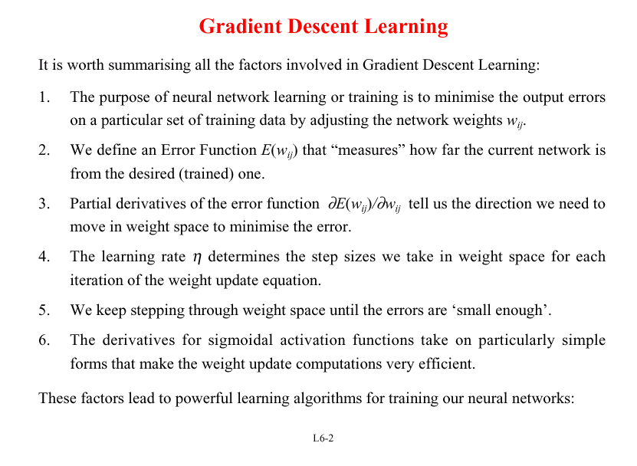

Slide 36
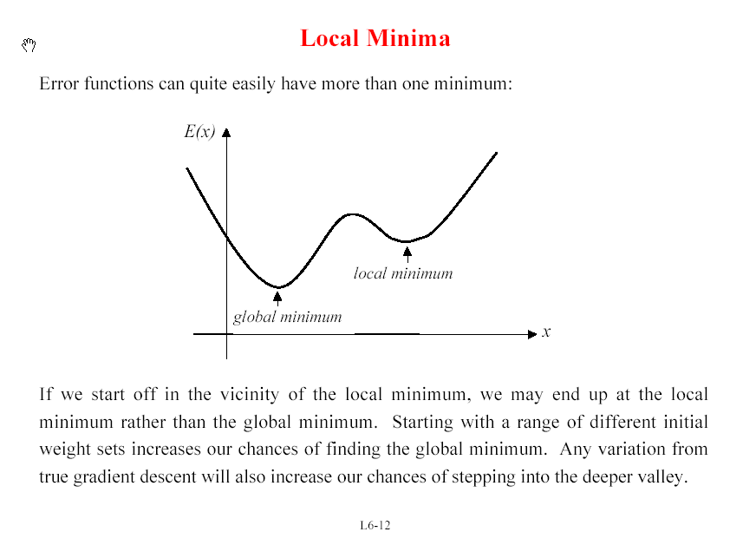

Slide 37
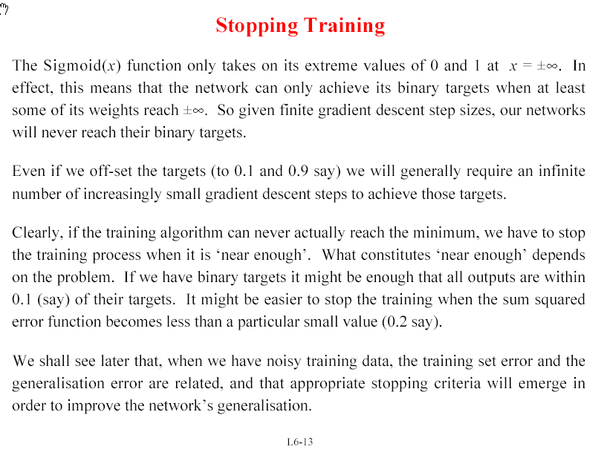

Slide 38
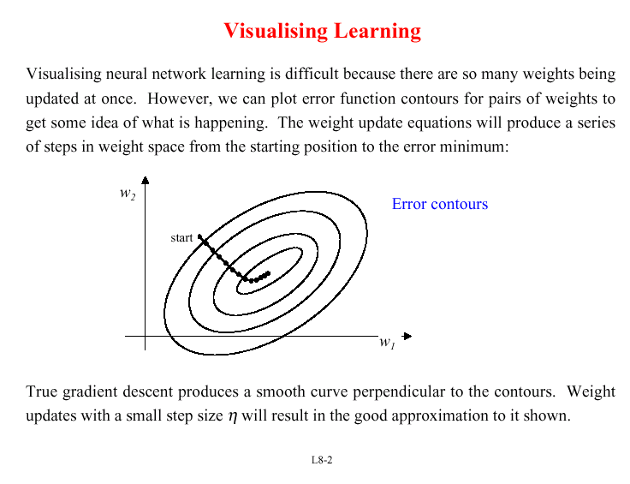

Slide 39
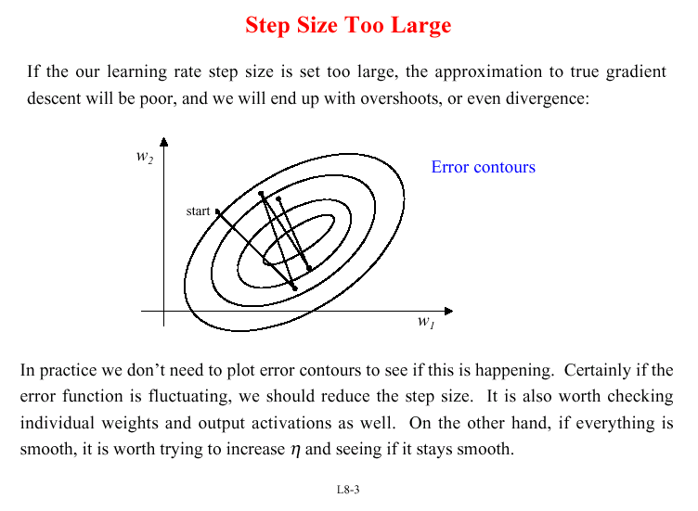

Slide 40
