Slide 1

Machine Learning
BS/MS (Computer Science)
Lecture-11
Summer: 19-July-2014

Slide 2
Revision
Machine Learning Dr. S. Nadeem Ahsan, IU

Slide 3
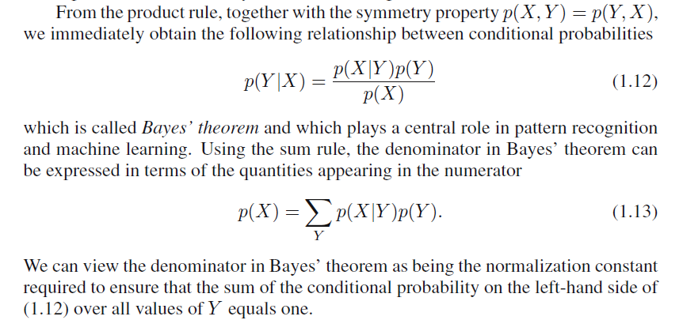
Baye’s Theorem
Machine Learning Dr. S. Nadeem Ahsan, IU

Slide 4
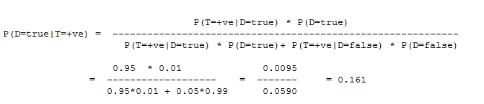
Baye’s Theorem (Example-1)
Problem: Suppose you have been tested positive for a disease; what is the probability that you actually have the disease? It depends on the accuracy and sensitivity of the test, and on the background (prior) probability of the disease.
Solution: Let
P(Test=+ve | Disease=true) = 0.95, so the false negative rate,
P(Test=-ve | Disease=true) =0.05m. Let,
P(Test=+ve | Disease=false) = 0.05,
Suppose the disease is rare: P(Disease=true) = 0.01 (1%).
Let D denote Disease (R in the above equation) and
"T=+ve" denote the positive Test (e in the above equation). Then
Machine Learning Dr. S. Nadeem Ahsan, IU

Slide 5
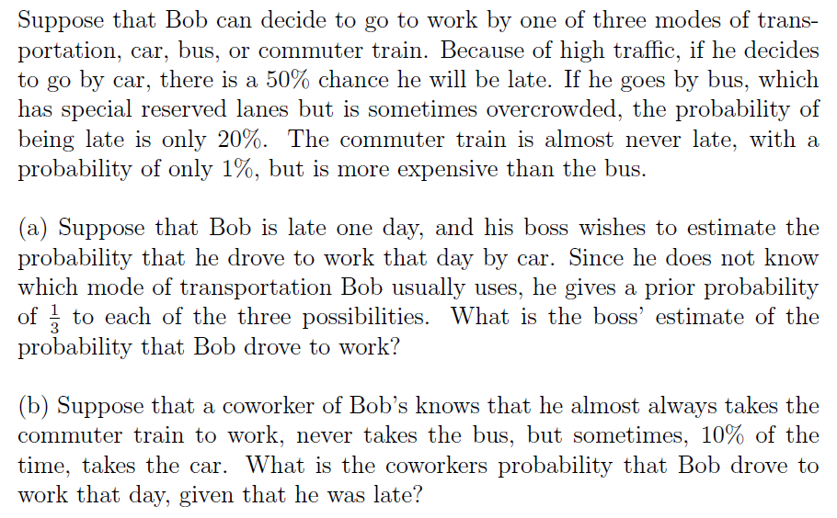
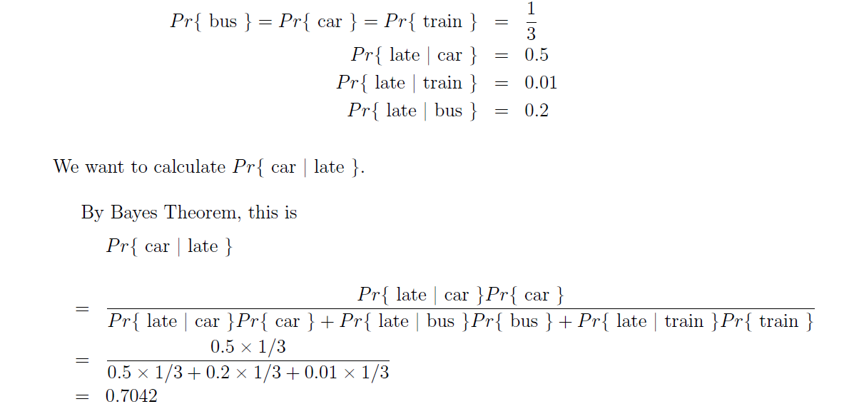
Baye’s Theorem (Example-2)
Machine Learning Dr. S. Nadeem Ahsan, IU

Slide 6
Graphical Model

Slide 7
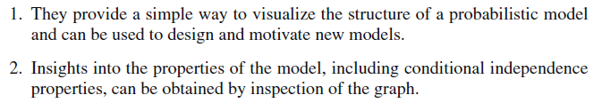

Probabilistic Graphical Model
Machine Learning Dr. S. Nadeem Ahsan, IU

Slide 8
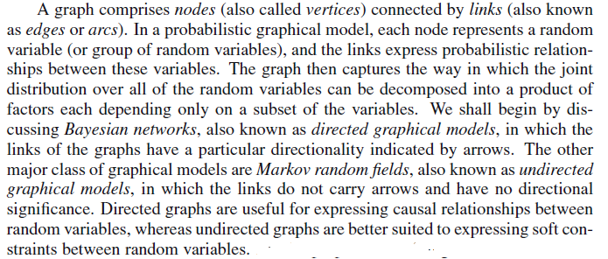
Probabilistic Graphical Model
Machine Learning Dr. S. Nadeem Ahsan, IU

Slide 9

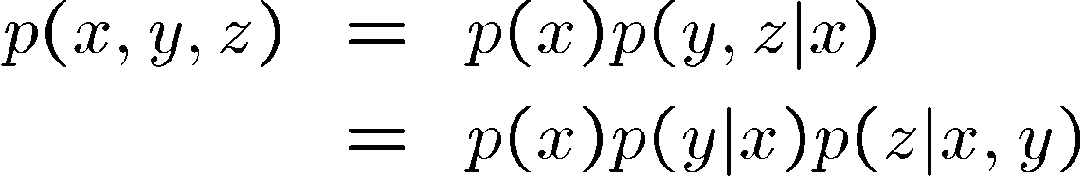
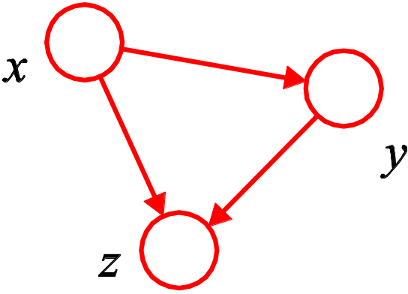
Joint Probability Distribution
(Role of Graphs)
Consider an arbitrary joint distribution
By successive application of the product rule
Machine Learning Dr. S. Nadeem Ahsan, IU

Slide 10
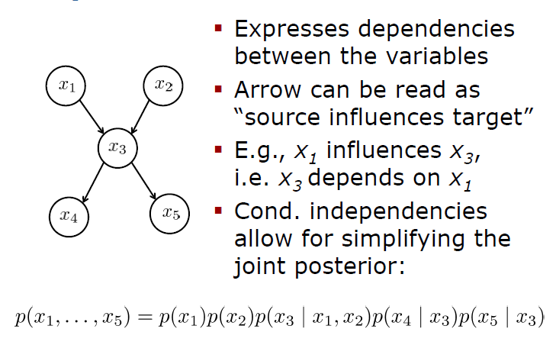
Bayesian Network (Directed Graph Model)
Machine Learning Dr. S. Nadeem Ahsan, IU

Slide 11



Bayesian Network (Directed Graph Model)
We can write the joint probability distribution in the form
Machine Learning Dr. S. Nadeem Ahsan, IU

Slide 12
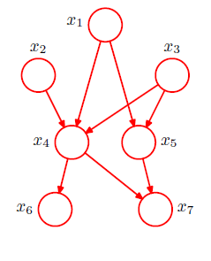
Bayesian Network (Directed Graph Model)
Machine Learning Dr. S. Nadeem Ahsan, IU

Slide 13
Application of Bayes Theorem and Probabilistic Graphical Model

Slide 14
Bayesian Classification
Why use Bayesian Classification:
Probabilistic learning: Calculate explicit probabilities for hypothesis, among the most practical approaches to certain types of learning problems
Incremental: Each training example can incrmentally increase/decrease the probability that a hypothesis is correct. Prior knowledge can be combined with observed data.
Probabilistic prediction: Predict multiple hypotheses, weighted by their probabilities

Slide 15
Naïve Bayes Classifier
A simplified assumption: attributes are conditionally independent:
Greatly reduces the computation cost, only count the class distribution.

Slide 16
Naïve Bayes Classifier
The probabilistic model of NBC is to find the probability of a certain class given multiple dijoint (assumed) events.
The naïve Bayes classifier applies to learning tasks where each instance x is described by a conjunction of attribute values and where the target function f(x) can take on any value from some finite set V. A set of training examples of the target function is provided, and a new instance is presented, described by the tuple of attribute values <a1,a2,…,an>. The learner is asked to predict the target value, or classification, for this new instance.

Slide 17
Naïve Bayes Classifier
Abstractly, probability model for a classifier is a conditional model P(C|F1,F2,…,Fn)
Over a dependent class variable C with a small number of outcome or classes conditional over several feature variables F1,…,Fn.
Naïve Bayes Formula:
P(C|F1,F2,…,Fn) = argmax_{c} [P(C) x P(F1|C) x P(F2|C) x…x P(Fn|C)] / P(F1,F2,…,Fn)
Since P(F1,F2,…,Fn) is common to all probabilities, we do not need to evaluate the denomitator for comparisons.

Slide 18
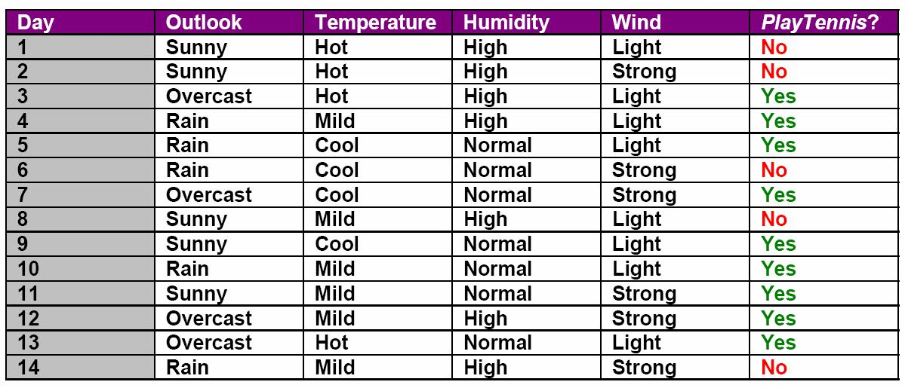
Naïve Bayes Classifier
Tennis-Example

Slide 19
Naïve Bayes Classifier
Problem:
Use training data from above to classify the following instances:
<Outlook=sunny, Temperature=cool, Humidity=high, Wind=strong>
<Outlook=overcast, Temperature=cool, Humidity=high, Wind=strong>

Slide 20
Naïve Bayes Classifier
Answer to (a):
P(PlayTennis=yes) = 9/14 = 0.64
P(PlayTennis=n) = 5/14 = 0.36
P(Outlook=sunny|PlayTennis=yes) = 2/9 = 0.22
P(Outlook=sunny|PlayTennis=no) = 3/5 = 0.60
P(Temperature=cool|PlayTennis=yes) = 3/9 = 0.33
P(Temperature=cool|PlayTennis=no) = 1/5 = .20
P(Humidity=high|PlayTennis=yes) = 3/9 = 0.33
P(Humidity=high|PlayTennis=no) = 4/5 = 0.80
P(Wind=strong|PlayTennis=yes) = 3/9 = 0.33
P(Wind=strong|PlayTennis=no) = 3/5 = 0.60

Slide 21
Naïve Bayes Classifier
P(yes)xP(sunny|yes)xP(cool|yes)xP(high|yes)xP(strong|yes) = 0.0053
P(no)xP(sunny|no)xP(cool|no)xP(high|no)x P(strong|no) = 0.0206
So the class for this instance is ‘no’. We can normalize the probility by:
[0.0206]/[0.0206+0.0053] = 0.795

Slide 22
Naïve Bayes Classifier
Answer to (b):
P(PlayTennis=yes) = 9/14 = 0.64
P(PlayTennis=no) = 5/14 = 0.36
P(Outlook=overcast|PlayTennis=yes) = 4/9 = 0.44
P(Outlook=overcast|PlayTennis=no) = 0/5 = 0
P(Temperature=cool|PlayTennis=yes) = 3/9 = 0.33
P(Temperature=cool|PlayTennis=no) = 1/5 = .20
P(Humidity=high|PlayTennis=yes) = 3/9 = 0.33
P(Humidity=high|PlayTennis=no) = 4/5 = 0.80
P(Wind=strong|PlayTennis=yes) = 3/9 = 0.33
P(Wind=strong|PlayTennis=no) = 3/5 = 0.60

Slide 23

Example
Example: Play Tennis

Slide 24
Example
Learning Phase
Outlook | Play=Yes | Play=No
Sunny | 2/9 | 3/5
Overcast | 4/9 | 0/5
Rain | 3/9 | 2/5
Temperature | Play=Yes | Play=No
Hot | 2/9 | 2/5
Mild | 4/9 | 2/5
Cool | 3/9 | 1/5
Humidity | Play=Yes | Play=No
High | 3/9 | 4/5
Normal | 6/9 | 1/5
Wind | Play=Yes | Play=No
Strong | 3/9 | 3/5
Weak | 6/9 | 2/5
P(Play=Yes) = 9/14
P(Play=No) = 5/14

Slide 25
Example
Test Phase
  Given a new instance,
  x’=(Outlook=Sunny, Temperature=Cool, Humidity=High, Wind=Strong)
  Look up tables
  MAP rule
P(Outlook=Sunny|Play=Yes) = 2/9
P(Temperature=Cool|Play=Yes) = 3/9
P(Huminity=High|Play=Yes) = 3/9
P(Wind=Strong|Play=Yes) = 3/9
P(Play=Yes) = 9/14
P(Outlook=Sunny|Play=No) = 3/5
P(Temperature=Cool|Play==No) = 1/5
P(Huminity=High|Play=No) = 4/5
P(Wind=Strong|Play=No) = 3/5
P(Play=No) = 5/14
P(Yes|x’): [P(Sunny|Yes)P(Cool|Yes)P(High|Yes)P(Strong|Yes)]P(Play=Yes) = 0.0053
P(No|x’): [P(Sunny|No) P(Cool|No)P(High|No)P(Strong|No)]P(Play=No) = 0.0206
Given the fact P(Yes|x’) < P(No|x’), we label x’ to be “No”.

Slide 26

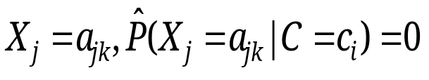
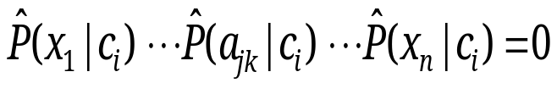
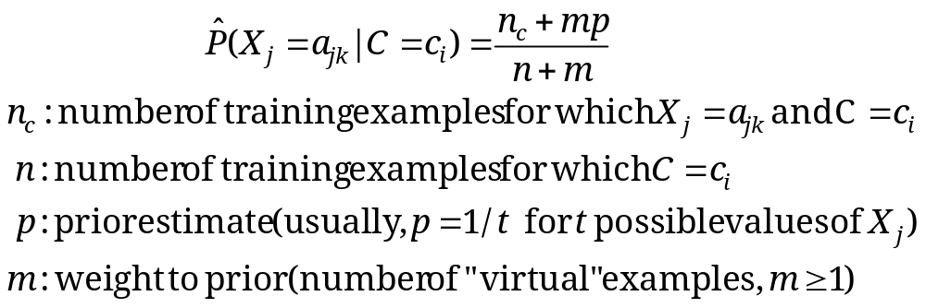
Relevant Issues
Violation of Independence Assumption
  For many real world tasks,
  Nevertheless, naïve Bayes works surprisingly well anyway!
Zero conditional probability Problem
  If no example contains the attribute value
  In this circumstance, during test
  For a remedy, conditional probabilities estimated with

Slide 27
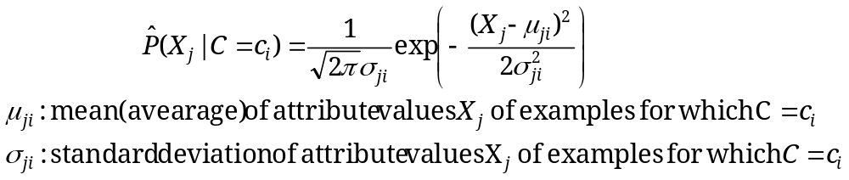




Relevant Issues
Continuous-valued Input Attributes
  Numberless values for an attribute
  Conditional probability modeled with the normal distribution
  Learning Phase:
  Output: normal distributions and
  Test Phase:
    Calculate conditional probabilities with all the normal distributions
    Apply the MAP rule to make a decision

Slide 28
Conclusions
Naïve Bayes based on the independence assumption
  Training is very easy and fast; just requiring considering each attribute in each class separately
  Test is straightforward; just looking up tables or calculating conditional probabilities with normal distributions
A popular generative model
  Performance competitive to most of state-of-the-art classifiers even in presence of violating independence assumption
  Many successful applications, e.g., spam mail filtering
  A good candidate of a base learner in ensemble learning
  Apart from classification, naïve Bayes can do more…

Slide 29
Bayesian Belief Network
A Bayesian network is a representation of the joint distribution over all the variables represented by nodes in the graph. Let the variables be X(1), ..., X(n).
Let parents(A) be the parents of the node A. Then the joint distribution for X(1) through X(n) is represented as the product of the probability distributions P(Xi|Parents(Xi)) for i = 1 to n. If X has no parents, its probability distribution is said to be unconditional, otherwise it is conditional.

Slide 30
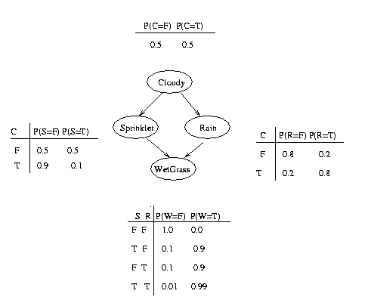
BAYESIAN BELIEF NETWORK

Slide 31
Bayesian Belief Network
By the chaining rule of probability, the joint probability of all the nodes in the graph above is:
P(C, S, R, W) = P(C) * P(S|C) * P(R|C) * P(W|S,R)
W=Wet Grass, C=Cloudy, R=Rain, S=Sprinkler
Example: P(W∩-R∩S∩C)
= P(W|S,-R)*P(-R|C)*P(S|C)*P(C)
= 0.9*0.2*0.1*0.5 = 0.009

Slide 32
Bayesian Belief Network
What is the probability of wet grass on a given day P(W)?
P(W) = P(W|SR) * P(S) * P(R) +
P(W|S-R) * P(S) * P(-R) +
P(W|-SR) * P(-S) * P(R) +
P(W|-S-R) * P(-S) * P(-R)
Here P(S) = P(S|C) * P(C) + P(S|-C) * P(-C)
P(R) = P(R|C) * P(C) + P(R|-C) * P(-C)
P(W)= 0.5985

Slide 33
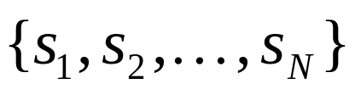
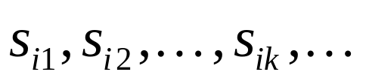
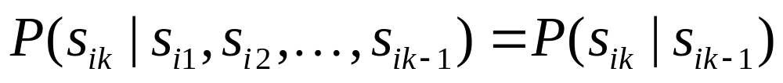
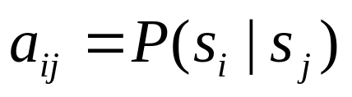
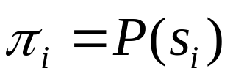
Introduction to Markov Models
Set of states:
Process moves from one state to another generating a sequence of states :
Markov chain property: probability of each subsequent state depends only on what was the previous state:
To define Markov model, the following probabilities have to be specified: transition probabilities and initial probabilities

Slide 34
Example of Markov Model
0.3
0.7
Rain
Dry
0.2
0.8
Two states : ‘Rain’ and ‘Dry’.
Transition probabilities: P(‘Rain’|‘Rain’)=0.3 , P(‘Dry’|‘Rain’)=0.7 , P(‘Rain’|‘Dry’)=0.2, P(‘Dry’|‘Dry’)=0.8
Initial probabilities: say P(‘Rain’)=0.4 , P(‘Dry’)=0.6 .

Slide 35
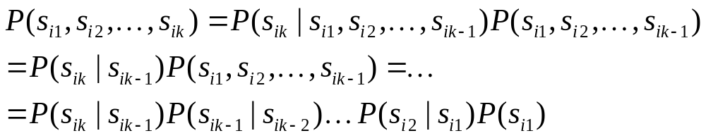
Calculation of sequence probability
By Markov chain property, probability of state sequence can be found by the formula:
Suppose we want to calculate a probability of a sequence of states in our example, {‘Dry’,’Dry’,’Rain’,Rain’}.
P({‘Dry’,’Dry’,’Rain’,Rain’} ) =
P(‘Rain’|’Rain’) P(‘Rain’|’Dry’) P(‘Dry’|’Dry’) P(‘Dry’)=
= 0.3*0.2*0.8*0.6

Slide 36
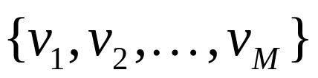
Hidden Markov models.
Set of states:
Process moves from one state to another generating a sequence of states :
Markov chain property: probability of each subsequent state depends only on what was the previous state:
States are not visible, but each state randomly generates one of M observations (or visible states)
To define hidden Markov model, the following probabilities have to be specified:
  matrix of transition probabilities A=(a_{ij}), a_{ij}= P(s_{i} | s_{j})
  matrix of observation probabilities B=(b_{i} (v_{m} )), b_{i}(v_{m} ) = P(v_{m} | s_{i})
  initial probabilities π=(π_{i}), π_{i} = P(s_{i}) . Model is represented by M=(A, B, π).

Slide 37
Example of Hidden Markov Model
0.3
0.7
Low
High
0.2
0.8
0.6
0.6
0.4
0.4
Rain
Dry
Two states : ‘Low’ and ‘High’ atmospheric pressure.

Slide 38
Example of Hidden Markov Model
Two states : ‘Low’ and ‘High’ atmospheric pressure.
Two observations : ‘Rain’ and ‘Dry’.
Transition probabilities: P(‘Low’|‘Low’)=0.3 , P(‘High’|‘Low’)=0.7 , P(‘Low’|‘High’)=0.2, P(‘High’|‘High’)=0.8
Observation probabilities : P(‘Rain’|‘Low’)=0.6 , P(‘Dry’|‘Low’)=0.4 , P(‘Rain’|‘High’)=0.4 , P(‘Dry’|‘High’)=0.3 .
Initial probabilities: say P(‘Low’)=0.4 , P(‘High’)=0.6 .

Slide 39
Calculation of observation sequence probability
Suppose we want to calculate a probability of a sequence of observations in our example, {‘Dry’,’Rain’}.
Consider all possible hidden state sequences:
P({‘Dry’,’Rain’} ) = P({‘Dry’,’Rain’} , {‘Low’,’Low’}) + P({‘Dry’,’Rain’} , {‘Low’,’High’}) + P({‘Dry’,’Rain’} , {‘High’,’Low’}) + P({‘Dry’,’Rain’} , {‘High’,’High’})
where first term is :
P({‘Dry’,’Rain’} , {‘Low’,’Low’})=
P({‘Dry’,’Rain’} | {‘Low’,’Low’}) P({‘Low’,’Low’}) =
P(‘Dry’|’Low’)P(‘Rain’|’Low’) P(‘Low’)P(‘Low’|’Low)
= 0.4*0.6*0.4*0.3

Slide 40
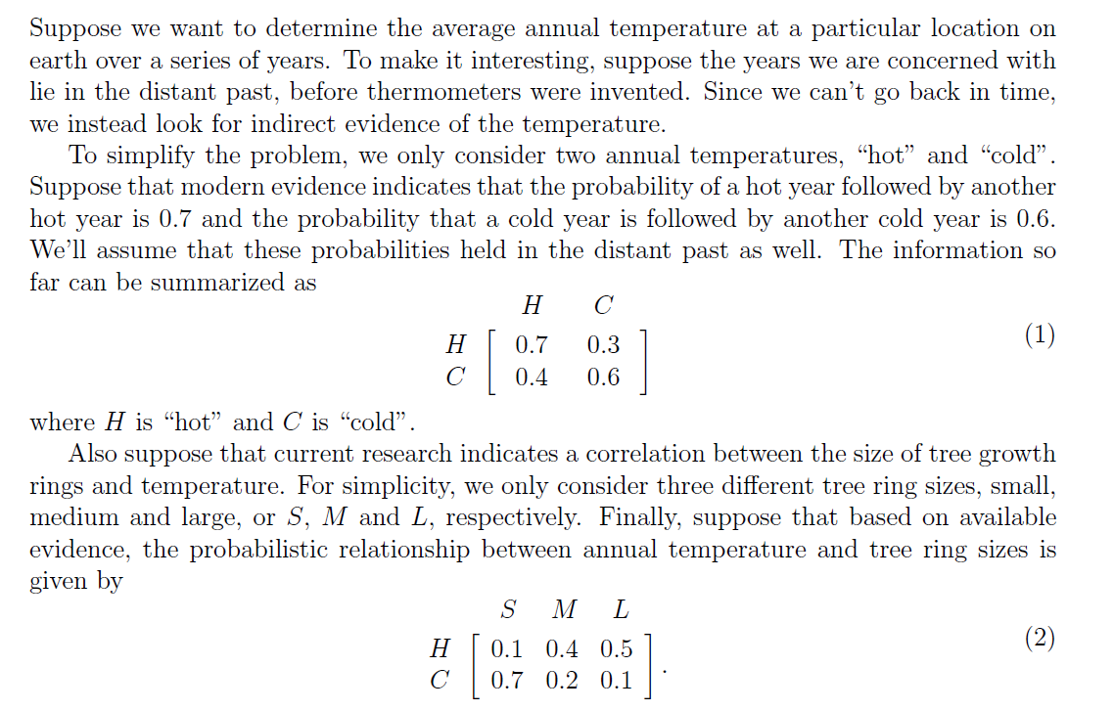
Hidden Markov Model
Machine Learning Dr. S. Nadeem Ahsan, IU

Slide 41
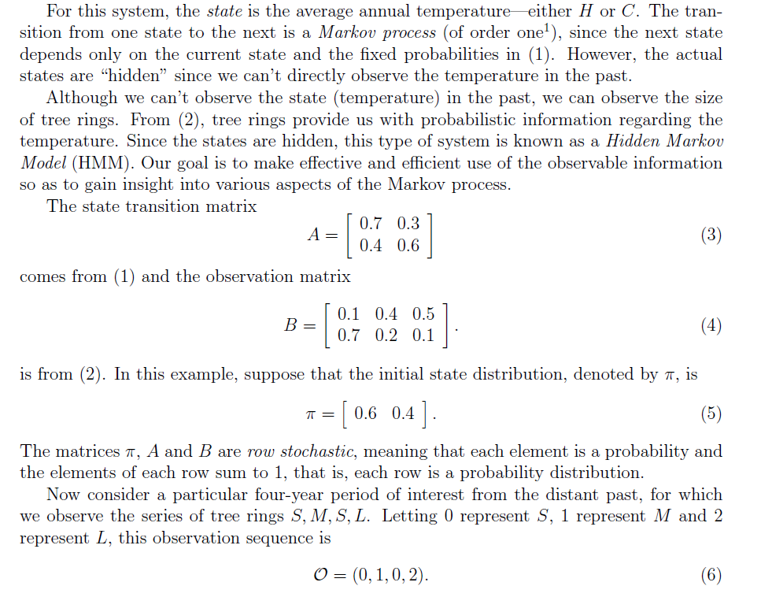
Hidden Markov Model
Machine Learning Dr. S. Nadeem Ahsan, IU

Slide 42
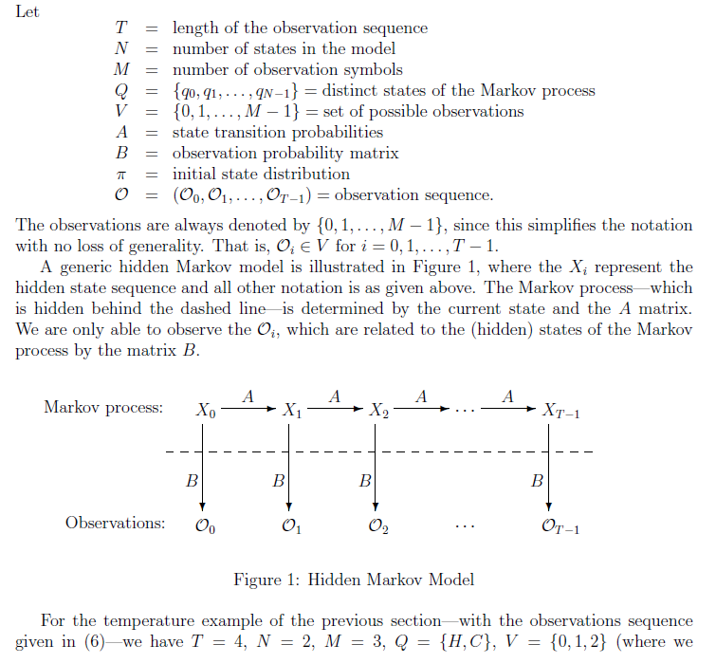
Hidden Markov Model
Machine Learning Dr. S. Nadeem Ahsan, IU

Slide 43
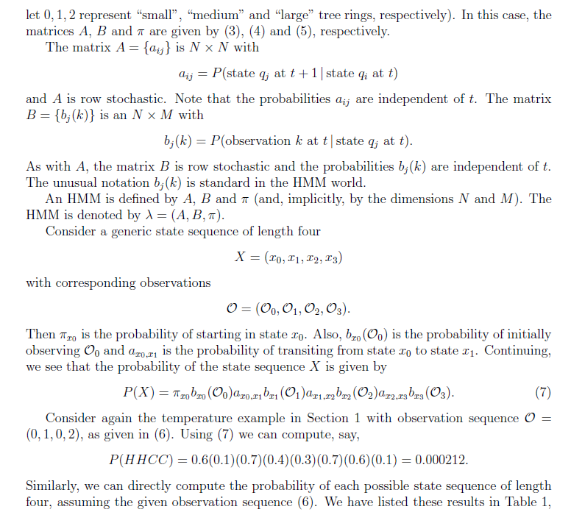
Machine Learning Dr. S. Nadeem Ahsan, IU

Slide 44
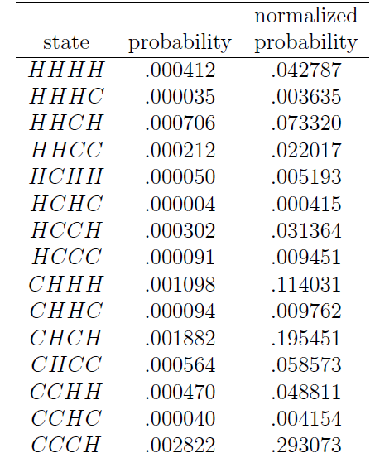
Table - 1
(state sequence probabilities of example Hot and Cold weather)
Machine Learning Dr. S. Nadeem Ahsan, IU

Slide 45
Lab Project Session
(Weka)

