Slide 1

Machine Learning
BS/MS (Computer Science)
Lecture-12
Summer: 20-July-2014

Slide 2
Bayesian Belief Network
Machine Learning Dr. S. Nadeem Ahsan, IU

Slide 3
Expert Systems: Rule Based Systems
1960s - Rule Based Systems
Model human Expertise using IF .. THEN rules or Production Rules.
Combines the rules (or Knowledge Base) with an inference engine to reason about the world.
Given certain observations, produces conclusions.
Relatively successful but limited.

Slide 4
Uncertainty
Rule based systems failed to handle uncertainty
Only dealt with true or false facts
Partly overcome using Certainty factors
However, other problems: no differentiation between causal rules and diagnostic rules.

Slide 5
Normative Expert Systems
Model Domain rather than Expert
Classical probability used rather than ad-hoc calculus
Expert support rather than Expert Model
1980s - More Powerful Computers make complex probability calculations feasible
Bayesian Networks introduced (Pearl 1986) e.g. MUNIN. Bayesian networks have been the most important contribution to the field of AI in the last 10 years
Provide a way to represent knowledge in an uncertain domain and a way to reason about this knowledge
Many applications: medicine, factories, help desks, spam filtering, etc.

Slide 6
A Bayesian Network
A Bayesian network is made up of two parts:
A directed acyclic graph
A set of parameters
B | P(B)
false | 0.999
true | 0.001
E | P(E)
false | 0.998
true | 0.002
Burglary
Earthquake
Alarm
B | E | A | P(A|B,E)
false | false | false | 0.999
false | false | true | 0.001
false | true | false | 0.71
false | true | true | 0.29
true | false | false | 0.06
true | false | true | 0.94
true | true | false | 0.05
true | true | true | 0.95

Slide 7
A Directed Acyclic Graph
Burglary
Earthquake
Alarm
The nodes are random variables (which can be discrete or continuous)
Arrows connect pairs of nodes (X is a parent of Y if there is an arrow from node X to node Y).
Intuitively, an arrow from node X to node Y means X has a direct influence on Y (we can say X has a casual effect on Y)
Easy for a domain expert to determine these relationships
The absence/presence of arrows will be made more precise later on

Slide 8
A Set of Parameters
B | P(B)
false | 0.999
true | 0.001
E | P(E)
false | 0.998
true | 0.002
Burglary
Earthquake
Alarm
B | E | A | P(A|B,E)
false | false | false | 0.999
false | false | true | 0.001
false | true | false | 0.71
false | true | true | 0.29
true | false | false | 0.06
true | false | true | 0.94
true | true | false | 0.05
true | true | true | 0.95
Each node X_{i} has a conditional probability distribution P(X_{i} | Parents(X_{i})) that quantifies the effect of the parents on the node
The parameters are the probabilities in these conditional probability distributions
Because we have discrete random variables, we have conditional probability tables (CPTs)

Slide 9
A Set of Parameters
Conditional Probability Distribution for Alarm
Stores the probability distribution for Alarm given the values of Burglary and Earthquake
B | E | A | P(A|B,E)
false | false | false | 0.999
false | false | true | 0.001
false | true | false | 0.71
false | true | true | 0.29
true | false | false | 0.06
true | false | true | 0.94
true | true | false | 0.05
true | true | true | 0.95
For a given combination of values of the parents (B and E in this example), the entries for P(A=true|B,E) and P(A=false|B,E) must add up to 1 eg. P(A=true|B=false,E=false) + P(A=false|B=false,E=false)=1
If you have a Boolean variable with k Boolean parents, how big is the conditional probability table?
How many entries are independently specifiable?

Slide 10
Semantics of Bayesian Networks

Slide 11
Bayes Nets Formalized
A Bayes net (also called a belief network) is an augmented directed acyclic graph, represented by the pair V , E where:
  V is a set of vertices.
  E is a set of directed edges joining vertices. No loops of any length are allowed.
Each vertex in V contains the following information:
  The name of a random variable
  A probability distribution table indicating how the probability of this variable’s values depends on all possible combinations of parental values.

Slide 12
Semantics of Bayesian Networks
Two ways to view Bayes nets:
A representation of a joint probability distribution
An encoding of a collection of conditional independence statements

Slide 13
Bayesian Network Example
Weather
Cavity
Toothache
Catch
P(A|B,C) = P(A|C)
I(ToothAche,Catch|Cavity)
Weather is independent of the other variables, I(Weather,Cavity) or P(Weather) = P(Weather|Cavity) = P(Weather|Catch) = P(Weather|Toothache)
Toothache and Catch are conditionally independent given Cavity
I(Toothache,Catch|Cavity) meaning P(Toothache|Catch,Cavity) = P(Toothache|Cavity)

Slide 14
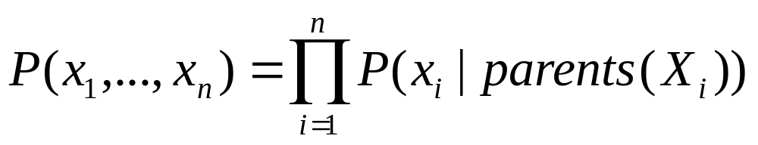
A Representation of the Full Joint Distribution
We will use the following abbrevations:
  P(x₁, …, x_{n}) for P( X₁ = x₁ ∧ … ∧ X_{n} = x_{n})
  parents(X_{i}) for the values of the parents of X_{i}
From the Bayes net, we can calculate:

Slide 15
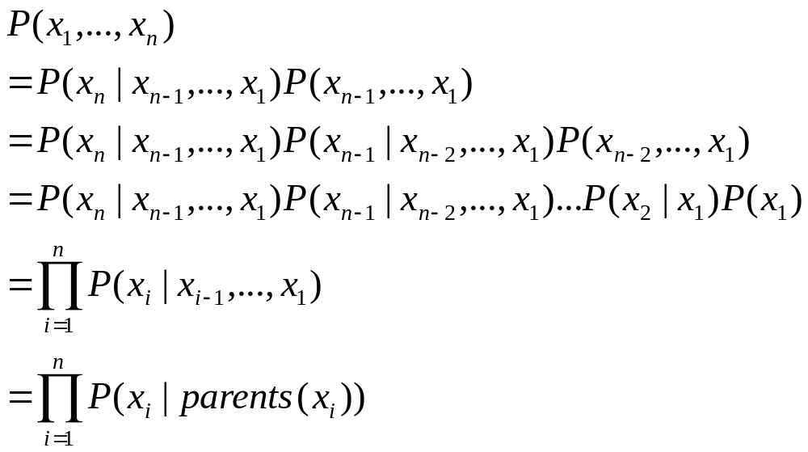
The Full Joint Distribution
( Chain Rule)
( Chain Rule)
( Chain Rule)
We’ll look at this step more closely

Slide 16
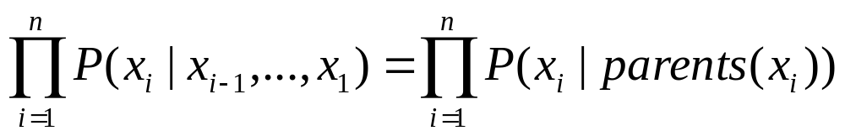
The Full Joint Distribution
To be able to do this, we need two things:
Parents(X_{i}) ⊆ {X_{i-1}, …, X₁}
This is easy – we just label the nodes according to the partial order in the graph
We need X_{i} to be conditionally independent of its predecessors given its parents
This can be done when constructing the network. Choose parents that directly influence X_{i}.

Slide 17
Example
Burglary
Earthquake
Alarm
JohnCalls
MaryCalls
P(JohnCalls, MaryCalls, Alarm, Burglary, Earthquake)
= P(JohnCalls | Alarm) P(MaryCalls | Alarm ) P(Alarm | Burglary, Earthquake ) P( Burglary ) P( Earthquake )

Slide 18
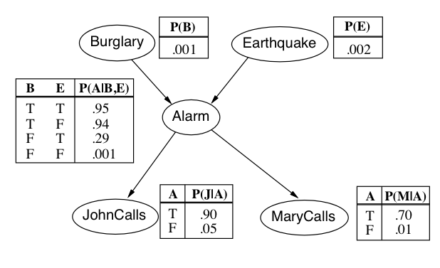
Example
What is the probability that there is a burglary given that John calls?
(0.0162)
Machine Learning Dr. S. Nadeem Ahsan, IU

Slide 19
Conditional Independence
Machine Learning Dr. S. Nadeem Ahsan, IU

Slide 20
Conditional Independence
To do inference in a Belief Network we have to know if two sets of variables are conditionally independent given a set of evidence.
Method to do this is called Direction-Dependent Separation or d-Separation.
d-Separation determines whether a set of nodes X is independent of another set Y given a third set E

Slide 21
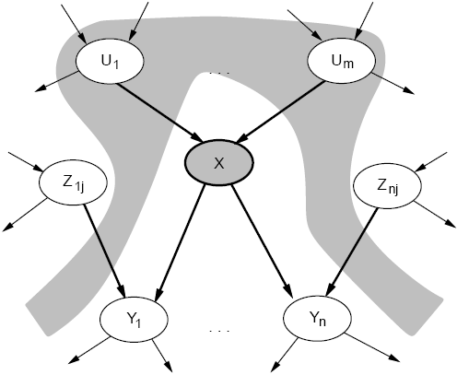
Conditional Independence
We can look at the actual graph structure and determine conditional independence relationships.
A node (X) is conditionally independent of its non-descendants (Z_{1j}, Z_{nj}), given its parents (U₁, U_{m}).

Slide 22
A1, A2, ..... non-descendants of C
B1 B2 ... parents of C
C
D1, D2, ... descendants of C
C is independent of C's non-descendants given C's parents
p( C | A1, ..., B1, ..., D1, ...) = p( C | B1, ..., D1, ...)

Slide 23
d-Separation
If every undirected path from a node in X to a node in Y is d-separated by E, then X and Y are conditionally independent given E. We will use the notation I(X, Y | E) to mean that X and Y are conditionally independent given E
Theorem [Verma and Pearl 1988]: If a set of evidence variables E d-separates X and Y in the Bayesian Network’s graph, then I(X, Y | E)
A set of nodes, E, d-separates two sets of nodes, X and Y, if every undirected path from a node in X to a node in Y is Blocked given E. A path is blocked given a set of nodes, E if:
  Z is in E and Z has one arrow leading in and one leading out.
  Z is in E and has both arrows leading out.
  Neither Z nor any descendant of Z is in E and both path arrows lead in to Z.

Slide 24
How to determine d-Separation
To determine if I(X, Y | E), ignore the directions of the arrows, find all paths between X and Y
Now pay attention to the arrows. Determine if the paths are blocked according to the 3 cases
If all the paths are blocked, X and Y are d-separated given E
Which means they are conditionally independent given E

Slide 25
Blocking
X
Y
E
Z
Z
Z

Slide 26
d-Separation - Example
Battery
Moves and Battery are independent given it is known about Ignition
Moves and Radio are independent if it is known that Battery works
Petrol and Radio are independent given no evidence. But are dependent given evidence of Starts
Radio
Ignition
Petrol
Starts
Moves

Slide 27
Case 1
What does it mean for a path to be blocked? There are 3 cases.
Case 1: There exists a node N on the path such that
  It is in the evidence set E (shaded grey)
  The arcs putting N in the path are “tail-to-tail”.
X
N
Y
X = “Owns expensive car”
N = “Rich”
Y = “Owns expensive home”
The path between X and Y is blocked by N

Slide 28
Case 2
There exists a node N on the path such that
It is in the evidence set E
The arcs putting N in the path are “tail-to-head”.
X
N
Y
X=Education N=Job Y=Rich
The path between X and Y is blocked by N

Slide 29
Case 3
There exists a node N on the path such that
It is NOT in the evidence set E (not shaded)
Neither are any of its descendants
The arcs putting N in the path are “head-to-head”.
X
N
Y
The path between X and Y is blocked by N (Note N is not in the evidence set)

Slide 30
Case 3 (Explaining Away)
Burglary
Earthquake
Alarm
Your house has a twitchy burglar alarm that is also sometimes triggered by earthquakes
Earth obviously doesn’t care if your house is currently being broken into
While you are on vacation, one of your nice neighbors calls and lets you know your alarm went off

Slide 31
Case 3 (Explaining Away)
Burglary
Earthquake
Alarm
But if you knew that a medium-sized earthquake happened, then you’re probably relieved that it’s probably not a burglar
The earthquake “explains away” the hypothetical burglar
This means that Burglary and Earthquake are not independent given Alarm.
But Burglary and Earthquake are independent given no evidence ie. learning about an earthquake when you know nothing about the status of your alarm doesn’t give you any information about the burglary

Slide 32
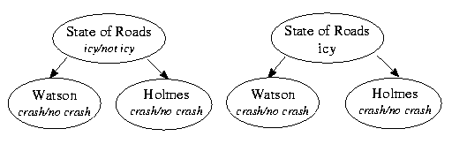

Holmes and Watson: “Icy roads” Example
E

Slide 33
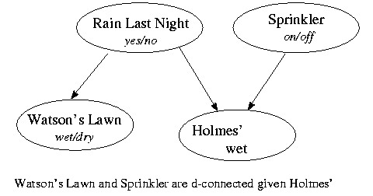
Holmes and Watson: “Wet grass” Example
grass
E
grass

Slide 34
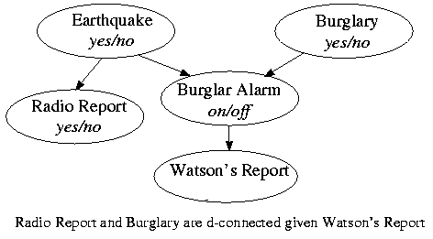
Holmes and Watson: “Burglar alarm” Example
yes
E

Slide 35

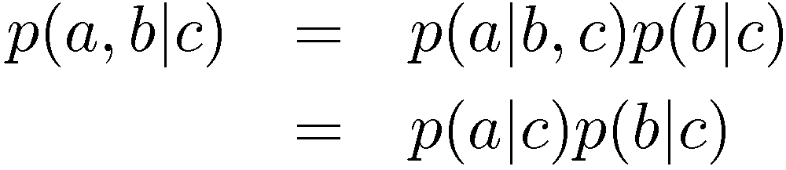

Conditional Independence
a is independent of b given c
Equivalently
Notation

Slide 36
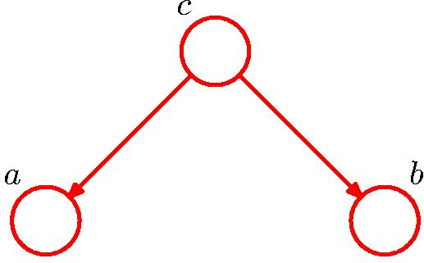
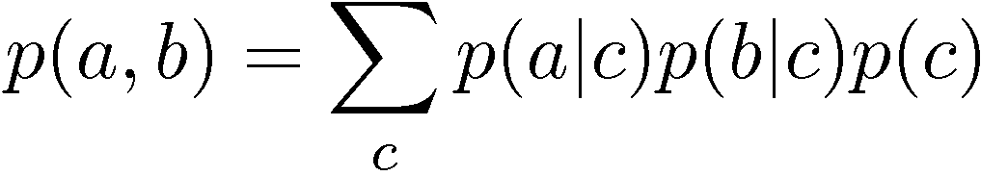

Conditional Independence: Example 1

Slide 37
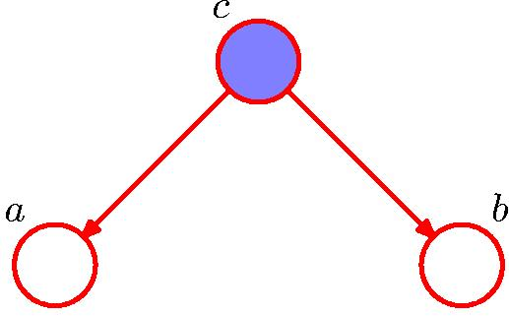
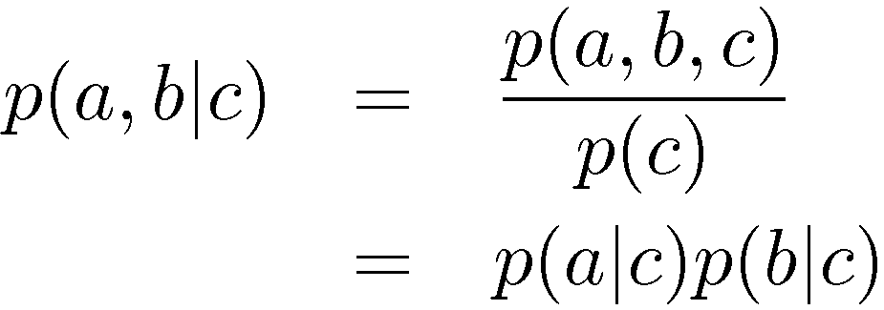
Conditional Independence: Example 1

Slide 38
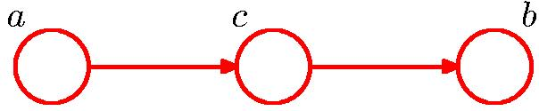
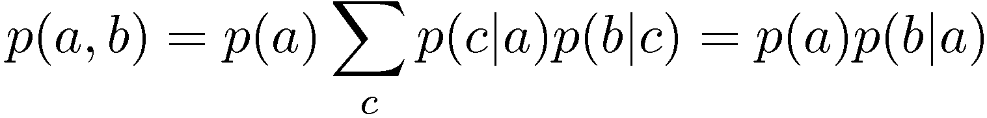
Conditional Independence: Example 2

Slide 39
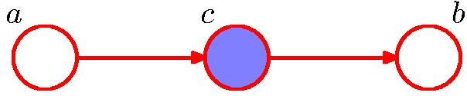
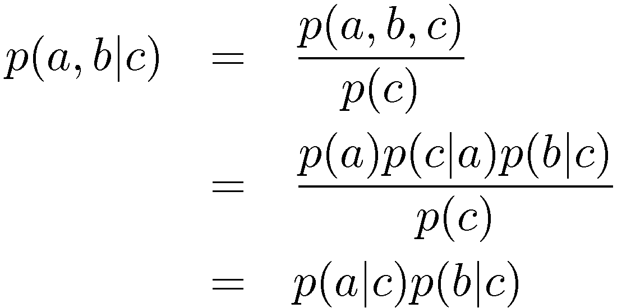
Conditional Independence: Example 2

Slide 40
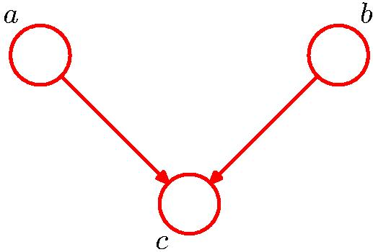


Conditional Independence: Example 3
Note: this is the opposite of Example 1, with c unobserved.

Slide 41
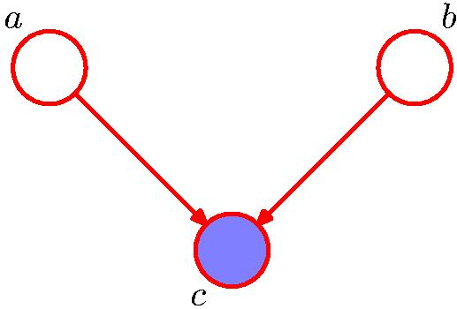
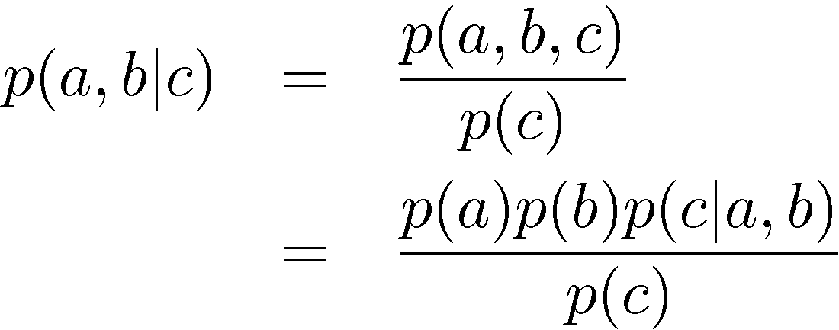

Conditional Independence: Example 3
Note: this is the opposite of Example 1, with c observed.

Slide 42
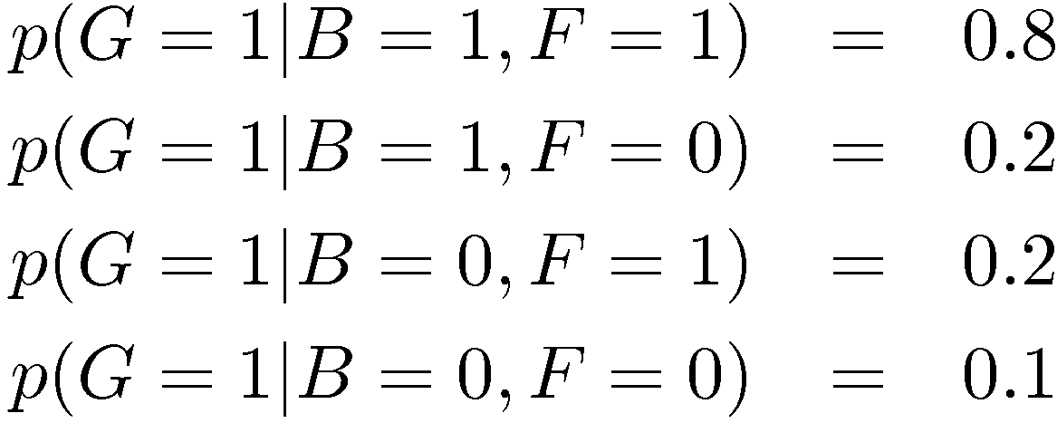
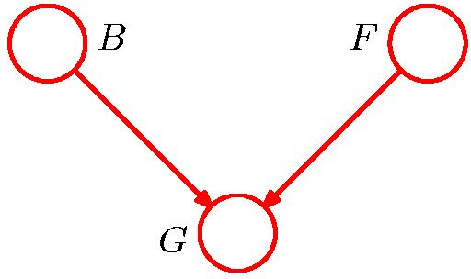
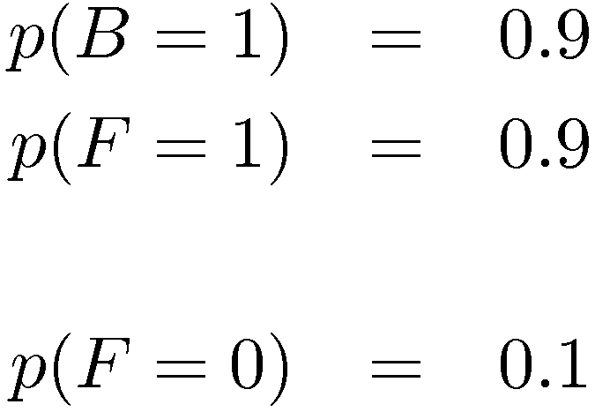
“Am I out of fuel?”
B = Battery (0=flat, 1=fully charged)
F = Fuel Tank (0=empty, 1=full)
G = Fuel Gauge Reading
(0=empty, 1=full)
and hence

Slide 43
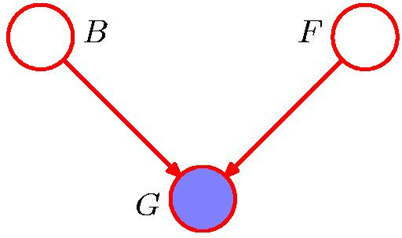
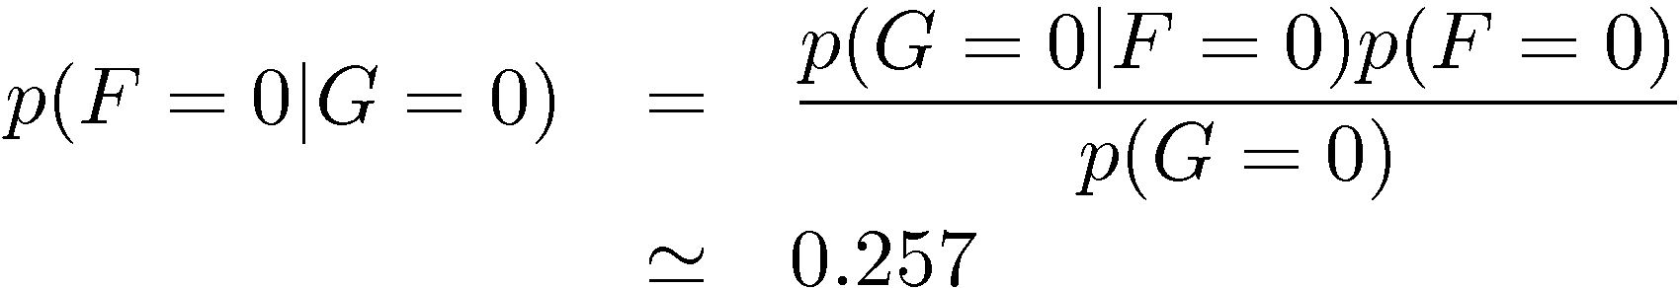
“Am I out of fuel?”
Probability of an empty tank increased by observing G = 0.

Slide 44
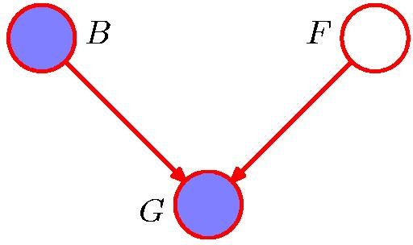
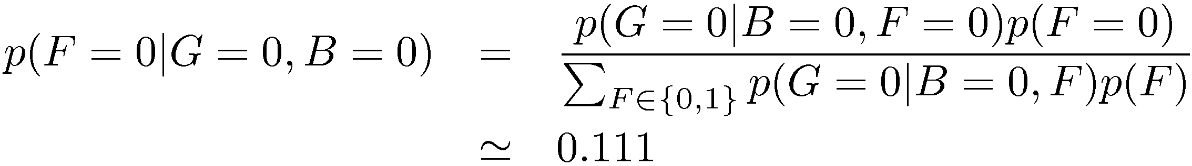
“Am I out of fuel?”
Probability of an empty tank reduced by observing B = 0.
This referred to as “explaining away”.

Slide 45
Markov Models
Machine Learning Dr. S. Nadeem Ahsan, IU

Slide 46
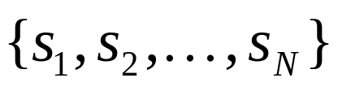
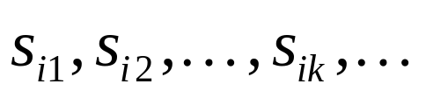
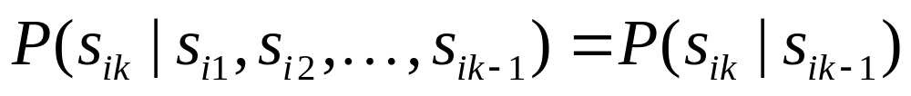
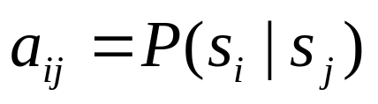
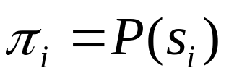
Introduction to Markov Models
Set of states:
Process moves from one state to another generating a sequence of states :
Markov chain property: probability of each subsequent state depends only on what was the previous state:
To define Markov model, the following probabilities have to be specified: transition probabilities and initial probabilities

Slide 47
Example of Markov Model
0.3
0.7
Rain
Dry
0.2
0.8
Two states : ‘Rain’ and ‘Dry’.
Transition probabilities: P(‘Rain’|‘Rain’)=0.3 , P(‘Dry’|‘Rain’)=0.7 , P(‘Rain’|‘Dry’)=0.2, P(‘Dry’|‘Dry’)=0.8
Initial probabilities: say P(‘Rain’)=0.4 , P(‘Dry’)=0.6 .

Slide 48
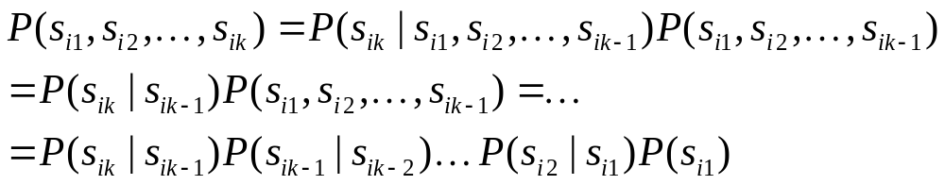
Calculation of sequence probability
By Markov chain property, probability of state sequence can be found by the formula:
Suppose we want to calculate a probability of a sequence of states in our example, {‘Dry’,’Dry’,’Rain’,Rain’}.
P({‘Dry’,’Dry’,’Rain’,Rain’} ) =
P(‘Rain’|’Rain’) P(‘Rain’|’Dry’) P(‘Dry’|’Dry’) P(‘Dry’)=
= 0.3*0.2*0.8*0.6

Slide 49
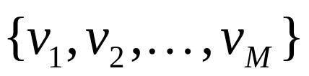
Hidden Markov models.
Set of states:
Process moves from one state to another generating a sequence of states :
Markov chain property: probability of each subsequent state depends only on what was the previous state:
States are not visible, but each state randomly generates one of M observations (or visible states)
To define hidden Markov model, the following probabilities have to be specified:
  matrix of transition probabilities A=(a_{ij}), a_{ij}= P(s_{i} | s_{j})
  matrix of observation probabilities B=(b_{i} (v_{m} )), b_{i}(v_{m} ) = P(v_{m} | s_{i})
  initial probabilities π=(π_{i}), π_{i} = P(s_{i}) . Model is represented by M=(A, B, π).

Slide 50
Example of Hidden Markov Model
0.3
0.7
Low
High
0.2
0.8
0.6
0.6
0.4
0.4
Rain
Dry
Two states : ‘Low’ and ‘High’ atmospheric pressure.

Slide 51
Example of Hidden Markov Model
Two states : ‘Low’ and ‘High’ atmospheric pressure.
Two observations : ‘Rain’ and ‘Dry’.
Transition probabilities: P(‘Low’|‘Low’)=0.3 , P(‘High’|‘Low’)=0.7 , P(‘Low’|‘High’)=0.2, P(‘High’|‘High’)=0.8
Observation probabilities : P(‘Rain’|‘Low’)=0.6 , P(‘Dry’|‘Low’)=0.4 , P(‘Rain’|‘High’)=0.4 , P(‘Dry’|‘High’)=0.3 .
Initial probabilities: say P(‘Low’)=0.4 , P(‘High’)=0.6 .

Slide 52
Calculation of observation sequence probability
Suppose we want to calculate a probability of a sequence of observations in our example, {‘Dry’,’Rain’}.
Consider all possible hidden state sequences:
P({‘Dry’,’Rain’} ) = P({‘Dry’,’Rain’} , {‘Low’,’Low’}) + P({‘Dry’,’Rain’} , {‘Low’,’High’}) + P({‘Dry’,’Rain’} , {‘High’,’Low’}) + P({‘Dry’,’Rain’} , {‘High’,’High’})
where first term is :
P({‘Dry’,’Rain’} , {‘Low’,’Low’})=
P({‘Dry’,’Rain’} | {‘Low’,’Low’}) P({‘Low’,’Low’}) =
P(‘Dry’|’Low’)P(‘Rain’|’Low’) P(‘Low’)P(‘Low’|’Low)
= 0.4*0.6*0.4*0.3

Slide 53
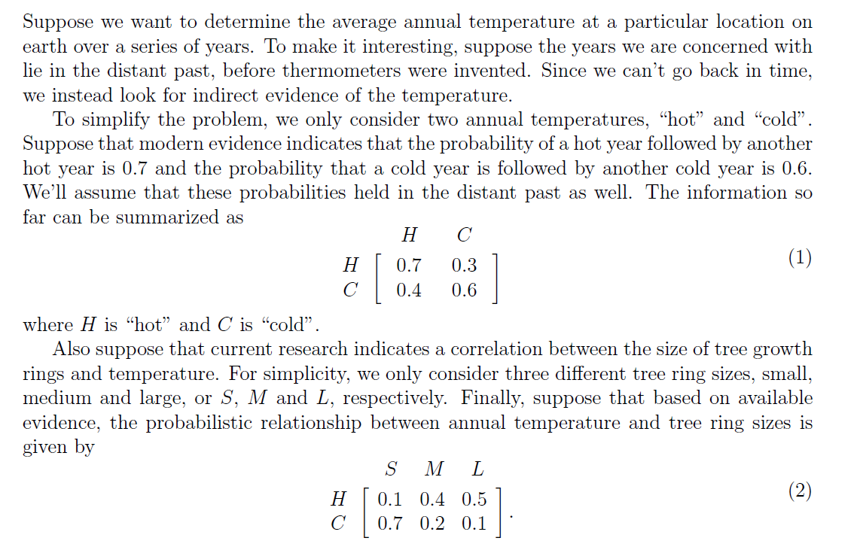
Hidden Markov Model
Machine Learning Dr. S. Nadeem Ahsan, IU

Slide 54
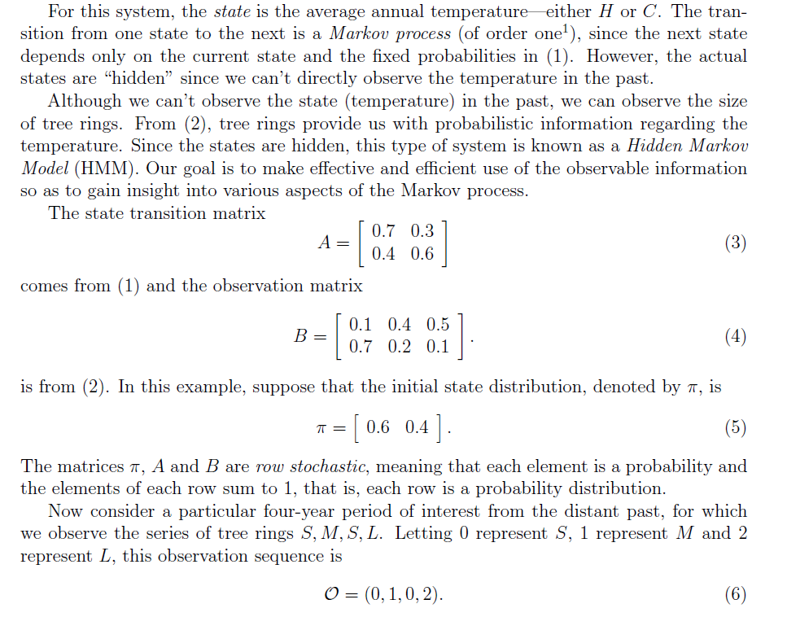
Hidden Markov Model
Machine Learning Dr. S. Nadeem Ahsan, IU

Slide 55
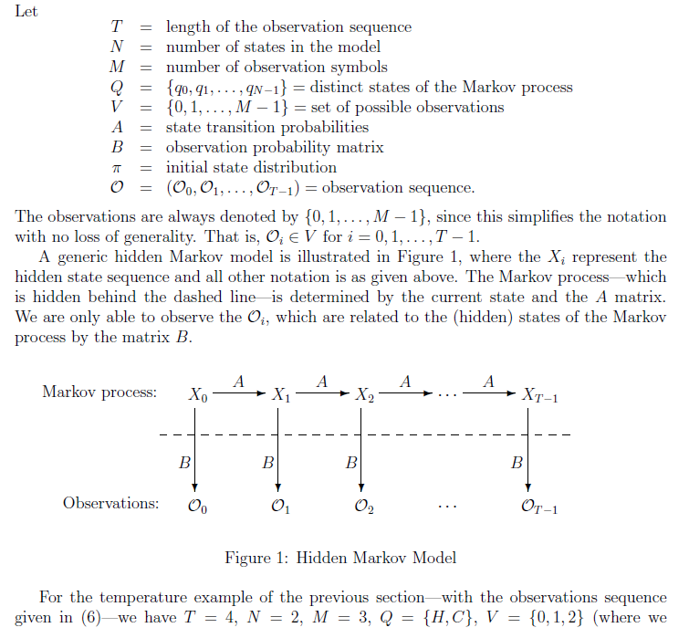
Hidden Markov Model
Machine Learning Dr. S. Nadeem Ahsan, IU

Slide 56
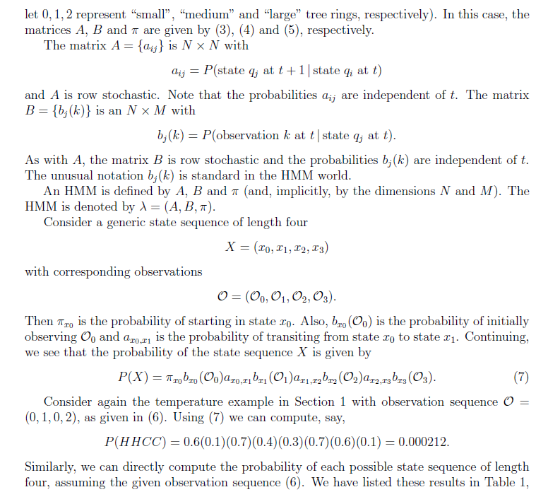
Machine Learning Dr. S. Nadeem Ahsan, IU

Slide 57
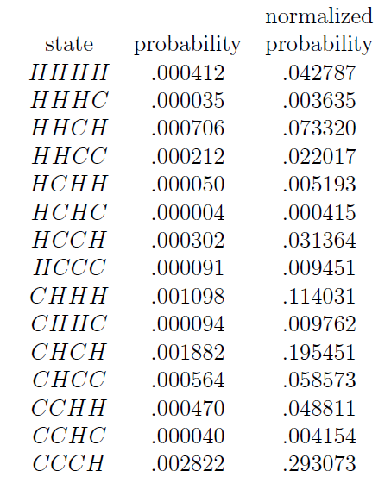
Table - 1
(state sequence probabilities of example Hot and Cold weather)
Machine Learning Dr. S. Nadeem Ahsan, IU

Slide 58
Lab Project Session
(Weka)

