Slide 1
Group 1 TaskRabbit
https://taskrabbit.streamlit.app/
https://youtu.be/7gM1E_j5XUI
Gao, Ge
Gupta, Krishan
Huang, Yanhuan
Lu,Yu
Sohail, Syed Ammad

Slide 2
TaskRabbit Business Overview
Platform Purpose:
Connects individuals & businesses with local freelancers.
Who are they?
Skilled professionals called "Taskers."
Diverse Service Range:
From home repairs & cleaning to admin tasks & event planning.
Sharing Economy Champion:
Harnesses the potential of community-based resource sharing.
Primary Benefit:
Outsourcing tasks for convenience, efficiency, and expertise.

Slide 3
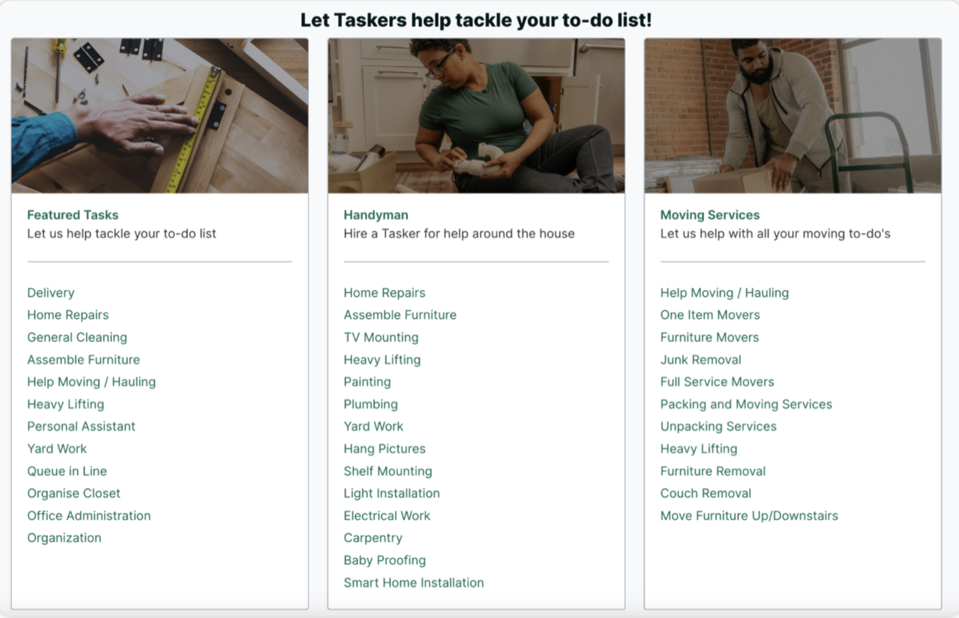
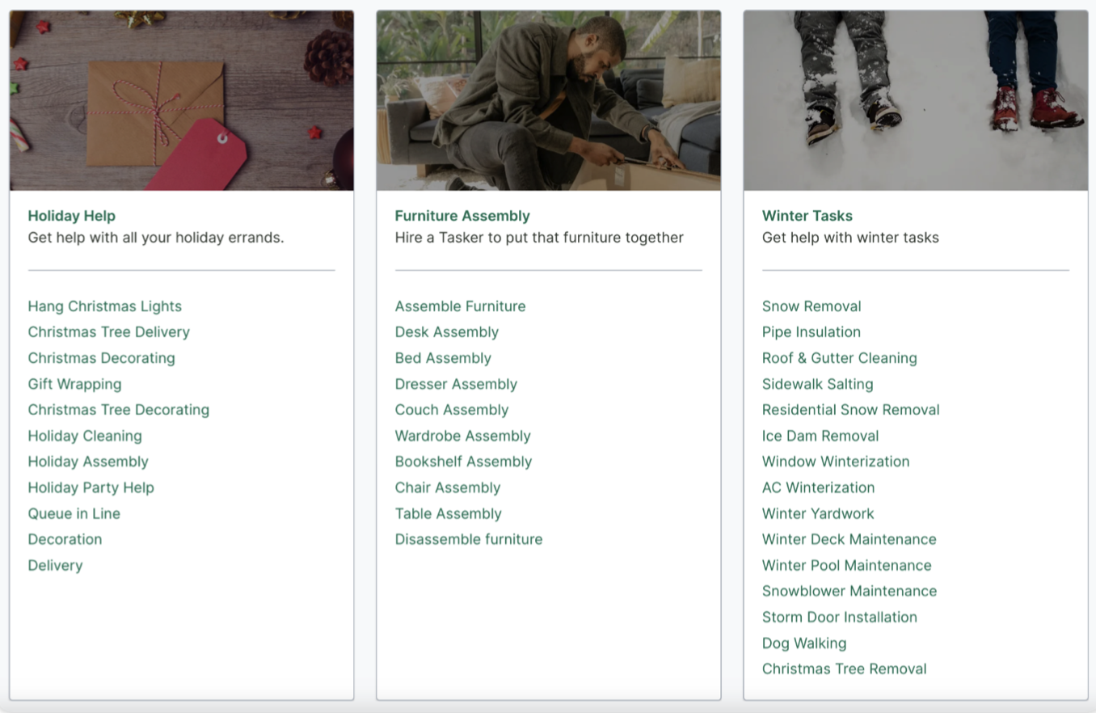
TaskRabbit Business Overview

Slide 4
TaskRabbit Business Overview
Platform Purpose:
Connects individuals & businesses with local freelancers.
Who are they?
Skilled professionals called "Taskers."
Diverse Service Range:
From home repairs & cleaning to admin tasks & event planning.
Sharing Economy Champion:
Harnesses the potential of community-based resource sharing.
Primary Benefit:
Outsourcing tasks for convenience, efficiency, and expertise.

Slide 5
Mission Statement
The purpose of the Taskers database system is to maintain the data that is used and generated to support Taskers profile displays for our clients and leads, and to facilitate user-centric experience and explore potential markets.

Slide 6

Mission Objectives
To maintain (enter, update, and delete) data on taskers.
To maintain (enter, update, and delete) data on tasks categories.
To maintain (enter, update, and delete) data on skills.
To maintain (enter, update, and delete) data on certifications.
To maintain (enter, update, and delete) data on vehicles.
To maintain (enter, update, and delete) data on tasks accomplished.
To maintain (enter, update, and delete) data on reviews.
To maintain (enter, update, and delete) data on customers.
To maintain (enter, update, and delete) data on address.
To maintain (enter, update, and delete) data on orders.
To maintain (enter, update, and delete) data on order details.
To maintain (enter, update, and delete) data on payments.

Slide 7

Mission Objectives
To perform searches on taskers.
To perform searches on task categories.
To perform searches on skills.
To perform searches on certifications.
To perform searches on vehicles.
To perform searches on tasks accomplished.
To perform searches on reviews.
To perform searches on customers.
To perform searches on address.
To perform searches on orders.
To perform searches on order details.
To perform searches on payments.
To track the status of orders.
To track the status of order details.
To track the status of payments.
To track the status of tasks accomplished.

Slide 8

Mission Objectives
To track the status of orders.
To track the status of order details.
To track the status of payments.
To track the status of tasks accomplished.
To report on taskers.
To report on task categories.
To report on skills.
To report on certifications.
To report on vehicles.
To report on tasks accomplished.
To report on reviews.
To report on customers.
To report on orders.
To report on address.
To report on order details.
To report on payments.

Slide 9
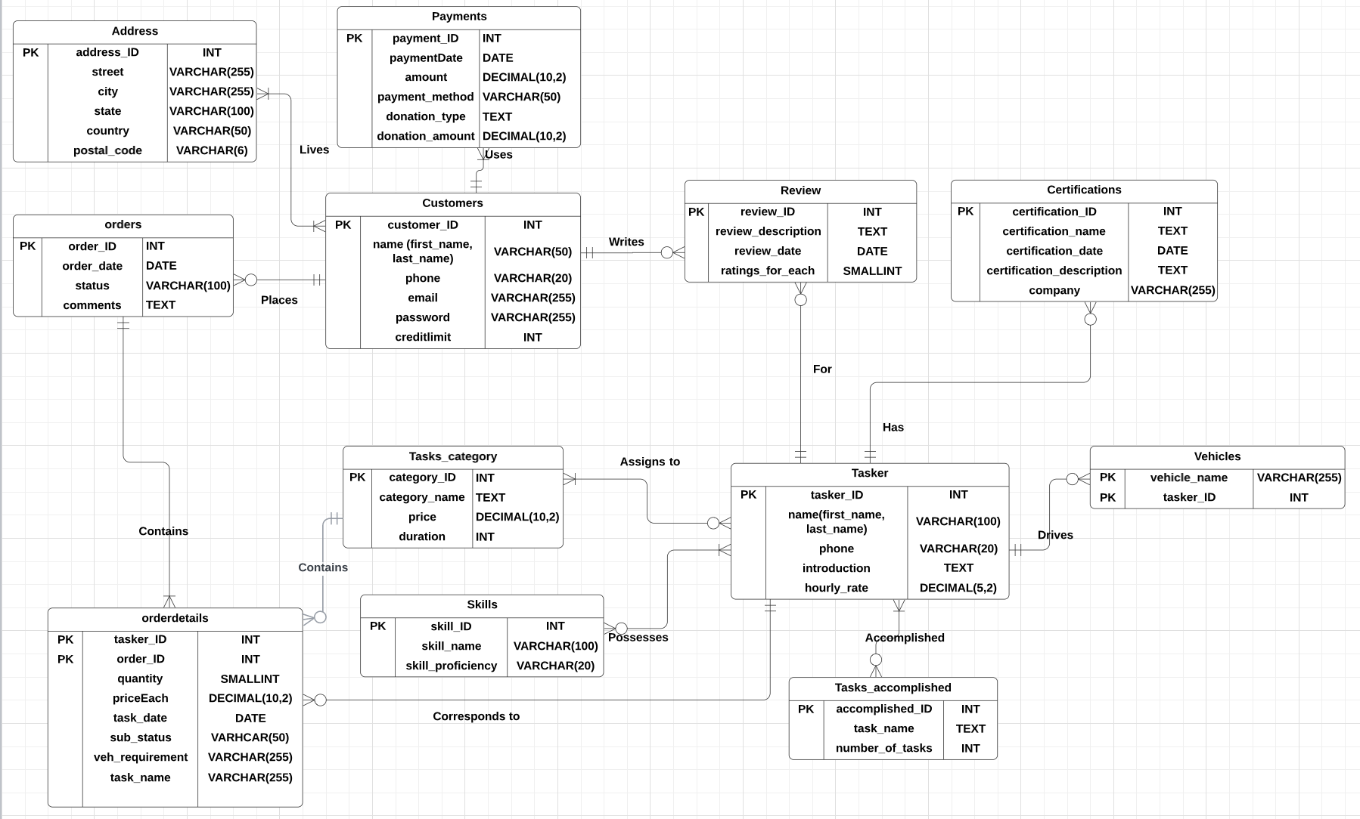
ERD

Slide 10
Relational Schema
-> Tasks_category (category_id, category_name, Price, Duration)
Primary Key: category_id
-> Skill (skill_ID, skill_name, skill_proficiency)
Primary Key: skill_ID
-> Tasks_accomplished (accomplished_ID, task_name, number_of _tasks)
Primary Key: accomplished_ID
-> Certification (certification_ID, certification_name, certification_date, certification_description, company)
Primary Key: certification_id
-> Address (address_ID, street, city, state, country, postal_code)
Primary Key: address_ID
-> Customers (customer_id, first_name, last_name, email, phone, password, creditlimit)
-> Payments (payment_id, paymentDate, amount, customer_id, payment_method, donation_type, donation_amt)
Primary Key: payment_id
Foreign Key: customer_id references Customers (customer_ID)

Slide 11
Relational Schema
-> Customer_address (customer_ID, address_ID)
Primary Key: customer_ID, address_ID
Foreign Key: customer_ID references Customers (customer_ID)
Foreign Key: address_ID references Address (address_ID)
-> Orders (order_id, order_date, status, comments, customer_id)
Primary Key: order_id
Foreign Key: customer_id references Customers (customer_ID)
-> Tasker (tasker_id, name, phone, self_introduction, hourly_rate, Skill_ID, certification_ID)
Primary Key: tasker_id
Foreign Key: Skill_ID references Skill (Skill_ID)
Foreign Key: Certification_ID references Certification (certification_ID)
-> Vehicles (tasker_id, vehicle_name)
Composite Primary Key: (tasker_id, vehicles_name)
Foreign Key: tasker_id references Tasker(tasker_id)
-> Review (review_id, customer_id, tasker_id, review_description, review_date, ratings_for_each)
Primary Key: review_id
Foreign Key: customer_id references Customers (customer_ID), tasker_id references Tasker(tasker_ID)

Slide 12
Relational Schema
-> Order_details (tasker_id, quantity, price_each, date_of_task, size, veh_requirement, task_name, order_id, Category_id)
Composite Primary Key: (tasker_id, order_id)
Foreign Key: tasker_id references Tasker (tasker_ID)
Foreign Key: order_id references Orders (order_ID)
Foreign Key: Category_id references Task_category (category_ID)
-> Tasker_category (tasker_ID, category_ID)
Composite Primary Key: (tasker_ID, category_ID)
Foreign Key: tasker_ID references Tasker (tasker_ID)
Foreign Key: category_ID references Tasks_category (category_ID)
-> Tasker_skill( tasker_ID, skill_ID)
Composite Primary Key: (tasker_ID, skill_ID)
Foreign Key: tasker_ID references Tasker (tasker_ID)
Foreign Key: skill_ID references Skill (skill_ID)
-> Tasker_accomplishments (tasker_ID, accomplished_ID)
Composite Primary Key: (tasker_ID, accomplished_ID)
Foreign Key: tasker_ID references Tasker (tasker_ID)
Foreign Key: accomplished_ID references Tasks_accomplished (accomplished_ID)

Slide 13
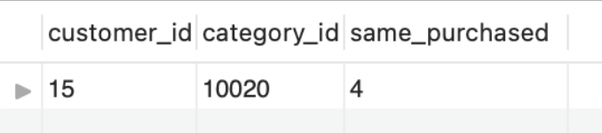
Most Challenging Queries
# Query 20: find the most similar user for customer 1 according to task category
(In other words, for customer 1, we need to find which customer has the most matched task catgories.)
Explain the purpose and how does the query work.
WITH CT AS ( SELECT Customers.customer_id, Tasks_category.category_id, OD.quantity FROM Customers INNER JOIN Orders ON Customers.customer_id = Orders.customer_id INNER JOIN Order_details OD ON OD.order_id = Orders.order_id INNER JOIN Tasks_category ON Tasks_category.category_id = OD.category_id )
CROSS JOIN (​ SELECT DISTINCT​ customer_id,​ category_id,​ quantity​ FROM​ CT​ WHERE​ customer_id != 1​ ) t2​ WHERE​ t1.category_id = t2.category_id​ GROUP BY​ t2.customer_id, t2.category_id​ ORDER BY​ same_purchased DESC;
SELECT TOP 1 t2.customer_id, t2.category_id, SUM(t2.quantity) AS same_purchased FROM ( SELECT DISTINCT customer_id, category_id FROM CT WHERE customer_id = 1 ) t1

Slide 14
Most Challenging Queries
# Query 20: find the most similar user for customer 1 according to task category
Query Purpose:
The provided SQL query aims to identify the customer who is the most similar to Customer 1 in terms of the task categories they have engaged with. In essence, if Customer 1 has ordered tasks from certain categories, which other customer has the maximum overlap or similarity in ordering from the same categories
Business Implications:
1. Understanding which customers have similar preferences or behavior can be vital for many reasons:
2. Recommendation Systems: If a new task category is introduced and Customer 1 shows interest, the business can also recommend this to the identified similar customer.
3. Personalized Marketing: Tailoring marketing campaigns based on grouped customer behaviors can be more effective.
4. Insights into Customer Behavior: By understanding clusters or groups of similar customers, the business can gain insights into common needs, desires, or problems faced by these groups.

Slide 15
Most Challenging Queries
# Query 20: find the most similar user for customer 1 according to task category
How Does the Query Work?
CT Common Table Expression (CTE):
The CTE named CT is defined to collate all the necessary information from the Customers, Orders, Order_details, and Tasks_category tables. This table would essentially give us a list of customers, the categories of tasks they have ordered, and the quantity they've ordered.
Isolating Customer 1's Preferences:
The first sub-query (SELECT distinct customer_id, category_id FROM CT WHERE customer_id = 1) t1 extracts distinct task categories that Customer 1 has engaged with.
Isolating Other Customers' Preferences:
The second sub-query (SELECT distinct customer_id, category_id, quantity FROM CT WHERE customer_id != 1) t2 extracts distinct task categories for all customers other than Customer 1.
Finding Matches:
The main body of the query then matches the task categories of Customer 1 (from t1) with those of other customers (from t2).
Summation and Ordering:
The matched categories are then summed up (using SUM(t2.quantity)) to derive a "similarity score". The results are then ordered in descending order of this score.
Picking the Top Match:
Finally, using TOP 1 (LIMIT 1 Equivalent for Azure SQL Database), only the most similar customer (the one with the highest overlap in task categories) is selected and returned by the query.

Slide 16
Challenges
Complex Relationship Mapping
Challenge: Efficiently link "Taskers" to categories, skills, & accomplishments.
Solution: Use composite keys and intermediate tables (Tasker_category, Tasker_skill, Tasker_accomplishments).
Ensuring Data Integrity
Challenge: Preserve integrity when updating or deleting dependent records.
Solution: Apply cascading delete/update constraints.
Hierarchical Data Structure
Challenge: Structure to hold both Customers and Order_details.
Solution: Use primary & foreign key constraints for a cohesive data model.

Slide 17
Lesson learned and Ideas to Extend the Project
Lessons Learned:
Granular Analysis is Essential: To capture all relevant data points and relationships, a deep dive into the business needs was crucial.
Regular Validation: Continual checks against real-world scenarios ensured that the schema remained practical and adaptable.
Modular Approach: Designing tables like Address separately allowed for better flexibility and reduced redundancy.
Ideas to Extend the Project:
Advanced Analytics Layer: Introduce tables to capture analytical insights, such as customer behavior patterns or tasker performance metrics.
Extend User Profiles: Add tables that capture customer preferences or tasker availability schedules.
Feedback Mechanism: Implement a system to capture feedback on completed tasks, enhancing the Review table to offer more detailed insights.

