Slide 1
Gym Management and Fitness Tracking
Abdul Rafay
Amman Haroon
Abdul Samee

Slide 2
Project Introduction
A web-based platform to manage and buy memberships, trainer's programs, and fitness tracking.
Features role-based secure access for members, trainers, and admins.
Ensures a clean and responsive user interface.

Slide 3
Functional Requirements
Members:
Register, login, manage and buy memberships, book programs, track progress.
Trainers:
View client profiles, add and remove workout plans, view booked programs.
Admins:
Manage users, memberships, trainers.

Slide 4
Non-Functional Requirements
Performance: Responds to user actions within 2 seconds.
Availability: Ensures 100% uptime for users.
Security: Complies with data privacy standards for user information.

Slide 5
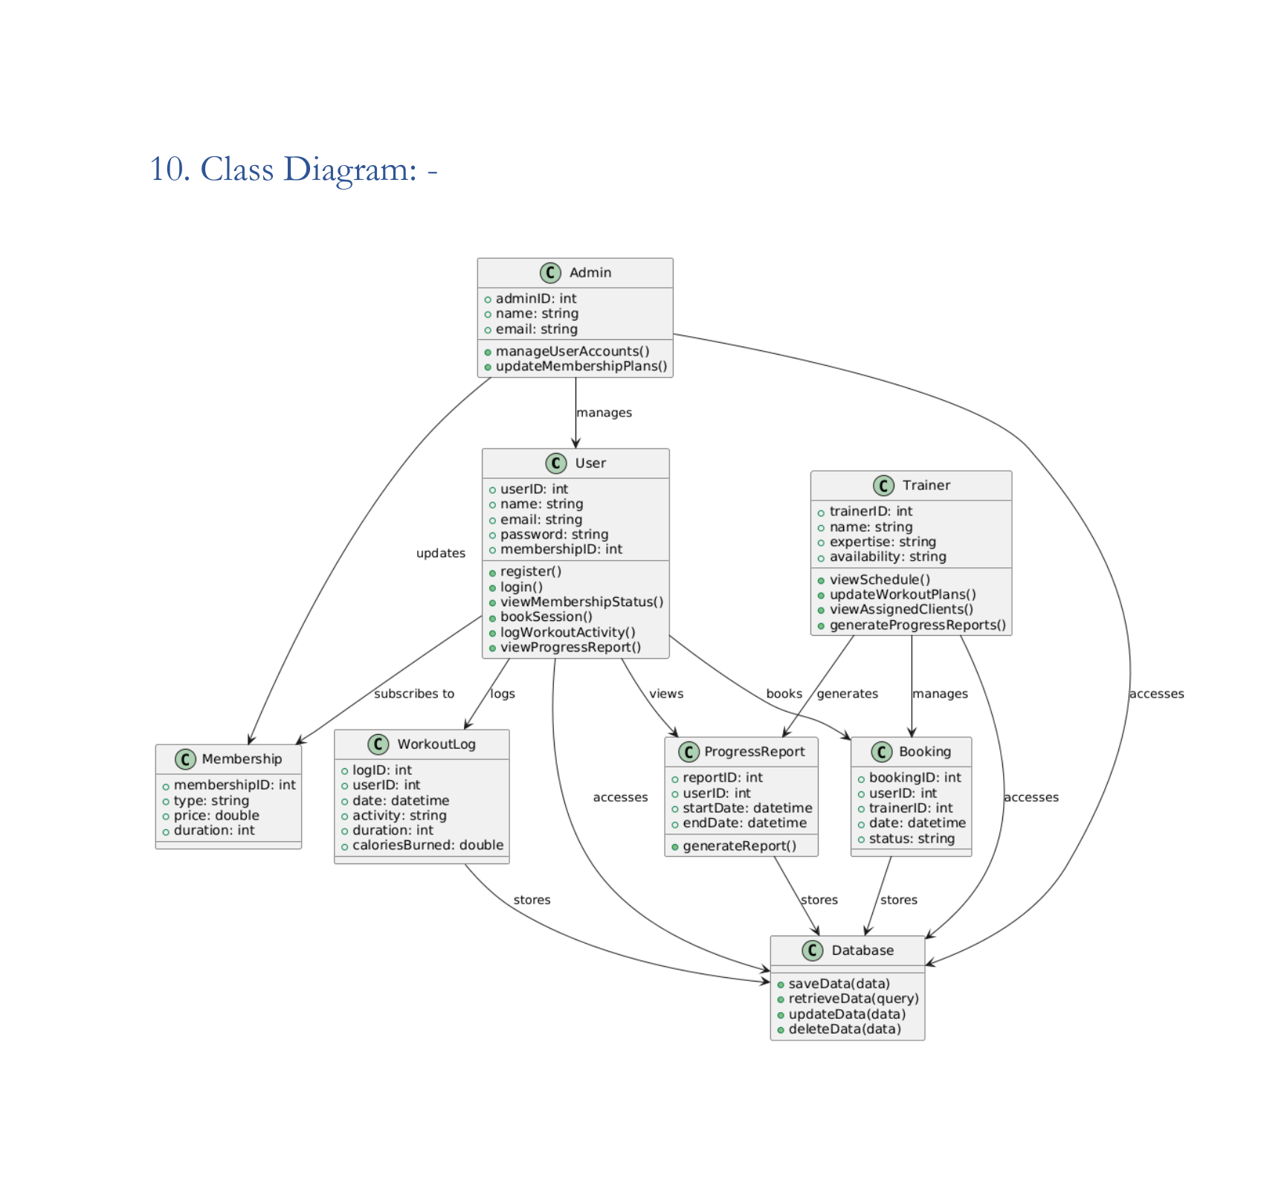
.

Slide 6
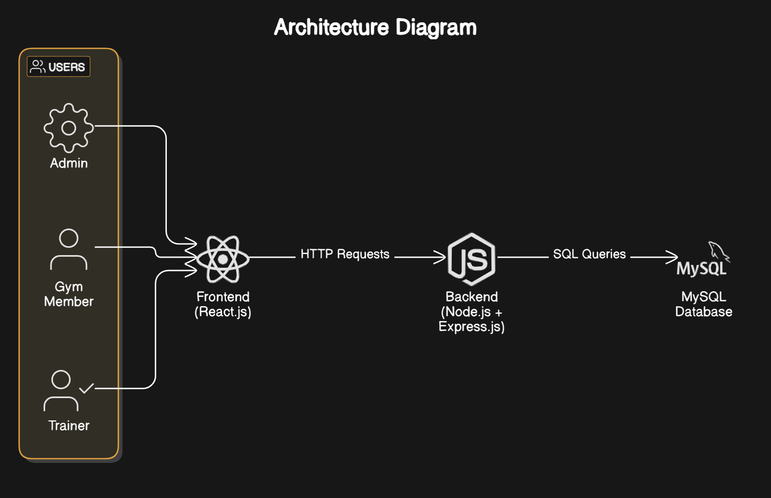
.

Slide 7
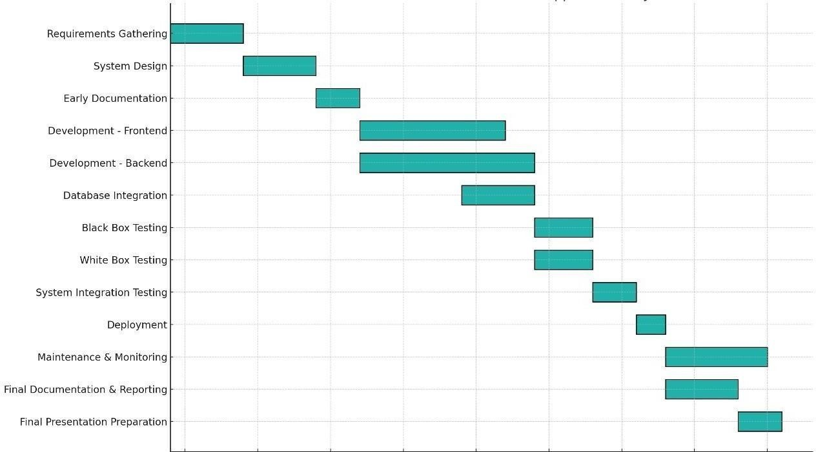
Gantt Chart
.

Slide 8
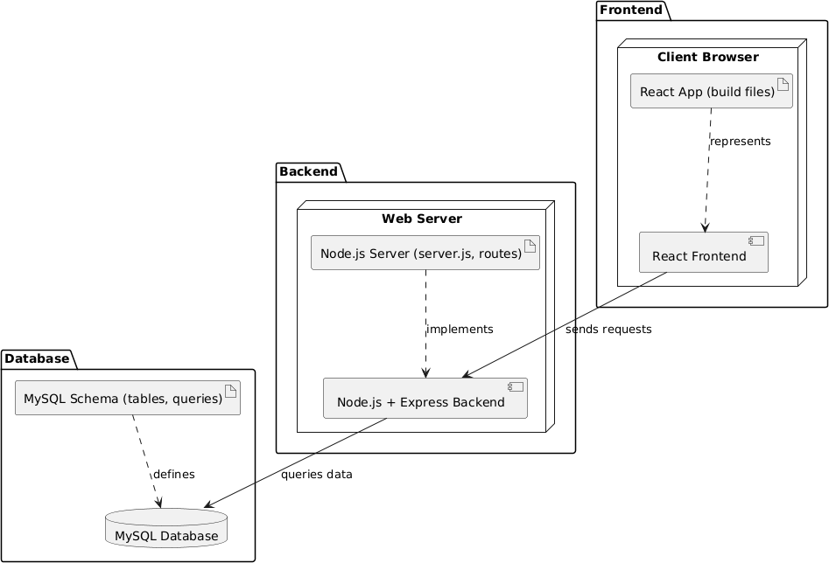
Deployment Diagram
.

Slide 9
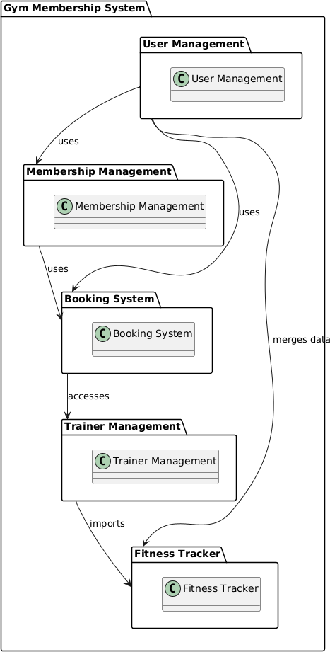
Package Diagram
.

Slide 10
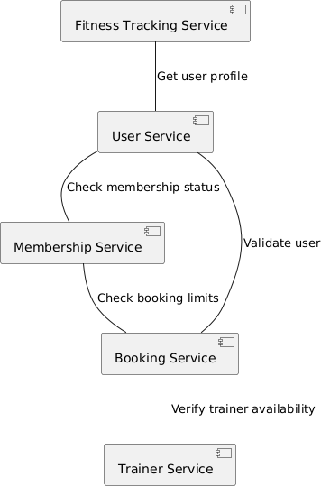
Component Diagram
.

Slide 11
.

Slide 12
Project Planner
Level 1: Project
Gym Membership and Fitness Tracking System
Level 2: Deliverables
Web Application
Database System
Documentation
Level 3: Components
User Management Module
Membership Management Module
Trainer Management Module
Booking System Module
Fitness Tracker Module
Level 4: Activities
Design Frontend Screens
Develop Backend
Integrate Frontend and Backend
Test Module Functionality
Write User Documentation
Level 5: Tasks
Create Login Form Validation
Implement Registration
Connect MySQL Database to Backend
Build Trainer Profile Page
Implement Session Booking Logic
Setup Fitness Logging UI
Test Membership Renewal Logic
.

Slide 13
User Stories
As a user, I want to securely pay for my gym membership online using my preferred payment method so that I can activate or renew my membership without visiting the gym physically.
As a user, I want to log my current weight, body fat percentage, and daily water intake so that I can monitor my fitness progress over time using visual graphs.
As a user, I want to book a workout program with my trainer so I can work on my fitness goal.
As a trainer, I want my profile to include my expertise and availability so users can choose me based on their needs.
.

Slide 14

Work Division
Abdul Rafay
Abdul Samee
Backend Development (Node.js, MySQL), Project Management, Frontend Develpoment(React.js)
Frontend Development (React.js), Documentation, Testing
Amman Haroon
Backend Development (Node.js, MySQL), Frontend Develpoment(React.js), Integration

Slide 15
Lesson Learned
Early prototyping and consistent communication were key to progress.
Gained hands-on experience with React, Node.js, and MySQL integration.
Improved collaboration using Trello for task management and GitHub for version control.

Slide 16
Implementation

Slide 17
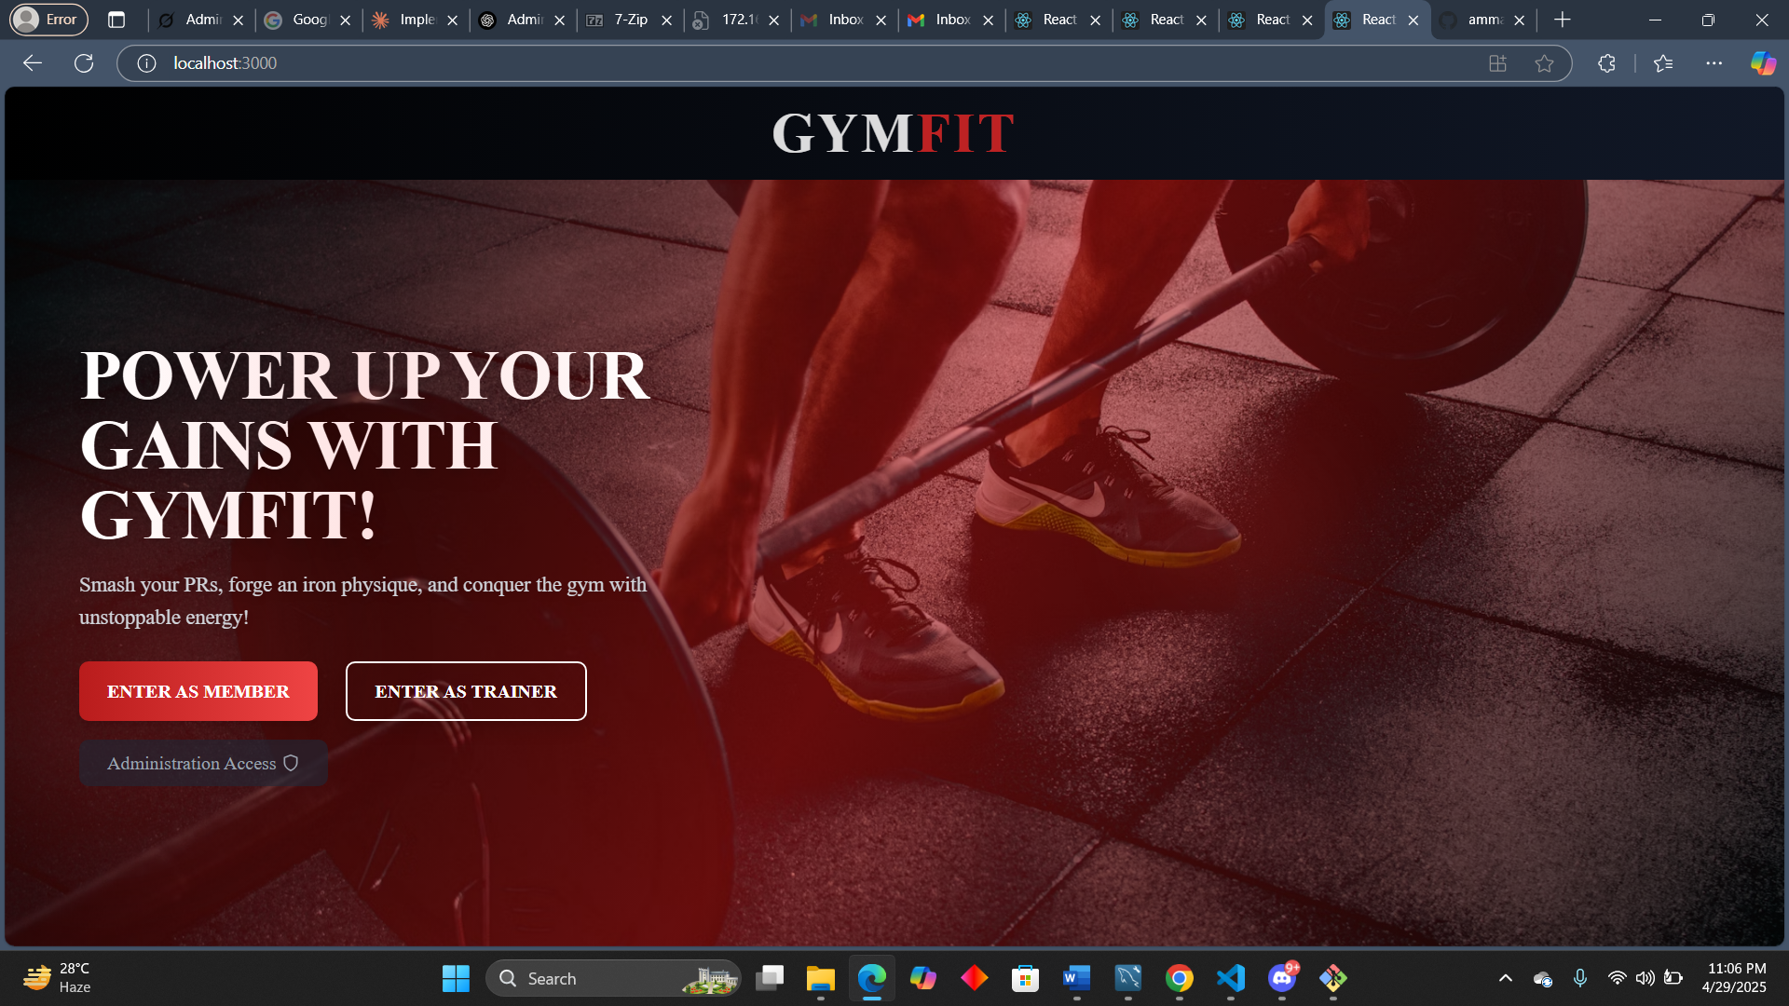

Slide 18
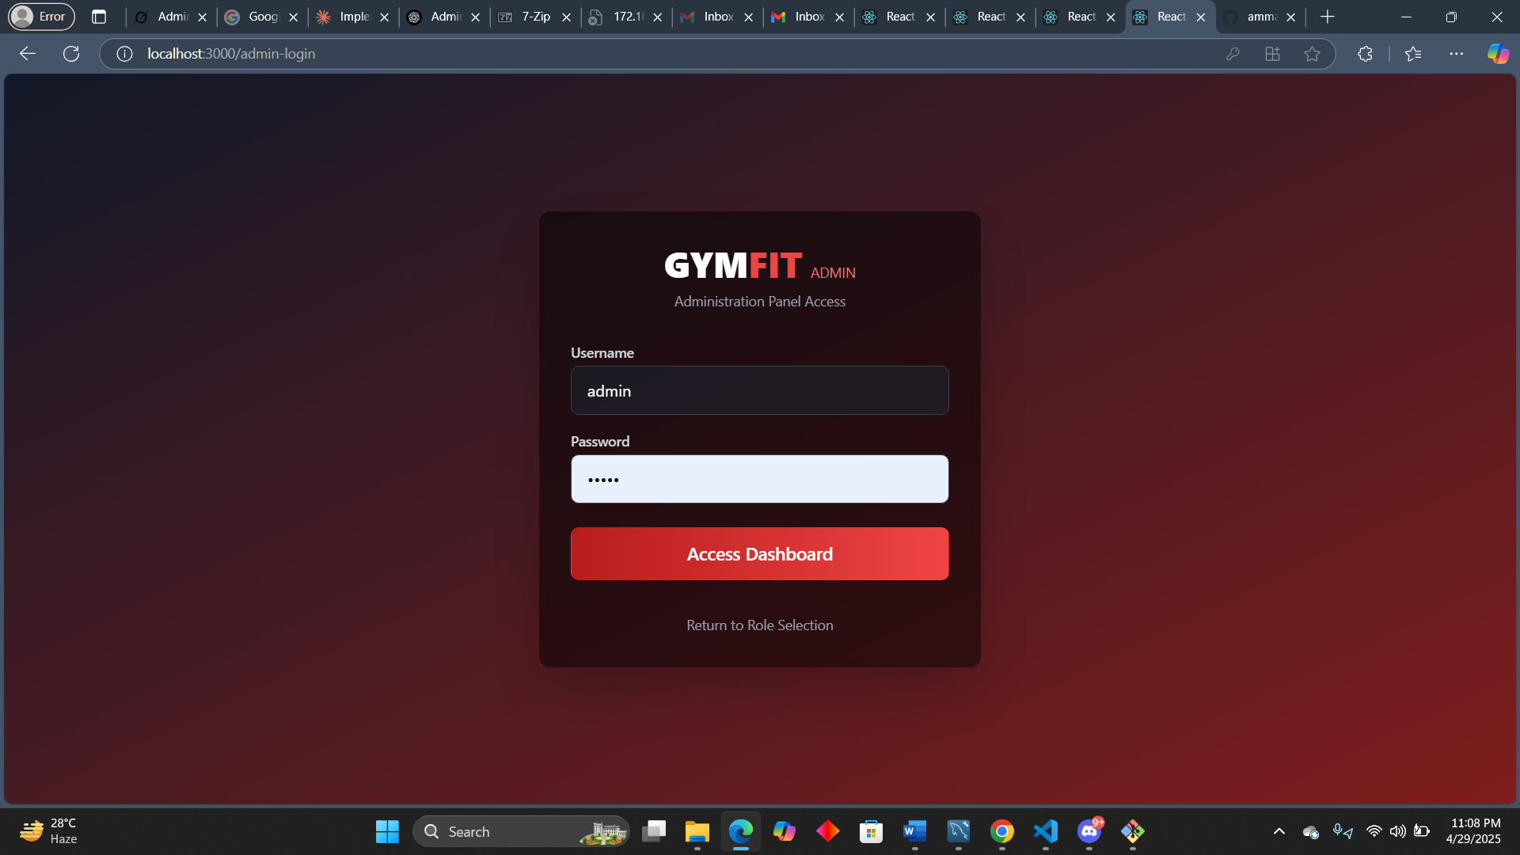

Slide 19
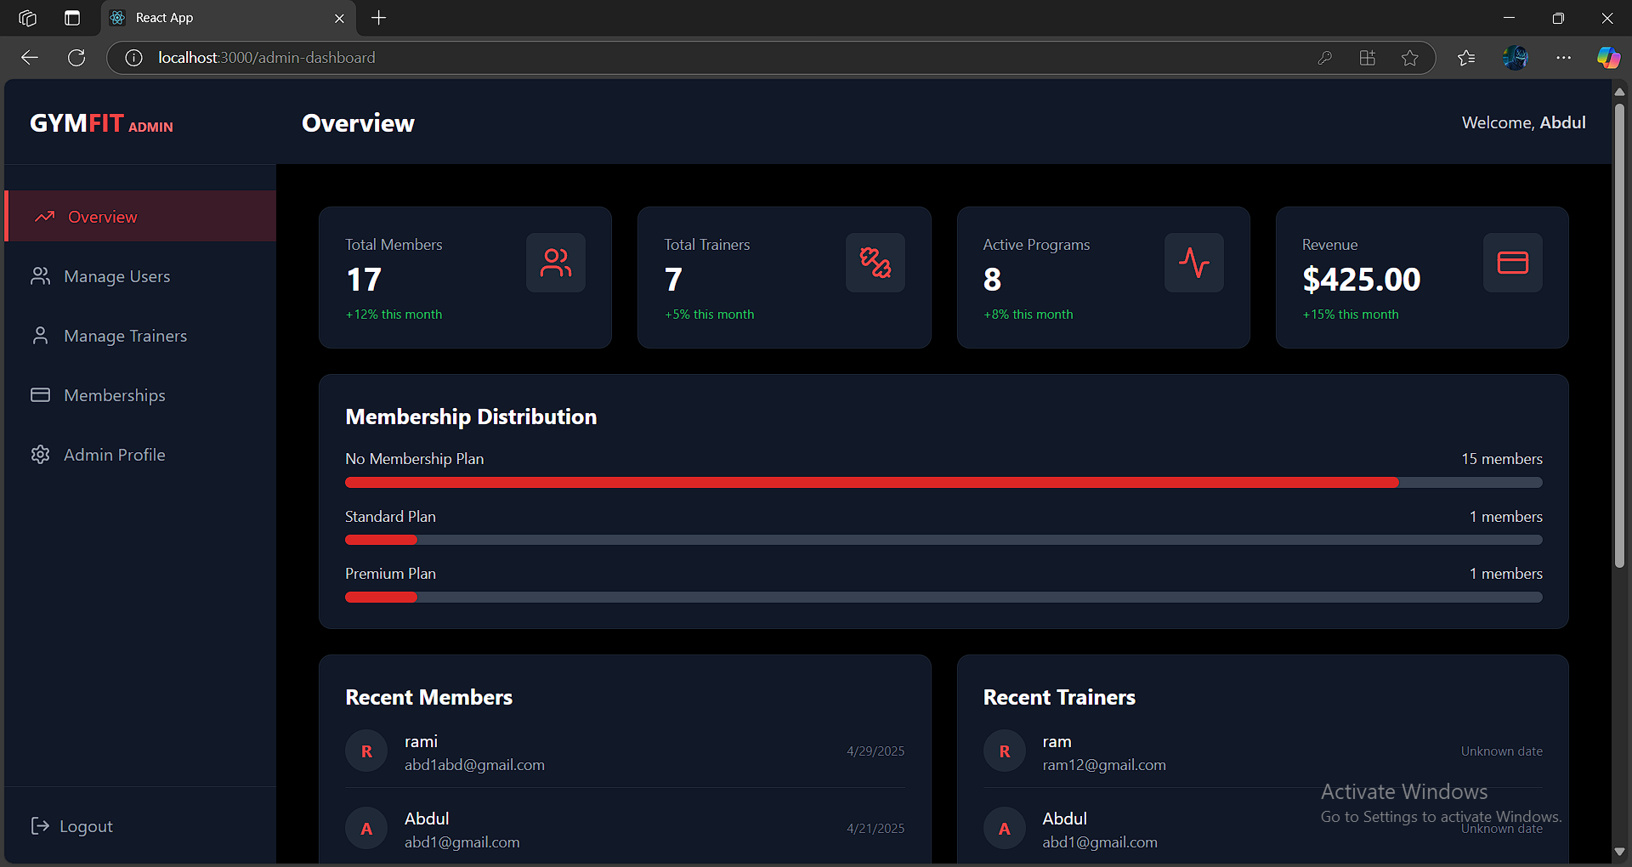

Slide 20
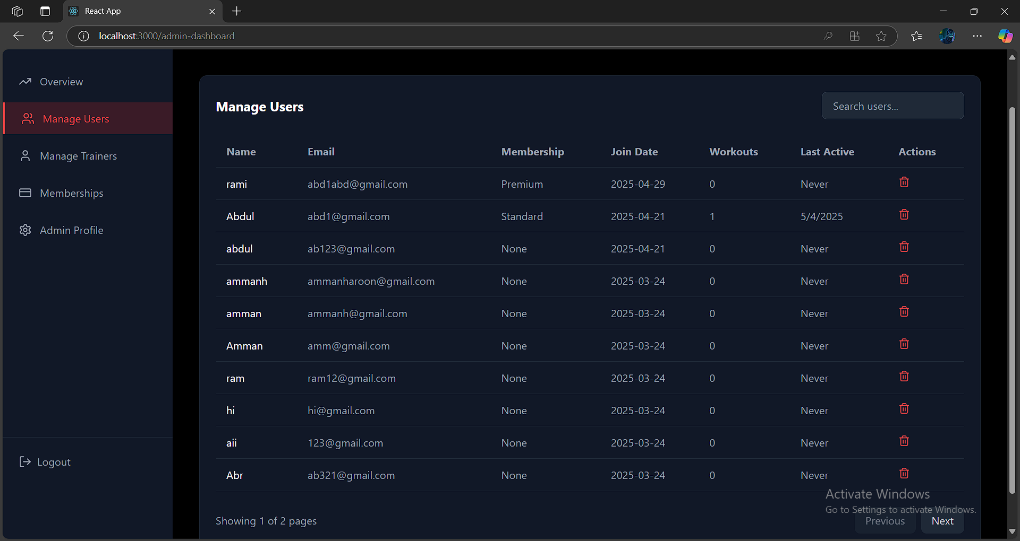

Slide 21
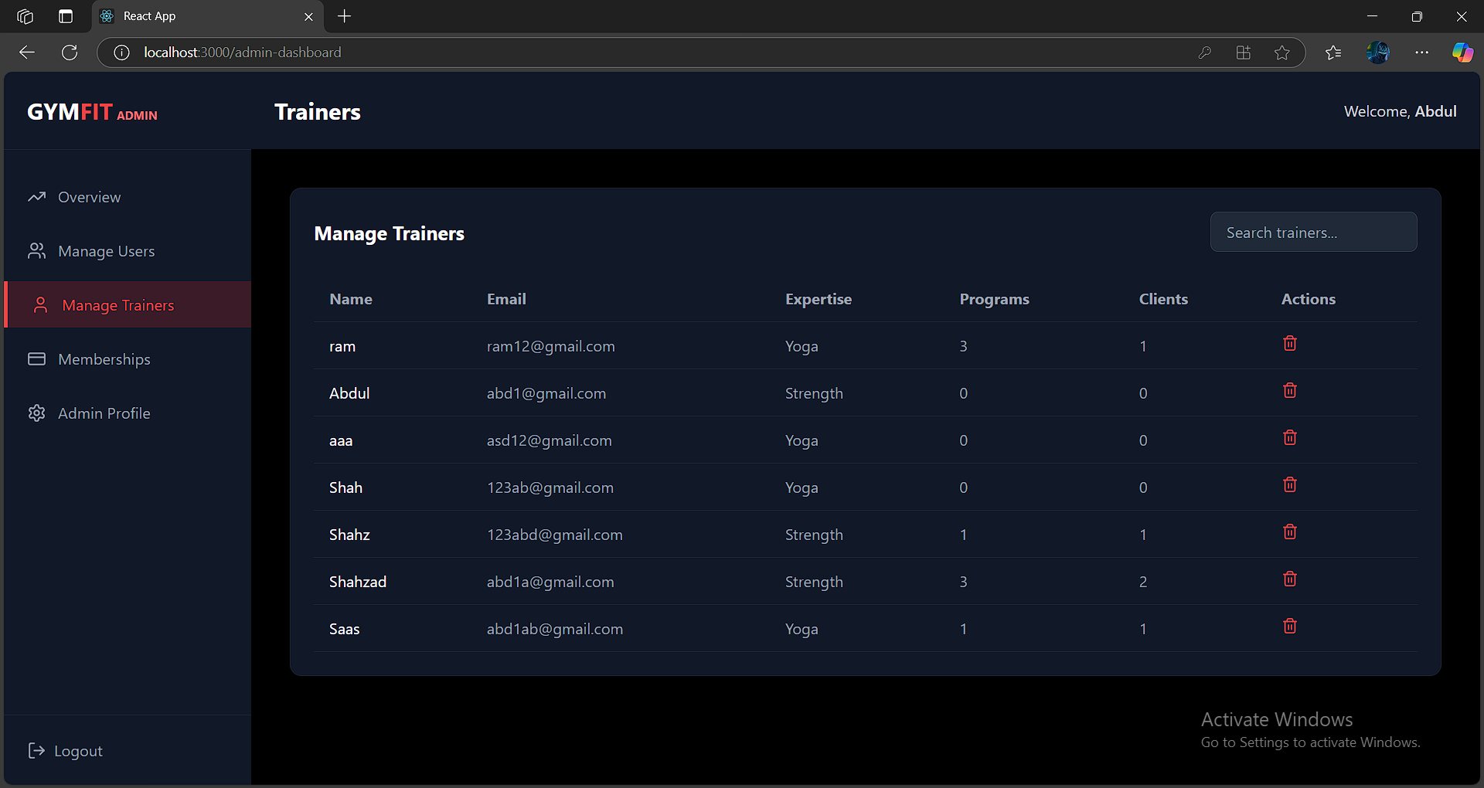

Slide 22
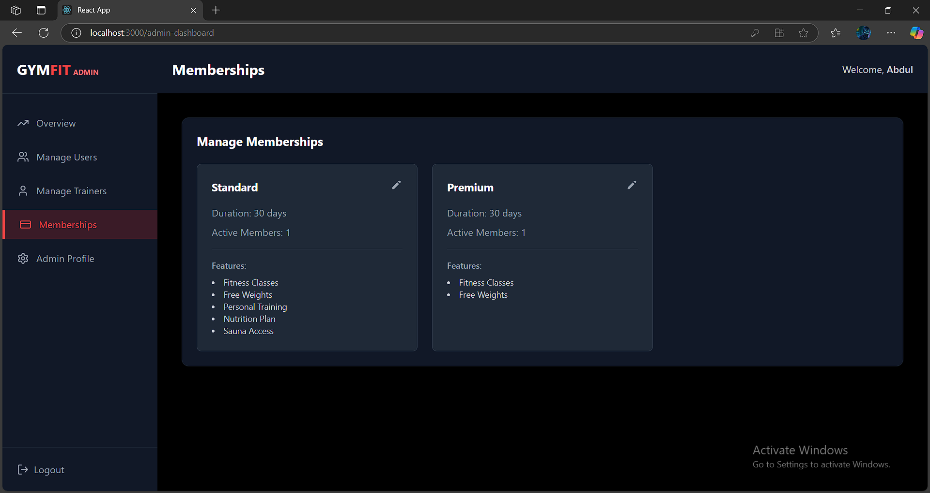

Slide 23
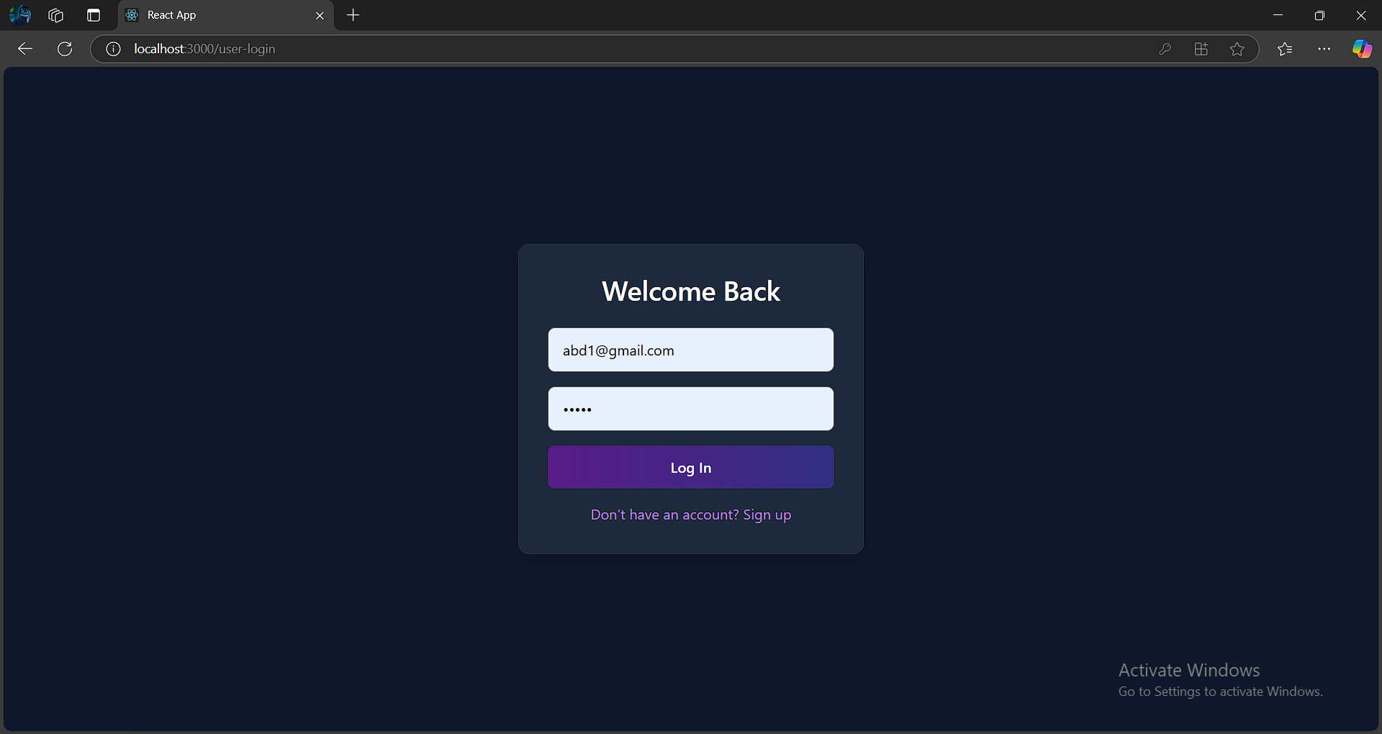

Slide 24
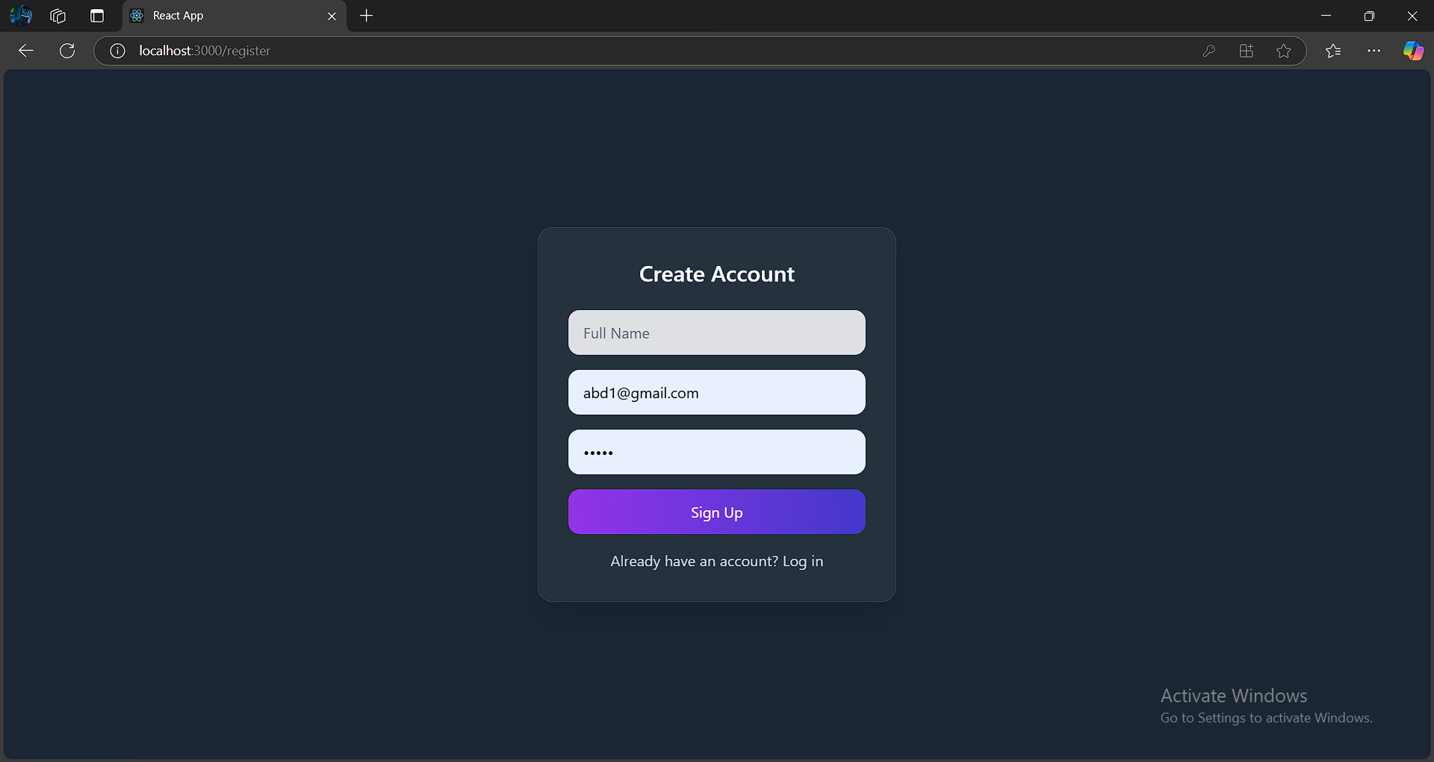

Slide 25
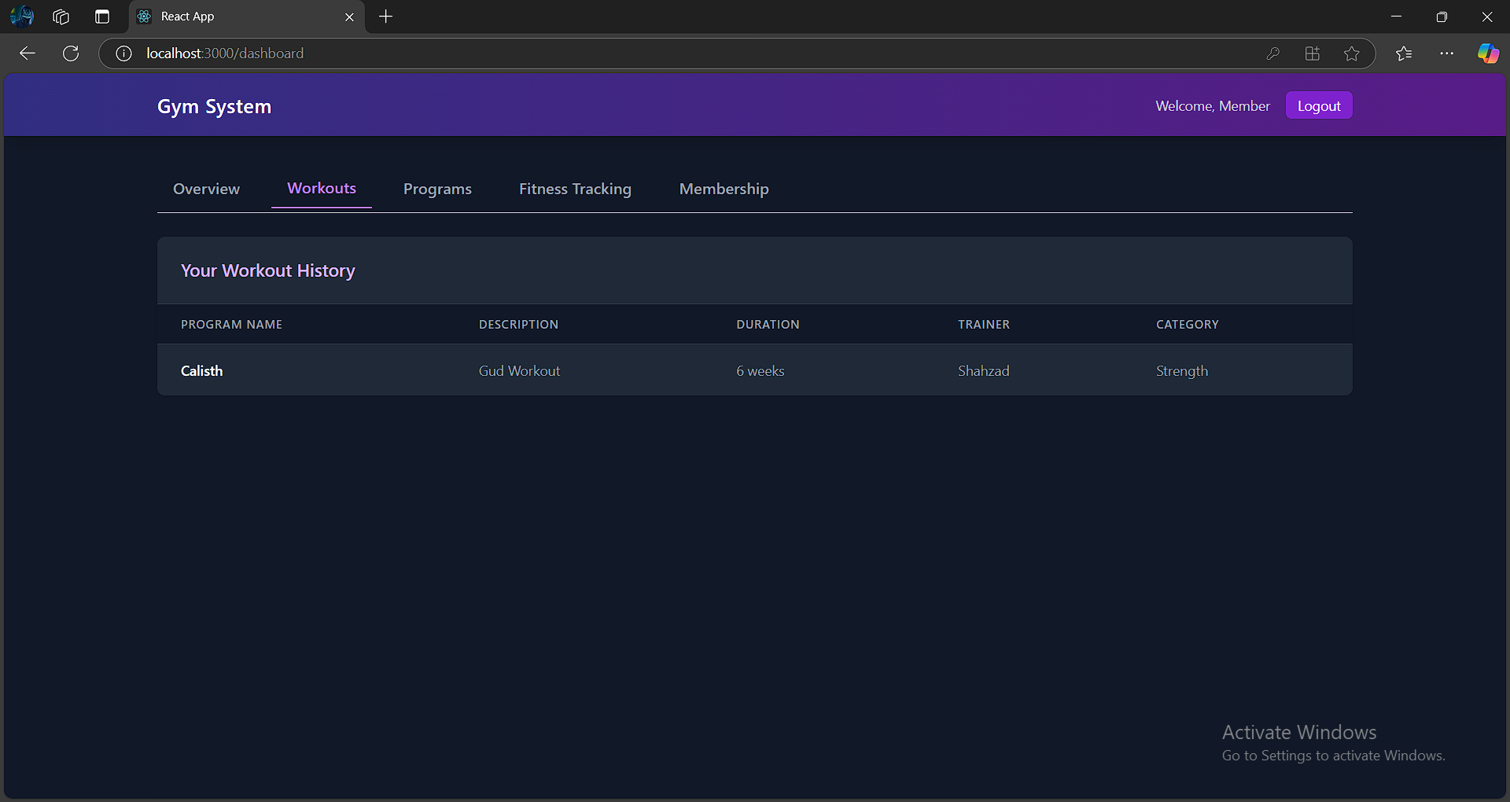

Slide 26
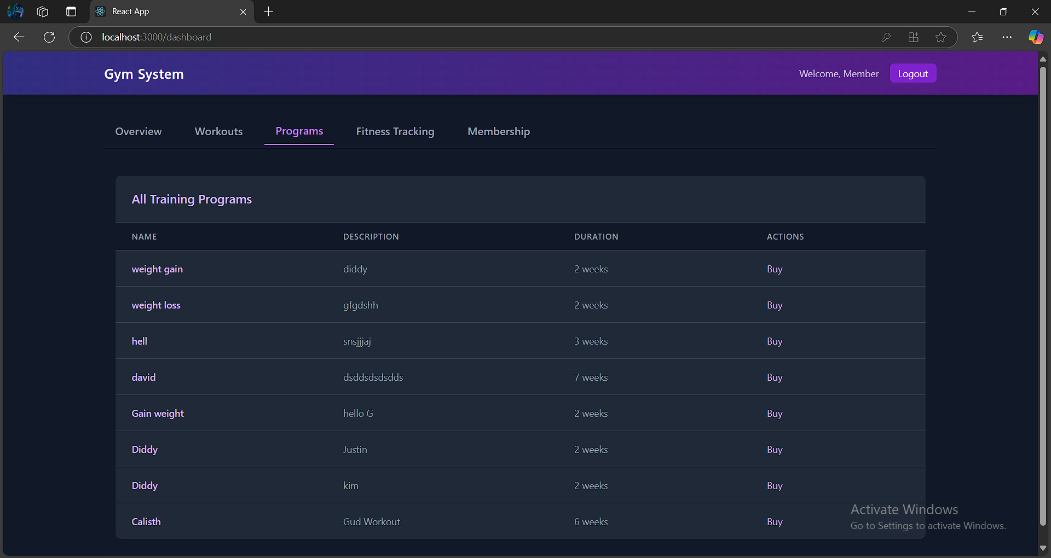

Slide 27
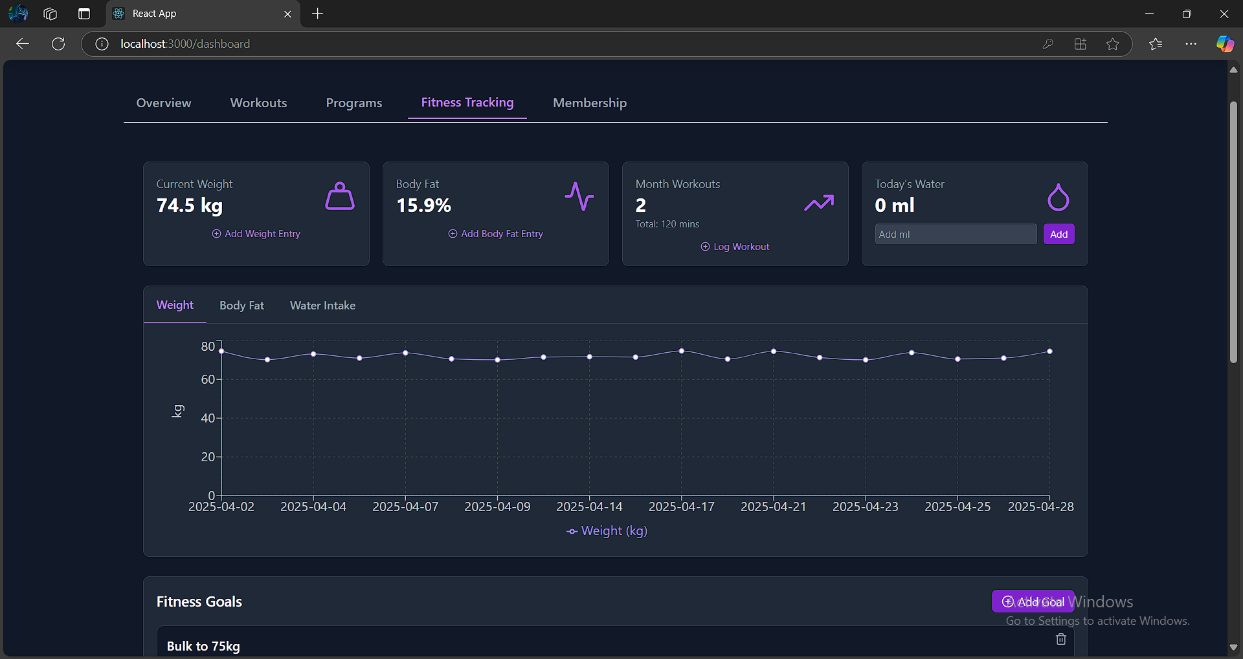

Slide 28
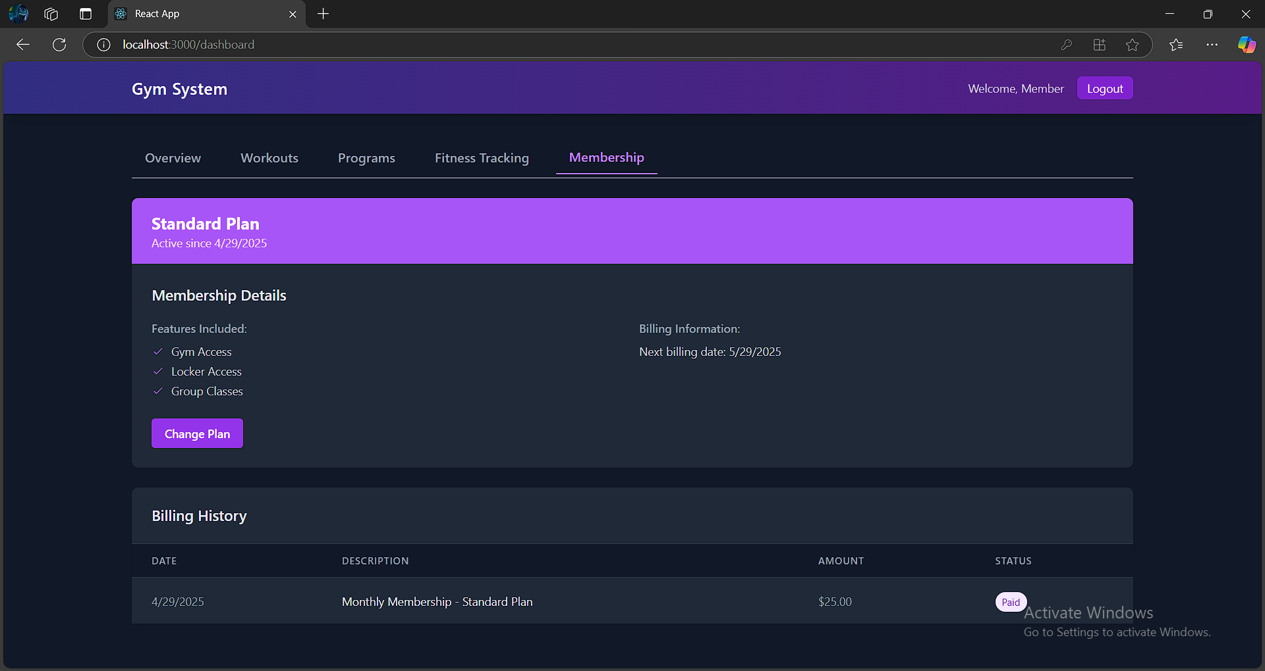

Slide 29
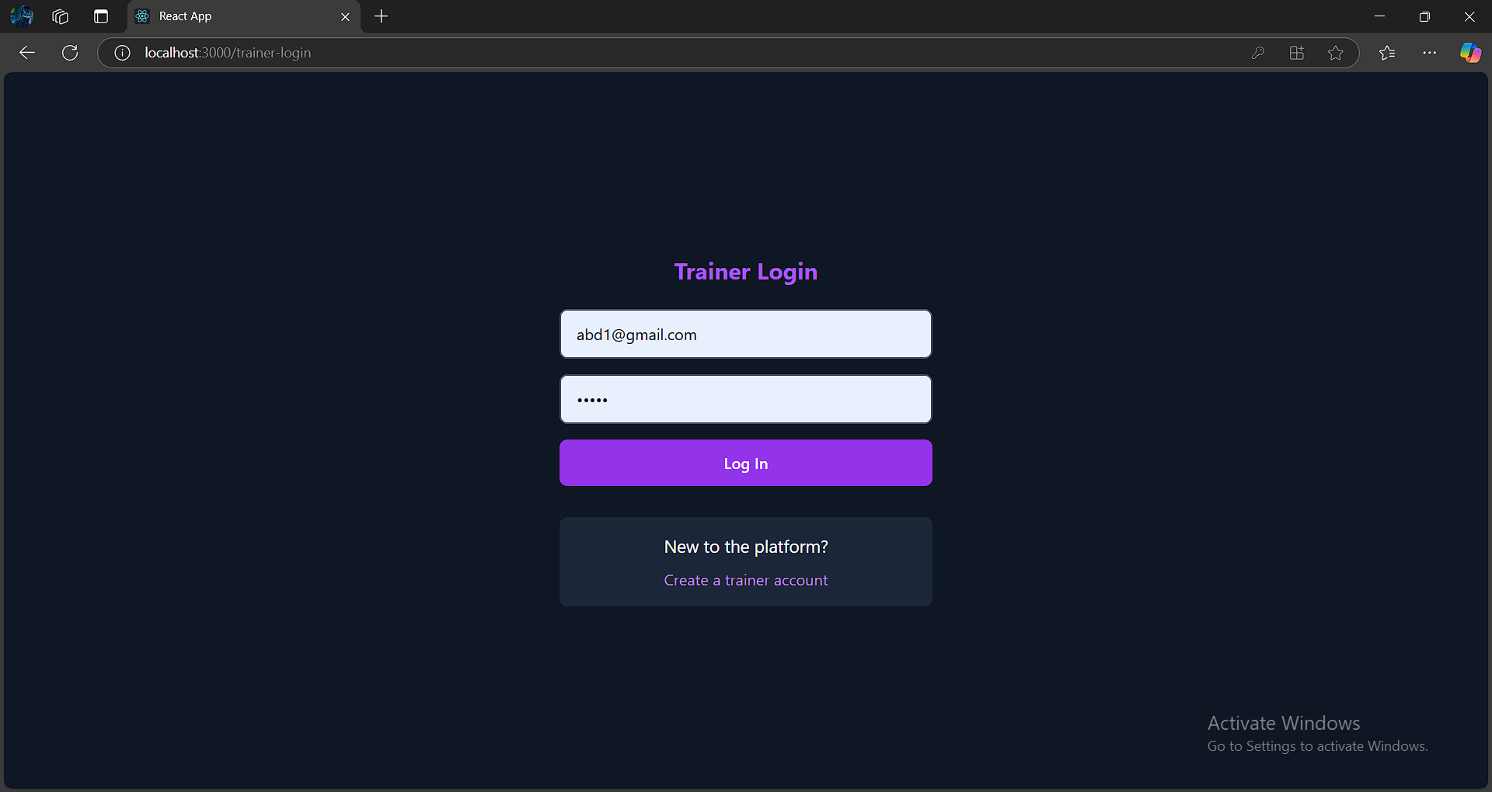

Slide 30
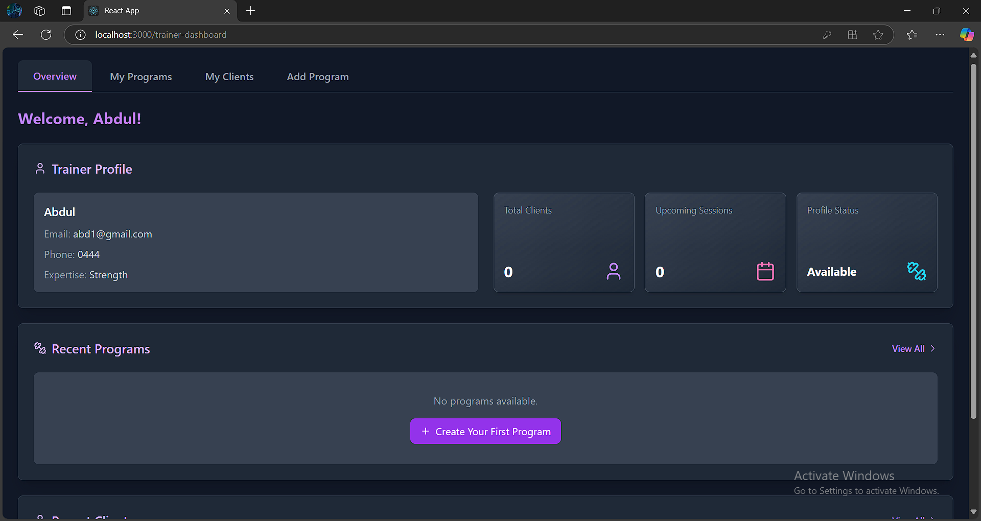

Slide 31
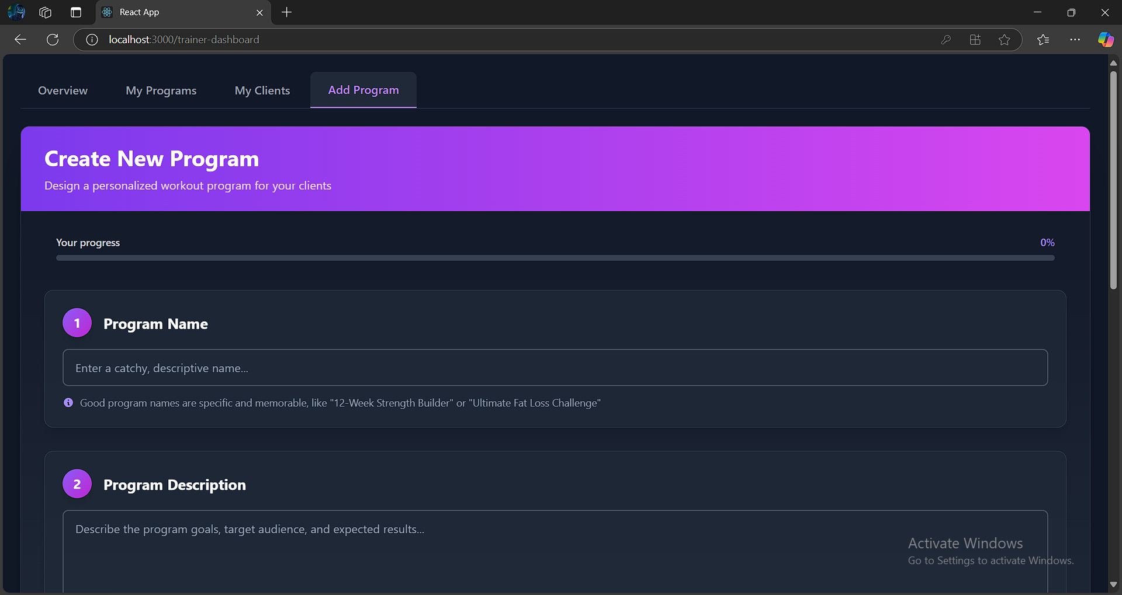

Slide 32
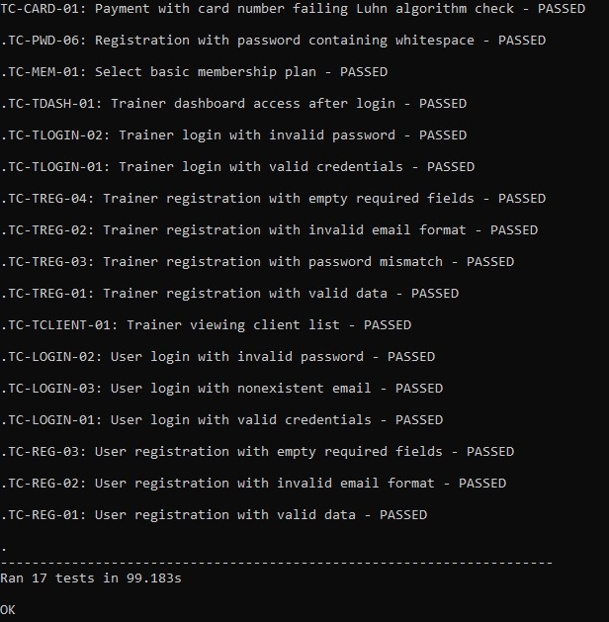
Black Box Testing

Slide 33
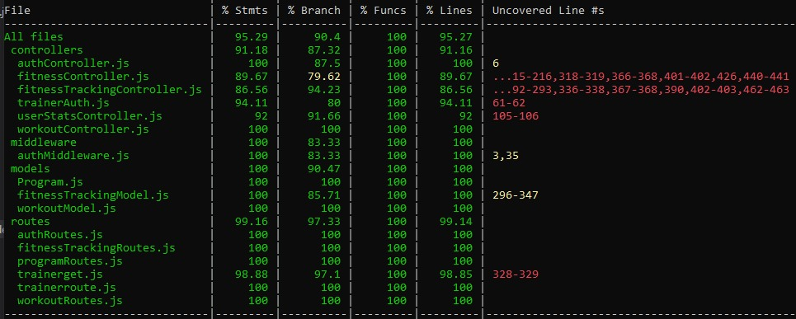
White Box Testing

Slide 34
Thank You

