Slide 1
Solar Energy Tracking System (S.E.T.S)
HEXVISION presents

Slide 2
Problem Statement
3
Homeowners struggle to understand solar savings and net metering bills due to fragmented solutions and complex calculations.
The project automates solar energy tracking, grid consumption monitoring, and net metering bill calculations.
Provides an integrated view with automated reports, eliminating manual meter reading and tariff interpretation.

Slide 3
Objectives
Fetch weather data
1
Fetch grid consumption
2
Calculate Solar Energy
3
Help Track Energy
4
Calculate Net Metering bill
5

Slide 4
Scope
Develop
An Energy Tracking System which calculates and monitors Solar Energy
Automate
NET-Metering bills
Provide
Projections for future energy usage
Their experience for efficiently tracking their energy
Enhance

Slide 5
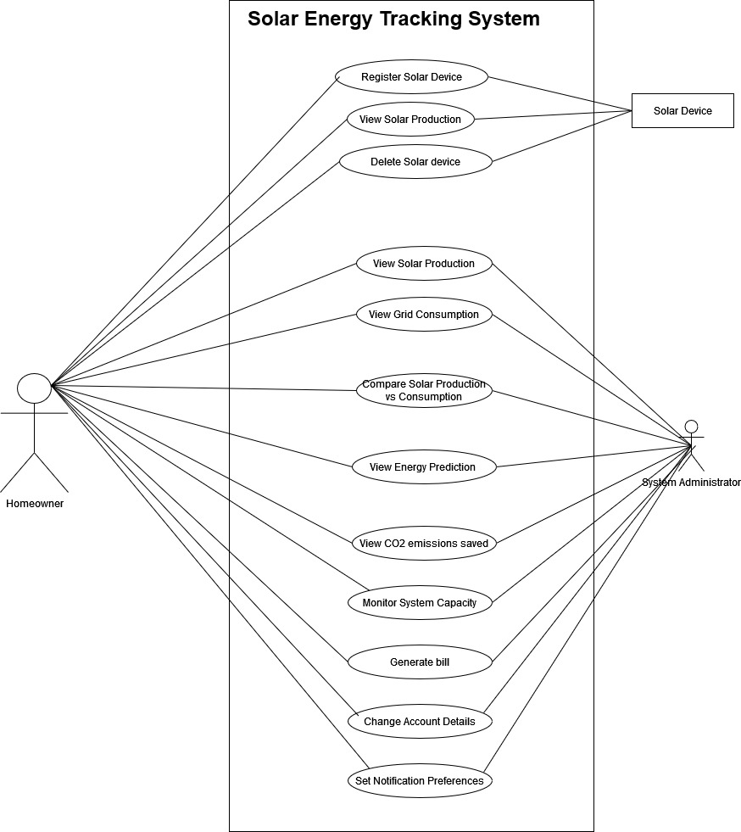

Slide 6
Thank you
Mirjam Nilsson​
mirjam@contoso.com
www.contoso.com

