Slide 1

Gamma Shielding Material Analysis: A Comparative Study

Slide 2

Objective and Background
Objective
Background
Compare gamma shielding properties of Lead, HY80, and 30MnB5.
Submarines require lightweight yet effective gamma radiation shielding.
Identify the best material or hybrid design for nuclear submarine shielding.
Cesium-137 (Eγ=0.662 MeV) is used as the gamma source.

Slide 3
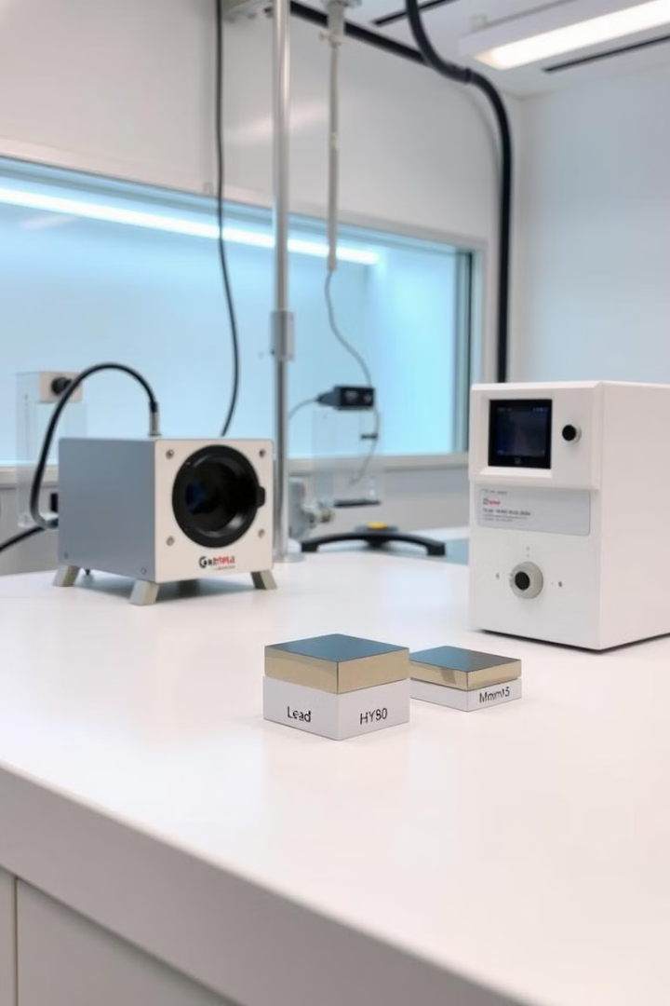
Experimental Setup
1
Gamma Source
2
Materials Tested
Cesium-137 (Eγ=0.662 MeV).
Lead (Pb): High density (11.34 g/cm3).
HY80 Steel: Medium density (7.87 g/cm3).
30MnB5 Steel: Medium density (7.835 g/cm3).
3
Data Analyzed
4
Tools Used
Peak intensity, FWHM, and Compton edge for thicknesses from 0 cm to 25 cm.
GEANT4 simulations and gamma spectroscopy.

Slide 4
Key Metrics Evaluated
Peak Intensity
FWHM
Compton Edge
Indicates attenuation efficiency.
Measures scattering contributions.
Highlights energy redistribution due to interactions.

Slide 5

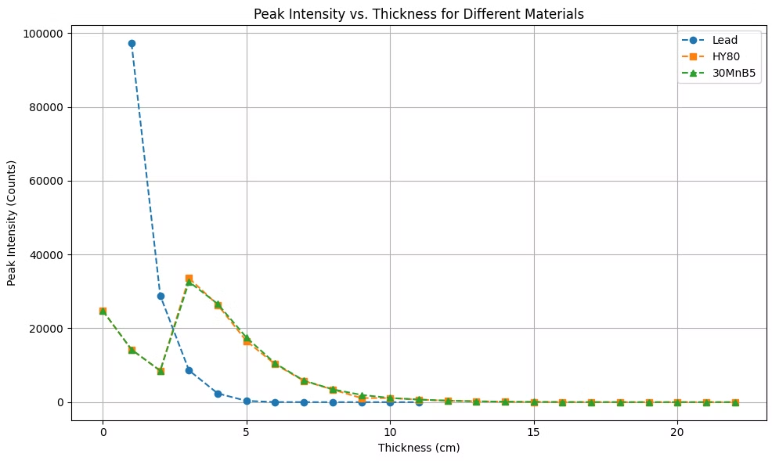
Results: Peak Intensity
Observation
Visualization
Lead shows the sharpest drop in peak intensity with increasing thickness, indicating superior attenuation.
Peak Intensity vs. Thickness graph.
HY80 and 30MnB5 require greater thickness for comparable attenuation.

Slide 6

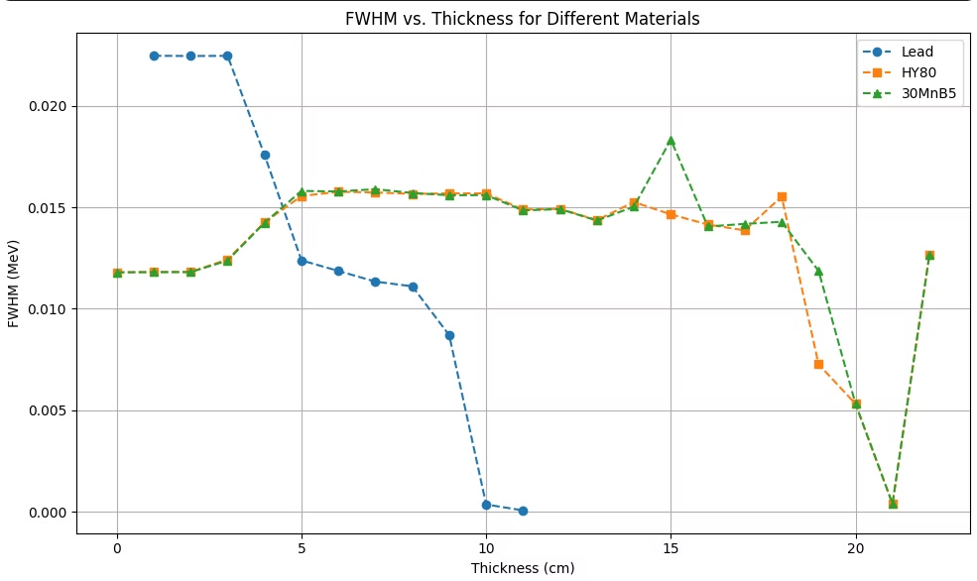
Results: FWHM
Observation
Visualization
Lead maintains a narrow and stable FWHM across thicknesses, suggesting minimal scattering.
FWHM vs. Thickness graph.
HY80 and 30MnB5 exhibit broader FWHM, reflecting increased scattering.

Slide 7

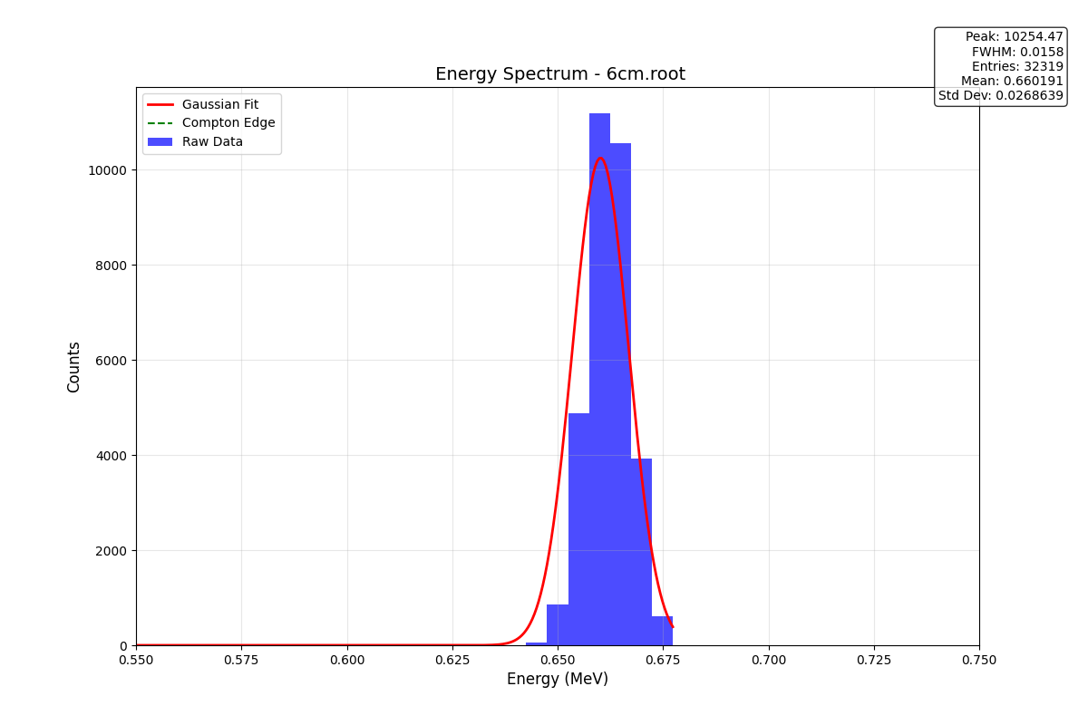


Gaussian Profiles
Lead
HY80 & 30MnB5
Sharp Gaussian peaks, minimal scattering.
Broader Gaussian curves, scattering contributions.

Slide 8

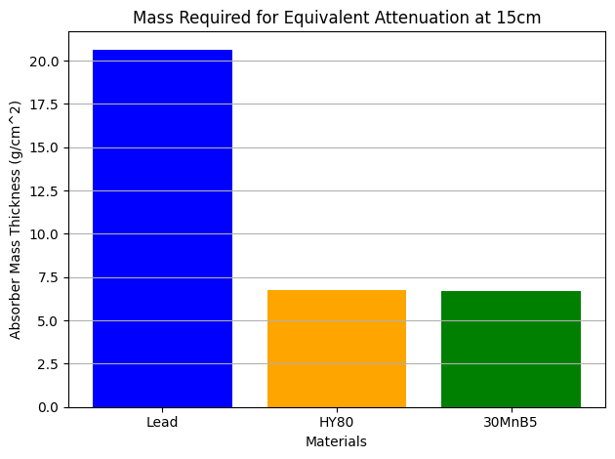
Weight vs. Performance
1
Lead
Most efficient gamma shield, heaviest.
2
HY80 & 30MnB5
Better weight-to-performance ratios, require increased thickness.

Slide 9
Recommendations and Conclusion
Hybrid Designs
1
Combine HY80 (outer layer) with 30MnB5 (inner layer).
Testing Conditions
2
Simulate high-pressure, high-temperature, and corrosive environments.
Optimization
3
Use simulation tools to refine material combinations.

Slide 11

Questions?

