Slide 1
Housing Market Austin, TX
By
Ammanuel F. WoldeAregay

Slide 2
Agenda
Introduction
Assess the housing market data from Zillow
Build a price predicting model
Share insights
Final tips & takeaways

Slide 3

Problem Statement
What opportunities exist for real estate developer who aims to make informed investment decisions in and around Austin, TX, considering the potential for housing price increases in 2022 by analyzing the historical housing price data from 2018 to 2021?

Slide 4
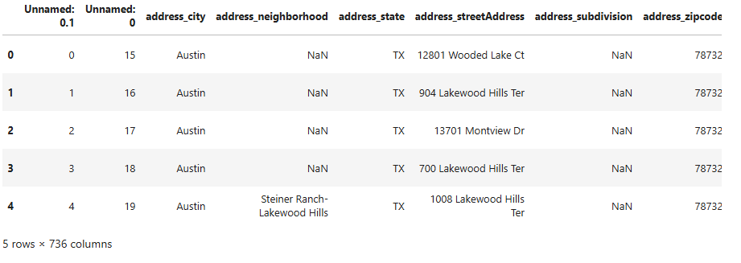
Raw Data Sample
16482 Rows
736 Columns

Slide 5
Data Wrangling
Original dataset had 16482 rows and Rows
736 columns
Only consider data from data from 2018 to 2021
Drop redundant columns
Apply correlation between independent variables and drop features that has less than 0.005 correlation value.
Drop rows with more than 80% of data missing values
Create a “price/square feet” feature
Target Variable: House Price

Slide 6
Data Wrangling
Additional Data
Austin, TX income by zipcode
Rows: 11
Columns: 111
Load US Income data to access Austin’s dara
Merge it with Austin House Listings semi-cleaned data

Slide 7
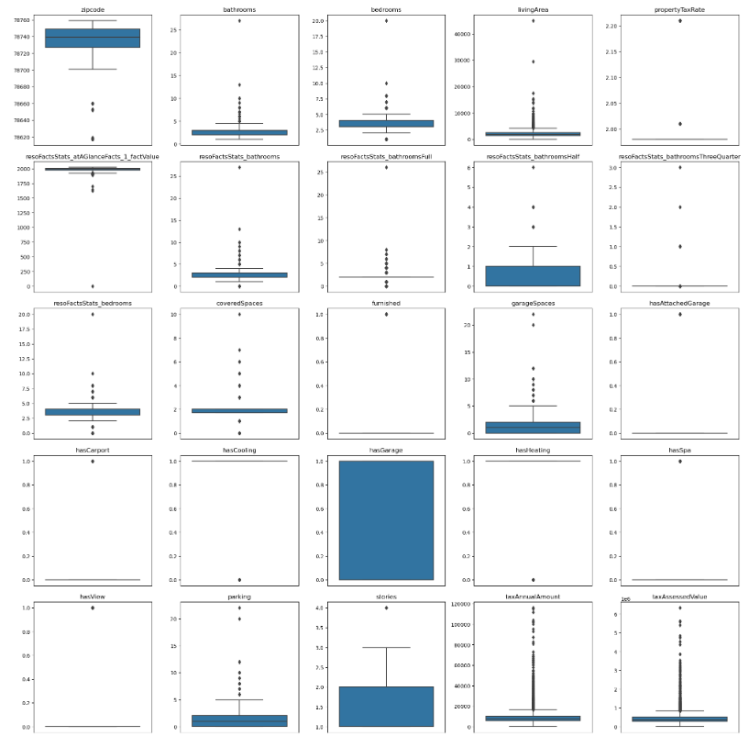
Exploratory Data Analysis
Analyzing Feature (Independent Variables) Distributions

Slide 8
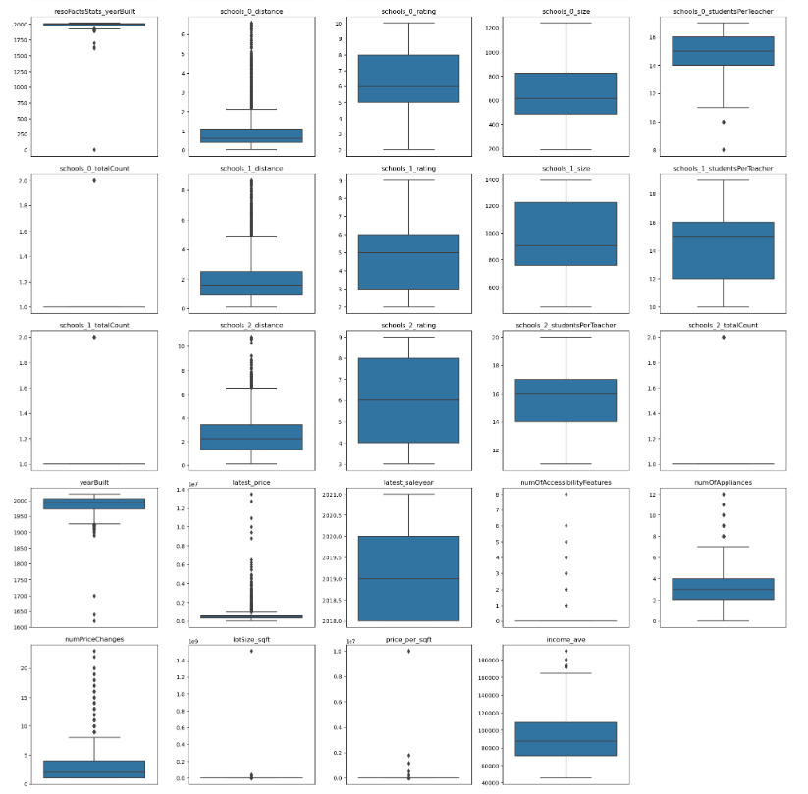
Exploratory Data Analysis
Analyzing Feature (Independent Variables) Distributions

Slide 9
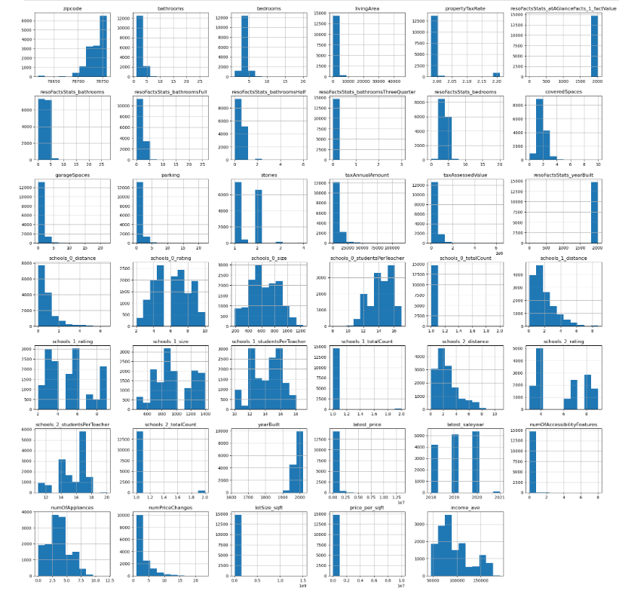
Exploratory Data Analysis
Comparing features that have numerical values

Slide 10
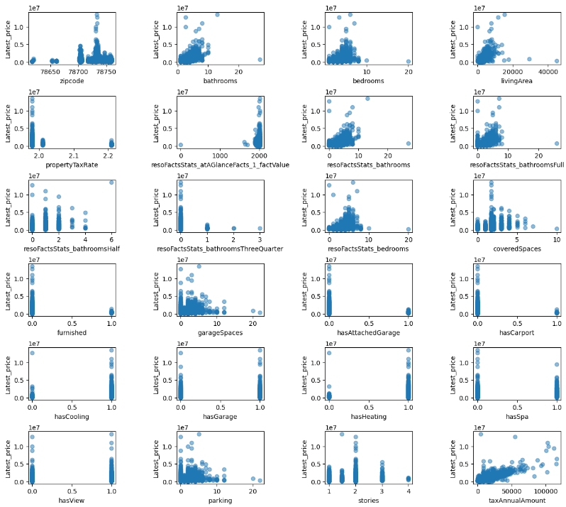
Exploratory Data Analysis
Comparing individual features (independent variables) with the target (dependent variable)

Slide 11
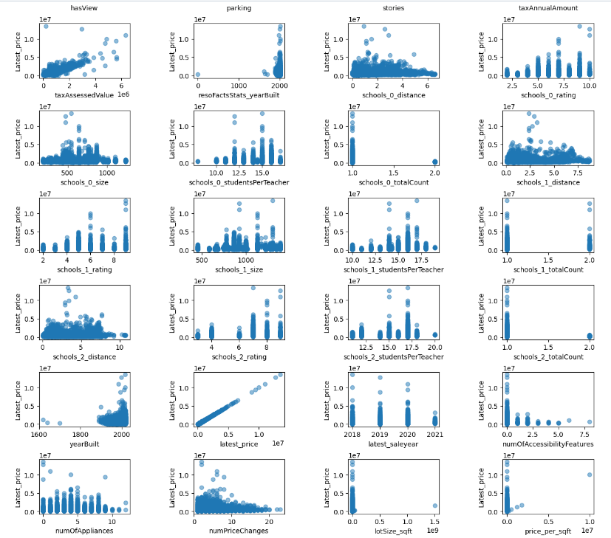
Exploratory Data Analysis
Comparing individual features (independent variables) with the target (dependent variable)

Slide 12
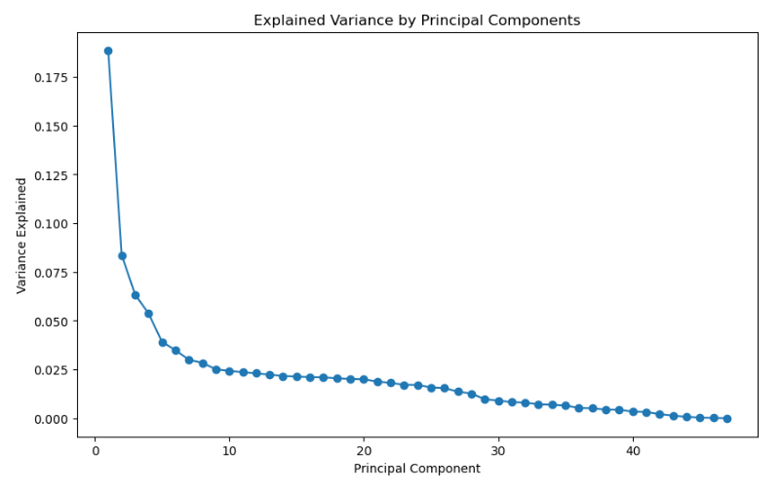
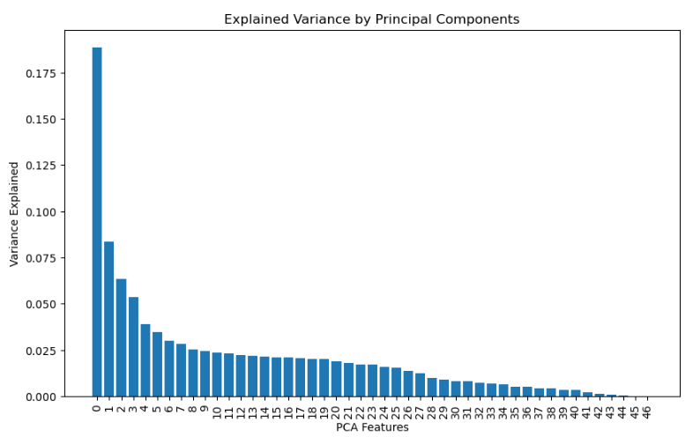
PCA Components Selection
Number of PCA components selected: 21

Slide 13
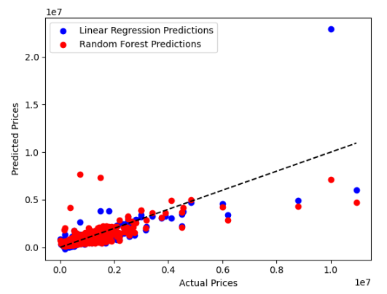
Model Selection
Compared models:
Logistic Regression
Random Forest Regressor

Slide 14
Takeaways​ & Final Tips
Random Forest Regressor is the preferred model
Test more parameters

Slide 15
THANK YOU
Ammanuel F. WoldeAregay

