Slide 1
BCI MOTOR IMAGERY CLASSIFICATION
CSP + SVM Pipeline for Left- vs. Right-Hand EEG Decoding
A DataFrame-first, sklearn-compatible pipeline: signal processing → EDA → Common Spatial Patterns → SVM → nested cross-validation
Notebook: Awad_SVM.ipynb · Dataset: eeg_hands_df.csv

Slide 2
OVERVIEW
What the notebook does
■
Goal
Classify single-trial EEG as Left-Hand vs. Right-Hand motor imagery, from raw multichannel signal to a validated model.
●
Scope
Processing → EDA → CSP feature extraction → SVM modeling → nested-CV evaluation — no deep learning, no deployment layer.
▲
Design choice
Data stays in pandas DataFrames end-to-end — even per-trial signals — so sklearn's CV splitters can index trials directly.
BCI Motor Imagery — CSP + SVM Pipeline
2

Slide 3
DATASET
eeg_hands_df.csv, at a glance
21
160 Hz
641
87
EEG channels
Sampling rate
Samples / trial
Clean trials
Fronto-central & centro-parietal montage
Derived from 0.00625 s time step
≈ 4 seconds per trial
44 Left Hand · 43 Right Hand
Cleaning: 3 of 90 trials removed by a per-trial standard-deviation outlier filter (z ≥ 2.5); 0 trials rejected by the peak-to-peak artifact check.
BCI Motor Imagery — CSP + SVM Pipeline
3

Slide 4
SIGNAL PROCESSING
Seven stages, one long-format DataFrame
Load &
sort
→
Outlier-trial
filter
→
Artifact
rejection
→
Band-pass
0.5–40 Hz
→
Common Avg.
Reference
→
Baseline
correction
→
Mu/Beta
8–30 Hz
Notch filter skipped by design: this PhysioNet-style dataset shows no dominant 50/60 Hz component in the 0.5–40 Hz band of interest, so a generic notch was omitted to avoid distorting the band without evidence of contamination.
Output: a trial-level DataFrame — one row per trial, with a `data` column whose cells are each a (time × channel) DataFrame.
BCI Motor Imagery — CSP + SVM Pipeline
4

Slide 5
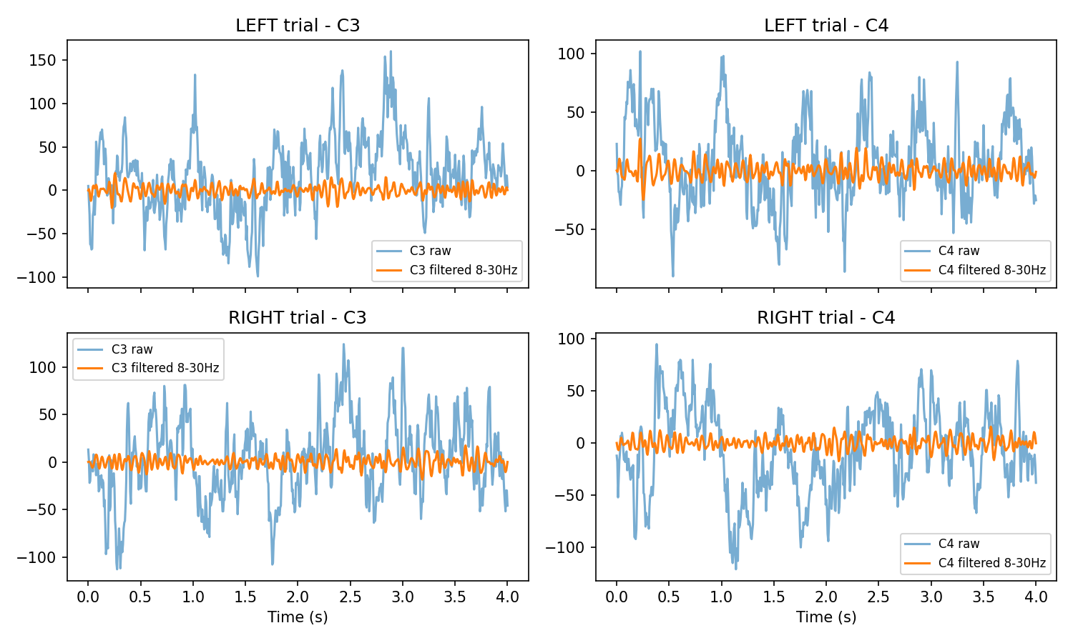
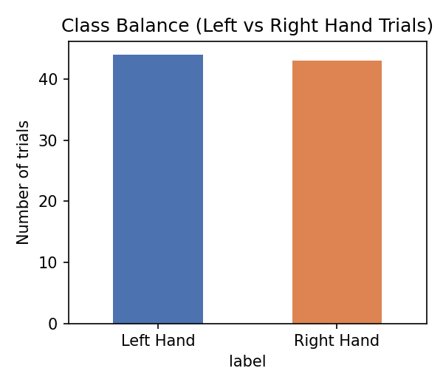
EXPLORATORY DATA ANALYSIS
Balanced classes, visible rhythm after filtering
Left: class counts (44 vs. 43) after cleaning. Right: raw vs. 8–30 Hz-filtered C3/C4 traces — filtering isolates the sensorimotor oscillation from broadband noise.
BCI Motor Imagery — CSP + SVM Pipeline
5

Slide 6
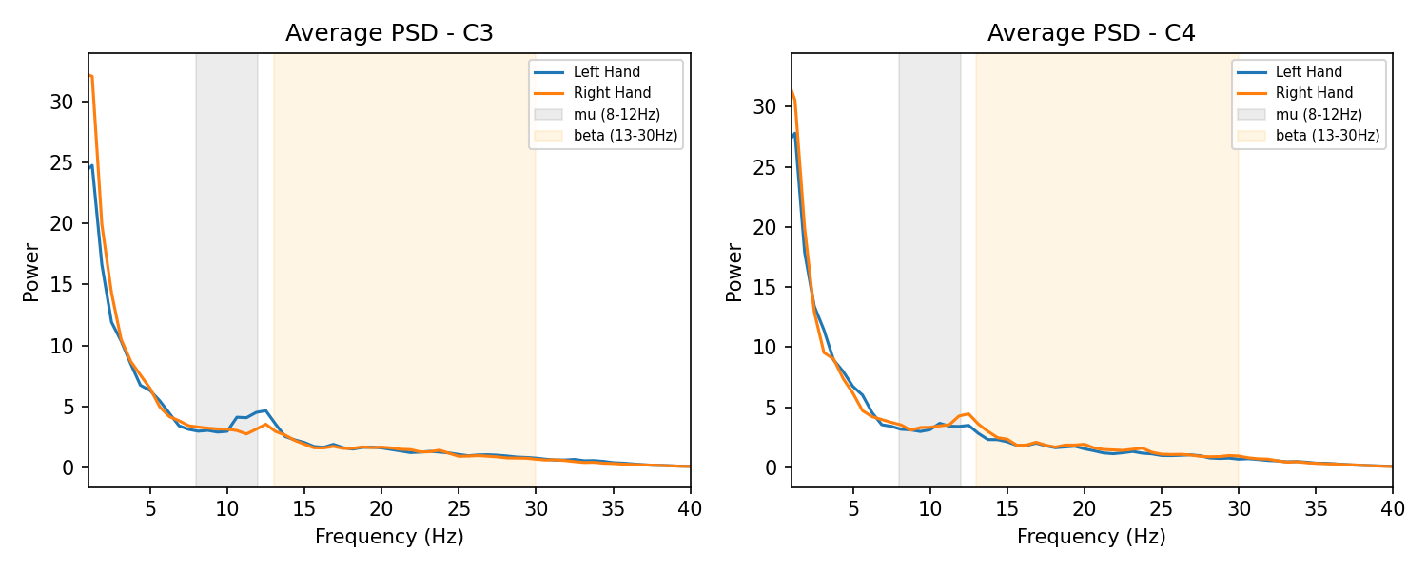
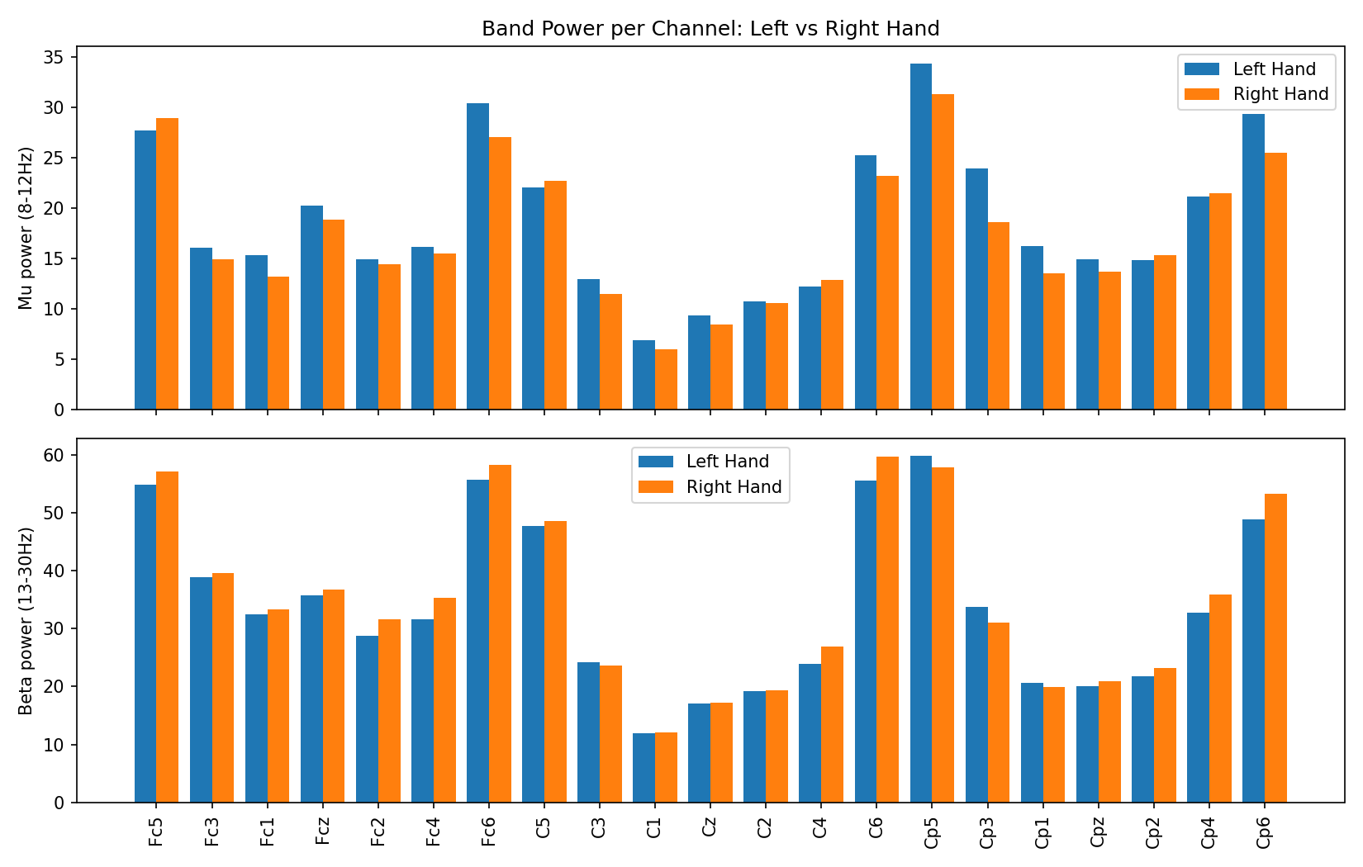
EXPLORATORY DATA ANALYSIS
Mu/beta power hints at contralateral desynchronization
Welch PSDs (left) show mu (8–12 Hz) and beta (13–30 Hz) bands shaded for C3/C4. Per-channel band power (right) shows the largest Left- vs. Right-Hand differences near central electrodes — motivating a spatial filter (CSP) over any single channel.
BCI Motor Imagery — CSP + SVM Pipeline
6

Slide 7
MODELING — FEATURE EXTRACTION
Common Spatial Patterns (CSP)
1
Per-class covariance
Average the regularized, trace-normalized spatial covariance matrix across each class's trials.
2
Generalized eigendecomposition
Solve for spatial filters that maximize the variance ratio between the two classes.
3
Project & log-variance
Project each trial through the filters; take the log-variance of each component as its feature.
Result: a 641-sample × 21-channel trial collapses to a handful of highly discriminative numbers (csp_1 … csp_n) — implemented as a custom scikit-learn transformer, so it slots directly into a Pipeline.
BCI Motor Imagery — CSP + SVM Pipeline
7

Slide 8
MODELING — CLASSIFIER & VALIDATION
Pipeline, grid search, and nested cross-validation
CSP
→
StandardScaler
→
SVC (RBF)
Grid search over:
Nested Cross-Validation
csp__n_components: 4, 6, 8
svm__C: 0.1, 1, 10, 100
svm__gamma: scale, auto
svm__kernel: rbf, linear
Outer loop — 5-fold stratified split gives an unbiased performance estimate.Inner loop — 3-fold stratified split (within each outer training fold) selects hyperparameters via GridSearchCV.Why nested? Prevents the optimistic bias from tuning and evaluating on the same folds.
BCI Motor Imagery — CSP + SVM Pipeline
8

Slide 9
EVALUATION
Nested cross-validation results
87.4%
87.3%
0.871
0.938
Accuracy
Balanced accuracy
F1 score
ROC AUC
Best parameters (full-data fit): n_components = 4, C = 0.1, gamma = scale, kernel = rbf
Per-fold outer accuracy: 88.9%, 88.9%, 88.2%, 88.2%, 82.4% — mean 87.3% ± 2.5% (tight spread across folds = stable, not one lucky split)
Precision / recall are balanced across classes: Left Hand 0.87 / 0.89, Right Hand 0.88 / 0.86 — the model does not favor one hand over the other.
BCI Motor Imagery — CSP + SVM Pipeline
9

Slide 10
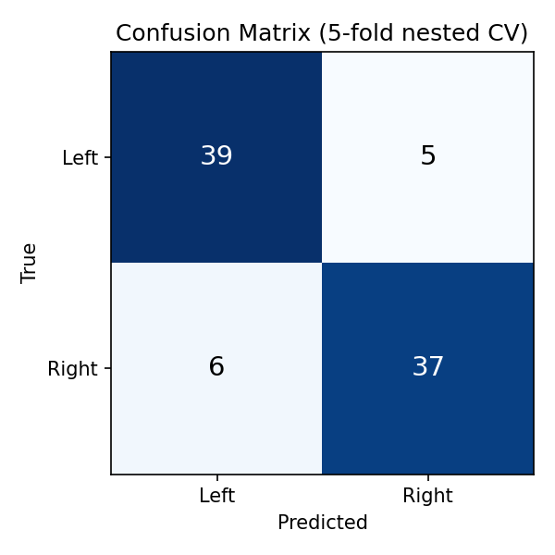
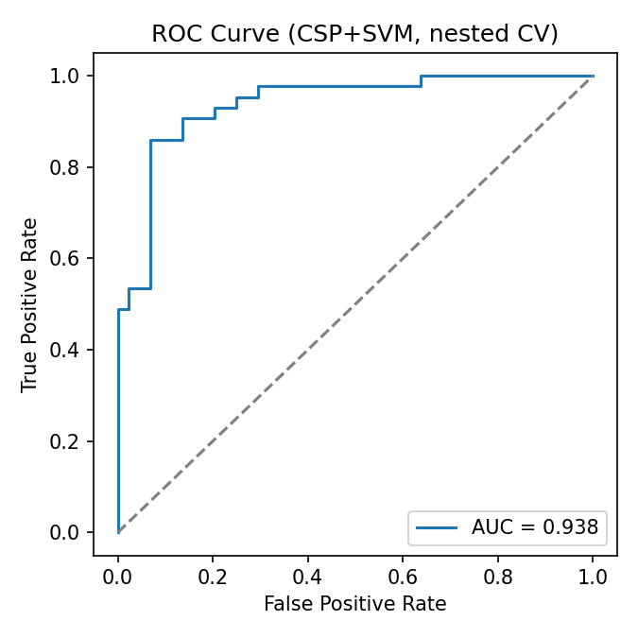
EVALUATION
Confusion matrix & ROC curve
BCI Motor Imagery — CSP + SVM Pipeline
10

Slide 11
DELIVERABLE
The trained pipeline, pickled
↓
csp_svm_model.pkl
The best full-data pipeline — fitted CSP transformer, StandardScaler, and SVC bundled together — is saved via pickle in the notebook's final cell.
One object, one call: reload the pickle and call .predict() on new trial DataFrames — CSP filters and scaler statistics travel with it automatically.
A sanity check after saving reloads the file and confirms it reproduces predictions before the notebook finishes.
Hyperparameters baked in: n_components=4, C=0.1, gamma=scale, kernel=rbf — the grid-search winner.
BCI Motor Imagery — CSP + SVM Pipeline
11

Slide 12
NOTES
Limitations & what's next
1
2
3
Sample size
Generalization
Class scope
87 trials from a single subject/session — read results as proof-of-concept, not a clinically validated benchmark.
5-fold nested CV validates within-session generalization only, not across sessions or subjects.
CSP here is binary; more motor-imagery classes would need one-vs-rest CSP+SVM or a multiclass CSP variant.
BCI Motor Imagery — CSP + SVM Pipeline
12

