Slide 1
CORTEXCALL
EEG Motor-Imagery Classification (LEFT vs RIGHT)
Stage 1 — Exploratory Data Analysis
Instructor Progress Review • Graduation Project
Data quality audit, artifact rejection strategy, and the first LEFT/RIGHT signal evidence from raw EEG.

Slide 2


STAGE 1 · OVERVIEW
What this EDA stage covered
Two notebooks, run back-to-back, to answer one question: is this raw dataset trustworthy enough to build on?
Notebook 1 — Data Quality Audit
Notebook 2 — Rejection Rule + PSD/ERD
Loading & alignment of signals with labels
Class balance, trial length, missing values
Channel anomalies & artifact detection
Quantify artifact-rejection thresholds
Finalize a cross-validated rejection list
Raw vs. filtered PSD, LEFT vs. RIGHT (C3/C4)
CortexCall — EDA Stage Review
2

Slide 3

DATA LOADING
Dataset snapshot
2,400 label rows were provided; 240 extra rows were dropped to align exactly with the 2,160 available signal files. Verified safe.
2,160
1,082 / 1,078
2,500
0
Usable EEG trials
(after alignment)
LEFT / RIGHT trials
— ~50/50 balance
Rows per trial
— consistent across all 2,160 files
Missing values (NaNs)
found across the dataset
Clean on every structural check
No flat / dead channels across the whole dataset • Every trial has the exact same length • Class balance is not biased toward either label
CortexCall — EDA Stage Review
3

Slide 4

OPEN ISSUE #1
Sampling rate is still unconfirmed
The problem
Ask for the instructor
The Time column inside each trial file does not tick at a steady interval — the gaps between readings jump around instead of staying constant.
That means the true sampling rate cannot be safely calculated directly from this column.
We are currently running all filtering and PSD code against a placeholder of fs = 250 Hz, purely to keep development moving.
Every downstream step depends on fs:
Band-pass filter design (8–30 Hz)
PSD / Welch frequency axis
Any epoching or timing alignment
We need the device's true fs confirmed before we finalize preprocessing next week.
CortexCall — EDA Stage Review
4

Slide 5

CHANNEL CHECK
C3 vs. C4: an unusual similarity
C3 and C4 are the two motor-cortex channels that should differ the most — that difference is literally what separates LEFT from RIGHT.
What we tested
46%
Whether this was a real hardware fault (e.g. cross-talk between electrodes) or an artifact of unfiltered raw noise.
of trials show C3 and C4 behaving almost identically
Likely cause: low-frequency drift
495 vs. 492
Low-frequency drift dominates the raw signal and masks the real C3/C4 difference. A proper band-pass filter later should mostly resolve it. Not confirmed as a hardware fault.
split almost evenly across LEFT / RIGHT — not biased toward one class
CortexCall — EDA Stage Review
5

Slide 6

ARTIFACT DETECTION
Two independent artifact checks
Check #1 — Extreme variability
Check #2 — Sudden jump
Channel swings far outside its normal range within a trial.
One large abrupt spike anywhere in the recording.
398
187 trials
341
flagged instances
8.7% of the dataset
flagged instances
(e.g. momentary electrode contact loss)
Same pattern in both checks — channel ranking by noisiness:
CZ
→
FZ
→
C3 / C4
Worst
2nd
Calmest
CortexCall — EDA Stage Review
6

Slide 7
OUTLIER DECISION
57 high-confidence bad trials — how do we handle them?
Flagged by BOTH independent artifact checks — two separate tests agreeing is a strong signal. Split evenly across classes (29 LEFT / 28 RIGHT), so exclusion won't bias the labels.
Option 1
CHOSEN
Option 3
Play it safe
Filter first, then decide
Option 2
Use the 3.0× IQR cutoff already tested.
Skip the rule, cut the 57
Band-pass filter to remove drift, then redo the rejection curve for a clearer cutoff.
Drop only the 57 trials both methods flagged as bad.
~9%
2.6%
TBD
of data removed
(~1,972 trials left)
of data removed
— smallest, cleanest cut
needs a re-run
to quantify
CortexCall — EDA Stage Review
7

Slide 8
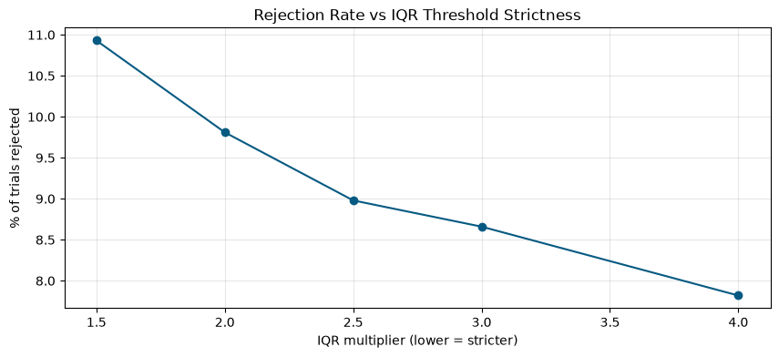
REJECTION RULE
Quantifying the rejection threshold
We tested IQR strictness from 1.5× to 4.0× on peak-to-peak amplitude to see if a natural cutoff point exists.
No clear "elbow"
Rejection rate moves smoothly from 10.9% down to 7.8% as the threshold loosens — there's no single obvious point where bad and good trials naturally separate.
Final cross-validated list
165 trials (7.6%)
Trials flagged by BOTH peak-to-peak AND max-jump. Saved to CSV — cleanup pending.
CortexCall — EDA Stage Review
8

Slide 9
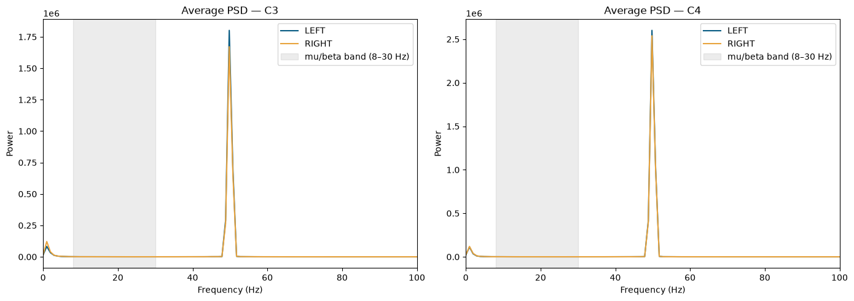

PSD ANALYSIS · RAW
Raw PSD: LEFT vs. RIGHT look identical
Average power spectral density on C3 and C4, computed directly on unfiltered signal (fs placeholder = 250 Hz).
Not because there's no real difference — the mu/beta band (8–30 Hz) is completely masked by low-frequency drift and other dominant noise in the raw signal.
CortexCall — EDA Stage Review
9

Slide 10
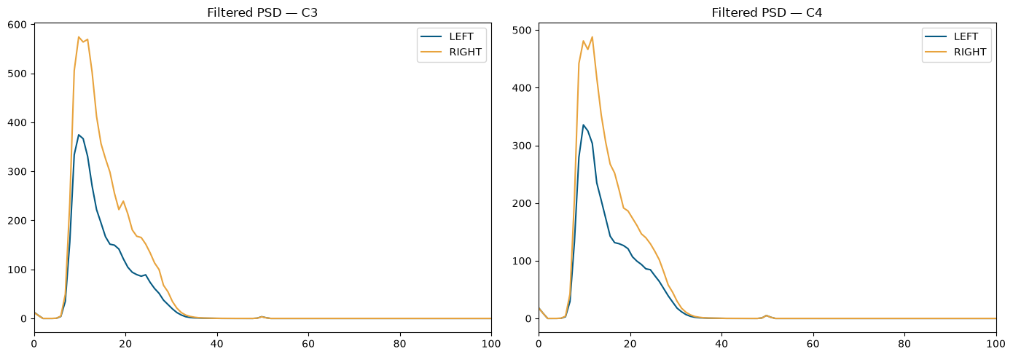
PSD ANALYSIS · FILTERED
Filtered PSD: real LEFT vs. RIGHT separation found
After an 8–30 Hz band-pass filter, a clear, visible separation appears on both C3 and C4.
What the filtered chart shows
RIGHT consistently sits above LEFT
across most of the mu/beta range, especially around the 10–12 Hz mu peak.
T-test on filtered band power:
C4: p = 0.034 (significant)
C3: p = 0.110 (not significant)
This is the first real evidence that this raw dataset contains a usable LEFT/RIGHT motor-imagery signal.
CortexCall — EDA Stage Review
10

Slide 11


STAGE 1 SUMMARY
Where the EDA stage leaves us
Dataset is clean on the basics: balanced, complete, consistent length, no flat channels
Open questions for instructors
57 highest-confidence bad trials identified — decision: exclude them (Option 2, 2.6% cut)
What is the device's true sampling rate?
We're placeholder-testing at 250 Hz — needs confirmation before preprocessing is finalized.
Is the C3/C4 similarity finding worth flagging to the data provider?
46% of trials show near-identical C3/C4 — we believe it's drift, not hardware, but haven't hard-confirmed it.
Filtered PSD confirms a real LEFT/RIGHT separation exists in the mu/beta band (8–30 Hz)
Next up: finalize the rejection list, confirm fs, and move into full preprocessing.
CortexCall — EDA Stage Review
11

Slide 12




STAGE 2 · OVERVIEW
Preprocessing: from raw signal to modeling-ready data
Two notebooks: the main pipeline (filter → reject → re-reference → epoching test) and a follow-up integrity pass (duplicate detection + notch filter).
Signal cleaning
Trial-level QC
Re-referencing
Epoching test
0.5–40 Hz band-pass filter, then a 50 Hz notch as an extra safety pass.
Apply the EDA's 165-trial rejection list, then a new duplicate-signal check.
Common Average Reference (CAR) tested as a separate, comparable branch.
9 candidate time windows scored — no advantage found, so none applied yet.
CortexCall — Preprocessing Stage Review
12

Slide 13
RESOLVED FROM STAGE 1
Sampling rate: confirmed by the instructor
This closes the open question raised at the end of the EDA stage.
What changes now
Every fs-dependent step from Stage 1 — the band-pass design, the PSD frequency axis, epoch timing — now runs on a confirmed value instead of a placeholder.
250 Hz
confirmed sampling rate
Time axis rebuilt
2,500 samples ÷ 250 Hz = 10 seconds of EEG per trial
The original Time column was irregular and started from large absolute numbers. For processed data, time is rebuilt as an even grid:
0.000, 0.004, 0.008, … (step = 1 / 250 Hz)
CortexCall — Preprocessing Stage Review
13

Slide 14
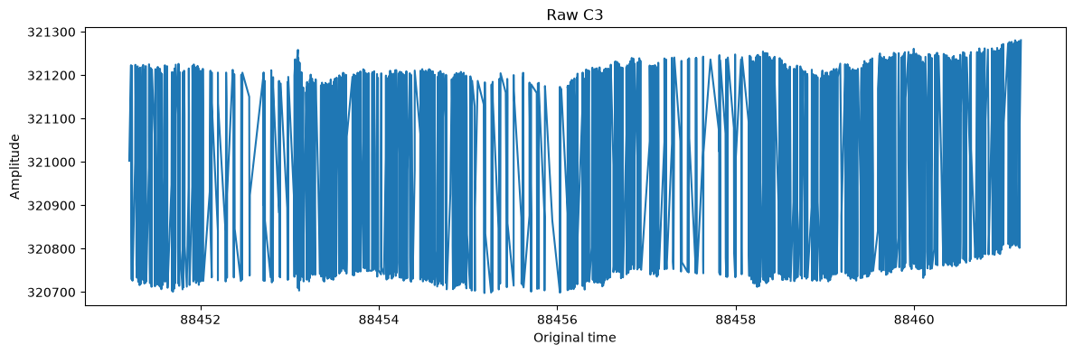
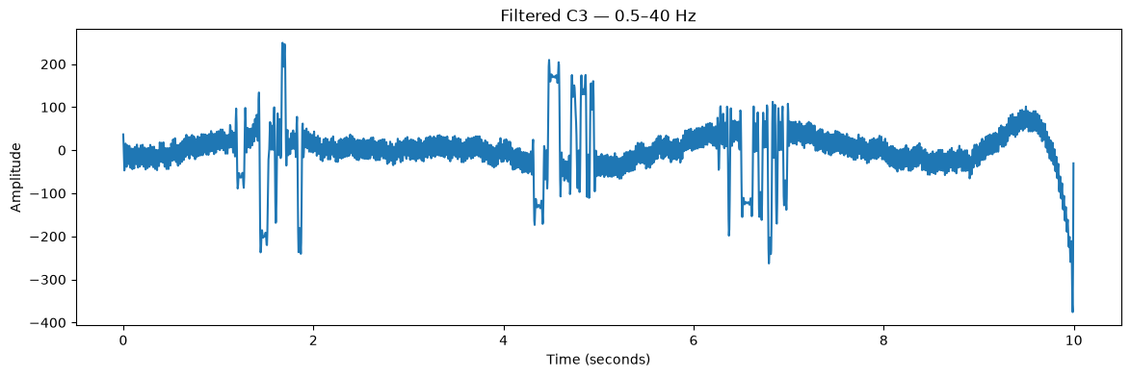
SIGNAL CLEANING
0.5–30 Hz? No — a 0.5–40 Hz band-pass filter
4th-order Butterworth, applied to all four channels on every trial — removes slow drift and high-frequency noise while preserving mu (8–12 Hz) and beta (13–30 Hz).
C3 — same trial, before / after
Kept: mu & beta
Mu (8–12 Hz) and beta (13–30 Hz) — the bands the whole classification task depends on — sit safely inside the 0.5–40 Hz pass-band.
Notch filter — not applied here
A separate 50 Hz notch was judged unnecessary at this stage — 50 Hz already sits outside the 0.5–40 Hz kept range.
CortexCall — Preprocessing Stage Review
14

Slide 15

TRIAL-LEVEL QC
Applying the EDA's rejection list
The 165-trial cross-validated list from Stage 1 is used as-is to filter the manifest — no re-flagging, no new thresholds.
2,160
165
1,995
999 / 996
Filtered trials
before rejection
Rejected
(86 LEFT / 79 RIGHT)
Remaining clean trials
(7.64% removed)
RIGHT / LEFT
— balance preserved (~50/50)
Rejection was cross-checked by class before committing
86 LEFT and 79 RIGHT trials removed (7.9% vs. 7.3% of each class) — close enough that rejection isn't quietly favoring one label. clean_manifest.csv is the resulting baseline dataset.
CortexCall — Preprocessing Stage Review
15

Slide 16
NEW FINDING
A second QC pass found duplicate EEG signals
Every trial's 4-channel signal was hashed (MD5) to catch identical recordings saved under different trial IDs — something raw inspection wouldn't reveal.
72
48
12
trials in duplicate groups
removed — conflicting labels
removed — same-label duplicates
→
→
36 groups of identical signal, found by hashing
24 groups where the SAME signal was labeled both LEFT and RIGHT — untrustworthy, dropped entirely
12 groups where duplicates agreed on label — kept one copy per group, dropped the rest
1,995 clean trials → 1,935 final unique trials (971 RIGHT / 964 LEFT)
CortexCall — Preprocessing Stage Review
16

Slide 17
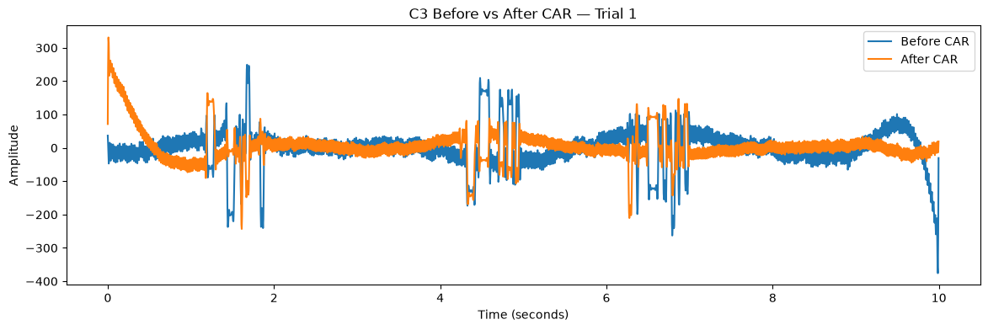
RE-REFERENCING
Common Average Reference — an experimental branch
At every time sample, subtract the average of FZ, C3, CZ, C4 from each channel:
channel(t) − mean(FZ, C3, CZ, C4)(t)
Sanity-checked
Averaging the 4 re-referenced channels comes out to ≈ 0 at every sample, as CAR requires by definition.
Treated as experimental, not default
With only 4 EEG channels, CAR's noise-cancelling benefit is less certain than in high-density montages — kept as a parallel branch, not assumed better.
CortexCall — Preprocessing Stage Review
17

Slide 18
SIGNAL CLEANING · REFINEMENT
Notch filter: added back as a final safety pass
The band-pass already excludes 50 Hz — but the follow-up cleaning pass applies a notch filter anyway, after deduplication, before saving the final dataset.
Original reasoning (Stage 2 report)
Final decision
"A separate 50 Hz notch filter was not considered necessary for the current 0.5–40 Hz pipeline because 50 Hz is already outside the kept frequency range."
Applied a 50 Hz notch filter (Q = 30)
as a final, low-risk safety pass on the deduplicated dataset — cheap insurance against any residual line noise.
Order of operations:
Filter (0.5–40 Hz) → Reject (165) → Dedup (60) → Notch (50 Hz) → final_clean_manifest.csv
This logic still holds for amplitude — but powerline interference can leak into neighboring frequencies through filter roll-off and any nonlinearity upstream.
CortexCall — Preprocessing Stage Review
18

Slide 19
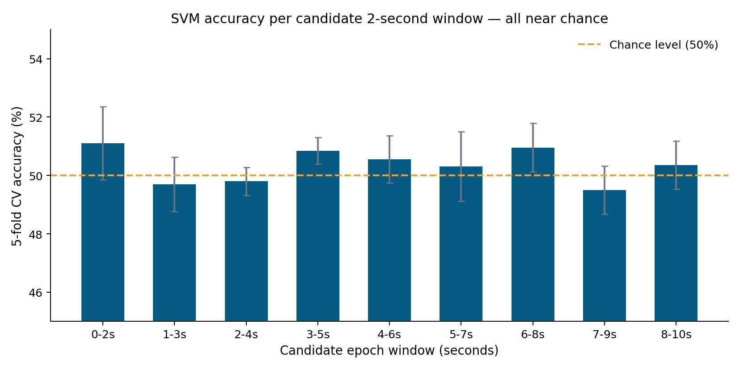
EPOCHING TEST
Testing 2-second windows: no advantage found
9 candidate windows (0–2s through 8–10s) were scored with mu/beta band-power features + a 5-fold cross-validated SVM.
~50% everywhere
Every window landed at essentially chance accuracy (49.5%–51.1%), with no window standing out as clearly informative.
Decision: don't crop yet
Keep full 10-second clean trials. Windowing is deferred to model-specific stages — CSP+SVM will focus on 8–30 Hz, EEGNet will use the full cleaned time series.
CortexCall — Preprocessing Stage Review
19

Slide 20
STAGE 2 SUMMARY
What modeling will start from
2,160
2,160
1,995
1,935
1,935
→
→
→
→
Raw EEG
0.5–40 Hz filter
Reject (EDA list)
De-duplicate
Notch filter
Final clean dataset (1,935 trials) splits into two comparable branches:
Clean filtered EEG
Clean filtered EEG + CAR
clean_manifest.csv → final_clean_manifest.csv
rereferenced_manifest.csv
Band-pass filtered, rejected, de-duplicated, notch-filtered. No re-referencing.
Same pipeline, plus Common Average Reference across FZ / C3 / CZ / C4.
Both branches will be compared during modeling using the same data split and evaluation method.
CortexCall — Preprocessing Stage Review
20

Slide 21
OPEN QUESTIONS
What we still need before finalizing preprocessing
Real experimental timing for epoching
We need the exact cue/onset timing: when the LEFT/RIGHT cue appears, when motor imagery starts and ends, and whether a true rest/baseline interval exists in the protocol.
Is CAR worth keeping with only 4 channels?
CAR is mathematically valid here, but its benefit is less proven with a 4-channel montage than with high-density EEG — we'd like a sanity check before treating it as anything more than experimental.
Should the 48 conflicting-label duplicates be reported upstream?
Identical signals carrying different LEFT/RIGHT labels suggest a labeling or logging issue at the data-collection stage, not just noise — worth flagging to the data provider.
CortexCall — Preprocessing Stage Review
21

Slide 22

STAGE 3 · MODELING
Modeling: three approaches, one shared ceiling
CSP + SVM, EEGNet, and a CNN + LSTM hybrid were all trained on the final 1,935-trial clean dataset (964 LEFT / 971 RIGHT).
Important context, learned after these runs
The instructor later confirmed the underlying EEG recordings are low quality. That reframes everything on the next slides: near-chance results point to a data ceiling, not necessarily failed modeling choices.
50.13%
How to read the next few slides
Every result is compared against this 50.13% baseline, not against 100%.
A model a few points above baseline is still a meaningful finding on this data.
The goal here is to identify which architecture is worth revisiting on cleaner data.
majority-class baseline on the test set — the number every model needs to beat
CortexCall — Modeling Stage Review
22

Slide 23
MODEL 1 · CLASSICAL ML
CSP + SVM — the classical baseline
Common Spatial Patterns for feature extraction, feeding a Support Vector Machine classifier — the standard first move for motor-imagery EEG.
Search performed
52.98%
3 channel sets
all 4 channels · central 3 (C3/CZ/C4) · motor 2 (C3/C4)
4 frequency bands
mu (8–12 Hz) · beta (13–30 Hz) · mu+beta (8–30 Hz) · wider MI (7–35 Hz)
12 configurations total, each scored with 5-fold cross-validation on the training split.
± 1.70% mean 5-fold CV accuracy
+2.85 pts over the 50.13% baseline — within noise, and CAR made it worse, not better.
Best configuration found
Verdict: standard single-band CSP + SVM does not provide strong class separation on this dataset.
Channels C3, CZ, C4 • 7–35 Hz band
CortexCall — Modeling Stage Review
23

Slide 24
MODEL 2 · DEEP LEARNING
EEGNet — compact CNN on raw trials
A lightweight, EEG-specific architecture (temporal conv → depthwise spatial conv → separable conv) trained directly on the full 10-second, 4-channel trials.
Setup
50.32%
2,497 parameters — tiny by deep-learning standards, chosen to suit a small dataset.
Input: normalized 4 × 2,500 raw trial (train-only mean/std, no leakage).
Up to 100 epochs, early stopping + LR reduction on validation loss.
70 / 15 / 15 train / validation / test split, stratified by class.
balanced accuracy on the held-out test set
50.39%
raw test accuracy — essentially equal to the 50.13% majority baseline
Training behavior
Verdict: model strongly favored RIGHT; full-trial EEGNet isn't extracting usable LEFT/RIGHT signal yet.
Training accuracy rose to ~59% while validation stayed ~50% and validation loss increased — classic overfitting on a signal without a strong pattern to learn.
CortexCall — Modeling Stage Review
24

Slide 25
MODEL 3 · DEEP LEARNING
CNN + LSTM — the best of the three
A 1D-convolutional feature extractor feeding an LSTM temporal head, benchmarked against a CNN-only version on the same split as EEGNet.
CNN only
CNN + LSTM ✓ selected
54.26%
62,049 params
53,921 params
50.32%
50.97%
test accuracy = balanced accuracy on held-out test set
validation accuracy
validation accuracy — selected as best model
+4.13 pts over the 50.13% majority baseline — the largest margin of the three models.
Balanced precision/recall (~0.53–0.55 for both classes) — a small but real edge, not a one-sided guess like EEGNet's.
Verdict: the most promising architecture of the three — worth revisiting first once cleaner data is available.
CortexCall — Modeling Stage Review
25

Slide 26
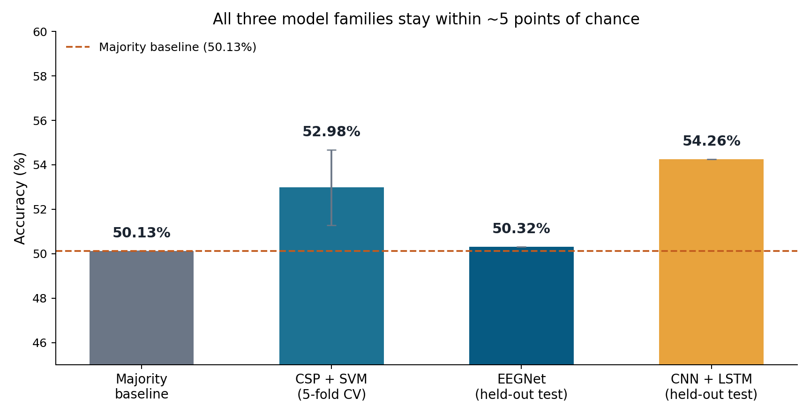
STAGE 3 SUMMARY
How the three models compare
Bottom line
CNN + LSTM leads
at 54.26%, the only model with a clear (if modest) margin over chance.
CSP + SVM and EEGNet
both land within ~2 points of the 50.13% baseline.
Read together with the low-quality-data finding,
this looks like a data ceiling, not an architecture problem.
CortexCall — Modeling Stage Review
26

Slide 27
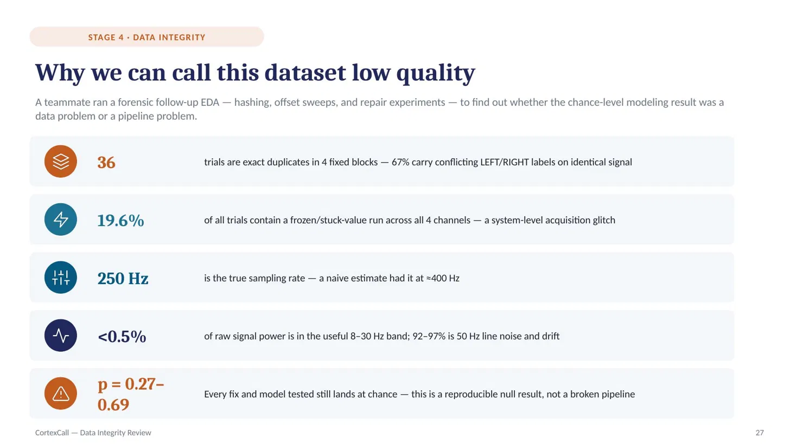

Slide 28
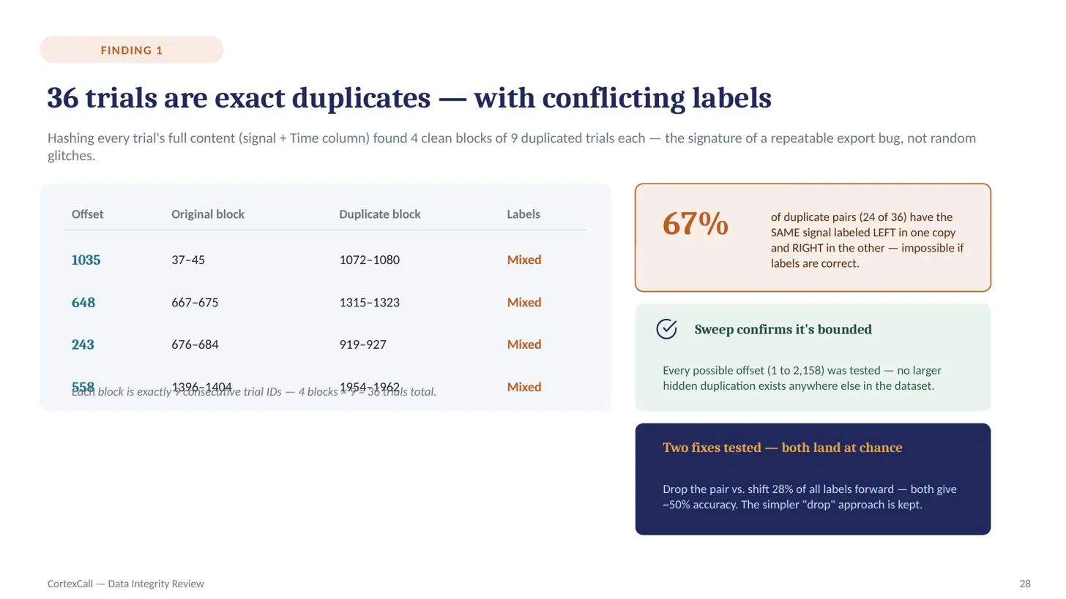

Slide 29
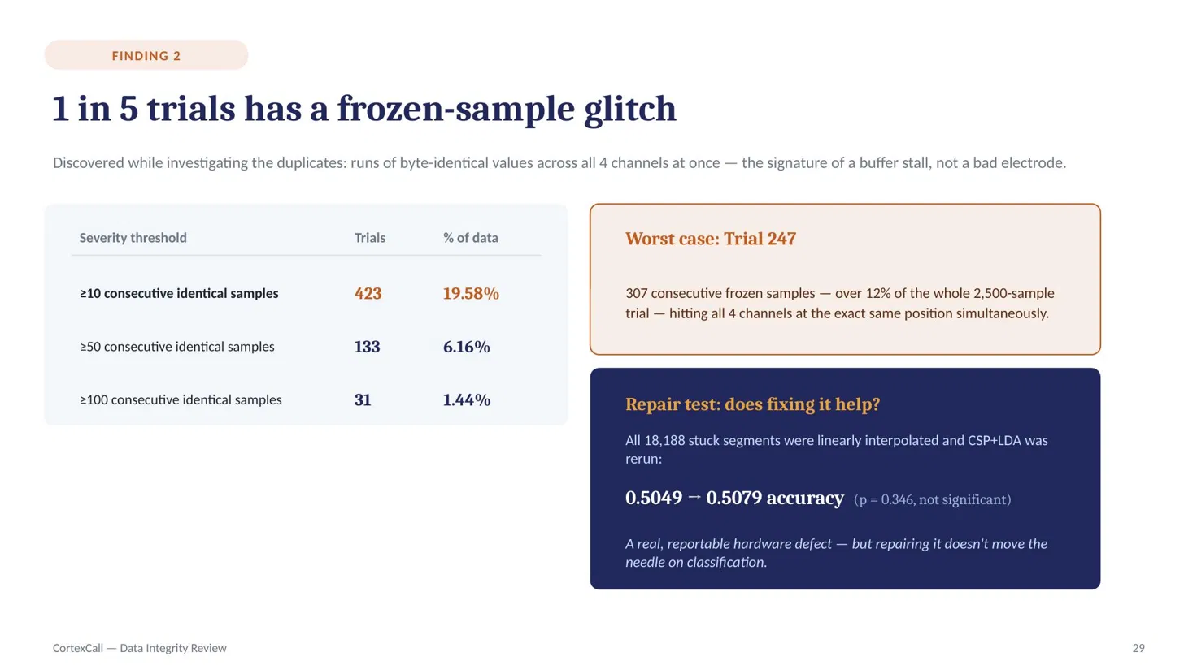

Slide 30
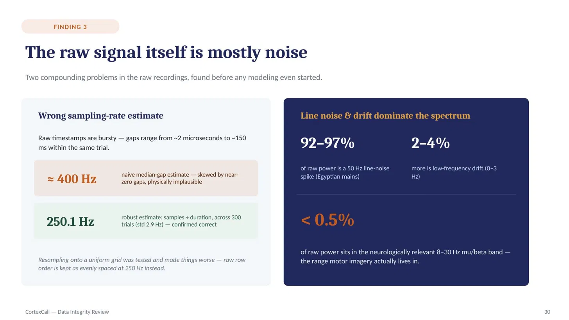

Slide 31
