Slide 1



Cellula Task1
Exploratory Data Analysis
Uber Fare Prediction Project
Prepared by : Ammar Mohamed

Slide 2



Table of contents
Basic Questions
01
Data Cleaning Stage
02
what i find weird in our dataset
whose mentioned in task pdf
More questions = More insights
03
discovering the good news

Slide 3


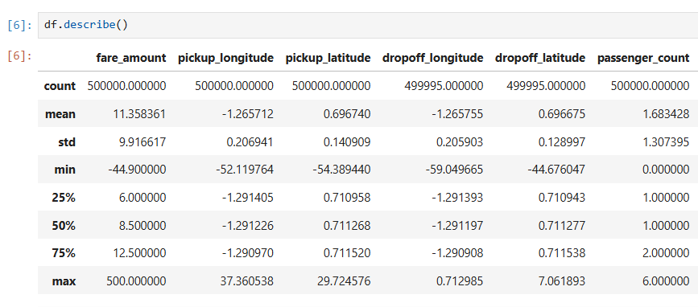
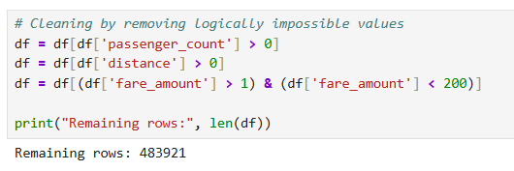

1) Data Cleaning
First I dropped the features that is not usefull in analysis such as User_ID , User_Name and Driver_Name
Also after running df.describe() , I notice logically invalid outliers as negative fare amount and Zero ride Distance , So i write a script for fixing this

Slide 4



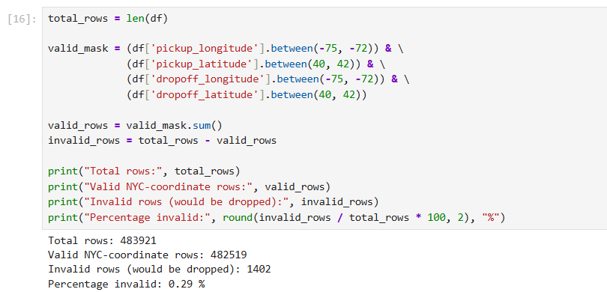
The Radians issue
Found: describe() showed impossible coordinates (mean longitude -1.27, not near NYC's -74)
Root cause: coordinates were stored in radians, not degrees
Fix: np.degrees() conversion → coordinates snapped correctly to NYC (-73.9, 40.75)
Also removed: negative fares, zero distance, zero passengers, 0.29% remaining GPS outliers

Slide 5


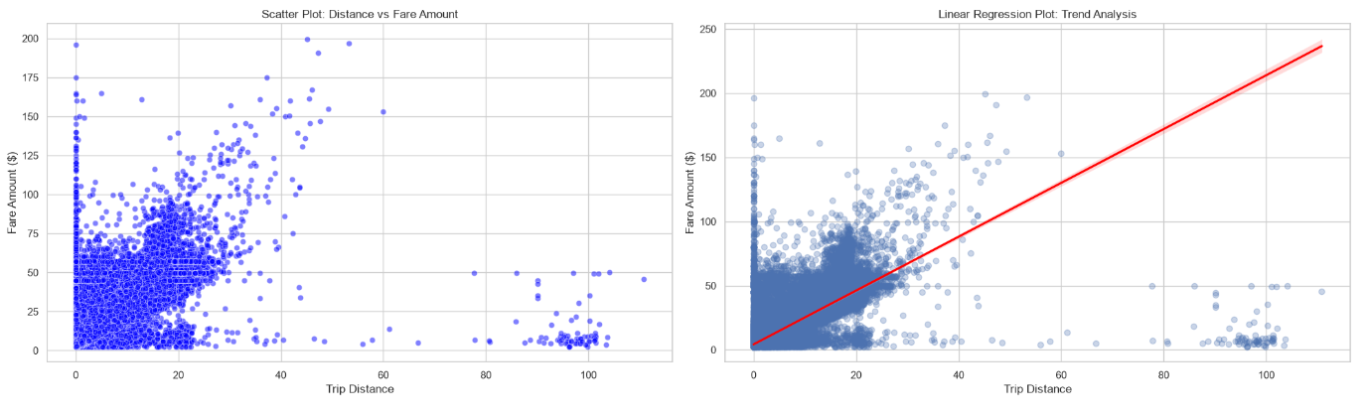
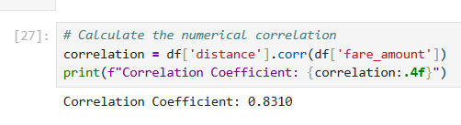



2) Basic Questions
Distance is the strongest fare predictor (Q5)

Slide 6


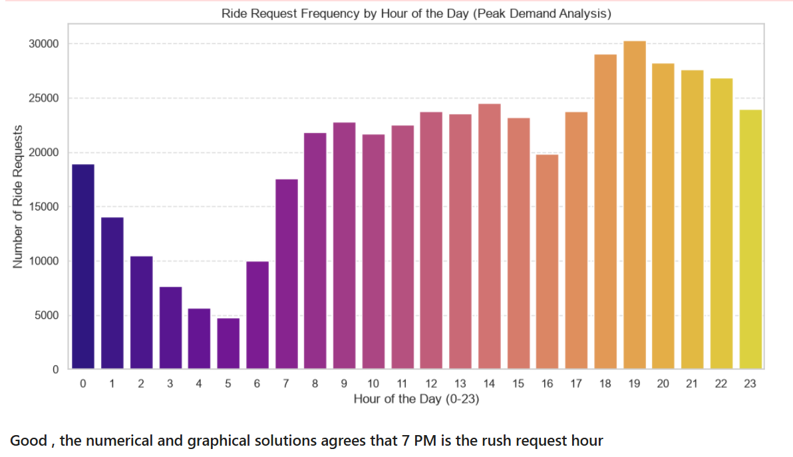
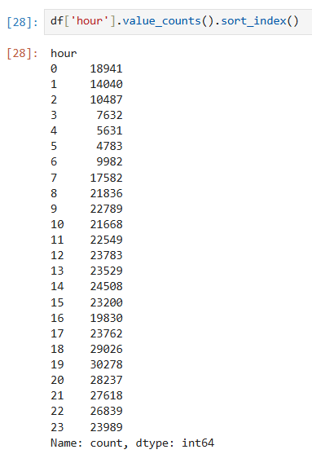

Peak demand hour (Q6)
Insight: 7 PM is the rush hour for ride requests — both numeric and visual confirm

Slide 7
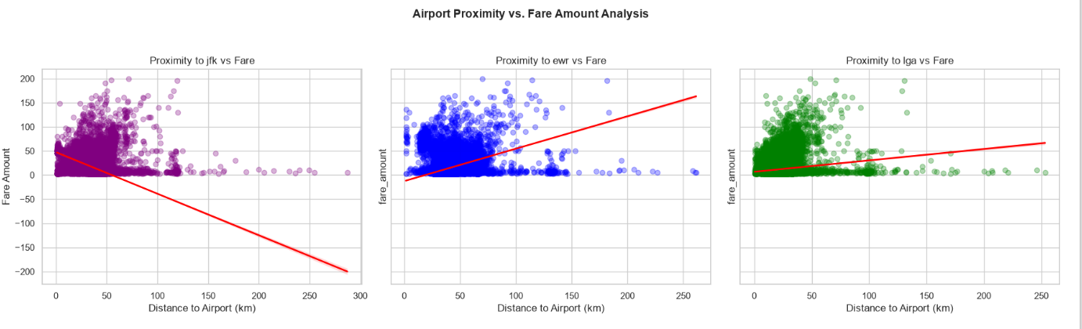
Airport proximity effect (Q8)
Insight: JFK rides show a fare premium near the airport; the pattern doesn't generalize to EWR/LGA

Slide 8


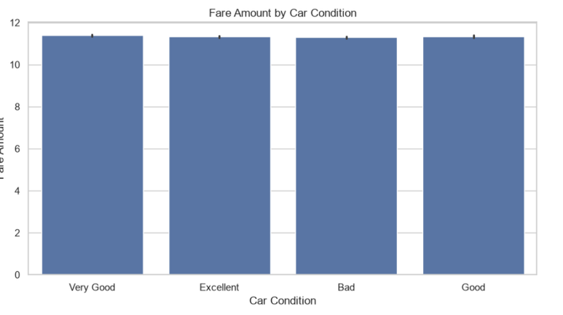
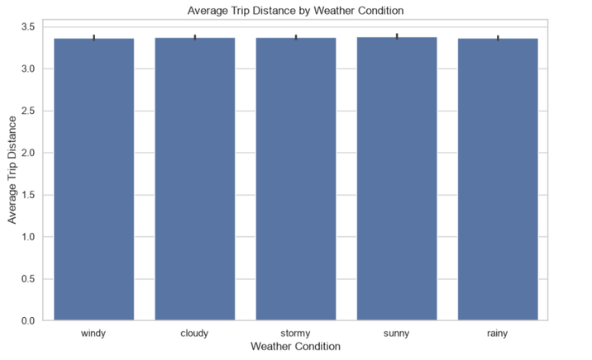
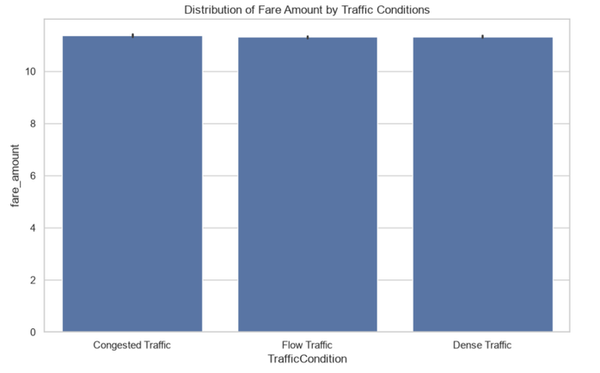

What doesn't affect fare
Car condition
Distance vs weather
traffic
Insight: Uber's core pricing model is driven by trip mechanics (distance/time), not ride conditions

Slide 9








3) Extra Questions for More Insights

Slide 10



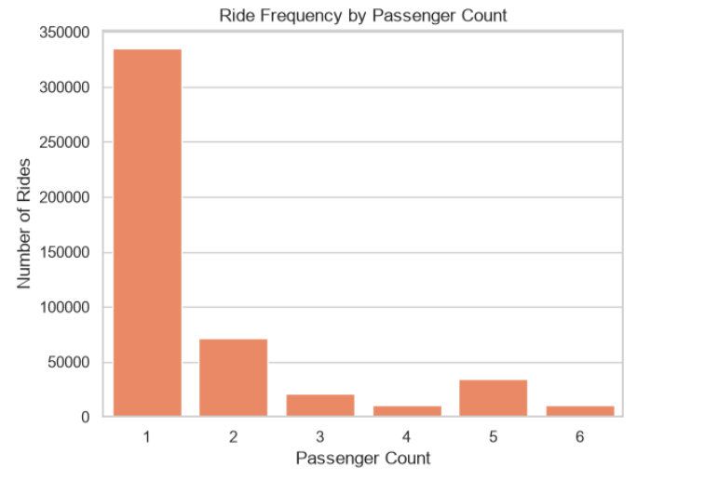
Solo rides dominate demand (Q11)
Insight: 1-passenger rides are by far the most common — single commuters drive peak demand

Slide 11
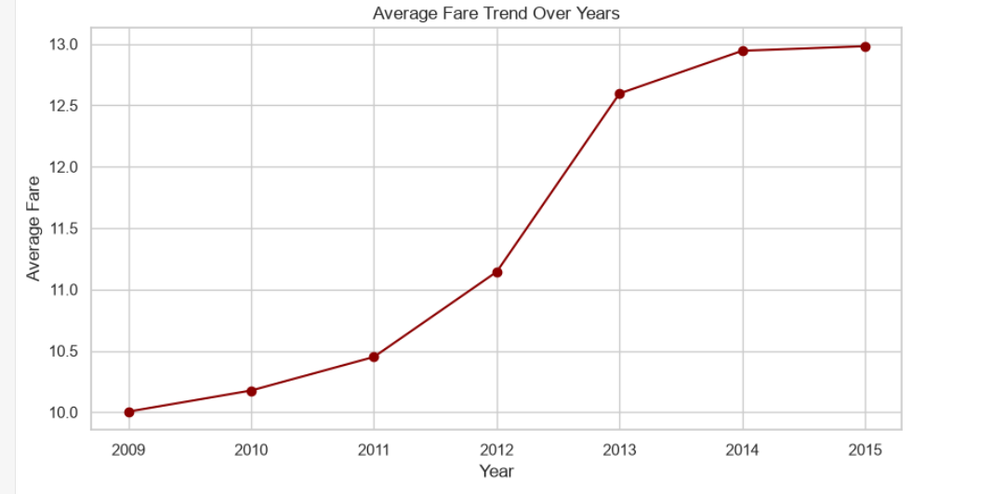
Fare trend over years (Q14)
Insight: Fares rise with inflation over time

Slide 12
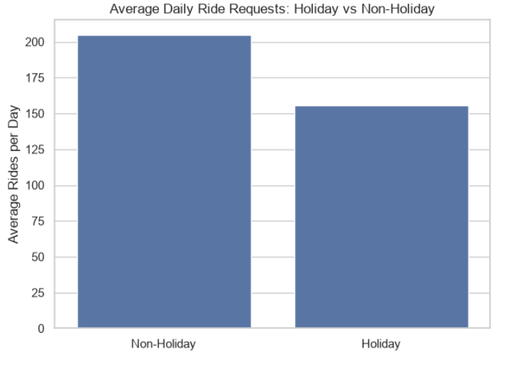
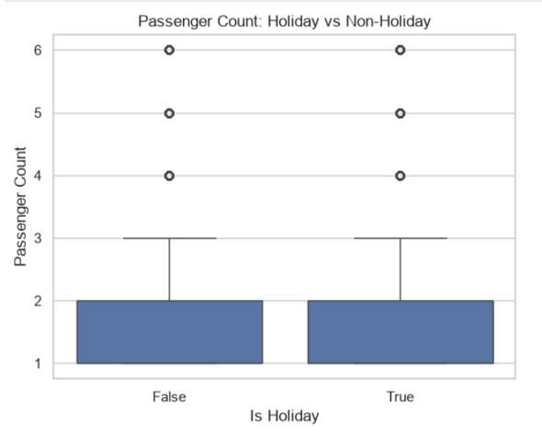
Holidays vs non-holidays (Q10)
Insight: Rides are requested more in a significant way in work days rather than holidays , but number of passengers variation is the same for both categories

Slide 13
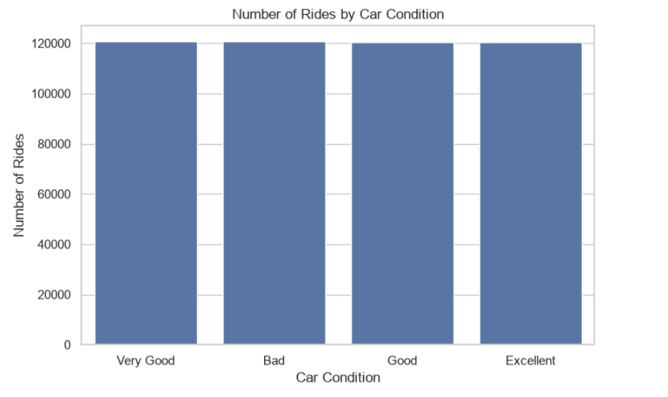
Car condition vs passenger count (Q13)
Insight: All types of car conditions share the same number of rides

Slide 14


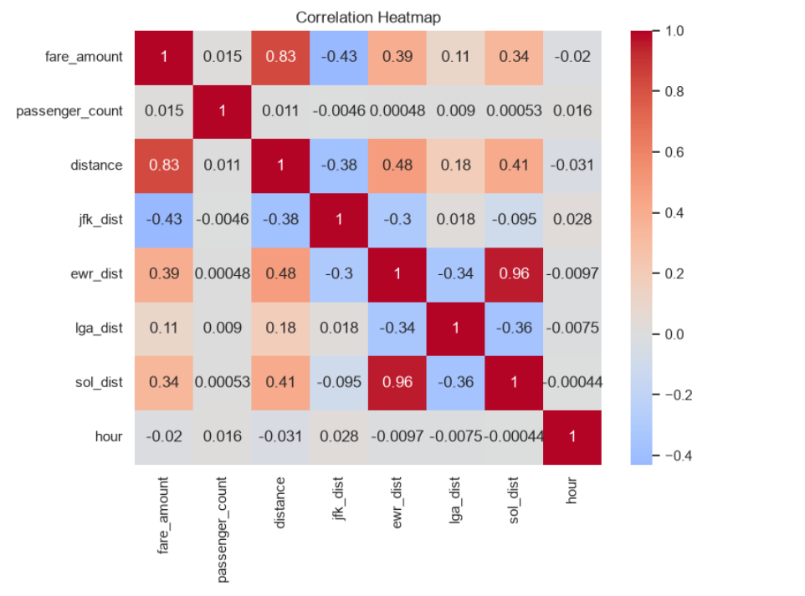

Correlation heatmap: The big picture
Insight: Distance is the strongest fare-correlated feature; everything else is weak — this directly sets up to the next modeling priorities

Slide 15


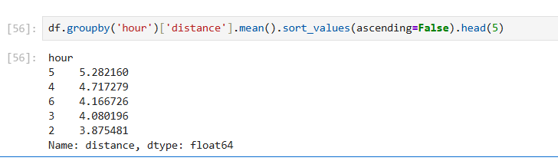
Conclusion
The Good news is that distance is the most feature we will focus on as developers when modeling for fares prediction
And one more evidence i found it weird but it helped in solving the case :
That 7 PM has the cheapest average fares knowing that it’s the rush hour While 5 AM is the least hour in ride requests but it has the highest fare amounts
And that’s condradicts with supply and demand famous principle
But here is the trick , i will show you on the notebook :

Slide 16



Thanks!
Do you have any questions?
https://github.com/ammar-abdelghany30/uber-data-analysis

