Slide 1
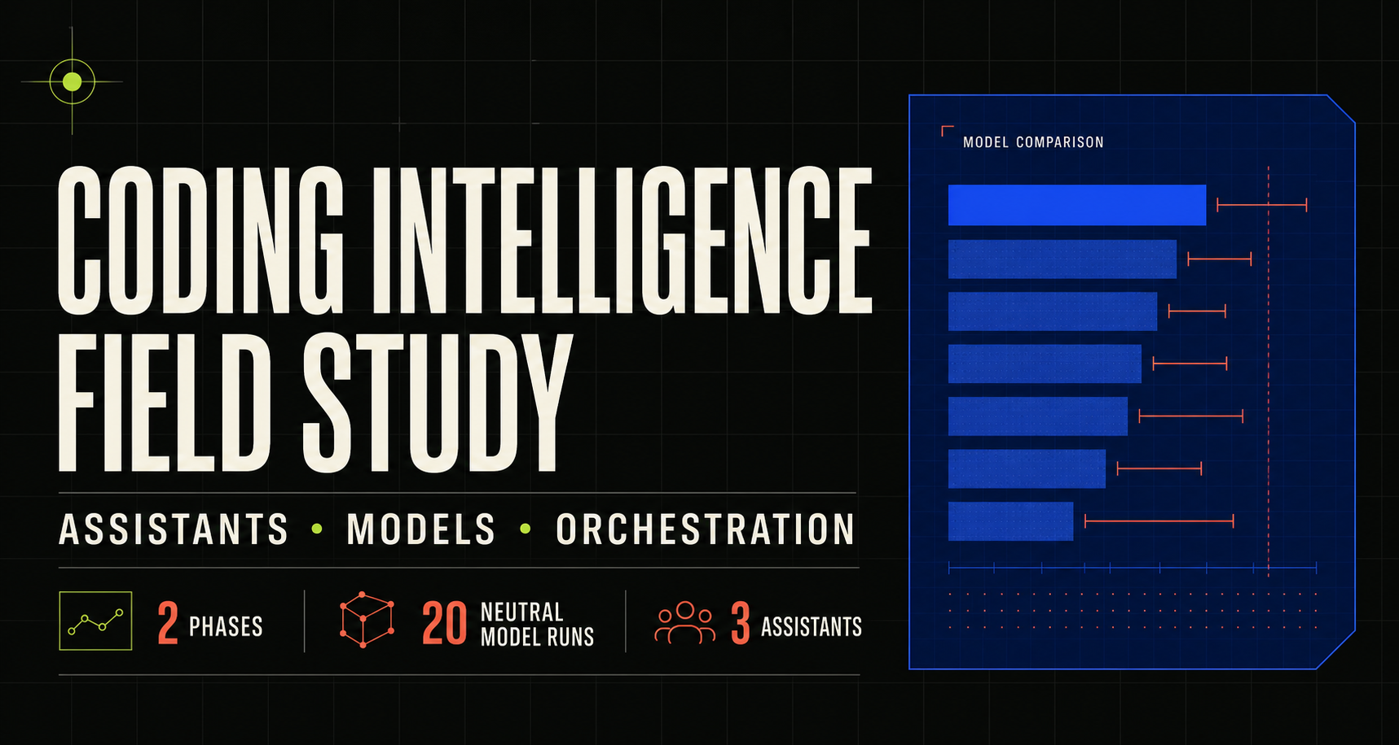
Notes:
Open with the question behind the study: are we evaluating the coding assistant, the model, or the workflow around both? State that the answer required two phases and working applications, not a single leaderboard.
[Sources]
- public/og.png
- benchmark/reports/final-study-report.md

Slide 2
01 / STUDY DESIGN
The product and the model are different experiments.
Phase 1 measured complete coding assistants. Phase 2 held the Pi control surface fixed and changed only the model route.
PHASE 1
PHASE 2
Assistant products
→
Models in one harness
Planning, permissions, tools, plugins, context, integration, and distributed work.
EVIDENCE
HANDOFF
Same baseline, prompt, tools, provider, timeouts, zero intervention, and private verification.
CODEX · CLAUDE CODE · OPENCODE
SOL · FABLE · GLM · QWEN · KIMI
This separation prevents assistant polish from being mistaken for model capability.
CODING INTELLIGENCE FIELD STUDY
02
Notes:
Explain that Phase 1 deliberately tested the whole product experience. Phase 2 then neutralized the assistant by using Pi. This is the methodological move that makes the conclusions useful.
[Sources]
- benchmark/reports/phase-1/PHASE-1-COMPREHENSIVE.md
- benchmark/phase-2/PROTOCOL.md

Slide 3
02 / ASSISTANT DIFFERENTIATION
Four tools earned four different jobs.
The assistant advantage sits around the model: permissions, tools, context, review posture, and integration discipline.
CODEX
Lead and integrator
Best default lead
CLAUDE CODE
Reviewer and alternate lead
Strongest independent challenger
OPENCODE
Open-model worker
Worth keeping for bounded routing
PI
Neutral model harness
The laboratory, not the winner
CODING INTELLIGENCE FIELD STUDY
03
Notes:
Walk left to right through the operating roles. Codex leads and integrates. Claude provides an independent challenge. OpenCode is useful when model flexibility matters. Pi is the neutral experiment surface.
[Sources]
- benchmark/reports/phase-1/PHASE-1-COMPREHENSIVE.md
- benchmark/reports/final-study-report.md

Slide 4
03 / PRODUCTS UNDER PRESSURE
The strongest products succeeded in different ways.
A frontier incident and a fixed-model harness exposed speed, review breadth, and product friction.
CODEX + SOL
CLAUDE + OPUS
OPENCODE + KIMI K2.7
99
97
99
129.209 s
228.453 s
55.115 s
Fastest accepted frontier repair
Broader independent review
Fastest fixed-model harness result
WHAT CHANGED
Codex emerged as the default integrator; Claude as the independent review lane; OpenCode as the flexible worker harness.
CODING INTELLIGENCE FIELD STUDY
04
Notes:
Use the cards to show that the scores alone are not the conclusion. Codex completed the accepted frontier repair fastest. Claude produced broader review behavior. OpenCode was fast in the fixed shared-model harness.
[Sources]
- benchmark/reports/T6-top-frontier-comparison.md
- benchmark/reports/T6-shared-kimi-harness-comparison.md

Slide 5
04 / NEUTRAL MODEL COMPARISON
Capability clustered. Reliability separated.
Strict weighted score across analysis, bounded implementation, and concurrent debugging.
GPT-5.6 Sol
100 · 3/3 writes
GLM 5.2
100 · 3/3 writes
Claude Fable 5
99.8 · 3/3 writes
Qwen3.8-27B
98.8 · 3/3 writes
Kimi K3
68.75 · 1/3 writes
RELIABILITY RULE
A saved patch can be capable and still fail the operating lane when the run times out.
CODING INTELLIGENCE FIELD STUDY
05
Notes:
Focus on the cluster at the top, then the operational gap. Sol and GLM tied at 100. Fable and Qwen were close. Kimi's saved patch later scored well, but the counted timeout and write acceptance remain part of the result.
[Sources]
- benchmark/reports/phase-2/PHASE-2-COMPREHENSIVE.md
- benchmark/blocks/phase-2-pi-model-comparison-2026-08-23.results.json

Slide 6
05 / ECONOMICS
Qwen was the cheapest reliable worker.
Pi-reported cost for the complete Phase 2 lane. Account-level reconciliation remains unresolved.
Qwen3.8-27B
$0.0160
GLM 5.2
$0.0562
Kimi K3
$0.0760
GPT-5.6 Sol
$0.0808
Claude Fable 5
$0.3644
RECONCILIATION CAVEAT
Saved Pi telemetry: $0.5933 · Observed account decrease: about $2.50
CODING INTELLIGENCE FIELD STUDY
06
Notes:
Position Qwen as the economical bounded worker, not as a universal replacement. State the cost caveat explicitly: saved Pi telemetry did not reconcile to the observed OpenRouter balance decrease, so route-level rankings are provisional.
[Sources]
- benchmark/reports/phase-2/PHASE-2-COMPREHENSIVE.md
- benchmark/phase-2/ACCESS-AND-BUDGET.md

Slide 7
06 / DISTRIBUTED WORKFLOW
Distribution bought auditability, not speed.
The multi-assistant route scored 100 with zero frontier repair, but took 3.57x as long as solo Codex.
3.57x
PLAN
CHALLENGE
BUILD
INTEGRATE
REVIEW
→
→
→
→
Codex
Claude
OpenCode + Kimi
Codex
Claude
SLOWER
Distributed
536.704 s
Solo Codex
150.206 s
DECISION
Distribute only when independent challenge or ownership separation justifies the coordination cost.
CODING INTELLIGENCE FIELD STUDY
07
Notes:
Describe the five handoffs, then compare the elapsed bars. The route was correct and auditable, but slower. The recommendation is selective distribution for high-risk or ownership-sensitive work, not distribution by default.
[Sources]
- benchmark/reports/T5-distributed-workflow-comparison.md
- benchmark/blocks/T5-distributed-workflow-v2-2026-08-23.results.json

Slide 8
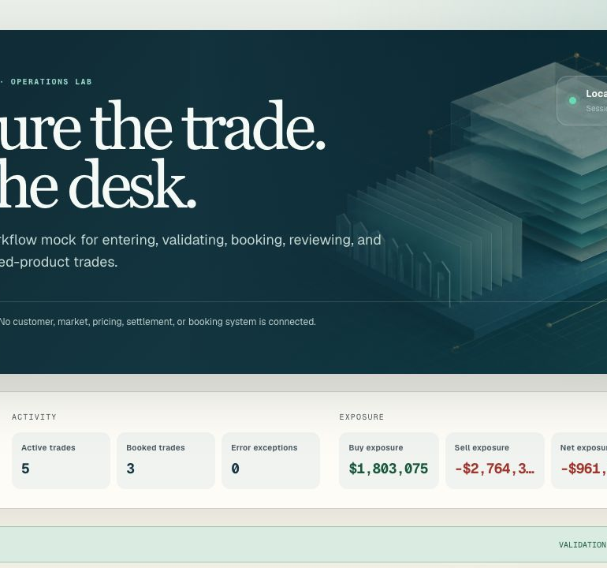
07 / WORKING APPLICATION
The research produced working software.
A deterministic securitized-products operations mock for capturing, validating, booking, reviewing, filtering, and cancelling synthetic trades.
Accepted distributed artifact
No external systems connected
Synthetic demonstration data only
LIVE ROUTE /trade-capture
Notes:
Pause the slide here and open the live trade-capture route. Show the desk totals, trade ticket, validations, and immutable lifecycle. Emphasize that it is synthetic and deterministic rather than connected to production systems.
[Sources]
- benchmark/reports/T7-distributed-trade-capture.md
- app/trade-capture/

Slide 9
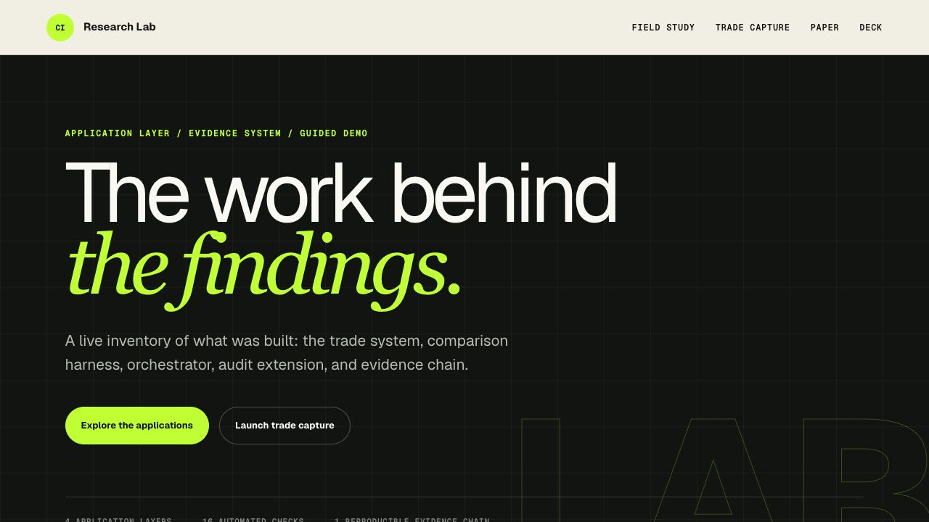
08 / APPLICATION STACK
The claims are inspectable through working surfaces.
01
Trade capture
Live application
02
Neutral Pi harness
Model comparison
03
Benchmark orchestrator
Assistant execution
04
Read-only audit MCP
Portable verification
SHAREABLE EXPERIENCE /lab
CODING INTELLIGENCE FIELD STUDY
09
Notes:
Use the Research Lab as the application directory. It links the live trade system, the neutral harness, assistant execution workflow, audit extension, paper, and this deck. The point is traceability from conclusion to working evidence.
[Sources]
- app/lab/research-lab.tsx
- benchmark/extensions/benchmark-audit/README.md
- benchmark/reports/final-study-report.md

Slide 10
09 / OPERATING MODEL
Build a portfolio of roles, not a brand leaderboard.
Frontier judgment at the top. Economical execution underneath. Independent review where risk warrants it.
01 / PLAN
Codex + Sol
↓
02A / BUILD
02B / BUILD
02C / CHALLENGE
QWEN
GLM
CLAUDE
Bounded build
Hard async work
Independent review
↓
03 / INTEGRATE
Codex final gate
PLAN HIGH · EXECUTE LOW · VERIFY EVERYTHING
CODING INTELLIGENCE FIELD STUDY
10
Notes:
Close with the practical operating model. Use Codex and Sol for planning and integration. Route bounded work to Qwen, hard asynchronous work to GLM, and high-risk review to Claude. Finish with the rule: plan high, execute at the lowest reliable tier, and verify everything.
[Sources]
- benchmark/reports/final-study-report.md
- benchmark/reports/phase-2/PHASE-2-COMPREHENSIVE.md

