Slide 1
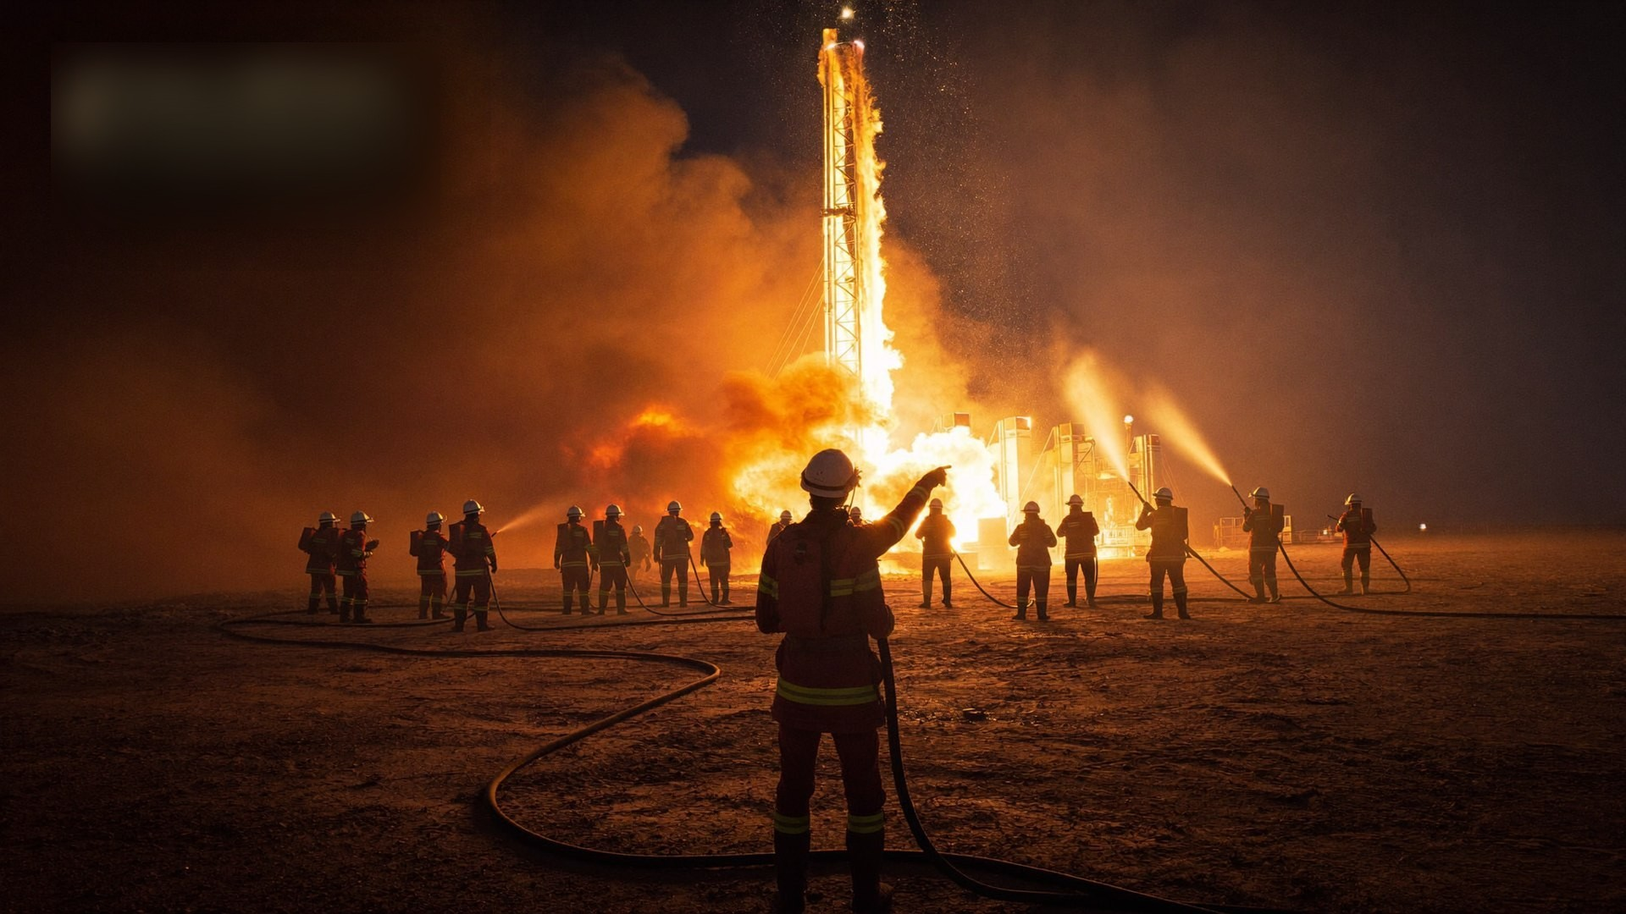
NEFT ENERGIES × SANAD • ADVANCED SUPERVISORY PROGRAM
FIRE FIGHTING
TEAM LEADER
Command Under Fire — a 3-day leadership course for the people who take charge when a drilling rig burns.
3 DAYS • SUPERVISORY / ADVANCED • 60–65% PRACTICAL • DRILLING OPERATIONS, SAUDI ARABIA
Notes:
Welcome the group. This course was built from the NEFT Energies technical proposal NERFQ26-5018 for SANAD. Emphasize: this is a leadership course, not a basic firefighting course — every participant already fights fire; here they learn to command it.

Slide 2
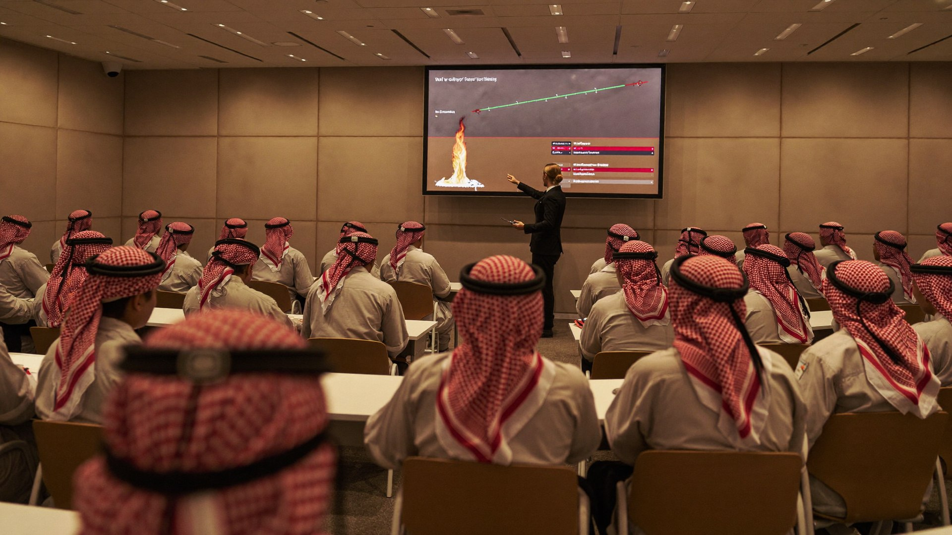




WELCOME
How this course runs
Timing — 07:30–16:30 daily. Practical blocks start on time, in full PPE.
Safety first — Training-ground rules are briefed before every practical. The safety officer's STOP is absolute.
Challenge everything — Question, argue, share real incidents from your rigs — experience in this room is course material.
NEFT Energies training delivery — classroom to fireground
You are always on — Assessors observe from the first minute. Leadership is a habit, not a performance.
Phones on silent. On a fireground, distraction kills. We practice that discipline here.
SANAD | FIRE FIGHTING TEAM LEADER
02
Notes:
Housekeeping (5 min). Introduce the delivery team: lead instructor, assessor, and exercise safety officer — one sentence each on their fireground background to establish credibility. Cover the four rules briskly, then do a 10-minute round of participant introductions: name, rig, years of service, and one fire or emergency they have personally seen. Write their expectations on a flipchart — you will return to it at course close. Confirm everyone's medical fitness for practical work and any dietary/prayer needs.

Slide 3
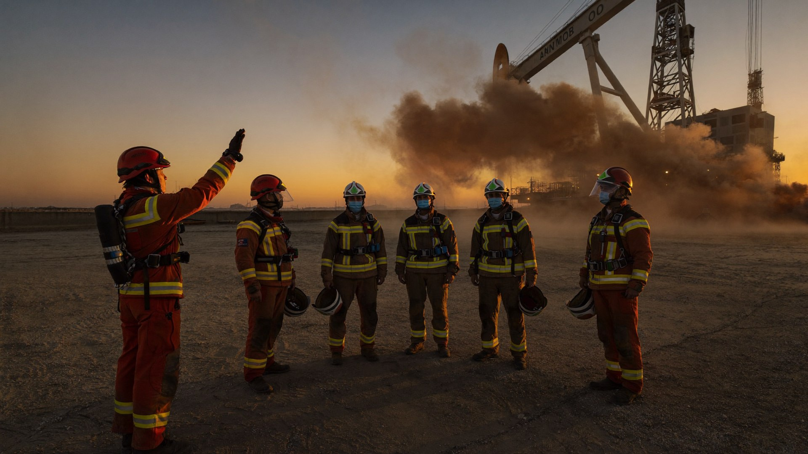
WHO THIS IS FOR
Built for SANAD's front line
SANAD crews operate drilling and workover rigs across the Kingdom for Saudi Aramco — often hours away from the nearest municipal fire station. When fire breaks out, the rig's own fire team IS the fire department.
Designed for Fire Team Leaders and Supervisors on SANAD rigs
Aligned with Saudi Aramco contractor emergency-response expectations
Scenario content drawn from real drilling-rig fire risks — not generic buildings
Delivered by NEFT Energies: ISO & TVTC approved, accredited by IADC, OPITO, NFPA, NEBOSH and IOSH
Team brief at first light — leadership starts before the alarm
3
6
65%
100%
days of intensive training
modules, leadership-first
hands-on practical delivery
scenario-based assessment
SANAD | FIRE FIGHTING TEAM LEADER
03
Notes:
Context slide (3 min). Make it personal: ask how far the nearest professional fire station is from each participant's current rig — let the answers hang in the air, because that distance IS the course justification. Reference SANAD's position as a Saudi Aramco drilling affiliate and the standard its rigs are held to. Point at the four stat tiles and emphasize 65% practical: 'You will spend most of these three days on your feet, not in this chair.'

Slide 4
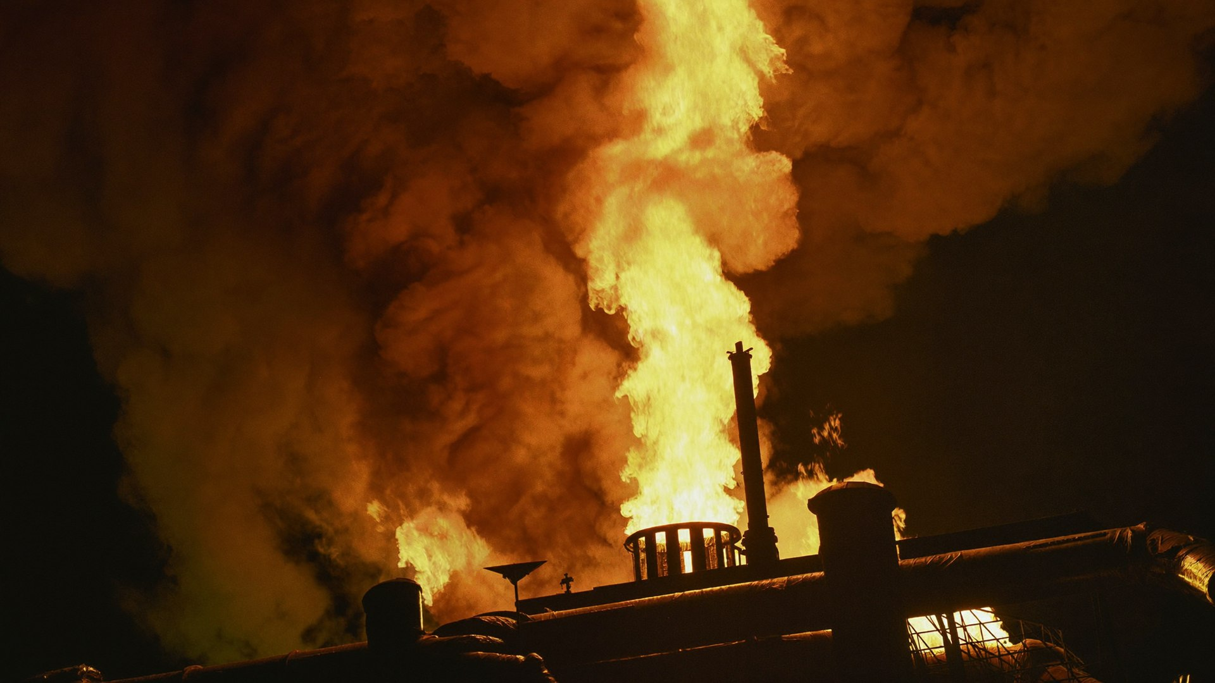
WHY THIS COURSE EXISTS
The first five minutes
decide the outcome.
A rig fire near fuel, mud gas or the wellhead can escalate from incident to catastrophe in minutes
Remote desert sites mean no cavalry — the on-site team leader owns the response
Saudi Aramco holds contractors to the highest emergency-readiness standard in the region
Equipment can be replaced. Trained, led, disciplined people are what save lives
5 min
1 leader
0
window that decides escalation
sets the tempo for every crew
the only acceptable loss of life
SANAD | FIRE FIGHTING TEAM LEADER
04
Notes:
Set the tone: this is not a compliance course. Ask the room: who here has seen a real fire on a rig? Let one or two answer. The gap between a near-miss and a disaster is almost always leadership in the first minutes.

Slide 5




THE NEFT APPROACH
Not another fire course
Most fire training teaches hands. This course trains the head that commands them — then proves it under realistic pressure.
Leadership first
Real fire realism
Human factors built in
60–65% practical
Command presence, decision-making and authority under pressure — the core of every module, not an afterthought.
Drills and simulations mirror drilling-rig fires: fuel, wellhead, mud gas, H2S — the fires SANAD crews could actually face.
Stress, panic, fear and discipline are trained deliberately — because people, not pumps, fail first.
Most of the course is spent doing: role-plays, tactical drills, command simulations and a full-scale evaluated exercise.
SANAD | FIRE FIGHTING TEAM LEADER
05
Notes:
Differentiation slide (3 min). Most participants have sat through basic fire training before — acknowledge that directly, then draw the line: basic courses certify hands, this course certifies command. Walk the four cards left to right. On 'Human factors built in', tell a short true-to-life story of a drill where a capable crew fell apart because of one panicking member — every experienced instructor has one. Close with: 'By Thursday afternoon you will have commanded a rig emergency six times. Nobody leaves here untested.'

Slide 6






BY THE END OF THIS COURSE
You will be able to…
Lead firefighting teams effectively — on shift, on scene, under fire
Conduct dynamic risk assessments as conditions change
Make sound decisions under time pressure and uncertainty
Manage team behavior, stress and performance in crisis
Apply structured emergency response strategies
Lead incident command and multi-team coordination
Conduct post-incident reviews that make the team better
Validated, not assumed: every objective is tested in scenario on Day 3.
SANAD | FIRE FIGHTING TEAM LEADER
06
Notes:
Objectives slide (3 min). These seven objectives come verbatim from the NEFT–SANAD proposal — read them as commitments, not aspirations. Ask each participant to silently pick the ONE objective they feel weakest on today; they will name it to their table group, and it becomes their personal focus for the practical blocks. Point at the dark callout: on Day 3, assessors score against exactly these seven lines. There is no hidden syllabus.

Slide 7



THE STANDARD
The Fire Team Leader competency profile
Competency = knowledge you can recall under stress + skills you can execute in gloves + behaviors you show when nobody reminds you.
KNOWS
DOES
IS
Rig fire hazards & fire behavior
Response strategies & ICS structure
Communication protocols & SITREP formats
Accountability & withdrawal procedures
Takes command and declares it
Sizes up and re-assesses continuously
Deploys, rotates and conserves resources
Runs closed-loop comms under load
Calm — the thermostat, not the thermometer
Decisive at 70% information
Ruthless on safety discipline
Honest in the debrief, hungry to improve
SANAD | FIRE FIGHTING TEAM LEADER
07
Notes:
Competency framing (4 min). This slide defines what 'competent' means for the rest of the course — knowledge, skills, behaviors. Stress the third column hardest: knowledge and skills decay gracefully, behaviors fail catastrophically. Ask the group: 'Which column do most fire courses test? Which column kills people when it fails?' The final competency validation on Day 3 signs off against all three columns, and the individual competency report they take home is structured the same way.

Slide 8
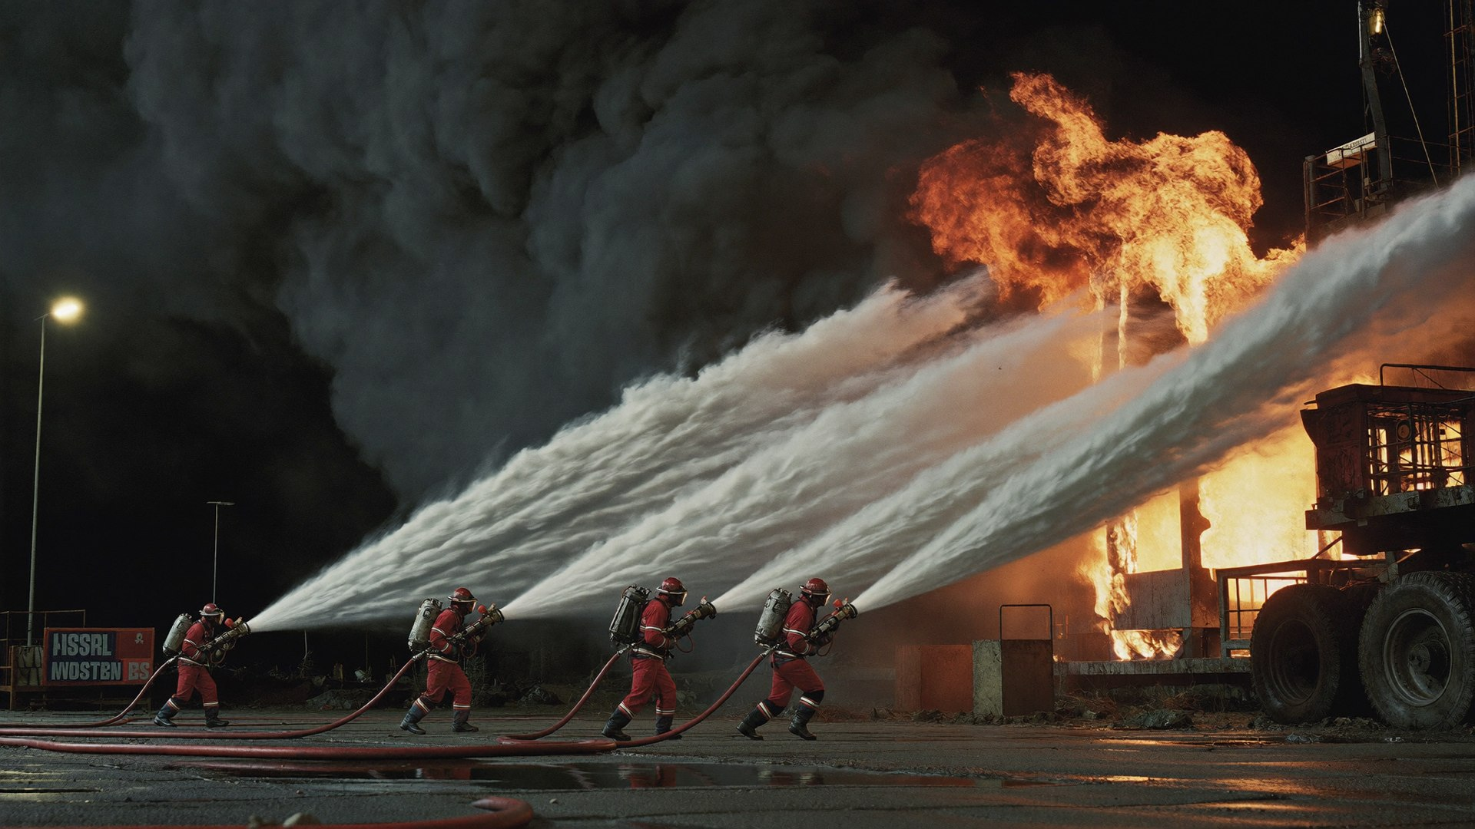
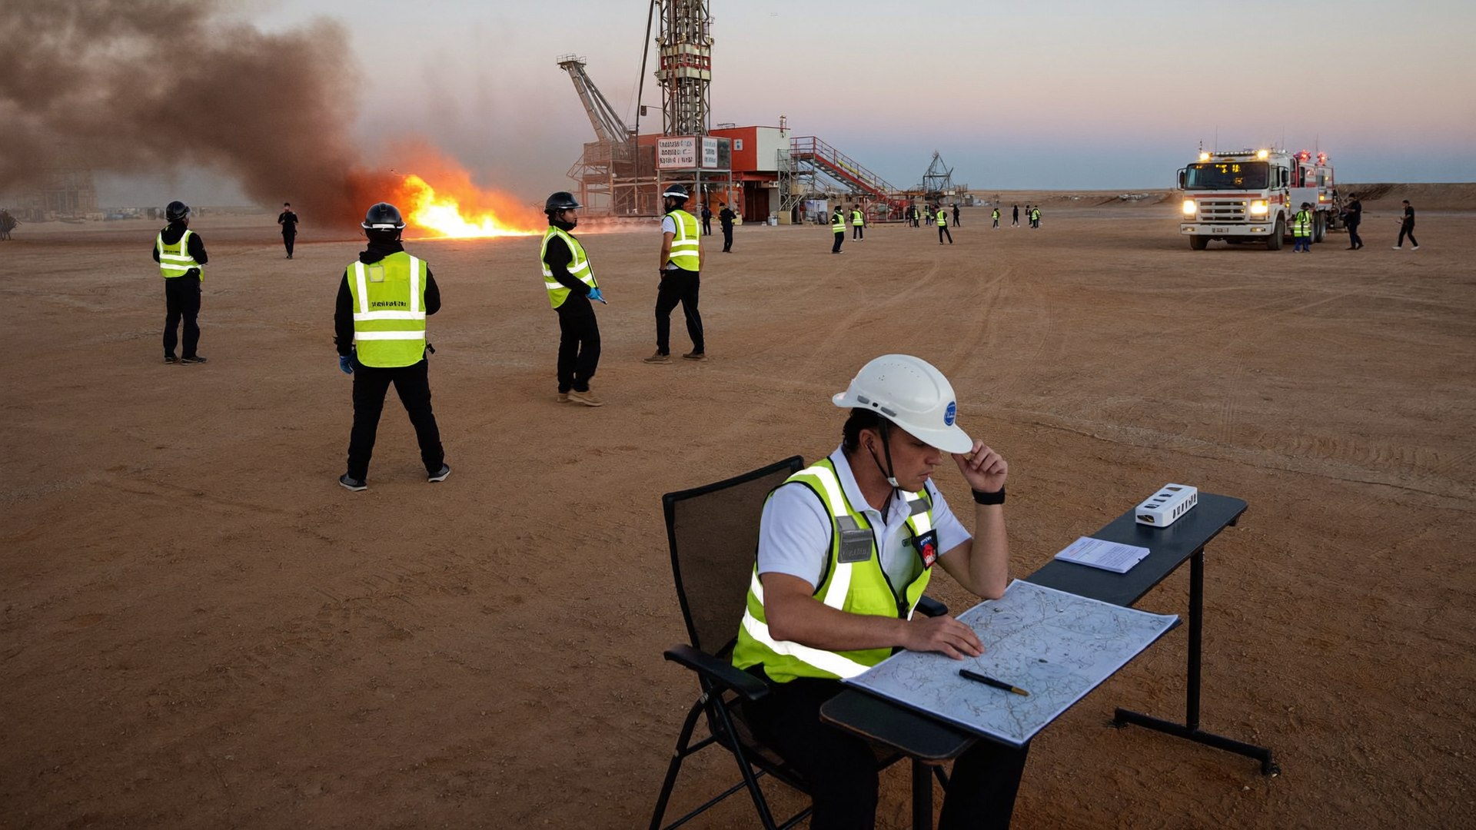
THE JOURNEY
Three days. Three gears.
DAY 1 — LEAD
DAY 2 — COMMAND
DAY 3 — PROVE
The Leader Under Pressure
Tactics, Coordination, Control
Full-Scale Simulation
Foundations of emergency leadership and the human factors that make or break a team.
Tactical fire response, communication discipline and structured incident command.
Complex multi-risk scenarios, evaluated in real time. Certification is earned here.
Modules 1–2
Modules 3–5
Module 6 + Assessment
SANAD | FIRE FIGHTING TEAM LEADER
08
Notes:
Journey slide (2 min). Lead–Command–Prove is the course spine; repeat those three verbs until they stick. Day 1 builds the leader, Day 2 builds the commander, Day 3 proves both under pressure. Point out that Day 3's card is dark for a reason: no new theory is introduced on the final day — if it isn't in their heads by Wednesday evening, the simulation will find the gap. Use this to justify the evening assignment culture.

Slide 9
COURSE ARCHITECTURE
Six modules, one mission
1
Leadership in Emergency Response
Day 1
2
Human Factors & Behavioral Leadership
Day 1
Command presence, styles, decisions under uncertainty
Stress, panic, discipline, unsafe-act prevention
3
Tactical Fire Response & Scene Management
Day 2
4
Communication & Command
Day 2
Attack strategies, size-up, risk-based decisions, resources
Protocols, multi-team coordination, control in escalation
5
Incident Command & Emergency Control
Day 2
6
Full-Scale Simulation & Evaluation
Day 3
ICS principles, control zones, escalation, accountability
Complex scenarios, real-time evaluation, structured debrief
SANAD | FIRE FIGHTING TEAM LEADER
09
Notes:
Architecture slide (2 min). Six modules exactly as contracted in the NEFT proposal — show the day mapping on the right of each card. Note the deliberate sequence: you cannot run incident command (M5) without communications (M4), and no tactic (M3) survives a team whose behavior collapses (M2), which is why leadership (M1) comes first. Invite participants to keep this slide photographed on their phones as their course map.

Slide 10


HOW YOU WILL BE MEASURED
Assessment & certification
Leadership performance evaluation
Scenario-based assessments
Final competency validation
Continuous assessor observation across all practical work — command presence, decisions, control of the team.
Graded performance in tactical drills, command simulations and the Day 3 full-scale exercise.
Structured sign-off against the Fire Team Leader competency profile, plus knowledge check.
Throughout
Days 2–3
Day 3
Certificate of Competency — Fire Fighting Team Leader. Issued by NEFT Energies (ISO & TVTC approved; accreditations include IADC, OPITO, NFPA, NEBOSH, IOSH) upon successful validation.
SANAD | FIRE FIGHTING TEAM LEADER
10
Notes:
Assessment overview (4 min). Be completely transparent about how they are measured — adults commit to standards they understand. Walk the three components and their timing chips: observation is continuous, scenarios are graded from Day 2, validation closes Day 3. Reassure and challenge in the same breath: 'Nobody fails by surprise here — you will get feedback every single day. But nobody coasts either; the certificate is signed against evidence, not attendance.' Preview the re-assessment pathway so anxiety doesn't block learning.

Slide 11

BUILT ON RECOGNIZED PRACTICE
Standards this course draws from
NFPA guidance
Incident Command System
Industrial fire brigade practice (NFPA 600 family), fire officer professional qualifications (NFPA 1021 concepts), and occupational safety principles for fire teams.
Internationally recognized ICS doctrine: unity of command, span of control, modular growth, common terminology.
Regulatory intent
Operator & contractor practice
Industrial fire brigade and emergency-response duty-of-care expectations applied in high-hazard energy operations.
Saudi Aramco contractor emergency-readiness expectations and SANAD's own emergency response plan — the course plugs into them, it does not replace them.
Site rules win. Where anything here differs from your rig's approved emergency response plan or Saudi Aramco direction, the approved site procedure governs.
SANAD | FIRE FIGHTING TEAM LEADER
11
Notes:
Standards slide (3 min). Position the course as grounded, not improvised: it draws on NFPA industrial fire brigade practice, ICS doctrine, and the emergency-readiness expectations that operators place on drilling contractors. Do NOT quote specific clause numbers from memory in class — if asked for a citation, note it and follow up in writing. Land hard on the bottom line: the approved site ERP always governs. This course makes them better at executing their rig's plan, never a license to deviate from it.

Slide 12
DAY 1 OF 3
LEAD.
The Leader Under Pressure
Foundations of emergency leadership — and the human factors that decide whether a team performs or panics.
Module 1 — Leadership in Emergency Response
Module 2 — Human Factors & Behavioral Leadership
Role-plays, decision drills, behavioral simulations
SANAD | FIRE FIGHTING TEAM LEADER
12
Notes:
Transition slide (2 min). Stand at the front, let the image land before speaking. Frame the day in one sentence: "Foundations of emergency leadership — and the human factors that decide whether a team performs or panics." Preview the blocks listed on the slide, state the day's finish time, and remind participants that everything today is assessed material for Day 3. Energy check: ask one participant what they want out of today.

Slide 13
DAY 1 — LEAD
Schedule of the day
TIME | SESSION | MODE
07:30 | Registration, safety briefing & course opening | Classroom
08:00 | Expectations, introductions & pre-course assessment | Classroom
08:30 | Module 1 — The role of the Fire Team Leader on a SANAD rig | Classroom
09:45 | Break | —
10:00 | Module 1 — Command presence, leadership styles, decision-making under uncertainty | Classroom
11:30 | Leadership role-play scenarios & time-pressure decision drills | Practical
12:30 | Lunch & prayer | —
13:30 | Module 2 — Stress and human performance in emergencies | Classroom
14:30 | Module 2 — Managing panic and fear; behavioral control & discipline | Classroom
15:15 | Behavioral leadership simulations & team performance exercises | Practical
16:15 | Day 1 debrief, takeaways & evening assignment | Classroom
SANAD | FIRE FIGHTING TEAM LEADER
13
Notes:
Walk the schedule top to bottom (2 min). Point out the practical blocks in orange — that is where the day is won. Confirm prayer and break timings with the group and flag any site-specific adjustments now, not mid-day. State the rule: practical blocks start on time, in full PPE, no exceptions — late arrival to a practical is a scored event. Ask for questions before moving on.

Slide 14

MODULE
01
Leadership in
Emergency Response
OBJECTIVE — Build leadership capability under pressure.
Role of the Fire Team Leader
Command presence & authority
Leadership styles in emergencies
Decisions in uncertain conditions
SANAD | FIRE FIGHTING TEAM LEADER
14
Notes:
Module opener (3 min). Read the objective aloud, exactly as written: "Build leadership capability under pressure." Then connect it to the last module in one sentence so the course feels like one continuous build, not six separate lectures. Preview the four content areas on the slide and tell participants which of them will be tested in the practical block. Do not teach content here — set up the "why" and move.

Slide 15


MODULE 1
The Fire Team Leader on a SANAD rig
You are the pivot between the alarm and the outcome. Four things are yours and no one else's:
Own the first response
Account for people
Take command at the scene, confirm the alarm, declare the incident level and set the initial plan before it sets itself.
Muster, headcount, missing-person confirmation. People first, then exposures, then the fire.
Interface upward
Hand over cleanly
Feed the rig manager / toolpusher and the emergency response plan with clear, timed situation reports.
When Saudi Aramco Fire Protection or Civil Defense arrives, brief and transfer command like a professional.
SANAD | FIRE FIGHTING TEAM LEADER
15
Notes:
Role definition (8 min). Map these four duties onto SANAD's own emergency response plan and the rig org chart — who currently does each on the participants' rigs, and where are the gaps? Facilitate, don't lecture: draw the rig chain of command (driller, toolpusher, rig manager, HSE) on the whiteboard and have the group place the Fire Team Leader on it. The usual discovery: the FTL role is clear on paper and blurry at 03:00. That blur is what Module 1 removes.

Slide 16



MODULE 1
The team you command
A leader commands roles, not a crowd. Know each position's job, load and failure mode:
Nozzle operator
Backup / hose team
Pump / hydrant operator
BA entry control
Medic / runner
Controls the stream and the advance. Fails by fixation — watch their tunnel vision.
Feeds line, shares nozzle reaction, protects the advance. Fails silently — check their fatigue.
Owns pressure and supply. A supply failure mid-attack is a leader's emergency.
Logs entries, cylinder times, due-outs. The one role you never leave unfilled.
First aid, messages when radios fail, rehab support. Your flexible reserve.
Leader's rule: you fill every role before the first line is charged — and you personally fill none of them. The leader who grabs a nozzle has just resigned from command.
SANAD | FIRE FIGHTING TEAM LEADER
16
Notes:
Team anatomy (6 min). Walk the five positions and their failure modes — experienced participants will recognize every one. Push the discussion: on a night shift with a minimum crew, which roles merge, and which one never disappears? (Answer: entry control.) Hammer the bottom bar: the most common command failure on real firegrounds is the leader becoming a firefighter. If you are holding a nozzle, nobody is holding the plan. This principle is scored in every practical block for the rest of the course.

Slide 17

MODULE 1
Command presence: look, sound, act
LOOK in command
SOUND in command
ACT in command
Positioned where you can see the scene and be seen
Still, deliberate movement — no running, no flapping
PPE immaculate; you are the standard
Lower, slower, louder than the chaos
Short imperative sentences: name → task → confirm
No shouting matches — repeat once, then act
Decide visibly; broadcast the plan early
Give tasks, not lectures — one task per person
Correct unsafe behavior instantly, every time
“The team does not follow the plan. The team follows the calmest person who has one.”
SANAD | FIRE FIGHTING TEAM LEADER
17
Notes:
Command presence (10 min incl. micro-drill). Teach Look/Sound/Act as trainable mechanics, not personality traits. Demonstrate the voice shift yourself: give the same order twice — once fast and high, once lower, slower, louder — and ask which leader they would follow into smoke. Run the 60-second micro-drill: each participant stands and delivers three orders to the room in command voice; peers score look/sound/act on a 1–5 show of fingers. Uncomfortable, fast, unforgettable. Close on the quote at the bottom — calmness is a decision, and it is contagious in both directions.

Slide 18

MODULE 1
Leadership styles — and when to switch
STYLE | HOW IT WORKS | USE WHEN | RULE OF THUMB
DIRECTIVE | Leader decides, team executes | Active fire, casualties, seconds matter | Default under fire
CONSULTATIVE | Leader decides after quick input | Complex scene, specialist knowledge on the team | When minutes allow
DELEGATIVE | Leader assigns outcomes, not steps | Trained sub-teams, parallel tasks, long incidents | For endurance phases
The emergency default is DIRECTIVE. Consultation is a luxury of time. When the scene is dynamic, decide, direct, and adjust. You can apologize for tone later — you cannot apologize for hesitation.
SANAD | FIRE FIGHTING TEAM LEADER
18
Notes:
Leadership styles (8 min). The table is descriptive; the dark box is the doctrine — emergencies default to directive. Pre-empt the objection that directive leadership is rude: on a fireground it is respectful, because it is the only style that protects the team's time. Give a worked example of style-switching inside one incident: directive during attack, consultative when choosing between two foam strategies with the senior operator, delegative for the long overhaul phase. Ask participants for a real moment they used the wrong style, and what it cost.

Slide 19


MODULE 1
Authority, accountability, duty of care
Your authority
Your accountability
Your duty of care
Delegated by the rig's emergency response plan: during a fire response you direct the fire team — and anyone on scene — until relieved. Use it fully; it exists for the worst hour.
You answer for the outcome of your orders AND for the orders you failed to give. 'Nobody told me' is not available at your rank.
Every person you command is somebody's father, son, brother. You spend their courage carefully, and never for property alone.
Moral courage is a command skill. The hardest orders are 'we are NOT going in' and 'everybody out.' You will practice giving both this week — so the first time is not on a real fireground.
SANAD | FIRE FIGHTING TEAM LEADER
19
Notes:
Authority & duty of care (7 min). This slide gives the role its weight. Authority: point to where the site ERP grants it — have a copy of a generic ERP excerpt ready. Accountability: contrast a decision that went wrong with a decision that was never made; the second is the true command failure. Duty of care: slow down here, let it be personal. Then set up the moral courage bar — Day 3's scenarios deliberately engineer a 'do not enter' and a 'withdraw now' moment, and assessors score the courage to give those orders as heavily as any attack decision.

Slide 20
MODULE 1
Deciding in the fog: the OODA loop
1
2
3
4
OBSERVE
→
ORIENT
→
DECIDE
→
ACT
What is actually happening? Smoke, wind, people, sounds — raw facts, not assumptions.
What does it mean here? Match the picture against known rig fire patterns.
Pick the best available option — not the perfect one.
Execute hard, watch the result, and loop again.
The 70% rule. A good decision executed now beats a perfect decision executed too late. Act when you have ~70% of the information — the loop will correct the rest.
Recognition beats analysis. Experienced leaders don't compare options — they recognize patterns. That is why this course drills scenarios: we are building your pattern library.
SANAD | FIRE FIGHTING TEAM LEADER
20
Notes:
Decision-making (10 min). Teach OODA as a loop with a speed, not a checklist: the side that cycles faster controls the incident — and fire cycles fast. Worked example on the board: smoke from the SCR house; run the four steps out loud twice, showing how the second loop corrects the first. Then the 70% rule: waiting for certainty is a decision too, usually the worst one. Link to the right-hand box — the scenarios this week are deliberately building their pattern library, which is what makes fast recognition possible for the rest of their careers.

Slide 21


MODULE 1
The first 60 seconds of command
From the moment the alarm sounds, five actions — in order, every time:
1
2
3
4
5
ASSESS
DECLARE
DEPLOY
COMMUNICATE
REASSESS
10 seconds of disciplined looking: what, where, who, wind.
“This is [name], I have command.” Confirm alarm level.
First tasks out: hose team, muster check, isolation.
First SITREP up to rig management — 20 seconds, structured.
Loop. Conditions changed the moment you started.
Drill target: all five, out loud, inside 60 seconds — under a stopwatch, in front of the class. You will run this drill until it is reflex.
SANAD | FIRE FIGHTING TEAM LEADER
21
Notes:
First 60 seconds (12 min incl. drill). This is the signature drill of the course — introduce it with ceremony. Model it once yourself at full speed against a scenario card, stopwatch visible. Then two volunteer runs with class scoring: did every step happen, in order, out loud? Common failures to name: skipping DECLARE (command by assumption), and DEPLOY before ASSESS (action addiction). Tell them the drill returns tomorrow at 07:30 with THEIR rig's scenario, and again inside every simulation. By Thursday it must be reflex.

Slide 22
CASE STUDY — MODULE 1
When command fails:
Piper Alpha, 1988
167 lives — lost on a North Sea production platform — the industry's darkest leadership lesson.
Command vacuum — Senior leadership was unable to take effective command; no clear orders reached the crew.
Muster breakdown — Most victims died waiting in the accommodation for instructions that never came.
Survivors decided — Those who lived largely made their own decision to move — leadership had defaulted to individuals.
The lesson is not about equipment. It is that in the worst hour, somebody must visibly, audibly, unmistakably COMMAND.
SANAD | FIRE FIGHTING TEAM LEADER
22
Notes:
Case study (12 min). Tell Piper Alpha as a story, not a slide: a routine maintenance handover error, a gas leak, and then — the leadership dimension — a command vacuum in which trained people waited for orders that never came. Keep the facts high-level and accurate; the point is the leadership vacuum, not the process engineering. Discussion questions: What would 'taking command out loud' have looked like in the first five minutes? Where in OUR operation could people end up waiting for instructions? Bridge to Module 2: fear plus silence is the deadliest combination on any facility, offshore or desert.

Slide 23
MODULE 1 — PRACTICAL
PRACTICAL BLOCK
Leading when the clock is hostile
Instructor-led pressure labs. Every participant leads at least twice; every performance is peer-reviewed.
Leadership role-plays
60-second decision drills
Hot-seat challenge
Take command of a staged rig incident: confused crew, conflicting reports, one radio. Lead the first five minutes.
Scenario cards, stopwatch running: assess, declare, deploy, communicate, reassess — graded on order and clarity.
The class injects complications mid-scenario. Hold command, re-plan aloud, keep the team moving.
ASSESSED: Command declaration, task clarity, decision speed and composure — assessor scored against the Module 1 rubric.
SANAD | FIRE FIGHTING TEAM LEADER
23
Notes:
Practical block briefing (5 min brief, then run the block). Brief each exercise card in under a minute: purpose, setup, roles, time limit. Assign the first leaders BEFORE moving to the training area so nobody can hide. Assessors position where they can hear the leader's orders, not just see the action. Assessment focus for this block: Command declaration, task clarity, decision speed and composure — assessor scored against the Module 1 rubric. Run a 2-minute hot debrief after each rotation — one keep, one change, next leader up. Safety officer has absolute stop authority throughout.

Slide 24
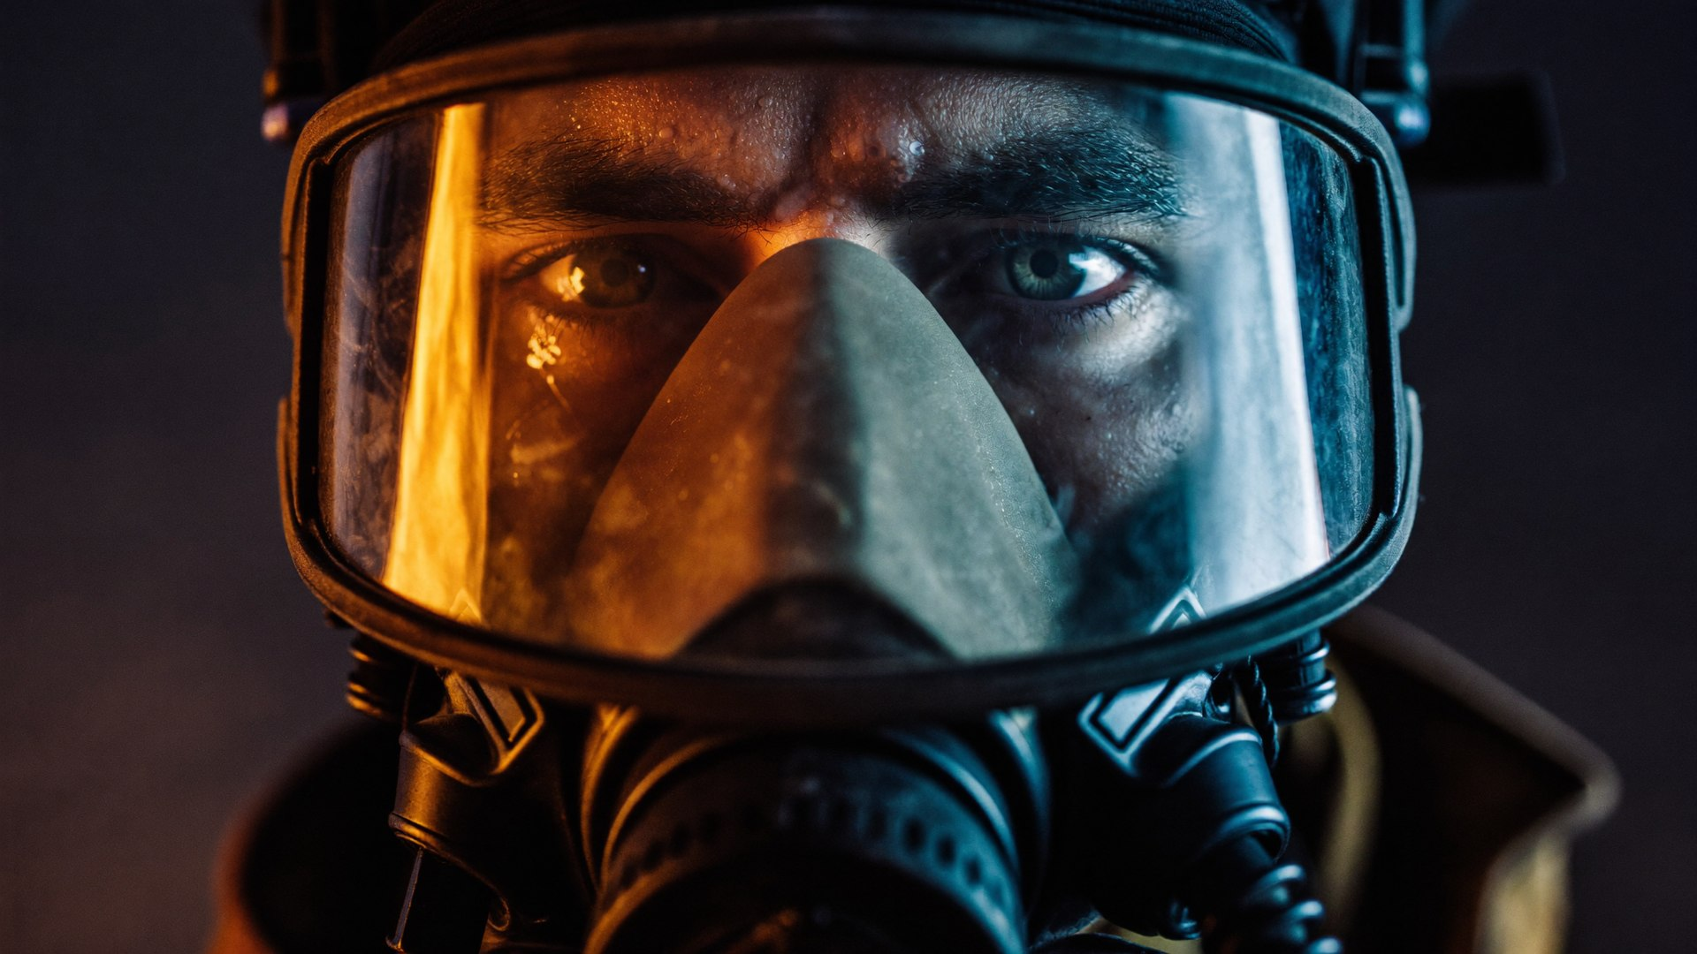

MODULE
02
Human Factors &
Behavioral Leadership
OBJECTIVE — Manage team behavior and performance when fear enters the scene.
Stress impact on performance
Managing panic and fear
Behavioral control & discipline
Preventing unsafe actions
SANAD | FIRE FIGHTING TEAM LEADER
24
Notes:
Module opener (3 min). Read the objective aloud, exactly as written: "Manage team behavior and performance when fear enters the scene." Then connect it to the last module in one sentence so the course feels like one continuous build, not six separate lectures. Preview the four content areas on the slide and tell participants which of them will be tested in the practical block. Do not teach content here — set up the "why" and move.

Slide 25


MODULE 2
What stress does to a firefighter
Under acute stress the body optimizes for running — not for fine skills, hearing or judgment. Leaders must expect and counter these effects:
Tunnel vision
Auditory exclusion
Motor degradation
Peripheral awareness collapses onto the flame. Counter: leader scans; “eyes up” calls.
Radio calls and shouts go unheard. Counter: closed-loop comms, physical touch, face checks.
Fine skills (couplings, valves, BA checks) fail first. Counter: over-train basics; buddy checks.
Time distortion
Cognitive narrowing
Physiological load
Seconds feel like minutes; estimates go wrong. Counter: leader owns the clock and calls elapsed time.
Only obvious options are seen. Counter: leader forced to verbalize plan B out loud.
HR >150 bpm degrades everything above. Counter: tactical breathing, rotation, hydration.
SANAD | FIRE FIGHTING TEAM LEADER
25
Notes:
Stress physiology (8 min). Normalize it first: these six effects happen to EVERYONE, including the instructor — stress response is biology, not weakness. Walk each card as effect-then-counter, and make participants say the counters back. Practical anchors: have them recall fumbling a simple coupling in a drill (motor degradation) or missing a radio call during a real event (auditory exclusion). The leader's job is not to eliminate stress but to design around it: closed loops, buddy checks, owned clocks. This vocabulary returns in every debrief for the rest of the course.

Slide 26
MODULE 2
Managing panic and fear
READ THE SIGNS
Freezing or repetitive, useless movement
Shouting, cross-talk, abandoning assigned tasks
Fixation on one victim / one task while the scene moves
Silent withdrawal — the most dangerous sign of all
LEAD THE RESPONSE
Name & claim
Task it
Use their name. Eye contact. “Ahmed. Look at me. You're with me.”
Panic cannot survive a concrete task. Give one, simple and physical.
Pair up
Breathe & reset
Nobody works alone. Pair the shaken with the steady.
Tactical breathing: in 4 – hold 4 – out 4. Ten seconds buys back the brain.
SANAD | FIRE FIGHTING TEAM LEADER
26
Notes:
Panic management (10 min). Read the four signs slowly — especially silent withdrawal, which most leaders miss because it looks like compliance. Then teach the four interventions as a sequence you can run in under 15 seconds: name & claim, task it, pair up, breathe & reset. Demonstrate 'name & claim' live on a participant: eye contact, name, 'you're with me' — let the room feel how fast it re-anchors a person. Practice tactical breathing together once (in 4, hold 4, out 4). This exact sequence is what the role-player scenario in the practical block will demand from them.

Slide 27
MODULE 2
Stress inoculation: train the panic out
Teams don't rise to the occasion — they fall to the level of their training. Build immunity in deliberate doses:
4
3
Add chaos
2
Add consequence
Injects, failures, casualties, conflicting reports — the full simulation environment of Day 3.
1
Add load
Peer observation, scoring, competition. Social pressure is rehearsal for real pressure.
Master the skill cold
Time limits, darkness, noise, weather. Skills must survive discomfort before they meet fear.
Couplings, BA checks, hose runs — flawless with no pressure, eyes closed, in gloves.
Your job after this course: run your rig's drills up this ladder — a team that has only ever drilled step 1 will meet steps 2–4 for the first time in a real fire.
SANAD | FIRE FIGHTING TEAM LEADER
27
Notes:
Stress inoculation (6 min). The staircase visual makes the point: each step is taller because each dose of pressure is bigger. Ask participants which step their current rig drills actually reach — most honest answers are step 1, occasionally step 2. That gap is why good crews still panic in real events. Connect forward: this course walks them up the entire ladder in three days, and the 30-day plan at the end of the course is how they rebuild the ladder for their own crews at home.

Slide 28

MODULE 2
Discipline: preventing the unsafe act
Most emergency injuries are not caused by the fire — they are caused by what someone did in front of it. Four behaviors, zero tolerance:
No freelancing
Buddy integrity
No self-assigned tasks. Every action flows from the leader's plan — heroics off-plan get people killed.
Teams of two, always in contact. Separation is an emergency in itself and is reported instantly.
PPE is non-negotiable
Stop authority
Full protective ensemble and BA discipline enforced by the leader — no exceptions for “just a quick look.”
Anyone can call STOP on an unsafe act. The leader backs every legitimate stop, publicly, every time.
Leadership truth: the standard you walk past is the standard you accept. Discipline is maintained in the drills, not discovered in the fire.
SANAD | FIRE FIGHTING TEAM LEADER
28
Notes:
Discipline (8 min). Four rules, zero tolerance — but explain the WHY behind each so it lands as protection, not bureaucracy: freelancing breaks the plan the leader is accountable for; buddy separation turns one casualty into two; PPE shortcuts are always invisible until the flash; stop authority is the team's immune system. Role-play the hard moment: a senior, respected hand skips a BA check — what exactly do you say, in front of the crew? Script it with the group. Close on the walk-past line at the bottom; it should sting a little.

Slide 29


MODULE 2
The other 364 days: leading between emergencies
Emergency performance is decided long before the alarm — in how you run drills, briefs and feedback all year:
Drill with purpose
Brief like it matters
Short, frequent, debriefed drills beat rare marathon exercises. One skill, done hard, every week.
Every shift handover includes the fire risk of the day: hot work, fuel transfers, well operations.
Feedback in both directions
Build pride
Praise specifically, correct privately, and ask your crew what YOU should do differently. They know.
Named roles, tracked times, visible standards. People protect an identity: 'we are the fire team.'
A crew that trusts you on Tuesday will follow you into smoke on Friday. Trust is built in boring moments.
SANAD | FIRE FIGHTING TEAM LEADER
29
Notes:
Everyday leadership (6 min). This slide converts the course from event to lifestyle. Walk the four cards, then run a quick self-audit: participants privately rate their own crew 1–5 on each card and circle the weakest. That weakest item becomes a required element of their 30-day action plan (Day 3). The bottom bar is the emotional core of Module 2 — authority in an emergency is withdrawn from leaders who never earned trust in normal operations. End Day 1 content on that note; it sets up the wrap slide.

Slide 30
MODULE 2 — PRACTICAL
PRACTICAL BLOCK
Behavioral leadership simulations
Stress is injected deliberately — noise, smoke machines, conflicting orders, a “panicking” role-player — and the leader must manage the humans first.
Panic management scenario
Team performance lab
Discipline moments
One crew member (actor) panics mid-drill. Recognize, isolate, re-task and reintegrate — without losing the fireground.
Lead a degraded team: fatigue, miscommunication, a silent withdrawer. Restore output within the exercise window.
Scripted unsafe acts appear during tasks. Spot them, stop them, correct them — firmly and without humiliation.
ASSESSED: Recognition speed, intervention quality and whether the team's performance recovers — Module 2 rubric.
SANAD | FIRE FIGHTING TEAM LEADER
30
Notes:
Practical block briefing (5 min brief, then run the block). Brief each exercise card in under a minute: purpose, setup, roles, time limit. Assign the first leaders BEFORE moving to the training area so nobody can hide. Assessors position where they can hear the leader's orders, not just see the action. Assessment focus for this block: Recognition speed, intervention quality and whether the team's performance recovers — Module 2 rubric. Run a 2-minute hot debrief after each rotation — one keep, one change, next leader up. Safety officer has absolute stop authority throughout.

Slide 31

END OF DAY 1
What you take to bed tonight
01
02
03
Command is declared, not assumed
Directive is the emergency default
People fail before pumps do
The scene has a leader the moment you say so — and not one second before.
Decide at 70%, broadcast the plan, loop the OODA. Hesitation is the only unforgivable error.
Expect tunnel vision, panic and freelancing — and lead them out of it by name and by task.
Evening assignment: sketch the first-60-seconds plan for YOUR rig's worst credible fire. Name the first three orders you would give and to whom. You will brief it to the class at 07:30.
SANAD | FIRE FIGHTING TEAM LEADER
31
Notes:
Day 1 wrap (10 min). Have three different participants read the three takeaways aloud, in their own words — retrieval beats repetition. Return to the flipchart of morning expectations and tick what was covered. Brief the evening assignment precisely: one page, their rig, worst credible fire, first three orders with names attached — presented in 90 seconds each at 07:30 tomorrow. This is not optional homework; it is tomorrow's opening practical and it is scored. Finish on time — a leadership course that runs late has already contradicted itself.

Slide 32
DAY 2 OF 3
COMMAND.
Tactics, Coordination, Control
From leading a crew to commanding an incident: attack strategy, communications discipline and structured emergency control.
Module 3 — Tactical Fire Response & Scene Management
Module 4 — Communication & Command
Module 5 — Incident Command & Emergency Control
SANAD | FIRE FIGHTING TEAM LEADER
32
Notes:
Transition slide (2 min). Stand at the front, let the image land before speaking. Frame the day in one sentence: "From leading a crew to commanding an incident: attack strategy, communications discipline and structured emergency control." Preview the blocks listed on the slide, state the day's finish time, and remind participants that everything today is assessed material for Day 3. Energy check: ask one participant what they want out of today.

Slide 33
DAY 2 — COMMAND
Schedule of the day
TIME | SESSION | MODE
07:30 | Recap: participants brief their first-60-seconds plans | Practical
08:00 | Module 3 — Fire hazards of the drilling rig; fire behavior essentials | Classroom
09:00 | Module 3 — Scene size-up and dynamic risk assessment | Classroom
10:00 | Break | —
10:15 | Tactical drills: attack lines, scenario planning, team deployment | Practical
12:00 | Lunch & prayer | —
13:00 | Module 4 — Communication protocols & multi-team coordination | Classroom
14:00 | Communication drills under pressure | Practical
14:45 | Module 5 — Incident command, control zones, escalation, accountability | Classroom
15:45 | Incident command simulation & multi-hazard tabletop | Practical
16:30 | Day 2 debrief & takeaways | Classroom
SANAD | FIRE FIGHTING TEAM LEADER
33
Notes:
Walk the schedule top to bottom (2 min). Point out the practical blocks in orange — that is where the day is won. Confirm prayer and break timings with the group and flag any site-specific adjustments now, not mid-day. State the rule: practical blocks start on time, in full PPE, no exceptions — late arrival to a practical is a scored event. Ask for questions before moving on.

Slide 34

MODULE
03
Tactical Fire Response
& Scene Management
OBJECTIVE — Develop operational control of a live fire scene.
Fire attack strategies
Scene size-up & hazard assessment
Risk-based decision-making
Resource allocation & deployment
SANAD | FIRE FIGHTING TEAM LEADER
34
Notes:
Module opener (3 min). Read the objective aloud, exactly as written: "Develop operational control of a live fire scene." Then connect it to the last module in one sentence so the course feels like one continuous build, not six separate lectures. Preview the four content areas on the slide and tell participants which of them will be tested in the practical block. Do not teach content here — set up the "why" and move.

Slide 35




MODULE 3
Know your enemy: fire on a drilling rig
Wellhead & well control
Diesel & fuel storage
Mud gas & shakers
Kicks and blowouts feeding ignition — the catastrophic case. Fire response and well control must speak with one voice.
Generators, day tanks, refueling ops. Class B pool and spray fires with fast spread across containments.
Gas breaking out of returns at shakers and pits — flammable atmospheres where nobody sees a “fuel.”
Electrical & SCR house
Camp & accommodation
H2S conversion
Energized switchgear and VFD/SCR rooms. De-energize first; wrong media turns rescuer into casualty.
Sleeping quarters, kitchens, laundry — the highest life risk on site, especially at night.
Any fire in a sour environment is a HAZMAT event too: gas monitoring, wind, and muster discipline rule the scene.
SANAD | FIRE FIGHTING TEAM LEADER
35
Notes:
Rig hazard map (10 min). Walk each hazard against the participants' actual rigs. Ask: where is your SCR room? Where does mud gas vent? How far is the camp from the wellhead? Have participants rank the six hazards for THEIR rig by likelihood and by consequence — wellhead usually wins consequence, diesel/electrical win likelihood. Record the rankings; Day 3 scenarios draw directly from this slide, and the size-up exercises reuse their own answers. Note the H2S card sets up the next slide.

Slide 36
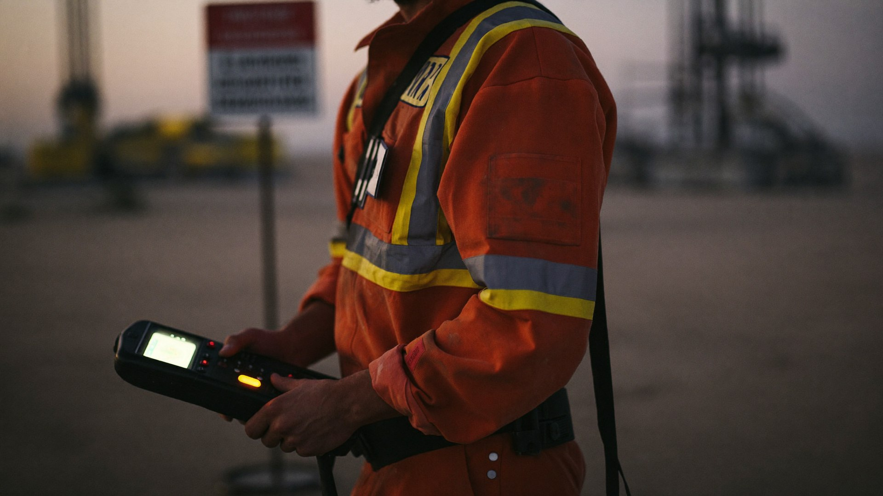
MODULE 3
H2S: the enemy you
cannot fight with water
Heavier than air — it pools in cellars, pits and low ground where crews work
Kills the sense of smell first: 'the smell went away' means it got WORSE
Any fire response in a sour area is a gas response first — monitor before you move
Wind direction dictates everything: approach, muster, ICP, escape routes
SCBA is the only acceptable protection in a suspected release — no exceptions
Leader's H2S reflex: gas reading → wind check → upwind muster → SCBA for entrants → account for everyone. In that order, every time.
SANAD | FIRE FIGHTING TEAM LEADER
36
Notes:
H2S (10 min). In Saudi sour-gas operations this slide deserves full attention — most participants hold H2S certificates, so position this as the LEADER'S view, not basic awareness. Drill the reflex chain on the bottom card until they can recite it. Discussion: a fire at the shakers with H2S alarm sounding — which problem commands first? (Gas does: it kills faster, travels invisibly, and dictates where firefighting can even happen.) Emphasize wind: have them name the prevailing wind on their rig right now — leaders who don't know the wind are planning blind. Site H2S contingency plans govern; this course integrates with them.

Slide 37
MODULE 3
Fire behavior, leader's cut
You know the tetrahedron — heat, fuel, oxygen, chain reaction. The leader's job is choosing which leg to break, with what, and accepting what that choice costs.
CLASS | TYPICAL RIG SOURCE | MEDIA | LEADER'S WATCH-OUT
A | Ordinary solids (camp, stores) | Water / foam | Watch re-ignition & overhaul
B | Flammable liquids & gas (diesel, mud, well fluids) | Foam / DCP; isolate fuel first | Never extinguish gas without isolation
C | Energized electrical (SCR, switchgear) | CO2 / DCP after de-energizing | Confirm isolation — then it's class A/B
D/K | Metals / kitchen media | Specialist agents only | Wrong media makes it worse
BLEVE / boilover / flashover: the three escalation monsters. If you cannot cool it, isolate it — and if you cannot isolate it, clear people and go defensive.
SANAD | FIRE FIGHTING TEAM LEADER
37
Notes:
Fire behavior for commanders (8 min). Participants know the tetrahedron from basic training — respect that and teach the LEADER'S layer: media selection is a command decision with consequences. Walk the table by rig location, not by chemistry. Spend extra time on class C: the de-energize-first rule and why the wrong call turns a rescuer into a casualty. Then the three escalation monsters at the bottom — define each in one sentence and give the command signature: cool it, isolate it, or clear people and go defensive. This vocabulary is required in Day 3 radio traffic.

Slide 38
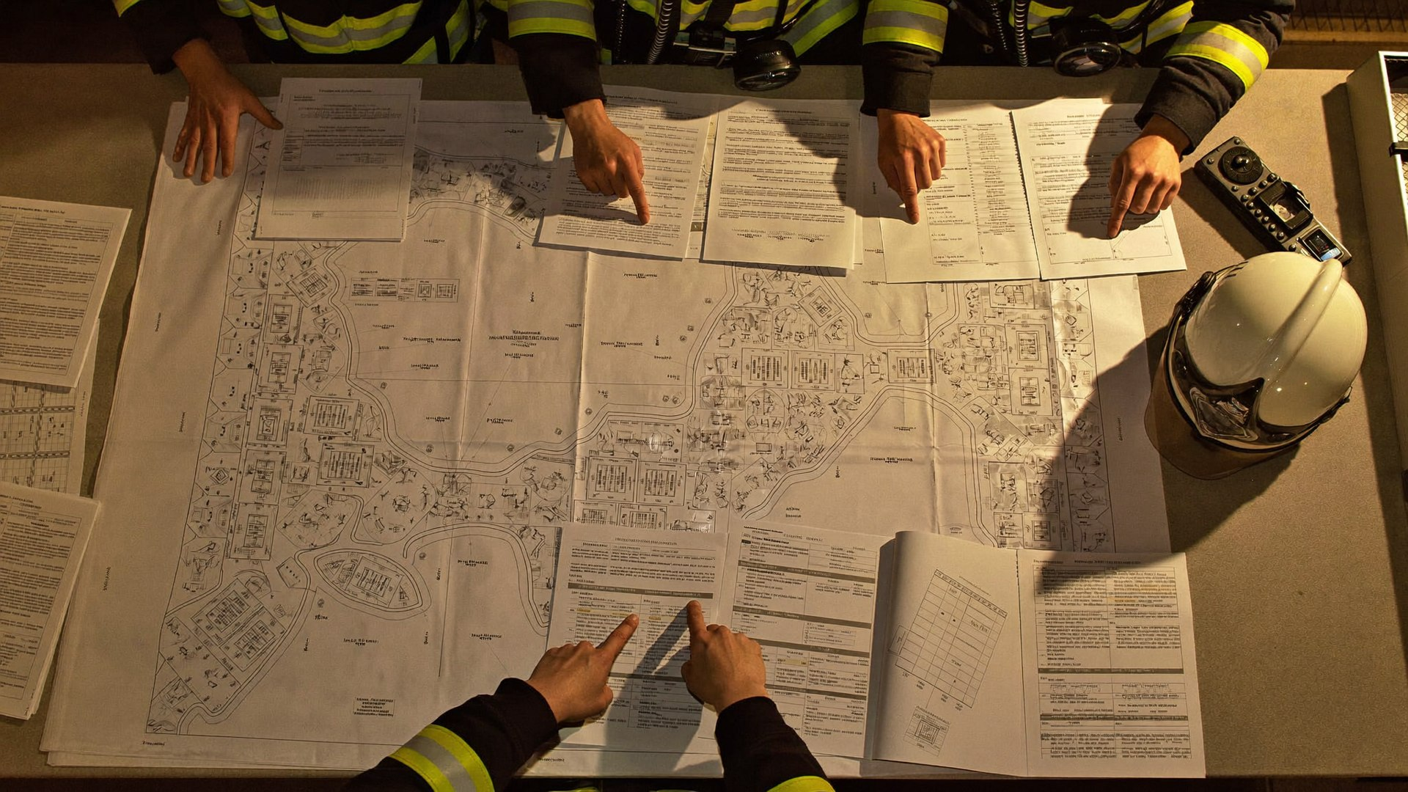
MODULE 3
Pre-incident planning: win before it starts
Pre-fire plans per hazard area One page each for wellhead, fuel, SCR, camp: attack routes, water points, isolation valves, muster.
Know your water cold Tank volumes, pump capacities, hydrant/monitor coverage, refill logistics — memorized, not looked up.
Isolation mapping Fuel shut-offs, electrical isolation, ESD points — who operates each, and the backup person for nights.
Walk it quarterly Plans rot: equipment moves, people rotate. A pre-plan nobody has walked is fiction with a title block.
The 3 AM test: if the alarm sounds tonight, does your relief shift know the plan as well as you do? If not, the plan is you — and you sleep.
SANAD | FIRE FIGHTING TEAM LEADER
38
Notes:
Pre-incident planning (8 min). The fireground rewards preparation with time — the only currency that matters at 3 AM. Walk the four elements, then run the tabletop micro-exercise: each participant sketches their rig's water sources and isolation points from memory in three minutes, then compares with a neighbor. The gaps they find ARE the lesson. Assign explicitly: rebuilding these pre-plans is Week 1 of the 30-day action plan. Tie to scenario planning in the practical block this afternoon, where a plot plan and scenario card start every evolution.

Slide 39
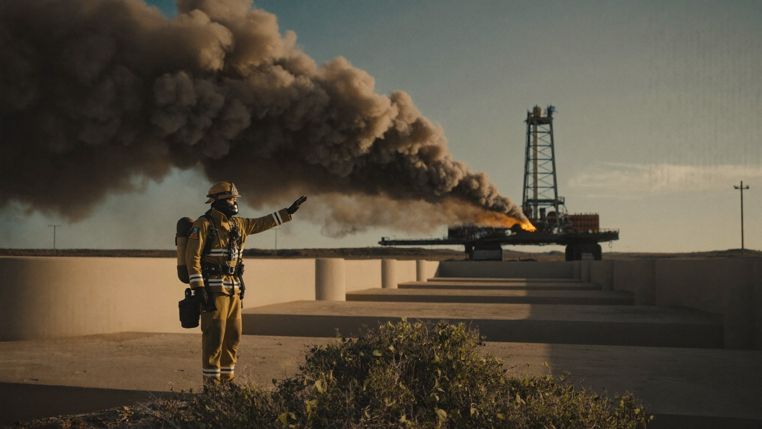
MODULE 3
Scene size-up: the 30-second read
Five questions, answered out loud, before the first order:
1
WHAT is burning — and what feeds it? Fuel, quantity, class, energy sources still live
2
WHERE will it go next? Wind, exposures, drainage, escalation paths
3
WHO is at risk? Missing persons, muster status, trapped or injured
4
WHAT do I have? People, water, foam, apparatus — now and in 10 minutes
Size-up never ends. It restarts every time the wind shifts, a report lands, or a crew moves. The leader who stops reading the scene is now managing a memory.
5
WHAT can go catastrophically wrong? BLEVE, well control loss, H2S, structural collapse
SANAD | FIRE FIGHTING TEAM LEADER
39
Notes:
Size-up (10 min incl. drill). Five questions, out loud, thirty seconds — the discipline is answering them in ORDER, because the order encodes priorities: fire, spread, people, resources, catastrophe. Run the photo drill: show any incident photo for 30 seconds, then cold-call a participant to deliver the five answers from memory. Repeat three times with different photos and people. Common failure: jumping to question 4 (what do I have) before question 3 (who is at risk) — action addiction again. The dark box matters most: size-up is a loop, not an event; 'managing a memory' is how scenes kill people.

Slide 40
MODULE 3
Dynamic risk assessment on the move
IDENTIFY
ASSESS
CONTROL
MONITOR
Hazards as they emerge — not as the pre-plan imagined them
Who is exposed, how severely, how likely, how fast
Eliminate, isolate, protect — or withdraw
Re-read the scene; every change restarts the loop
THE RISK PHILOSOPHY EVERY ORDER MUST PASS
We risk a lot, within a plan, to save a life. We risk a little, with control, to save property. We risk nothing for what is already lost.
SANAD | FIRE FIGHTING TEAM LEADER
40
Notes:
Dynamic risk assessment (8 min). The four-step loop is simple by design — a wheel that spins continuously, not a form to fill. Contrast DRA with the pre-task risk assessments they know from permit work: same logic, compressed to seconds, repeated forever. Then the risk philosophy — have the whole room read the three lines aloud together, once. It sounds theatrical; it works. Every order they give on Day 3 will be judged against these three lines, and the debrief question will be: 'which line was that order operating under?' They should hear the lines in their heads when deciding.

Slide 41
MODULE 3
Choosing the attack: offensive, defensive, transitional
OFFENSIVE
DEFENSIVE
TRANSITIONAL
Crews advance to extinguish at the seat.
Protect exposures; let the fire consume what's lost.
Fast exterior knockdown, then re-decide.
Life risk demands it, or fire is small and resourced
Requires: trained crews, water/foam secured, escape routes
Leader stays out of the hose stream — commanding, not nozzling
Structural risk, BLEVE potential, or resources insufficient
Cool exposures, isolate fuel, hold the perimeter
Declaring defensive is command courage — not defeat
Buys time while size-up completes or resources arrive
Never let “transitional” become “undecided”
Announce the mode — every crew must know which fight this is
SANAD | FIRE FIGHTING TEAM LEADER
41
Notes:
Attack strategy (10 min). Key teaching point: the mode is a command decision, announced on the radio, logged with time. Changing mode without announcing it is how crews end up inside a collapse zone. Walk the three columns, then run the decision drill: read out four quick scenarios (small mud-pump fire, day-tank pool fire with BLEVE exposure, camp fire at 02:00 with missing person, wellhead ignition) and have the room vote a mode for each with a show of hands — then defend the split votes. Emphasize the middle column's hardest sentence: declaring defensive is command courage, not defeat.

Slide 42
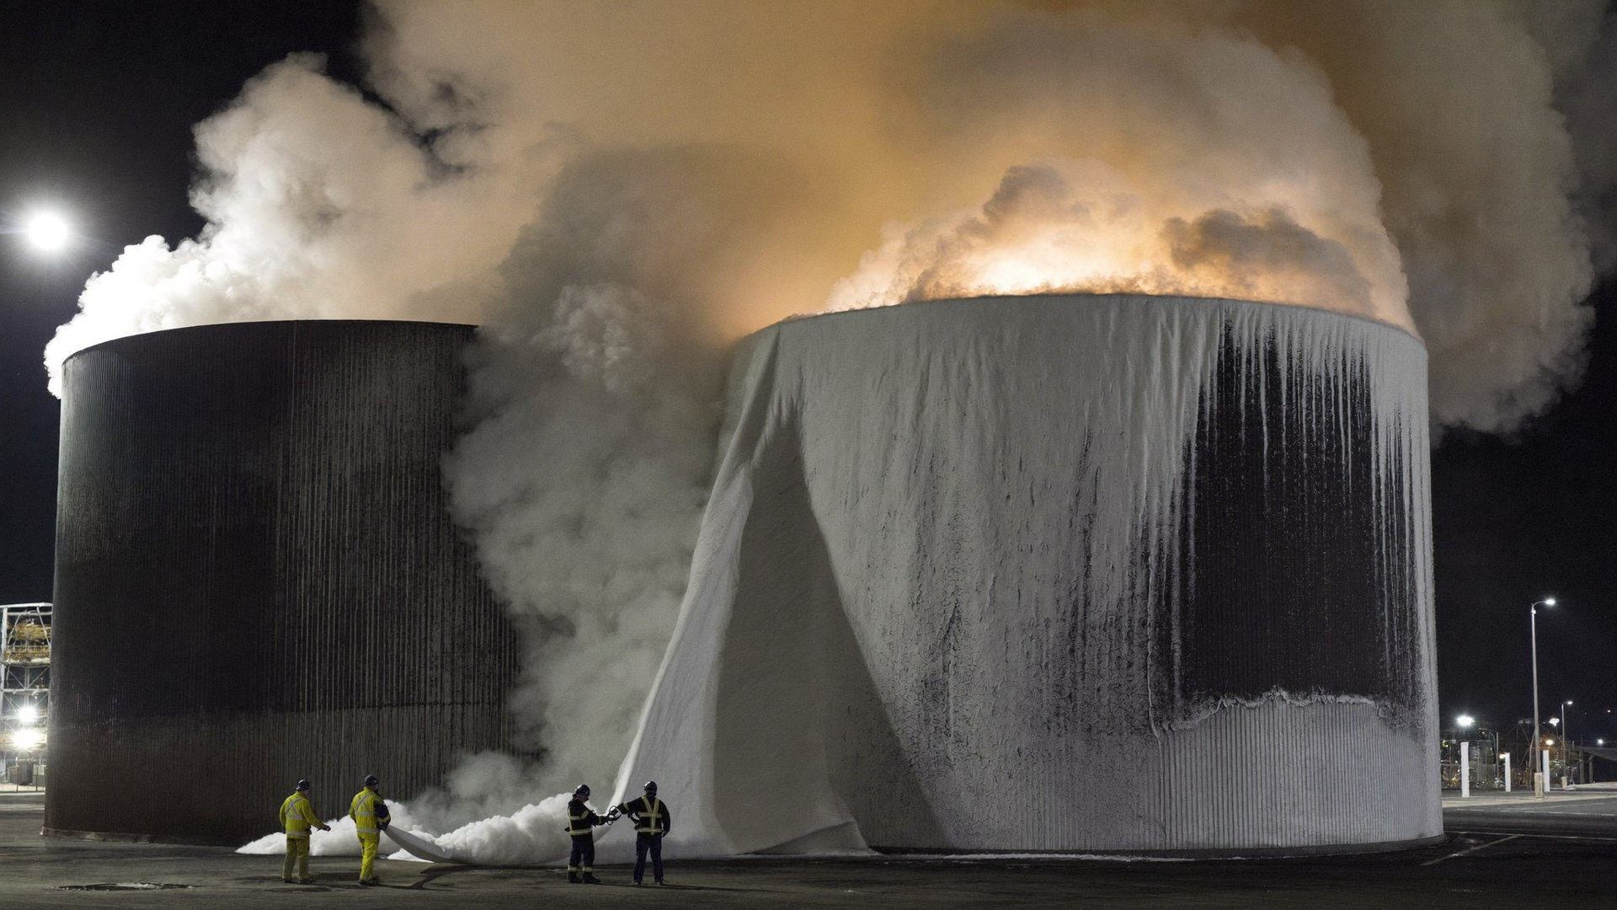
MODULE 3
Water & foam: the leader's arithmetic
Supply before attack — Confirm total water on site and refill time BEFORE committing lines. An attack that outruns its water ends inside the hazard.
Foam is a one-shot weapon — Check concentrate stock against the burning surface area first. A foam blanket you cannot finish is foam wasted — and fuel re-exposed.
Never break the blanket — Once foam is down, no straight streams, no walking through it. The blanket is the extinguishment.
Keep a tactical reserve — One charged line and one crew held back, always — for the rescue, the flare-up, the surprise. Spending your reserve is a mode change.
SANAD | FIRE FIGHTING TEAM LEADER
42
Notes:
Water & foam logistics (8 min). Keep the math conceptual in class — exact application rates come from their site's fire plan and equipment data sheets; the leader's job is to ask the arithmetic QUESTIONS before committing. Walk the four rules. War-story moment: ask if anyone has seen an attack run dry mid-fight — the stories teach better than the slide. Emphasize the tactical reserve as a hard rule the assessors score: in every Day 3 scenario, a leader with no reserve at the moment of the inject loses points, because the inject is coming.

Slide 43
MODULE 3
Resource allocation: never run out mid-fight
People
Water & foam
Crew rotation before exhaustion; reserve team held back; BA wearers tracked by cylinder time, not by feel.
Confirm supply before committing lines. Foam is finite — calculate application rate vs. stock before the attack, not during.
Apparatus & equipment
Medical & logistics
Pumps, monitors, extinguishers staged and crewed. One line held in reserve is worth two in the fight.
Rehab point, hydration, first aid at the warm zone edge. A casualty among responders doubles your incident.
Deployment principle: task + location + objective + comms check — every team, every move. “Go help over there” is not an order.
SANAD | FIRE FIGHTING TEAM LEADER
43
Notes:
Resource allocation (6 min). Four resource families, one common failure: spending everything early. People — rotate before exhaustion, because tired crews volunteer to die; track BA by cylinder time, not by feel. Water/foam — refer back to the arithmetic slide. Apparatus — one line in reserve is worth two in the fight; make them argue why. Medical — a responder casualty doubles the incident and halves the team's mind. Close on the deployment formula in the bottom bar and drill it once verbally: pick a participant, have them deploy a team using all four elements.

Slide 44
MODULE 3 — PRACTICAL
PRACTICAL BLOCK
Tactical drills: command the fireground
Field exercises on the training ground. Leaders rotate through command of each evolution.
Attack line evolutions
Scenario response planning
Team deployment exercise
Deploy, advance and rotate hose teams against a live training fire — leader controls mode, tempo and safety.
Given a rig plot plan and a scenario card, build and brief a complete attack plan in 10 minutes.
Multiple simultaneous taskings with limited crews — allocate, sequence, hold a reserve, adjust as injects land.
ASSESSED: Mode selection and announcement, resource logic, and whether the plan survives first contact — Module 3 rubric.
SANAD | FIRE FIGHTING TEAM LEADER
44
Notes:
Practical block briefing (5 min brief, then run the block). Brief each exercise card in under a minute: purpose, setup, roles, time limit. Assign the first leaders BEFORE moving to the training area so nobody can hide. Assessors position where they can hear the leader's orders, not just see the action. Assessment focus for this block: Mode selection and announcement, resource logic, and whether the plan survives first contact — Module 3 rubric. Run a 2-minute hot debrief after each rotation — one keep, one change, next leader up. Safety officer has absolute stop authority throughout.

Slide 45
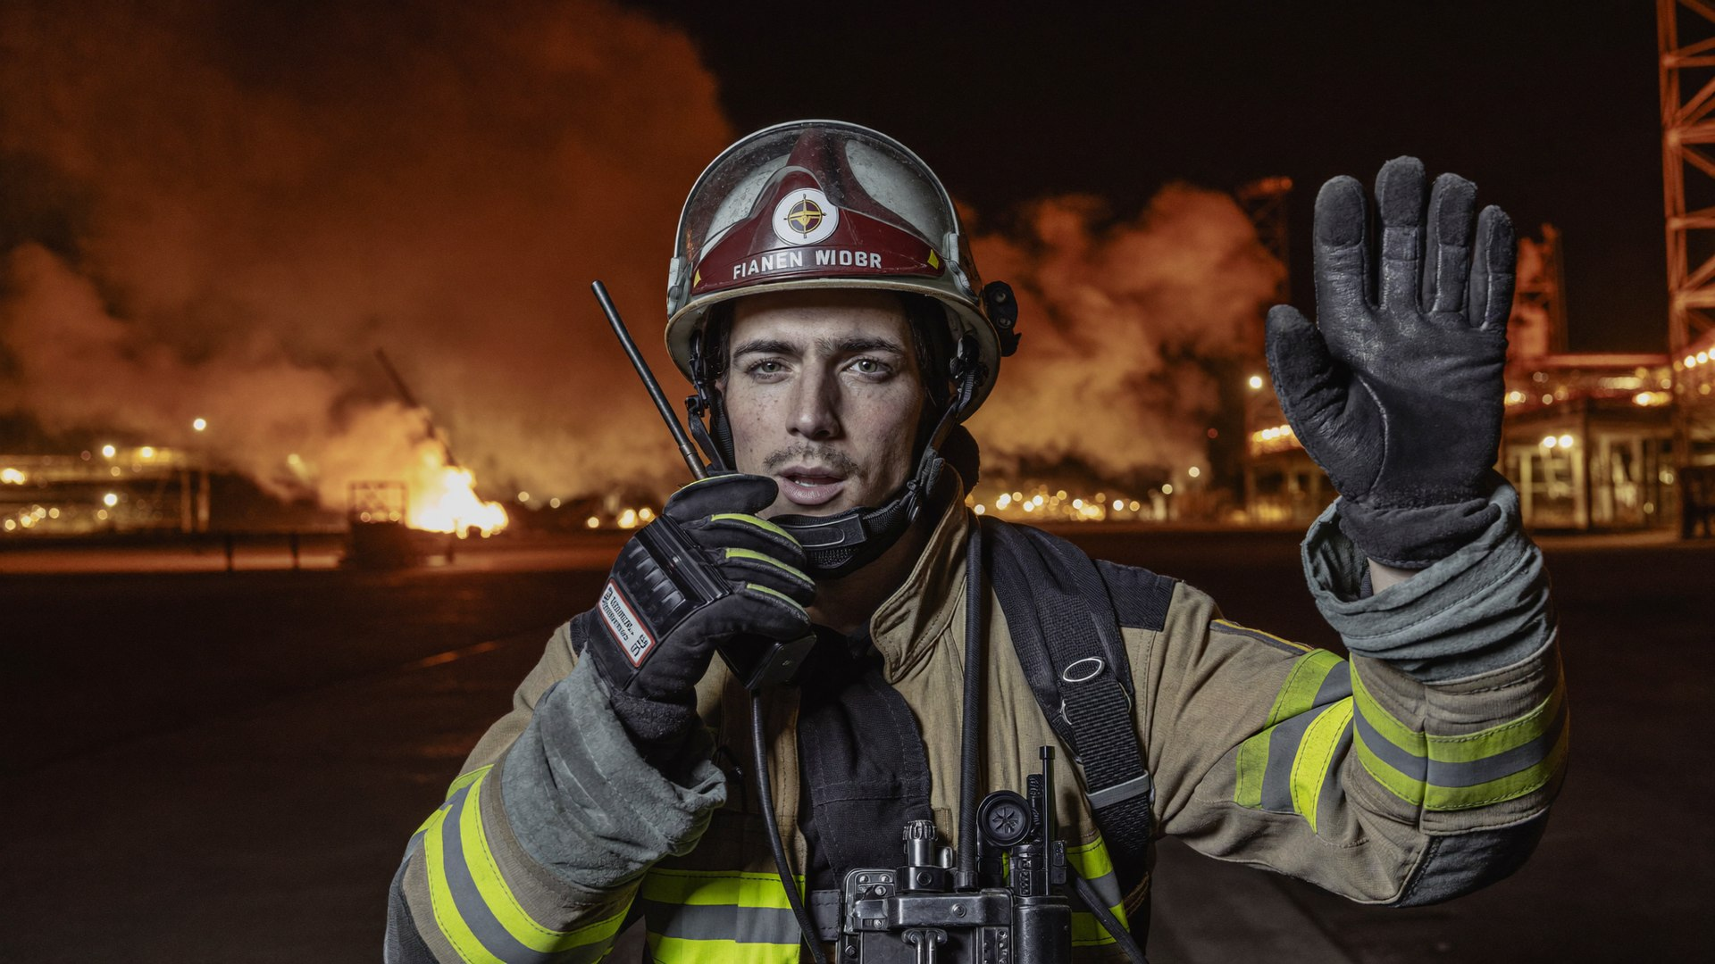

MODULE
04
Communication
& Command
OBJECTIVE — Ensure effective coordination and control when the noise starts.
Communication protocols
Multi-team coordination
Command structure & reporting
Control during escalation
SANAD | FIRE FIGHTING TEAM LEADER
45
Notes:
Module opener (3 min). Read the objective aloud, exactly as written: "Ensure effective coordination and control when the noise starts." Then connect it to the last module in one sentence so the course feels like one continuous build, not six separate lectures. Preview the four content areas on the slide and tell participants which of them will be tested in the practical block. Do not teach content here — set up the "why" and move.

Slide 46
MODULE 4
Radio discipline: closed loop or open disaster
SENDER orders
MESSAGE short, structured
READBACK receiver repeats
CONFIRM “Correct — go”
→
→
→
One net, one speaker at a time — the leader enforces radio silence for priority traffic
Names, not “hey you”: task follows identity, identity follows task
Standard phrases: MAYDAY (life threat), URGENT (scene change), PRIORITY (command traffic)
No radio? Runner, hand signals, air horn withdrawal signal — brief the fallback BEFORE the incident
THE 20-SECOND SITREP (C.A.N.)
C — CONDITIONS “Diesel fire, day tank area, wind from north, spreading east.” A — ACTIONS “Two foam lines in defensive mode, fuel isolated, muster complete.” N — NEEDS “Request Aramco Fire Protection, medic standby, more foam stock.”
SANAD | FIRE FIGHTING TEAM LEADER
46
Notes:
Radio discipline (10 min incl. drill). Teach the closed loop as a chain that is only as strong as its READBACK link — most real-world comms failures are un-read-back orders that mutated in transit. Play the whisper-chain game once with a 12-word order to prove mutation, then repeat with mandatory readback to prove the fix. Walk the CAN card and have two participants deliver a CAN report on a scenario you improvise; score for under 20 seconds and all three letters. Standard phrases (MAYDAY/URGENT/PRIORITY) must match the site's radio procedure — reconcile any differences now.

Slide 47
MODULE 4
Orders that stick: the brief-back standard
An order is not what you said — it is what they heard. Close the gap with structure:
WHO
WHAT + WHERE
WHY / INTENT
BRIEF-BACK
Name the person or team. Orders without owners evaporate.
One task, one location, concrete verbs.
One phrase of purpose, so they can adapt when reality shifts.
They repeat it in their own words. Now it is their plan too.
→
→
→
“Faisal — hose team two —”
“—charged line to the day tank's north side—”
“—to cool the exposure, NOT extinguish—”
“Tell me the task.” … “Correct — go.”
Under pressure you will not rise to eloquence — you will fall back on structure. Build the structure now, use it forever.
SANAD | FIRE FIGHTING TEAM LEADER
47
Notes:
Orders that stick (8 min). Walk the four-part chain with the worked example across the cards — read it aloud as one continuous order so they hear the rhythm. The intent clause is the professional's secret: a team that knows WHY can adapt without freelancing when conditions change; a team that only knows WHAT freezes or improvises. Pair drill: partner A gives a rig-realistic order using all four parts, partner B deliberately briefs back wrong, A must catch and correct it. Two rounds, swap roles. Brief-back becomes mandatory in every practical from this moment on.

Slide 48



MODULE 4
Coordinating many teams without losing one
Sectorize the scene
Span of control 1:5
Split the fireground into named sectors (Attack, Exposure, Water, Medical). One officer per sector, one voice per sector.
No leader directs more than ~5 units. Beyond that, appoint sector officers — or lose the picture.
Common operating picture
Deconflict movement
Everyone hears mode changes, hazard warnings and withdrawal orders. Critical info is broadcast, not whispered.
Hose streams vs. electricity, crews vs. vehicle paths, opposing nozzles: the leader owns the geometry of the scene.
Escalation warning signs: rising radio traffic, unanswered calls, crews improvising, conflicting reports. Any two together = pull back, regroup, re-command.
SANAD | FIRE FIGHTING TEAM LEADER
48
Notes:
Multi-team coordination (8 min). Sectorization is how one brain commands twenty people: name the sectors in plain language (Attack, Exposure, Water, Medical), one officer and one voice per sector. Span of control 1:5 is a biological limit, not a preference — when a leader exceeds it, the sixth report simply doesn't get processed. Draw the geometry point on the whiteboard: two hose teams on opposite sides of a fuel fire are pushing it at each other; only the leader sees the whole board. Close on the warning signs — any two together means the incident is now commanding you.

Slide 49
MODULE 4
Alarm levels: matching response to reality
LEVEL 1
LEVEL 2
LEVEL 3
Local response
Rig emergency
Major emergency
Small, contained, no immediate escalation path. Fire team responds; rig management informed; operations may continue in unaffected areas.
Growing or near critical equipment. General alarm, muster, operations secured, SANAD emergency response activated, external support alerted.
Life threat, well control interface, or spread beyond the rig. Full ERP: Saudi Aramco Fire Protection, medevac readiness, possible evacuation.
Declare early, downgrade later. Nobody was ever hurt by an over-declared alarm. People die in under-declared ones. Your rig's ERP defines the exact triggers — know them by heart.
SANAD | FIRE FIGHTING TEAM LEADER
49
Notes:
Alarm levels (7 min). Present the three-level model as the common industry pattern and map it live onto SANAD's actual ERP levels — terminology differs between plans, triggers matter more than labels. The leader's specific duty: DECLARING the level out loud and upward, because the level is what mobilizes resources they cannot see (management notifications, mutual aid, medevac). Drill the doctrine in the bottom bar: declare early, downgrade later — ask why the reverse instinct (wait and see) feels safer but is deadlier. Homework hook: 'know your triggers by heart' goes into the 30-day plan.

Slide 50
MODULE 4 — PRACTICAL
PRACTICAL BLOCK
Communication drills under pressure
Noise, blackout masks and jammed frequencies. If your communication survives here, it will survive a fireground.
Radio-only command
Degraded comms inject
SITREP gauntlet
Lead a deployment you cannot see — sector officers report by radio; you command through the CAN structure alone.
Mid-exercise the radio “fails.” Switch to runners and signals without losing crew accountability.
Deliver 20-second CAN reports up the chain while the scene changes every 60 seconds. Scored for structure and brevity.
ASSESSED: Closed-loop compliance, SITREP quality and whether every team can state its task at any freeze point — Module 4 rubric.
SANAD | FIRE FIGHTING TEAM LEADER
50
Notes:
Practical block briefing (5 min brief, then run the block). Brief each exercise card in under a minute: purpose, setup, roles, time limit. Assign the first leaders BEFORE moving to the training area so nobody can hide. Assessors position where they can hear the leader's orders, not just see the action. Assessment focus for this block: Closed-loop compliance, SITREP quality and whether every team can state its task at any freeze point — Module 4 rubric. Run a 2-minute hot debrief after each rotation — one keep, one change, next leader up. Safety officer has absolute stop authority throughout.

Slide 51
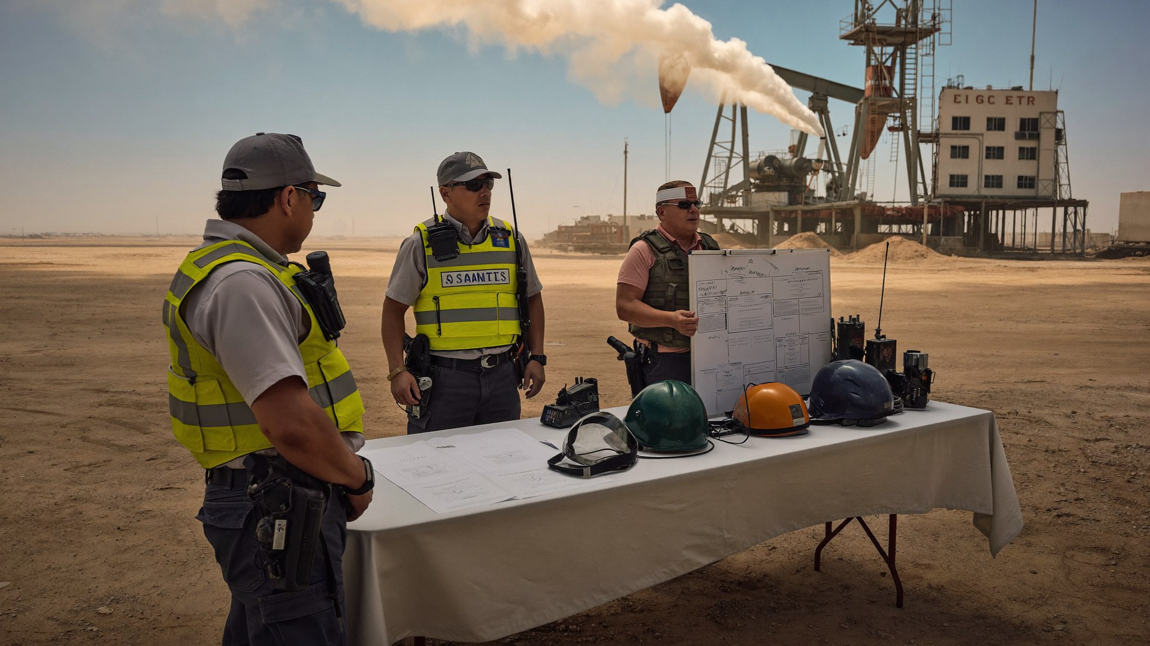

MODULE
05
Incident Command &
Emergency Control
OBJECTIVE — Apply structured command systems to control the whole emergency.
Incident command principles
Control zones & structure
Escalation management
Accountability systems
SANAD | FIRE FIGHTING TEAM LEADER
51
Notes:
Module opener (3 min). Read the objective aloud, exactly as written: "Apply structured command systems to control the whole emergency." Then connect it to the last module in one sentence so the course feels like one continuous build, not six separate lectures. Preview the four content areas on the slide and tell participants which of them will be tested in the practical block. Do not teach content here — set up the "why" and move.

Slide 52
MODULE 5
Incident command: structure beats chaos
Unity of command
Manageable span
Objectives-driven
Modular expansion
Every person answers to exactly one leader. Two bosses on one crew is zero bosses.
1 to 5 reporting units per leader. Grow the structure, not the span.
Command sets clear incident objectives; sectors turn them into tasks; crews execute.
The system starts small and grows with the incident — same structure at every size.
RIG INCIDENT COMMAND — TYPICAL FIRST STRUCTURE
On-Scene Commander
(Fire Team Leader)
Attack Sector
Exposure / Water Sector
Muster & Accountability
Medical / Rehab
SANAD | FIRE FIGHTING TEAM LEADER
52
Notes:
ICS principles (8 min). Four principles, then the typical first structure at the bottom — emphasize it is the STARTING shape, not the final one; modular expansion means sectors appear as the incident grows, and disappear as it shrinks. Unity of command deserves a story: ask who has ever received two conflicting orders during an event, and what they did. Note the leader's box is orange because on a rig, the Fire Team Leader IS initial incident command until relieved — there is no separate commander coming in the first fifteen minutes. Structure is what lets an average leader perform above themselves.

Slide 53
MODULE 5
Control zones: geography of survival
COLD
HOT ZONE
Immediate danger area. Full PPE + BA, tracked entry only, minimum crews, maximum discipline.
WARM
WARM ZONE
HOT
Support ring: entry control, BA staging, decon, equipment pool. Controlled access only.
COLD ZONE
Command post, muster points, medical, staging — always upwind, uphill, out of the escalation path.
ICP placement rule: upwind, sight of the scene, escape route behind you.
SANAD | FIRE FIGHTING TEAM LEADER
53
Notes:
Control zones (7 min). Zones are drawn by the leader in the first minutes and they MOVE — wind shift, escalation, or a new hazard redraws all three rings. Walk hot/warm/cold with the discipline each demands, then the ICP placement rule: upwind, sight of the scene, escape route behind you — have them recite it. Rig-specific challenge: where do the rings go for a shaker fire when the camp is 200 meters downwind? Muster location choice becomes life-or-death in H2S conditions; that's the next slide's territory. Zones without enforcement are decoration — enforcement is a scored behavior on Day 3.

Slide 54
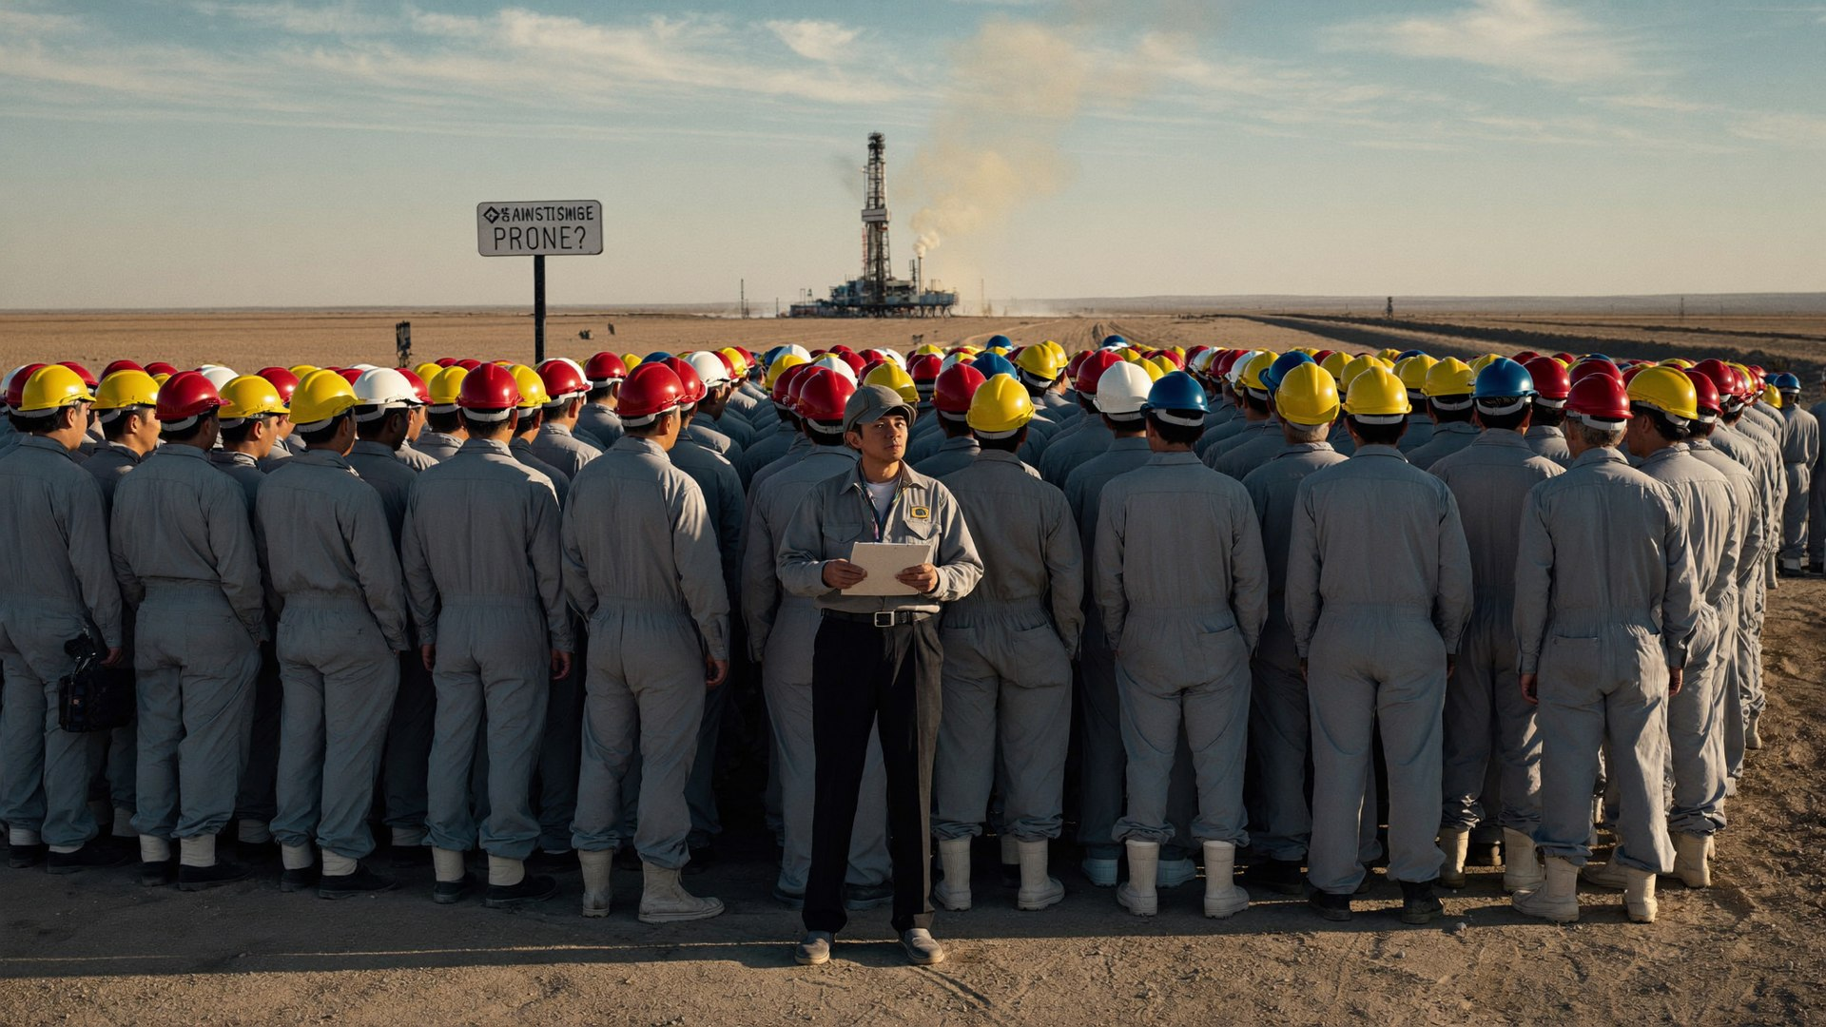
MODULE 5
Muster: the count that
changes everything
1
Alarm → all non-responders to primary muster (upwind alternate if wind dictates)
2
Muster checkers count against the POB list — live, not from memory
3
Count reported to the leader: “POB 86, mustered 84, two unaccounted”
4
Names and last known locations of the missing — inside 3 minutes
5
Missing persons drive the ENTIRE tactical plan from that second
An accurate count in 3 minutes is worth more than a hose line in 30 seconds.
SANAD | FIRE FIGHTING TEAM LEADER
54
Notes:
Muster procedure (7 min). Walk the five steps as a timeline and stress step 3's exact report format — numbers first, then names. The tactical hinge is step 5: 'two unaccounted' converts a property fire into a rescue operation, changes the mode, the risk philosophy line in play, and where every crew goes. Common real-world failures to discuss: muster point downwind of the smoke (nobody re-declared the alternate), and double-counting from memory instead of the live POB list. Cross-check with participants how their rigs actually track POB — dayshift/nightshift/visitors is where counts break.

Slide 55
MODULE 5
Escalation: growing the response without losing it
TIER 1
TIER 2
TIER 3
TIER 4
Rig fire team
SANAD emergency response
Saudi Aramco Fire Protection
Civil Defense & mutual aid
First response — your team, your command, first 15 minutes decide everything.
→
Company ERP activates: management notification, mutual aid, logistics, next-of-kin readiness.
→
Professional industrial fire response. Structured handover: SITREP, actions taken, hazards, resources.
→
Major incident. Unified command; rig leader becomes the site knowledge authority.
The professional handover (60 seconds): “I am [name], on-scene commander. Situation. Actions taken. People status. Hazards. Resources deployed. What I need from you.” Then: “Do you accept command?” — and log the time.
SANAD | FIRE FIGHTING TEAM LEADER
55
Notes:
Escalation tiers (8 min). Walk the four tiers left to right and hammer the first card's line: the first fifteen minutes belong to the rig team, and nothing that arrives later can undo what was lost in them. The handover script at the bottom is a memorize-item — have the room read it aloud once, then two volunteers perform a full 60-second handover with the class timing them. Teach the closing question ('Do you accept command?') as non-optional: command transfer must be explicit, accepted, and logged, or the scene has two commanders — which is zero commanders.

Slide 56
MODULE 5
Accountability: everyone, everywhere, always
Entry control
PAR checks
A named entry-control officer logs every hot-zone entry: names, task, cylinder pressure, time in / time due out.
Personnel Accountability Report on the clock (every 10–15 min) and at every event: mode change, collapse, mayday.
T-card / tag system
Emergency withdrawal
Physical tags or T-cards track every crew's location and task — survives radio failure and battery death.
One unmistakable signal (air horn blasts / radio call) = everyone out, muster, immediate PAR. Drilled until instant.
The question you must always answer in 30 seconds: “Where are all of your people right now?” If you can't, stop the fireground until you can.
SANAD | FIRE FIGHTING TEAM LEADER
56
Notes:
Accountability systems (8 min). Four mechanisms, one purpose: answering 'where is everyone' in 30 seconds at any moment. Entry control is the never-unfilled role; PAR checks run on the clock AND on events; T-cards survive dead batteries; the withdrawal signal must be unmistakable and drilled. Live test: mid-sentence, stop and ask a participant to account for their table group right now — the hesitation makes the point better than the slide. During Day 3 simulations, assessors will freeze the exercise at a random moment and demand a PAR; leaders who cannot deliver lose critical-competency points.

Slide 57
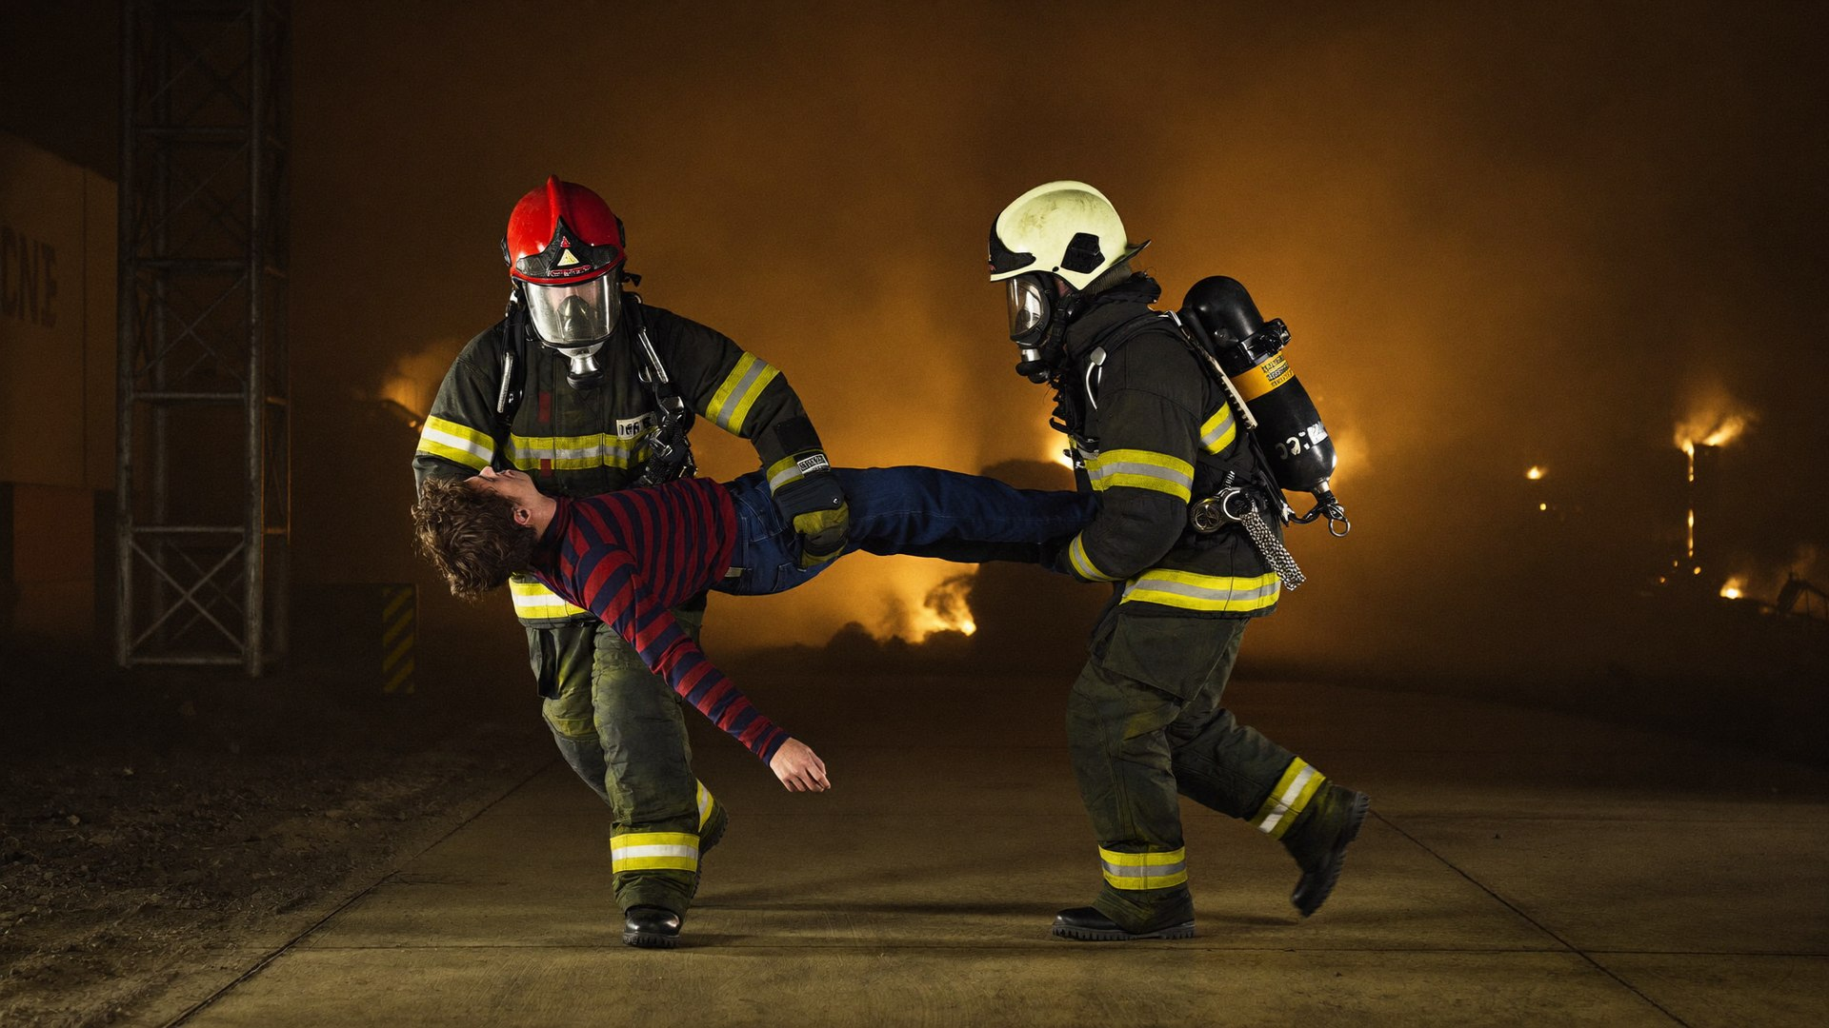
MODULE 5
MAYDAY: when the rescuer needs rescue
CALL IT EARLY — ANY OF THESE:
Firefighter down, trapped, lost or separated from buddy
BA emergency: low air, mask or regulator failure in the hot zone
Sudden condition change: collapse, flashover, engulfment
LEADER'S MAYDAY RESPONSE:
1
Clear the net — “MAYDAY traffic only”
2
LUNAR from the caller: Location, Unit, Name, Air, Resources needed
3
Deploy the standby/rescue team — this is why the reserve exists
4
Continue or contain the fire fight with remaining crews — two incidents now run in parallel
5
PAR on everyone else — one mayday often hides another
SANAD | FIRE FIGHTING TEAM LEADER
57
Notes:
MAYDAY (10 min). The hardest command moment in the fire service: one of your own is down, and your job is to NOT become the rescuer. Walk the triggers — stress calling it early; embarrassment has killed more firefighters than pride ever saved. Teach LUNAR as the information frame, then the five-step response with brutal honesty about step 4: the fire does not pause for the rescue, so the leader must run two incidents with half a heart and a full head. This is why the tactical reserve rule exists. A mayday inject appears in Day 3 round 2 — tell them it is coming; knowing does not make it easier.

Slide 58
MODULE 5 — PRACTICAL
PRACTICAL BLOCK
Incident command simulations
Tabletop-to-field command labs run against the clock, with assessors tracking every order.
Command post exercise
Multi-hazard scenario
The handover gauntlet
Run an ICP for a simulated rig fire: build the structure, set objectives, manage sector reports and SITREPs upward.
Fire + H2S alarm + missing person, simultaneously. Prioritize, structure, and keep accountability intact.
Command transfers mid-incident — brief the incoming commander in 60 seconds without losing the scene.
ASSESSED: Command structure, zone discipline, PAR integrity and handover quality — Module 5 rubric.
SANAD | FIRE FIGHTING TEAM LEADER
58
Notes:
Practical block briefing (5 min brief, then run the block). Brief each exercise card in under a minute: purpose, setup, roles, time limit. Assign the first leaders BEFORE moving to the training area so nobody can hide. Assessors position where they can hear the leader's orders, not just see the action. Assessment focus for this block: Command structure, zone discipline, PAR integrity and handover quality — Module 5 rubric. Run a 2-minute hot debrief after each rotation — one keep, one change, next leader up. Safety officer has absolute stop authority throughout.

Slide 59

END OF DAY 2
The commander's checklist you now own
TACTICS
COMMUNICATION
COMMAND & CONTROL
Size-up in 30 seconds, out loud
Closed-loop on every order
ICS structure grown to fit the incident
DRA loop running continuously
CAN SITREPs — 20 seconds, structured
Hot / warm / cold zones enforced
Mode declared: offensive / defensive / transitional
Sector officers, span of control 1:5
Entry control + PAR without gaps
Reserve resources protected
Fallback comms briefed in advance
Escalation tiers and handover ready
Tomorrow there are no slides. Tomorrow you command.
SANAD | FIRE FIGHTING TEAM LEADER
59
Notes:
Day 2 wrap (10 min). This checklist IS the course in twelve lines — have participants photograph it, then close their phones and recite their weakest line to their table. Run a lightning round: call out any line, and the named participant must explain it in one sentence. Set expectations for tomorrow with weight: full PPE from 07:30, hydration tonight, no new theory — only proof. Read the bottom line aloud and leave it hanging. Dismiss on time.

Slide 60
DAY 3 OF 3
PROVE.
Full-Scale Simulation
Everything from Days 1 and 2 — under pressure, in real time, evaluated. This is where certification is earned.
Module 6 — Full-Scale Leadership Simulation & Evaluation
Real-time decision-making evaluation
Final assessment, validation & certification
SANAD | FIRE FIGHTING TEAM LEADER
60
Notes:
Transition slide (2 min). Stand at the front, let the image land before speaking. Frame the day in one sentence: "Everything from Days 1 and 2 — under pressure, in real time, evaluated. This is where certification is earned." Preview the blocks listed on the slide, state the day's finish time, and remind participants that everything today is assessed material for Day 3. Energy check: ask one participant what they want out of today.

Slide 61
DAY 3 — PROVE
Schedule of the day
TIME | SESSION | MODE
07:30 | Readiness check, safety briefing & assessment rules | Classroom
08:00 | Module 6 — Scenario brief, team assignments, command rotations | Classroom
08:45 | Full-scale simulation round 1 — rig fire with casualty | Practical
10:15 | Break + hot debrief of round 1 | Practical
10:45 | Full-scale simulation round 2 — escalating multi-risk emergency | Practical
12:30 | Lunch & prayer | —
13:30 | Structured debrief & lessons-learned workshop | Practical
14:30 | Final assessment — leadership performance evaluation & knowledge check | Practical
15:30 | Individual competency validation & feedback interviews | Practical
16:15 | Certification & course closing | Classroom
SANAD | FIRE FIGHTING TEAM LEADER
61
Notes:
Walk the schedule top to bottom (2 min). Point out the practical blocks in orange — that is where the day is won. Confirm prayer and break timings with the group and flag any site-specific adjustments now, not mid-day. State the rule: practical blocks start on time, in full PPE, no exceptions — late arrival to a practical is a scored event. Ask for questions before moving on.

Slide 62

MODULE
06
Full-Scale Simulation
& Evaluation
OBJECTIVE — Validate leadership capability in realistic, complex scenarios.
Complex emergency scenarios
Multi-risk environments
Safety vs. urgency decisions
Post-incident review
SANAD | FIRE FIGHTING TEAM LEADER
62
Notes:
Module opener (3 min). Read the objective aloud, exactly as written: "Validate leadership capability in realistic, complex scenarios." Then connect it to the last module in one sentence so the course feels like one continuous build, not six separate lectures. Preview the four content areas on the slide and tell participants which of them will be tested in the practical block. Do not teach content here — set up the "why" and move.

Slide 63
MODULE 6
Exercise safety: realistic, never reckless
Dedicated safety officer
Two magic words
Present on the training ground throughout, outside the exercise play, with absolute STOP authority no one can override.
The exercise stop word freezes play instantly. The site's REAL emergency phrase — different, unmistakable — ends the exercise and starts a genuine response.
Controlled fire only
People protected
All live fire, smoke and props are operated by the training-ground team. Participants never handle fuel or ignition sources.
Full PPE standards as per real operations, hydration breaks between segments, medic on standby, heat-stress watch in summer conditions.
A training injury teaches one lesson only: that we failed as instructors. Nothing on this ground is worth a real casualty.
SANAD | FIRE FIGHTING TEAM LEADER
63
Notes:
Exercise safety (6 min, mandatory before any practical deployment). Deliver this slide with complete seriousness — it models exactly the safety leadership the course teaches. Name the safety officer in person and have them stand. Rehearse both magic words out loud with the whole class: the exercise stop word, then the real-emergency phrase; confirm everyone can distinguish them under noise. State the heat protocol explicitly with today's actual forecast. This briefing repeats in short form before every deployment — repetition is the point.

Slide 64

MODULE 6
The scenarios: built from your worst day
Both rounds are constructed from Day 2's rig hazard map. Expect layered, evolving problems — not a single tidy fire:
A credible rig fire
Casualties in play
Escalation injects
Resource scarcity
Fuel area, mud gas or electrical — staged with live training props, smoke and heat cues.
Injured or missing role-players force the rescue-vs-attack decision early.
Wind shift, second ignition, H2S alarm, comms failure — delivered mid-scenario, unannounced.
Never quite enough people, water or time. Exactly like the real thing.
Command rotation: every participant holds command for a graded segment — and serves as sector officer for peers. Leading and following are both assessed.
SANAD | FIRE FIGHTING TEAM LEADER
64
Notes:
Scenario design (5 min). Explain the design philosophy: scenarios are assembled from THEIR Day 2 hazard rankings, so nobody can call them unrealistic. Walk the four ingredients and be honest about resource scarcity — it is deliberate, because real firegrounds never have enough. Explain command rotation mechanics: graded command segments of 15–20 minutes each, with peers as sector officers; following well is scored too, because leaders who cannot follow wreck other leaders' scenes. Do not reveal the specific injects — anticipation without specifics is the productive kind of stress.

Slide 65
MODULE 6 — SIMULATION
90 MIN + DEBRIEF
Round 1: fire at the day tank
The situation
Your resources
Refueling operation goes wrong: spill ignites at the diesel day tank. Wind moderate, holding steady — for now. One operator seen near the tank at ignition; current location unknown.
Standard rig fire team, two hose lines, foam stock as briefed, one standby crew. Water refill 40 minutes away. Exactly enough — if nothing goes wrong.
Expected decision points
What assessors score
Rescue vs. attack priority • mode declaration • foam commitment arithmetic • muster and the unaccounted operator • first SITREP upward inside 3 minutes.
The first 60 seconds executed as drilled • closed-loop orders with brief-back • DRA verbalized when conditions change • reserve intact at the 30-minute mark.
SANAD | FIRE FIGHTING TEAM LEADER
65
Notes:
Round 1 brief (10 min). Read the situation card verbatim, once — commanders must learn to extract facts from a single telling. Answer only clarifying questions about rules, never about tactics. Assign the first commander and sector officers publicly. Safety reminders before moving out: real PPE standards apply, the exercise safety officer's stop is absolute, and the word for a REAL emergency during the exercise is the site's actual emergency phrase — drill it. After the round: 10-minute hot debrief on scene, then rotate command and reset props for the next segment.

Slide 66
MODULE 6 — SIMULATION
105 MIN + DEBRIEF
Round 2: the day everything happens
Round 2 escalates past any single playbook. Expect layered injects — in any order, at the worst times:
Second ignition
Wind shift
H2S alarm
A new fire where the plan is thinnest
Zones, muster and ICP all move — or should
The gas reflex chain, under fire conditions
Casualty
Comms failure
MAYDAY
Rescue-vs-attack with real triage decisions
Runners, signals, and the fallback you briefed
A responder in trouble — the reserve's moment
The test is not perfection. It is whether structure survives chaos: command held, people counted, decisions owned out loud.
SANAD | FIRE FIGHTING TEAM LEADER
66
Notes:
Round 2 brief (8 min). Show the six inject families WITHOUT revealing sequence or timing — knowing the categories is fair; knowing the order would be rehearsal. Exercise control drops injects when the current commander is stable, not on a fixed clock: the goal is finding each leader's edge, not humiliating anyone. Remind sector officers their performance is also graded. Re-brief safety: exercise stop word, real-emergency phrase, hydration between segments, and the safety officer's absolute authority. Read the dark bar aloud as the final word before deployment — structure surviving chaos is the whole course in one line.

Slide 67
MODULE 6
Safety vs. urgency:
the leader's dilemma
Urgency without safety creates a second incident inside the first
Safety without urgency lets a savable situation become unsavable
The balance point moves every minute — that is why the DRA loop never stops
Your decisions will be replayed in the debrief: be able to say WHY, not just WHAT
THE THREE DECISION GATES
1. Is anyone savable at this risk? 2. Do I control the hazard, or does it control me? 3. If this goes wrong in 60 seconds, can I get everyone out?
SANAD | FIRE FIGHTING TEAM LEADER
67
Notes:
Safety vs urgency (8 min). The dilemma has no formula — that is precisely why it needs a framework. Walk the four bullets, then teach the three decision gates as questions the leader asks OUT LOUD, so the team hears the reasoning and the debrief can audit it. Run the ethics case: a possible casualty near the day tank, BLEVE risk rising — take the room through the gates and let them disagree with each other before you weigh in. The point to land: both recklessness and paralysis are failures; the framework is what separates courage from gambling.

Slide 68

MODULE 6
How each simulation round runs
1
2
3
BRIEF
DEPLOY
ESCALATE
Scenario, roles, safety rules, assessment criteria — no surprises about how you're graded.
Alarm sounds. Commander takes the scene; teams respond as tasked.
Injects land: new hazards, failures, casualties. The plan must bend without breaking.
4
5
6
COMMAND
TERMINATE
DEBRIEF
Structure grows, SITREPs flow, accountability holds. Assessors track every order.
Exercise director closes the scenario at the objective — or at a safety stop.
Hot debrief in 10 minutes while memory is fresh: keep / change / never again.
SANAD | FIRE FIGHTING TEAM LEADER
68
Notes:
Safety note for instructors: a dedicated exercise safety officer with stop authority is present throughout; all pyrotechnics/smoke are controlled by the training ground team, never by participants.

Slide 69
MODULE 6
What the assessors are watching
COMPETENCY | WHAT “GOOD” LOOKS LIKE IN THE EXERCISE | MODULE
Command presence | Takes and holds command; visible, audible, calm under injects | M1
Decision-making | OODA tempo; 70% rule; decisions announced and revisited | M1
Human factors leadership | Detects stress/panic; intervenes by name and task; enforces discipline | M2
Tactical judgment | Size-up quality; DRA; correct mode; resource logic | M3
Communications | Closed loop; CAN SITREPs; radio discipline under load | M4
Command & control | ICS structure; zones; accountability and PAR without gaps | M5
Debrief contribution | Honest self-review; converts lessons into actions | M6
SANAD | FIRE FIGHTING TEAM LEADER
69
Notes:
Assessment transparency (5 min). Walk all seven rows and show the module column: nothing on this table is new — it is the whole course restated as observable behavior. Invite participants to self-score each row 1–5 right now in their notebooks; the delta between self-score and assessor score becomes the richest part of their individual feedback interview. Answer process questions fully, tactics questions not at all. Close with the standard: 'good' under exercise pressure, not perfection — assessors are looking for structure that survives stress, recovery after mistakes, and honesty in the debrief.

Slide 70
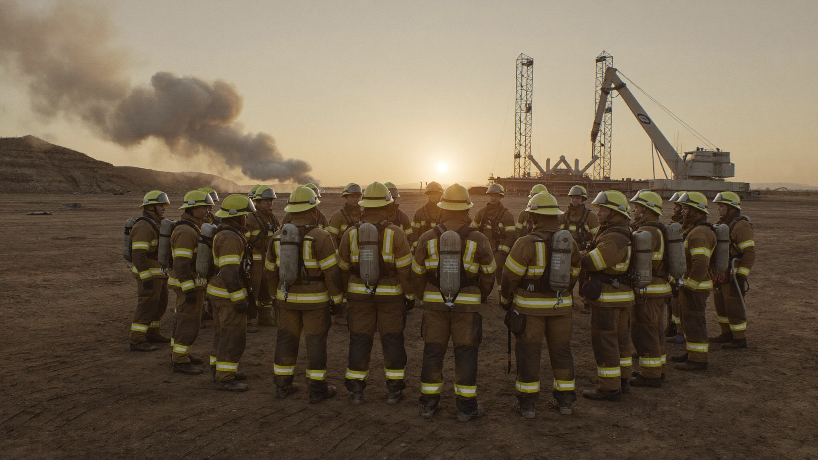
MODULE 6
The debrief: where experience becomes skill
Hot debrief (on scene, 10 min)
Immediately after termination, gear still on: what happened, what surprised us, any safety issues. Facts only.
Cold debrief (structured, 60 min)
Timeline reconstruction, decision review at each gate, assessor observations, peer feedback — no blame, full honesty.
Lessons into actions
Blame-free is not consequence-free. We are ruthless about the decision and generous with the decider. That is how teams learn to tell the truth fast.
Every finding becomes an owner + an action: a drill to run, an SOP to fix, a pre-plan to update on YOUR rig.
SANAD | FIRE FIGHTING TEAM LEADER
70
Notes:
Debrief methodology (7 min). Hot debrief: on scene, ten minutes, gear on, facts only — what happened, what surprised us, safety issues; no judgments while adrenaline is high. Cold debrief: structured hour with timeline reconstruction and decision-gate review; the leader speaks LAST so the team's honesty isn't anchored by rank. Lessons into actions: every finding leaves the room with an owner and a date, or it evaporates. Teach the dark box carefully — ruthless about decisions, generous with deciders — and model it in every course debrief; participants copy what instructors do, not what slides say.

Slide 71

MODULE 6
Feedback that lands: the debrief skill
Day 3 runs on peer feedback. Deliver it so it builds leaders instead of walls:
OBSERVED
IMPACT
NEXT TIME
Start with what you saw or heard — verbatim, no interpretation. “At 10:14 the mode changed with no radio announcement.”
→
State the consequence, factually. “Attack sector kept advancing into what had become a defensive fire.”
→
One concrete alternative, offered — not imposed. “Announce the mode on all-call, then confirm by sector.”
Receiving feedback is also scored: listen fully, ask one clarifying question, say thank you. Defending kills the debrief — and the defender learns nothing.
SANAD | FIRE FIGHTING TEAM LEADER
71
Notes:
Feedback skill (6 min). Observed–Impact–Next time: three steps, no personality commentary, no 'you always'. Read the worked example across the cards so they hear a complete, professional feedback sentence about a serious command error delivered without humiliation. Practice once: pairs exchange feedback on this morning's round using the structure, 60 seconds each way. Then the dark bar — receiving is scored too, because a leader who argues with feedback in a classroom will silence a safety observation on a rig. This is culture-building disguised as a technique.

Slide 72
DAY 3
Final assessment & competency validation
40%
40%
20%
Leadership performance
Scenario assessments
Knowledge check
Assessor scoring across both simulation rounds: command, decisions, human-factors leadership.
Graded practical blocks from all three days — tactics, communications, incident command.
Short written/oral validation of the frameworks: size-up, DRA, CAN, ICS, accountability.
TO PASS
Overall score ≥ 80% with no critical-competency failure (safety violation, lost accountability, abandoned command)
Full attendance and participation in every practical block
Unsuccessful candidates receive a development plan and one re-assessment pathway
SANAD | FIRE FIGHTING TEAM LEADER
72
Notes:
Final assessment (5 min). Restate the 40/40/20 split and what evidence feeds each bucket — by this point nothing should surprise anyone. Define the critical-competency failures precisely: a genuine safety violation, losing accountability of people, or abandoning command mid-scenario; these fail regardless of the numeric score, and participants deserve to know that bright line. Explain the feedback interview format: private, fifteen minutes, strengths first, self-score vs assessor score compared, development plan agreed together. Keep the tone confident — the assessment confirms three days of evidence; it does not ambush anyone.

Slide 73
DAY 3
Knowledge check: how ready are you?
Sample of the style — short, applied, no trick questions. Answer from doctrine, in your own words:
Q1
Name the five actions of the first 60 seconds — in order.
Q2
Your CAN report for a shaker-area fire with two lines deployed: give all three parts in 20 seconds.
Q3
Which risk-philosophy line covers cooling an exposed, evacuated storage container — and what does it permit?
Q4
You hear MAYDAY. What are your first three actions as incident commander?
Q5
The wind shifts 180° during a defensive fuel fire. What moves, and what do you announce?
Format: written + oral, 30 minutes, doctrine from Modules 1–6 only. If you led the simulations well, you already know every answer.
SANAD | FIRE FIGHTING TEAM LEADER
73
Notes:
Knowledge check preview (5 min). Run these five as a rapid-fire class warm-up before the written paper — cold-call, short answers, correct errors immediately. Model answers: Q1 assess-declare-deploy-communicate-reassess; Q2 any structured CAN inside 20 seconds; Q3 the property line — risk a little, with control; Q4 clear the net, take LUNAR, deploy the standby team; Q5 zones, muster and ICP move, announced on all-call with a PAR to follow. The message: the exam is the course, restated. Nobody who engaged for three days should fear it — and a confident room performs better this afternoon.

Slide 74

DAY 3
Certification: what you leave with
Certificate of Competency — Fire Fighting Team Leader Issued by NEFT Energies, ISO & TVTC approved training institution.
Individual competency report Strengths, development areas and assessor commentary — usable in SANAD's competency management system.
Leader's field pack Size-up card, CAN SITREP card, DRA loop, handover script and accountability checklists — pocket-sized for the rig.
Accreditation footprint: NEFT Energies is recognized by IADC, OPITO, LEEA, CIEH, DROPS, NFPA, IASP, IPAF, NEBOSH and IOSH.
Refresher pathway Recommended refresher and drill program to keep the capability alive between emergencies.
SANAD | FIRE FIGHTING TEAM LEADER
74
Notes:
Certification (4 min). Walk the four deliverables and their practical value: the certificate evidences competency for SANAD and client audits; the individual report feeds the competency management system and their next appraisal; the field pack is designed to live in a coverall pocket on shift, not in a drawer; the refresher pathway keeps the certificate honest. Hand the field packs out physically at this point — an object in the hand beats a bullet on a slide. Note the accreditation footprint for anyone whose HR needs the formal pedigree.

Slide 75
AFTER THE COURSE
Back on the rig: the 30-day command plan
WEEK 1
WEEK 2
WEEK 3
WEEK 4
Walk your ground
Drill the first 60 seconds
Test communications
Simulate & report
Re-do the size-up of your own rig: hazards, water points, muster, ICP location. Brief your crew on what you found.
→
Run the five-step drill with your shift — twice. Time it. Fix what stumbles.
→
Run a radio-discipline drill and a degraded-comms fallback. Issue the CAN card to every team member.
→
Lead one tabletop scenario with your crew. Send the lessons-learned summary to your HSE leadership.
Capability decays without repetition. The certificate proves what you could do on Day 3 — the 30-day plan proves what your rig can do on day 33.
SANAD | FIRE FIGHTING TEAM LEADER
75
Notes:
30-day plan (6 min). Walk the four weeks and make each one small enough to survive rig reality — every item fits inside existing shift routines. Have participants write week 1 into their phones now, with a date, before leaving the room; intentions without dates are wishes. Add the personal item from Day 1's self-audit (their weakest everyday-leadership card) to whichever week fits. Offer the follow-through hook: NEFT can support a 30-day check-in with their HSE leadership if SANAD requests it — turning individual training into organizational capability.

Slide 76
AFTER THE COURSE
Keeping it alive: the annual drill rhythm
RHYTHM | FORMAT | FOCUS
Weekly | One-skill micro-drill (15 min) | Hose deployment, BA donning, first-60-seconds — one skill, timed, debriefed in two sentences.
Monthly | Team evolution (45 min) | Full fire team against one pre-plan scenario. Rotate the leader every month — depth beats dependence.
Quarterly | Integrated exercise | Fire + muster + rig ERP interfaces. Walk one pre-fire plan on the ground and update what moved.
Annually | Full-scale with external interfaces | SANAD ERT and, where arranged, Saudi Aramco Fire Protection — the complete escalation chain, tested for real.
Fifteen minutes a week beats three days a year. Rhythm is what turns this course from an event into a capability your rig owns.
SANAD | FIRE FIGHTING TEAM LEADER
76
Notes:
Drill rhythm (5 min). Present the cadence as the minimum heartbeat of a living capability — weekly micro-drills carry the load, and everything scales up from them. Reconcile against SANAD's existing drill requirements: this table organizes what is already mandated, adding only the leadership rotation and the two-sentence debrief discipline. Leader rotation is the strategic move — a rig where one person owns emergencies is one crew change away from owning nothing. Suggest they pin this table in the doghouse next to the drill log.

Slide 77
COURSE SUMMARY
The Fire Team Leader's creed
01
I take command out loud — the scene will never wonder who leads it.
02
I decide at 70% and correct at full speed.
03
I read my people as closely as I read the fire.
04
I choose the mode, announce it, and own what it costs.
05
My communication is short, closed-loop, and calm.
06
I always know where every one of my people is.
07
I risk a lot to save a life, and nothing for what is already lost.
08
After every incident I tell the truth fast — that is how my team gets better.
SANAD | FIRE FIGHTING TEAM LEADER
77
Notes:
Read the creed aloud together before certificates are handed out. Corny? Maybe. Memorable? Absolutely — and memorable is what survives contact with a real fire.

Slide 78
COMMAND IS EARNED
BEFORE THE ALARM SOUNDS.
Thank you — and lead safely.
NEFT ENERGIES • Technical Proposal NERFQ26-5018 Mohamed Gamal — Regional Operations Manager | M: +966 55 518 8213 | E: m.gamal@neftenergies.com
SANAD | FIRE FIGHTING TEAM LEADER
78
Notes:
Closing (10 min). Certificates first, one at a time, with a handshake and one specific strength you observed in each graduate — specificity is the gift. Then the creed read together one final time. Close the loop on Day 1's expectations flipchart: what was met, what NEFT will follow up on in writing. Final words brief and true: 'You came here as firefighters who lead. You leave as leaders who fight fire. Go build the same in your crews.' Course photos, feedback forms, safe travels — and note the NEFT contact block on screen for anything they need after they are back on the rig.

