Slide 1

Name : Muhammad Ammar Jan Roll No : 435 Section : G

Slide 2

Fourier Transform
A Fourier transform is a mathematical technique for converting a time function into one expressed in terms of frequency.
A Fourier transform is a circuit analysis technique that decomposes or separates a waveform or function into sinusoids of different frequency which sum to the original waveform.
The Fourier transform helps in extending the Fourier series to non-periodic functions.

Slide 3
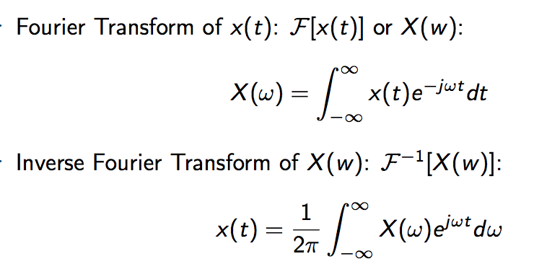
Properties of Fourier transform include:

Slide 4
Properties of Fourier transform include:
Linearity:
The Fourier transform holds linearity. More precisely, if we have two Fourier pairs f(x) to F(s) and g(x) to G(s), it can be shown that the Fourier transform of the sum of f(x) scaled by some constant a and g(x) scaled by some constant b is the sum of F(s) scaled by a and G(s) scaled by b.

Slide 5
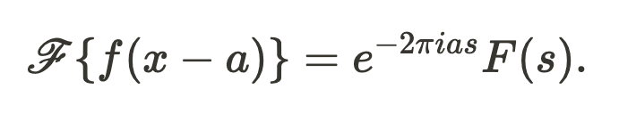
Properties of Fourier transform include:
Shift Theorem
The Shift Theorem for Fourier transforms states that for a Fourier pair g(x) to F(s), we have that the Fourier transform of f(x-a) for some constant a is the product of F(s) and the exponential function evaluated as:

Slide 6
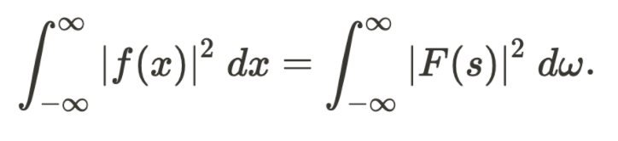
Properties of Fourier transform include:
Parseval's Theorem:
Parseval's Theorem states that the Fourier transform is unitary. More precisely, for a Fourier pair f(x) and F(s), that the integral of the square of f(x) is equivalent to the integral of F(s). This can be expressed as:

Slide 7
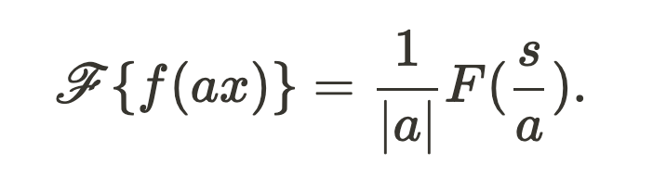
Properties of Fourier transform include:
Similarity Theorem:
For a Fourier pair f(x) and F(s), the Similarity Theorem states that the Fourier transform of g evaluated at the product of a constant a and x equals product of the reciprocal of the magnitude of a and G evaluated at the quotient of s and a:

Slide 8
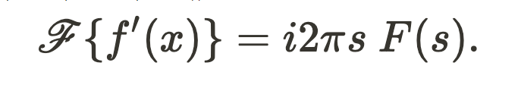
Properties of Fourier transform include:
Derivative Theorem:
For a Fourier pair f(x) and F(s), we have that the Fourier transform of the derivative of f(x) is equal to the product of i2pi*s and F(s):

Slide 9
Applications of Fourier transform include:
Fourier transform is used to solve partial differential equations.
NMR ,MRI and other kinds of spectroscopy.
Signals and systems analysis.
Digital signal processing.
uantum mechanics.
Application to IBVP
Circuit Analysis
Signal Analysis
Cell phones
Image Processing
Signal Processing& LTI system

Slide 10
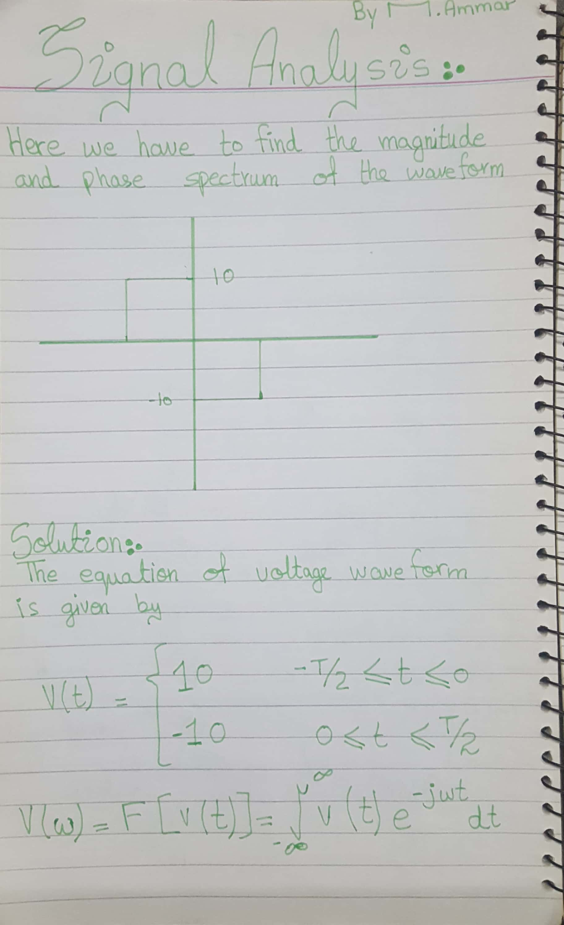

Slide 11
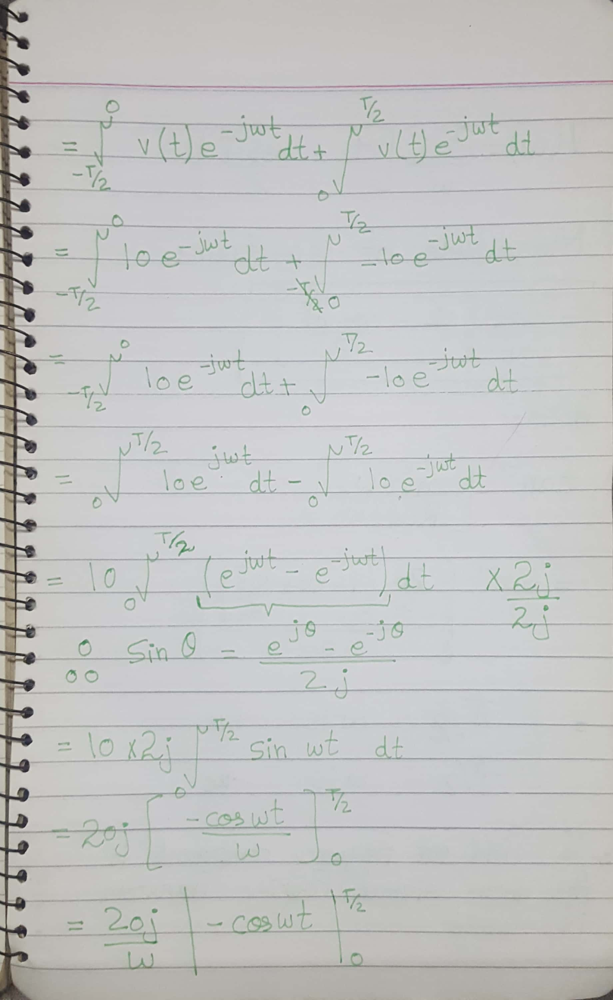

Slide 12
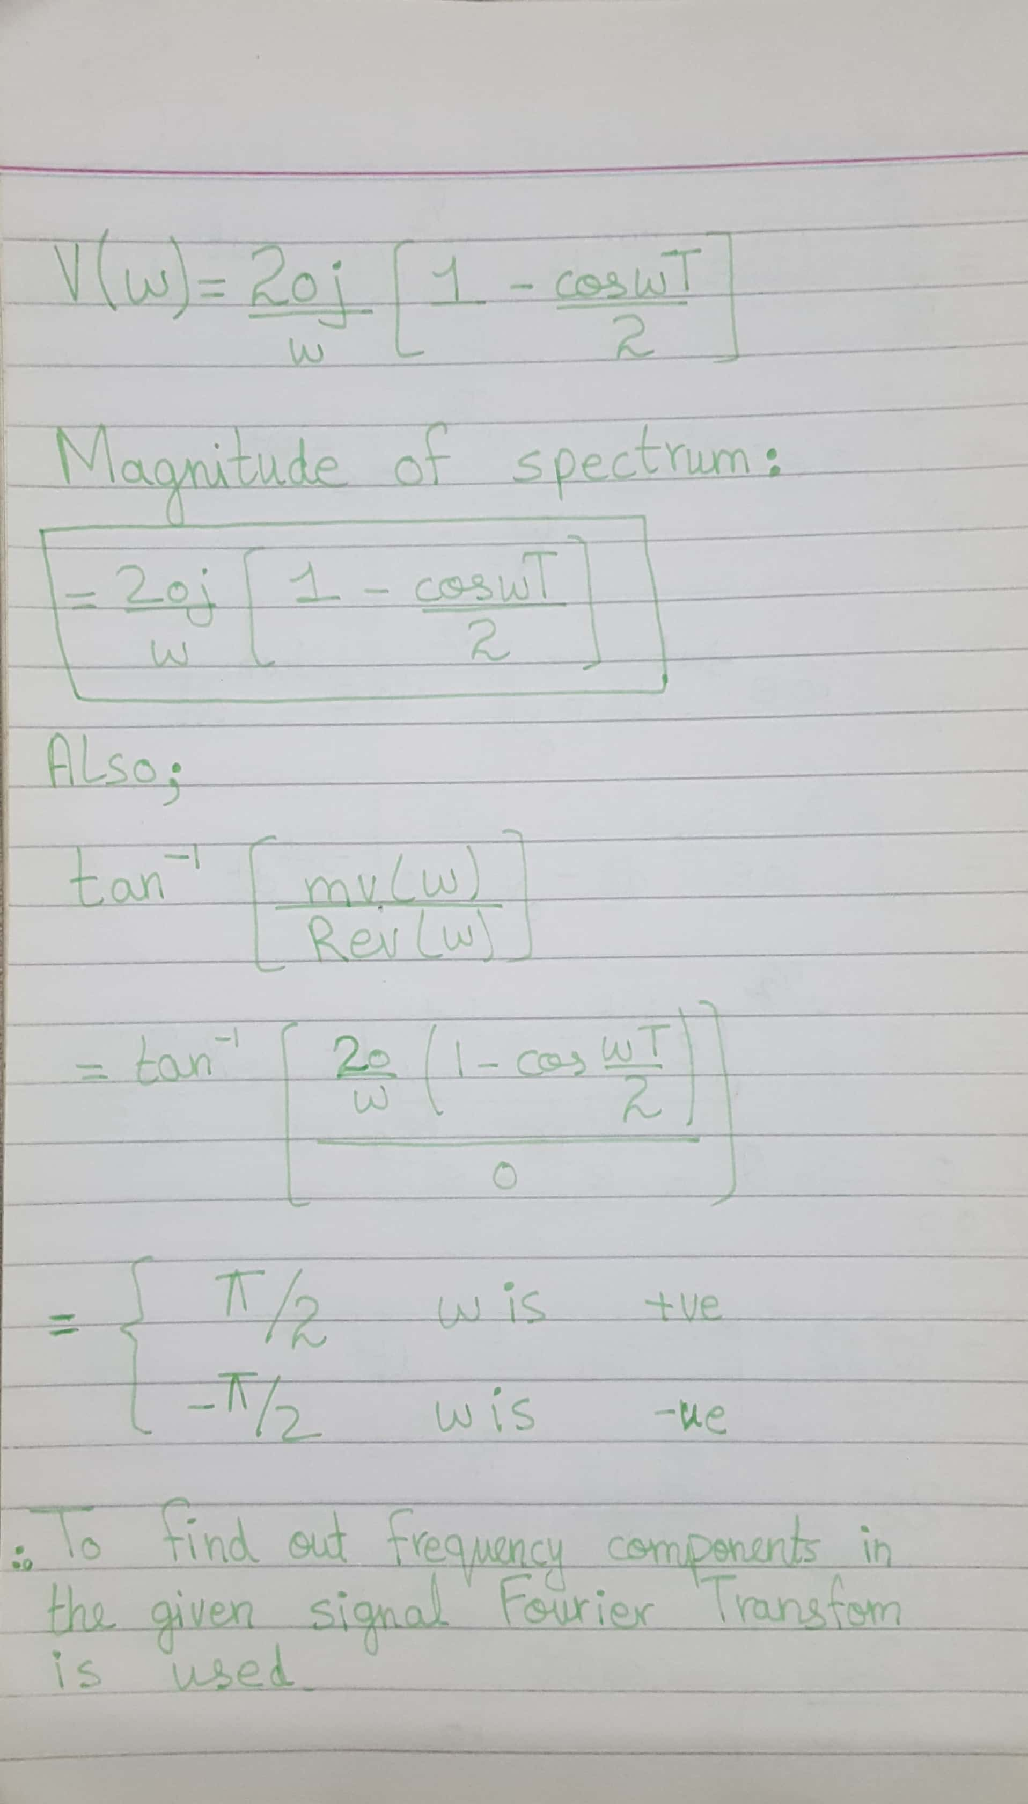

Slide 13
Reference:
https://en.wikipedia.org/wiki/Fourier_transform
https://www.techopedia.com/definition/7292/fourier-transform
https://www.quora.com/What-are-some-application-of-Fourier-transform-or-Fourier-series-in-Astrophysics

Slide 14
Thanks

