Slide 1
Cluster Analysis
Finding groups of objects such that the objects in a group are similar (or related) to one another and different from (or unrelated to) the objects in other groups
Intra-cluster distances
are minimized
Inter-cluster distances
are maximized
A good clustering method will produce high quality clusters with:
  high intra-class similarity
  low inter-class similarity

Slide 2
Clustering Applications
Marketing: Help marketers discover distinct groups in their customer bases, and then use this knowledge to develop targeted marketing programs
Land use: Identification of areas of similar land use in an earth observation database
Insurance: Identifying groups of motor insurance policy holders with a high average claim cost
City-planning: Identifying groups of houses according to their house type, value, and geographical location
Earth-quake studies: Observed earth quake epicenters should be clustered along continent faults

Slide 3
Requirements of Clustering in Data Mining
Scalability
Ability to deal with different types of attributes
Discovery of clusters with arbitrary shape
Minimal requirements for domain knowledge to determine input parameters
Able to deal with noise and outliers
High dimensionality
Insensitive to order of input records
…

Slide 4
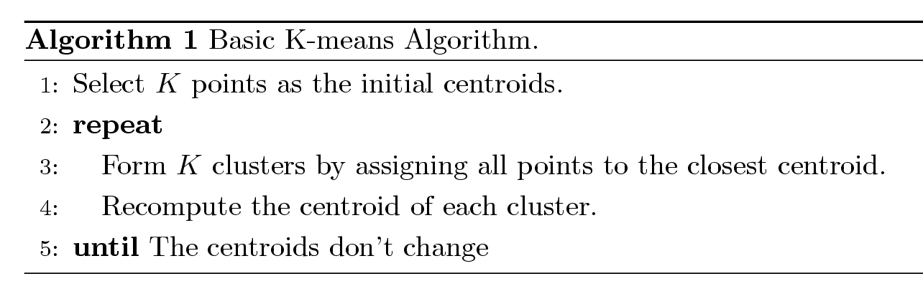
K-Means Clustering
Partitional clustering approach
Each cluster is associated with a centroid (center point)
Each point is assigned to the cluster with the closest centroid
Number of clusters, K, must be specified
The basic algorithm is very simple
Input:
k: the number of clusters,
D: a data set containing n objects.
Output: A set of k clusters.

Slide 5
K-Means Clustering – Details
Initial centroids are often chosen randomly.
  Clusters produced vary from one run to another.
The centroid is (typically) the mean of the points in the cluster.
‘Closeness’ is measured by Euclidean distance, Hamming distance, etc.
Most of the convergence happens in the first few iterations.
  Often the stopping condition is changed to ‘Until relatively few points change clusters’
the computational complexity of the algorithm is O(nkt), where
  n is the total number of objects,
  k is the number of clusters,
  t is the number of iterations.
  Normally, k <<n and t << n.

Slide 6
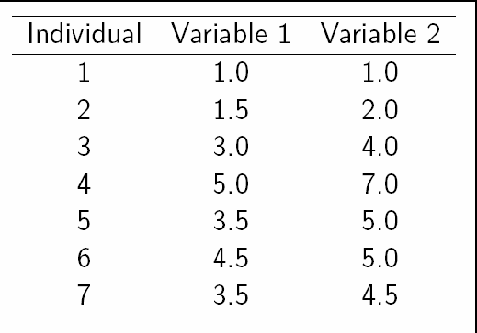
A Simple example showing the implementation of k-means algorithm (using K=2)

Slide 7
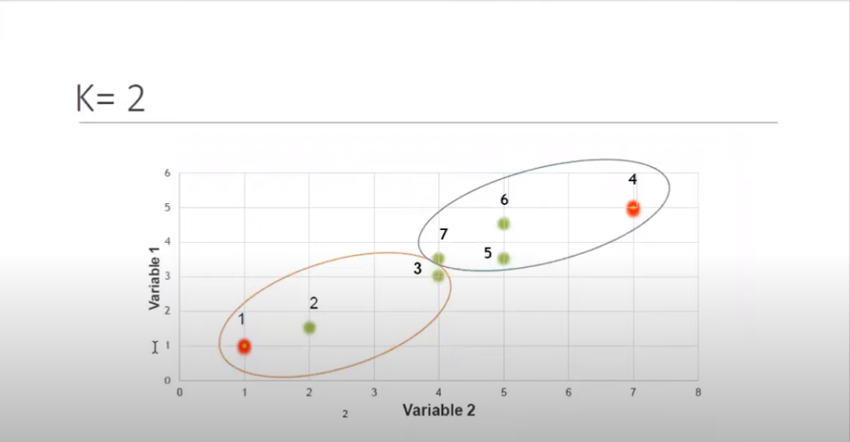

Slide 8
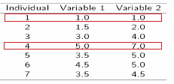

Step 1:
Initialization: Randomly we choose following two centroids (k=2)for two clusters.
In this case the 2 centroid are :m1(1.0,1.0) , m2(5.0,7.0)

Slide 9
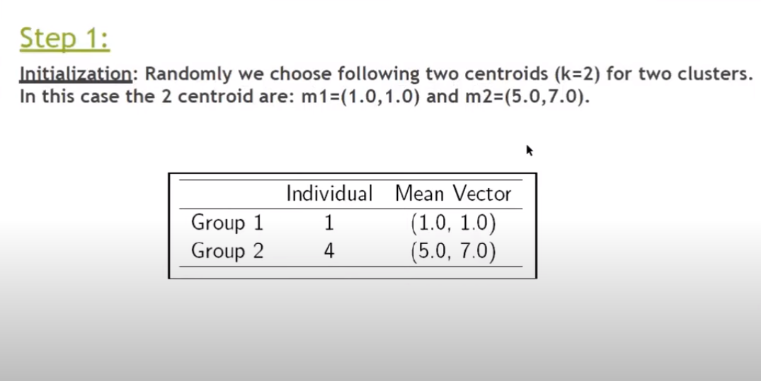

Slide 10
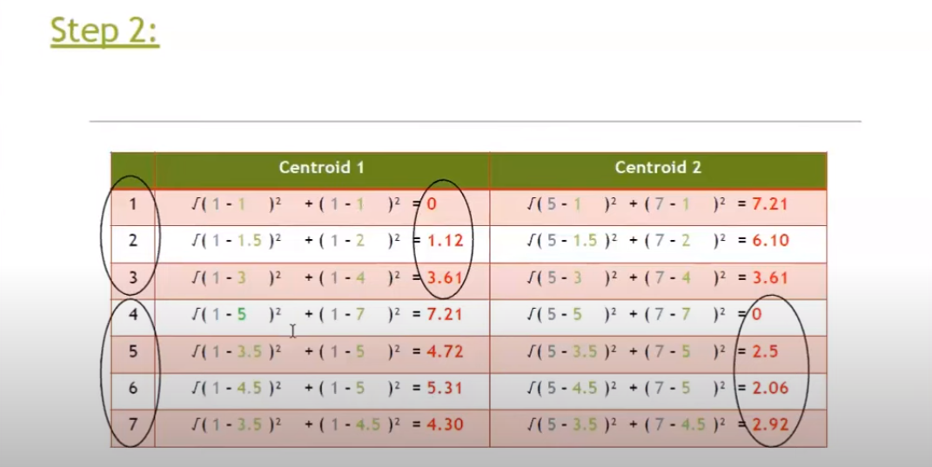

Slide 11
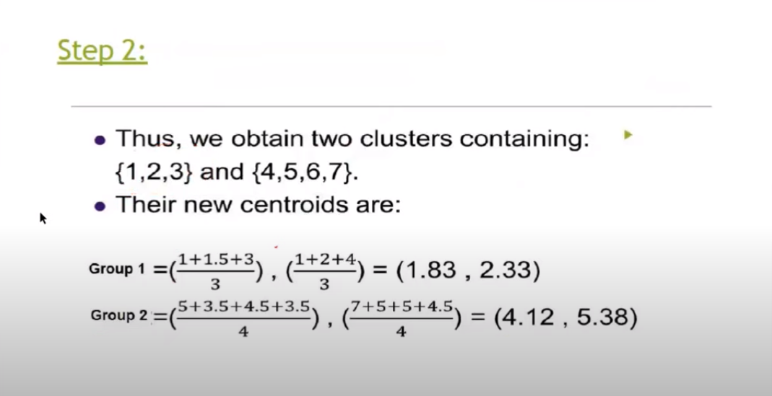

Slide 12
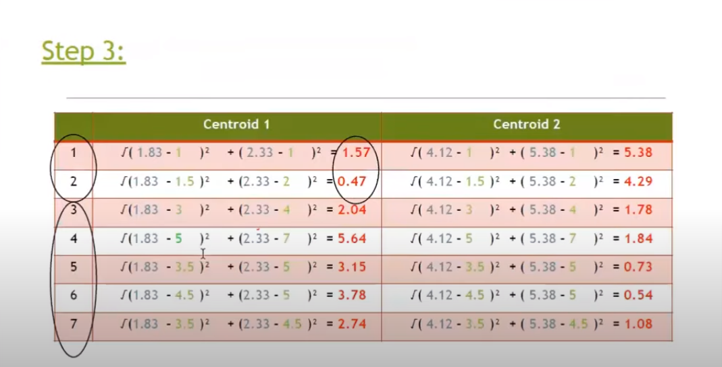

Slide 13
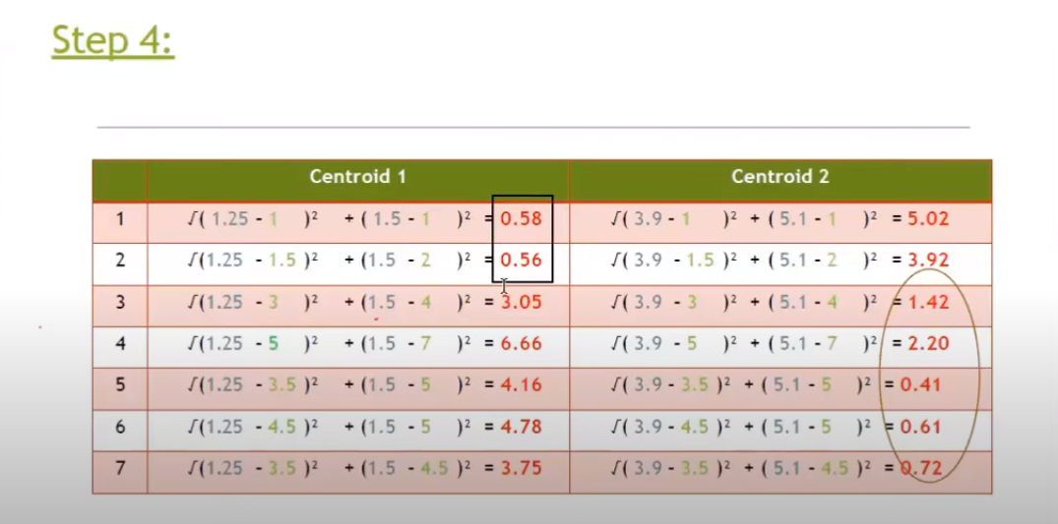

Slide 14
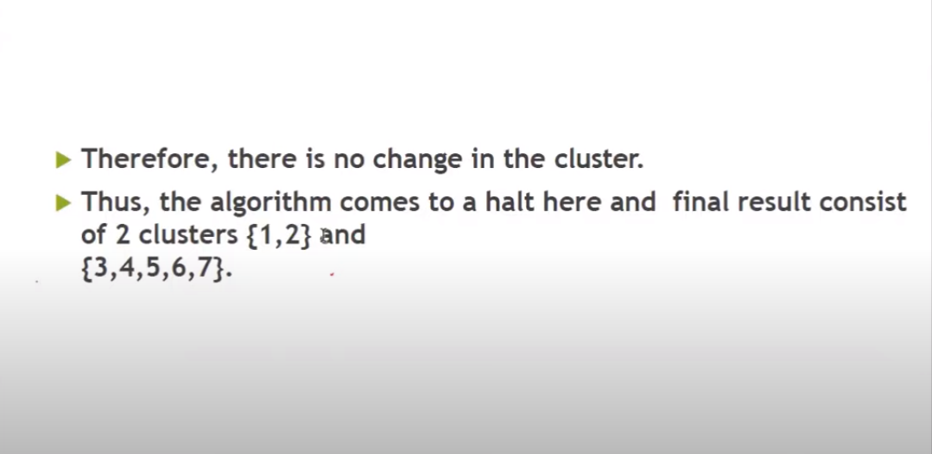

Slide 15
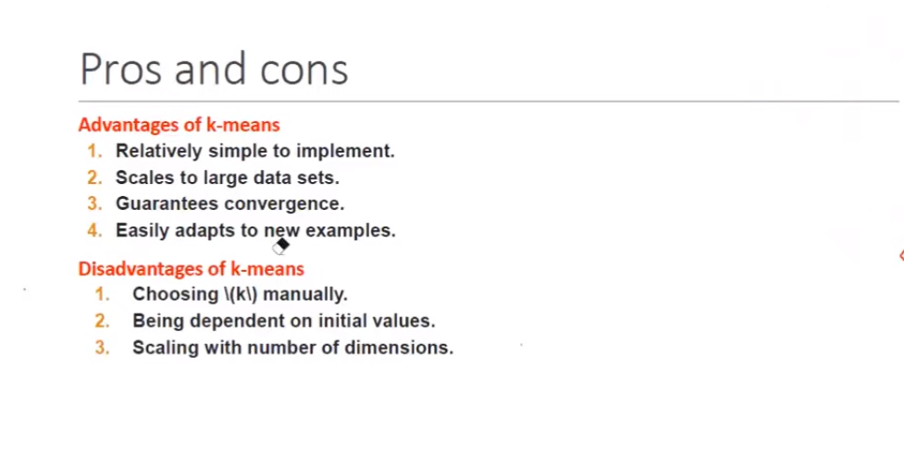

Slide 16
Weaknesses of k-means
The algorithm is only applicable if the mean is defined.
  For categorical data, the centroid is represented by most frequent values.
The user needs to specify k.
The algorithm is sensitive to outliers
  Outliers are data points that are very far away from other data points.
  Outliers could be errors in the data recording or some special data points with very different values.
    The k-means algorithm is not suitable for discovering clusters that are not hyper-ellipsoids (or hyper-spheres).

Slide 17
K-Means weakness
  One method is to remove some data points in the clustering process that are much further away from the centroids than other data points.
  To be safe, we may want to monitor these possible outliers over a few iterations and then decide to remove them.
Another method is to perform random sampling. Since in sampling we only choose a small subset of the data points, the chance of selecting an outlier is very small.
  Assign the rest of the data points to the clusters by distance or similarity comparison, or classification

