Slide 1
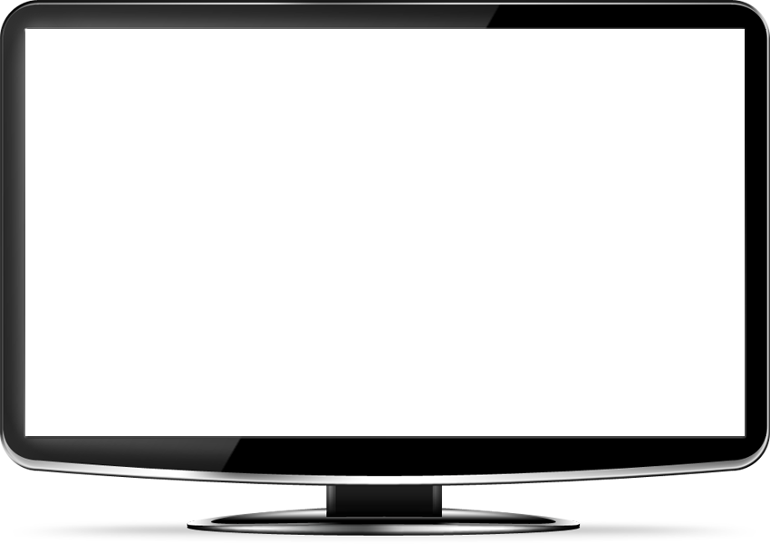
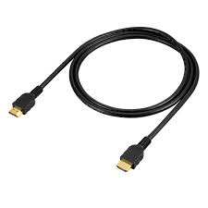
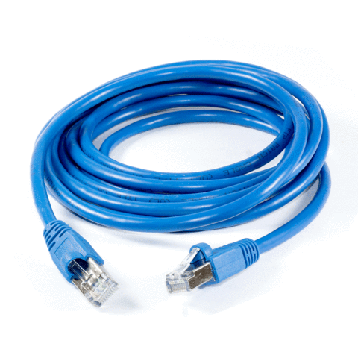
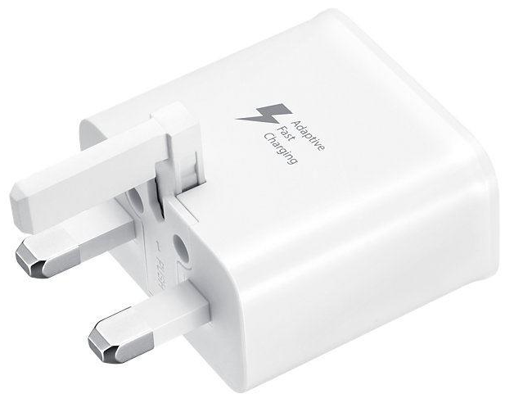
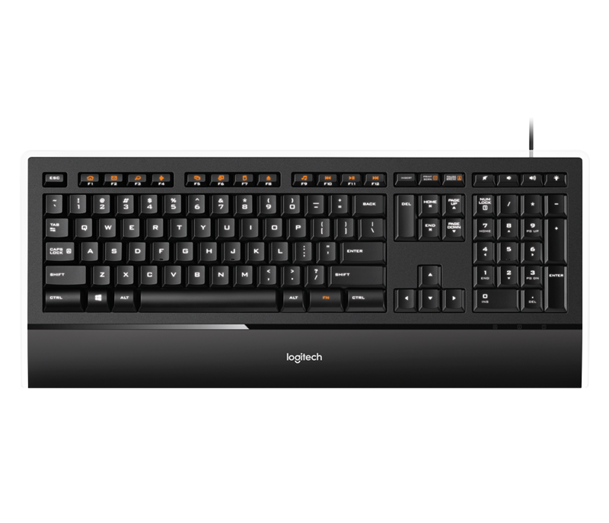
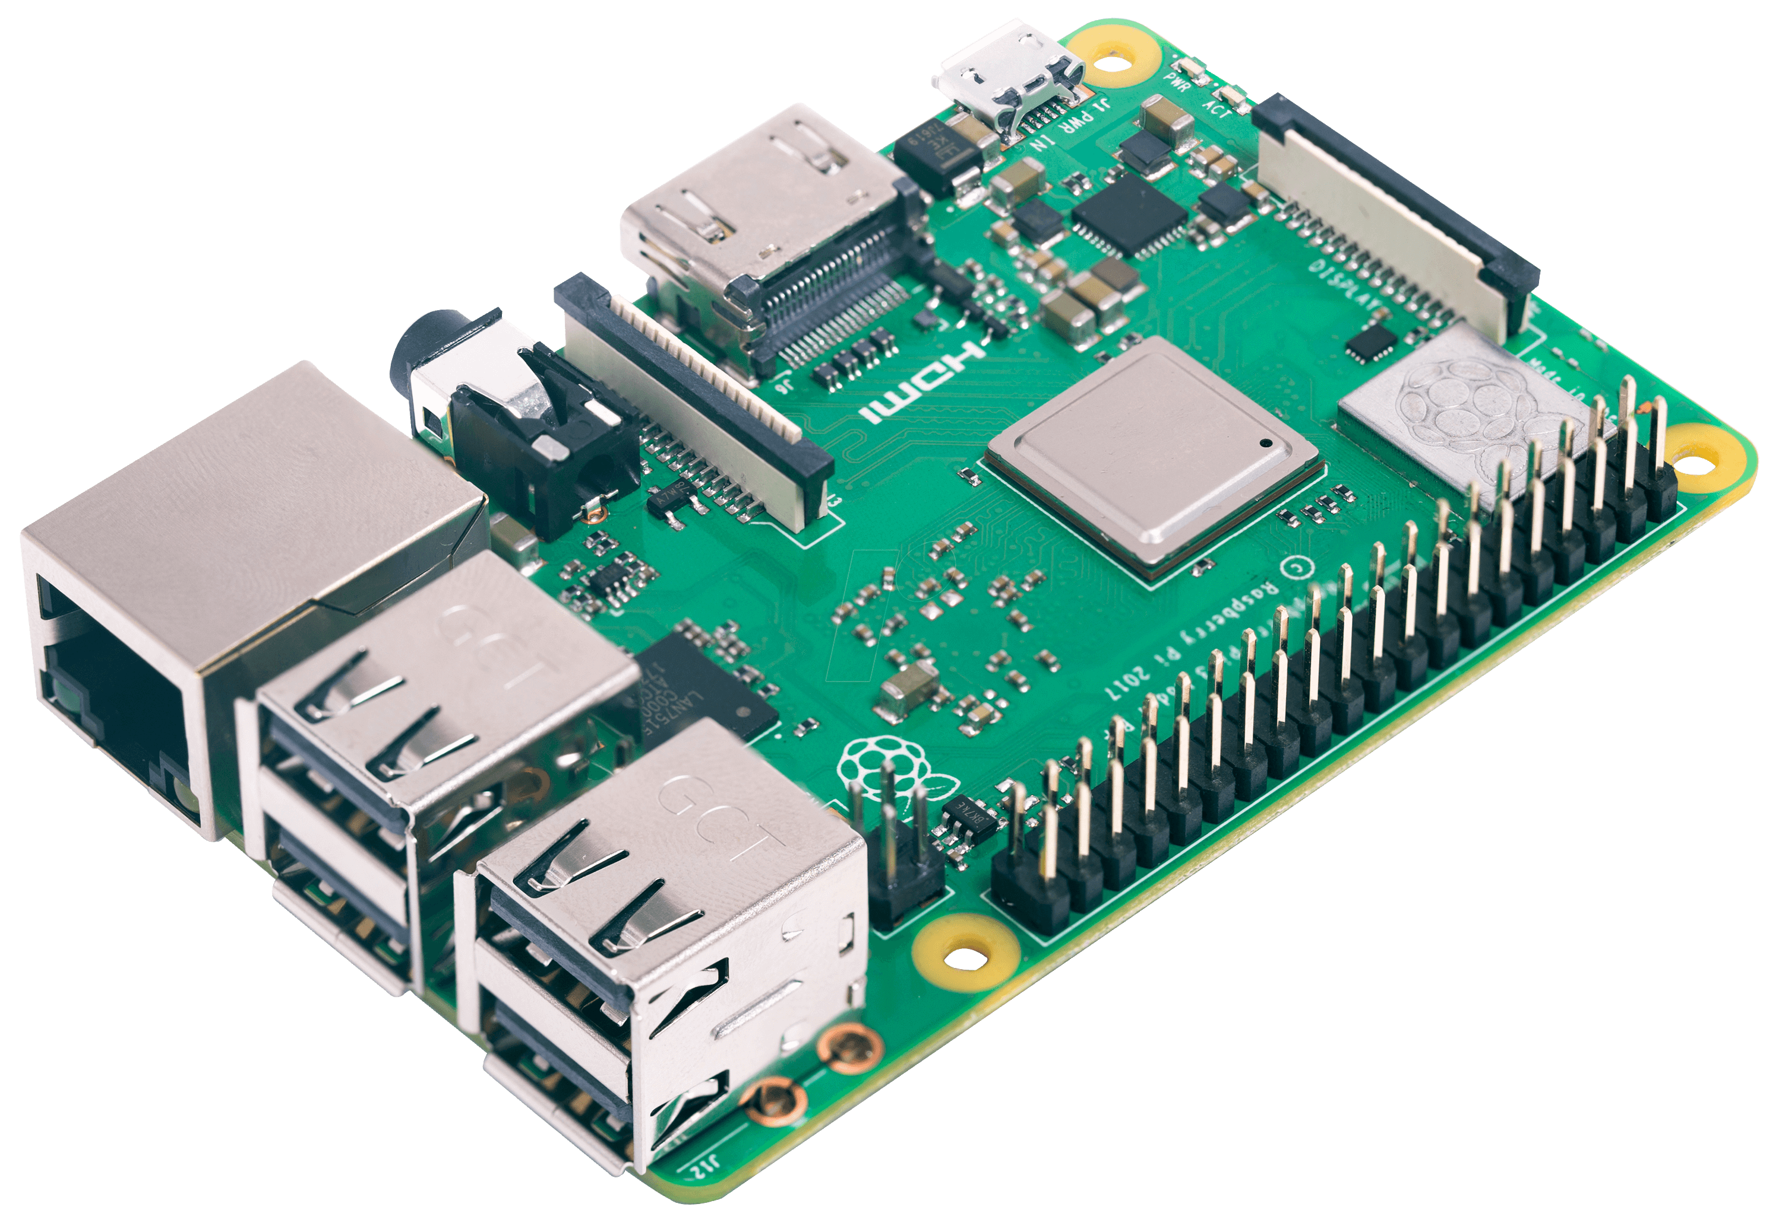
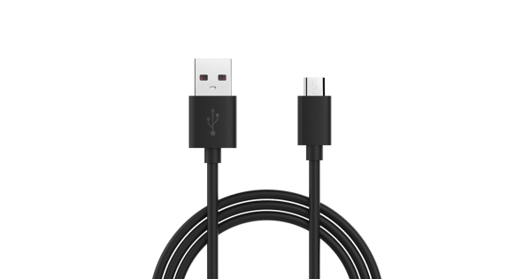
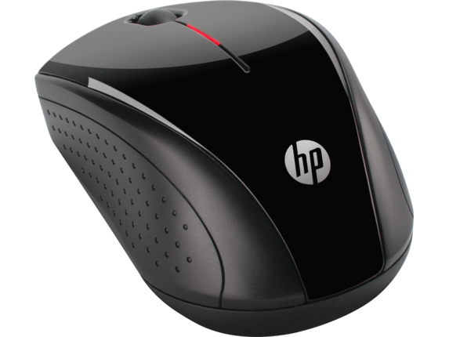
Raspberry Pi to PC Remote Desktop Connection
[ ] you will need the following for setting up the raspi for the first time
. HDMI enabled monitor
. HDMI cable
. Micro USB and 2A power adapter
. Mouse and keyboard
. LAN cable
. Internet (to download packages)

Slide 2
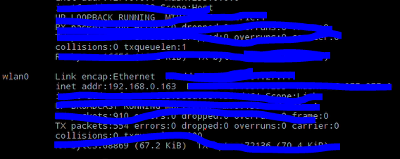
Raspberry Pi to PC Remote Desktop Connection
sudo apt-get remove xrdp vnc4server tightvncserver
sudo apt-get install tightvncserver
sudo apt-get install xrdp
sudo ifconfig
Raspi IP address
sudo reboot
Open ‘Remote Desktop Connection’
default user: pi
default password: raspberry

