Slide 1
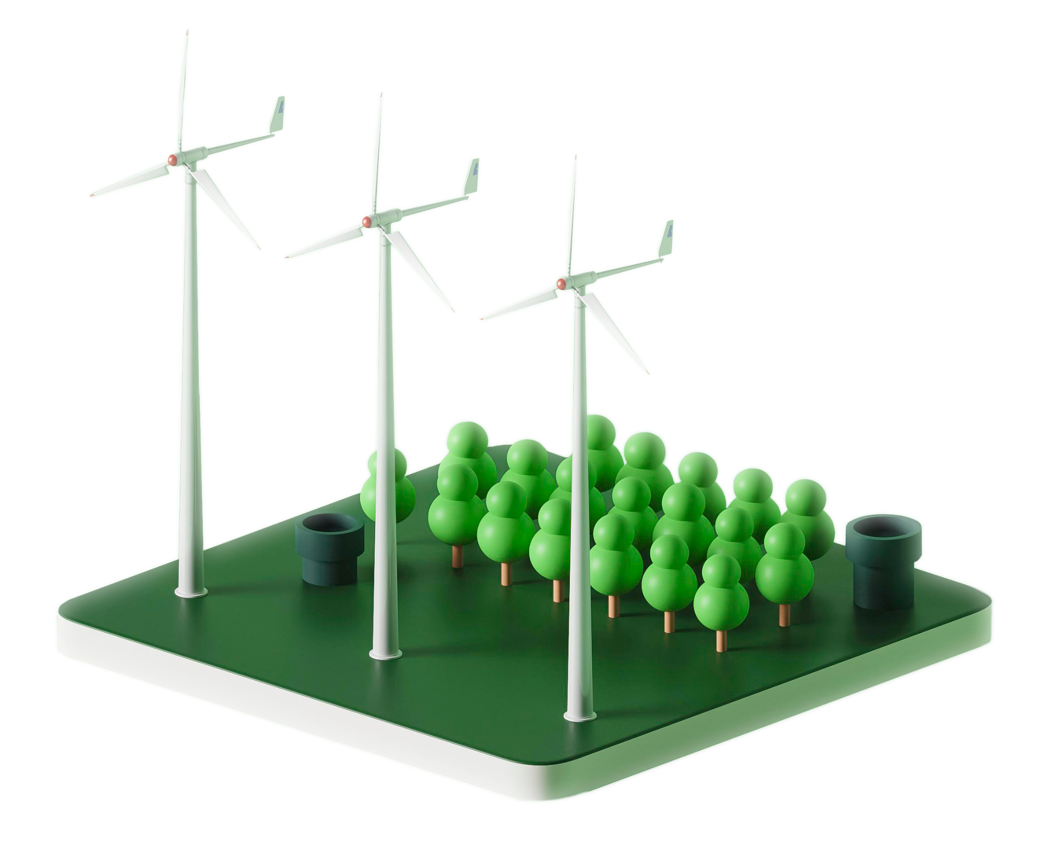
Python for {
'Energy System Modelling'
[PyPSA Workshop]
From hourly data to an optimised dispatch, with open-source tools
Ammar Ahmed Wafad
Sustainable energy engineer
Founder, Nortum Ltd
MSc Sustainable Engineering: Energy, NTU 2024
}
# Lecture and workshop · Nottingham Trent University
# 22 October 2026
Notes:
Quick hello. I did this same MSc and graduated in 2024.
Today I work across energy engineering, research and my own company, and Python is in almost everything I do. By the end of the session you will have run three small energy models yourselves: a home with solar and a battery, a power system with a carbon price, and rooftop solar on one of this university's own buildings. No coding experience needed.

Slide 2
Four steps: the ideas, a short practice, three hands-on tasks, then what your results mean
agenda(120 min):
01
03
Lecture · Why code?
02
Tasks 1, 2 and 3
04
< models, tools, PyPSA, live demo >
Practice · JupyterLab
< groups of three or four, 15 min each >
Results + quiz
00 to 50 min
< open, run, edit, rerun, restart >
60 to 105 min
< class results, quiz and feedback >
50 to 60 min
105 to 120 min
Notes:
The first hour is mostly me: why we code, what an energy model is, the tools and a short live demo, then ten minutes of practice so everyone has JupyterLab or Colab open and the first cell run.
The second hour is yours: three tasks of about fifteen minutes each, in groups of three or four, then the class results, a short quiz and feedback.
Roles: the Modeller runs the notebook, the Reviewer reads each step and checks the method, and the Reporter checks the numbers and fills in the form. In a group of four, the Second reviewer supports the Reviewer. Swap roles after each task.

Slide 3
An energy system model is a simplified, testable description of how energy is supplied and used
energy_model():
01
It answers planning questions: how much capacity, when it runs, what it costs and what it emits.
inputs
demand · weather
costs · assumptions
02
Simulation follows fixed rules (Task 1). Optimisation finds the cheapest option (Task 2).
model()
results
capacity · dispatch
cost · CO2
03
The same methods scale from one home to a national grid or a whole continent.
Every model simplifies: the assumptions decide the answer
Notes:
An energy system model is a simplified description of how energy is produced, stored, moved and used, written down precisely enough that a computer can calculate with it.
It answers planning questions: how much solar or storage to build, when each power station runs, what the system costs and what it emits.
Two families. Simulation applies fixed rules and shows what happens: our battery in Task 1 charges when there is spare solar. Optimisation searches for the best answer under constraints: in Task 2, PyPSA finds the cheapest way to meet demand in every hour.
The same ideas work at every scale, from a single home to the whole European grid.
Key message: every model simplifies, so always ask which assumptions drive the result.
Point to the box: data and assumptions go in, the model calculates, and the results answer the planning questions in point 01: how much capacity, when it runs, what it costs and what it emits.

Slide 4
Open-source tools make energy models transparent, reusable and free to learn
tools():
PyPSA
oemof
Calliope
PLEXOS
Python; power and sector-coupled systems, from a home to a continent
Open Energy Modelling Framework (Python)
Python; multi-scale models defined in simple text files
commercial market and dispatch software used in industry
# open source: anyone can inspect the code, check the assumptions and reproduce the results
Notes:
There are many energy modelling tools. Four examples:
PyPSA, which we use today: Python, open source, for power systems and sector-coupled systems.
oemof, the Open Energy Modelling Framework: also Python, a flexible toolbox for building energy system models.
Calliope: Python, with models described in simple text files, designed for multi-scale studies.
PLEXOS: commercial software widely used by utilities and consultancies for market and dispatch studies.
Why open source matters in research: anyone can inspect the code, check the assumptions and reproduce the results. That is good scientific practice, and it is free to learn.
If asked about TIMES: a long-term planning framework from the IEA's ETSAP programme, used for national energy strategies.

Slide 5
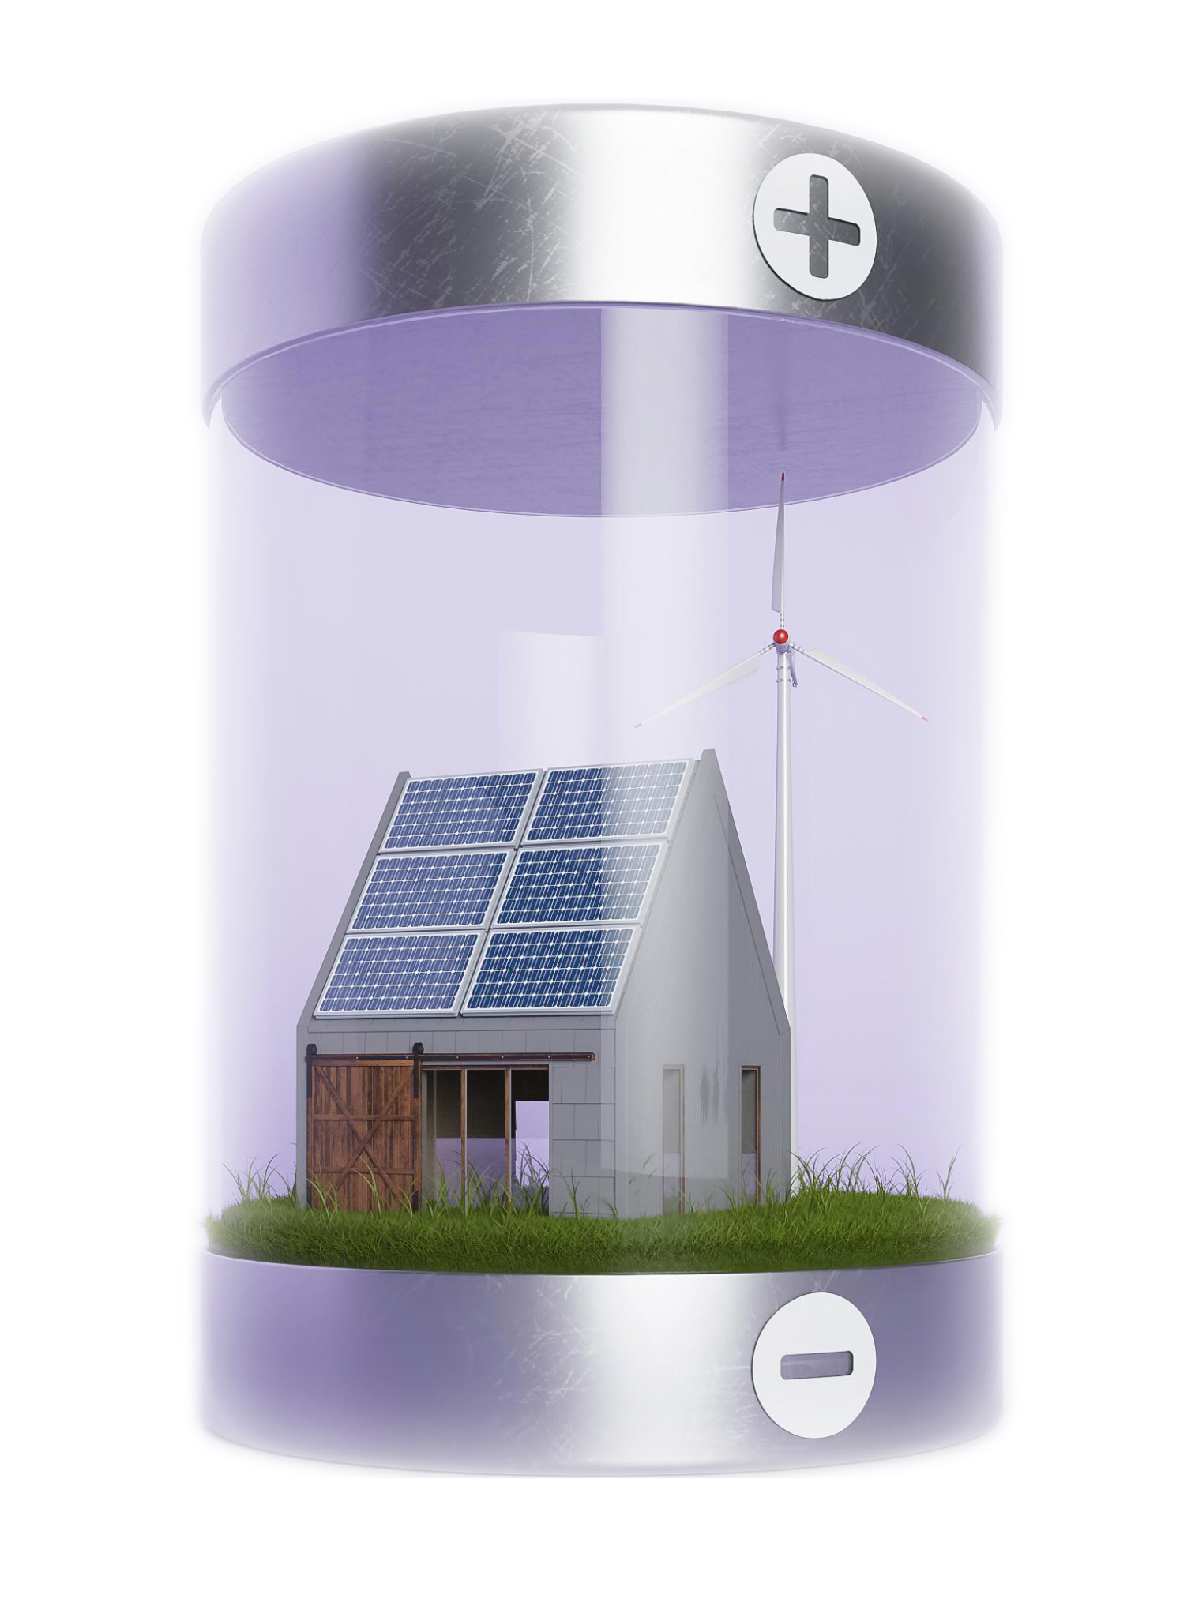
01 {
[Why code in energy?]
Spreadsheets struggle once 8,760 hours meet several assets and many scenarios. Code makes every assumption visible and every run repeatable.
}
Notes:
Why write code at all, when a spreadsheet can hold a year of data? Ask the room: who has built an energy calculation in Excel? Keep that in mind for the next slide.
The short answer: once thousands of hours meet several assets and many scenarios, code keeps every assumption visible and lets you rerun everything in seconds.

Slide 6
One household year is 8,760 hourly decisions, so scenarios quickly outgrow a spreadsheet
scale():
8,760
× 4
× 10
350,400
hours in one year of a single home
components: solar, battery, grid, demand
scenarios: tariffs, battery sizes, weather
values to compute and compare
# change one assumption → rerun everything in seconds
Notes:
A year is 8,760 hours.
Add a few components and a few scenarios and you’re at 350,000 numbers.
Excel can store that, but it can’t reliably optimise it: Excel’s built-in Solver is limited to 200 decision variables, and our battery model has thousands.
The bigger point is repeatability. With code you change one line and rerun everything.
If asked “why not Excel?”: fine for quick checks. It’s error-prone at scale, hard to audit, and can’t solve real optimisation problems.

Slide 7
A PyPSA model follows one pipeline: data, network, optimisation, results
workflow():
PV
battery
hour demand pv
00:00 0.31 0.00
06:00 0.42 0.05
12:00 0.38 1.92
18:00 0.95 0.12
…8,760 rows · kWh
~
n.optimize()
HiGHS solver
bus
load
data
pandas time series
network
PyPSA components
optimise
linopy + HiGHS
results
dispatch · £ · tCO₂
Notes:
A PyPSA model follows four steps. Task 2 uses all four; Tasks 1 and 3 use the data and results steps with a simple rule in place of the optimiser.
Data comes in as a table, using pandas.
We describe the system: buses, generators, storage, load. That is PyPSA.
A solver finds the cheapest way to meet demand every hour. HiGHS is a free, open-source solver; linopy is the layer that writes the maths for it.
We get results: who generated what, prices, costs, emissions.
pandas: Python’s standard library for tables and time series. It loads our hourly data, here 8,760 rows of demand and solar, and lets us filter, sum and plot it.
PyPSA: describes the energy system as components (buses, generators, storage, loads) and sets up the model from them.
linopy: the layer under PyPSA that turns the model into a mathematical optimisation problem: variables, constraints and a cost to minimise.
HiGHS: a free, open-source solver developed at the University of Edinburgh. It solves that problem and finds the cheapest way to meet demand in every hour.
If asked about other tools: oemof, Calliope and pandapower do similar jobs. PyPSA is widely used in research and industry, and it is the one I used in my published paper.

Slide 8
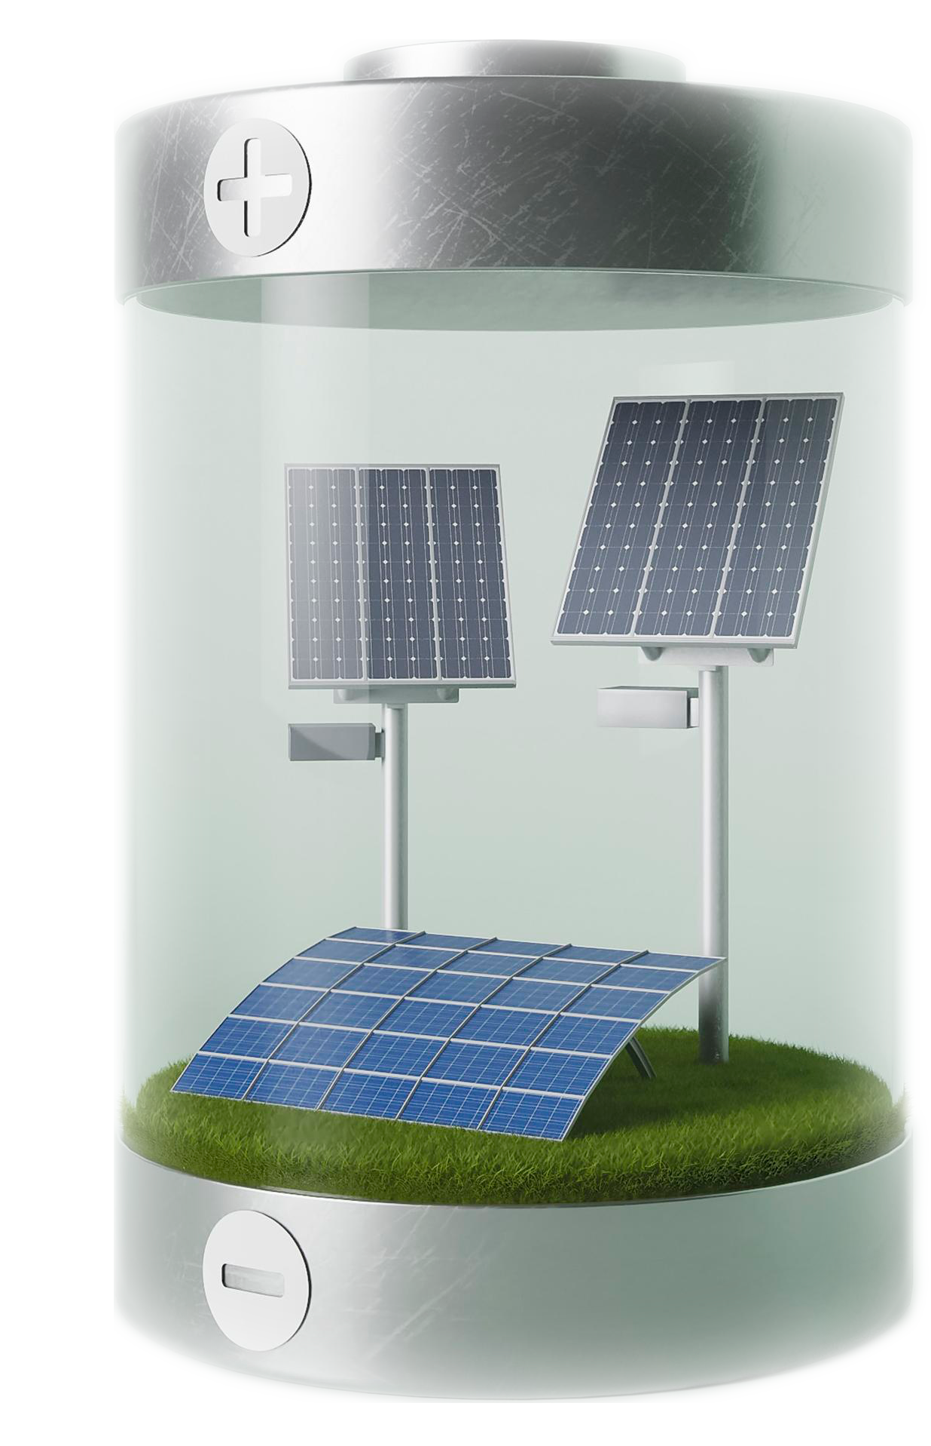
pypsa():
PyPSA: Python for Power System Analysis, open source and widely used
import pypsa # free and open source, MIT licence
Build: buses, loads, generators, storage, lines
Add time series: demand and weather, hour by hour
Optimise: n.optimize() finds the least-cost plan
Read results: dispatch, prices, costs, emissions
used_by = IEA · ENTSO-E · grid operators · PyPSA-GB · PyPSA-IMG
Notes:
PyPSA stands for Python for Power System Analysis. It is open source under the MIT licence, and is developed by an open community; Open Energy Transition and TU Berlin are among the main contributors.
The workflow has four steps. Build the network from components: buses are connection points, loads are demand, generators produce, storage shifts energy in time, lines move it between places. Add time series such as hourly demand and weather. Call n.optimize(), which hands the problem to a solver; we use HiGHS, which is also free. Then read the results: who generated what, prices, costs and emissions.
Who uses it: the IEA in its Global Energy and Climate Model, ENTSO-E, grid operators such as Austrian Power Grid, and consultancies and think tanks. For Great Britain there is PyPSA-GB, published in Energy Strategy Reviews in 2024.
In Task 2 you will build a small version of exactly this.

Slide 9
With PyPSA you can plan, operate and decarbonise energy systems, from one site to a continent
pypsa(applications):
plan
operate
couple
scale
choose the least-cost mix of solar, wind, storage and grid to build
schedule generators and batteries hour by hour; find prices and emissions
link power with heat, transport and hydrogen: heat pumps, EVs, electrolysers
start from open models: PyPSA-GB, PyPSA-Eur and PyPSA-Earth, PyPSA-IMG
# Research project ideas: campus solar + storage, local heat pumps, industrial hydrogen
Notes:
What can you actually do with PyPSA? Four things.
Plan: capacity expansion. Give it costs and let the optimiser decide how much solar, wind, storage and grid to build. This is the question behind most net zero studies.
Operate: dispatch. Given what is built, it schedules every generator and battery hour by hour and gives you prices, costs and emissions. Task 2 is a small version of this.
Couple: sector coupling. Electricity can be linked to heat, transport and hydrogen, so you can model heat pumps, electric vehicles or electrolysers in the same system.
Scale: you do not need to start from scratch. PyPSA-GB models Great Britain, PyPSA-Eur models Europe and PyPSA-Earth covers countries worldwide, all open source.
Dissertation ideas: rooftop solar and batteries for a campus, which you will start in Task 3; heat pumps on a local network; or hydrogen for an industrial site, which is what my own PyPSA model looks at.

Slide 10
Ten lines of PyPSA describe a household with solar, battery and grid
build(household):
import pypsa
n = pypsa.Network()
n.set_snapshots(demand.index) # 8,760 hours
n.add("Bus", "home")
n.add("Load", "demand", bus="home", p_set=demand)
n.add("Generator", "pv", bus="home", p_nom=4, p_max_pu=pv_cf)
n.add("Generator", "grid", bus="home", p_nom=10, marginal_cost=0.25)
n.add("StorageUnit", "battery", bus="home",
p_nom_extendable=True, max_hours=2, capital_cost=60)
n.optimize() # HiGHS
Battery size is a decision, not an input
p_nom_extendable lets the solver choose the kW that minimises total cost.
Units are your choice; here kW, kWh and £. capital_cost is annualised £/kW/yr; all costs illustrative.
Notes:
Don’t read every line, just the pattern: create a network, then add the parts one at a time.
The highlighted line is the clever bit. We don’t tell it the battery size; p_nom_extendable=True lets the solver choose the size that minimises total cost. That’s the difference between simulating and optimising. The costs are illustrative.
If asked “what’s capital_cost?”: the battery’s purchase cost spread over its lifetime, per kW per year.

Slide 11
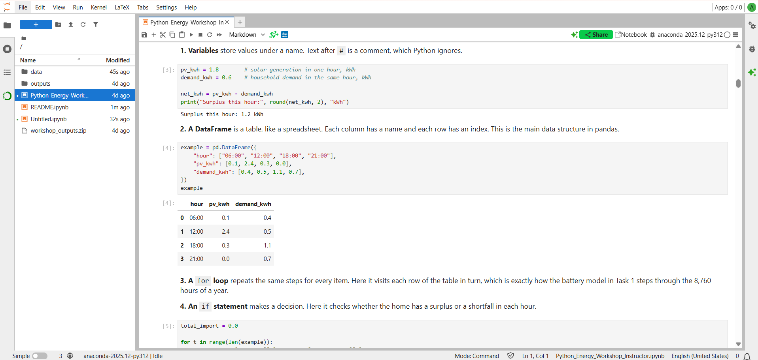
JupyterLab: code, results and notes in one place
jupyter(lab):
[ Screenshot: JupyterLab after launching it from Anaconda Navigator ]
File browser open and upload files
Launcher start a new notebook
Tabs several files open side by side
Kernel status idle or busy, top right
Menus Run and Kernel hold the key commands
Launch it: Anaconda Navigator, then JupyterLab, then Launch. It opens in your web browser.
Notes:
This is where you will work today.
To launch it: open Anaconda Navigator from the software portal, find the JupyterLab tile and click Launch. It opens in your web browser, but it runs on this computer.
Point to each part on the screenshot. On the left, the file browser: this is where you open and upload files. The launcher starts a new notebook. Files open in tabs, so you can have the notebook and the data side by side. Top right, the kernel status shows whether Python is busy or idle. The Run and Kernel menus hold the commands we will use most.
On your own laptop, Google Colab gives you the same experience in the browser with nothing to install.
Kernel: It is the Python engine running behind the notebook. When you run a cell, the kernel executes the code and remembers the results, such as variables and loaded data, so later cells can use them. Restarting the kernel wipes that memory and starts Python fresh. That’s why “Restart Kernel and Run All” fixes most out-of-order problems.

Slide 12
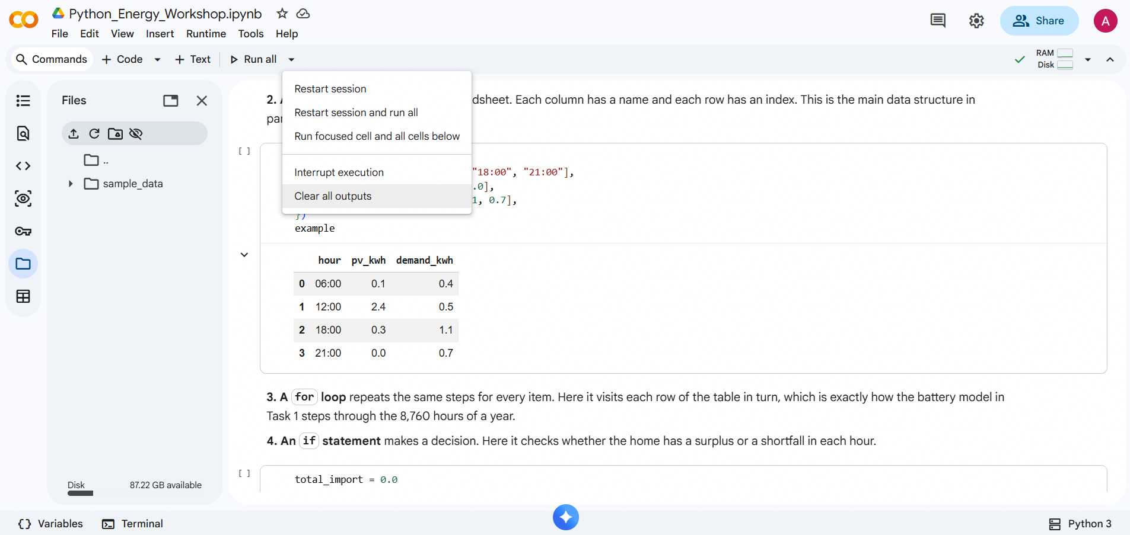
Google Colab: the same notebook in your browser
colab():
[ Screenshot: the workshop notebook open in Google Colab ]
Files folder icon on the left
Run play button or Shift + Enter
Runtime menu Run all, Restart session
Connect / RAM top right; shows it is running
Save a copy File > Save a copy in Drive
Open it: the Open in Colab button on GitHub, or colab.research.google.com, then File > Upload notebook.
Notes:
Google Colab is the alternative to JupyterLab: the same notebook, running in your web browser on Google's servers, with nothing to install. You need a Google account.
Two ways in: the Open in Colab button in the student folder on GitHub, or go to colab.research.google.com and choose File, then Upload notebook.
Point to each part on the screenshot. The folder icon on the left shows the files, including the outputs folder. Run a cell with the play button or Shift + Enter. The Runtime menu has Run all and Restart session, the equivalents of the Run and Kernel menus in JupyterLab. Top right, Connect or the RAM indicator shows the session is running.
Two warnings. If Colab says the notebook was not written by Google, click Run anyway. And files in a Colab session are deleted when it ends, so use File, then Save a copy in Drive, and download the outputs zip from the last cell.

Slide 13
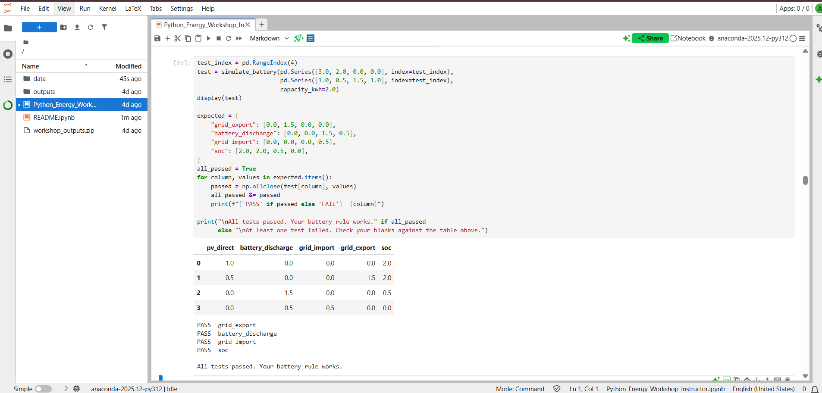
A notebook mixes text cells and code cells
notebook(anatomy):
[ Screenshot: the workshop notebook showing a text cell, a code cell and its output ]
Text cell explanation; read it first
Code cell grey box; Shift + Enter runs it
[*] then [12] running, then finished
Output tables and figures appear below
Restart Kernel > Restart and Run All
Run order matters: a cell can only use what earlier cells have created. If in doubt, restart and run all.
Notes:
A notebook is a document made of cells.
White cells are text: they explain what the next step does, so read them first.
Grey cells are code: click one and press Shift + Enter to run it and move to the next.
While a cell runs, the brackets show a star. When it finishes, a number appears, which records the order in which cells were run. Results, tables and figures appear directly below the cell.
The most common problem is running cells out of order: a cell can only use what earlier cells created. The fix is Kernel, then Restart Kernel and Run All Cells.
This cell tests your battery rule on four made-up hours, where we already know the right answer: the battery charges, spills to the grid when full, discharges, and finally runs out. If all four lines say PASS, your rule is correct and you can run the full year with confidence.

Slide 14
Five pieces of Python are all you need for Task 1
basics(python):
import pandas as pd
df = pd.read_csv("data/home.csv")
total_import = 0.0
for t in range(len(df)):
net = df["pv_kwh"][t] - df["demand_kwh"][t]
if net < 0:
total_import += -net
print(round(total_import, 1), "kWh")
DataFrame a table, one row per hour
variable a named value you update as you go
for loop repeat the same steps once per hour
if decide: surplus or shortfall this hour?
print + round show the answer, with units
Error? Read the last line first. KeyError: "demand_kw" means a column name is misspelt.
Notes:
These five things are all you need for Task 1. A DataFrame is a table. A variable is a number we keep updating. The for loop goes hour by hour. The if checks whether we have spare solar or a shortfall. Then print the result with its units.
The two columns in home.csv are pv_kwh and demand_kwh, one row per hour.
This code calculates how much electricity the home buys from the grid in a year without a battery.
pd.read_csv loads the data into a DataFrame, df: a table with one row per hour, 8,760 rows. total_import is a variable that starts at zero.
The for loop runs once per hour: len(df) is the number of rows, and range counts through them. In each hour, net is solar minus demand; a negative value means a shortfall.
If net < 0, we add the shortfall to the total. The minus in -net makes it positive, and += means “add to the total”.
Finally, print and round show the answer with its unit. These five pieces are all you need for Task 1.
Live demo: load the file, plot a week, then mistype a column name on purpose, for example demand_kw. Read the error out loud, last line first. Errors are normal; reading them is a skill.

Slide 15
practice():
Ten minutes to get comfortable with JupyterLab before the tasks
Open JupyterLab and the student folder
Open data/home.csv and read the columns
Open the notebook; run the first cell
Change a number, rerun, then restart
time = 10 # minutes
files = notebook + data/home.csv
goal = open, run, edit, rerun, restart
ready = first cell prints 'is ready'
help = raise your hand
Notes:
Ten minutes of practice before the tasks.
First, open JupyterLab and go to the student folder. Second, open data/home.csv: it opens as a table. Look at the three columns: the time, the solar output and the household demand, one row per hour for a whole year. That is the data behind Task 1.
Third, open the workshop notebook and run the first code cell. It installs PyPSA, which takes a minute or two; wait until it prints that PyPSA is ready.
Finally, change a number in a code cell, run it again and see the output change, then use Restart Kernel and Run All Cells once, so you know how to start clean.
By the end, everyone should have the notebook open and the first cell finished.

Slide 16
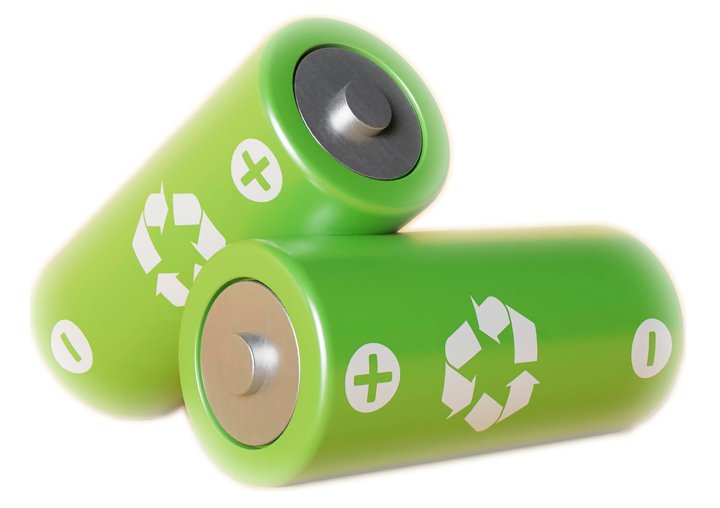
task_01():
How much does a 5 kWh battery raise a Nottingham home's self-sufficiency?
Run the baseline (4.2), note the result
Fill the three blanks (4.3), test (4.4)
Predict, then run the full year (4.5)
Run your scenario (4.8); Reporter submits
inputs = home.csv # hourly pv + demand, kWh
output = self_cons_%, self_suff_%, bill_£
time = 15 # minutes
roles = Modeller · Reviewer · Reporter
stretch= battery sizes 0 to 15 kWh
Notes:
You're modelling a typical Nottingham home: 4 kW of solar, using PVGIS satellite-based solar data for 2019, and a typical UK demand of 2,500 kWh a year.
First run the baseline in section 4.2 and note the self-sufficiency rate.
Then fill the three blanks: charge the battery when there's spare solar, discharge it when there's a shortfall, and buy from the grid whatever is still missing. Run the test in 4.4; all four lines should say PASS.
Before running 4.5, agree a prediction and put it in the form (question 2). Then type your group number in 4.8 and run your scenario (questions 3 and 4).
Two terms: self-sufficiency or energy independence is how much of the home's demand your own solar covers. Self-consumption is how much of your solar you use rather than export.
Stretch task: try battery sizes from 0 to 15 kWh and watch the gains shrink.

Slide 17

Record your group's results as you go
report(results):
01
One response per group. The Reporter scans the code and keeps the form open on one phone.
results()
[ QR code ]
02
Questions 2 and 5 are predictions: answer them before you run the matching cell.
03
Questions 1 to 4 are Task 1 and 5 to 10 are Task 2. Task 3 is compared in class, not on the form.
Scan to open the group results form
Notes:
Before Task 1 starts, ask each Reporter to scan this code and keep the form open on their phone.
One response per group. The group number in question 1 is the same number they type as MY_GROUP in the notebook.
Questions 2 and 5 are predictions, so they must be answered before running sections 4.5 and 5.4.
Only the group number is required, so a group that runs short of time can still submit. Editing is on, so they can submit after Task 1 and update after Task 2.
Leave this slide on screen while groups work, so late scanners can still reach the form.
There are no form questions for Task 3. We compare those results together at the end.

Slide 18
The battery shifts midday solar into the evening peak, cutting grid imports
result(task_01):
no_battery
39%
self-sufficiency over the year
battery = 5 kWh
79%
over the year, realistic battery
Chart: one illustrative summer day. Figures: full year 2019; 4 kWp PV, 5 kWh / 3 kW battery
Notes:
The chart shows one summer day: midday solar is stored and used in the evening, when demand peaks and the sun has gone.
Over the full year, self-sufficiency rises from 39% with no battery to 79% with the realistic 5 kWh battery, and 80% with the idealised one. Your numbers should match. If a group is far off, check the blanks and that the test in 4.4 passed.
Why the gains shrink as the battery grows: the first few kWh get used every day. Extra kWh are only useful on the sunniest days, so each one is worth less.

Slide 19
task_02():
What does a carbon price do to the clearing price and to emissions?
carbon_price = 80 # £/tCO₂ ← the only line you change
Predict the effect of £80/tCO₂ (form question 5)
Run at £0, then £80; record peak price and CO₂
Say which unit sets the peak price, and why it changed
Run your group scenario (5.6); the Reporter submits
time = 15 # minutes · stretch: find the coal-to-gas switch price
Notes:
One line to change: the carbon price.
First agree a prediction and put it in the form (question 5).
Run at zero, then at 80. Record the peak-hour price and the CO₂ at 80 (questions 6 and 7), and say which unit sets the price and why.
Then run your group scenario in section 5.6 (questions 8 and 9) and agree one sentence for question 10.
Stretch answer: coal and gas swap at about £47/tCO₂. That's where 35 + 0.9 × price equals 60 + 0.37 × price.

Slide 20
An £80/tCO2 carbon price moves coal behind gas and lifts the clearing price
merit_order(carbon_price):
carbon_price = 0 # £/tCO₂
carbon_price = 80 # £/tCO₂
120
demand 45 GW
120
demand 45 GW
£90/MWh
80
80
£60/MWh
40
40
Nuclear
Nuclear
Wind
Coal
Gas
Wind
Gas
Coal
0
0
0
20
40
60
0
20
40
60
x: cumulative capacity (GW) · y: marginal cost (£/MWh)
Coal shown as a ‘what-if’ unit (GB closed its last coal plant in 2024)
Costs and emission factors illustrative, direct CO₂ only
Notes:
Power stations line up from cheapest to most expensive to run. The last one needed to meet demand sets the price for everyone.
At £0: coal is cheaper than gas, so gas is last in line and sets £60/MWh.
At £80: coal is dirtier (about 0.9 t per MWh versus 0.37 for gas), so it gets hit harder and jumps behind gas. Gas still sets the price, but gas now costs about £90.
Emissions in this hour drop from about 13,400 t to about 8,100 t, roughly 40% less, because coal no longer runs.
Coal note: GB closed its last coal plant in 2024. It’s here as a “what-if”, which is how much of Europe still looks.
If asked about tCO₂ vs tCO₂e: for power stations they’re almost identical; we use direct CO₂.

Slide 21
task_03():
How much of the Engineering building's electricity could rooftop solar supply?
Check the building's monthly data (2.1)
Fill the one blank: solar used (4)
Predict, then read the year's results (5)
Run your scenario (6); compare in class
Notes:
Task 3 uses real data: the monthly electricity invoices of the Engineering and Institute for Digital Innovation building, August 2021 to July 2022. The data is for this session only, so please do not share the file.
Start with the chart in section 2.1. September 2021 is only 6.4 MWh, ten times lower than May. Ask why before modelling anything.
We do not know the roof size, so the notebook assumes 100 kWp, roughly 500 square metres of panels. Groups can change it.
Fill the one blank in section 4: the solar used each month is the smaller of the solar output and the demand. Predict the share before running section 5, then run your group scenario in section 6.
There is no form for Task 3; we compare the results in class.
Stretch: the largest system with no export in any month, with and without September.

Slide 22
100 kWp of rooftop solar could supply about a fifth of the building's electricity
result(task_03):
22%
18.4 t
× 3.3
76 kWp
of the building's demand, from 100 kWp
CO2e saved per year
the CO2 saved by 4 × the solar (400 kWp), as exports grow
largest size with no export, set by one doubtful month
# monthly totals overstate on-site use: the real share is lower
Notes:
Ask each group to call out its scenario result before showing the key.
Answer key, share of demand from solar and CO2 saved per year: U, 50 kWp: 11% and 9.4 t. V, 200 kWp: 42% and 35.5 t. W, 400 kWp: 74% and 61.5 t. X, Clifton Library, 100 kWp: 57% and 17.7 t. Y, Interdisciplinary Science and Technology Centre, 100 kWp: 6% and 18.8 t.
Three points to draw out. First, four times the solar saves only 3.3 times the CO2, because more of it is exported. Second, a high share is not the same as a large saving: the same 100 kWp covers only 6% of the science centre but saves the most CO2, because it uses every kWh. Third, the largest size with no export is about 76 kWp only because of the doubtful September figure; without it, the answer is about 200 kWp, limited by August.
Limitation: comparing monthly totals assumes daytime solar can be used at any time in the month, so the real share is lower. A real design would use half-hourly meter data and the hour-by-hour method from Task 1.

Slide 23

Three things to take away, one from each task, then the exit quiz and feedback
debrief():
01
Storage moves energy in time; its value depends on what it displaces.
quiz()
[ QR code ]
02
A carbon price raises the clearing price through the unit that sets it; it cuts emissions when it pushes high-carbon units out of the merit order.
03
Check the data before you trust a result: one doubtful month cut the largest solar size from about 200 kWp to 76 kWp.
Scan for the quiz and feedback form
Notes:
Show the class results for Tasks 1 and 2 from the form's response sheet first. Where groups agree, the model is behaving. Outliers are the most interesting: usually units, or a blank filled slightly wrong.
Then one take-away from each task: the battery in Task 1, the carbon price in Task 2 and the data check in Task 3.
Give five minutes for the quiz and feedback form.

Slide 24
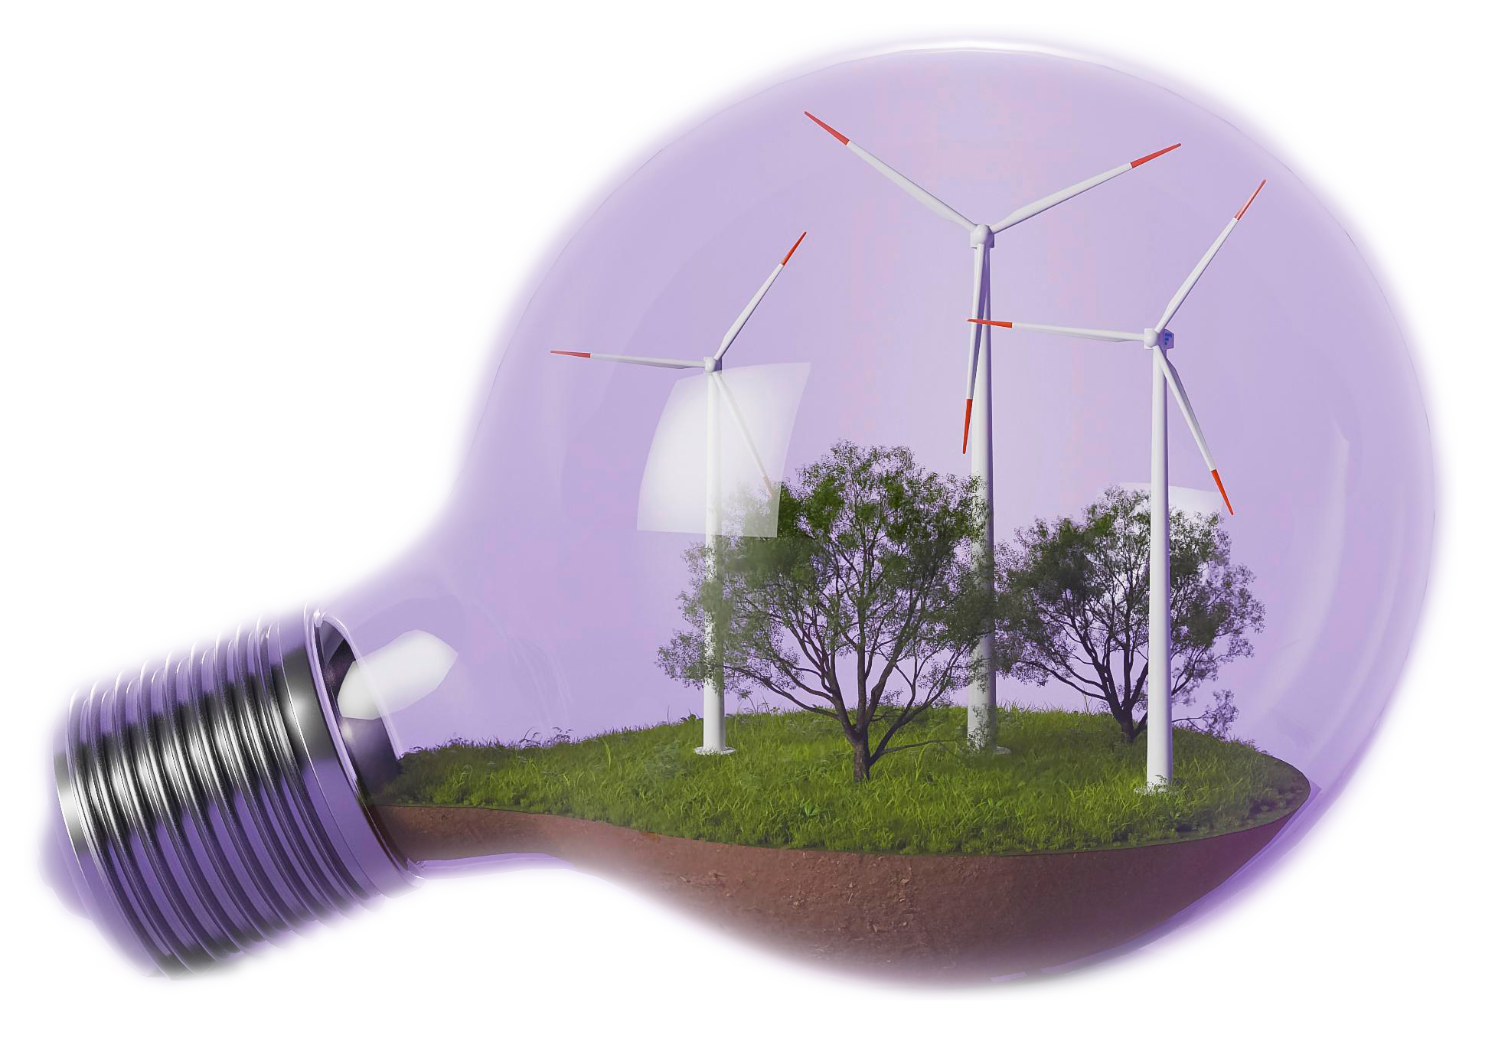
next_steps():
You can now build, solve and question a dispatch model. Next, scale it up.
learn = [
'github.com/ammarahmedwafad/PyPSA-energy-modelling-workshop',
'fneum.github.io/data-science-for-esm',
'docs.pypsa.org',
'github.com/ammarahmedwafad/pypsa-img',
]
Ammar Ahmed Wafad
aawafad@nortum.co.uk
www.linkedin.com/in/ammar-ahmed-wafad-1921ab7b
Notes:
If you want to go further: Fabian Neumann’s free TU Berlin course is the best next step, and it’s all Python and PyPSA. My open-source model is on GitHub if you want to see this scaled up to an industrial site. Happy to connect on LinkedIn, and please do get in touch about dissertation ideas.

