Slide 1
SMOKE DETECTION SYSTEM
AFTAB AHMED
ALI RAZA
AMMAR ALI

Slide 2
The system has been designed that contains trained model for smoke detection that will sense the smoke and beep the alarm.

Slide 3
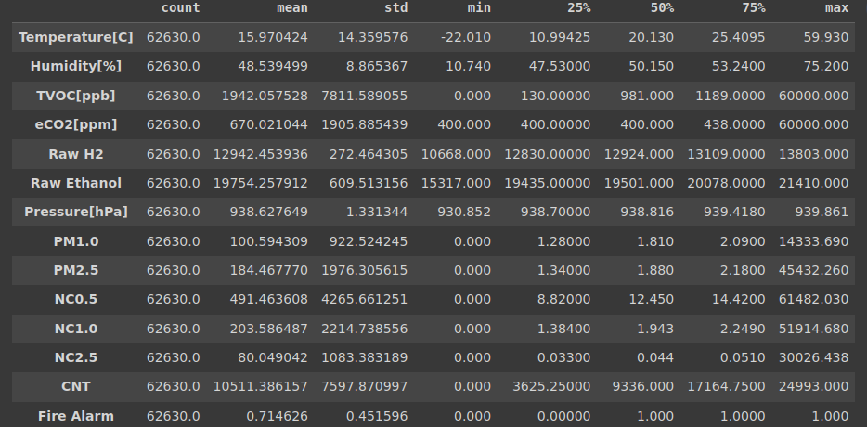
DATA SET

Slide 4
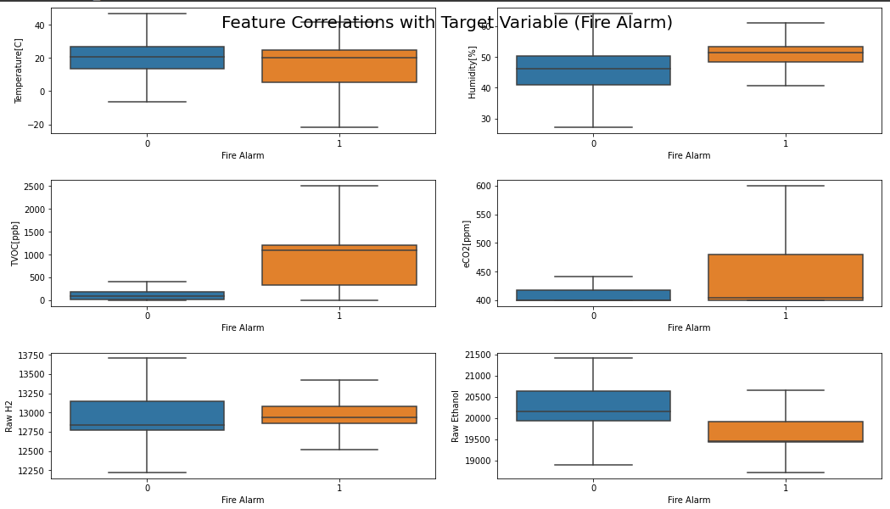
BOX PLOTS

Slide 5
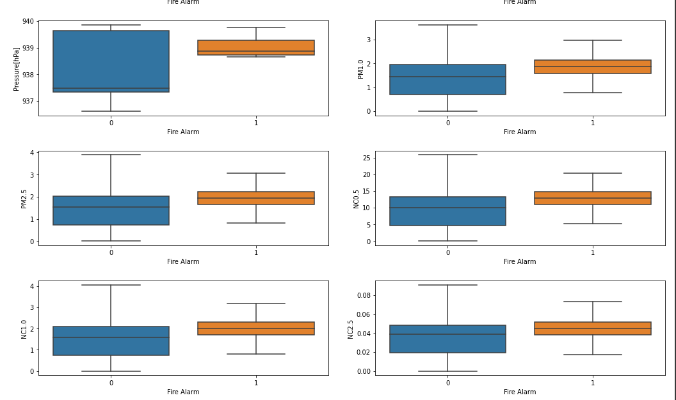
BOX PLOTS

Slide 6
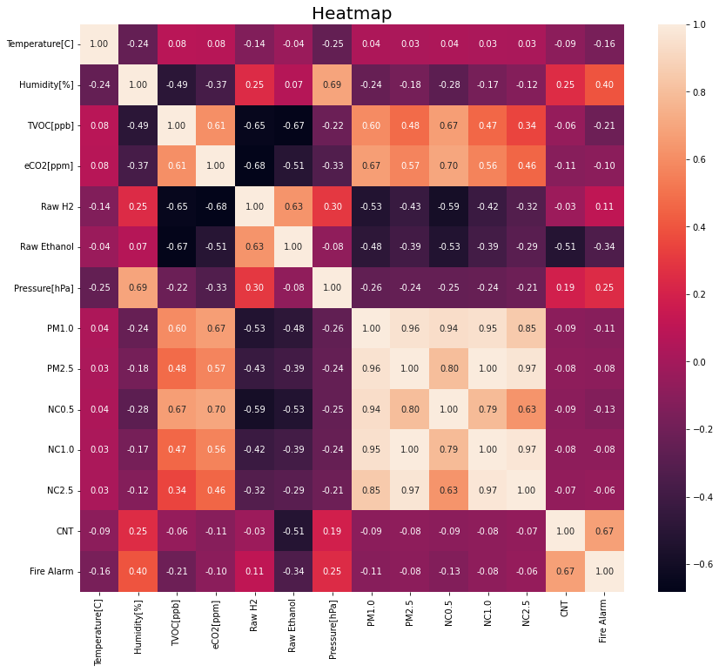
HEAT MAP

Slide 7
PRE-PROCESSING
Two Features were removed that weren’t important
id (It was just referring the row number)
UTC ( it was time that wasn’t important
All Missing values were removed
There were no outliers
Four features were removed that were highly correlated
PM2.5
NC0.5
NC1.0
NC2.5

Slide 8
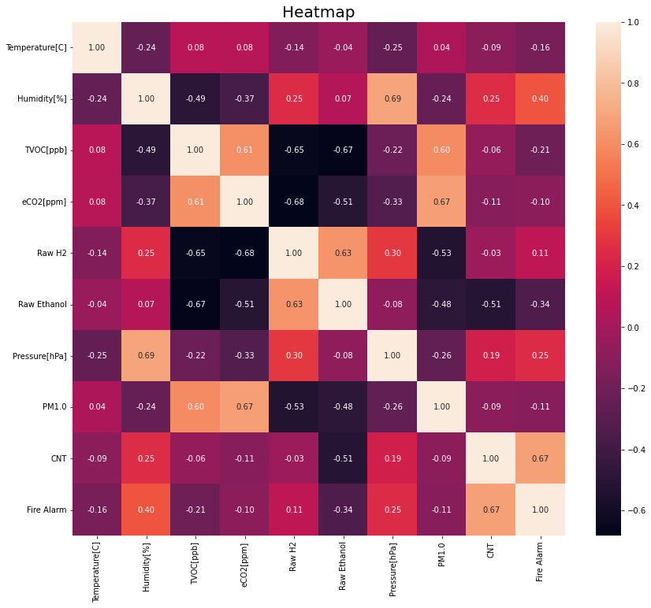
HEAT MAP

Slide 9
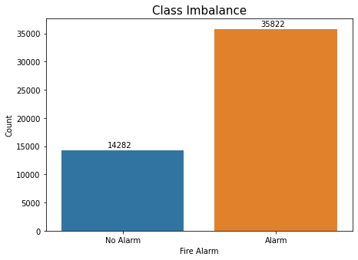
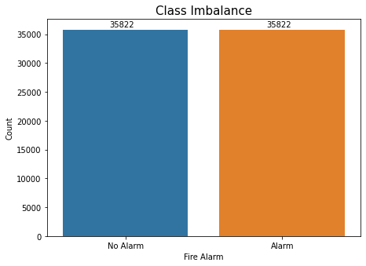
SMOTE

Slide 10
MODELS
0.98
0.99
0.97
0.99
0.99
Logistic regression
Logistic regression
Decision Tree
ANN
Random forest
SVM

Slide 11
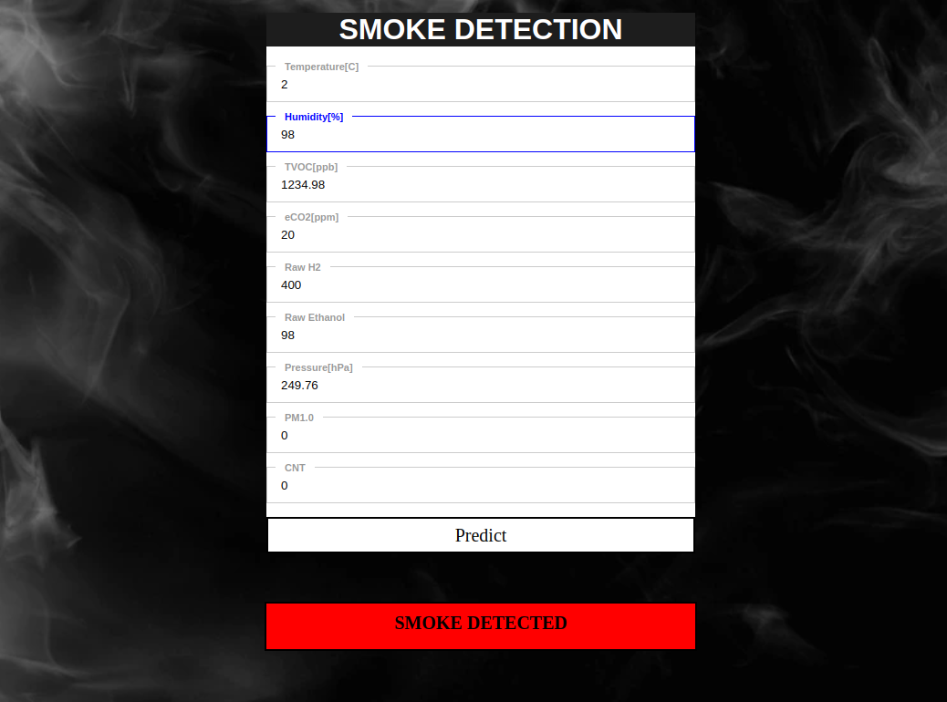
DEPLOYMENT

Slide 12
THANK YOU

