Slide 1
TELECOM BILLING MANAGEMENT SYSTEM
Project Code: PRJ 151
A First Year Project For the partial fulfillment of requirement for the degree of
Bachelor of Computer Application (BCA)
Project Supervisor
Namraj Koirala
Department of IT,
Crimson College of Technology
Project Team Members
Aashish Khanal
Ammar Bahadur Kunwar
Nabin Chaudhary
Pratham Gyawali

Slide 2
Telecom Billing Management System
“Telecom Billing Management System” is useful for computerizing billing system. This software is useful for viewing customer information, calculating taxes, updating billing details, calculating other charges etc.
“Telecom Billing Management System ” is developed as per seeing the increasing requirement to speed up the work and incorporate a new work culture. Thus, a new software has been proposed to reduce manual work, improving work efficiency, saving time.

Slide 3
Objectives
The main objective while implementing the project Telecom Billing Management System were to minimize the work and at the same time increase the speed of the work done.
This system is built with the following objective:
The objective of Telecom Billing Management System is to handle the entire billing activity of a Telecom.
The software keeps track of all the information about the calls and their complete user details.
The interface of the software will be user friendly.
The system contains files where all the information will be stored safely.

Slide 4
Scope and Purpose of Project
This project is for those organizations who want to keep the record of Telecom Billing Management System. It provides features to insert, display, modify, search, and delete the records.
The main purpose of this project is to facilitate the processes of the Telecom Billing Management System. The user of this program is generally the Administration of the Telecom billing counter, and this program helps them to keep records of their customers and prepare the bill based on the total calls made.

Slide 5
Project Development Life Cycle
Program Development Life Cycle is a process used by software development teams to plan, design, develop, test, and maintain software. The process include following phases.
The first three phases (Planning, Requirement and Designing) focus on defining the product and its features, as well as determining if it's feasible and viable to bring it to market.
The last three phases (Coding, Testing and Operations ) focus on building, testing, and launching the product, ensuring that it meets customer needs and is of high quality.

Slide 6
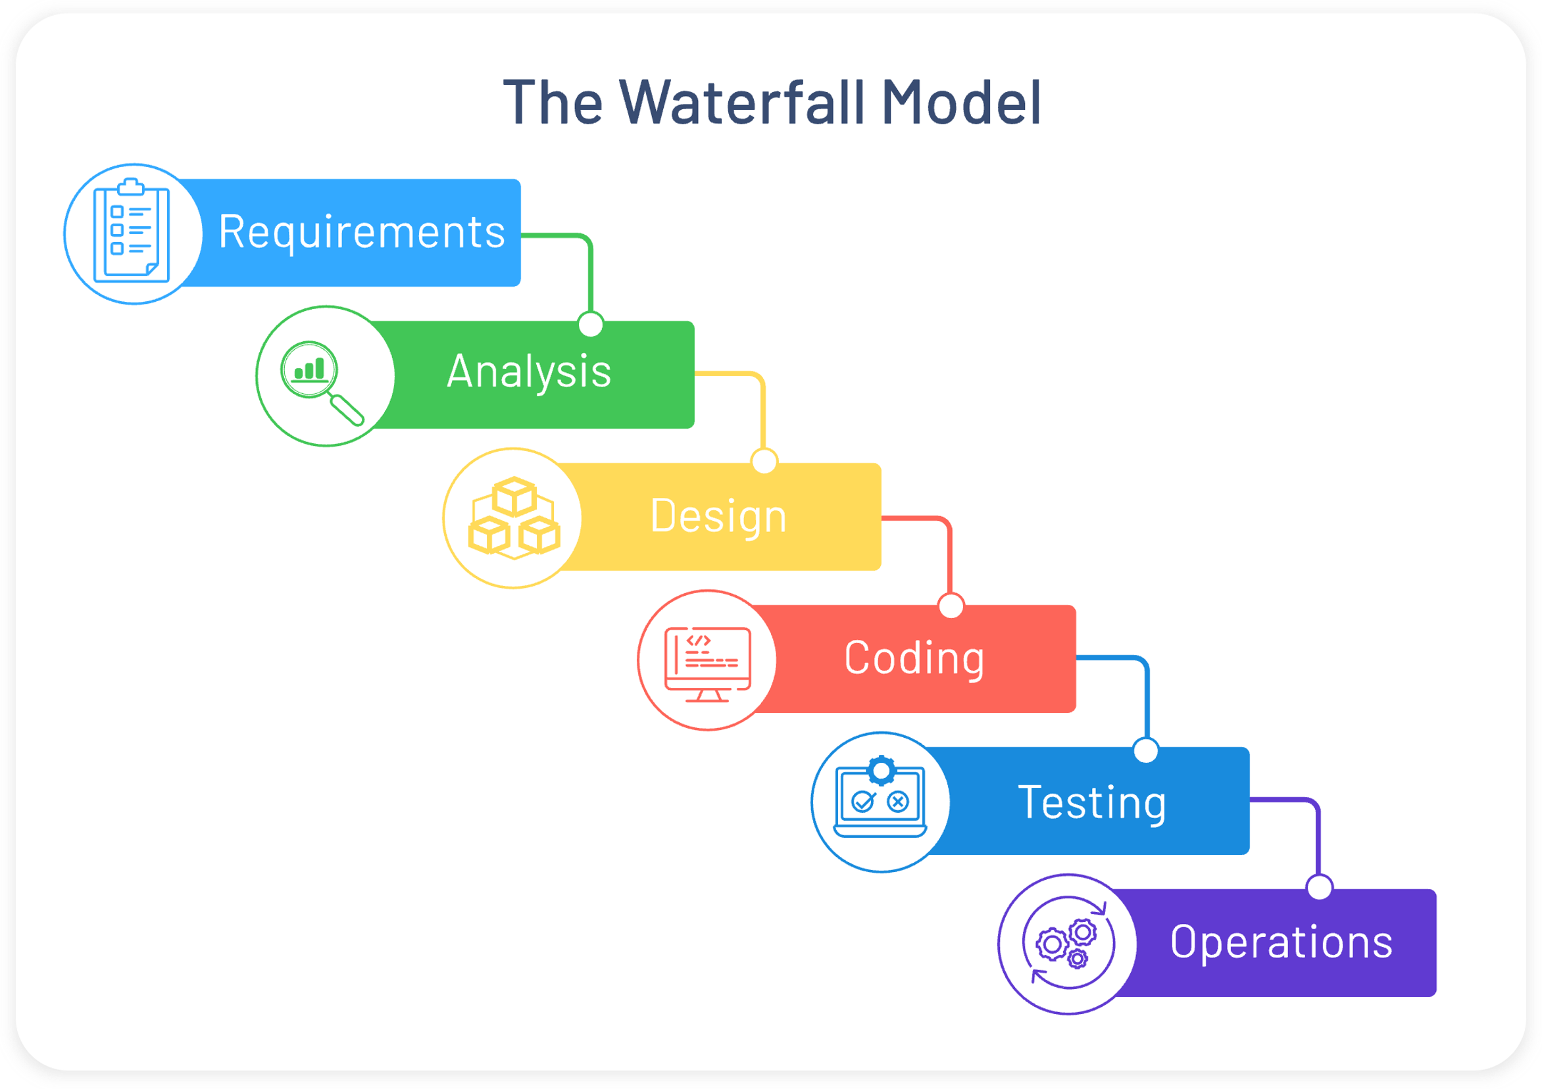
Methodology
We have used Water Fall Model to develop this project. This model consists of the following phases.

Slide 7
Hardware and Software Requirement
To run this program, we will require following hardware and software:
Minimum Hardware Requirements :
RAM – 512 MB and above
Hard Disk – 20GB and above
Processor Speed – 2.4GHZ and above
Minimum Software Requirements :
Operating System – at least Microsoft Windows XP
Dev-C++, Turbo C++, or any C-compiler.

Slide 8
DEMO

Slide 9
Limitation of the System
This system is based on the stand-alone programming. So, it doesn’t have its own database.
This system cannot hold much detail information about the costumer and is made for the billing purpose only.
This system does not support any graphics.
This System is not multiuser.
Data loss can occur due to technical issue, so it is necessary to make to back up at regular interval of time.

Slide 10
Web References:-
1.Yeswant Kanetkar: Let us C
2. A Textbook of C Programming

