Slide 1
Design of an efficient Interleaver for Turbo Codes
Ammar Falih A. Hasan
Notes:
Introductory Page

Slide 2



The Encoder
Output data
Input data
RSC Encoder
Output parity
Interleaver
RSC Encoder
Both data streams are coded with RSC encoders
Data are applied from the source
Both original data and the parity are processed for transmition
A copy from the data enters an interleaver to be permuted
Notes:
The general description of the encoder system

Slide 3

Example
Assume the series of zero bits codeword is transmitted.
Assume a single bit is subjected to change due noise.
Notes:
A frame of bits subjected to noise

Slide 4
The transmitted frame enters the RSC encoder,
the recurssive nature of the RSC encoder
makes the single bit encoded into a nearly infinite frame code
The problem appears when a certain non-zero frame codeword
enters the RSC encoder to produce a finite codeword
frame of a limited size. This will be estimated badly at the
decoder side
Notes:
The effect of a disturbed frame on the output of the encoder

Slide 5
To solve this problem, two RSC encoders are connected in parallel separated by a well designed interleaver. In this case if a codeword applied to the first encoder produces a finite size codeword, it is unlikely that the interleaved version would produce the same result in the second RSC Encoder.
RSC 1
Interleaver
RSC 2
If the interleaver is not well designed, it might produce another codeword that produces a finite size result like the first RSC encoder.
The interleaver must assure the separation of the distributed bits as far as possible from each other.
Notes:
The importance of the interleaver on avoiding finite length codewords out of the RSC encoder

Slide 6

Data enters to an interleaver block
And then gets interleaved
Interleaver
This process, will add a significant gain to the system by avoiding noise bursts.
In turbo codes, it serves increasing the free distance of codewords as well.
Notes:
Properties of the interleaver

Slide 7

The Performance of the turbo code
Depends on increasing the length of the
code to maximize the free distance
The problem of bad designs is that it might end in joining
locations of interleaving close to each other in a way that
they might produce limited sizes codewords.
Notes:
What the problem of bad design interleaver

Slide 8
The new interleaver design
(Circle Distribution)
A single bit flies through all the assigned entities measuring the distances between the spaces through any two bits.
The Design is based on distributing the bits on a circle in a way that ensures the bits are as far as possible from each other.
Finally it decides to fit itself in the position with the largest distance space
The process continues for all values
Notes:
The new interleaver design

Slide 9
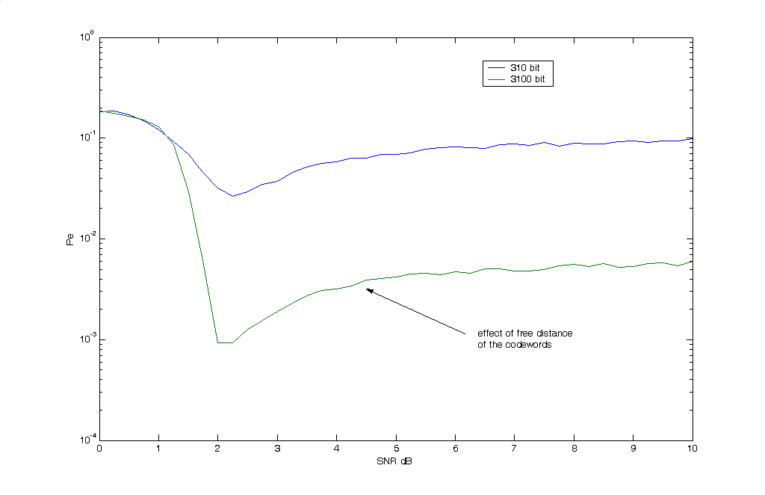
Effect of the size of the interleaver
On the normal design mode
Notes:
The effect of size on the performance of normal design

Slide 10
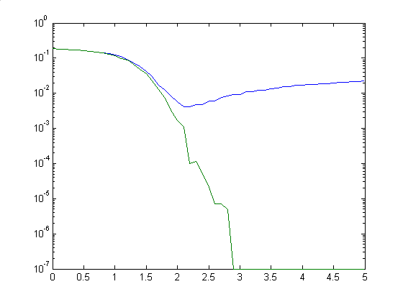
Effect of the similed constraint on the performance graphs
Notes:
The effect of simield constraint on the performance of the encoder. The similed constraint is what constraints made on the design of the interleaver to make them both end at the same state.

Slide 11
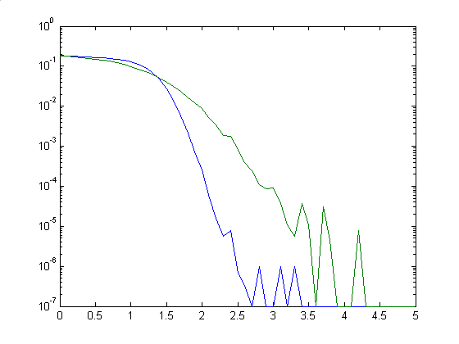
Effect of the sizes of the interleaver on the performance with the similed random interleaver design
Notes:
The effect of the size of the interleaver on the gain of the system

Slide 12
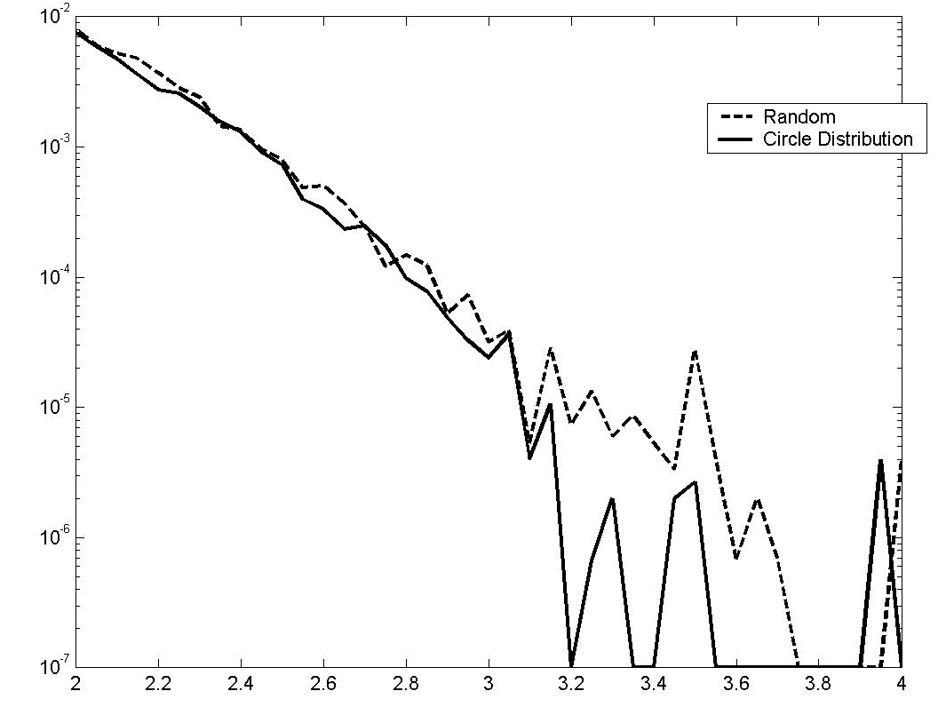
The new design implementation compared to the random design
Notes:
The effect of the new design on the performance of the system as compared to the random interleaver

