Slide 1
NOC W/ ML MODEL

Slide 2
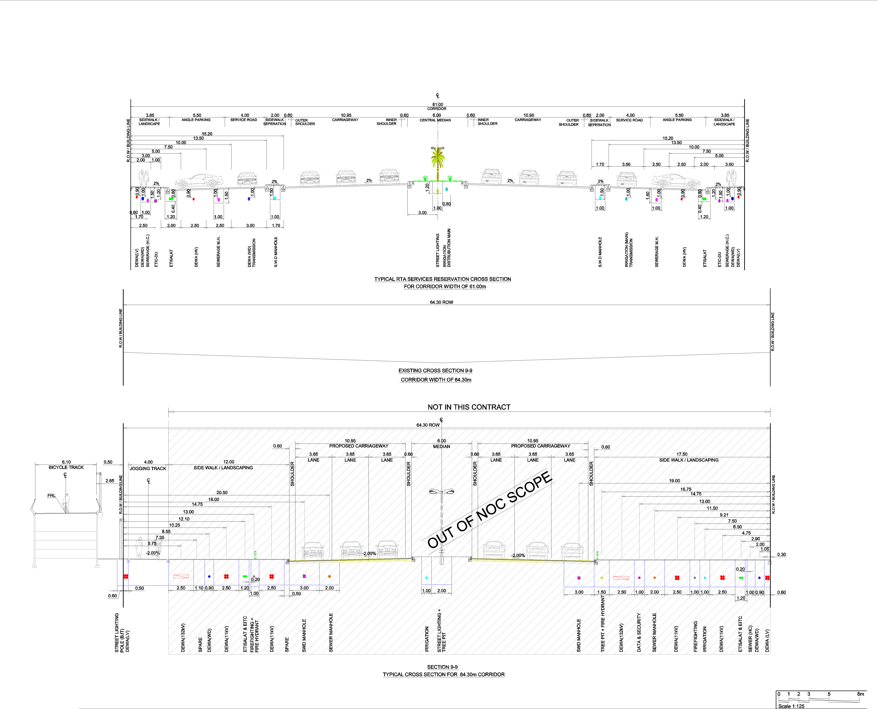
INPUT IMAGE

Slide 3
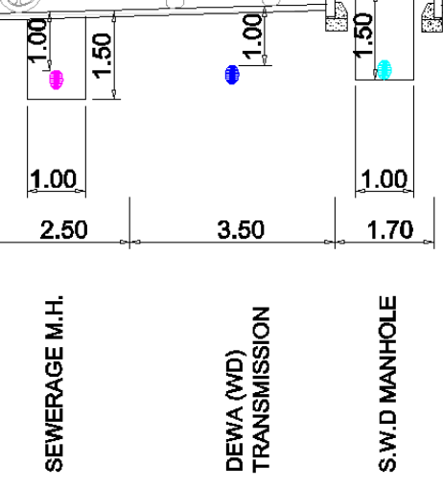
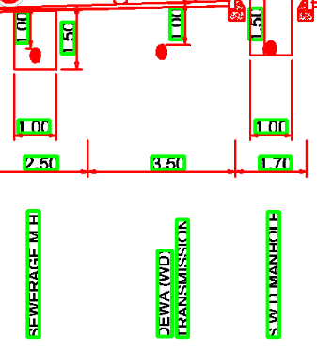
INPUT IMAGE AND TAILORMADE
CROPPED PART OF INPUT IMAGE
OUPUT FROM TAILORMADE

Slide 4
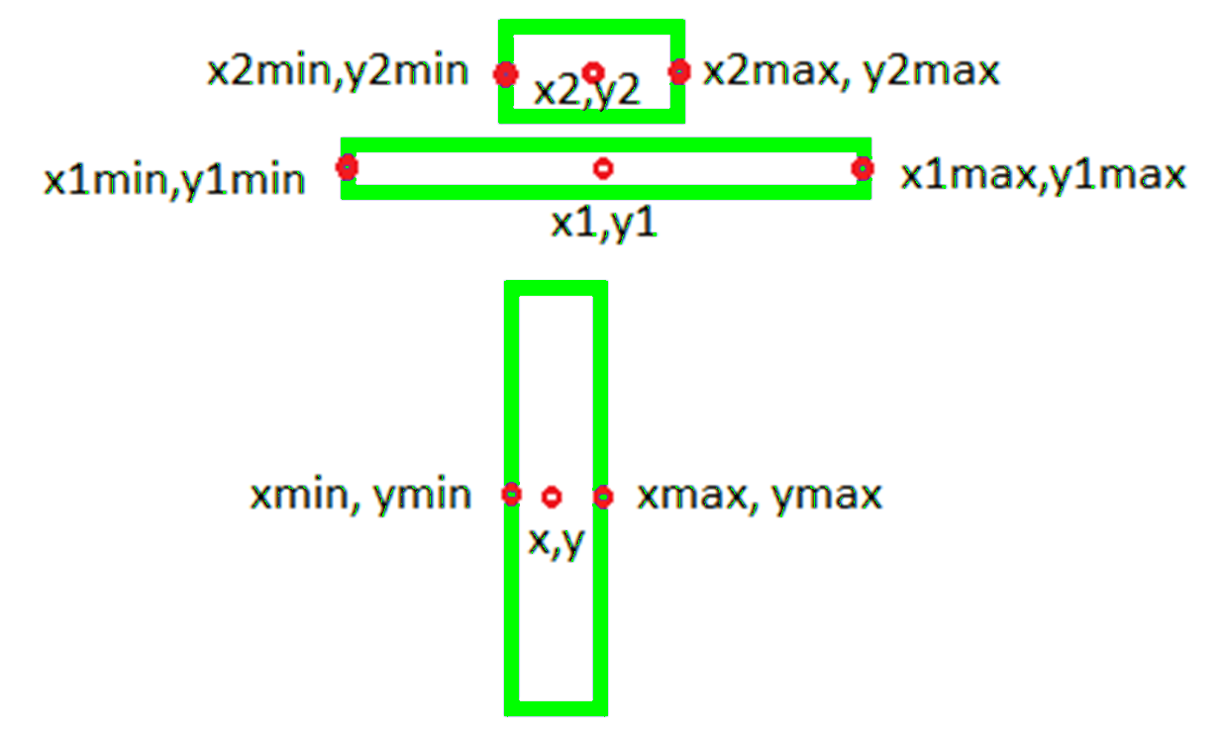
DATASET POINTS
We are extracting all the texts and polylines from the Tailormade
Blue boxes are coordinates of texts and polylines
Red circles are the points we are taking as datapoints for the dataset
ARROW RECTANGLE
NUMBER RECTANGLE
TEXT RECTANGLE

Slide 5
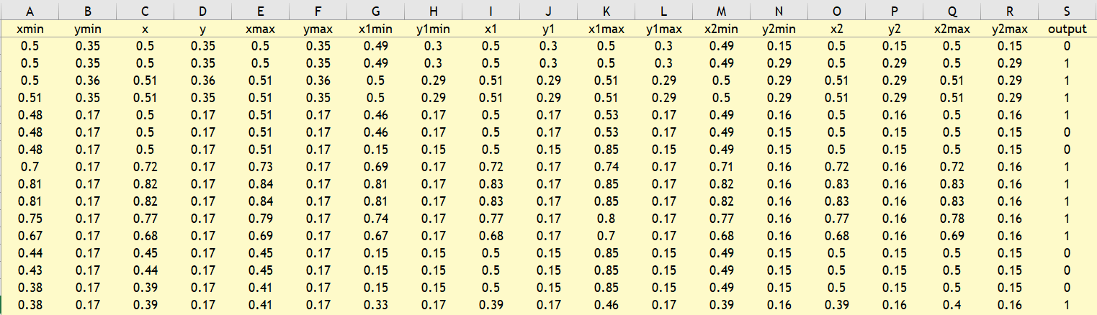
DATASET
TEXT POINTS
ARROW POINTS
NUMBER POINTS
Providing this dataset to our cnn model for training. Total of 4622 dataset.

Slide 6
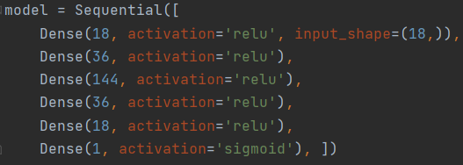

TF MODEL SUMMARY AND TRAINING
Dividing dataset into Train, Test, Validation set
Training set to cnn model shown in the figure.
Input shape : 18
Hidden Layers
Output shape : 1
Training accuracy : 98%
Testing accuracy : 98%

Slide 7
TESTING
INPUT IMAGE
Taking a Noc input image
Extracting data from tailormade
Providing 18 datapoints as an input to model

Slide 8
TESTING
MODEL PREDICTION
Model processes the data and gives the output as 0 or 1.
1 indicates that the connection is valid
0 indicates that the connection is not valid
Valid connections are considered and stored in csv

Slide 9
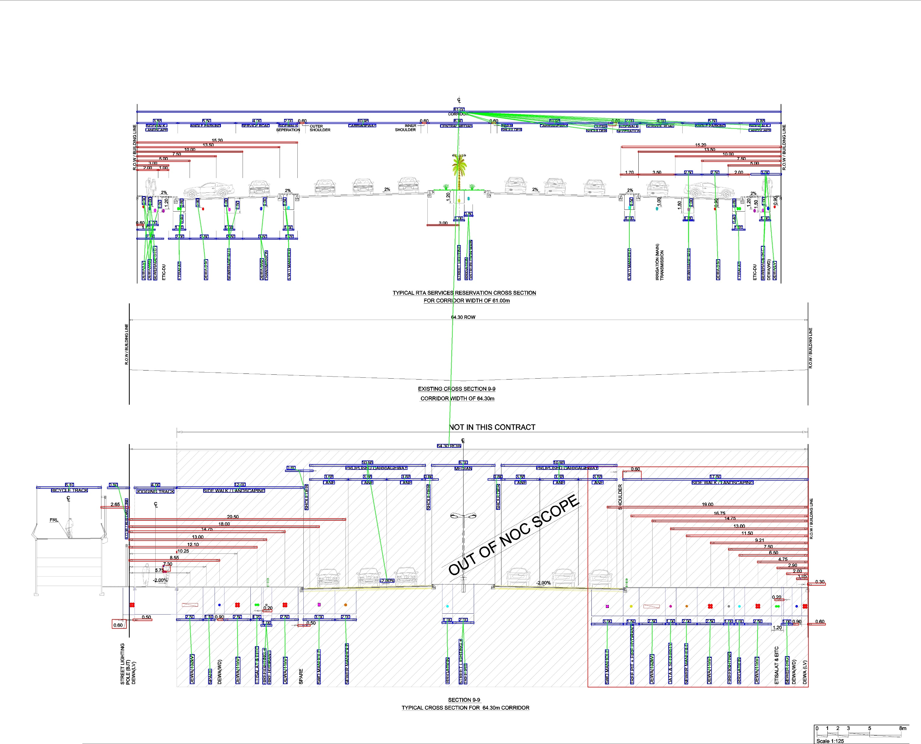
MODEL PREDICTION ON INPUT IMAGE

Slide 10
CSV FOR GRAPH DATABASE (TIGERGRAPH)
We created 3 csv’s :
noc_entity.csv
noc_parent_child_default.csv
noc_ed_relation.csv
noc_entity.csv :
uid | parent | type | description | xmin | ymin | xmax | ymax
0 | None | project | cycle_jogging_project | None | None | None | None
1 | 0 | file | Design | None | None | None | None
2 | 1 | document | CrossSections_and_markers-8.csv | None | None | None | None
3 | 2 | text | 64.30 ROW | 2373 | 2412 | 2502 | 2430
4 | 2 | text | 6 | 2491 | 2502 | 2538 | 2520
5 | 2 | text | MEDIAN | 2468 | 2535 | 2561 | 2553

Slide 11
noc_parent_child_default.csv
noc_ed_relation.csv
parent | child | confidence
0 | 1 | 1
1 | 2 | 1
2 | 3 | 1
2 | 4 | 1
2 | 5 | 1
2 | 6 | 1
entity1 | entity2 | eDistance | confidence
3 | 83 | 1827.828 | 0.979503
5 | 4 | 33 | 0.998827
9 | 8 | 32 | 0.999725
11 | 10 | 32 | 0.999652
11 | 12 | 109 | 0.99971
11 | 12 | 109 | 0.999493

Slide 12
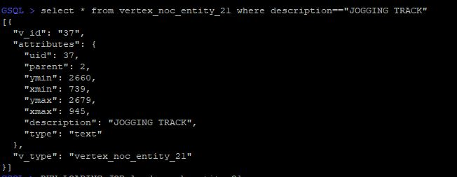
GRAPHDB (TIGERGRAPH)

