Slide 1
History and Evolution
Created with AI Presentation Generator

Slide 2
Introduction
Generative Artificial Intelligence (AI) refers to a subset of AI that generates new content, such as images, music, or text, based on patterns learned from existing data. This technology has the potential to revolutionize various industries, including entertainment, education, and advertising. With the rapid advancements in generative AI, it is essential to understand its applications, benefits, and limitations.

Slide 3
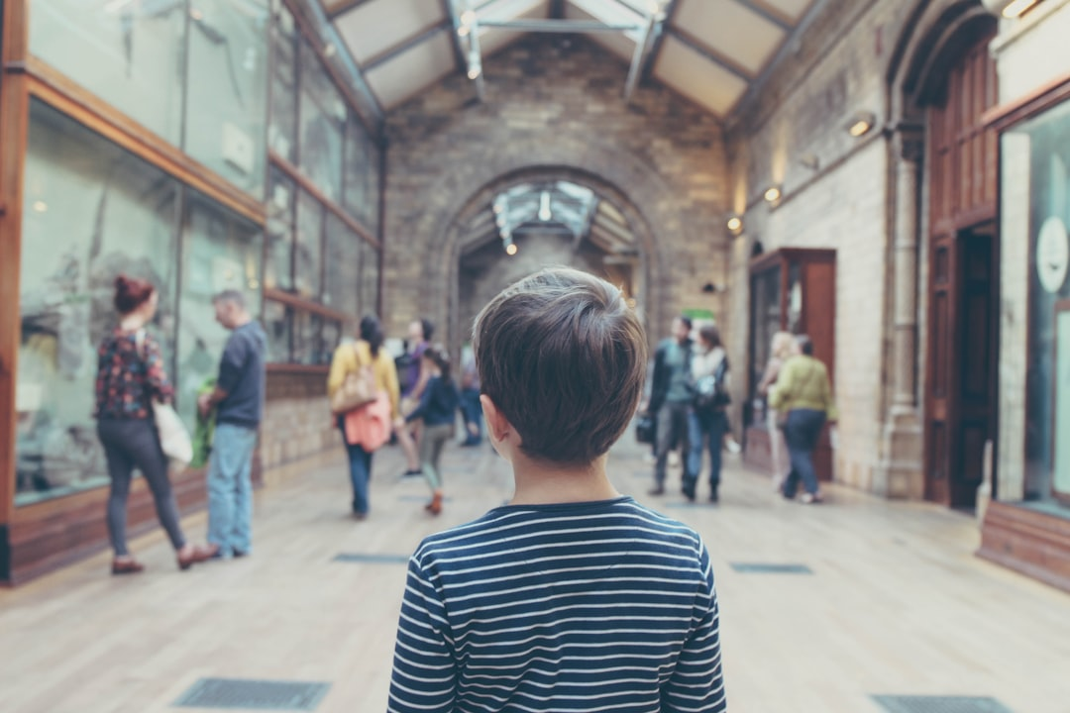
History and Evolution
The concept of generative AI dates back to the 1980s with the introduction of Generative Adversarial Networks (GANs), which enables AI to generate new data samples indistinguishable from real ones.
In the 2010s, the development of deep learning algorithms and neural networks significantly improved the performance of generative AI models, leading to their increased adoption.
Recent advancements in transformer-based models, such as Generative Transformers, have further improved the quality and diversity of generated content.

Slide 4
Types of Generative AI
Text Generative AI: uses natural language processing (NLP) to generate text, such as articles, stories, or even entire books, based on input prompts or styles.
Image Generative AI: utilizes convolutional neural networks (CNNs) to generate realistic images or videos from scratch or based on input data, such as facial recognition or object detection.
Music and Audio Generative AI: employs neural networks to generate original music, audio effects, or even entire soundtracks based on input styles or prompts.

Slide 5
Applications and Use Cases
Content Creation: generative AI can assist in content creation for industries such as entertainment, advertising, and education, reducing costs and increasing efficiency.
Artistic Expression: generative AI enables artists to explore new creative possibilities, collaborate with machines, and push the boundaries of human imagination.
Data Augmentation: generative AI can be used to augment existing datasets, increasing their diversity and size, which can improve the performance of machine learning models.

Slide 6
Challenges and Limitations
Bias and Fairness: generative AI models can perpetuate biases present in the training data, leading to unfair or discriminatory outcomes.
Ethics and Transparency: the use of generative AI raises concerns about authorship, ownership, and accountability, requiring clear guidelines and regulations.
Technical Challenges: generating high-quality, coherent, and contextually relevant content remains a significant technical challenge, requiring further research and development.

Slide 7
Conclusion
Generative AI has the potential to transform various industries by enabling the creation of new, innovative content. However, it is crucial to address the challenges and limitations associated with this technology to ensure its responsible use and adoption.

Slide 8
Thank You!
Questions & Discussion

