Slide 1
What is Generative AI?
Created with AI Presentation Generator

Slide 2
Introduction
Generative AI refers to the use of artificial intelligence algorithms that can generate new, original content such as images, music, and text. This field has seen significant advancements in recent years, with applications in various industries. In this presentation, we will explore the core concepts, applications, and future of generative AI.

Slide 3
What is Generative AI?
Definition
Types (Image, Music, Text)
Techniques (GANs, VAEs, RNNs)
Applications (Art, Music, Content Generation)
Limitations and Challenges
Potential Impact

Slide 4
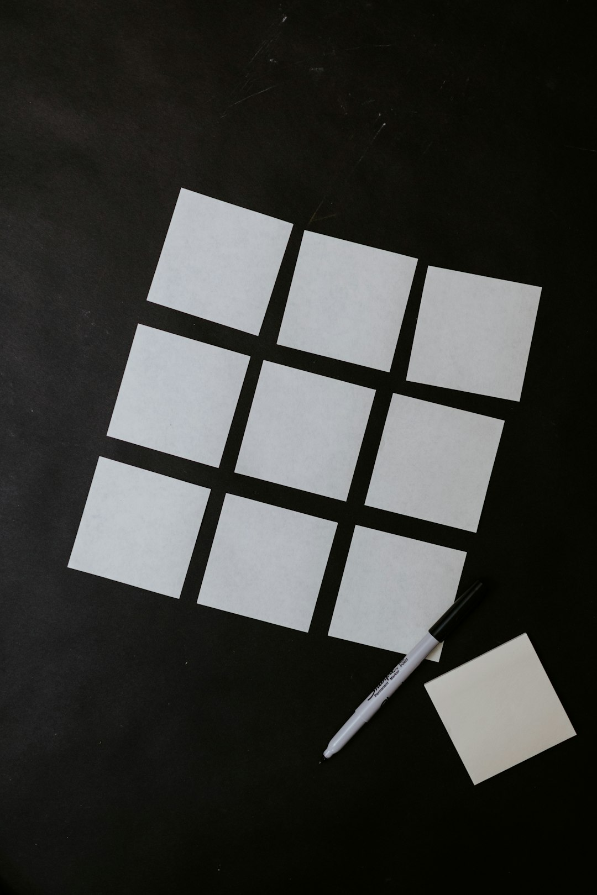
Core Concepts
Generative Adversarial Networks (GANs)
Variational Autoencoders (VAEs)
Recurrent Neural Networks (RNNs)
Deep Learning Architectures
Latent Space Representation
Optimization Techniques

Slide 5
Applications in Art
Image Generation
Artistic Style Transfer
Music Composition
Poetry and Writing
Video Generation
Digital Twins

Slide 6
Applications in Music
Music Composition
Music Generation
Audio Processing
Emotional Analysis
Music Recommendation
Audio Dubbing

Slide 7
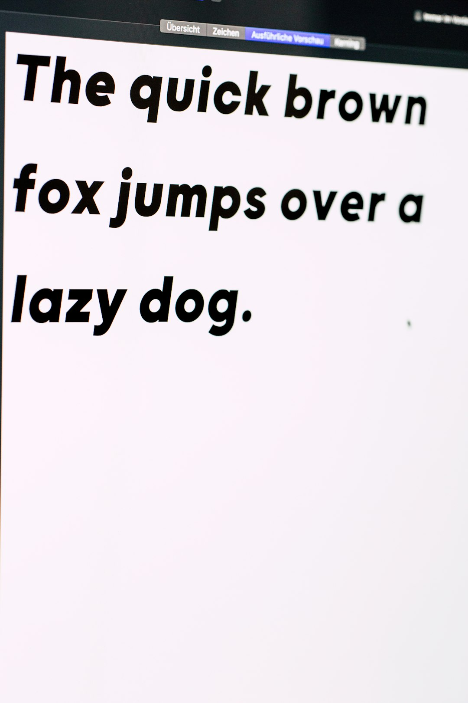
Applications in Content Generation
Text Summarization
Article Generation
Chatbots and Conversational AI
Product Description Generation
Social Media Content Creation
Language Translation

Slide 8
Applications in Industry
Product Design
Fashion Design
Interior Design
Architecture
Engineering Design
Scientific Visualization

Slide 9
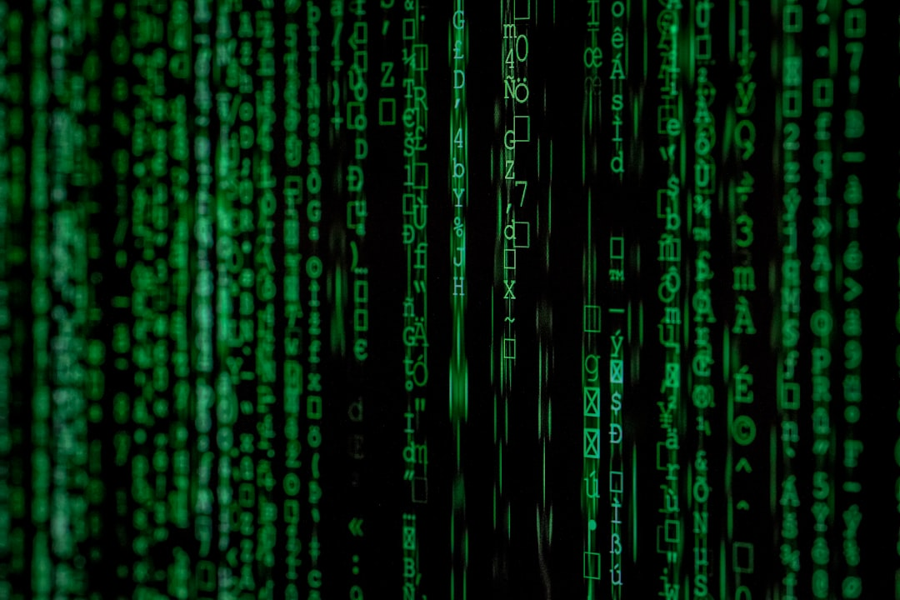
Future of Generative AI
Advancements in Algorithms
Increased Computational Power
Integration with Other AI Technologies
Ethical Considerations
Regulatory Frameworks
Societal Impact

Slide 10
Challenges and Limitations
Lack of Understanding
Limited Control
Bias and Fairness
Intellectual Property
Security Risks
Transparency and Explainability

Slide 11
Conclusion
Recap of Key Points
Future Directions
Potential Impact

Slide 12
Thank You!
Questions & Discussion

