Slide 1
Egyptian History and Culture
Created with AI Presentation Generator

Slide 2
Introduction
Egypt is a country with a rich history and culture, attracting millions of tourists each year. The tourism industry has a significant impact on the country's economy. Egypt's unique blend of ancient ruins, natural wonders, and vibrant cities makes it an attractive destination for travelers. With a long history dating back to the pharaohs, Egypt has a wealth of cultural and historical sites to explore.

Slide 3

Egyptian History and Culture
The Pyramids of Giza, one of the Seven Wonders of the Ancient World, are a must-visit attraction for any tourist in Egypt.
Ancient Egyptian temples, such as the Temple of Karnak and the Temple of Hatshepsut, showcase the country's rich spiritual heritage.
The Museum of Egyptian Antiquities in Cairo houses an extensive collection of artifacts and relics from ancient Egyptian civilization.

Slide 4
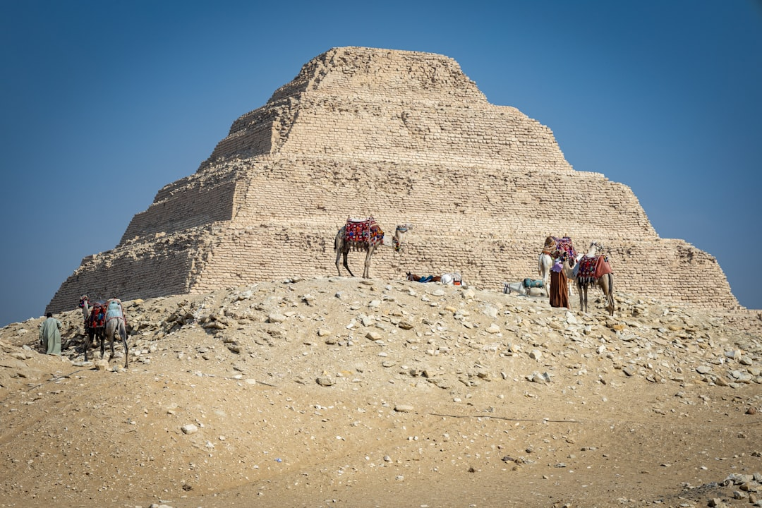
Natural Wonders of Egypt
The Nile River, the longest river in the world, flows through Egypt and offers stunning views and exciting boat tours.
The Sinai Peninsula, with its crystal-clear waters and coral reefs, is a popular destination for scuba diving and snorkeling.
The Egyptian desert landscapes, including the Western Desert and the Black Desert, offer breathtaking scenery and unique experiences.

Slide 5
Economic Impact of Tourism
Tourism is a significant contributor to Egypt's GDP, generating billions of dollars in revenue each year.
The tourism industry supports thousands of jobs, both directly and indirectly, in various sectors such as hospitality, transportation, and local crafts.
The government of Egypt has implemented initiatives to develop and promote the tourism industry, including infrastructure development and marketing campaigns.

Slide 6

Challenges and Opportunities
Egypt faces challenges in maintaining the quality and security of tourist attractions and accommodations.
The country has opportunities to develop sustainable tourism practices, such as eco-tourism and cultural heritage tourism, to reduce its environmental impact and promote cultural exchange.
The rise of social media has created new opportunities for Egypt to promote its tourism industry and reach a wider audience.

Slide 7
Conclusion
Egypt's rich history, culture, and natural beauty make it an attractive destination for tourists from around the world.
The tourism industry has a significant impact on the country's economy and supports thousands of jobs.
By developing and promoting sustainable tourism practices, Egypt can ensure the long-term success and growth of its tourism industry.

Slide 8
Thank You!
Questions & Discussion

