Slide 1
Ancient History and Landmarks
Created with AI Presentation Generator

Slide 2
Introduction
Egypt has a rich history and diverse culture that makes it an attractive destination for tourists worldwide. The tourism industry is a significant contributor to Egypt's economy and provides employment opportunities for its citizens. With its unique blend of ancient history, vibrant cities, and natural wonders, Egypt has the potential to become a premier tourist destination.

Slide 3
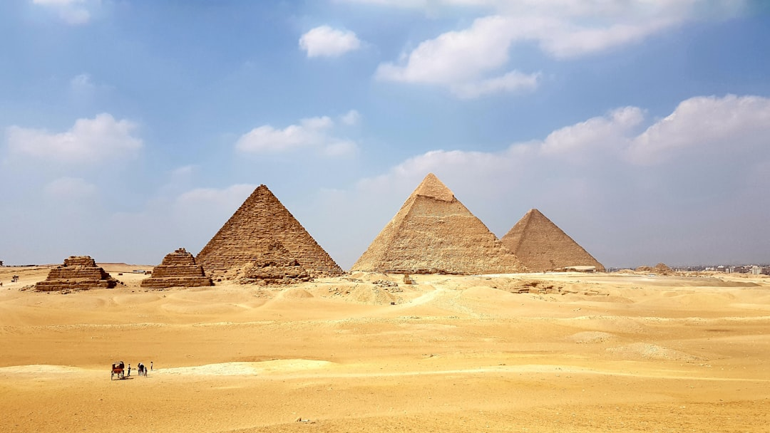
Ancient History and Landmarks
The Pyramids of Giza, one of the Seven Wonders of the Ancient World, are a must-visit attraction for history enthusiasts.
The temples and monuments of Luxor, such as Karnak and Hatshepsut, showcase Egypt's rich architectural heritage.
The Valley of the Kings in Luxor is a fascinating archaeological site that features elaborate tombs and mummies.

Slide 4

Natural Wonders and National Parks
The Sinai Peninsula is home to Saint Catherine's Monastery, a UNESCO World Heritage Site, and the beautiful beaches of Sharm El-Sheikh.
The Nile River, the world's longest river, offers a scenic cruise experience and opportunities for water sports.
The White Desert, a unique natural wonder, features towering white limestone formations and a breathtaking landscape.

Slide 5
Cultural and Urban Attractions
Cairo, the capital city, offers a rich cultural experience with its museums, galleries, and traditional markets, such as Khan El-Khalili.
The city of Alexandria, with its Mediterranean coastline and historical landmarks, is a popular destination for tourists.
The annual Cairo International Festival for Experimental Theatre showcases the country's vibrant arts scene.

Slide 6
Tourism Infrastructure and Development
Egypt has invested in modernizing its airports, hotels, and transportation systems to cater to the growing tourist demand.
The government has implemented initiatives to promote eco-tourism and responsible travel practices.
The development of new tourist attractions and destinations, such as the Red Sea resorts, is expected to boost the industry.

Slide 7

Challenges and Opportunities
The Egyptian tourism industry faces challenges such as security concerns, economic instability, and competition from other destinations.
However, the country's unique cultural heritage, natural wonders, and strategic location present opportunities for growth and development.
The government and private sector must work together to address the challenges and capitalize on the opportunities.

Slide 8
Conclusion
The tourism industry in Egypt has the potential to become a significant contributor to the country's economy and cultural development. By promoting cultural heritage, natural wonders, and responsible tourism practices, Egypt can become a premier tourist destination.

Slide 9
Thank You!
Questions & Discussion

