Slide 1
Historical Significance
Created with AI Presentation Generator

Slide 2
Introduction
Egypt, a country with a rich history, diverse culture, and breathtaking landscapes, has become a prime destination for tourists from around the world. With its ancient pyramids, temples, and monuments, Egypt offers a unique travel experience. This presentation will explore the various aspects of tourism in Egypt.

Slide 3
Historical Significance
Ancient Pyramids
Egyptian Temples
Pharaonic Monuments
Islamic Architecture
Cultural Heritage

Slide 4
Tourist Attractions
Pyramids of Giza
Egyptian Museum
Valley of the Kings
Nile River Cruises
Red Sea Resorts

Slide 5
Cultural Experiences
Traditional Cuisine
Arabic Music
Belly Dancing
Local Markets
Sufi Whirling Dervishes

Slide 6
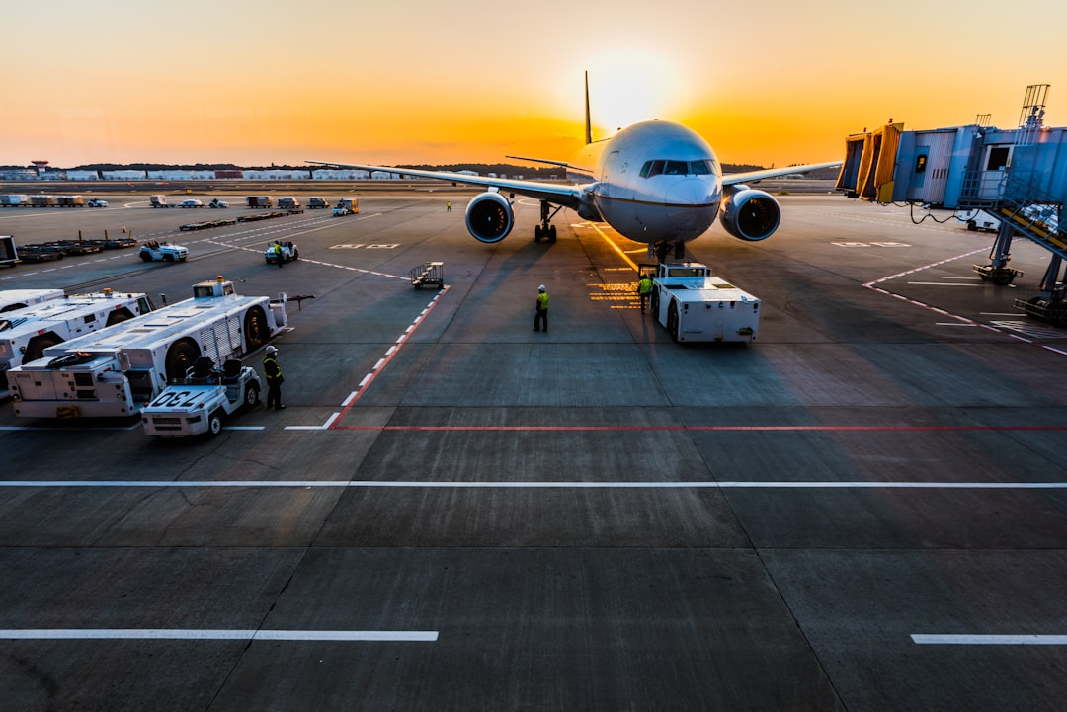
Tourist Infrastructure
• Airport Expansion
• Hotel Chains
• Transportation Systems
• Guide Services
• Tour Operators

Slide 7

Economic Impact
• Job Creation
• Foreign Exchange
• Government Revenue
• Infrastructure Development
• Local Economy Growth

Slide 8

Challenges and Opportunities
Security Concerns
Environmental Issues
Seasonal Fluctuations
Sustainable Tourism
Diversification of Offerings

Slide 9

Marketing Strategies
• Social Media Campaigns
• Online Advertising
• Travel Trade Shows
• Destination Marketing
• Collaborations with Airlines

Slide 10
Sustainable Tourism
Eco-Friendly Practices
Community Engagement
Responsible Travel
Cultural Sensitivity
Environmental Conservation

Slide 11
Tourist Safety
• Security Measures
• Emergency Services
• Health Precautions
• Weather Advisories
• Travel Insurance

Slide 12
Conclusion
Tourism is a vital sector in Egypt's economy, offering a unique blend of history, culture, and natural beauty. To ensure the sustainability of this industry, it is essential to address the challenges and opportunities that lie ahead.

Slide 13
Thank You!
Questions & Discussion

