Slide 1
Historical Significance
Created with AI Presentation Generator

Slide 2
Introduction
Egypt has a rich history and diverse culture, making it an attractive destination for tourists. With its ancient monuments, vibrant cities, and warm hospitality, Egypt offers a unique travel experience. As one of the world's most popular tourist destinations, Egypt's tourism industry continues to grow and evolve.

Slide 3
Historical Significance
Pyramids of Giza
Egyptian Museum
Valley of the Kings
Sphinx of Giza
Ancient Egyptian Temples

Slide 4
Natural Wonders
Nile River
Sinai Peninsula
Red Sea Coast
Wadi Rum Desert
Abu Simbel Temples

Slide 5
Cultural Attractions
Egyptian Cuisine
Traditional Music
Arabic Calligraphy
Islamic Architecture
Folkloric Dance

Slide 6
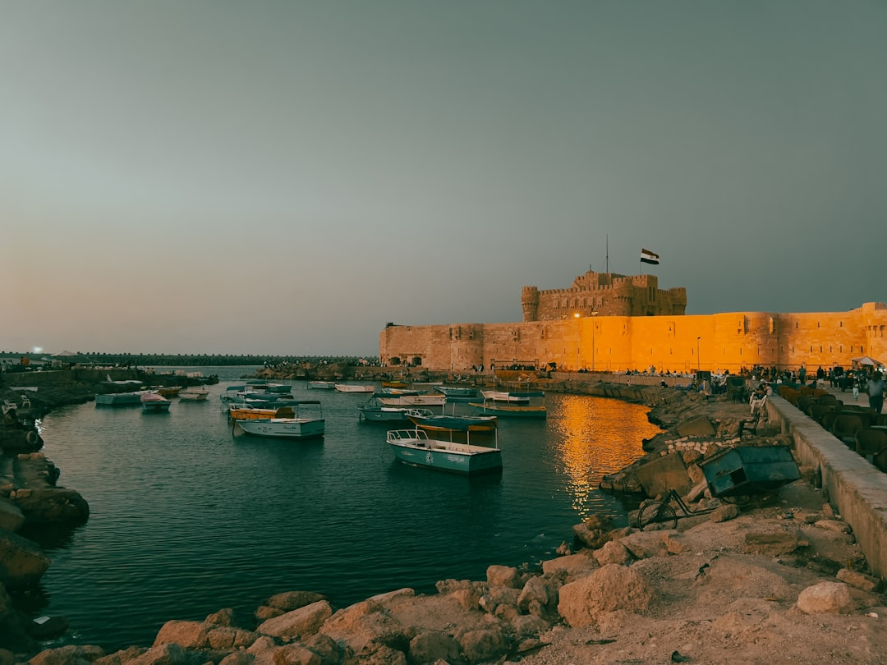
Popular Destinations
• Cairo City
• Alexandria City
• Luxor City
• Sharm El-Sheikh
• Aswan City

Slide 7

Tourist Infrastructure
• Hotels and Resorts
• Transportation Options
• Tourist Information Centers
• Language Support
• Currency Exchange Services

Slide 8

Economic Impact
Job Creation
GDP Growth
Foreign Exchange Earnings
Government Revenue
Infrastructure Development

Slide 9
Challenges and Opportunities
Security Concerns
Environmental Conservation
Sustainable Tourism
Cultural Preservation
Infrastructure Development

Slide 10
Tourist Safety
Crime Prevention
Health and Medical Services
Emergency Response
Tourist Information
Cultural Awareness

Slide 11
Conclusion
Egypt's rich history, cultural diversity, and natural beauty make it an ideal destination for tourists. With proper planning and precautions, tourists can have a safe and enjoyable experience in Egypt.

Slide 12
Thank You!
Questions & Discussion

