Slide 1
History and Cultural Significance
Created with AI Presentation Generator

Slide 2
Introduction
Egypt, a country with a rich history and cultural heritage, has been a popular tourist destination for centuries, attracting millions of visitors each year. The country's unique blend of ancient monuments, vibrant cities, and natural wonders makes it an ideal destination for tourists from around the world. With its warm hospitality and rich cultural experiences, Egypt is a must-visit destination for anyone interested in history, culture, and adventure.

Slide 3
History and Cultural Significance
Egypt's ancient history, including the Pyramids of Giza and the temples of Luxor, is a major draw for tourists, who come to marvel at the country's architectural and artistic achievements.
The country's rich cultural heritage, including its Islamic and Coptic traditions, is reflected in its vibrant cities, museums, and historical sites.
The Nile River, which runs through the heart of Egypt, has played a crucial role in the country's history and culture, and is a major tourist attraction in its own right.

Slide 4

Tourist Attractions and Activities
• The Great Pyramid of Giza, one of the Seven Wonders of the Ancient World, is a must-see for any tourist visiting Egypt, along with the Sphinx and the Solar Boat Museum.
• The Valley of the Kings and Queens, a vast burial ground for pharaohs and nobles, is a fascinating and atmospheric site to explore.
• Visitors can also enjoy a range of outdoor activities, including snorkeling and diving in the Red Sea, as well as camel rides and desert safaris.

Slide 5
Economic and Social Impact
Tourism is a major contributor to Egypt's economy, generating significant revenue and creating jobs for local people.
The tourism industry also has a positive impact on local communities, supporting small businesses and promoting cross-cultural understanding.
However, the rapid growth of tourism has also raised concerns about over-tourism, environmental degradation, and the erosion of local cultures.

Slide 6
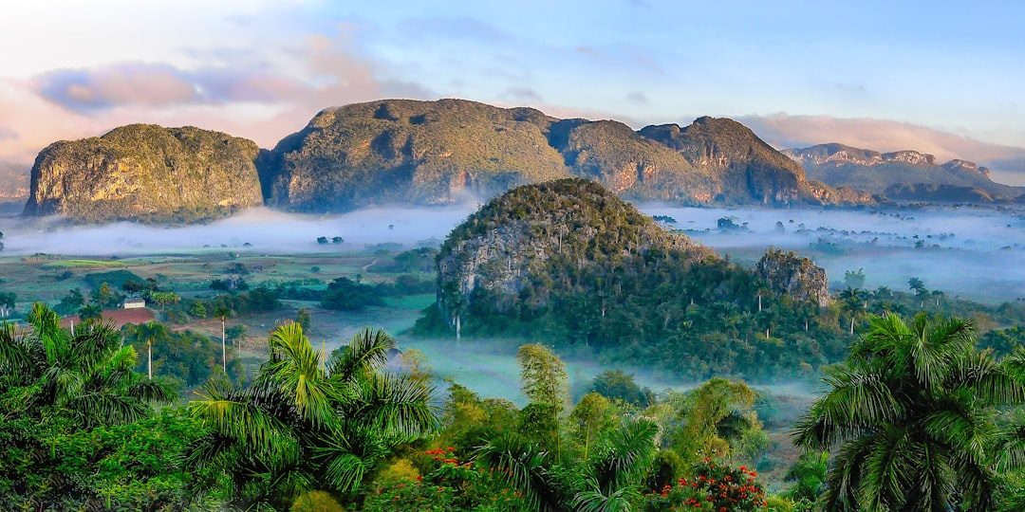
Challenges and Opportunities
• Climate change and environmental degradation are major challenges facing the tourism industry in Egypt, with rising temperatures and sea levels threatening the country's natural resources and tourist attractions.
• The government and tourism industry must work together to promote sustainable tourism practices and protect the country's cultural and natural heritage.
• At the same time, there are opportunities for growth and development, including the expansion of eco-tourism and cultural tourism initiatives.

Slide 7
Conclusion
Egypt's rich history, culture, and natural beauty make it a unique and fascinating tourist destination, with something to offer for every type of traveler.
However, the country's tourism industry also faces significant challenges, including over-tourism and environmental degradation.
With careful planning and management, Egypt can continue to promote sustainable tourism practices and protect its cultural and natural heritage for future generations.

Slide 8
Thank You!
Questions & Discussion

