Slide 1
History and Heritage
Created with AI Presentation Generator

Slide 2
Introduction
Egypt, a country with a rich ancient history and diverse landscapes, has become a major tourist destination, attracting millions of visitors annually. With its iconic landmarks, vibrant culture, and warm hospitality, Egypt offers a unique experience that caters to various interests and preferences. The tourism industry has become a significant contributor to Egypt's economy, creating employment opportunities and driving economic growth. As the country continues to develop its infrastructure and services, tourism is expected to play an increasingly important role in Egypt's future development.

Slide 3
History and Heritage
Egypt's ancient civilization has left an indelible mark on the country's architecture, with iconic landmarks such as the Pyramids of Giza and the Great Sphinx of Giza being among the most visited attractions in the world.
The Valley of the Kings, the Temple of Hatshepsut, and the Egyptian Museum in Cairo are other notable historical sites that showcase the country's rich cultural heritage and provide insights into its ancient past.

Slide 4
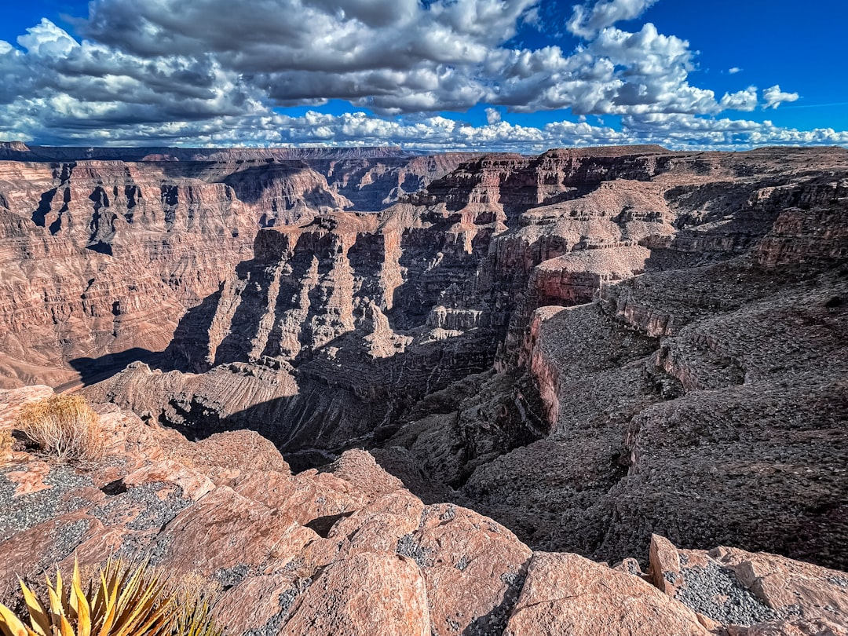
Natural Wonders
• Egypt's diverse landscapes offer a range of natural wonders, including the majestic Nile River, the majestic Red Sea coastline, and the vast deserts of the Sahara and Sinai.
• The stunning natural beauty of the White Desert, the majestic rock formations of the Red Sea Mountains, and the tranquil Lake Nasser are just a few examples of Egypt's breathtaking natural scenery.

Slide 5
Modern Attractions
Egypt's modern cities, such as Cairo, Alexandria, and Port Said, offer a unique blend of traditional and modern architecture, with vibrant markets, bustling streets, and world-class museums and galleries.
The Suez Canal, one of the world's most important shipping routes, is another modern marvel that is steeped in history and offers a fascinating glimpse into Egypt's role in global trade and commerce.

Slide 6
Tourism Infrastructure
• Egypt has invested heavily in developing its tourism infrastructure, with new hotels, resorts, and tour operators springing up to cater to the growing demand for tourism services.
• The country's airports, roads, and transportation systems have also been upgraded to facilitate easier travel and transportation for tourists.

Slide 7

Challenges and Opportunities
• Egypt's tourism industry faces challenges such as security concerns, infrastructure limitations, and environmental degradation, which must be addressed to ensure sustainable tourism development.
• Opportunities for growth and development exist in areas such as eco-tourism, cultural tourism, and adventure tourism, which can help diversify the industry and attract new markets.

Slide 8
Conclusion
Egypt's rich history, diverse landscapes, and vibrant culture make it an attractive destination for tourists from around the world, with the potential to become a major player in the global tourism industry.
By addressing the challenges and capitalizing on the opportunities presented by tourism, Egypt can ensure a sustainable and prosperous future for its people.

Slide 9
Thank You!
Questions & Discussion

