Slide 1
History of Space Exploration
Created with AI Presentation Generator

Slide 2
Introduction
Space exploration is a vast and ongoing journey that has captured the imagination of humans for centuries. From the early days of rocketry to the current era of private spaceflight, space exploration has transformed our understanding of the universe and its many mysteries. As we continue to venture further into space, new discoveries and opportunities await us.

Slide 3
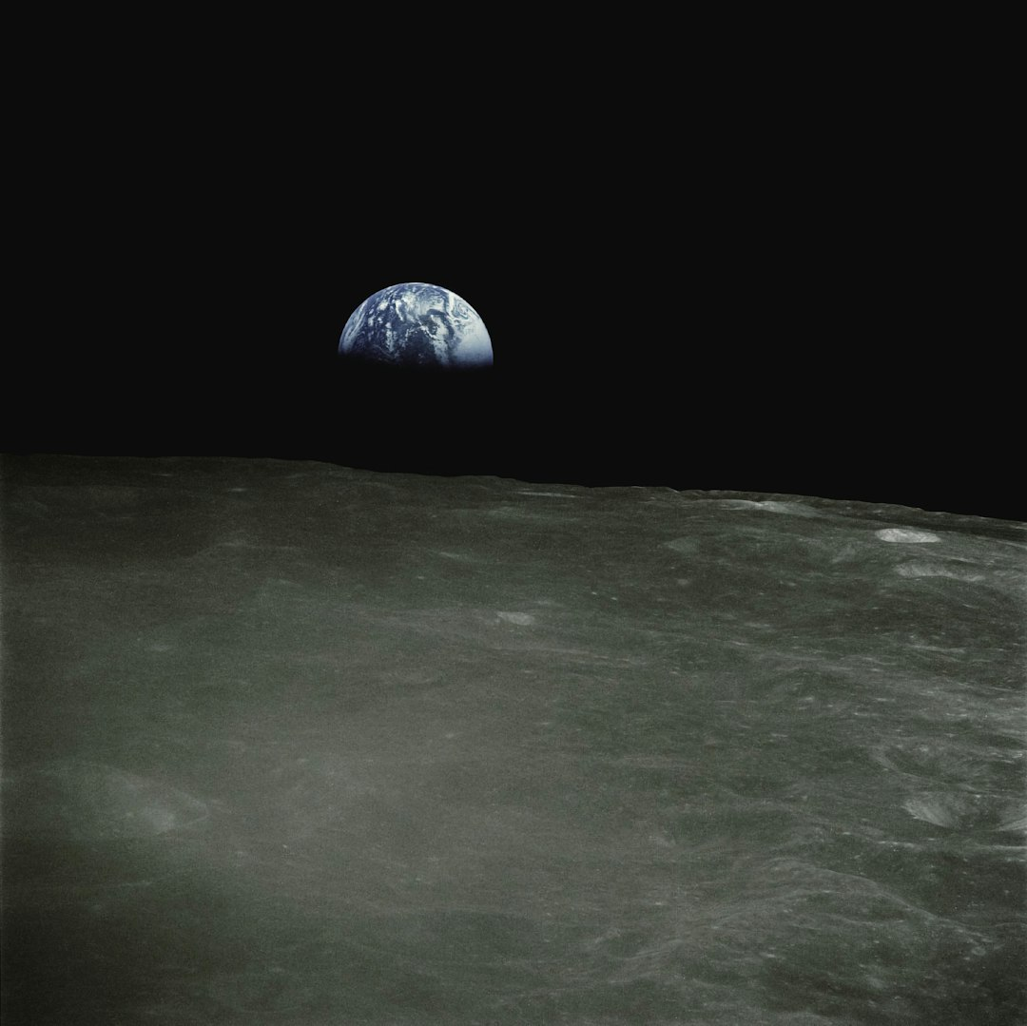
History of Space Exploration
Sputnik 1
Mercury Program
Apollo 11
Voyager Missions
Mars Exploration
International Space Station

Slide 4
Key Players
NASA
SpaceX
Roscosmos
European Space Agency
China National Space Administration
Blue Origin

Slide 5
Technologies Used
Rocket Propulsion
Space Suits
Communication Systems
Life Support Systems
Navigation Systems
Orbital Mechanics

Slide 6
Challenges Faced
Radiation Exposure
Space Debris
Gravity Mitigation
Psychological Effects
Distance and Communication
Limited Resources

Slide 7

Future Missions
Mars 2020
Artemis Program
Europa Clipper
NASA's Orion Spacecraft
SpaceX's Starship
Private Space Stations

Slide 8
Benefits of Space Exploration
Scientific Discovery
Technological Advancements
Resource Utilization
Potential for Human Settlement
Understanding of the Universe
Inspiration for Future Generations

Slide 9

Impacts on Society
Global Cooperation
Economic Growth
Improved Communication
Advances in Medicine
Environmental Awareness
Inspiration for Education

Slide 10
Conclusion
Recap of key points
Future prospects for space exploration
Continued investment in space research

Slide 11
Thank You!
Questions & Discussion

