Slide 1
Historical Milestones
Created with AI Presentation Generator

Slide 2
Introduction
Space exploration is a rapidly advancing field that has captivated human imagination for centuries. From the early astronauts to the current-day robotic probes, space exploration continues to push the boundaries of human knowledge and understanding. This presentation will discuss the key aspects of space exploration.

Slide 3
Historical Milestones
Mercury
Apollo 11
Soyuz
Space Shuttle
International Space Station

Slide 4
Space Agencies
NASA
ESA
Roscosmos
CNSA
ISRO

Slide 5
Spacecraft Design
Orbiter
Lander
Rover
Probe
Satellite

Slide 6
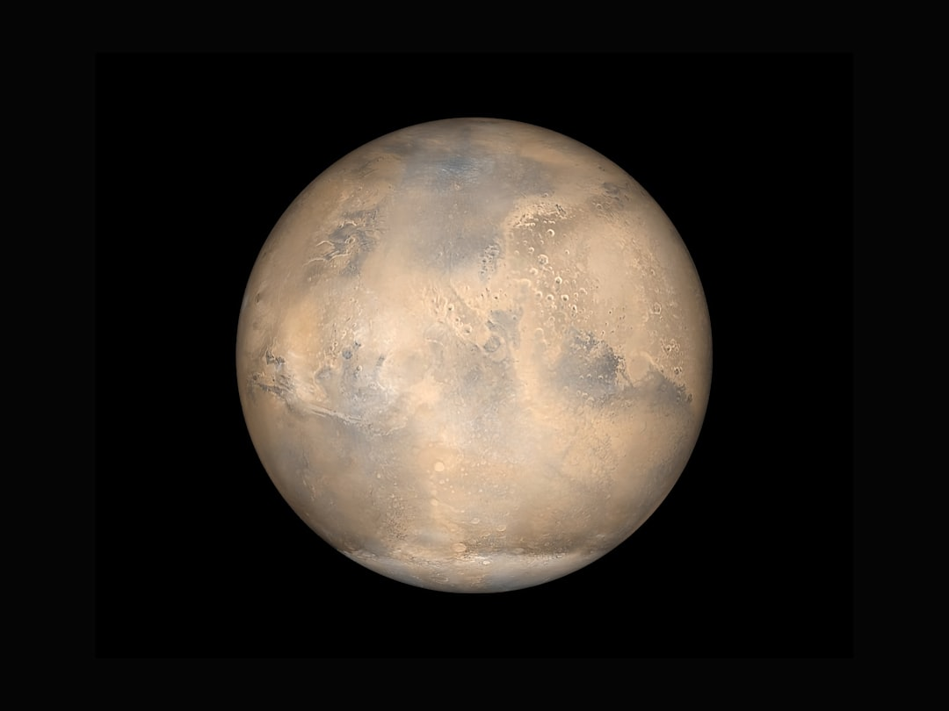
Planetary Exploration
Mars
Moon
Venus
Jupiter
Saturn

Slide 7
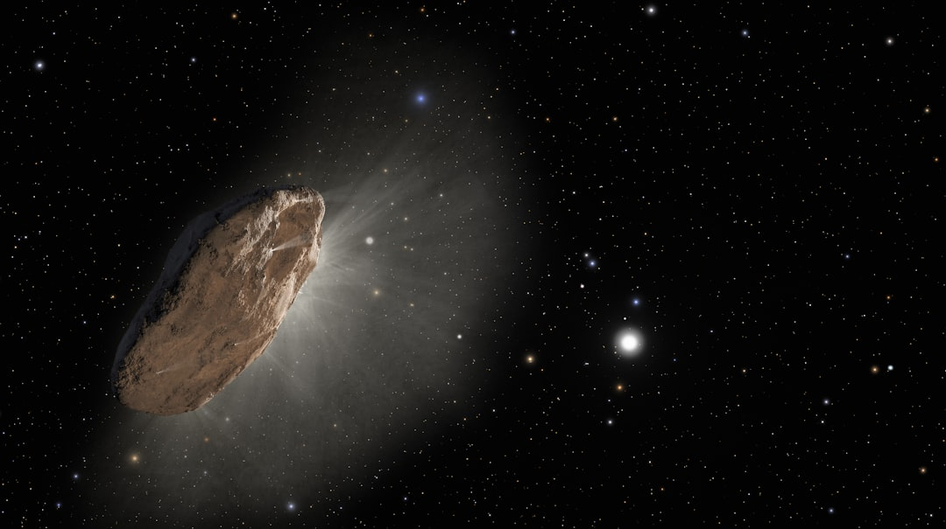
Asteroid and Comets
Asteroid Belt
Comets
Kuiper Belt
Oort Cloud
Meteoroids

Slide 8

Space Tourism
Virgin Galactic
SpaceX
Blue Origin
Orbital ATK
Sierra Nevada

Slide 9
Challenges and Risks
Radiation
Microgravity
Distance
Isolation
Communication

Slide 10
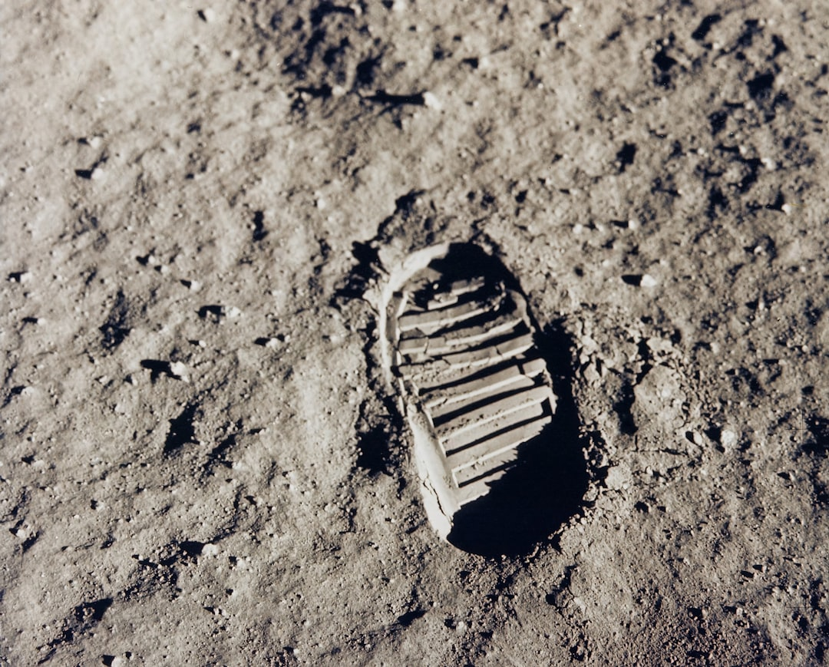
Future Prospects
Mars Colonization
Lunar Bases
Asteroid Mining
Space Elevator
Interstellar Travel

Slide 11

Technological Advancements
Reusability
Propulsion Systems
Life Support Systems
Navigation
Communication Systems

Slide 12
Conclusion
Recap of key points
Future directions
Continued exploration

Slide 13
Thank You!
Questions & Discussion

