Slide 1
Deforestation and Its Consequences
Created with AI Presentation Generator

Slide 2
Introduction
Forest conservation is a critical topic that requires immediate attention to preserve the world's remaining forests and mitigate the effects of climate change. The importance of forest conservation cannot be overstated, as it affects not only the environment but also local communities and the global economy. This presentation aims to highlight the need for forest conservation and explore effective strategies for its implementation.

Slide 3
Deforestation and Its Consequences
Forests cover approximately 30% of the Earth's land surface, but they are being cleared at an alarming rate, resulting in soil erosion, loss of biodiversity, and increased greenhouse gas emissions.
Deforestation has severe consequences, including the displacement of indigenous communities, increased risk of natural disasters, and decreased water quality.
The loss of forests also contributes to climate change, as trees play a crucial role in absorbing carbon dioxide and producing oxygen.

Slide 4
Importance of Forest Ecosystems
Forests provide essential ecosystem services, including clean air and water, soil conservation, and habitat for a vast array of plant and animal species.
Forests also support local livelihoods, as they provide timber, fuelwood, and non-timber forest products, which are essential for the well-being of communities.
Forests play a critical role in regulating the climate, as they absorb and store carbon dioxide, helping to mitigate the effects of climate change.

Slide 5
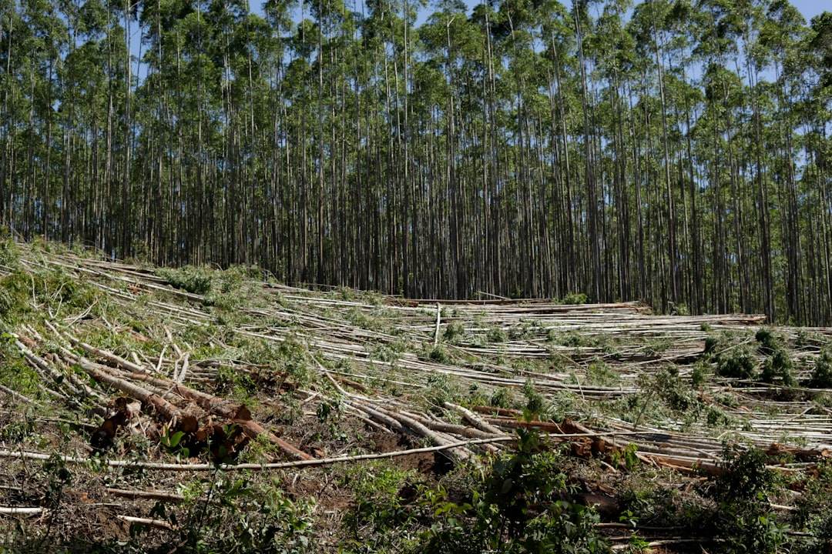
Forest Conservation Strategies
Sustainable forest management practices, such as selective logging and reforestation, can help to reduce the impact of forestry activities on forest ecosystems.
The establishment of protected areas, such as national parks and wildlife reserves, can help to conserve biodiversity and ecosystem services.
Community-led forest management initiatives can empower local communities to take ownership of forest conservation and provide them with economic benefits.

Slide 6
Policy and Action
Governments and international organizations must establish and enforce policies that protect forests and promote sustainable forest management.
Civil society organizations and local communities must work together to raise awareness about the importance of forest conservation and advocate for policy changes.
Individuals can make a difference by making conscious choices about their consumption habits, such as choosing products that are certified as sustainably sourced.

Slide 7

Implementation
Developing and implementing effective forest conservation policies and laws at the local, national, and international levels.
Empowering local communities to take ownership of forest conservation and providing them with economic benefits.
Supporting research and development of sustainable forest management practices.

Slide 8
Conclusion
Forest conservation is essential for maintaining the health of the planet, supporting local livelihoods, and mitigating the effects of climate change.
Effective forest conservation strategies, such as sustainable forest management and protected areas, can be implemented with the support of governments, civil society, and local communities.

Slide 9
Thank You!
Questions & Discussion

