Slide 1
Forest Ecosystem Services
Created with AI Presentation Generator

Slide 2
Introduction
Forest conservation is a vital effort to protect and preserve the world's forests, which play a crucial role in maintaining biodiversity, regulating the climate, and supporting human livelihoods. Forests provide numerous ecosystem services, including oxygen production, soil conservation, and water cycling. Effective forest conservation requires a multi-faceted approach that involves governments, local communities, and international organizations.

Slide 3
Forest Ecosystem Services
Biodiversity
Oxygen production
Soil conservation
Water cycling
Carbon sequestration

Slide 4
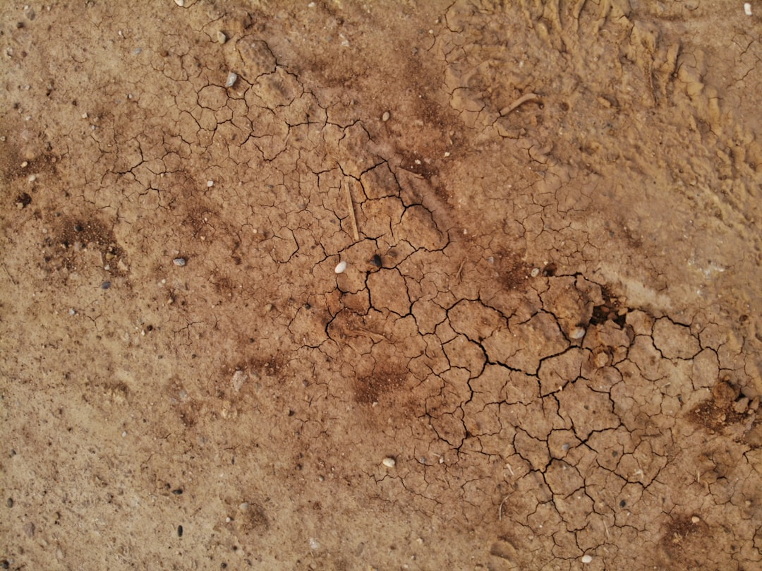
Threats to Forests
Deforestation
Land degradation
Climate change
Pollution
Overexploitation

Slide 5

Causes of Deforestation
Agriculture
Urbanization
Logging
Mining
Infrastructure development

Slide 6

Conservation Strategies
Sustainable forest management
Reforestation
Afforestation
Eco-tourism
Community engagement

Slide 7
International Agreements
Paris Agreement
UN REDD+ program
Convention on International Trade in Endangered Species
Forest Stewardship Council
Climate Change Convention

Slide 8
Role of Local Communities
Community-led conservation
Sustainable forest use
Ecotourism income
Forest-based livelihoods
Environmental education

Slide 9
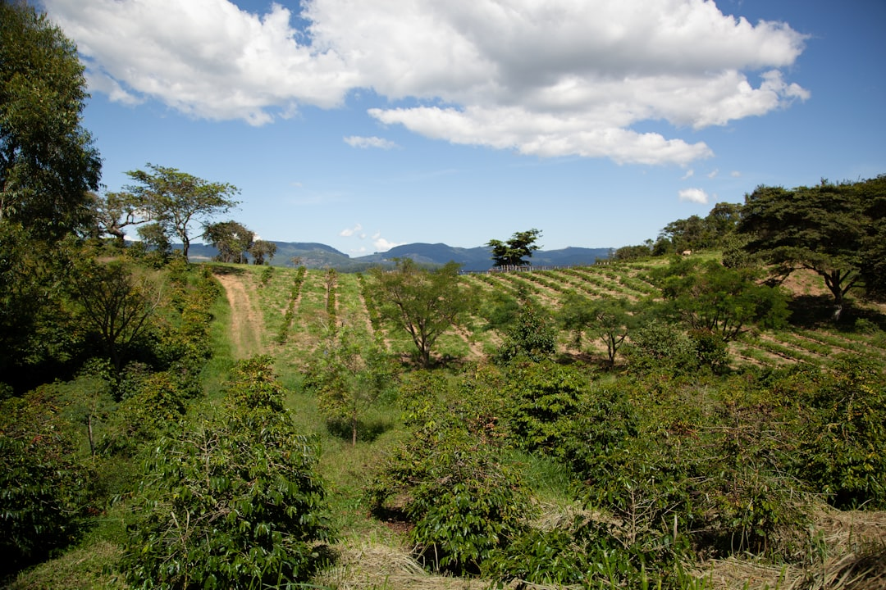
Forest Restoration Techniques
Reforestation techniques
Agroforestry practices
Silviculture methods
Ecological restoration
Erosion control measures

Slide 10

Monitoring and Evaluation
Forest inventory
Remote sensing
Field monitoring
Indicators and metrics
Data analysis tools

Slide 11
Challenges and Limitations
Funding constraints
Lack of coordination
Limited capacity
Conflict and violence
Inadequate legislation

Slide 12
Conclusion
Forest conservation is essential for the planet's future
A collaborative approach is necessary for success
Sustainable forest management is key

Slide 13
Thank You!
Questions & Discussion

