Slide 1
Ancient Civilizations and Pyramids
Created with AI Presentation Generator

Slide 2
Introduction
Pyramids have been an integral part of ancient cultures, representing a symbol of power, spirituality, and architectural innovation. They have fascinated people for centuries, with their enigmatic presence still evoking curiosity and awe. As we delve into the world of pyramids, we will explore their history, construction, and significance.

Slide 3
Ancient Civilizations and Pyramids
The ancient Egyptians were the most renowned pyramid builders, constructing over 130 pyramids between 2600 and 1500 BCE, with the Great Pyramid of Giza being the largest.
The Mayans and Aztecs in Mesoamerica also built pyramids as sacred structures, often serving as tombs for their rulers and centers for worship.
The ancient Sudanese built their pyramids as elaborate tombs for their monarchs, showcasing a unique blend of Egyptian and Nubian architectural styles.

Slide 4
Construction and Engineering
The construction of pyramids required immense engineering skills and manpower, with thousands of workers laboring for years to build these massive structures.
The use of limestone and granite blocks, often weighing several tons, was a testament to the advanced engineering capabilities of ancient civilizations.
The precise alignment of pyramids with celestial bodies, such as the stars and constellations, demonstrates a sophisticated understanding of astronomy.

Slide 5
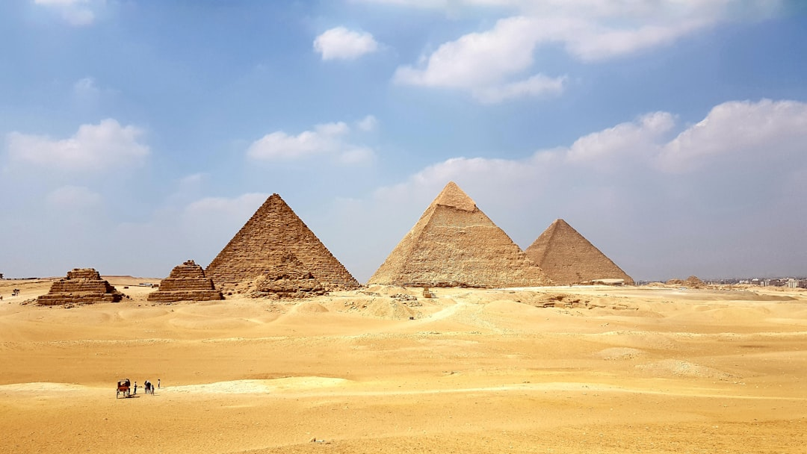
Symbolism and Significance
Pyramids often symbolized the connection between the earthly and spiritual realms, serving as a bridge between the mortal world and the afterlife.
The pyramid's geometric shape represented the unity and harmony of the universe, reflecting the ancient cultures' understanding of the cosmos.
The pyramids' grandeur and precision have inspired countless artistic and cultural expressions, cementing their place in the collective human imagination.

Slide 6
Preservation and Conservation
The preservation of pyramids requires careful attention to their fragile structures, with many undergoing restoration and conservation efforts to ensure their longevity.
Advances in technology, such as 3D scanning and virtual reality, have enabled archaeologists to better understand and document the pyramids.
The protection of pyramids from human impact, such as tourism and looting, is essential to preserve their historical and cultural significance.

Slide 7
Conclusion
The pyramids of ancient civilizations continue to captivate us with their mysterious presence and architectural grandeur.
Their construction, symbolism, and significance serve as a testament to the ingenuity and creativity of our ancestors.
The preservation and conservation of pyramids are crucial to ensuring their enduring impact on our collective cultural heritage.

Slide 8
Thank You!
Questions & Discussion

