Slide 1
Importance of Forests
Created with AI Presentation Generator

Slide 2
Introduction
Forest conservation is crucial for maintaining ecological balance and preserving biodiversity. The world's forests play a vital role in regulating the climate, supporting wildlife habitats, and providing essential resources for human societies. Effective forest conservation requires a multi-faceted approach that involves governments, local communities, and international organizations.

Slide 3

Importance of Forests
Oxygen production
Carbon sequestration
Soil conservation
Biodiversity preservation
Climate regulation

Slide 4
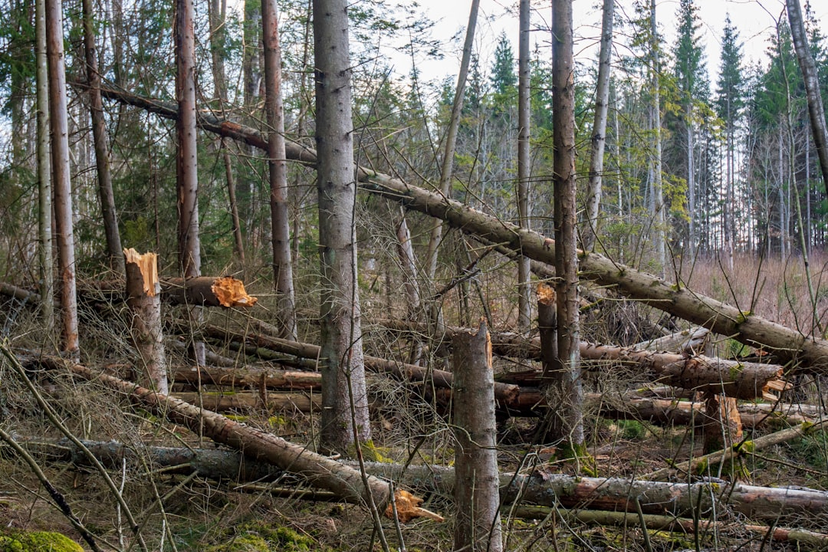
Threats to Forests
Deforestation
Over-harvesting
Land degradation
Climate change
Human encroachment

Slide 5
Conservation Efforts
Reforestation programs
Sustainable forest management
Protected areas establishment
Community engagement
Policy reforms

Slide 6

Challenges in Forest Conservation
Limited resources
Conflicting interests
Lack of awareness
Ineffective governance
Climate change impacts

Slide 7
Sustainable Forest Management
Selective logging
Forest certification
Timber substitution
Agroforestry practices
Ecosystem services

Slide 8

Role of Technology
Remote sensing
GIS mapping
Drones monitoring
Data analytics
Cloud computing

Slide 9
Community Involvement
Education and awareness
Participatory planning
Co-management
Eco-tourism development
Local employment opportunities

Slide 10
Policy and Legislation
National forest acts
International agreements
Protected area laws
Environmental regulations
Climate change policies

Slide 11
Economic Benefits
Job creation
Poverty reduction
Forest product value
Ecotourism revenue
Carbon credits

Slide 12
Conclusion
Forest conservation is essential for the planet's well-being
Collective action is necessary to protect our forests
Sustainability and innovation are key to successful conservation

Slide 13
Thank You!
Questions & Discussion

