Slide 1
Ancient Egyptian Civilizations
Created with AI Presentation Generator

Slide 2
Introduction
The ancient Egyptian pyramids are one of the most impressive architectural achievements in history, built as tombs for the pharaohs of Ancient Egypt. These pyramids were constructed over 4,500 years ago and have captivated the imagination of people around the world. Today, we will explore the fascinating history and features of these incredible structures.

Slide 3
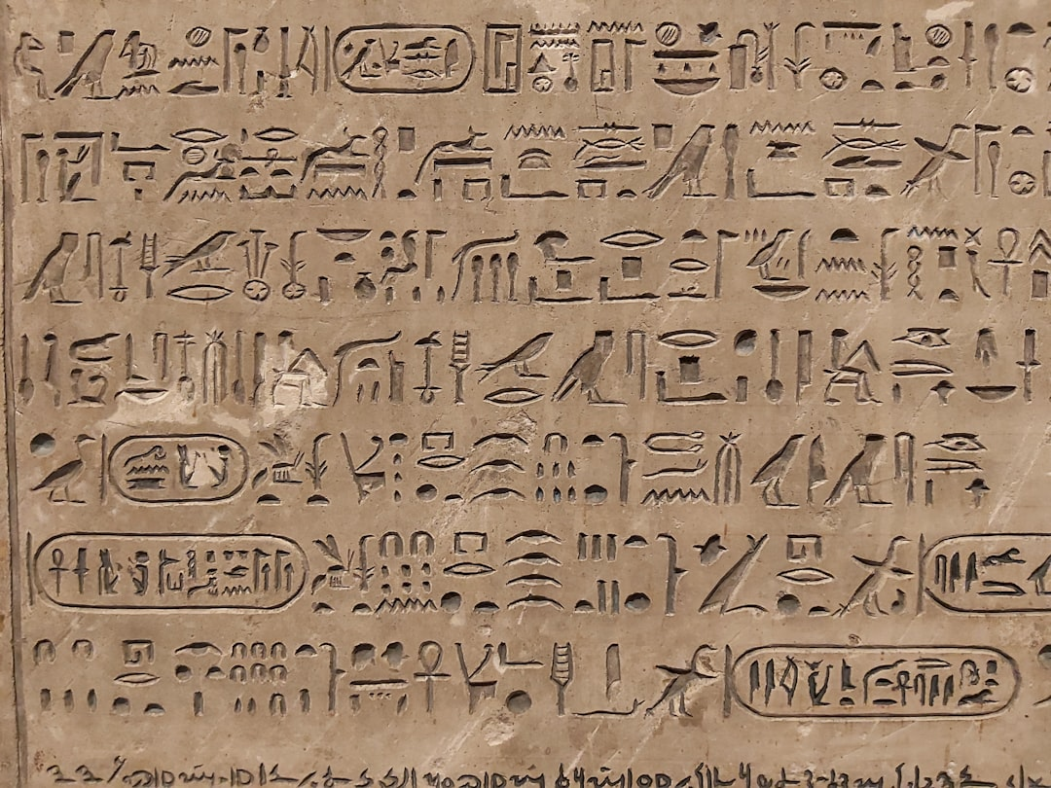
Ancient Egyptian Civilizations
Early Dynastic Period
Old Kingdom
New Kingdom
Pyramids builders
Nile River Valley

Slide 4
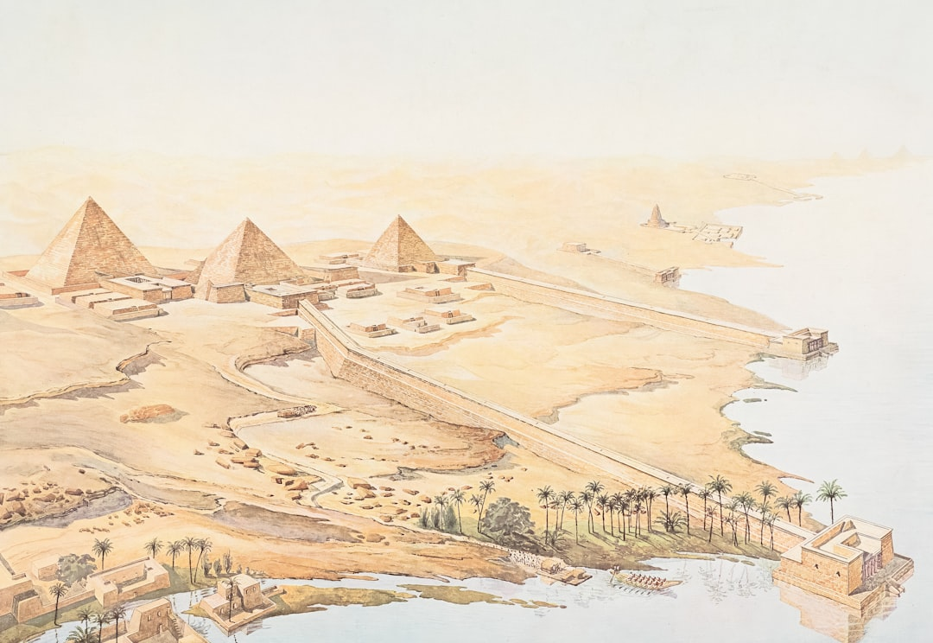
Pyramid Construction
Pharaohs order
Skilled laborers
Stone quarrying
Masonry techniques
Ladder and pulley systems

Slide 5
Pyramid Layout
Square base
Triangular sides
Apex chamber
Descending passageway
Entrance chamber

Slide 6
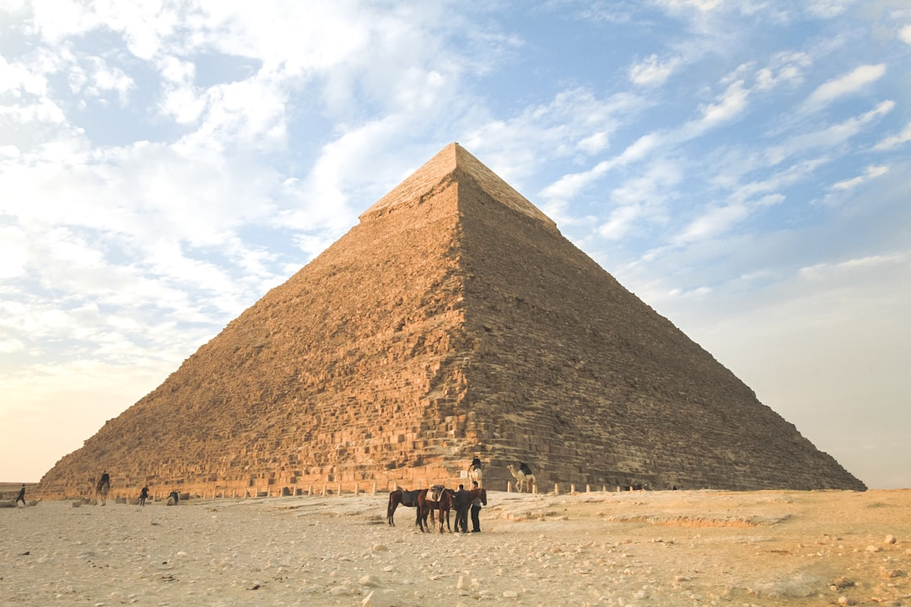
Pyramid Types
Step pyramid
Bent pyramid
True pyramid
Pyramid of Giza
Pyramid of Dashur

Slide 7
Notable Pyramids
Great Pyramid of Giza
Pyramid of Khafre
Pyramid of Menkaure
Red Pyramid
Great Pyramid of Saqqara

Slide 8
Symbolism and Purpose
Spiritual tombs
Burial chambers
Mummification process
Ancestral worship
Pharaoh's afterlife

Slide 9
Pyramid Engineering
Geometric precision
Architectural innovations
Heavy stone lifting
Pulley systems
Ladder technology

Slide 10
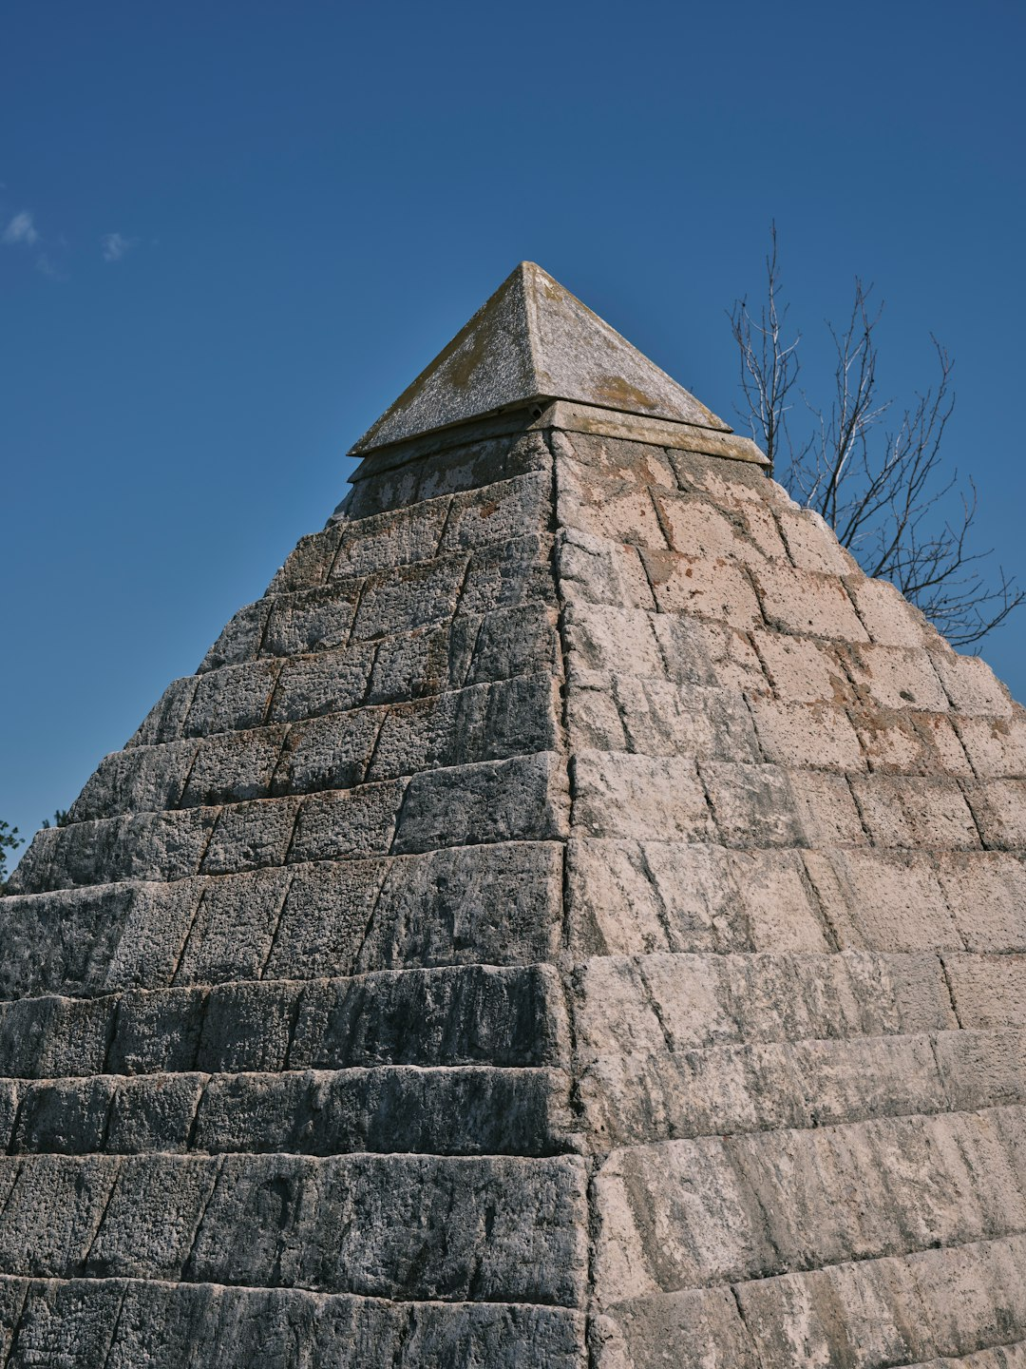
Pyramid Preservation
Weathering and erosion
Sandstorms and dust
Human impact
Conservation efforts
Archaeological discoveries

Slide 11
Conclusion
Summary of key points
Final thoughts on Egyptian pyramids

Slide 12
Thank You!
Questions & Discussion

