Slide 1
Ancient History
Created with AI Presentation Generator

Slide 2
Introduction
The Egyptian pyramids are one of the most impressive architectural achievements in history, built over 4,500 years ago as tombs for the pharaohs of Ancient Egypt. These majestic structures have captivated the imagination of people around the world with their sheer scale and engineering ingenuity. In this presentation, we will explore the history, construction, and significance of the Egyptian pyramids.

Slide 3
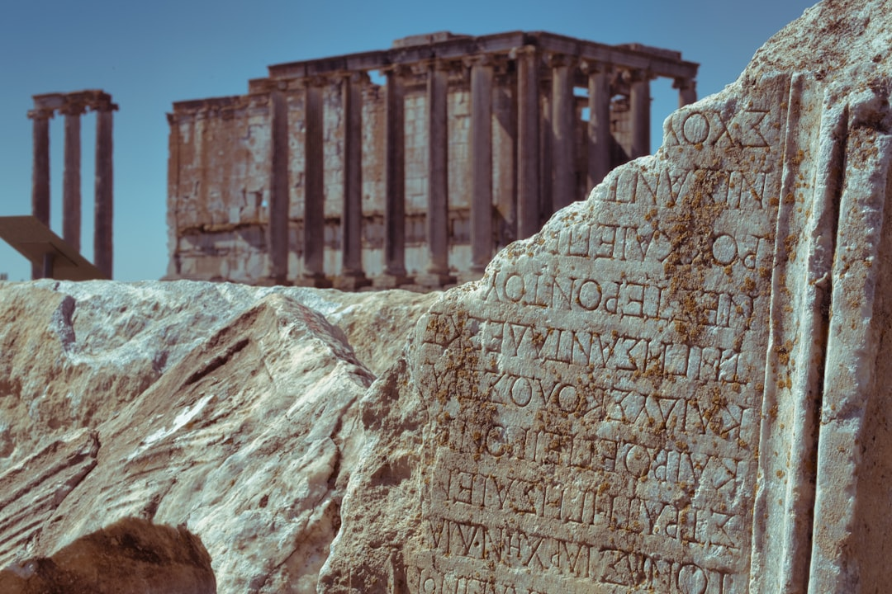
Ancient History
Construction began around 2600 BC
Built as tombs for pharaohs
Pyramid of Giza is the largest
Built during Old Kingdom period
Last major pyramid was built around 1500 BC

Slide 4
Construction Techniques
Massive stone blocks used
Limestone and granite used
Internal chamber and passageway
Smooth exterior to reduce erosion
Advanced pulley and lever systems

Slide 5
Pyramid of Giza
Largest pyramid in Egypt
Built for Pharaoh Khufu
Original height over 481 feet
Original base perimeter over 3,025 feet
Took over 20 years to build

Slide 6
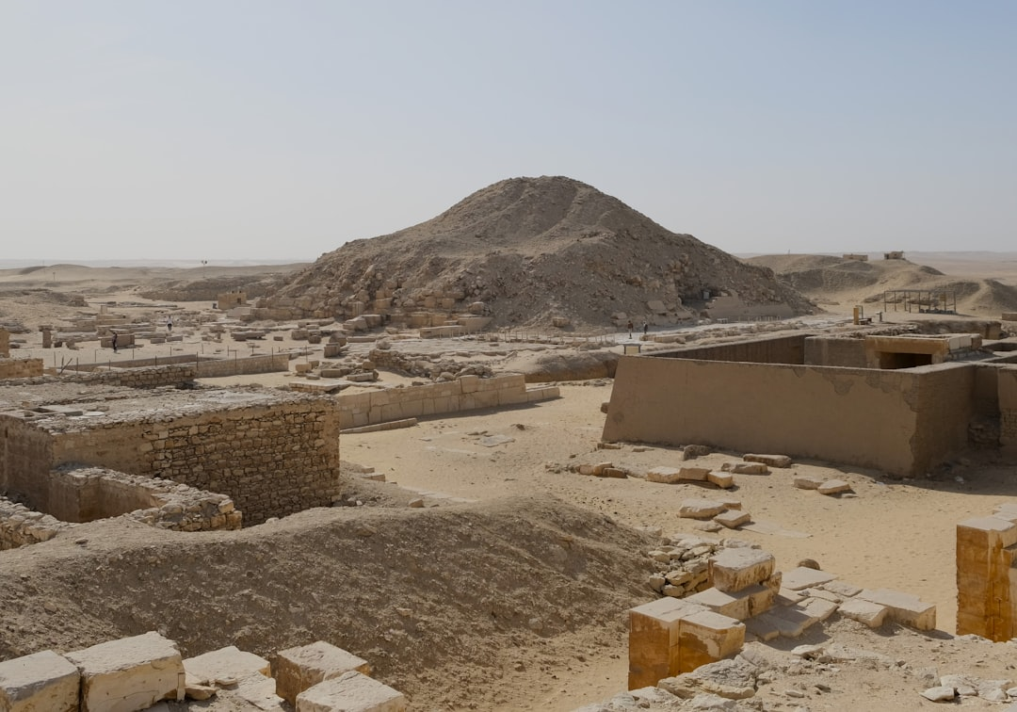
Pyramid of Khafre
Second-largest pyramid in Egypt
Built for Pharaoh Khafre
Original height over 446 feet
Original base perimeter over 709 feet
Built using the same construction techniques

Slide 7
Pyramid of Menkaure
Smallest pyramid in Giza
Built for Pharaoh Menkaure
Original height over 218 feet
Original base perimeter over 344 feet
Built using limestone and granite

Slide 8
Internal Chambers
Queen's chamber and grand gallery
King's chamber and sarcophagus
Relieving chambers to reduce pressure
Air shafts to allow sunlight in
Well-preserved internal architecture

Slide 9
Pyramid Alignment
Aligns with true north
Aligns with stars and constellations
Aligns with Nile River
Aligns with desert landscape
Aligns with ancient astronomical knowledge

Slide 10
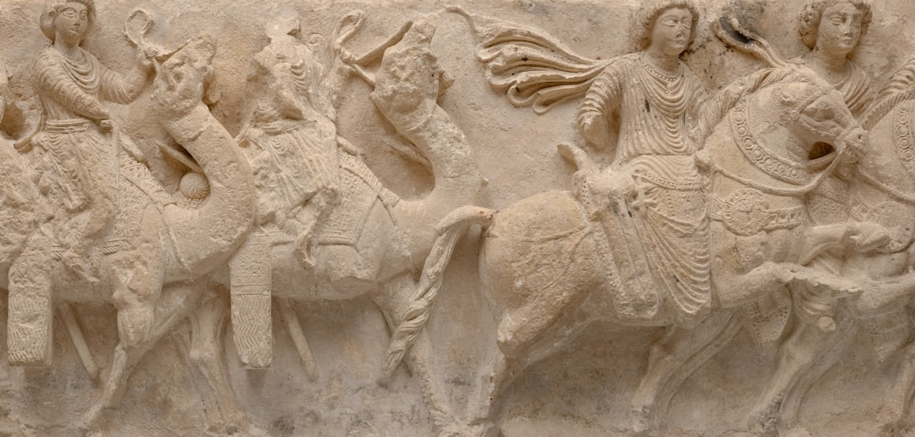
Purpose of Pyramids
Tombs for pharaohs and nobles
Symbol of power and wealth
Offerings to gods and goddesses
Gateways to the afterlife
Representations of the universe

Slide 11
Pyramid Discoveries
Uncovered by archaeologists
Excavations and restoration efforts
New discoveries and theories
Improved understanding of ancient techniques
Preservation of ancient structures

Slide 12

Pyramid Significance
UNESCO World Heritage Site
Cultural and historical significance
Representations of ancient civilization
Engineering and architectural marvel
Enduring symbols of human creativity

Slide 13
Conclusion
The Egyptian pyramids are a testament to the ingenuity and creativity of the ancient Egyptians, who built these magnificent structures using advanced techniques and materials. Their construction, purpose, and significance continue to fascinate and inspire people around the world.

Slide 14
Thank You!
Questions & Discussion

