Slide 1
Core Concepts
Created with AI Presentation Generator

Slide 2
Introduction
Generative AI refers to a subfield of artificial intelligence that focuses on creating new, original content such as images, music, and text based on patterns and structures learned from existing data. This technology has the potential to revolutionize various industries, including entertainment, education, and marketing. In this presentation, we will explore the core concepts, applications, and future of generative AI.

Slide 3
Core Concepts
Autoregressive Models
Generative Adversarial Networks (GANs)
Variational Autoencoders (VAEs)
Recurrent Neural Networks (RNNs)
Deep Learning Architectures

Slide 4
Types of Generative AI
Generative Adversarial Networks (GANs)
Variational Autoencoders (VAEs)
Autoregressive Models
Markov Chain Monte Carlo (MCMC)
Evolutionary Algorithms

Slide 5
Applications
Image and Video Generation
Music and Audio Generation
Text and Language Generation
Data Augmentation and Labeling
Creative Writing and Art

Slide 6

Real-World Examples
Deep Dream Generator
Prisma App
AI Painter
Google's AutoML
Adobe's Fresco

Slide 7
Challenges and Limitations
Lack of Control and Understanding
Mode Collapse and Overfitting
Data Quality and Diversity
Interpretability and Explainability
Ethics and Bias

Slide 8
Future of Generative AI
Advances in Compute Power and Data
Improved Explainability and Transparency
Integration with Other AI Technologies
Increased Adoption in Industries
New Applications and Use Cases

Slide 9
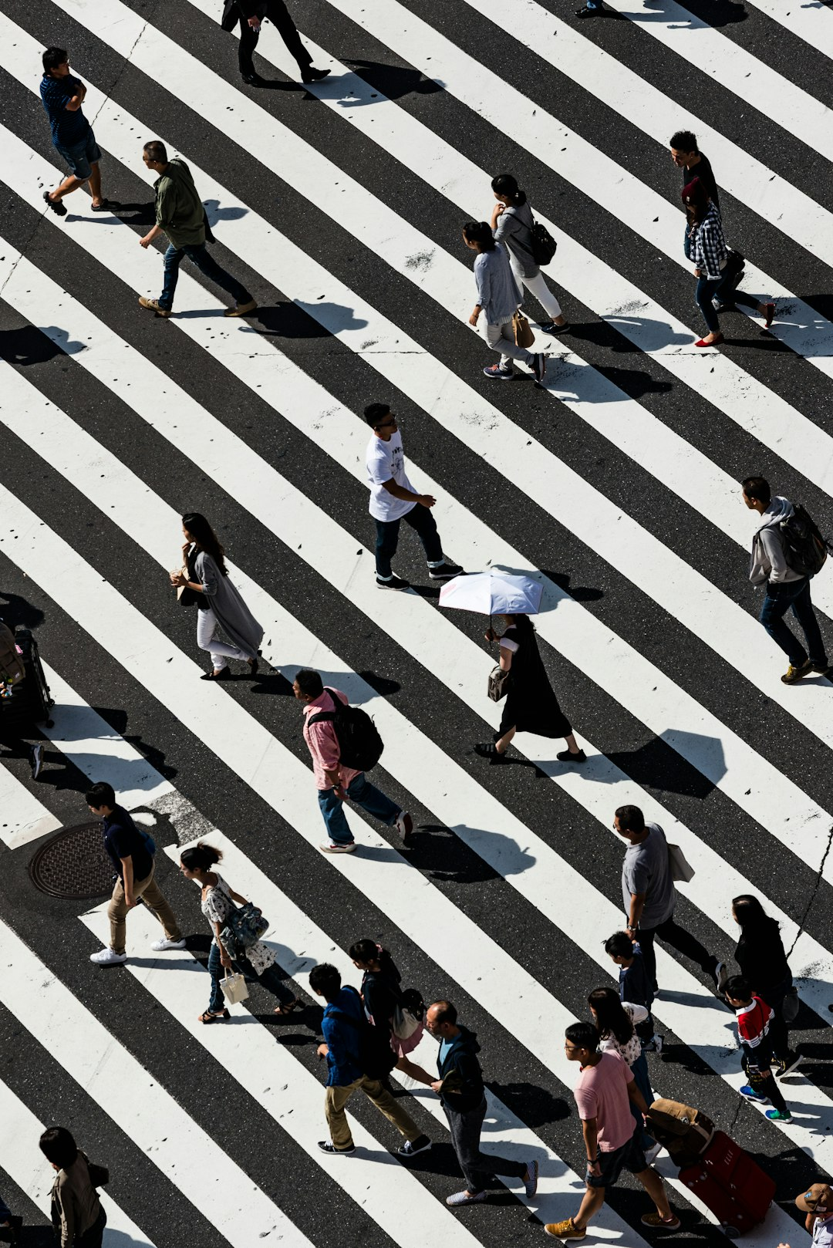
Impact on Society
Job Creation and Disruption
New Forms of Creative Expression
Enhanced User Experience
Increased Efficiency and Productivity
Ethical Concerns and Debate

Slide 10
Conclusion
Summary point: Generative AI has the potential to revolutionize various industries and create new forms of creative expression.

Slide 11
Thank You!
Questions & Discussion

